Slide 1
H-1B Ready to Work
Getting Them to Come Back: Strategies for Retaining LTU Participants in the Program
DOL/ETA and HIP

Slide 3
Polling
Polling Question # 1
Let’s get to know who is on the call today. Using the poll, select the role that you play in your H-1B RTW grant.
For this grant initiative I am the:
Authorized Representative
Program Director/Manager
IT/Data Manager or staff
Training Partner
Employer Partner
Service Provider

Slide 4
Ayreen cadwallader
Moderator: Workforce Analyst
U.S. Department of Labor
Employment and Training Administration
Washington DC

Slide 5
Angel Harlins
Facilitator: H-1B RTW Technical Assistance Project Lead
Performance Excellence Partners
Dan Salemson
Subject Matter Expert
Dan Salemson
Workforce Development Consultant
Salemson Consulting Group
e – salemson@gmail.com
www.linkedin.com/in/salemson/

Slide 6
Today’s Objective:
Provide Ready to Work grantees with practical strategies to engage and reengage participants in training programs to boost program retention.

Slide 7
Customer Retention Principles from the Business World.
Retention is a Toolbox: Do You Have the Right Tools?
Tool #1: Collect Information
Tool #2: Build a “Retention Culture”
Tool #3: Boost Motivation to Stay
Tool #4: Maximize Positive Influencers
Tool #5: Recognize, Recognize, Recognize

Slide 8
Getting Them to Come Back: Strategies for Retaining LTU Participants in the Program
Dan Salemson

Slide 9
How Does a Business Retain YOU?
Think about the main place you buy your groceries. What is the TOP reason you shop there?
Convenience of location
Lower prices than competitors
Range or quality of food
Non-food products and services in / near the store (ie: bank branch, dry cleaners, pharmacy)
Rewards card & loyalty bonuses
Other reason(s)
POLL TIME: Why do you shop where you do?

Slide 10
Retention is a toolbox
What Does This Mean?
One tool will not work for everyone
Have a variety of tools available
Understand what’s missing from your toolbox

Slide 11
Retention Tool #1: Information
Why do Customers Leave?
Surveys show that, on average, businesses lose customers for the following reasons:
4% move or pass away
14% are lured by a competitor
14% are turned off by quality dissatisfaction
68% are unhappy with how they are treated
Source: Bob Livingston, How You Do... What You Do: Create Service Excellence That Wins Clients For Life (2008)

Slide 12
Are You Being Ghosted?
Do You Know When and Why Your Participants Leave?
When are the major drop off points in your program cycle?
Why do people stop participating?
What is the most successful method for keeping in touch?
Do you have a Customer Relationship Management (CRM) system or other robust tracking solution that can tell you this?
ghost
verb
Definition of ghost
transitive verb
informal : to abruptly cut off all contact with (someone, such as a former romantic partner) by no longer accepting or responding to phone calls, instant messages, etc.
www.merriam-webster.com/dictionary/ghost

Slide 13
Tool #2: Build a “Retention Culture”
Sending the Right Message
“People don’t buy goods and services, they buy Good Feelings and Solutions to Problems”
What can you offer to create good feelings and solutions to problems?
Make successful completion and the benefits from obtaining the new skills THE central focus of your materials and presentations.

Slide 14
How Do Supermarkets Do It?

Slide 15
How Do Supermarkets Do It?

Slide 16
How Do Supermarkets Do It?

Slide 17
Building a Retention Culture
How Does Your Program Space & Message Land?
What do they see?
Is it a place YOU would find appealing?
Are there positive images of success?
Do staff and participants seem engaged?
What do they hear?
Level playing field
Results orientation
Genuine emotional connections
High expectations, accountability and model behavior

Slide 18
Tool #2: Build a “Retention Culture”
In Which Place Would You Want to Spend Your Day?

Slide 19
Tool #2: Build a “Retention Culture”
Make Success Visible

Slide 20
Retention Issues Often Reflect the Stress of Unemployment
“Research studies have shown that job loss can take a psychological and biological toll as well, leading to depression, anxiety disorders, increased somatic symptoms, such as fatigue or headaches, and higher rates of medical illness. This toll may be worse for men, who are socialized to evaluate their self-worth in terms of their financial and career success.”
Psychology Today, “Preserving Mental Health During Unemployment,” Oct. 14, 2011.

Slide 21
Tool #3: Boost Motivation to Stay
Motivational Interview (MI) Principles
Arguing, pleading, and ordering are rarely effective in overcoming resistance. They may cause a temporary change in behavior, but rarely a long-term change in internal drive.
The key to successful change: People tend to commit to actions that they verbalize.
Use strategic questions to prompt positive talk about challenges and encourages individuals to identify for themselves the pros and cons of an action.

Slide 22
Tool #3: Boost Motivation to Stay
Non-MI vs. MI: Consider the Difference
Participant: “There’s no point in continuing here, I’ll never get a job at my age.”
Staff Member: “Sure you will, lots of people like you do. Just keep showing up and see what happens.”
Participant: “Okay, whatever.”
The participant is never heard from again
Participant: “There’s no point in continuing here, I’ll never get a job at my age.”
Staff Member: “I hear that you’re frustrated. What will you do if you stop coming?”
P: “I really don’t know.”
SM: “What is the hardest part of this for you?”
P: “I see others finding jobs, but it never happens for me.”
SM: “Why do you think that is?”
P: “I guess they’ve been here longer and have been sending out more applications.”
SM: “So consistency and numbers are the key. How many applications will you commit to doing before you call it quits?”
P: “I dunno, maybe 50.”
SM: “50 is a great number. Let’s start getting those out.”

Slide 23
Tool #3: Boost Motivation to Stay
Incorporate MI on Day 1
Remember: People tend to commit to actions that they verbalize.
On the first day, have participants tell the rest of the group why they joined the program.
Participants write a letter to themselves listing all their reasons for joining the program, what they hope to accomplish, and why that’s important.

Slide 24
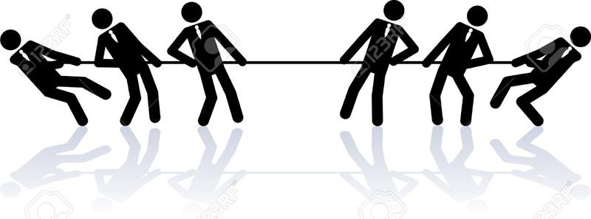
Tool #4: Maximize Positive Influencers
Constructive Competition & Peer Pressure
Where possible, divide participants into groups and make each group responsible for the success of all its members.
Use a variety of individual and team-based incentives & rewards to increase connection.

Slide 25
Tool #4: Maximize Positive Influencers
Setting Up Competition
Divide participants into groups of 4 or 5, with different skill levels.
Award points to groups based on positive behaviors and accomplishments.
Record points on a visible chart. Give rewards to high scorers on a regular basis.

Slide 26
Tool #4: Maximize Positive Influencers
Competition & Peer Pressure
Tying individuals together unleashes positive peer pressure within each group. People try harder and support each other when their behavior impacts a group.
Competition between groups creates and sustains excitement over the long term.

Slide 27
Tool #5: Recognize, Recognize, Recognize
But What Kind of Recognition Is Most Effective?
Cash and cash equivalents (such as gift cards) have short term impact but quickly fade.
Peer recognition has medium-term impact.
Individualized recognition from a mentor or admired authority figure is the strongest motivator.

Slide 28
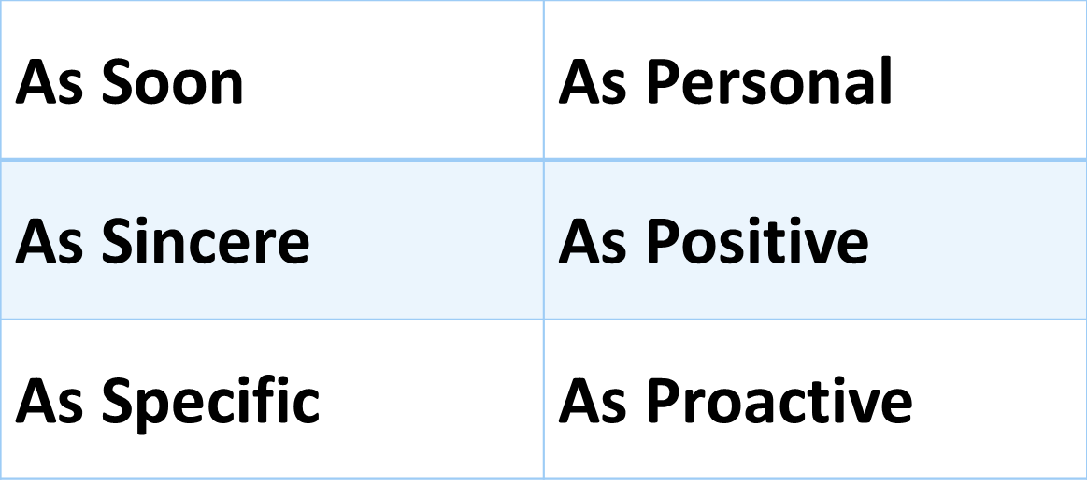
Effective Rewards: The ASAP³ Model
To make rewards impactful, follow Dr. Bob Nelson’s ASAP³ (“ASAP cubed”) Model of Recognition:
www.drbobnelson.com

Slide 29
Rewards Ideas: Cash / Cash Equivalents
Free Items
www.freecycle.org
www.craigslist.org (free section)
www.nextdoor.com
Ask coworkers to donate unwanted items that are in good shape.
Free Tickets / Services
Contact local theaters, sports teams, and other entertainment venues for comp tickets
Solicit local businesses for gift certificates for their services
Cash & Gift Cards
Collect spare change, turn into gift cards at a CoinStar machine: www.coinstar.com
Qualified organizations can sign up for rewards programs like AmazonSmile: org.amazon.com
Ask for donations from board members, contractors, employers and others with a connection to your program.

Slide 30
Rewards Ideas: Peer Recognition
Name tags with different colored stickers to reflect progress through the program (like karate belts).
Student / Group of the Day music selection
Participant(s) & Team of the Week certificates / award ceremony
Weekly prize drawing – whenever someone has a success, drop his / her name into a raffle box.
Ask outstanding participants to speak at the next orientation or teach a workshop.
Install a classroom bell people get to ring to mark a positive achievement.
Birthday club to celebrate special day.

Slide 31
Reward Ideas: Mentor Recognition
Handwritten note of congratulations or appreciation.
Keep inexpensive mementos to give to individual participants
One-on-one or small group lunches with staff members and participant(s)
Ask outstanding participants to become mentors to others in the program.

Slide 32
Create Formal Teams and Expectations
Set clear expectations about alumni participation from Day 1.
At time of active program completion, provide each participant with an “Alumni punch card” that will reward them after a certain number of contacts with the program.
If possible, replicate the classroom team structure among alumni. Reward the teams that meet post-program goals.
Schedule periodic micro-interventions: brief check-ins via text, phone, email, social media or other preferred form of communication can have significant impact on behavior.
If space and logistics permit, create an onsite “Alumni lounge” where program grads can access a computer or other resources.

Slide 33
Create Formal Teams and Expectations
Develop a package of benefits that alumni can receive if they stay connected over the long-term. Examples include advanced training, transportation subsidies, access to resources through partner agencies, assistance in claiming the EITC, participation in an Individual Development Account (IDA) program, etc.
Schedule monthly / quarterly alumni meetings with attendance prizes and door raffles for those who come. Survey alumni to determine the best times / locations for the meetings.
Invite grads to return as guest speakers or mentors. This works especially well with those who feel like they no longer need the program themselves, but are willing to help others.
Create a monthly alumni newsletter or webpage with updates on the program, individual alumni successes, and a “Have you seen . . .” section for “missing” alums.
Provide a “finders fee” to those who get missing alumni to reconnect.

Slide 34
Presentation Take-aways
Keys to Successful Retention
Retention is a process that must begin on Day 1 of a program.
Long-term unemployment has significant impact on financial, physical and psychological wellbeing that may impact participation. We must be aware of these factors in order to mitigate them.
Accurate, complete tracking of participation and contact helps identify key drop off points and possible warning signs.
Our physical space and how we present our program has a significant impact on participants’ desire to stay.

Slide 35
Presentation Take-aways
Keys to Successful Retention
The principles of Motivational Interviewing (MI) can overcome resistance and boost internal commitment to the program.
Competition and Peer Pressure are powerful influencers of behavior. Incorporated correctly, they can increase program attachment.
Frequent recognition following the ASAP3 model builds program attachment.

Slide 37
Dan Salemson
salemson@gmail.com
www.linkedin.com/in/salemson/

Slide 38
Next Step: Roundtable Discussion
Upcoming Technical Assistance
H-1 B Ready to Work (RTW) Long Term Unemployed (LTU) Subject Matter Expert (SME) Webinar Series Roundtable Discussion August 1st at 2:30pm
.
H-1B Ready to Work Community of Practice
WorkforceGPS site for Ready to Work
https://h1breadytowork.workforcegps.org/
LinkedIn Platform
Have you joined our LinkedIn page yet?
https://www.linkedin.com/groups/H-1B-Ready-Work-RTW-7018078/about

Slide 39
Ready to Work Grantee Mailbox RTW@dol.gov To Reach your Federal Project Officer, DOL National Office and Technical Assistance Providers

Slide 40
Post Webinar Feedback Tool
Thank you for participating in the H-1B RTW: Long Term Unemployed Webinar Series
Getting Them to Come Back: Strategies for Retaining LTU Participants in the Program
Please take a minute to complete this brief feedback tool regarding the Webinar today, July 31st 2017.
The input you provide will help us better the delivery of future webinars and create technical assistance meaningful for your work.

