Slide 3
Introduction to Technical Assistance for H1-B SWFI Grantees
Office of Workforce Investment, Division of Strategic Investments

Slide 4
Presenters
Moderators:
Monica A. Evans, workforce analyst, H-1B Grants, Employment and Training Administration (ETA), Division of Strategic Investments
Danielle Kittrell, workforce analyst, H-1B Grants, ETA, Division of Strategic Investments
Presenters:
Emily Sama-Miller, senior researcher, Mathematica Policy Research
Elizabeth Brown, researcher, Mathematica Policy Research
Jessica Harding, researcher, Mathematica Policy Research
#

Slide 5
Monica A. Evans
Workforce Analyst, H-1B Grants
ETA, Division of Strategic Investments
Danielle Kittrell
Workforce Analyst, H-1B Grants
ETA, Division of Strategic Investments

Slide 6
Emily Sama-Miller
Senior Researcher
Mathematica Policy Research
Washington, DC
Elizabeth Brown
Researcher
Mathematica Policy Research
Rock Springs, Wyoming
Jessica Harding
Researcher
Mathematica Policy Research
Princeton, NJ

Slide 7
Give Strengthening Working Families Initiative (SWFI) grantees an opportunity to connect and discuss their project work
Provide an overview of technical assistance (TA) activities and opportunities under SWFI
Introduce the TA coaches and senior subject matter experts (SMEs) and clarify their roles for grantees
Provide next steps for requesting and receiving TA

Slide 8
Overview of SWFI
Overview of SWFI TA model
SWFI systems and program TA
Introduction to the TA team and their roles
Responsive TA
Coaching
How to request TA
How to provide feedback on TA
Next steps
Questions

Slide 9
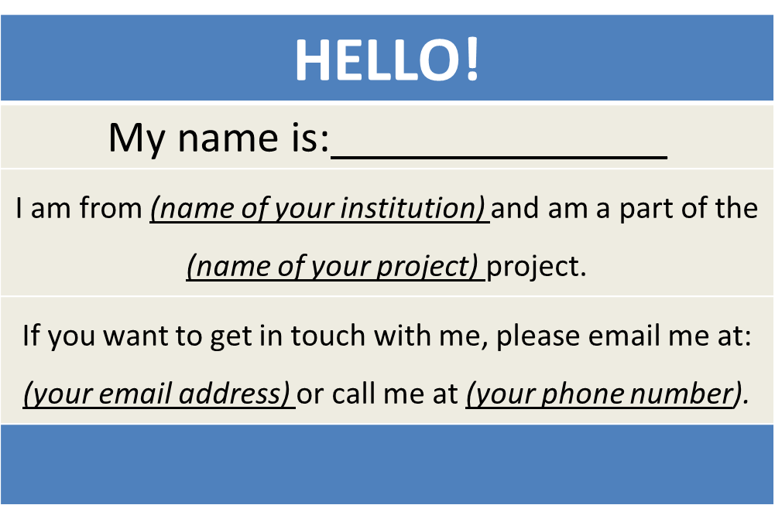
SWFI Grantees
Create a virtual name tag…
#
9

Slide 10
Grantee Polling Question
Using the poll, select the role that you play in your SWFI grant
Choose the answer that best reflects you (or your group):
Authorized representative
Program director/manager
IT/Data manager or staff
Training partner
5. Employer partner
6. Service Provider
7. Other (please specify in main chat box!)

Slide 11
Overview of SWFI

Slide 12
SWFI Grant Objectives
Awarded $54,394,080 to 14 public-private partnerships across the U.S.
Provide support to parents who face barriers to training and need skills and competencies to prepare them for middle- or high-skilled jobs
Give working parents a career pathway into middle- or high-skilled jobs
Give more working parents a career pathway into higher-wage jobs by addressing major barriers to (1) participating in and completing training and (2) finding and acquiring affordable, quality child care

Slide 13
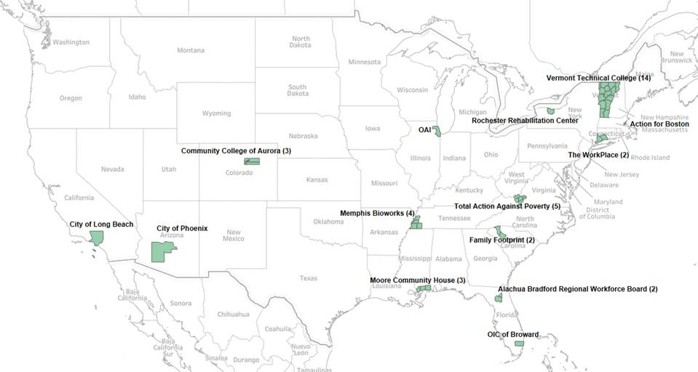
Map of SWFI Grantees

Slide 14
SWFI H-1B Industries

Slide 15
Grantee Activities
As of December 2016:
8 grantees began recruitment;
3 conducted classroom trainings;
2 grantees offered credential programs;
2 grantees established job clubs or mentoring programs;
3 grantees provided participants services and activities that support skill development, training retention, and employment; and
3 grantees also offered child and/or dependent care, or financial counseling.

Slide 16
Grantee Polling Question
In what stage of implementation is your SWFI project?
Choose the answer that best reflects your (or your group’s) project:
Preparation: Key staff are being hired; key policies and procedures are being identified
Early implementation: Staff have been hired; initial participants recruited for service delivery
Full implementation: Project is fully staffed; service delivery is under way
Other (please specify in the main chat box)

Slide 17
SWFI Technical Assistance

Slide 18
Meet the TA team
1
TA project leaders
Emily Sama-Miller
Charlene Kemmerer
Project manager
Grants management specialist

Slide 19
Meet the TA team
2
TA coaches
Lily Roberts
Talia Kahn-Kravis
Elizabeth Brown
Jessica Harding
SME
SME

Slide 20
Meet the TA Team – SME Experts
3
Senior SMEs
Gina Adams
(Urban Institute)
Shayne Spaulding
(Urban Institute)
The intersection of early care and education programs with workforce development programs and policies
Workforce development and postsecondary education programs and strategies

Slide 21
TA Objectives
Provide grantees and their partners with tools, resources, information, and support that will help them achieve their goals and meet the objectives of SWFI
Highlight promising practices
Address common challenges
Support the SWFI program office and grantees’ federal project officer (FPO)

Slide 22
Overview of TA
Program-level TA: relates to changes with service delivery or direct work with a target population; offered at three levels
General, for all grantees
Customized, for small groups of grantees
Individual, in coaching relationships and/or during site visits
Systems-level TA: relates to changing policy, practice, funding, and institutions

Slide 23
Types of TA
TA type | Delivery
Coaching calls | Through regular phone calls and e-mails, grantees and their TA coach will check on grant progress and address TA needs. Coaches will help grantees focus their work based on findings from high quality research.
Webinars | In interactive webinars, SMEs will discuss key areas of interest to grantees. May be general or customized in focus.
Peer learning opportunities | Grantees with similar goals or challenges will have a chance to share and learn from each other through teleconference calls or webinars.
Community of Practice (CoP) | The CoP will include curated resources and new tools developed by the team to support implementation, and online discussion boards moderated on the SWFI CoP on WFGPS.
Written resource materials | The TA team will develop materials such as tip sheets on best practices, newsletters, and answers to frequently asked questions. The team will also connect grantees to existing tools and resources that are relevant to SWFI; all will be made available on the SWFI CoP.
Site visits | On-site, program-level TA may be provided to grantees on a limited basis.

Slide 24
Collaborative, Evidence-Informed Approach to TA Delivery
TA approach systematically brings together theory, evidence, and practice
Collaboratively deliver and customize TA based on emerging grantee needs
Identify project challenges and brainstorm practical, evidence-based solutions
Plan to implement new solutions to address problems
Develop systems for continual improvement of ongoing efforts
Support evidence-informed strategic planning
Build grantee capacity for analytically focused program improvement

Slide 26
Grantee Polling Question
What is your biggest need for TA?
Choose the answer that best reflects your (or your group’s) project:
Training or education: Understanding what training participants need; identifying appropriate training or education resources; connecting participants to training and education
Employment activities: Connecting participants to the workforce or helping them retain jobs
Child care: Assessing needs; structuring training, education, or work activities to align with the availability of child care; helping participants access the care they need
Program design or practices: Reaching and recruiting participants; covering the cost of services; building tools or data systems; developing partnerships; aligning processes and communication across partners
Other (please specify in the main chat box)

Slide 27
Grantee Polling Question
What are your strengths?
Choose the answer that best reflects your (or your group’s) project:
Training or education: Understanding what training participants need; identifying appropriate training or education resources; connecting participants to training and education
Employment activities: Connecting participants to the workforce or helping them retain jobs
Child care: Assessing needs; structuring training, education, or work activities to align with the availability of child care; helping participants access the care they need
Program design or practices: Reaching and recruiting participants; covering the cost of services; building tools or data systems; developing partnerships; aligning processes and communication across partners
Other (please specify in the main chat box)

Slide 28
The SWFI CoP
One-stop shop for TA resources
Discussion boards for connecting with other grantees
Announcements for upcoming events
Coming soon

Slide 29
SWFI Coaching

Slide 30
Coaches
Elizabeth Brown
Jessica Harding
Talia Kahn-Kravis
Lily Roberts

Slide 31
Senior SMEs
Provide support focused on system-level needs
Participate in convenings, some peer learning activities, and webinars
Work with your coach to coordinate collaboration with senior SMEs

Slide 32
The Role of your FPO vs. Your TA Coach
FPOs provide guidance with technical grant needs, including: | TA coaches provide support with program-level TA needs, including:
Clarification of Funding Opportunity Announcement (FOA) | Strategies for program improvement
Modifications to the statement of work | Development of partnerships
Quarterly performance reports | Program sustainability
Fiscal questions | Organizational structure
Other policy questions | Connections to other grantees or SMEs

Slide 33
Grantee Polling Question
What type of TA are you most interested in?
Choose the answer that best reflects your (or your group’s) project:
Peer learning opportunities
SWFI CoP
Written resource materials
Coaching
Webinars
Other (please specify in the main chat box)

Slide 34
Requesting TA

Slide 35
How to Request TA
Contact your TA coach
Send an email to SWFI: SWFI@dol.gov
Include your grant name and number
Copy your FPO

Slide 36
Ways to Inform TA
Respond to webinar polls
Provide feedback to TA coaches during regular calls
Send an email to SWFI: SWFI@dol.gov

Slide 37
Next Steps for TA
A link to this webinar will be available on the SWFI CoP
Grantees can review the TA menu emailed earlier today
Coaches will contact their grantees to arrange an initial call within the next two weeks
Your FPO will be copied on this correspondence
The CoP will be live by late Spring/early Summer
Keep your eye out for a Save the Date for an in-person grantee convening in DC!

Slide 38
Wrap-Up

Slide 39
Program Contact Information
Send updated point-of-contact information to SWFI@dol.gov
Be sure to include:
Type of POC (i.e. primary, additional, etc)
Name
Address
Phone
Email
Addition/replacement

Slide 40
SWFI Mailbox
SWFI@dol.gov

