Slide 1
Workforce Data Integration and Planning: Three States, Three Models, Three Regional Approaches!
A look behind the scenes in Missouri, Kansas, and Massachusetts
06/14/17
Presented by:
U.S. Department of Labor

Slide 2
Poll Question
What is your organizational affiliation?
State Board
Local Board
State Agency-Labor
Service Provider/One Stop Operator
State/Local Agency-Education
Other

Slide 3
Poll Question
Are you part of a current or past TAACCCT grant?
Yes
No
What’s a TAACCCT Grant?

Slide 4
Cheryl Martin, Program Manager, TAACCCT Grants, U.S. Department of Labor, Employment and Training Administration
Andrew Ridgeway, Manager, Adult Performance Unit, WIOA Adult Programs, U.S. Department of Labor, Employment and Training Administration

Slide 5
Dawn Busick-Drinkard, MCCA MoWINs Grant Director Missouri Community College Association
Christa Smith, Research Analyst, KanTRAIN, Washburn University of Topeka
Kathleen Kirby, Statewide Project Director, GPSTEM, Massasoit Community College
Kimberly Vitelli, U.S. Department of Labor, Deputy Administrator, Office of Workforce Investments

Slide 6
WIOA Data Integration
Quality Services
Quality Data
Effective Connections
Efficient Systems
Workforce Data Quality Initiative
Workforce Connect
WIOA IT Support Center
Future Intersections

Slide 7
TAACCT Grant Overview
Department of Labor TAACCCT Round Four Grants awarded in 2014:
$451 million awarded to “create industry-driven strategies that are responsive to regional labor markets and state economies”
Included a “Data Integration Project Supplemental”
Three states that received this supplemental award
Students will be able to make informed choices about career options and investing in their education
Higher education leaders will be equipped with the tools to assess programs based on job placement outcomes for students
assess programs based on job placement outcomes for students

Slide 8
Session Objectives
We will explore how each state:
Developed regional, industry-aligned partnerships
Partnership models
Review of challenges and barriers encountered
Accessed and integrated labor market information and planning
Review of State Data Warehouse models integrating Data Wage data, Workforce data, education program data and student records
Types and sources of labor market information utilized
Worked collaboratively with workforce, business, and industry partners to develop and sustain the systems and infrastructure that identify and respond to workforce needs
Planning and implementation process templates
Examples of data applicability and benefit to workforce, business, and industry partners

Slide 9
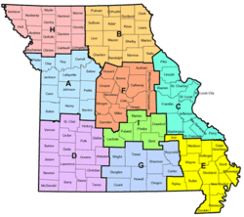
Dawn Busick-Drinkard
MCCA MoWINs Grant Director
Missouri Community College Association

Slide 10
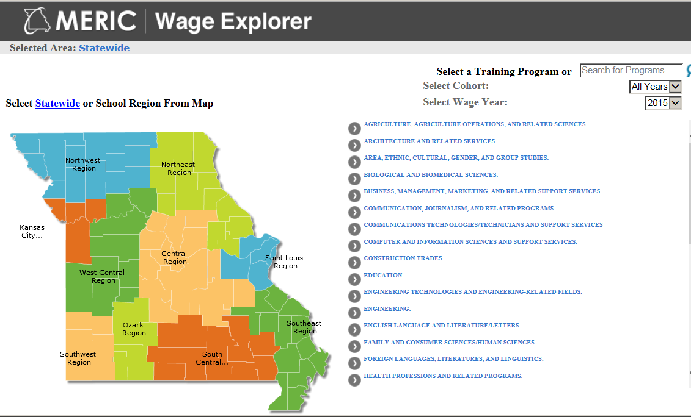
Partnerships
Partner Agencies
Economic Development
Higher Education
Elementary & Secondary Education
Labor and Industry Relations
Social Services

Slide 11
Missouri’s Longitudinal Data System
DESE
Early Childhood data
K-12 data
DHE
Public two and four-year inst.
Graduate characteristics
Data Warehouse
End User
FSD
TANF data
SNAP - Food Stamp - data
Workforce Programs
DWD
Interagency Data Governance
Work Group
UI status
Benefits file
DOLIR

Slide 12
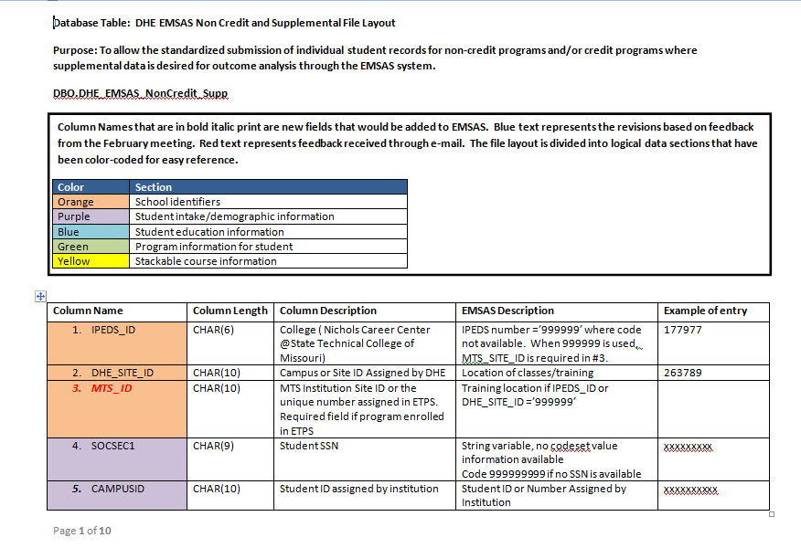
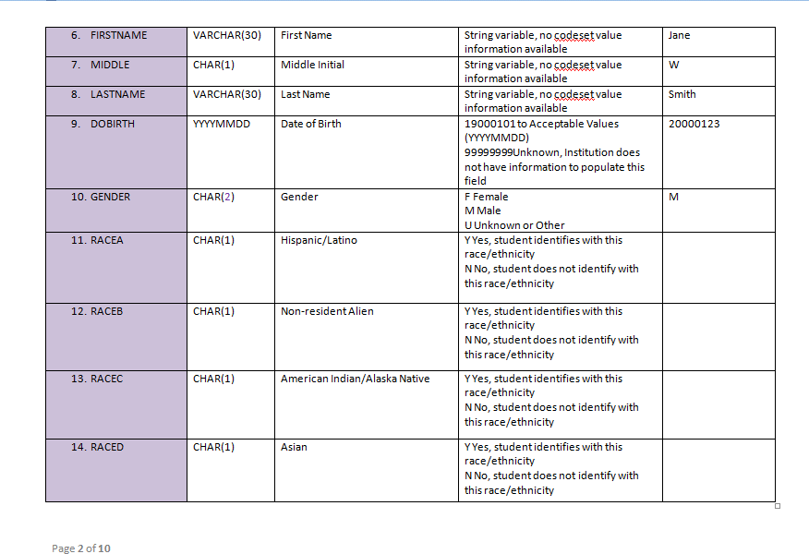
Supplemental Noncredit Data File

Slide 13
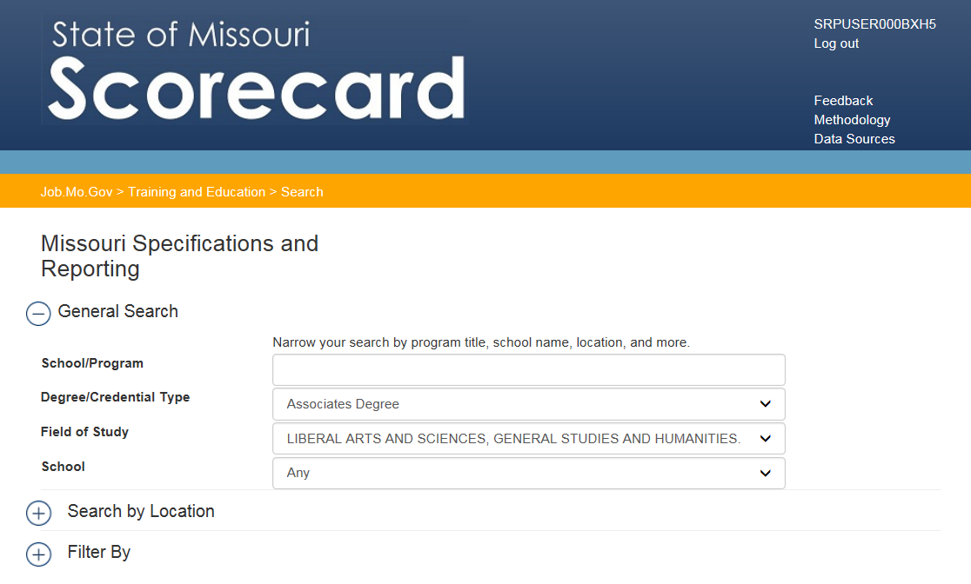
Search

Slide 14
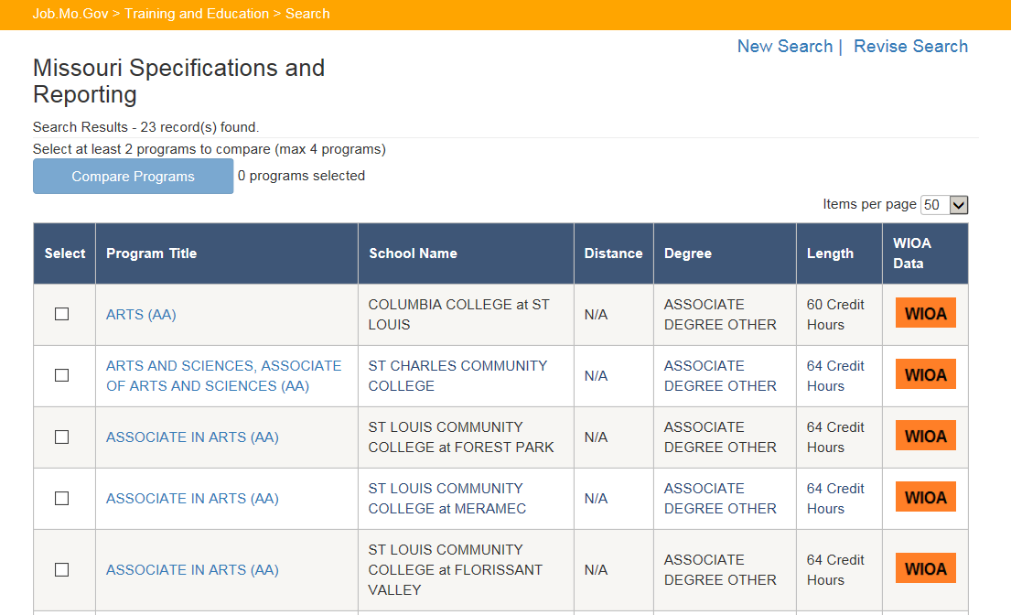
Search Results

Slide 15
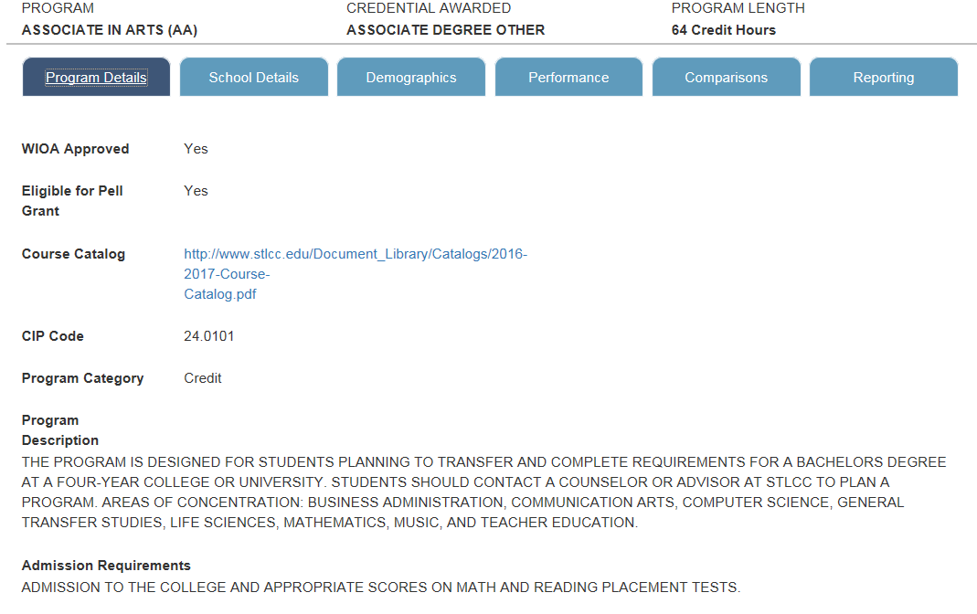
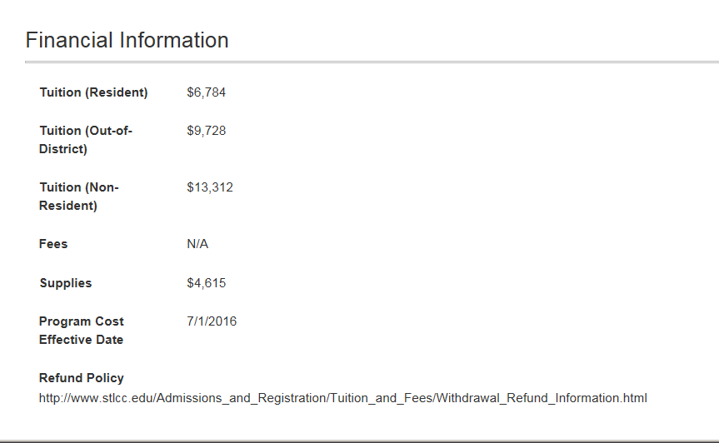
Program Details

Slide 16
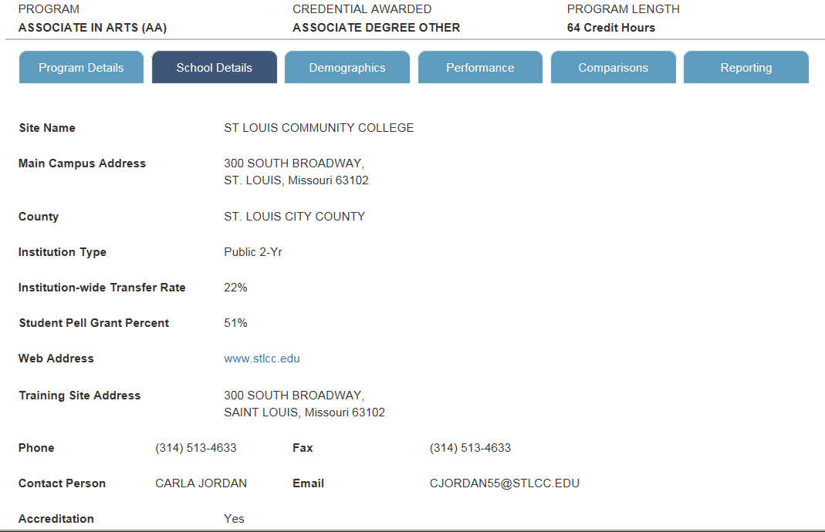
School Details

Slide 17
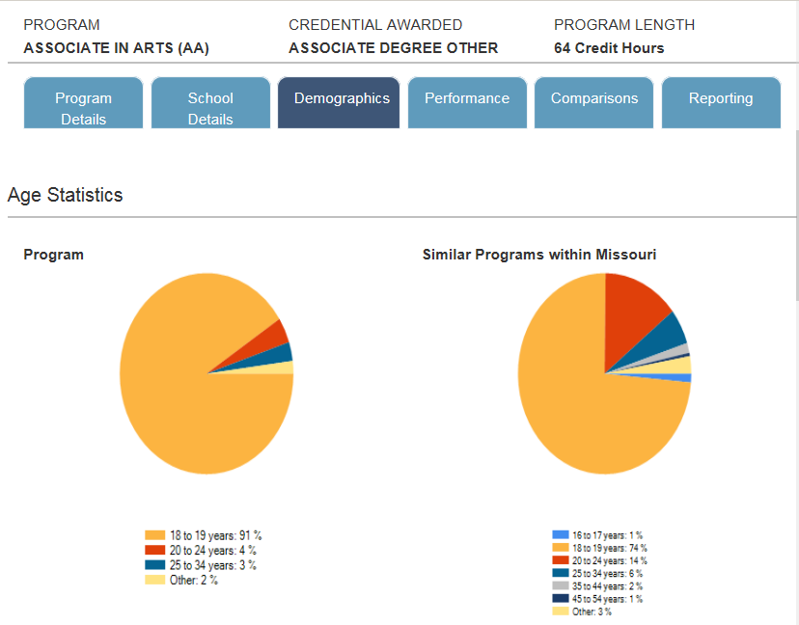
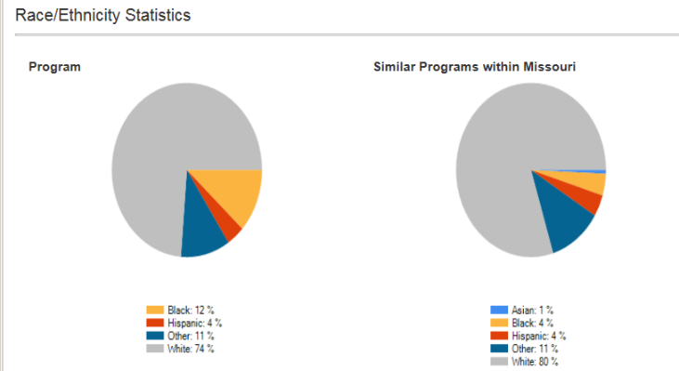
Scorecard - Demographics

Slide 18
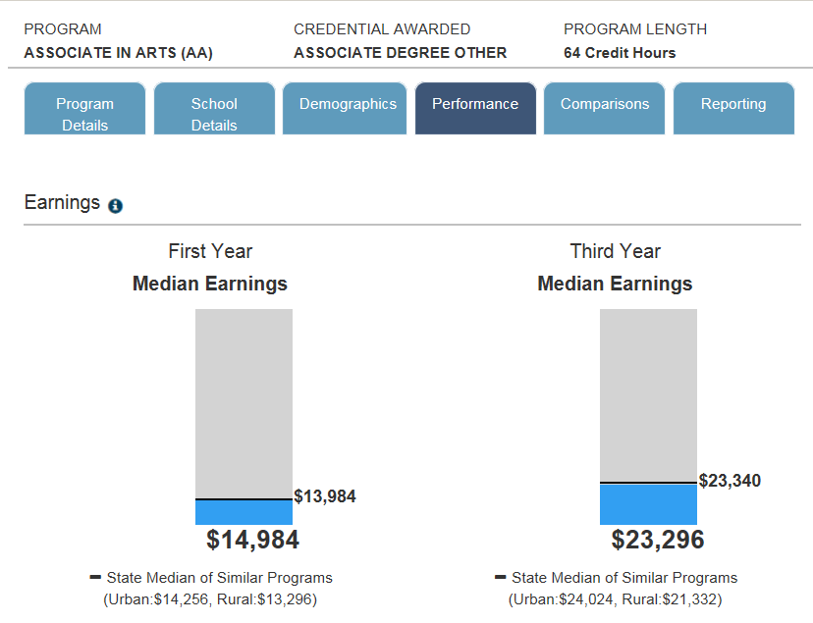
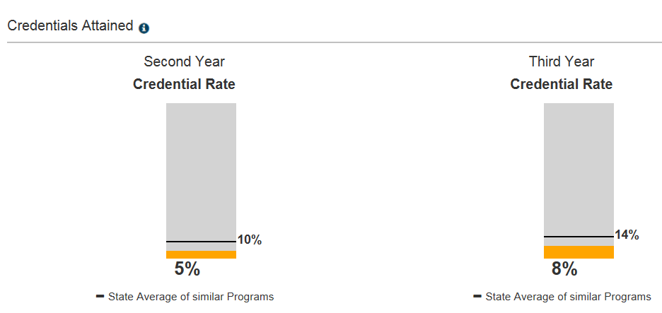
Scorecard - Performance

Slide 19
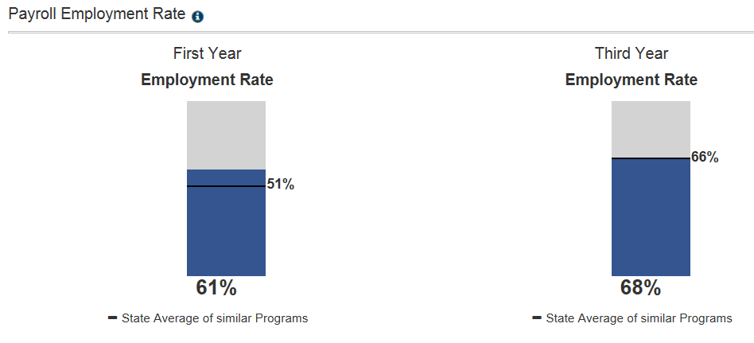
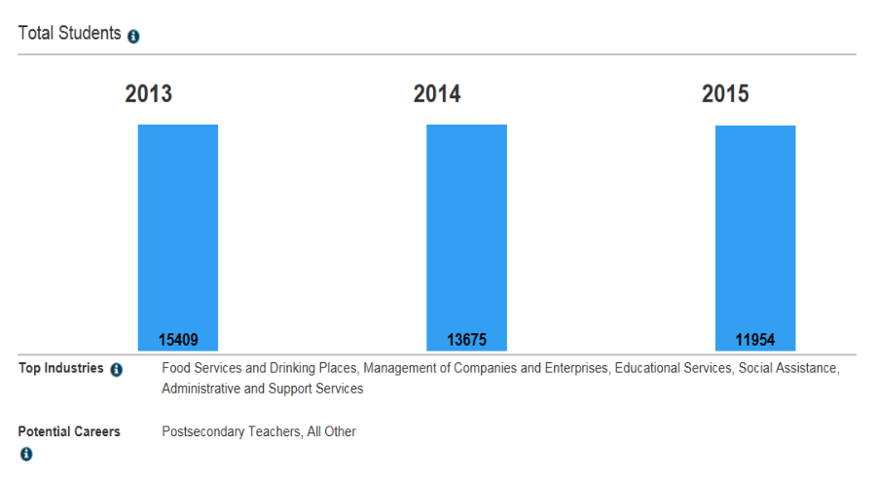
Scorecard Performance - continued

Slide 20
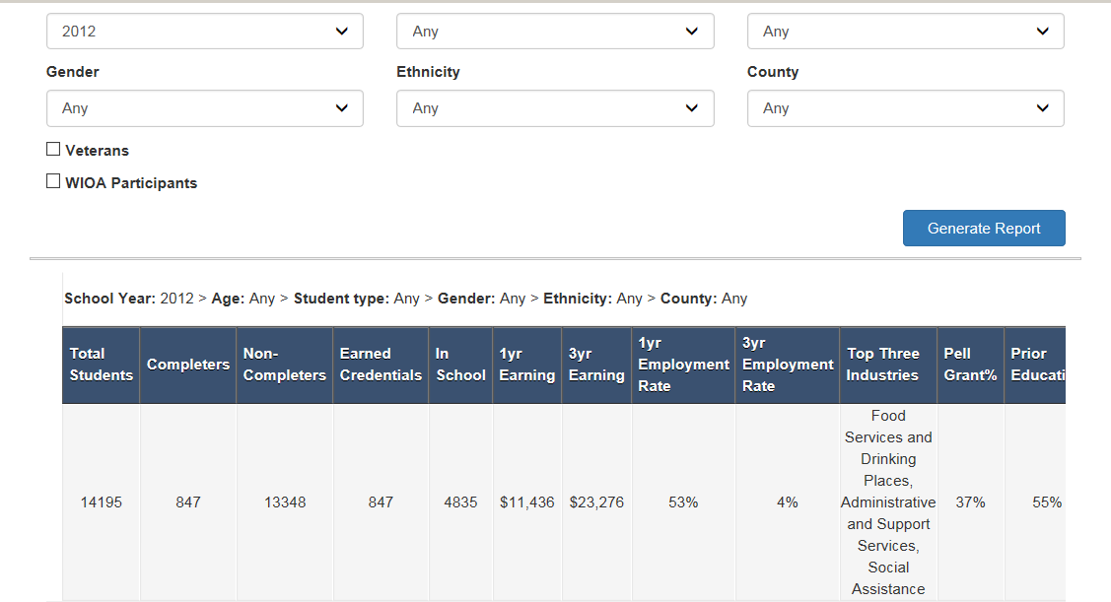
Scorecard - Reports

Slide 21
Phase 3
Planned Enhancements:
Add career exploration tools
Integrate occupational projections
Modify ETPS system to allow data uploads of course information
More detailed reporting

Slide 22
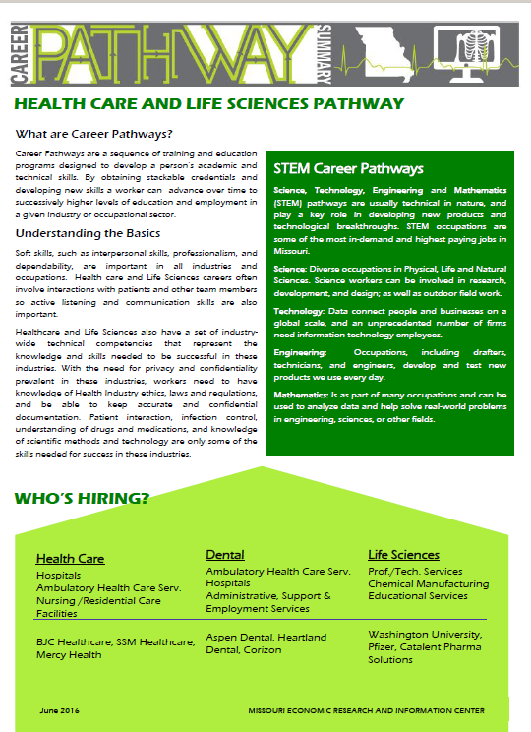
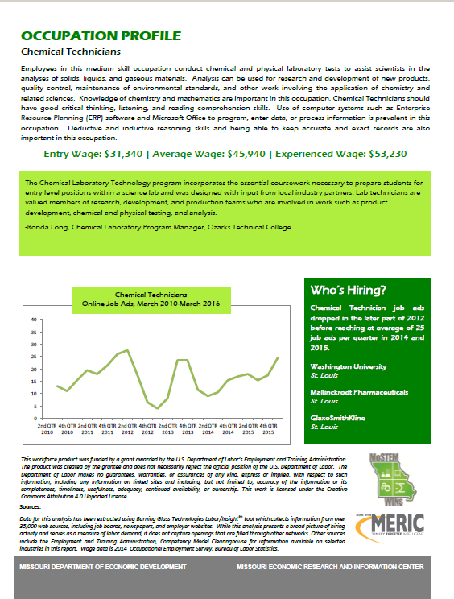
Career Pathways Publications

Slide 23
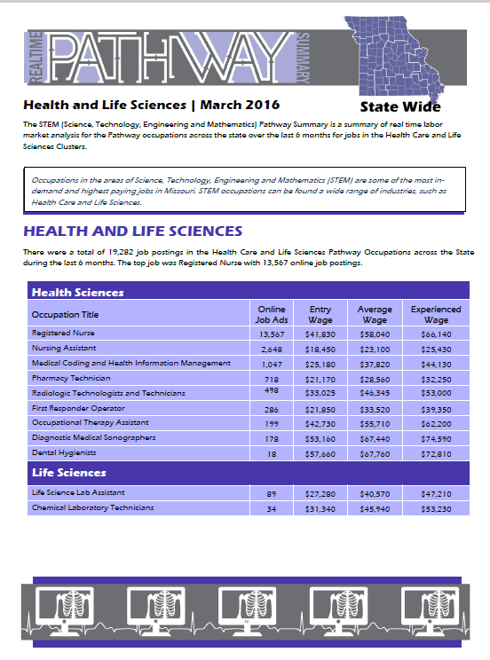
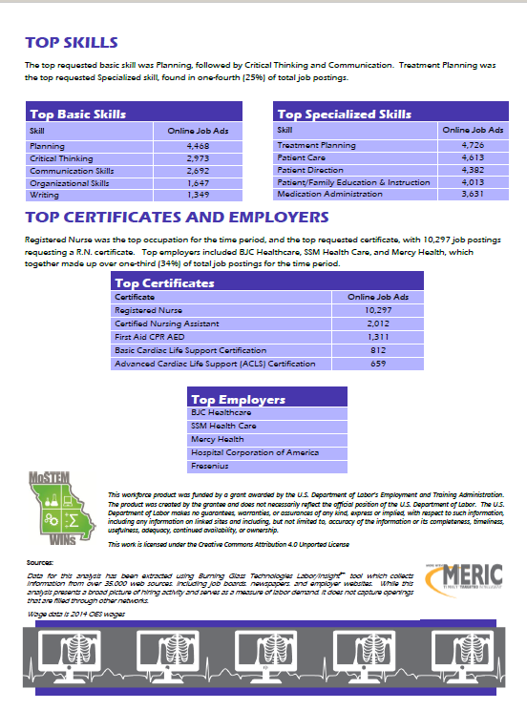
Career Pathways Publications

Slide 24
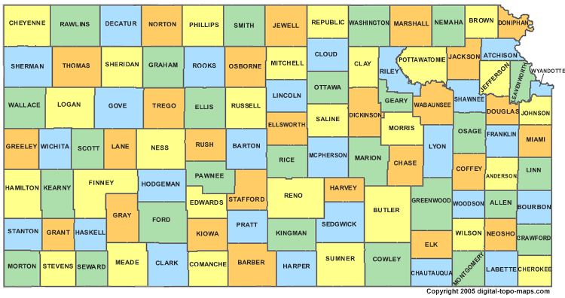
Christa Smith
Research Analyst, KanTRAIN
Washburn University of Topeka

Slide 25
Developing Partnerships
Kansas Model Background:
19 Community Colleges and 6 Technical Colleges: Independently Governed
Kansas Board of Regents = Statewide Coordinating Board
5 Kansas Workforce Areas
Washburn as lead for Rounds 1 (TRAC-7) and 4 (KanTRAIN) consortium TAACCCT grants

Slide 26
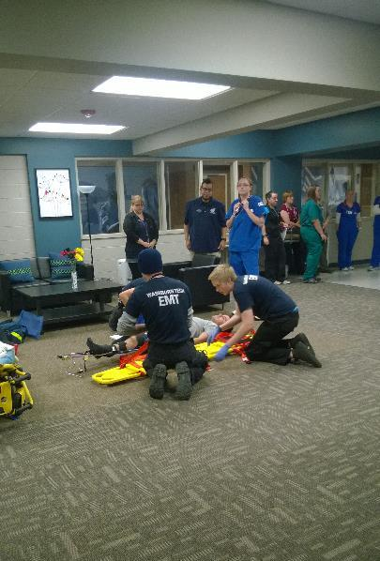
Systems Alignment
Statewide Longitudinal Data System grant (SLDS) for P-20 July 2010 - June 2014 for KSDE & KBOR
Workforce Data Quality Initiative (WDQI) (2013-16) and (2015-18) for Commerce & Labor
Consortium (perspective) alignment of workforce, industry, & education:
TRAC-7 focus on statewide education and workforce, then regional education by industry
KanTRAIN focus on regional education, industry and workforce

Slide 27
KanTRAIN Two-Tier Partnership Model
Transitioned from the TRAC-7 State model:
To the KanTRAIN Two-tiered Systems & Practice model:
Grant-based State alignment with
IHE-based Regional/Local alignment
Grant
State: KBOR & Commerce
Sites
Industry
LWIBs
Consortium Leadership
State: KBOR
State: Commerce
National industry partners
IHE-based Leadership
Site-based Reporting KBOR
Site-based Industry Relationships
LWIB Relationships

Slide 28
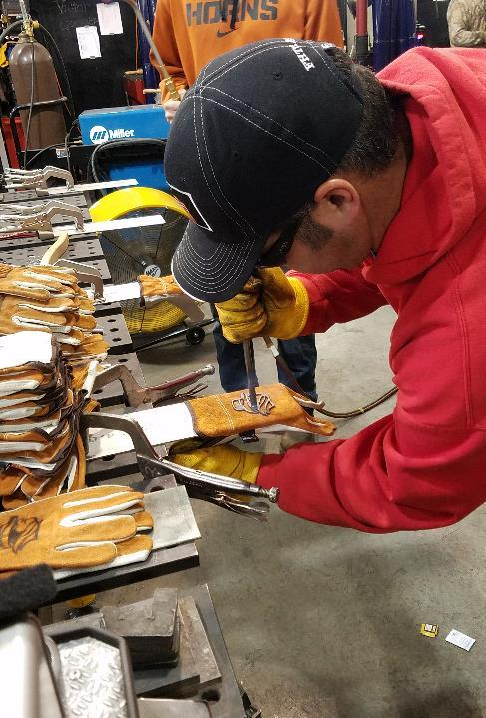
Lessons Learned: Partnerships
Focus:
Grant-focus vs Sustainable Systems focus or both
Systems vs. Practice:
Different roles and expectations for different outcomes
Sustainable Leadership:
Who owns it

Slide 29
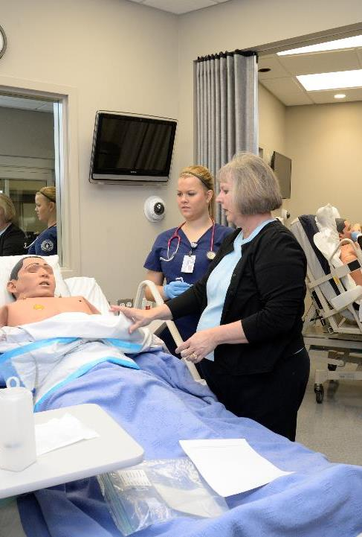
KanTRAIN Data Hub
KBOR Data, Research & Planning
Implement integrated system of postsecondary data collection, maintenance, analysis and reporting
Coordinate the Integrated Postsecondary Education Data System (IPEDS) for all KS higher education institutions
Design and implement a state-wide postsecondary database system
Develop electronic data collection and reporting systems

Slide 30
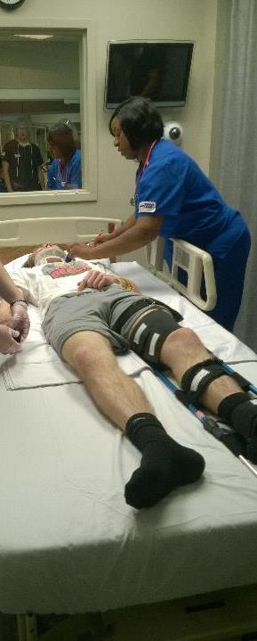
KanTRAIN Data Warehouse Model
Used existing systems
Created new linkages
Developed new report
Integrated student records, program, data, LMI
Added WIOA Support Services
KSDE
PK - 12
KDOL
LMI
Commerce:
Workforce
KBOR Data Warehouse

Slide 31
LMI Information & Planning
IHEs
KBOR
KDOL
LWIBs
How it was:
Utilizing current systems to create new linkages:
IHEs
KBOR
KDOL
LWIBs

Slide 32
Lessons Learned: Data Sharing
Confidentiality of Student Data
Data Sharing & Storage
Building on Established Agreements
Embedded Practice & Sustainability

Slide 33
Collaborative, Sustainable Data Systems: Embedded Practice
KBOR Electronic data collection & reporting systems: IHEs, Labor, KBOR
Workforce-IHEs: Workforce support services, Campus-based Workforce staff, Co-Enrollment, Information-Sharing and Tracking
IHE-KBOR: Expanded Reporting (ID)
Industry-IHEs: Responsive & Predictive Reporting (ID)

Slide 34
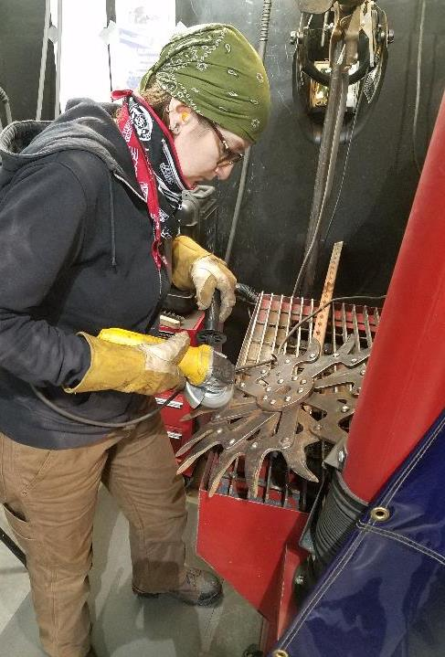
Lessons Learned: Data Integration and Planning Considerations….
Time
Money
Shared Resources
Partners Working Together
Persistence
Patience
Targeted Goals

Slide 35
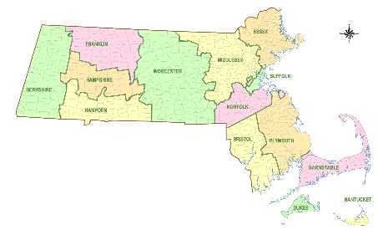
Kathleen Kirby
Statewide Project Director, GPSTEM
Massasoit Community College

Slide 36
Environment Overview
MA: 3 DOL grants: TAACCCT (community college), SLDS (K-12), WDQI (Labor and Workforce)
Community Colleges are not a centrally managed system
No standing data sharing agreements between state agencies
No wage matching between higher education and workforce for three years
No legislation
No WRIS 2
No consistent/formal reporting of noncredit workforce data
Legitimate concern regarding the use of college program performance data in an era of performance-based funding

Slide 37
Environment Overview (cont’d)
At the same time. . .
drive toward closing middle-skills gap
desire to align education and training programs to meet workforce demands
commitment to higher ed as economic engine (in MA specifically)
belief that community colleges have a positive story to tell

Slide 38
Environment Overview (cont’d)
Main barrier: lack of infrastructure and existing foundational relations
Workforce skills Cabinet (Education, Labor and Workforce, Economic Development) in place for about five years
New administration preserved that structure, and reinvested in data-driven approaches
WIOA—new drive toward regionalization and faster turnaround toward workforce alignment
Mass IT roll-up into Executive Office of Education
TAACCCT grant provided critical mass--some champions have emerged

Slide 39
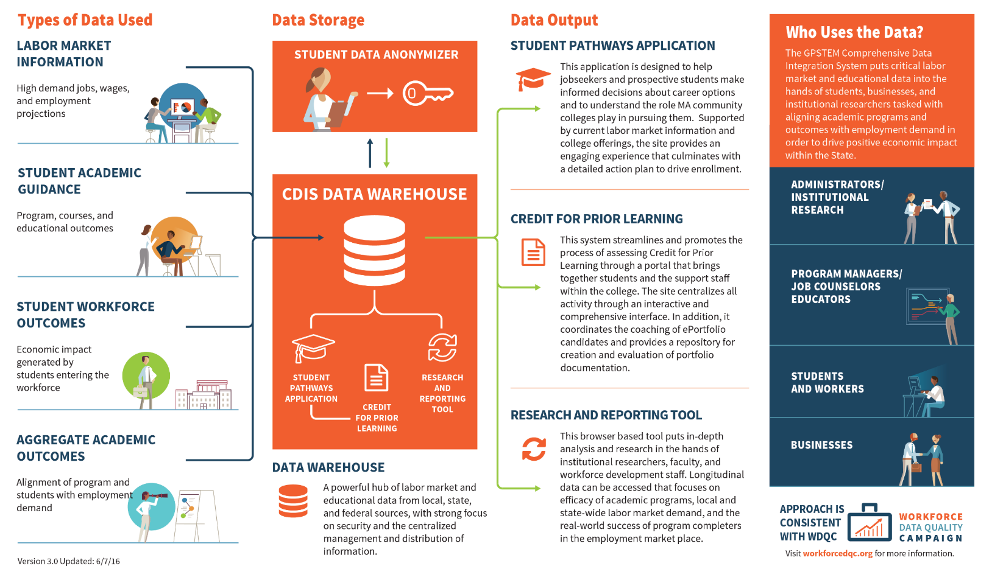
GPSTEM Data Integration Project Overview

Slide 40
Student Pathways Application
Connect jobseekers and prospective students with high-demand careers and relevant academic programs.
Deliver a tailored and comprehensive Action Plan, detailing critical next steps.

Slide 41
Student Pathways Application Overview
Access & Referrals Market and bring prospective students to the application
Assess Experiences & Preferences Gain an understanding of the applicant’s matching characteristics
View High-Demand Job Opportunities Show applicants high-demand and relevant job options
Filter Job Opportunities Narrow potential opportunities
Select College Program Connect applicants with applicable college programs

Slide 42
Match Engine Overview
Wanted Analytics, BLS
ONET, Student
Job Families
Student
Jobs aligned to interests
Interest Profiler
Jobs Data
Programs aligned to preferences
Qualifying Questions
College Selection
Program Mapping
Program/Course
Student, MSA
Colleges

Slide 43
Prospective Student Career Action Plan

Slide 44
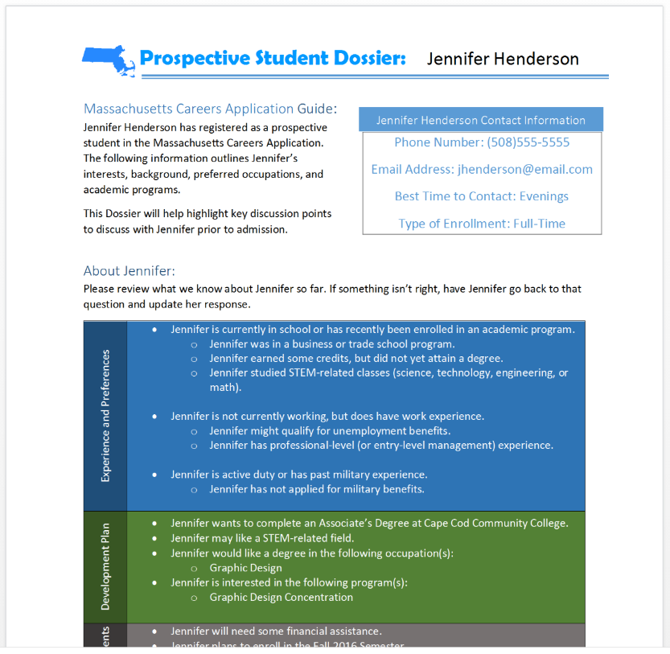
Prospective Student Dossier

Slide 45
Research & Reporting Tool
In-depth analysis and research in the hands of researchers, faculty and workforce development staff.
Longitudinal data about the efficacy of academic programs, and state-wide labor market demand.

Slide 46
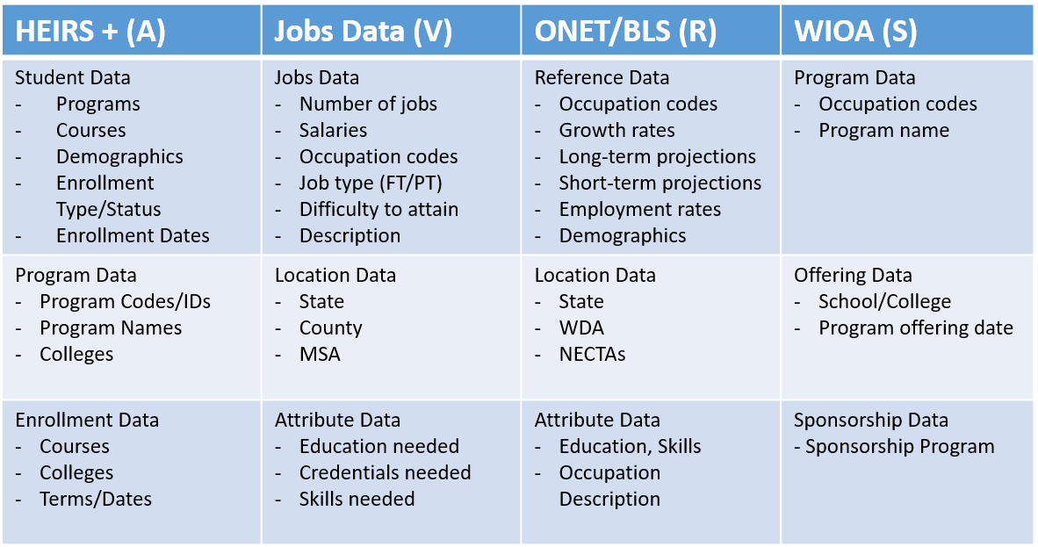
Data Sources
.
A=Academic V=Vendor R=Reference S=Sponsorship/Funding

Slide 47
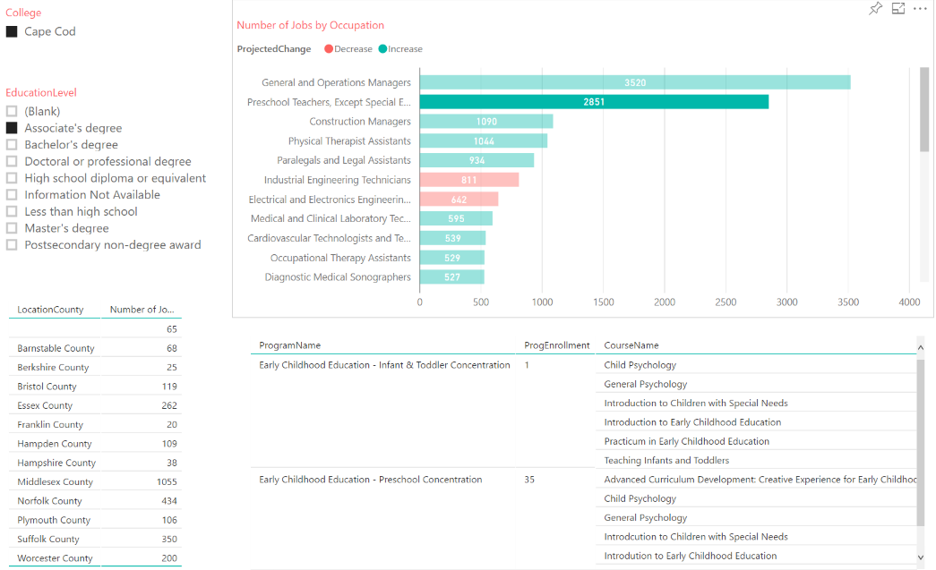
View 1: High-Demand Occupations and College Programs

Slide 48
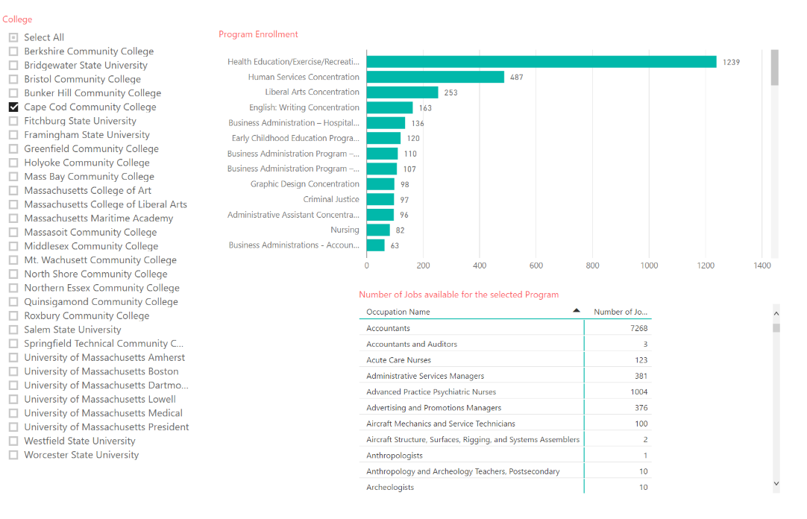
View 2: Occupations & Outcomes for Funded Students

Slide 49
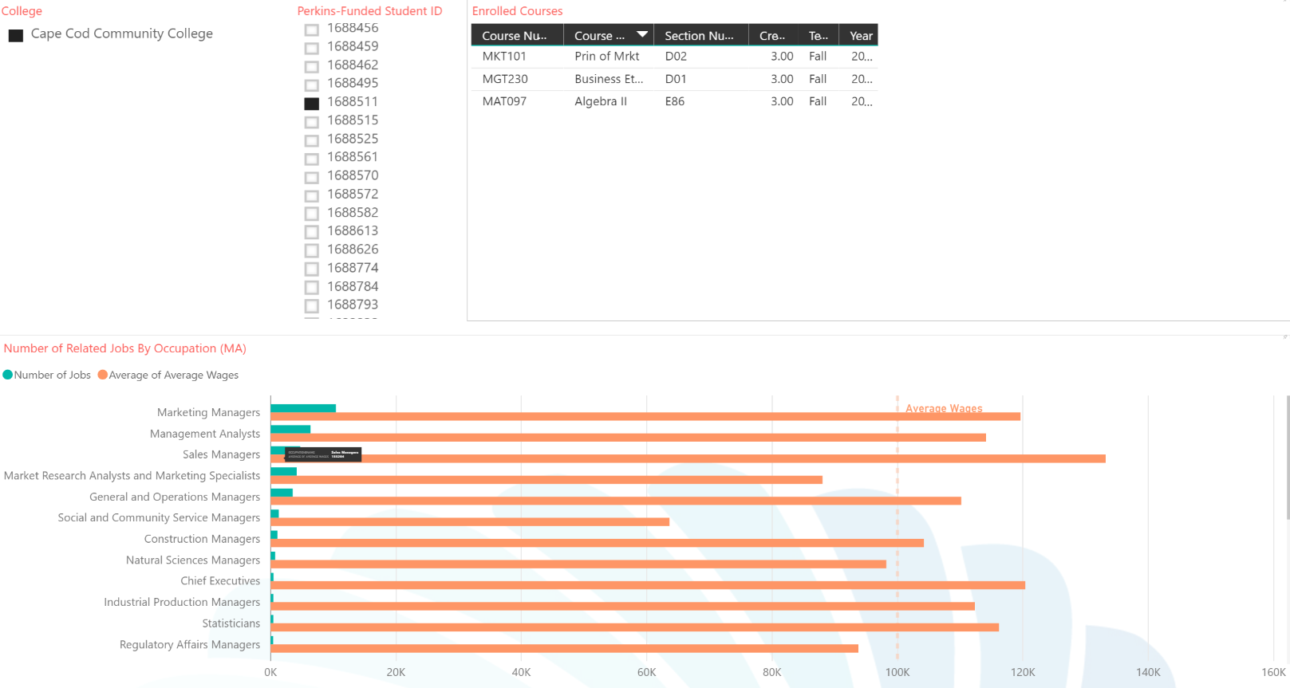
View 3: Occupations & Outcomes for Funded Students

Slide 50
Next Steps
Campus communications to foster adoption/use
Determine format for collection of non-credit workforce data
Determine connection points to higher education and Executive Office of Education data collection and storage
Secure Wage Matching Agreement
Determine post-grant sustainability and ownership
Promote and Publicize!

