Slide 1
Round 4
Sustainability Virtual Institute:
Grantee Sustainability Plans

Slide 2
TAACCCT Round 4
Sustainability Virtual Institute
Iowa’s 15 Community Colleges

Slide 3
What Are You Sustaining and How?
Enhanced and Expanded Simulation Centers & Learning Labs
Colleges enhanced their healthcare simulation centers & increased training capacity by the incorporation of equipment & simulation in the training centers
Partnerships with business & industry
Increased usage of labs at the college
Healthcare Simulation Network Group
Iowa’s community college simulation coordinators developed a network to share best practices & align and incorporate International Nursing Association for Clinical Simulation and Learning (INACSL) Standards of Best Practices into training scenarios
The network is supported by the Iowa Department of Education
The network is also supported by the college deans & leadership
EMSI Career Coach
All 15 community colleges implemented EMSI Career Coach, which aligns with the Future Ready Iowa portal. Future Ready Iowa is an initiative to build Iowa’s talent pipeline. www.futurereadyiowa.gov
Working with college leadership and state agencies on sustainability

Slide 4
Next Steps:
Identify additional best practices & success models developed with the IHUM grant
Continue conversations with college leadership, business and industry, & state agencies
Continue conversations with IHUM leads and directors to discuss best practices in sustainability efforts
During monitoring visits of the IHUM sub recipients, discuss best practices & their sustainability plan at their own college

Slide 5
Contact Information
Mallory Jensen Todd Oesterle
IHUM Project Director IHUM Marketing & Workforce Coordinator
Mallory.Jensen@hawkeyecollege.edu todd.Oesterle@hawkeyecollege.edu
319-296-4486 319-296-4416
Kathleen Williams Constance Grimm
IHUM Project Assistant Associate Director of Grants and Resource Development
Kathleen.Williams@hawkeyecollege.edu constance.grimm@hawkeyecollege.edu
319-296-2320 ext. 1056 319-296-4439

Slide 6
Universidad Metropolitana – Puerto Rico Photonics Institute New Horizons: Puerto Rico Lasers and Photonics Career Pathways TC-27462-14-60-A72
What are we sustaining and how?
What are our next steps?

Slide 7
What are we sustaining
Sustainability was integral to our program from its formation
New Horizons enabled the development of optics and photonics education in Puerto Rico
We are sustaining everything and building off of it
Specific benefits from our TAACCCT project that will be sustained and built upon
Industry relations
Knowledge and skillsets
Internships
Careers
Entrepreneurship
Will pursue a track on our newly-minted AAS degree for entrepreneurship in photonics

Slide 8
What are the Next Steps?
We are already well along this path
AAS Degree
Current curriculum
New tracks (entrepreneurship, specialization)
Professional Certificates and Continuing Education
Short courses and Workshops for professionals and educators
These will be organized with our industry affiliates in order to maximize impact
Expanded outreach (Day of Light, Partnerships)

Slide 9
Building Workforce Capacity in
IT Networking
Software Development
Computer Engineering
Game Development

Slide 10
Innovation | Metrics | Steps to Sustainability | Implementers
Short-term Certificates | Alignment with current industry certifications & workforce needs Job placement rates Wage rates | Ensure certificates are stackable, Monitor enrollment & retention rates, Track costs, Increase program awareness with workforce partners | Faculty, Dept. Heads, Marketing Dept., State Employment Dept.
Accelerated Remediation | Higher retention rates Higher 2 year completion rates Alignment with other CCSNH initiatives | Monitor enrollment & completion rates Track graduation rates of completers, Increase program awareness | ACE Director, VPAA Advising Dept., Faculty, VPAA
Industry Advisory Boards | Industry input on program outcomes Higher job placement rates | Meet with industry partners regularly Incorporate Board feedback | Faculty, Dept. Heads, Employers, President

Slide 11
Innovation | Metrics | Steps to Sustainability | Implementers
Prior Learning Assessments | Higher enrollment rate of non-traditional students Alignment with other CCSNH initiatives | Increase program awareness, Obtain employer support, Track Participation and graduation rates | Faculty, Dept. Heads, Advising Dept. , VPAA
IT Career Counselor | Higher retention and completion rates Higher job placement rates Successful recruitment rates at high schools, state agencies and companies | Track completion rates vs. other programs, Track employment rates vs. other programs, Track costs vs. enrollment & retention revenue | Dept. Head, faculty, Employers, VPAA, Advising Dept.
Lab Technician | Higher retention and completion rates Higher enrollment rates Higher job placement rates | Track costs vs. enrollment & retention revenue | Dept. Head, faculty, VPAA

Slide 12
Arizona Regional Advanced Manufacturing Professional Upgrade Project Consortium
Central Arizona College Gateway Community College – Central City College Eastern Arizona College Estrella Mountain Community College
Andrew Clegg - Grant Director 520-494-6625 Andrew.Clegg@centralaz.edu

Slide 13
Sustainability Goals
Retention of Career Navigators
Utilize data to demonstrate Career Navigator value
Expand role to entire division
Focus role to maximize value
Continuation of certificate and degree programs
Focus on programs that are meeting enrollment
Adjust programs to increase student enrollment
Continue and strengthen relationships with workforce partners
Create agreements with workforce partners to formalize relationships

Slide 14
Next Steps
Complete review of Career Navigator ROI and create justification for administration to retain Navigators
Create agreements with workforce partners to formalize relationships
Review programs and create strategies to increase student enrollments in underperforming programs

Slide 15
Statewide Project Director: Kathleen M. Kirby, Ph.D.
Massasoit Community College
kkirby3@Massasoit.mass.edu
508.588.9100 x2012

Slide 16
At the 15 MA Community Colleges. . . .
College & Career Navigator for outreach/recruitment
COMPLETE COLLEGE AMERICA Strategies:
Meta Majors (Areas of Study)
Academic Maps with Milestones
Career Pathways and goal-oriented planning
Co-requisite remediation in math
Retention and completion strategies such as proactive advising and technology-enabled advising and registration

Slide 17
STATEWIDE INITIATIVES
Gathering non-credit workforce data as part of our standard reporting to BHE
MassTransfer: Ongoing work on articulation and transfer
Credit for Prior Learning
Open Education Resources
Mass Colleges Online Website
Data Integration System for guiding students into workforce-aligned programs at the community colleges

Slide 18
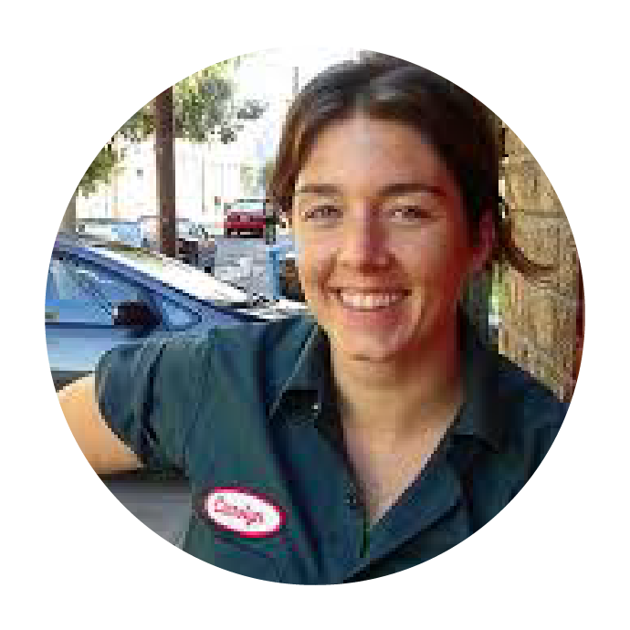
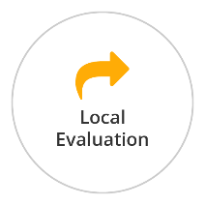
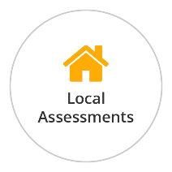
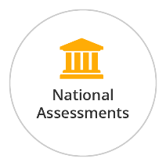
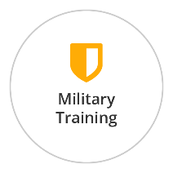
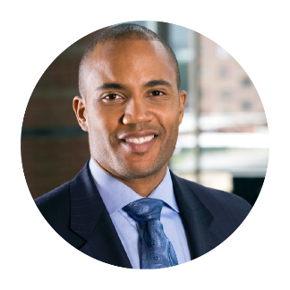
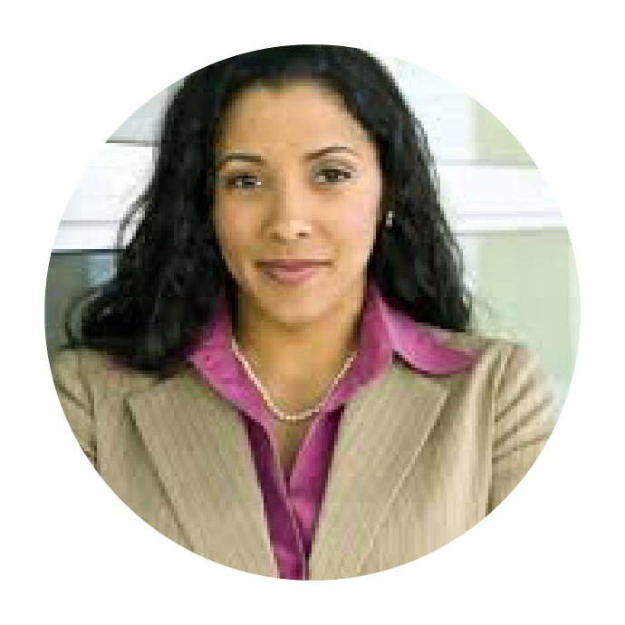
Credit for Prior Learning Application Overview
Adult Student
Get Orientation on CPL Process
Complete the Prior Learning Wizard
View Possible College & Opportunities
Complete one or more CPL Petitions
If Petition is ePortfolio
CPL Specialist (Local College)
Counsel Adult Student on CPL Eligibility & Enrollment
Create & Manage CPL Petition
Submit for Credit and Close Petition
Portfolio Coach (North Shore CC)
Portfolio Evaluator (Statewide SME/Faculty)
Work With Adult Student to Complete ePortfolio
Determine if College Credit Should be Awarded for ePortfolio Petition

Slide 19
Massachusetts Community Colleges Go Open Statewide OER Initiative
101 Faculty are participating in the project (Rounds 1 & 2)
8,116 Students will save over $1.2 million during the first academic year

Slide 20
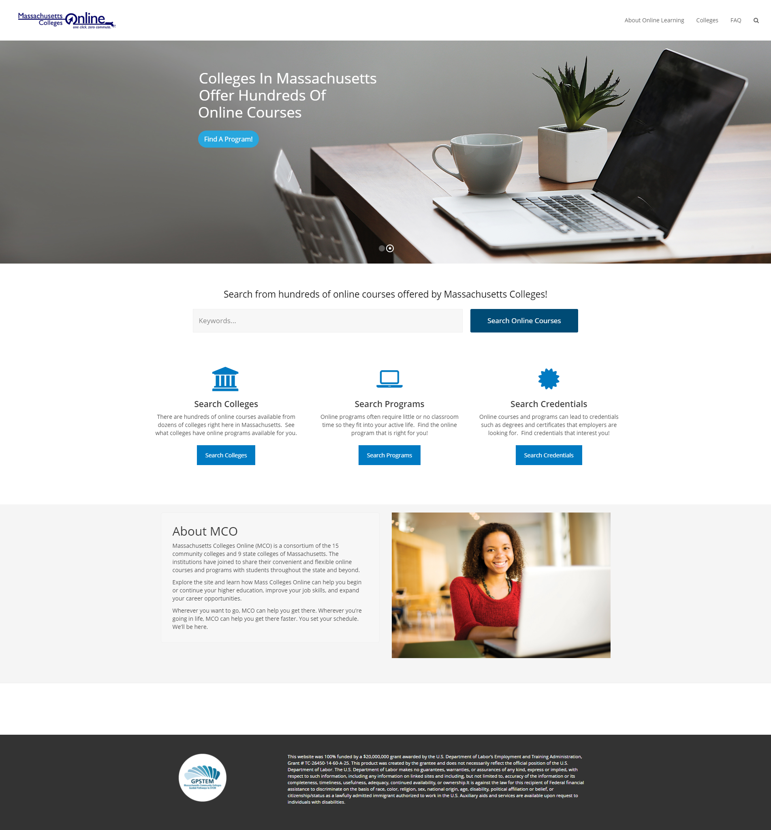
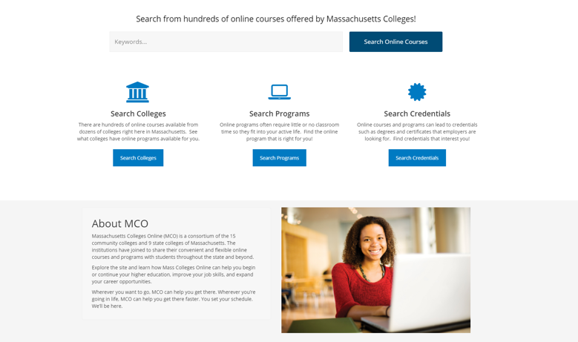

Slide 22
Kansas Technical Re/training Among Industry-targeted Networks (KanTRAIN) Sustainability Planning
Pamela Combes
KanTRAIN Grant Director
Flint Hills Technical College
Christa Smith
KanTRAIN Research Analyst
Washburn University

Slide 23
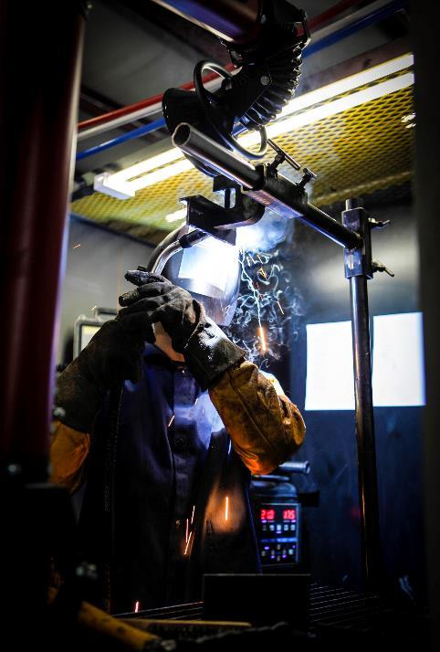
KanTRAIN Background
$11,997,957 Round 4 TAACCCT grant award
State-wide (Kansas) consortium
Washburn University
Washburn Institute of Technology
Flint Hills Technical College
Garden City Community College
Wichita Area Technical College
Focus on two core industries:
Health Care
Advanced Manufacturing

Slide 24
KanTRAIN Sustainability Process
Grant level sustainability work:
Started by keeping the end in mind
SOAR Analysis
Strengths
Opportunities
Aspirations
Results
Results, as measured by

Slide 25
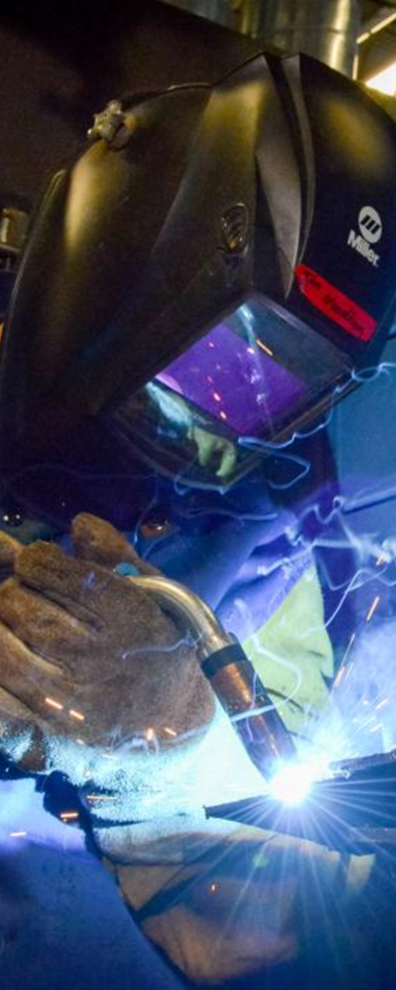
KanTRAIN Sustainability Process
Site-Based sustainability work:
Align Innovations/Practices/Methods to TAACCCT Core Elements
Evidence-based designs
Sustain the AWS certification process established during the grant
What has had the greatest impact?
Sector strategies and employer engagement
Sustain the annual Reverse Career Fair event which creates a strong connection between the college, students, and businesses

Slide 26
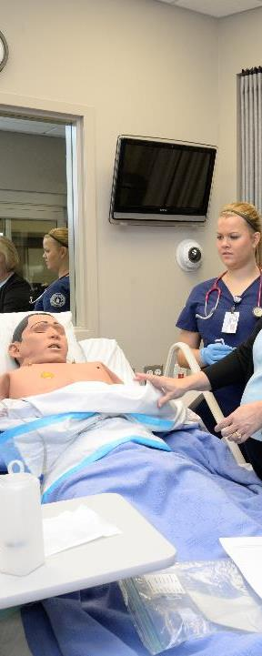
Prioritize Innovations/Practices/Methods
Which are critical to success?
Does this align with the institution’s strategic plan?
Do you have college leadership on-board?
Support your plan with performance data
Use the QNPR and APR
Enrollment
Employment

Slide 27
KanTRAIN
Christa Smith
KanTRAIN Research Analyst
christa.smith@washburn.edu
785-670-2288
Debra Mikulka
KanTRAIN Project Director
debra.mikulka@washburn.edu
785-670-1403
Pamela Combes
KanTRAIN Grant Director
pcombes@fhtc.edu
785-670-

Slide 28
Career Pathway Scorecard
TAACCCT 4, Exceeding the Cap
Advancing Careers of TAA and Transitioners (ACT2)
Take Career Pathway Advancement in Wisconsin to Greater Scale and Alignment.
Using Data to Inform Decisions

Slide 29
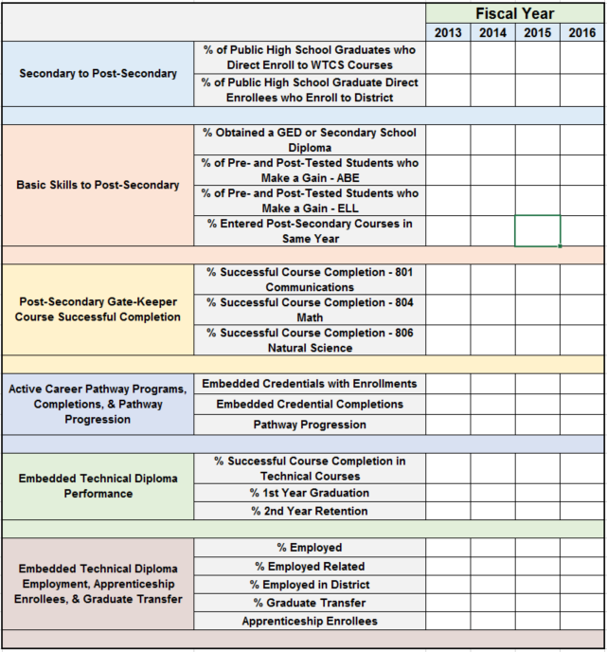
Using Data to Inform Decisions
20 Indicators
Key Transition Points
Multiple Data Sources
Institutional Research Staff
Curriculum Development/Approval Process

Slide 30
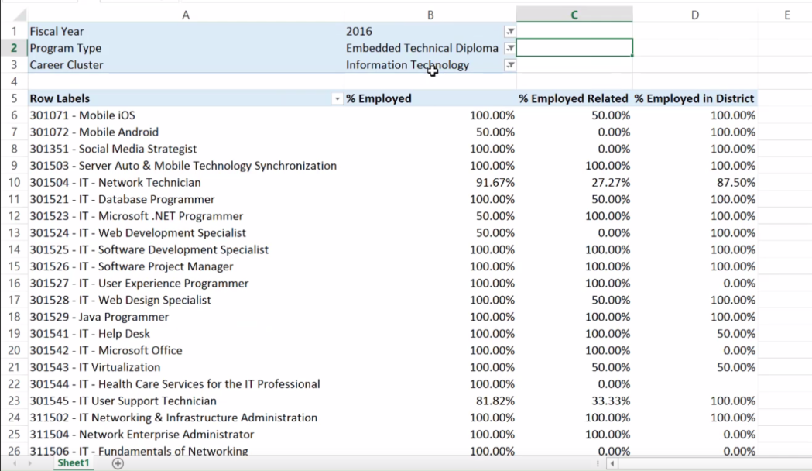
Sustained In Policy and Practice

Slide 31
Ohio TechNet

Slide 32
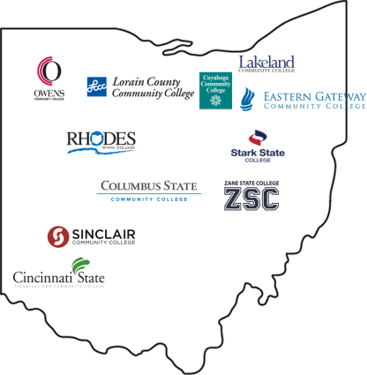
Ohio TechNet ADDRESSES THE SKILLS GAP by developing
TARGETED MANUFACTURING TRAINING PROGRAMS for transitioning adults.
$15 MILLION | + | $1.7 MILLION
INVESTMENT |  | LEVERAGED RESOURCES
ADULTS ARE LEARNING INDUSTRY-RECOGNIZED SKILLS FOR IN-DEMAND OCCUPATIONS
that provide family-supporting wages.
100+
PROGRAMS CREATED OR ENHANCED
1451
INDIVIDUALS ENROLLED
IN OTN PROGRAMS
1025
CREDENTIALS EARNED BY
STUDENTS IN OTN PROGRAMS
300+
EMPLOYER
PARTNERS
ENGAGED
Figures reflect data as of February 28, 2017
KEY COLLABORATIONS Partnering nationally and statewide to address Ohio’s manufacturing skills gap.

Slide 33
Sustainability Efforts: Keeping Progress in TAACCCT
Employer Engagement
Acceleration/Modularization Strategies (PLA, CBE, Remediation)
Work-Based Learning Models (Apprenticeship, Earn/Learn Programs)
Supportive Services

Slide 34
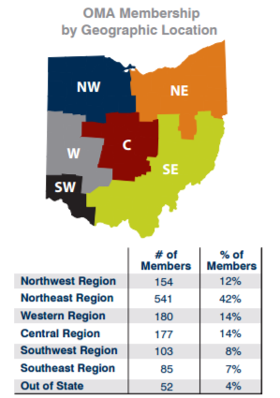
Ohio Manufacturers’ Association (OMA) 2017 Workforce Strategy
Identify Current Local Efforts
Local & Regional Industry Champions and Stakeholders
State-level Stakeholders
Create Statewide Asset Map
Host Regional OMA Membership / Manufacturing Listening Sessions
Summarize Key Themes & Priorities for Action
Common issues & solutions
Scale or replicate what works
Identify solutions that work
Identify & Engage

Slide 35
Bernie Gosky
Ohio TechNet Project Manager | Lorain County Community College
bgosky@lorainccc.edu | 440-366-4233
Terri Burgess Sandu
Director, Talent and Business Innovation | Lorain County Community College
tsandu@lorainccc.edu | 440-366-4215
www.OhioTechNet.org | https://www.facebook.com/OhioTechNet/

Slide 36
HealthCARE Montana: Creating Access to Rural Education
HealthCARE Montana is connecting employer and education partners to develop high quality, locally accessible, industry relevant training opportunities
Missoula College plus 14 College Partners: Blackfeet, Bitterroot, Chief Dull Knife, City, Flathead, Gallatin, Great Falls, Helena, Highlands Montana Tech, Miles, Northern, Salish Kootenai, Stone Child, Western
Over 200 industry partners
MT Department of Labor and Industry
Montana Area Health Education Centers
Office of the Commissioner of Higher Education

Slide 37
Innovative Programs and Activities
Employer and Faculty Partnership for Curriculum Development
Created Rapid Response Network (16 surveys to healthcare facilities over 2 years provided input through survey monkey from 405 unique individuals)
Shortened nursing training (PN, RN, RN-BSN Completion by 1 semester each) and included rural practice content
Developed distance Practical Nursing Program (currently pre-nursing and nursing students from 33 rural and frontier towns)
Aligned consistent pre-reqs and core competencies for all healthcare education
Workforce Coordinators and Healthcare Apprenticeship Specialists created 84 healthcare apprenticeships in 14 occupations in 29 facilities
Developed LEAD (Learn, Engage, Adapt, Do): Fostering Self-Awareness for Workplace Success
Materials have been distributed to 61 healthcare facilities
Updated Statewide Healthcare Workforce Strategic Plan

Slide 38
Mechanisms for Sustainability
Area Health Education Centers
MUS Healthcare Education & Workforce Coordinating Council
Cross Training
Braided Funding
Tuition and Fees Sustain Health Education Programs

Slide 39
NJ-PREP
Bergen Community College-Lead Agency
Brookdale Community College
Essex Community College
Hudson County Community College
Mercer County Community College
Middlesex County College
County College of Morris
Ocean County College
Passaic County Community College
Raritan Valley Community College
Sussex County Community College
Union County College
Building upon earlier Federal funding (HHS), “the consortium was formed to foster synergy across the partnership and to institute unified approaches to supplying the region’s employers with skilled and credentialed workers”.

Slide 40
Sustainability Process
Lead College President requested counter-parts to appoint Task Force
Each college appointed a Task Force, chaired by VP, to develop plan
Consolidated with NJHPC plan, leading to an integrated approach
Priorities to be Sustained
College specific, but candidates include:
Updated and improved academic programs
Student support systems
Workforce Relationships
Management systems

Slide 41
Approaches to Sustainability
Colleges’ budget funding
Public workforce support
Employer support
Grants and Private Foundation support
Integrate NJHPC into the NJ Council of Community Colleges

Slide 42
HigherEd.org A New Learning Ecosystem & Portal for Personalized Competency-Based Education
Knowledge to Work TAACCCT Grant Lord Fairfax Community College John Milam (540) 868-7249 jmilam@lfcc.edu
Knowledge to Work and the HigherEd.org portal are funded in part by a TAACCCT grant from the U.S. Department of Labor’s Employment and Training Administration

Slide 43
There is no educational search engine for individual learners, just admissions guides, content/OER repositories, & provider-specific training resources
So we created a mashup: Amazon meets Google for learning

Slide 44
Sustaining portal & CBE programs with:
Storytelling using videos & a country western song about CBE called “A robot took my job”
Reframing to work more w/ employers to help them assess job roles in terms of competencies & promoting OER to get them
Looking to join other portal efforts at DOL, state, & Virginia Community College System level
Co-branding, partners, advertisers, investment

Slide 45
Cape Cod Community College Grant Program: Massachusetts Credentials and Careers in Aviation Building an Aviation Maintenance Technology Program
Contact Information: Marie Murphy mmurphy@capecod.edu 508-362-2131, ext. 4507

Slide 46
Sustainability Plans
Planning to Sustain
College certificate and degree programs
Pathway to obtain FAA certification
Program faculty: 3 full-time; 3-5 part-time
Program staff: Retention Specialist, Administrative Assistant
Sustainability Methods
Sustained grant costs will move to college budget/maintain with student enrollment & retention
Strengthen and build employer partnerships
Offset equipment costs
Student scholarship opportunities
Develop additional programs/revenue sources that utilize existing infrastructure

Slide 47
Next Steps
Grow Enrollment
Develop veterans outreach and PLA pathway
Create AMT program articulation agreements with other MA community colleges
Configure a dual enrollment pathway
Establish higher level connections with One-Stops in service area
Develop comprehensive marketing plan that extends beyond CCCC traditional reach
Program Enhancements
Develop distance learning program component
Refine student screening/enrollment guidance
Develop internship opportunities at employer sites

Slide 48
IT Pathways in Indiana Ivy Tech Community College of Indiana Matthew Cloud, Project Director TAACCCT Grant mcloud3@ivytech.edu, 574-289-7001 x5369

Slide 49
WE ARE SUSTAINING: Supplies (including computers) purchases through - Regional/campus state-wide funding (State budget) - Donations - Reuse/recycle of outdated internal equipment Virtual Data Center - Reinvent student labs virtually with low consumable fees Instructor Training - Professional Development - IT Academies - Student/Instructor certification courses one and the same - Others utilizing our training, K12/4-year colleges/military IT Competition - Corporate Sponsorships - Certification Sponsorships Advising Tools - Expansion to other program areas - Vendor Sponsorship Employer relationships and Boards - Expanding Project Director role to Statewide Instructor Training - Expand Employment opportunities for students

Slide 50
NEXT 3 MONTHS: Finalize purchase sustainability programs Increase K12 involvement in Instructor Training Expand employment tracking Expand additional IT Academies outside of Ivy Tech Create new roles

Slide 51
Minnesota Advanced Manufacturing Partnership Project Sustainable under MnAMP
Core curriculum and portable, transferable latticed manufacturing pathways
+Connect – mediated telepresence platform to train incumbent workers
Fiscal Manager position to manage all grants
Dual-Training and Registered Apprenticeship models
Credit for Prior Learning as it related to Industry Credentials
Alignment of Industry credentials in technical programs

Slide 52
Next Three Months
Lay out our sustainable models into the toolkit
Devise a ROI
Share with leadership at college or colleges
Leadership share sustainability plan with internal people and those affected and give input and direction to establish strong communication and support.
Design and implement programs without grant funds

Slide 53
Minnesota Advanced Manufacturing Partnership Project
South Central College
Anne Willaert
anne.Willaert@southcentral.edu
1920 Lee Blvd
North Mankato, MN 56003
507.389.7217

Slide 54
Career Pathways & Contextualized Learning in Workforce Development and Lifelong Learning
Workforce Development and Lifelong Learning Division

Slide 55
Sustainability Goals
Contextualized, accelerated healthcare administration and hospitality Programs
Courses will continue post-grant
Institutionalization of Industry Councils
Continue integration of partner involvement in the development of courses and career pathways
Partnerships will be enhanced
Retention of Staff
Curriculum developers and instructional designer are key to contextualizing courses

Slide 56
Next Steps
Draft memo to justify staff continuously enhancing or reshaping courses and translating in-person courses to online and hybrid certificate programs
Meet with industry council to discuss seamless integration

Slide 57
Career Pathways & Contextualized Learning in Workforce Development and Lifelong Learning
Tony Johnson, Ed.D. Dean, Workforce Development and Lifelong Learning | Emmanuelle St. Jean, MPH Healthcare Administration Project Director | Brandon Schweitzer, Ph.D. Hospitality Project Director
Tony.johnson1@udc.edu | Emmanuelle.Stjean@udc.edu | Brandon.Schweitzer@udc.edu
(202) 274-7181 | (202) 274-6039 | (202) 274-5534

