Slide 1

Participant Poll
What is your current role in the grant?
  Project Manager
  Faculty
  Dean/VP/Other Leadership Role
  Career Navigator/Coach
  Other (list in chat)
Were you a part of the past two Sustainability Virtual Institute webinars?

Slide 2
Round 4
Sustainability Virtual Institute:
Final Webinar
June 27, 2017
2 – 3:30 p.m. EST

Slide 3
Presenters
MODERATOR:
Eugenie Agia, Workforce Analyst, TAACCCT Grants, U.S. Department of Labor, Employment, and Training Administration
FACILITATOR:
Cheryl Martin, Program Manager, TAACCCT Grants, U.S. Department of Labor, Employment, and Training Administration.

Slide 4
Agenda
Welcome and Introductions
Grantee Examples
What happens after the SVI?
Q&A
Closing and Wrap-up

Slide 5
Grantee Examples

Slide 6

Kansas Technical Re/training Among Industry-targeted Networks (KanTRAIN) Sustainability Planning
Pamela Combes
KanTRAIN Grant Director
Flint Hills Technical College
Christa Smith
KanTRAIN Research Analyst
Washburn University

Slide 7
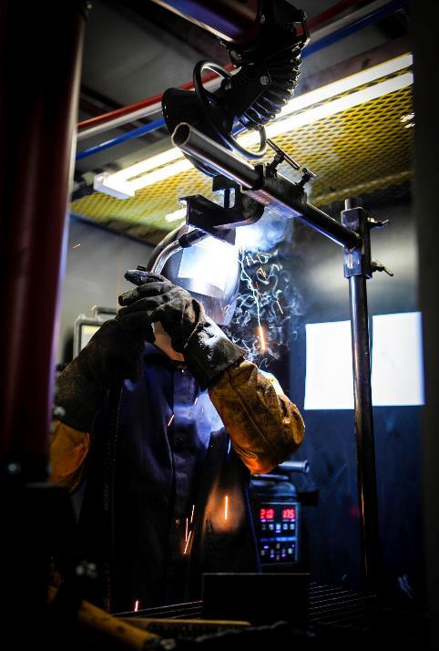
KanTRAIN Background
$11,997,957 Round 4 TAACCCT grant award
State-wide (Kansas) consortium
  Washburn University
  Washburn Institute of Technology
  Flint Hills Technical College
  Garden City Community College
  Wichita Area Technical College
Focus on two core industries:
  Health Care
  Advanced Manufacturing

Slide 8

KanTRAIN Sustainability Process
Grant level sustainability work:
Started by keeping the end in mind
SOAR Analysis
  Strengths
  Opportunities
  Aspirations
  Results
Results, as measured by

Slide 9

KanTRAIN Sustainability Process
Site-Based sustainability work:
Align Innovations/Practices/Methods to TAACCCT Core Elements
  Evidence-based designs
    Sustain the AWS certification process established during the grant
What has had the greatest impact?
  Sector strategies and employer engagement
    Sustain the annual Reverse Career Fair event which creates a strong connection between the college, students, and businesses

Slide 10
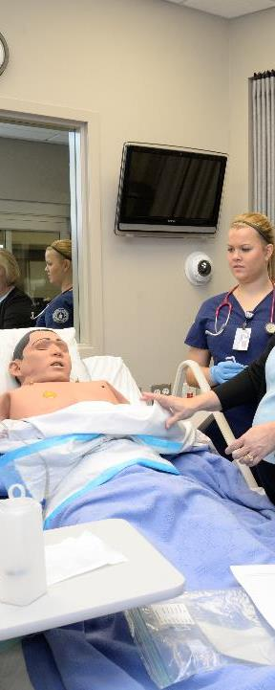
Prioritize Innovations/Practices/Methods
Which are critical to success?
Does this align with the institution’s strategic plan?
Do you have college leadership on-board?
Support your plan with performance data
  Use the QNPR and APR
  Enrollment
  Employment

Slide 11
KanTRAIN
Christa Smith
KanTRAIN Research Analyst
christa.smith@washburn.edu
785-670-2288
Debra Mikulka
KanTRAIN Project Director
debra.mikulka@washburn.edu
785-670-1403
Pamela Combes
KanTRAIN Grant Director
pcombes@fhtc.edu
785-670-

Slide 12
Q&A

Slide 13
IMPACT Consortium

Slide 14

Career Pathway Scorecard
TAACCCT 4, Exceeding the Cap
Advancing Careers of TAA and Transitioners (ACT2)
Take Career Pathway Advancement in Wisconsin to Greater Scale and Alignment.
Using Data to Inform Decisions

Slide 15
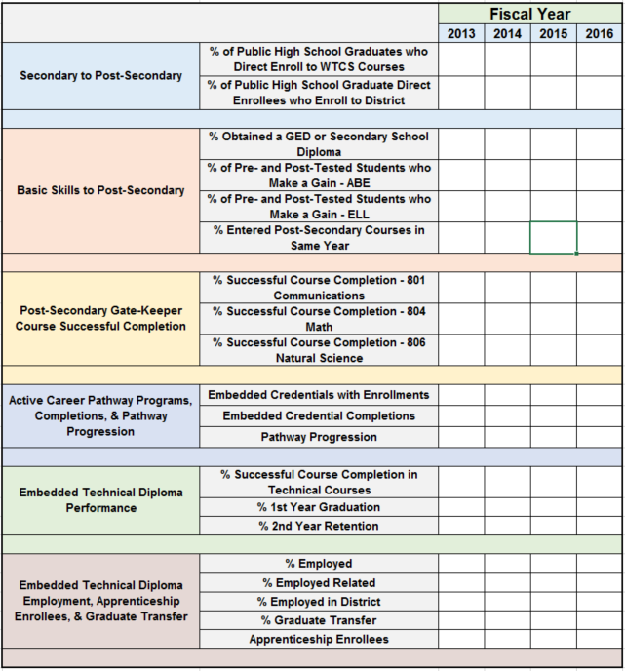
Using Data to Inform Decisions
20 Indicators
Key Transition Points
Multiple Data Sources
Institutional Research Staff
Curriculum Development/Approval Process

Slide 16
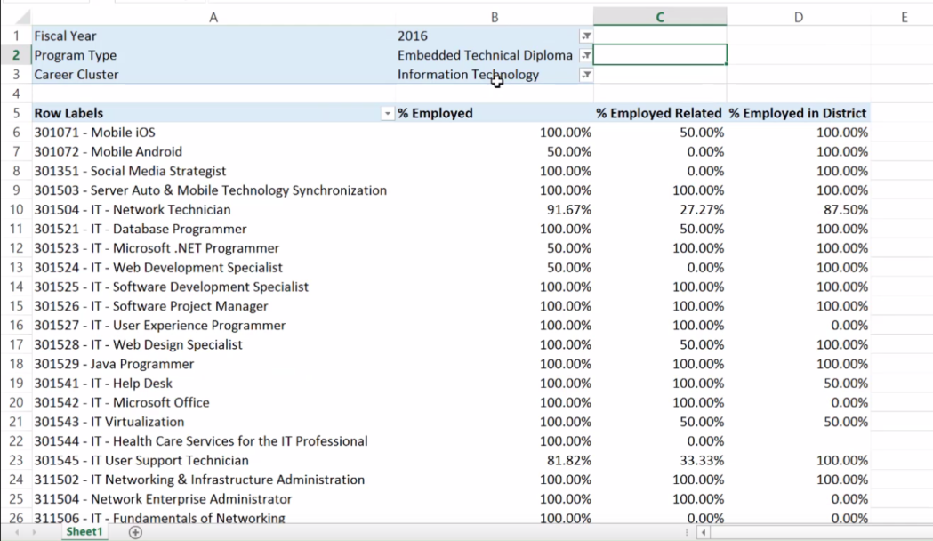
Sustained In Policy and Practice

Slide 17
Q&A

Slide 18
Ohio TechNet

Slide 19
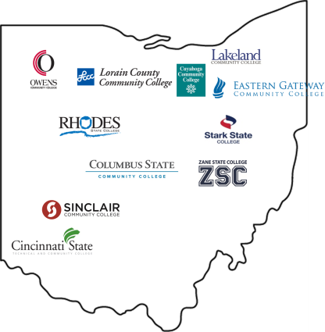
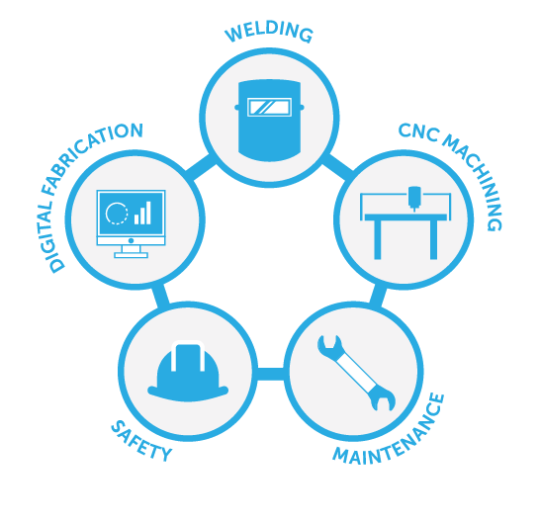











Ohio TechNet ADDRESSES THE SKILLS GAP by developing
TARGETED MANUFACTURING TRAINING PROGRAMS for transitioning adults.
$15 MILLION | + | $1.7 MILLION
INVESTMENT |  | LEVERAGED RESOURCES
ADULTS ARE LEARNING INDUSTRY-RECOGNIZED SKILLS FOR IN-DEMAND OCCUPATIONS
that provide family-supporting wages.
100+
PROGRAMS CREATED OR ENHANCED
1451
INDIVIDUALS ENROLLED
IN OTN PROGRAMS
1025
CREDENTIALS EARNED BY
STUDENTS IN OTN PROGRAMS
300+
EMPLOYER
PARTNERS
ENGAGED
Figures reflect data as of February 28, 2017
KEY COLLABORATIONS
Partnering nationally and statewide to address Ohio’s manufacturing skills gap.

Slide 20

Sustainability Efforts: Keeping Progress in TAACCCT
Employer Engagement
Acceleration/Modularization Strategies
(PLA, CBE, Remediation)
Work-Based Learning Models
(Apprenticeship, Earn/Learn Programs)
Supportive Services

Slide 21
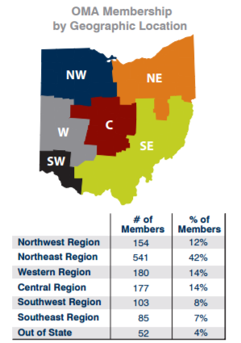
Ohio Manufacturers’ Association (OMA)
2017 Workforce Strategy
Identify Current Local Efforts
Local & Regional Industry Champions and Stakeholders
State-level Stakeholders
Create Statewide Asset Map
Host Regional OMA Membership / Manufacturing Listening Sessions
Summarize Key Themes & Priorities for Action
Common issues & solutions
Scale or replicate what works
Identify solutions that work
Identify & Engage

Slide 22

Bernie Gosky
Ohio TechNet Project Manager | Lorain County Community College
bgosky@lorainccc.edu | 440-366-4233
Terri Burgess Sandu
Director, Talent and Business Innovation | Lorain County Community College
tsandu@lorainccc.edu | 440-366-4215
www.OhioTechNet.org | https://www.facebook.com/OhioTechNet/

Slide 23
Q&A

Slide 24
HealthCARE Montana

Slide 25
HealthCARE Montana: Creating Access to Rural Education
HealthCARE Montana is connecting employer and education partners to develop high quality, locally accessible, industry relevant training opportunities
Missoula College plus 14 College Partners: Blackfeet, Bitterroot, Chief Dull Knife, City, Flathead, Gallatin, Great Falls, Helena, Highlands Montana Tech, Miles, Northern, Salish Kootenai, Stone Child, Western
Over 200 industry partners
MT Department of Labor and Industry
Montana Area Health Education Centers
Office of the Commissioner of Higher Education

Slide 26
Innovative Programs and Activities
Employer and Faculty Partnership for Curriculum Development
  Created Rapid Response Network (16 surveys to healthcare facilities over 2 years provided input through survey monkey from 405 unique individuals)
  Shortened nursing training (PN, RN, RN-BSN Completion by 1 semester each) and included rural practice content
  Developed distance Practical Nursing Program (currently pre-nursing and nursing students from 33 rural and frontier towns)
  Aligned consistent pre-reqs and core competencies for all healthcare education
  Workforce Coordinators and Healthcare Apprenticeship Specialists created 84 healthcare apprenticeships in 14 occupations in 29 facilities
  Developed LEAD (Learn, Engage, Adapt, Do): Fostering Self-Awareness for Workplace Success
    Materials have been distributed to 61 healthcare facilities
Updated Statewide Healthcare Workforce Strategic Plan

Slide 27
Mechanisms for Sustainability
Area Health Education Centers
MUS Healthcare Education & Workforce Coordinating Council
Cross Training
Braided Funding
Tuition and Fees Sustain Health Education Programs

Slide 28
Q&A

Slide 29
NJ – PREP

Slide 30
NJ-PREP
Bergen Community College-Lead Agency
Brookdale Community College
Essex Community College
Hudson County Community College
Mercer County Community College
Middlesex County College
County College of Morris
Ocean County College
Passaic County Community College
Raritan Valley Community College
Sussex County Community College
Union County College
Building upon earlier Federal funding (HHS), “the consortium was formed to foster synergy across the partnership and to institute unified approaches to supplying the region’s employers with skilled and credentialed workers”.

Slide 31

Sustainability Process
Lead College President requested counter-parts to appoint Task Force
Each college appointed a Task Force, chaired by VP, to develop plan
Consolidated with NJHPC plan, leading to an integrated approach
Priorities to be Sustained
College specific, but candidates include:
      Updated and improved academic programs
      Student support systems
      Workforce Relationships
      Management systems

Slide 32
Approaches to Sustainability
  Colleges’ budget funding
  Public workforce support
  Employer support
  Grants and Private Foundation support
  Integrate NJHPC into the NJ Council of Community Colleges

Slide 33
Q&A

Slide 34
What happens after the SVI?

Slide 35
Participant Poll
Would you participate in this virtual institute process again?
  Yes
  No
What best describes the timeline process of the SVI?
  Was the right amount of time
  Felt rushed
  Could have been condensed
How useful was it working with a sustainability coach?
  Very useful
  Somewhat useful
  Not useful

Slide 36
Participant Poll
How do you feel about the progress of your sustainability planning?
  Not where we expected to be
  Still have a lot of work to do
  Made considerable progress and feel confident moving forward
How useful was the TAACCCT Sustainability Toolkit in the process?
  What toolkit?
  Very useful
  Somewhat useful
  We didn’t use it during the process

Slide 37
Q&A

Slide 38
Thank You!
Download the new TAACCCT Sustainability Toolkit & Resources on WorkforceGPS
Check out a collection of TAACCCT sustainability plans and resources
Ask questions and to connect with peers and resources at TAACCCT@dol.gov
If you want to learn more about peer mentoring email TAACCCT@dol.gov

