Slide 1
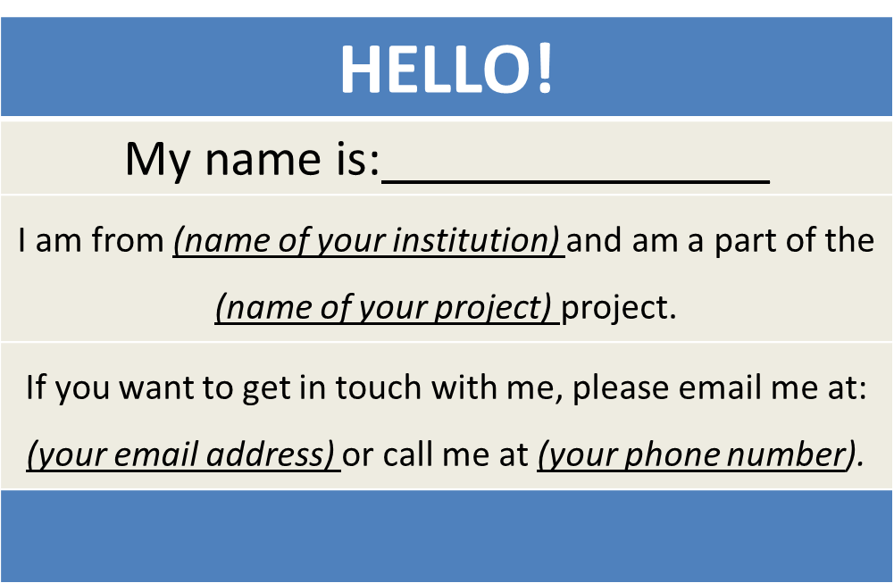
Let’s Chat!
Please use the Chat Window to Chat Amongst your H-1B Grant Colleagues!

Slide 2
Checking In!
Let’s get to know who is on the call today. Using the poll, select your H-1B Grant Program
Choose the answer that best reflects you (or your group):
H-1B America’s Promise (AP) Grantee
H-1B Strengthening Working Families Initiative (SWFI) Grantee
H-1B TechHire Partnership (TechHire) Grantee
Other

Slide 3
H-1B Performance Reporting Orientation
For H-1B TechHire Partnership
Strengthening Working Families Initiative
America’s Promise Grantees
U.S. Department of Labor, Employment and Training Administration

Slide 5
Megan Baird
Program Manager, H-1B Grants
U.S. Department of Labor, Employment and Training Administration
Ayreen Cadwallader
Workforce Analyst
U.S. DOL ETA
Gregory Scheib
Timmy Dudley
Workforce Analyst
Workforce Analyst
U.S. DOL ETA
ICF International

Slide 6
Checking In!
Let’s get to know who is on the call today. Using the poll, select the role that you play in your grant
Choose the answer that best reflects you (or your group):
Authorized Representative
Program Director/Manager
IT/Performance Data Manager Staff
Training Partner
5. Employer Partner
6. Service Provider
7. Other (please specify!)

Slide 7
Provide an overview of performance reporting requirements for H-1B grantees
Familiarize grantees with important policy guidance for H-1B programs
Provide an opportunity for grantees to ask questions about the performance reporting process

Slide 8
H-1B Performance Reporting Overview
WIOA Indicators of Performance and H-1B Real-Time Performance Outcomes
DOL PIRL: Amended H-1B PIRL Data Elements (DEs)
Performance Reporting TA
Tracking Participant Level Data
Preparing Data Files

Slide 9
Feedback Loop!
Which performance reporting topic are you most interested in learning about today?
Choose the answer that best reflects you (or your group):
What are the changes to the amended H-1B PIRL Data Elements that I should be aware of?
What should I be doing to prepare for performance reporting?
How and when do we start using the WIPS reporting system?

Slide 10
H-1B Quarterly Performance Reporting and Interim Reporting Guidance

Slide 11
H-1B Reporting Requirements
Quarterly Progress Reports
H-1B TechHire, SWFI and AP grantees are required to submit two reports in order to track performance:
Quarterly Performance Report (QPR)
Quantitative performance outcomes of all participants served
Submitted through DOL ETA’s Workforce Integrated Performance System, or WIPS, using data files with participant-level information
Quarterly Narrative Report (QNR)
Qualitative summary of activities that aren’t reported in the QPR
Suggested QNR Template

Slide 12
Data Collection Requirements: Includes SSNs and Personally Identifiable Information (PII)
Data collected and reported to DOL/ETA includes participant Social Security Numbers (SSNs)
Data must be protected through utilization of PII protocol
Hyperlink
TEGL No. 39 - 11

Slide 13
How to Generate a Quarterly Performance Report (QPR) Form
How do I generate a QPR Form?
Grantees are required to submit participant-level data (via a data file) into the WIPS system
WIPS will generate a Quarterly Performance Report (QPR) form using this data
What is a Data File?
Comma Separated Values (or csv) file with participant-level information using data elements from the ETA-9172 DOL PIRL

Slide 14
Access to the Workforce Integrated Performance System (WIPS)
Timeline for Grantee Access to WIPS
6/30/2017 Reporting Quarter: Interim Reporting Guidance
Prepare Participant Data Files
9/30/2017 Reporting Quarter: Submit Data Files in WIPS
Technical Assistance Coming Soon!
How to Prepare Data Files
How to Access WIPS

Slide 15
Quarterly Progress Report
Each grantee must submit a Quarterly Progress Report
Due no later than 45 days after the end of a quarter
Upcoming reporting quarters and due dates for 2017 - 2018
Quarter End Date | Progress Report Due Date | Report Activities Occurring Between
June 30, 2017 | August 14, 2017 | April 1 – June 30, 2017
September 30, 2017 | November 14, 2017 | July 1 – September 30, 2017
December 31, 2017 | February 14, 2018 | October 1 – December 31, 2017
March 31, 2018 | May 15, 2018 | January 1 – March 31, 2018

Slide 16
Interim Reporting Guidance for Quarter Ending 6.30.2017
Quarterly Performance Report (QPR) Form
WIPS is not yet available for H-1B grantees
Grantees will NOT submit participant-level data; however, grantees must collect participant-level data:
Demographic information, services and training received, credential outcomes, and employment
Includes participant SSNs
Please ensure you follow PII protocol.
Report cumulative data for all participants served as soon as WIPS is available

Slide 17
Interim Reporting Guidance for Quarter Ending 6.30.2017
Quarterly Narrative Report (QNR)
Grantees will submit a QNR to ETA via email
Next deadline of August 15, 2017
America’s Promise Grants: AmericasPromise@dol.gov
SWFI Grants: SWFI@dol.gov
TechHire Grants: TechHire@dol.gov
The suggested Quarterly Narrative Report template has been provided in Microsoft Word:
Hyperlink
Suggested QNR Template

Slide 18
Knowledge Check!
For the Performance Reporting Quarter Ending June 30th, our H-1B grant program will submit a
(Choose the answer that is the best answer)
Data File Upload in WIPS
Quarterly Narrative Report to my FPO with a cc to my Grant Mailbox
Quarterly Performance Report (QPR) Form in WIPS
Request for Technical Assistance (We’re Not Sure!)

Slide 20
WIOA Primary Indicators of Performance VS. H-1B Real-Time Performance Outcome Measures

Slide 21
WIOA Performance Reporting Alignment
ETA is aligning performance accountability systems to workforce programs
Although H-1B grants are not authorized under WIOA, H-1B grants will align with the WIOA performance reporting requirements, as applicable
In general, performance reporting definitions align with WIOA PIRL DEs, however there are some exceptions for H-1B grants

Slide 22
H-1B Grants Performance Outcome Measures
H-1B grants report on two types of performance outcome measures:
WIOA primary indicators of performance; and
H-1B specific “real-time” outcome measures
H-1B grantees will use the DOL-only WIOA PIRL DEs which include:
WIOA PIRL DEs shared by other programs
Those DE specifically identified for H-1B
H-1B specific DEs (PIRL DEs #2101-2126)

Slide 23
WIOA Primary Indicators of Performance
1 | Employment Rate in the 2nd quarter after exit
2 | Employment Rate in the 4th quarter after exit
3 | Median earnings
4 | Credential attainment
5 | Measurable skills gains
6 | Effectiveness of serving employers

Slide 24
WIOA Primary Indicators of Performance
Employment Rate – 2nd Quarter After Exit
Employment Rate – 4th Quarter After Exit
Median Earnings – 2nd Quarter After Exit
DOL will track these Employment Exit-Based Employment Primary Indicators of Performance for grantees, using SSNs provided

Slide 25
Why Do We Collect SSNs?
DOL will calculate the exit-based WIOA Primary Indicators Of Performance for employment on behalf of grantees using SSNs.
H-1B grantees may not have access to wage records in order to track and report exit-based employment rates and median earnings
Reporting timelines for these exit-based indicators will generally fall after the conclusion of the grant’s period of participation

Slide 26
WIOA Primary Indicators of Performance
Credential Attainment
Measurable Skills Gains
H-1B grantees are required to track and report PIRL DEs to report on these measures

Slide 27
WIOA Primary Indicators of Performance
Effectiveness of Serving Employers
In alignment with WIOA performance reporting requirements, ETA is seeking to determine the appropriateness and feasibility for non-core programs to report against WIOA Effectiveness in Serving Employer measures.
Check out the “QNR Suggested Template” which includes a narrative field for reporting on effectiveness in serving employers

Slide 28
WIOA Primary Indicators of Performance
SUMMARY
DOL will have the capacity to track the exit-based employment placement and median earnings on your behalf using PII.
The WIOA credential attainment and measurable skills gain measures will be tracked and reported by grantees using PIRL DEs.

Slide 30
H-1b Real-Time Performance Outcome Measures
Projections for real-time employment placement outcomes were required in H-1B FOA
Grantees provided outcome measure projections in your SOW.
These measures are separate from, and in addition to, the WIOA Primary Indicators of Performance
DOL/ETA will use these measures
To track quarterly performance data against your target projections, and
To identify technical assistance opportunities

Slide 31
Knowledge Check!
Can you guess what the H-1B Real-Time Performance Measures are?!
(Enter your comments in the Chat Window!)

Slide 32
H-1B Real-Time Performance Outcome Measures
1 | Total Participants Served
2 | Total Participants Enrolled in Education/Training Activities
3 | Total Participants Completing Education/Training Activities
4 | Total Participants Who Complete Education/Training Activities AND Receive a Degree or Other Credential
5 | Total Number of Unemployed Participants who Obtain Employment
6 | Total Number of Incumbent Worker Participants that Advanced into a New Position
7 | Median earnings*

Slide 33
Pop Quiz!
What are H-1B Real-Time Performance Measures?
Choose the answer that best reflects the right answer:
Outcome measures that we provided target outcome numbers in our Statement of Work
Outcome measures that ETA will use to track my grant’s quarterly performance and identify TA opportunities
Exit-based outcomes
Options 1 & 2 Above

Slide 34
DOL Information collection Request (ICR): WIOA Performance Accountability, Information and Reporting System

Slide 35
Amended ETA-9172-DOL PIRL H-1B Grants
Revised! WIOA DEs to track WIOA outcome measures, including the Primary Indicators of Performance
Redefined! H-1B Definitions for Underemployed Worker and Date Entered Employment
New! H-1B DEs to report Program Completion and Training-Related Employment
Deleted! Some DEs that were selected for H-1B when the WIOA PIRL was originally approved by OMB, but no longer apply

Slide 36
PIRL Data Elements Overview
What Makes a Data Element?
DE number and name
Data definition and instruction
Code value
Edit check logic
QPR Aggregation Rules
H-1B Data Element Sections
Individual Information
Program Participation
Services and Training Activities
Program Outcomes
H-1B Grants report on 86 data elements out of the 478 ETA DOL PIRL Data Elements
Amended ETA-9712 DOL PIRL for H-1B Grants
Hyperlink

Slide 37
New DOL PIRL Data Elements for H-1B Grants
Proposed WIOA PIRL Data Elements that will apply to H-1B
100 Unique Individual Identifier (WIOA)
101 State Code of Residence (WIOA)
904 Dislocated Worker(WIOA)
1303 Type of Training Service #1 (WIOA)
1310 Type of Training Service #2 (WIOA)
1315 Type of Training Service #3 (WIOA)
1332 Participated in Postsecondary Education During Program Participation(WIOA)
1401 Enrolled in Secondary Education Program at Program Entry (WIOA)
1813 Date Completed, During Program Participation, an Education or Training Program Leading to a Recognized Postsecondary Credential or Employment(WIOA)
2126 Entered Training-Related Employment

Slide 38
DOL PIRL Data Elements No Longer Required for H-1B (Proposed)
PIRL data elements related to demographic information:
102 - County Code of Residence
103 - Zip Code of Residence
105 - Special Project ID - 1
106 - Special Project ID - 2
107 - Special Project ID - 3
108-A - ETA-Assigned 1st Local Workforce Board Code

Slide 39
DOL PIRL Data Elements No Longer Required for H-1B (Proposed)
PIRL data elements related to disabilities and veterans:
203 - Category Of Disability
204 - Individual With A Disability SDDA Services
205 - Individual With A Disability LSMHA Services
206 - Individual With A Disability Medicaid HCBS Services
207 - Individual With A Disability Work Setting
208 - Individual With A Disability Type of Customized Employment Services Received
209- Individual With A Disability Financial Capability
300 - Veteran Status

Slide 40
DOL PIRL Data Elements No Longer Required for H-1B (Proposed)
PIRL data elements related to services provided and employment outcomes:
1206 - Date Received Financial Literacy Services;
1608 - Employment Related to Training (2nd Quarter After Exit) (WIOA);
1610 - Occupational Code (if available);
1614 - Industry Code of Employment 1st Quarter After Exit Quarter

Slide 41
Let’s Chat!
Do you have any additional questions or comments about the ETA-9172 DOL PIRL for H-1B Grants?
(Enter your comments in the Chat Window!)

Slide 42
Performance Reporting Technical Assistance

Slide 43
Tips & Tricks: Tracking Participant Level Data
Develop an electronic case management system that can be transferable between training providers
Ensure all data elements are reviewed and definitions are understood
Ensure participants and training providers understand why certain information is collected
Add relevant dates to the enrollment form
Do not leave records containing PII open and unattended

Slide 44
Feedback Loop!
What systems are you using to track and report your participant-level data?
Choose the answer that best reflects you (or your group):
Existing MIS System
Third-Party Vendor
Excel Spreadsheet
Access Database
Other

Slide 45
Tips & Tricks: Preparing Data Files
Use existing resources or develop Management Information System for case management
The system must be able to save or export participant records as one CSV data file
Make sure your system includes EVERY data element as a data field entry for each participant record.
A participant record should have a corresponding code value for each data element.
Make sure that your data file does not include participant names, data element headers, additional rows, blank entries when code values are required, or a null value instead of a blank or a space.
In some cases, leaving the data field blank is an option if the data element does not apply to the participant. Spaces are counted as a code value.

Slide 46
PLACEHOLDER: Sample Case Management and CSV Data File
Sample CSV Data File:
Sample Case Management and CSV Data File
Hyperlink

Slide 48
Closing & Reminders

Slide 49
Upcoming Performance Resources
Resource | Usage | Timeline
H-1B Grants Performance Reporting Handbook & WIPS Reporting Guidance | A guide to understanding performance policy | Released on 6.30.17
Performance Toolkit | A compilation of performance technical assistance information and resources | Summer 2017
Performance Office Hours | A quarterly opportunity for H-1B grantees to ask and listen to performance questions | Two weeks prior to quarterly submission deadline
Pre-Recorded Tutorials | Pre-recorded tutorials for specific topics on performance reporting | Early July
H-1B Performance Reporting Resources for TechHire, SWIFI and America's Promise Grants
Hyperlink

Slide 51
Feedback Loop!
How are you feeling about your ability to submit performance data?
Choose the answer that best reflects you (or your group):
Geronimo! We are ready to jumpstart our performance reporting!
Performance What?!…We still have a few more questions!
A little overwhelmed, but excited!

