Slide 1
Best Practices in Supportive Services for Women in the Trades and Other occupations in which Women are Underrepresented
Women in Apprenticeship and Nontraditional Occupations Grantees

Slide 3
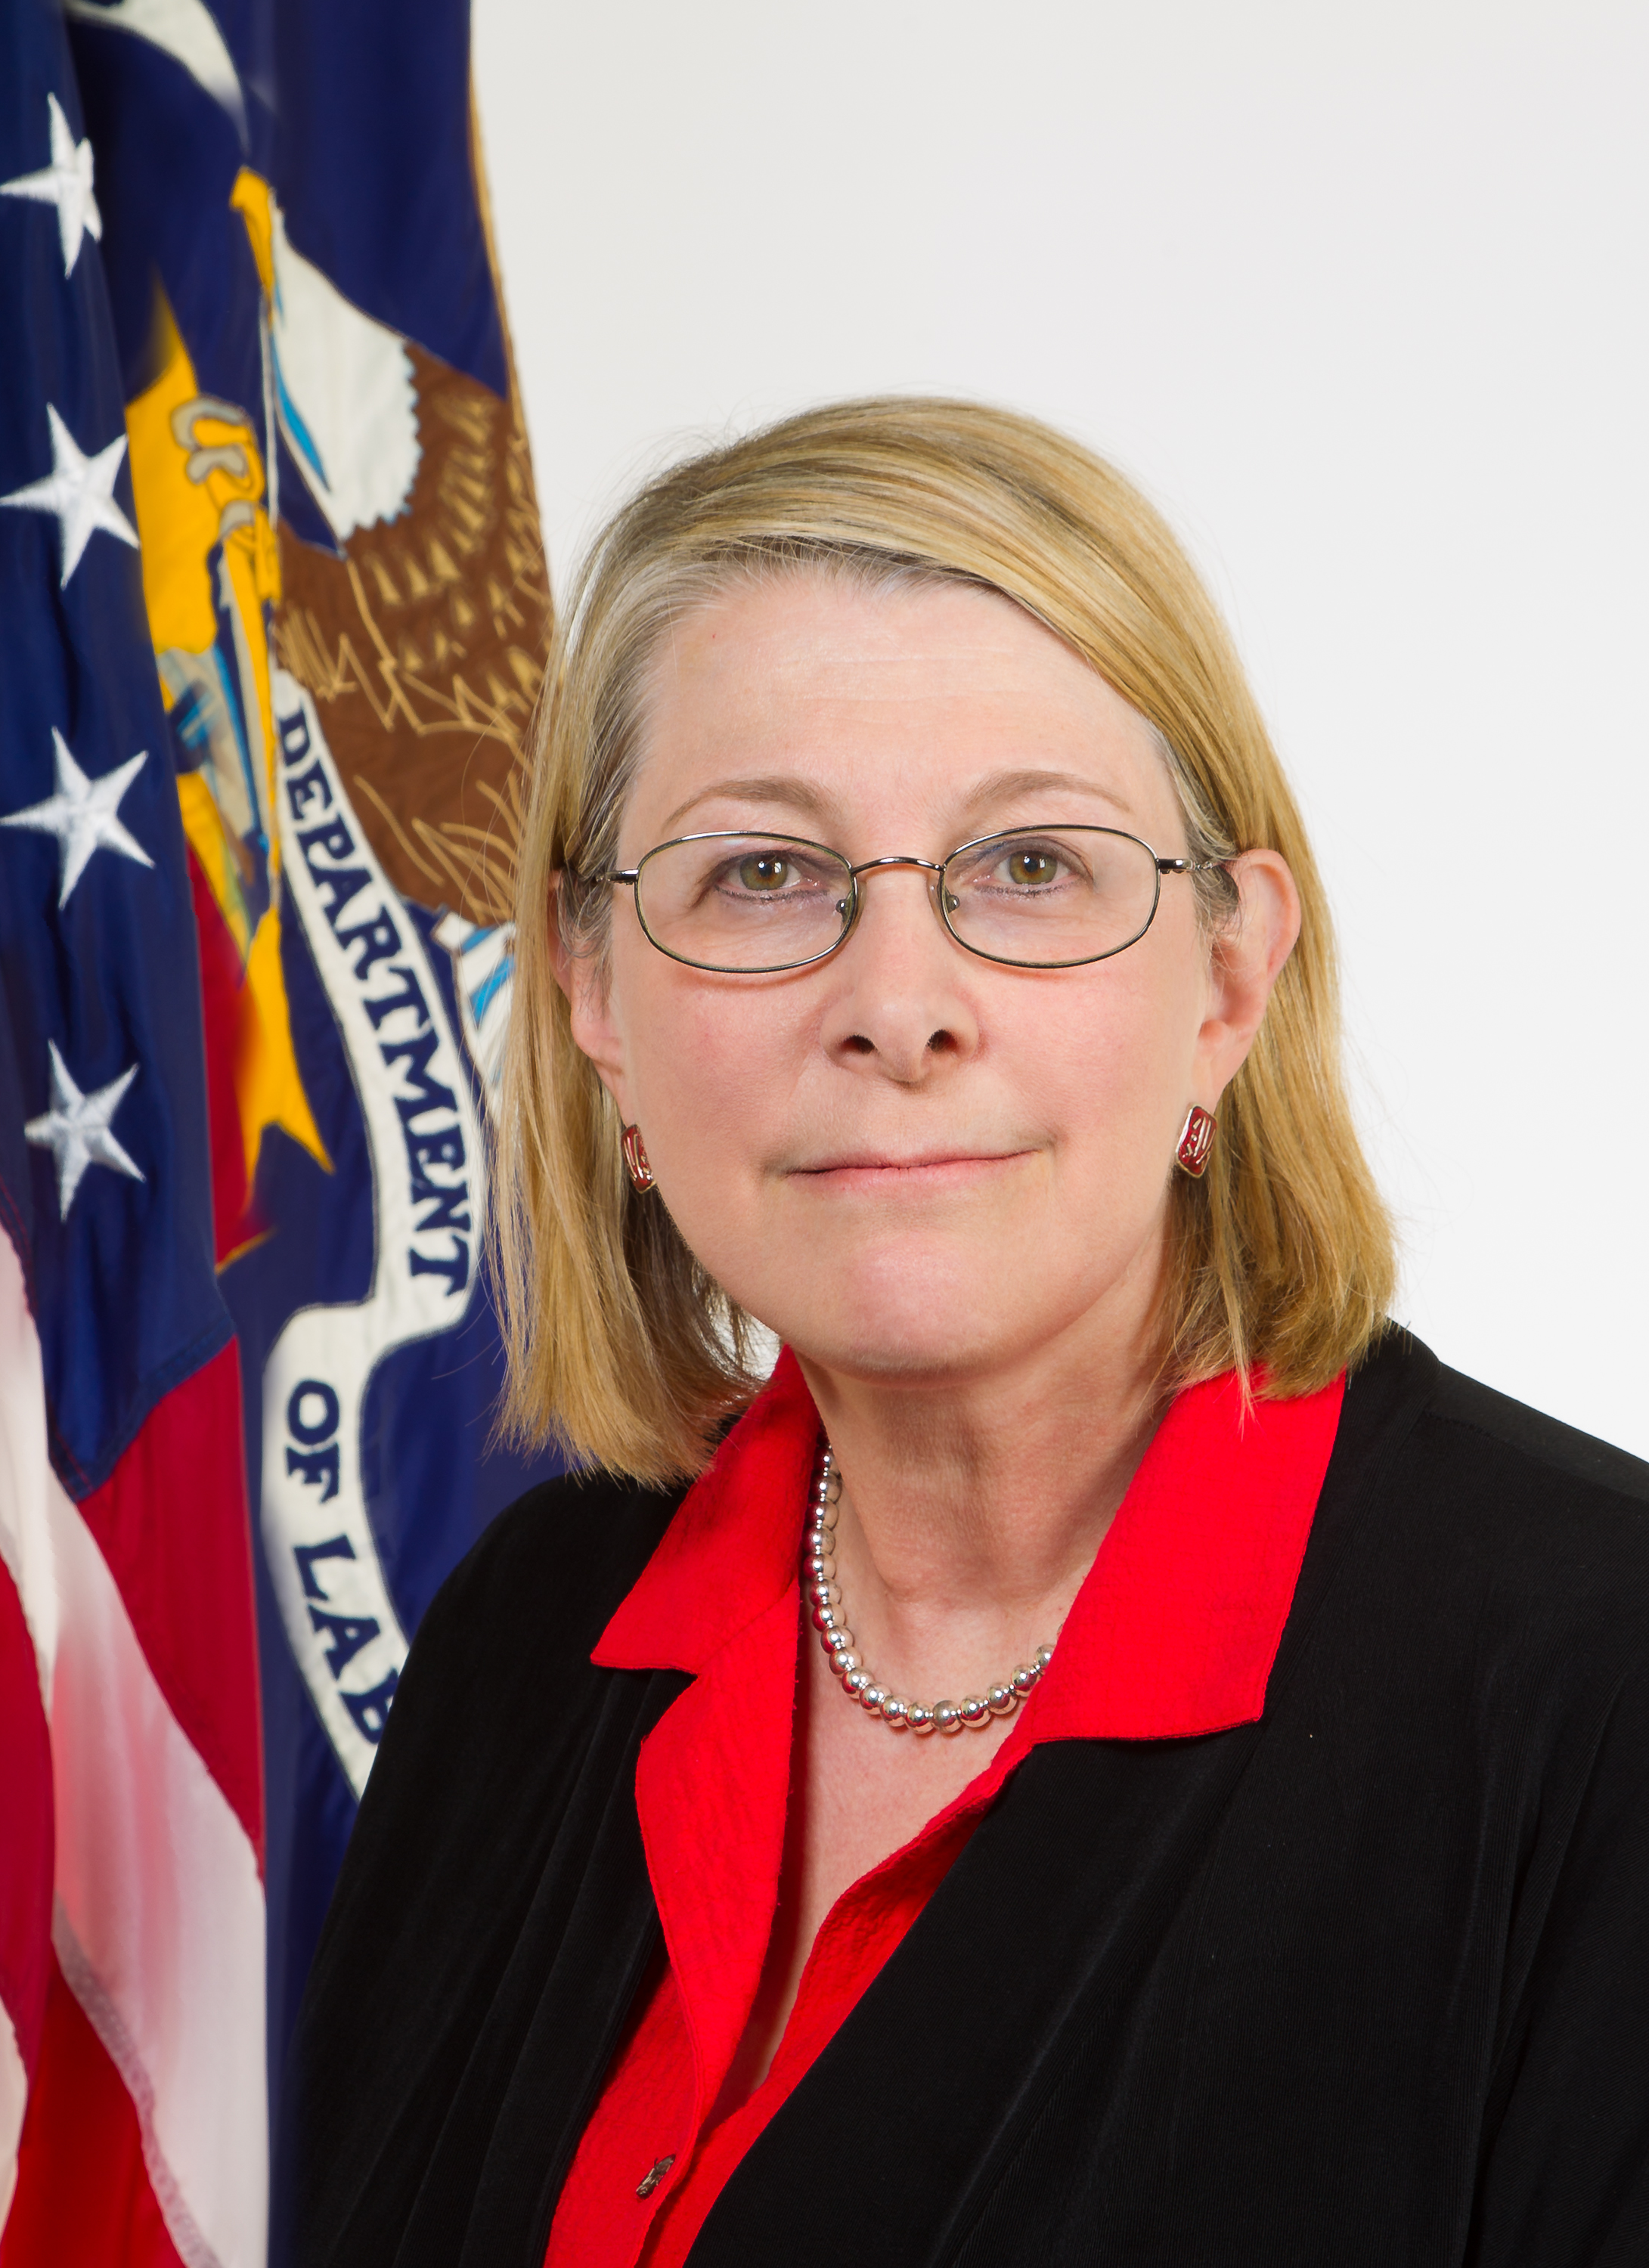
Donna Lenhoff
Senior Advisor
Office of Apprenticeship, Employment and Training Administration
U.S. Department of Labor
.

Slide 4
WANTO OVERVIEW
The Women in Apprenticeship and Nontraditional Occupations (WANTO) Act of 1992 authorized the U.S. Department of Labor to award grants to Community-based Organizations to assist employers and labor unions in promoting the recruitment, training, employment and retention of women in apprenticeship and nontraditional occupations.
The U.S. Department of Labor funded a total of $1,998,000 in grants to help women through the WANTO program, an initiative designed to recruit, train and retain women in high-skill occupations in advanced manufacturing, transportation, energy, construction, information technology and other industries.

Slide 5
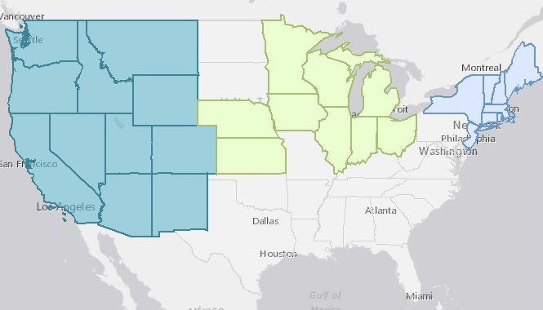
WANTO Regional Technical
Assistance Centers
Nontraditional Employment for Women (NEW NYC)
Chicago Women in Trades
Western WANTO Consortium
Oregon Tradeswomen, Inc.
Tradeswomen, Inc. (CA)
Apprenticeship and Nontraditional Employment for Women (ANEW – WA)

Slide 6
Survey Question
What type of industry stakeholder are you?
  Registered Apprenticeship Program
  Employer
  WIOA / American Jobs Center
  Community College
  Community-based service program
  Government
  Other

Slide 7
1:00 | Department of Labor Introduction,
with Donna Lenhoff
1:05 | Research and Application, Maura Kelly, Portland State University
1:15 | Social Service Programming, Linda Young, Nontraditional Employment for Women
1:25 | Funding Supportive Services, Julie Kuklinski, Moore Community House
1:35 | Question and Answer, Chad Aleshire
2:00 | Thank you and Wrap up

Slide 8

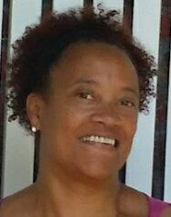

Maura Kelly
Associate Professor of Sociology
Portland State University
Portland, OR
Linda Young
Director of Social Services
Nontraditional Employment for Women (NEW)
New York, NY
Julie Kuklinski
Program Director
Moore Community House
Biloxi, MS

Slide 9
Best Practices in Supportive Services:
Evaluation Research in Oregon
Maura Kelly
Associate Professor of Sociology
Portland State University

Slide 10
The BOLI/ODOT Highway Construction Workforce Development Program
Program goal: To improve stability and diversity of the highway construction workforce by promoting recruitment and retention of apprentices.
Elements of the program included in the PSU evaluation:
Pre-apprenticeship programs (to improve recruitment and retention of apprentices)
Supportive services (to improve retention of apprentices)

Slide 11
The BOLI/ODOT Highway Construction Workforce Development Program
Pre-apprenticeship programs prepare students for careers in the construction trades. These programs teach students the necessary skills to enter an apprenticeship program.
Pre-apprenticeship programs
Oregon Tradeswomen, Inc.
Constructing Hope

Slide 12
The BOLI/ODOT Highway Construction Workforce Development Program
Supportive Services
Fuel assistance for travel to and from job sites and required classes
Lodging and per diem for jobs that are more than 60 miles from home
Job readiness supplies (work tools, work clothing, personal protective equipment)
Childcare subsidies
Non-financial support services (counseling, formal mentoring)

Slide 13
The BOLI/ODOT Highway Construction Workforce Development Program
Supportive services are available to current apprentices in registered apprenticeships who are:
Working in eligible trades: carpenters (and allied trades), cement masons, ironworkers, laborers, operating engineers (and allied trades), and painters
Working on a highway and/or bridge job (any trade)
Some additional criteria apply for specific services

Slide 14
New Apprentices in Oregon Heavy Highway Construction Trades by Race and Gender (2005-2015)

Slide 15
Completion Rates of Recently Active Apprentices, by Race/Ethnicity and Gender (2014-2015)

Slide 16
Percentage of Apprentices Completing Who are Women and People of Color, by Year

Slide 17
Percentage of Apprentices in Eligible Trades Active in 2014-2015 Served by BOLI/ODOT Services, by Race/Ethnicity and Gender

Slide 18
Number of Active Apprentices Who Completed a Pre-Apprenticeship Program, by Gender and Race/Ethnicity (2014-2015)

Slide 19
Completion Rates Among Apprentices in Eligible Trades, by Receipt of BOLI/ODOT Supportive Services, by Gender and Race/Ethnicity (2005-2015)

Slide 20
Change in Log Odds of Completing an Apprenticeship when Receiving BOLI/ODOT Supportive Services, by Gender and Race/Ethnicity (2005-2015)

Slide 21
Percentage of Apprentices in Eligible Trades Working as Journey Workers or in Construction after Apprenticeship, by Receipt of Services, by Gender and Race/Ethnicity (2014-2015)

Slide 22
Maura Kelly
Associate Professor of Sociology
Portland State University
(503) 725-8302
maura.kelly@pdx.edu
www.pdx.edu/sociology/maura-kelly

Slide 23
Best Practices in Social Services
Linda Young
Director of Social Services
Nontraditional Employment for Women (NEW)

Slide 24

Intake Assessment
Social Services engages potential candidates once they are accepted (passed Entrance Interview).
Determines candidate’s readiness for one of NEW’s training programs (BCP or NAN).
Ensures that the candidate has adequate childcare in place, including back up child care.
Ensures that the candidate has stable housing.

Slide 25
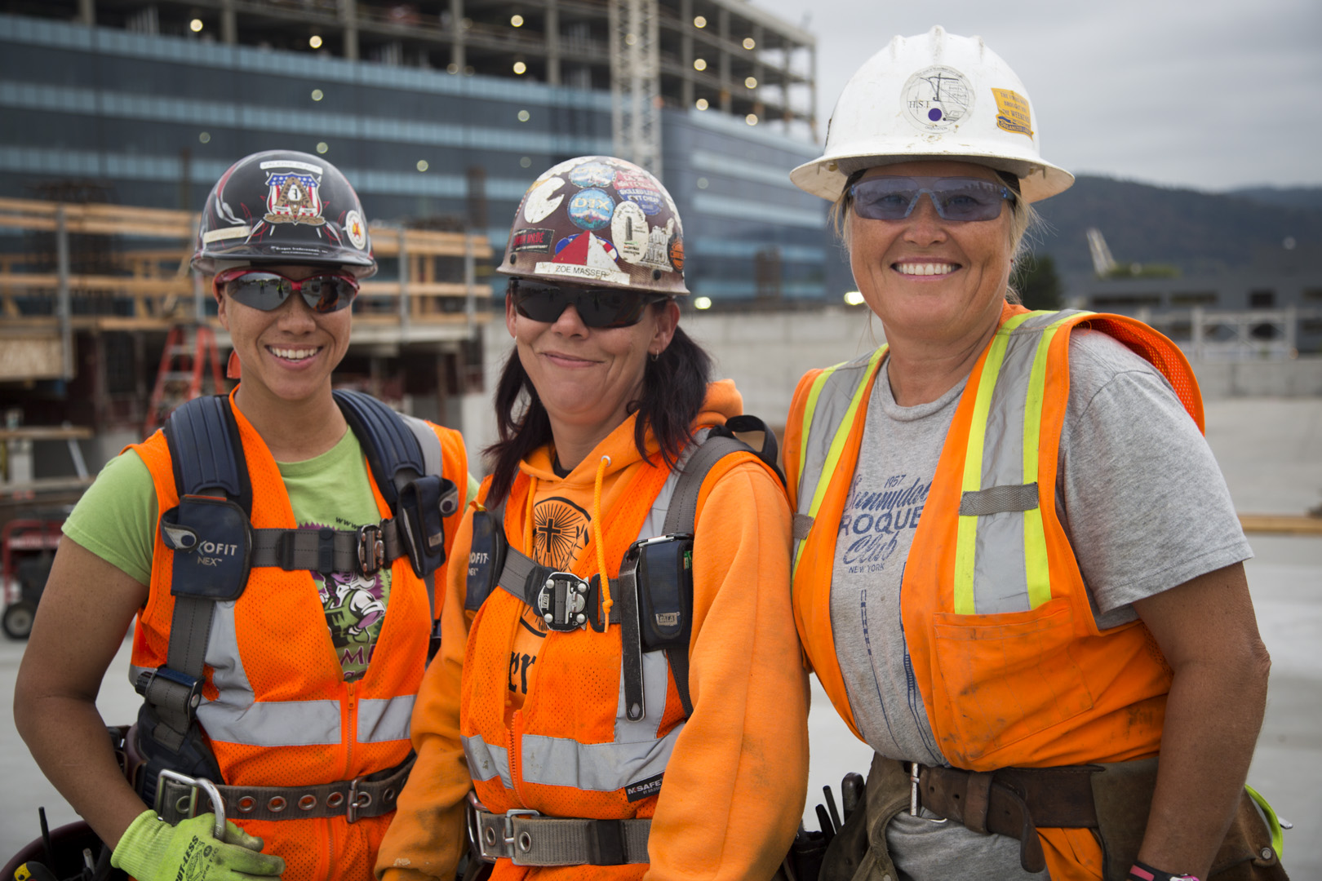
Intake Assessment
Connects candidate with the necessary resources
Human Resources Administration (HRA) Benefits (SNAP, CASH etc.)
Health Insurance
Housing (shelter system, when necessary)
Childcare
Mental Health Counseling
Unemployment Benefits

Slide 26
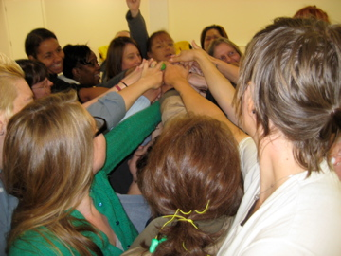
Supportive Services During Pre-Apprenticeship
Social Services facilitates the following workshops:
Wellness Workshop – promotes healthy choices to support long term success while in the program and beyond. Areas covered physical, emotional, social, environmental wellness etc.
Self Esteem – empowers the candidate with self awareness and self care.

Slide 27
Supportive Services During Pre-Apprenticeship
Sexual Harassment – educates the candidate on the types of harassment in the workplace, how write a complaint/report, all through the use of situational scenarios.
Attends Midterm and Exit Evaluations

Slide 28
Ongoing Supportive Services
Childcare
Medical Benefits and Health Care
Housing
Public Assistance
Unemployment Insurance Benefits
Brief Counseling and Referrals

Slide 29
Ongoing Supportive Services
LGBTQ Issues
Crisis Intervention
Domestic Violence (referrals)
Conflict Resolution (referrals)
Financial Literacy (referrals)
Legal Issues (referrals)

Slide 30
Linda Young
Director of Social Services
Nontraditional Employment of Women (NEW)
(212) 627-6252
lyoung@new-nyc.org
http://www.new-nyc.org/

Slide 31

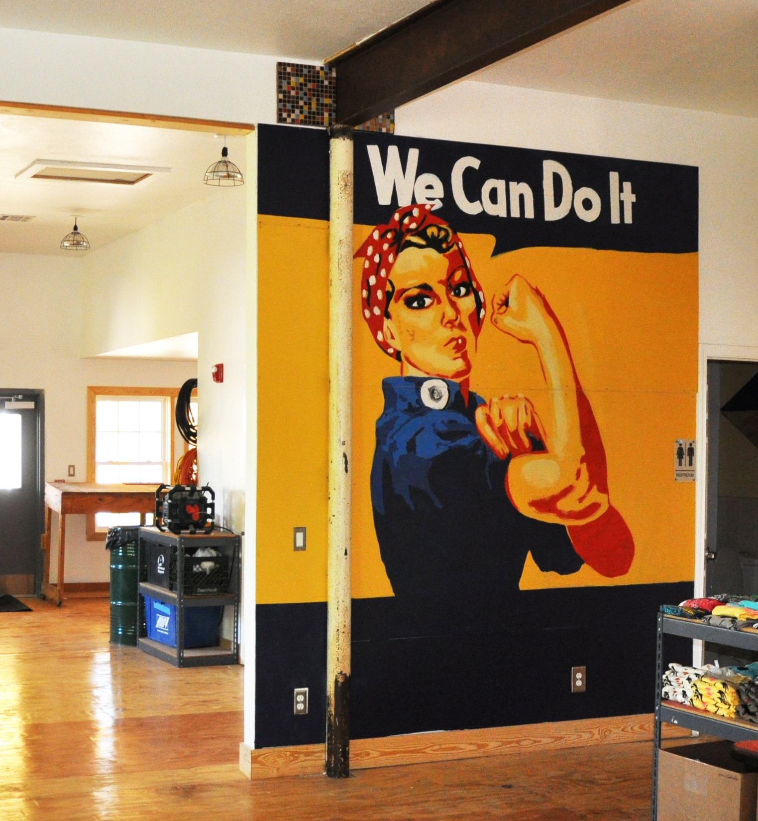
Funding Supportive Services
Julie Kuklinski
Program Director
Women in Construction Program - Moore Community House

Slide 32

Julie Kuklinski, Program Director

Slide 33
MS WOMEN IN THE WORKFORCE
women make less than men and are concentrated in minimum wage jobs. this gender inequity prevents women from working their way to economic security.
MINIMUM WAGE LEAVES FAMILIES BELOW POVERTY
Mississippi Minimum Wage: $7.25
Full-time Equivalent, 52 weeks/year: $15,080
2016 Federal Poverty Level, Family of 2 (a mom and one child): $16,020
Source: U.S. HHS ASPE, 2015 American Community Survey, National Women’s Law Center (2015), https://nwlc.org/wp-content/uploads/2016/10/Women-and-the-Minimum-Wage-State-by-State-Tables.pdf

Slide 34
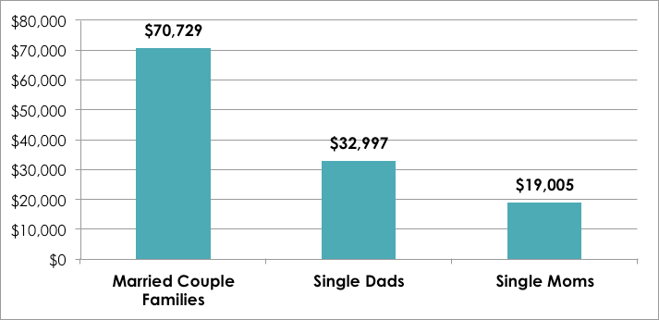
Single Moms in MS Work, but are Stuck in Low-Wage Jobs

Slide 35
An Opportunity to Rethink Workforce Training for Low-Income Moms
MS Middle Skills Gap and Mississippi’s Low Workforce Participation
Single Moms in MS Workforce
Priority and the provision of child care for moms is essential, but not enough
To disrupt occupational segregation and gender wage disparity, higher paying work for women in the realm of middle skills jobs

Slide 36
Moore Community House Women in Construction (MCH WinC)
Lack of affordable child care is a major barrier
WinC has an integrated, innovative program design enabled by the Strengthening Working Families Initiative (SWFI) grant and TANF
WinC is an emerging best practice model for programs interested in pairing training and child care services.

Slide 37
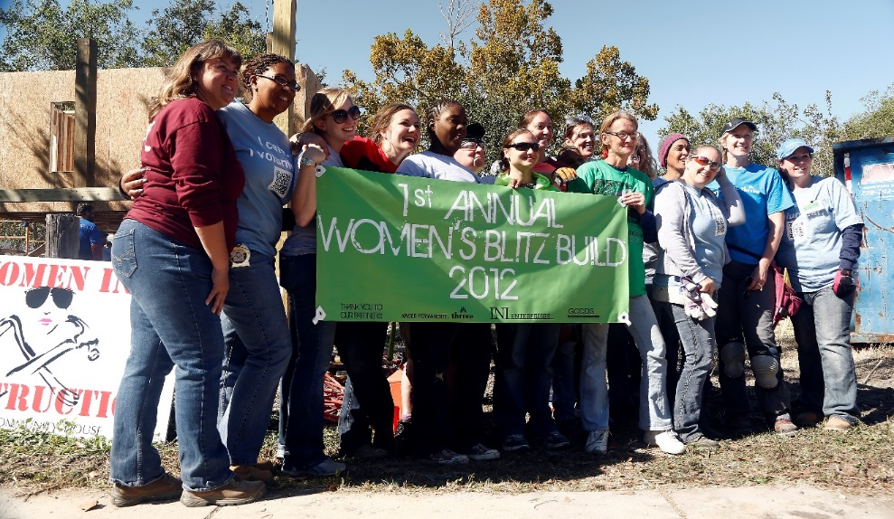
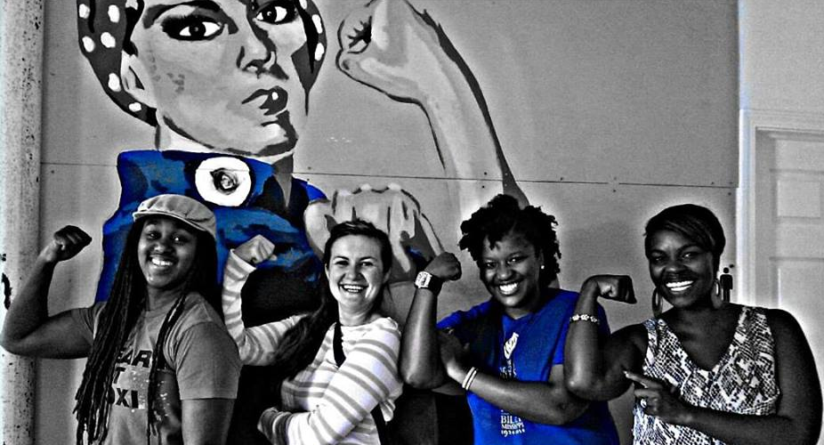
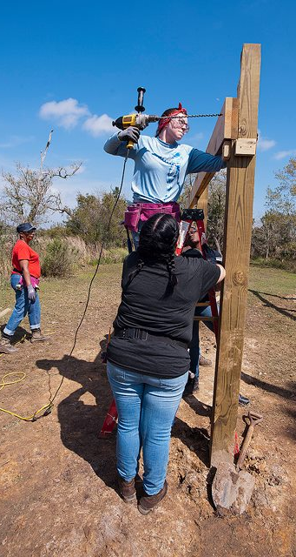
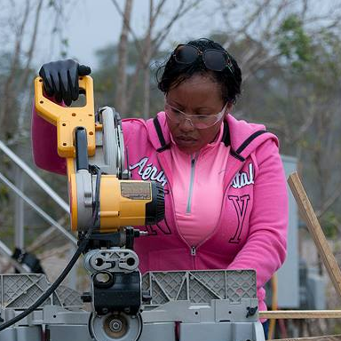
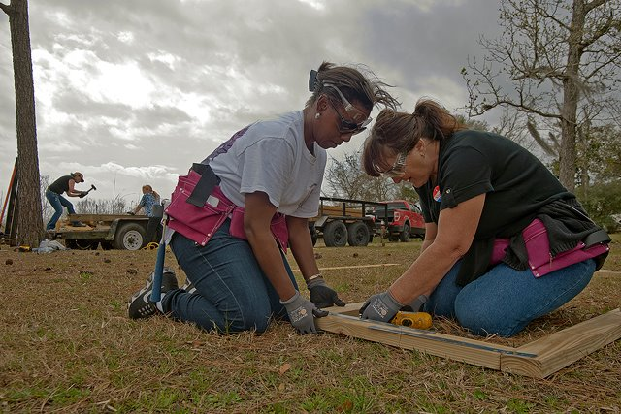
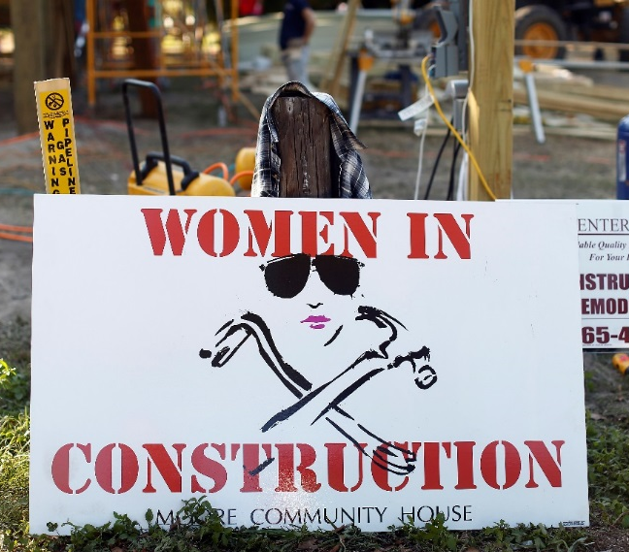
Women in Construction Program
We recruit, train, place, & retain women in apprenticeship and nontraditional occupations

Slide 38
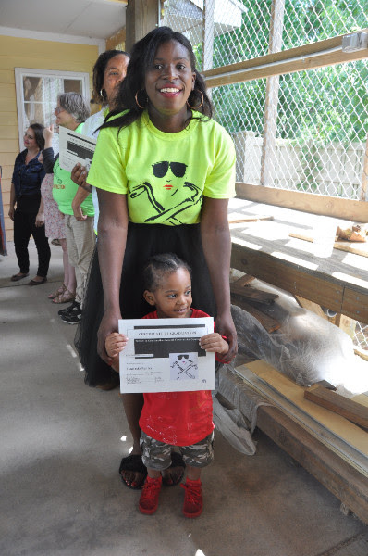
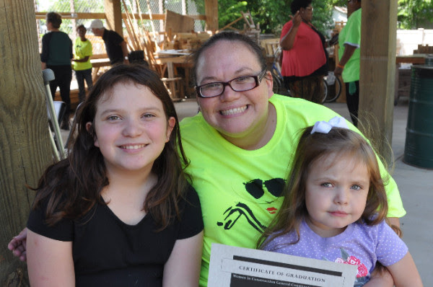


Women in Construction Program
+

Slide 39
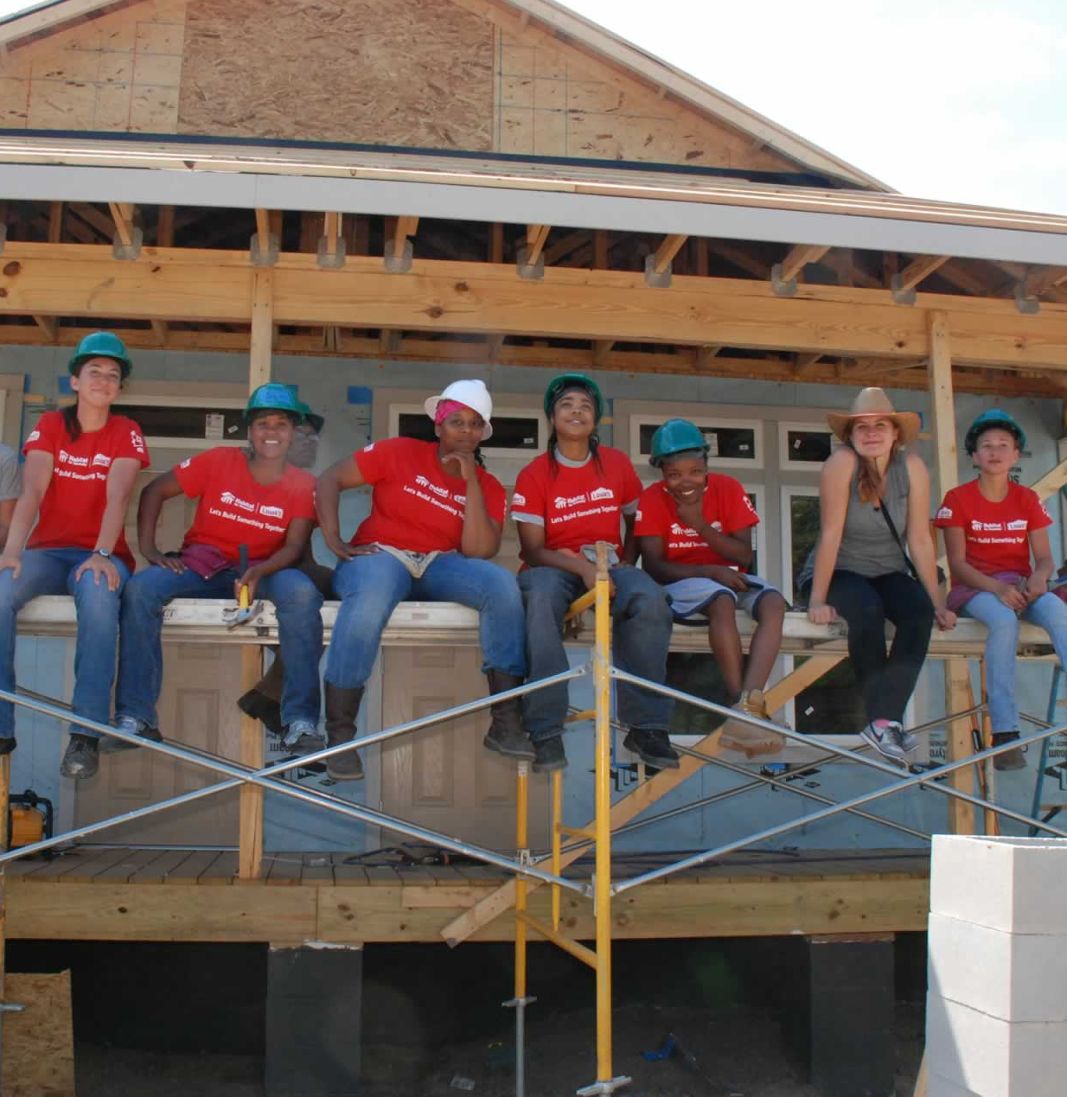

Women in Construction Program

Slide 40
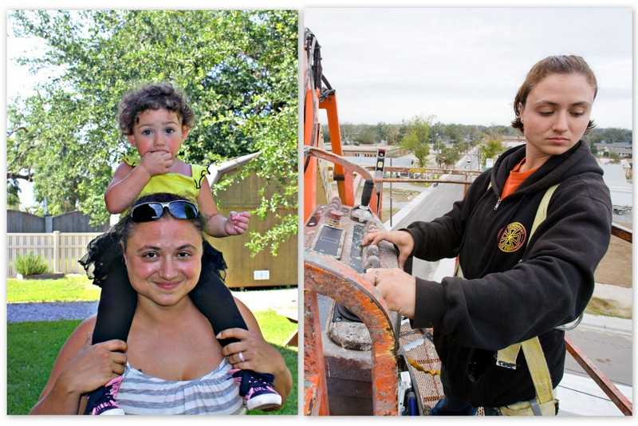
"I would like tomorrow to be a place where my daughters won’t have to be afraid, hold back, or settle for less”

Slide 41
Julie Kuklinski
Program Director
Women in Construction Program - Moore Community House
(228) 207-5265
julie.womeninconstruction@gmail.com
https://www.moorecommunityhouse.org/winc

Slide 43
Survey Questions
  What other topics would you like to see presented?
  Mentoring
  Tradeswomen Committees
  Pre-apprenticeship Training
  Gender Inclusive Curriculum
  Sexual Harassment Prevention
  EEO Compliance Resources

Slide 44
Western Resource for Women in Apprenticeship
    http://womeninapprenticeship.org
National Center for Women’s Equity in Apprenticeship and Employment
    www.womensequitycenter.org
U.S. Department of Labor’s Apprenticeship US website
www.apprenticeshipusa.workforcegps.org/resources/2017/03/13/10/10/Expanding-Apprenticeship-for-Women

Slide 45
For More Information:
For more information on the WANTO grant,
please contact the U.S. Department of Labor:
Donna R. Lenhoff
Senior Advisor
Office of Apprenticeship, Employment and Training Administration
U.S. Department of Labor
lenhoff.donna@dol.gov
202-693-2687
http://www.doleta.gov/

