Slide 1
TAACCCT Performance Reporting Q&A: .
June Topic: Tracking Outcomes Prior to Exit: Who Counts Where and When?
U.S. Department of Labor
Employment & Training Administration
June 29, 2017

Slide 2
Presenters
Kristen Milstead
Staff Lead for Performance, TAACCCT Grants
Scott Estrada
Performance Specialist, Maher & Maher, TAACCCT Grants

Slide 3
TAACCCT Performance Reporting Key Resources

Slide 4
Today’s Agenda
Questions From You
Today’s Special Topic:
Tracking Outcomes Prior to Exit: Who Counts Where and When?
Status Outcomes: What Triggers Them?
In-School Outcomes: When They Count and When They Don’t
Open Question Period

Slide 5
Question #1:
If a person completes their FIRST grant-affected program of study AFTER the March 31st 2018 deadline, can you count that participant for post-completion outcomes?

Slide 6
Response #1
No. All of the APR outcomes can be counted through March 31 of the fourth year. However, #1-6 can only be counted if they occurred prior to March 31. After this date, only follow-up outcomes #7-10 can be counted. In this scenario, the participant would be counted as retained, not a completer. If the participant is never counted as a completer, his or her follow-up outcomes would not be reported.

Slide 7
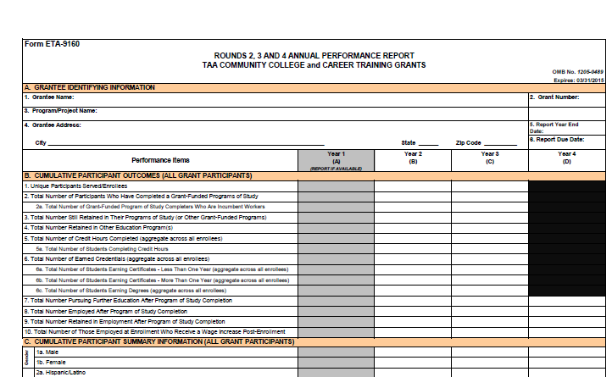

Slide 8
Question #2:
If an adult does not have a high school diploma or equivalent, can he or she be a participant?

Slide 9
Response #2
Yes, as long as they are 18 or older and meet all of the other requirements of being a participant. Note that they cannot be working toward a GED or equivalent, as this is not considered industry-recognized credential.

Slide 10
Question #3:
What if a student did not identify at the time of enrollment whether or not they were an incumbent worker?

Slide 11
Response #3
Grantees should document their methods and attempts to collect the required information in the APR. If information that was previously unknown or unavailable is later learned, request to open the APR for the year he or she first enrolled and make the change.

Slide 12
Tracking Outcomes Prior to Exit:
Who Counts Where and When?

Slide 13
Types of Outcomes
Status Outcomes (B.2, B.3 and B.4)
Where is the participant currently located in their progress toward completion?
In-School Outcomes (B.5 and B.6 with subparts)
What has the participant accomplished academically?
Follow-Up Outcomes (B.7, B.8 and B.9)
What did completers who have exited do after they left?
Special Outcomes
Participant Outcome (B.1)- at enrollment
Incumbent Worker Outcome (B.10)- for subset of participants employed at enrollment who received wage increases at any point prior to the end of the grant

Slide 14
Status Outcomes:
What Triggers Them?

Slide 15
Participant Status
Once enrolled, only four possible results (statuses) pertaining to where someone is in the process of completing a TAACCCT program
Completed a TAACCCT program (B.2)
Retained in a TAACCCT program (B.3)
Retained in a non-TAACCCT program (B.4)
Exit from institution (and didn’t complete a TAACCCT program) *Not reported!

Slide 16
Status Outcome B.2: Completion
When all of the credit hours required for the first certificate or degree are earned, a participant is considered a completer
Even if a participant remains at the institution to enroll in additional certificate or degree programs
Examples: stacked or latticed credentials
Certificate or degree must be industry-recognized (more on this later)
Only count as a completer one time for the first credential

Slide 17
Status Outcome B.3: Retained in a TAACCCT Program
When a participant has not completed the first certificate or degree, but is still enrolled in a grant-funded program
Count in every reporting year in which this status still applies
Participants who count in B.3 in Years 1, 2 and/or 3 must eventually be in one of the other three statuses in a subsequent year(s)
The exception is participants who are still enrolled at the end of the program activities extension, who will stay in B.3

Slide 18
Status Outcome B.4: Retained in a Non-TAACCCT Program
When a participant:
Leaves a TAACCCT-funded program without completing it
Is still enrolled in the institution in a non-TAACCCT funded program
Count one time in the year it occurs
Once occurs, stop tracking the participant for DOL reporting purposes

Slide 19
Status Result: No Longer Enrolled
When a participant leaves the institution without completing or going into any other program
IMPORTANT: Result not outcome
Track but do not report
Once occurs, stop tracking the participant for DOL reporting purposes

Slide 20
TAACCCT Enrollee (B.1)
Completed TAACCCT Program (B.2)
Still Enrolled in TAACCCT Program (B.3)
Still Enrolled in non-TAACCCT Program (B.4)
EXIT POINT
Exit from Institution
WITHOUT COMPLETING
(Not Reported - Derived from B.1-(B.2+B.3+B.4)
EXIT POINT

Slide 21
In-School Outcomes:
When They Count and When They Don’t

Slide 22
Two Types of In-School Outcomes
Credits
B.5 and B.5a
Credentials
B.6, B.6a, B.6b. And B.6c

Slide 23
Which Credits Count
Grant-funded
Credit granted on transcript
Hours earned after the start of the grant period

Slide 24
How to Count Credits
In each year:
B.5: Sum together the total number of credit hours earned by all participants in that year only
B.5a: Sum together the total number of participants whose credit hours were counted in B.5 in that year

Slide 25
Which Credentials Count
Industry-recognized
Certificates
Less than one year
More than one year
Degrees

Slide 26
What is Industry-Recognized?
Developed, offered or recognized by an industry association or by companies for purposes of hiring
Career-enhancing
Portable
Stackable
Accredited
*TEGL 15-10 and Attachment 2

Slide 27
How to Count Credential Types: The Big Picture
The CRENDENTIAL RULE for understanding B.6a/B.6b/B.6c
Each participant can only count in each of these one time throughout the life of the grant, but can count in as many as are applicable
Count in the year earned
Remember: only count as a completer once (B.2) after the first credential

Slide 28
How to Count Credentials Annually
In each year:
B.6a/B.6b/B.6c: Sum together the total number of participants who earned certificates of less than one year (B.6a), certificates of more than one year (B.6b), and degrees (B.6c) in that year for each of these three outcomes separately
B.6: Sum together the total number of all of the certificates of less than one year, and certificates of more than one year, and degrees earned by participants in that year only

Slide 29
Example: End of the Year Credential Rack-Up
 | Cert. Less | Cert. More | Degree
John | 2 | 1 | 1
Alicia | 1 |  | 1
Patricia | 2 |  | 1
David | 3 | 2
Lisa | 4

Slide 30
Putting It All Together: Status and In-School Outcomes
TAACCCT Enrollee (B.1)
Completed TAACCCT Program (B.2)
Number of TAACCCT Credit Hours Completed (B.5)
Number of Earned TAACCCT Degrees/ Credentials (B.6)
Still Enrolled in TAACCCT Program (B.3)
Number of TAACCCT Credit Hours Completed (B.5)
Still Enrolled in non-TAACCCT Program (B.4)
EXIT POINT
Number of TAACCCT Credit Hours Completed (B.5)
Exit from Institution
WITHOUT COMPLETING
(Not Reported - Derived from B.1-(B.2+B.3+B.4)
EXIT POINT
Number of TAACCCT Credit Hours Completed (B.5)
Certificates
< 1 year)
(B.6a)
Certificates
> 1 year)
(B.6b)
Degrees
(B.6c)

Slide 31
How “Status” Affects Counting Credits and Credentials: B.2
B.2 (Completion): The only status where credentials will be counted!
Count all applicable credentials in the year earned according to the CREDENTIAL RULE until exit OR program activities extension ends
Count all applicable credits in the year earned until exit OR program activities extension ends
*Exit then triggers follow-up status for these status holders only

Slide 32
How “Status” Affects Counting Credits: B.4
B.4 (Retained in Non-TAACCCT Program)
Count all applicable credits in the year earned after enrollment until participant:
Moves to a Non-TAACCCT program (B.4)
THEN:
STOP TRACKING THE PARTICIPANT

Slide 33
How “Status” Affects Counting Credits: Exit from Institution
Exit from Institution (Not Reported!)
Count all applicable credits in the year earned after enrollment until participant:
Is no longer enrolled at the college in any program of study
Exit without completion of TAACCCT programs!
THEN:
S STOP TRACKING THE PARTICIPANT

Slide 34
How “Status” Affects Counting Credits: B.3
B.3 (Retained in TAACCCT Program)
Count all applicable credits in the year earned after enrollment until participant:
Completes (B.2) and then exits, OR
Moves to a Non-TAACCCT program (B.4), OR
Exits the institution without completing a TAACCCT program, OR
Grant ends

Slide 35
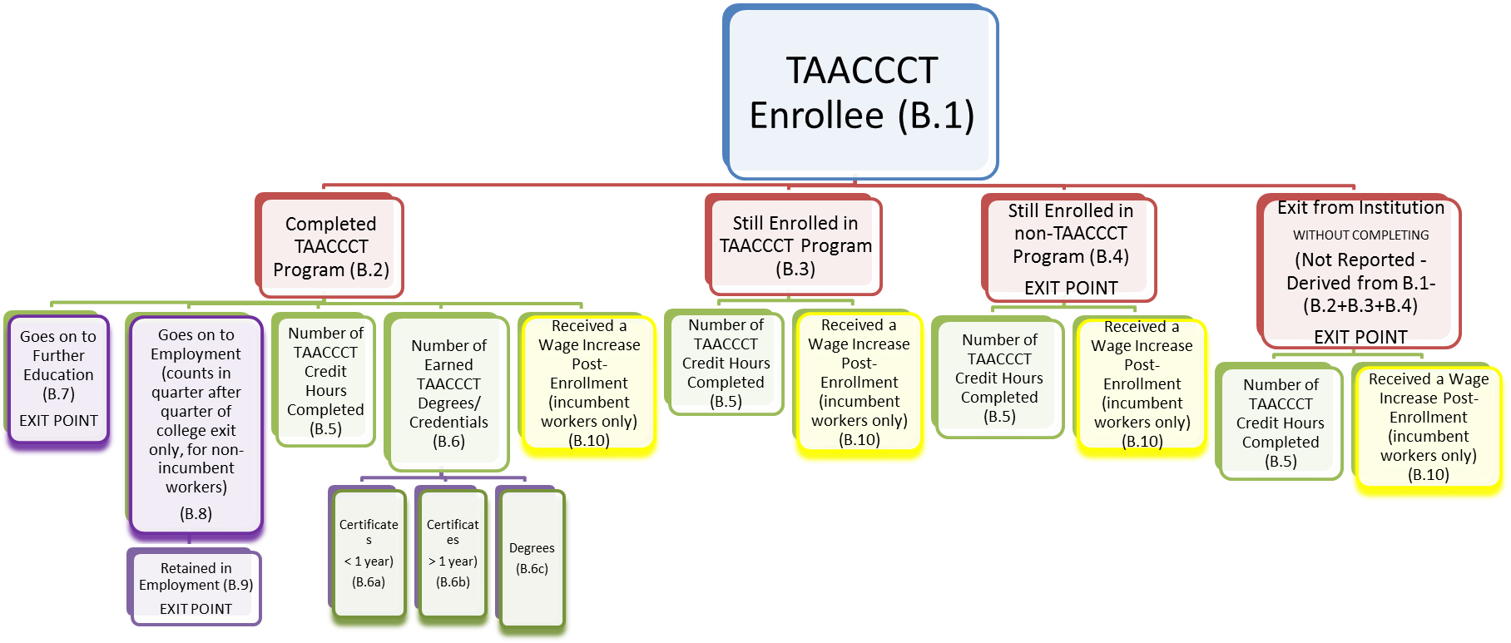
Status Outcomes
In-School Outcomes
Follow-Up Outcomes
Special Outcomes*

Slide 36
Questions?

Slide 37
Knowledge Check #1
 | Cert. Less | Cert. More | Degree
Felicia | 4 | 1
Hal | 2 |  | 1
Sean | 1 | 2
What number should be reported in Outcome #6? ___
6.a? ___
6.b? ___
6.c? ___

Slide 38
Knowledge Check #2
If a participant switches to a non-TAACCCT funded program, grantees should avoid counting any TAACCCT-funded credits he or she completed.
True
False

Slide 39
Knowledge Check #3
Of the four statuses, only _______ allows participants to be counted in it more than once, if applicable.
Completion (B.2)
Retained in a TAACCCT program (B.3)
Retained in a non-TAACCCT program (B.4)
Exit from the institution

Slide 40
Knowledge Check #4
Which is the only status to trigger follow-up outcomes?
Completion (B.2)
Retained in a TAACCCT program (B.3)
Retained in a non-TAACCCT program (B.4)
Exit from the institution

Slide 41
Thank you
for attending!

