Slide 1
Implementing Comprehensive, Affiliate, and Colocation Requirements

Slide 3
Larry Burns U.S. Department of Labor Office of Unemployment Insurance
Winston Tompoe U.S. Department of Labor Office of State Systems, Region 3
Charlotte Harris U.S. Department of Labor Office of Workforce Investment

Slide 4
Provide a deeper dive of key components of Part 678.305, 678.310, and 678.315 of the Joint regulations and guidance to include:
One-Stop Comprehensive, Affiliate, and Co-location of the American Job Center Network
Representatives from two local American Job Centers presenting promising practices for integration
A review of upcoming, topic specific, One-Stop technical assistance events.

Slide 5
WIOA Vision
The workforce system will be characterized by three critical hallmarks of excellence:
The needs of business and workers drive workforce solutions;
American Job Centers (or American Job Centers) provide excellent customer service to jobseekers and employers and focus on continuous improvement; and
The workforce system supports strong regional economies and plays an active role in community and workforce development.
Across the system, continuous improvement is supported through evaluation, accountability, identification of best practices, and data driven decision making.

Slide 6
Comprehensive and Affiliate American Job Centers

Slide 7
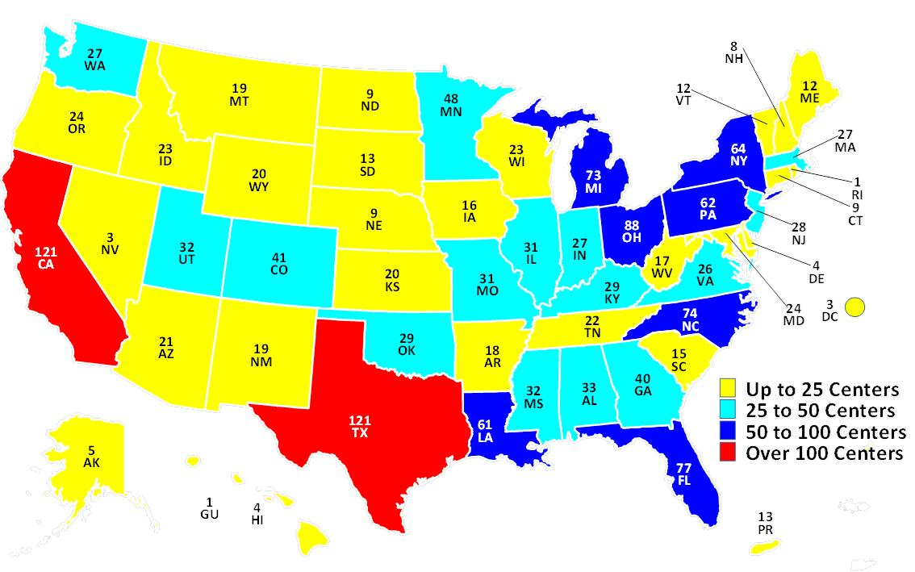
1,609 Comprehensive American Job Centers (February 17, 2017)

Slide 8
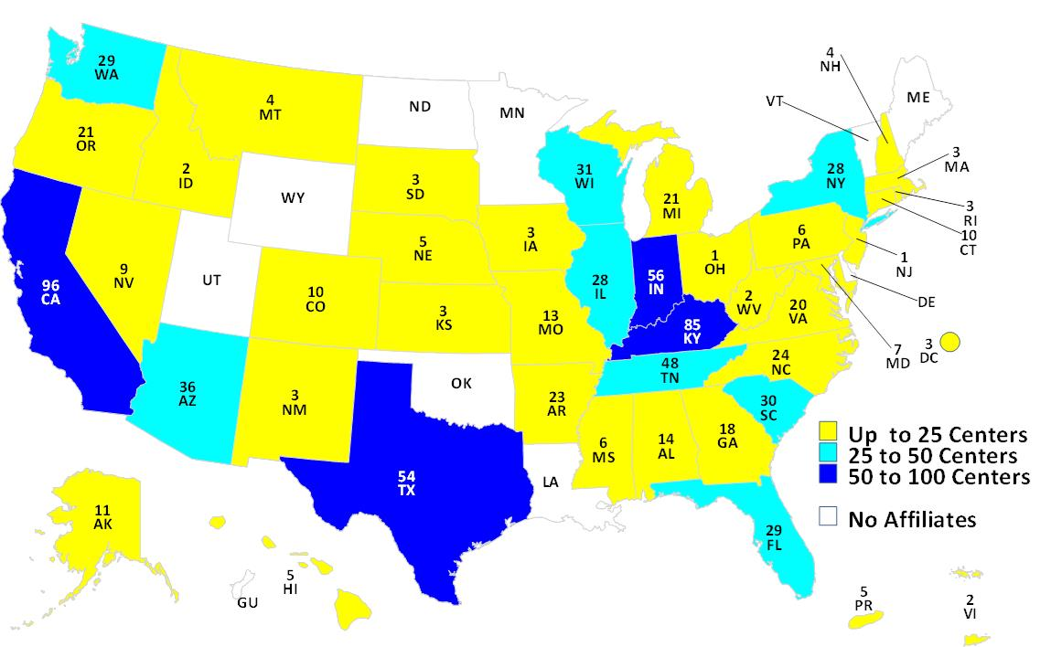
805 Affiliate American Job Centers (February 17, 2017)

Slide 9
Comprehensive Center

Slide 10
Poll Question 1
How far has your local system come in achieving partner integration into your Comprehensive American Job Center?
All of the core programs and required partners are physically located onsite.
Most of the core programs and required partners are physically located onsite.
All of the core programs and required partners are physically located onsite or accessible through another allowable method, i.e. direct linkage or the training of a partner staff.
We are nowhere near integration.
Other: Type in the chat box

Slide 11
Poll Question 2
What are some of the major challenges to successful integration of all required partners into the American Job Center? (answer more than one, if applicable)
Standing lease agreements/real property;
Program management;
Funding stream concerns, to include infrastructure costs;
Ensuring that our customers will be adequately served;
Regulatory and programmatic provisions that impede implementation;
Other (please use chat feature to specify).

Slide 12
What is a Comprehensive American Job Center?
Is a physical location where job seekers and employer customers can access the programs, services, and activities of all required one-stop partners, along with any additional partners as determined by the Local WDB.
Must have at least one Title 1 program staff person physically present. 20 CFR 678.305(a).

Slide 13
Requirements of the Comprehensive American Job Center
All required partners must provide access to their programs, services, and activities during regular business days.
Physical presence of program staff at the American Job Center.
Trained staff from different partner program physically located in the comprehensive center.
Direct linkage through technology to program staff who can provide meaningful information or services.

Slide 14
Requirements of the Comprehensive American Job Center
Physical and programmatic accessibility to individuals with disabilities.
Workforce and labor market information.
Notes:
Physical and programmatic accessibility includes things such as ramps for wheel chairs or people on crutches; split level counter tops to be at eye level with differing customers; closed captioning services during workshops, etc.

Slide 15
What is Provided in the Comprehensive Center?
Career services, including: 20 CFR 678.430
Basic
Individualized
Follow-up
Business services that assist businesses and industry sectors in overcoming the challenges of recruiting, retaining, and developing talent for the regional economy.
Access to employment and training activities funded under local funding stream for adult and dislocated workers. 20 CFR 678.305

Slide 16
Affiliate and Specialized Centers

Slide 17
Affiliate and Specialized American Job Centers
Supplemental access points consisting of one or more of the one-stop partners’ programs, services, and activities available.
Not mandated to provide access to every required partner program.
Must be physically and programmatically accessible to individuals with disabilities.
Frequency of program staff’s physical presence in an affiliated site determined through partner MOU negotiations at the local level.

Slide 18
Affiliate and Specialized American Job Centers
Specialized centers may also be established to serve a particular population.
Must be physically and programmatically accessible to individuals with disabilities.
Should make referrals to comprehensive or affiliate American Job Centers as appropriate.
Partner services provided through specialized American Job Centers determined through partner MOU negotiations at the local level.

Slide 19
Colocation of Wagner-Peyser Employment Services

Slide 20
Poll Question 3
WIOA now requires the co-location of Wagner-Peyser Employment Services into the American Job Centers. Has your State(s) achieved successful co-location? (If no, write the reason why in the chat box)
Yes
No

Slide 21
Colocation of Wagner-Peyser Services
WIOA sec. 121(e)(3) requires colocation of ES offices and American Job Centers established under title I of WIOA.

Slide 22
WIOA Co-Location Requirement
Separate stand-alone Wagner-Peyser Act Employment Service offices are not permitted under WIOA.
If Wagner-Peyser Act services are provided at an affiliated site, the following must occur:
at least one or more other One-Stop partners must be located in the affiliated site, and
there must be physical presence of combined staff over 50 percent of the time the center is open.

Slide 23
WIOA Co-Location Requirement
Where the Employment Service is provided at an affiliated site, the other partner must not be the partner administering local veterans’ employment representatives (LVER), disabled veterans’ outreach program (DVOP), or Unemployment Insurance (UI) programs.

Slide 24
WIOA Co-Location Requirement
If ES, LVER, DVOP, and UI programs are provided at an affiliated site, additional partner(s) must have presence of combined staff in the center more than 50 percent of the time the center is open.
20 CFR 678.315 (b)

Slide 25
Timeline for Colocation
The expectation is that colocation should be completed as expeditiously as possible.
Provide the Department with a plan
Include steps State will take to achieve colocation

Slide 26
Poll Question 4
Would you be interested in participating in a Wagner-Peyser Co-location Peer Learning Group?
Yes
No
If yes, what specific issues would you like the Peer Learning Group to address? (Type your answer into the chat box.)

Slide 27
Contact Information for Interest in Wagner-Peyser Co-Location Peer Learning Group
Larry Burns U.S. Department of Labor Office of Unemployment Insurance
Email: burns.lawrence@dol.gov

Slide 28
Representatives from Two American Job Centers

Slide 29
Arlington Employment Center
Howard Feldstein Director, Arlington Employment Center, Virginia
hfeldstein@arlingtonva.us
Myrna Tejada Workforce Services Administrator Virginia Employment Commission
Edythe Richards Counselor Northern Virginia Community College
Jerrilyn Young Specialist Adult Education Arlington Public Schools

Slide 30
Staff Training and Cross-Training
Regular team meetings
“Day-in-the-Life” Job Shadowing
Include everyone (even fiscal staff)

Slide 31
Create American Job Center Identity
AJC identity replaces program identity of the staff – even on business cards !
Coordinated business services for employers
“No Wrong Door Policy” for job seekers
Notes:
Physical and programmatic accessibility includes things such as ramps for wheel chairs or people on crutches; split level counter tops to be at eye level with differing customers; closed captioning services during workshops, etc.

Slide 32
Diverse Community Partnership
Virginia Employment Commission
Virginia Dept of Rehabilitative Services
Northern Virginia Community College
Arlington Public Schools Adult Education
National Council on Aging
TANF Program
SNAP E&T Program
Ticket to Work
Financial literacy coach (CFPB)
Entrepreneur Coaching
Linden Resources (TANF client assistance)
Arlington Public Library
Notes:
Physical and programmatic accessibility includes things such as ramps for wheel chairs or people on crutches; split level counter tops to be at eye level with differing customers; closed captioning services during workshops, etc.

Slide 33
“Take a Sledgehammer to the Silos”
Service delivery team is seated in a common area
Lines of supervision; common work rules
Integrated data management system
Team approach working with clients
Notes:
Physical and programmatic accessibility includes things such as ramps for wheel chairs or people on crutches; split level counter tops to be at eye level with differing customers; closed captioning services during workshops, etc.

Slide 34
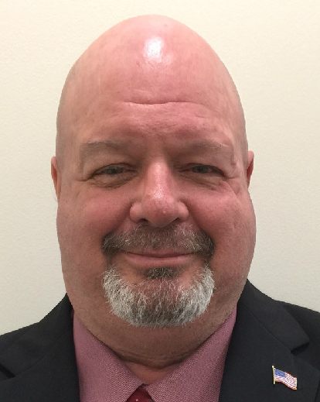
North Tennessee Workforce Board Clarksville, Tennessee
Marla W. Rye
President, Workforce Essentials
mrye@Workforceessentials.com
Natalie McLimore
TANF District 5-7
John Alexander
Tennessee Department of Labor &
Workforce Development

Slide 35
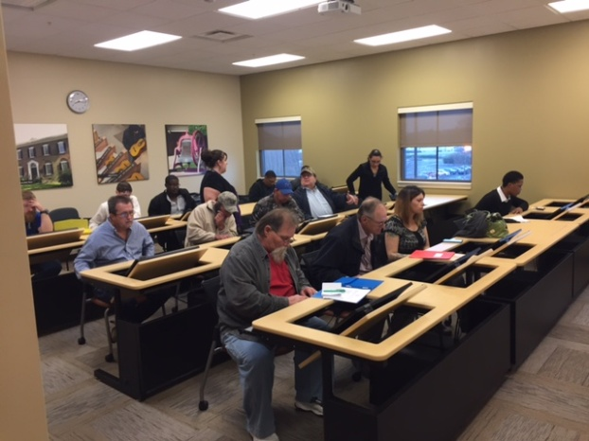
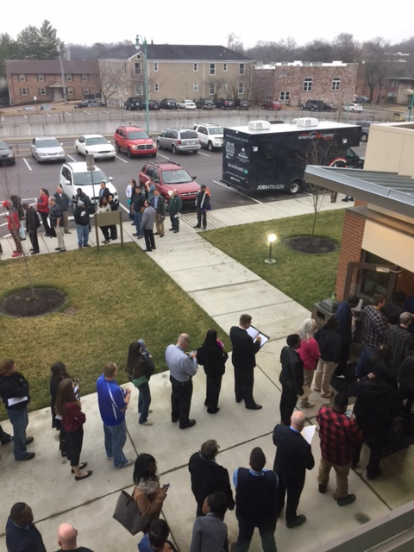
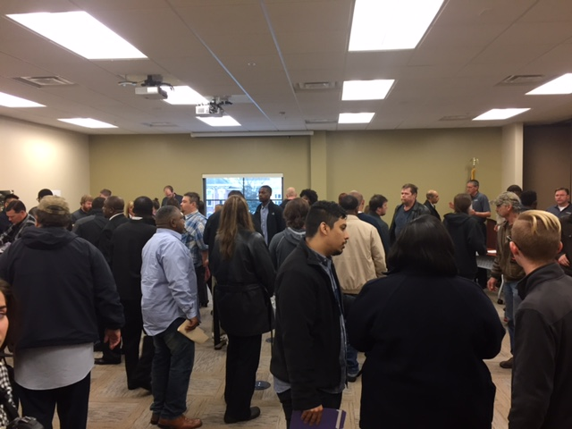
Build it and THEY will come
Partners
& Employers

Slide 36
Comprehensive AJC
On-Site Partners Clarksville, TN
Title 1-WIOA
Title II-Adult Ed
Title III-Wagner Peyser
Title IV-Voc Rehab.
Job Corps
SCSEP
Vets-LVER
Vet-DVOP
Unemployment
Insurance
TANF
Ticket to Work
RESEA
SNAP
TAA
Employers

Slide 37
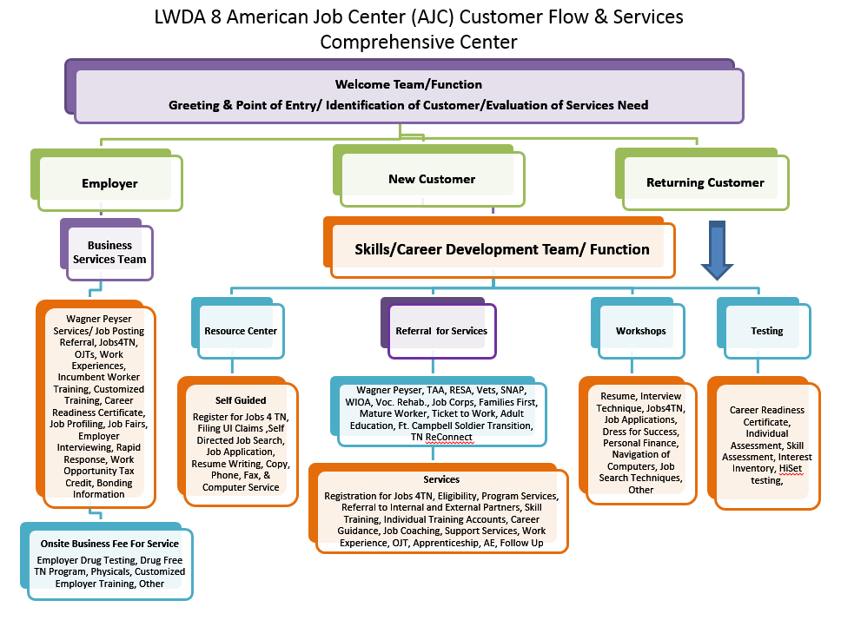
Functional Alignment

Slide 38
Alignment of Partners
AJC System Training - All staff members certified as Workforce Professionals
Minimum of Monthly Partner Meetings
AJC Certification- Bottom up
Shared Data System
Enhanced Customer Service

Slide 39
AJC Branding
Partner Identity
AJC Business Cards
Name Badges
Shared Intake
Community Representation

Slide 40
AJC Management Structure
One-Stop Operator
Current-Consortium of Partners
Procurement forthcoming
Partner Site Leads w/joint management
Share Staffing-Funded through RSA

Slide 41
Examples & Questions
Enhanced Customer Service
TANF
TAA & SNAP Integration
Adult Education
Business Services
Questions

Slide 42
Upcoming One-Stop Technical Assistance Events

Slide 43
Upcoming One-Stop Technical Assistance Webinars
One-Stop Operator Competition: The Basics March 8, 2017 | Interactive dialogue covering: Background, Roles, and Functions Eligible Entities Procurement Standards
Universal Design: A Customer Centered Approach March 15, 2017 | Engage with two local areas who will share their process and innovations for a customer centered One-Stop
To register for these events, go to https://ion.workforcegps.org/events

Slide 44
Upcoming One-Stop Technical Assistance Webinars
American Job Center Branding for the Next Generation Workforce System April 5, 2017 | Exploration of available resources Branding success highlights from around the country
American Job Center Certification: A Tool to Maximize State’s Quality and Consistency of Services April 12, 2017 | Discussion on: Emerging practices occurring in states evaluating effectiveness Physical and programmatic accessibility Continuous improvement
MOU Part I: Overview & Development April 26, 2017 | Discussion of different types of MOUs and key elements Showcase a sample MOU document
To register for these events, go to https://ion.workforcegps.org/events

Slide 45
Upcoming One-Stop Technical Assistance Webinars
Increasing Opportunity for Shared Customers: Integrated Service Delivery through the American Job Center Network May 17, 2017 | Advice and lessons learned when building an integrated service delivery system
MOU Part II: Local vs. State Funding Mechanism May 31, 2017 | Infrastructure costs are funded either through the Local or State funding mechanism Federal partners walk participants through both options and provide examples
One-Stop Operator Competition: “Deep Dive” Date TBD | Interactive dialogue covering: Competitive Procurement Process Essential Contract Elements Avoiding Conflicts of Interest Transition, Implementation, and Monitoring
To register for these events, go to https://ion.workforcegps.org/events

Slide 47
ION Website – New Focus Areas Tab
The new Focus Areas navigation tab on the ION homepage offers a host of resources on 11 key elements of WIOA. This information was formerly housed on the WIOA Implementation Training page.

