Slide 1
Universal Design: A Customer Centered Approach
March 15, 2017

Slide 3
David Jones
Workforce Analyst
US Department of Labor - ETA
Virginia Hamilton
Region 6 Administrator
US Department of Labor- ETA

Slide 4
Dawn Karber
Chief Operations Officer
Spokane Workforce Development Council
(local workforce board)
Kevin Williams
One-Stop Operator
WorkSource Spokane
(with Career Path Services)
Stacey L. Thompson
Workshop Facilitator
Career Center of Lowell, Massachusetts
(One Stop Operator)

Slide 5
Understand the meaning of universal design and the linkage to customer centered design
Demonstrate how universal design has been applied to address challenges in the American Job Center (AJC) Network to benefit customers accessing services
Recognize the importance of “design thinking” to maximize seamless service delivery for the customer

Slide 6
What is Universal Design?
Universal Design is a strategy for making products, environments, operational systems and services welcoming and usable to the most diverse range of people possible.
Its key principles are simplicity, flexibility, ease of access and efficiency.
It’s a lens through which all aspects of interaction can be viewed, and can be applied to products, services, physical environments, communications, technology, policies, and practice.

Slide 7
What is Universal Design?
Universal Design is a proactive approach that anticipates the barriers people might face regardless of the cause and creates approaches to overcome or accommodate them.
Developing services that are accessible to the largest number of people and reduces the need for:
specialized assistance;
individualized accommodation requests, and
delays while accommodations are put in place.

Slide 8
Ensuring Meaningful Access to All Customers under WIOA
American Job Centers must be physically and programmatically accessible to all customers.
Physical Accessibility refers to the extent to which facilities are designed, constructed, or altered so they are accessible by individuals with disabilities.
Programmatic Accessibility refers to the extent to which the full range of services is available to all AJC customers regardless of disability or cultural background.

Slide 9
Universal Design Principles
Examples of universal design principles could include:
Flexibility in space usage;
Pictorial, written, and tactile modes to present information;
Providing clear lines of sight to information for seated or standing users;
Providing necessary accommodations; and
Providing adequate space for the use of assistive devices or personal assistants.

Slide 10
Establishing a Welcoming Environment
The value of cross-training and planning across partners are two key ways to enhance the principles of universal design in creating a welcoming environment through:
Understanding the needs of specific populations across different programs
Understanding the needs of employers to provide both the quantity and quality of candidates they need

Slide 11
Customer Centered
Design

Slide 12
The Customer Centered Design Process A collaborative, discovery-based journey.
Get inspired by the people you’re serving.
Start by listening to people to get new ideas about how to design for them.
Identify patterns and surprising insights to inspire new opportunities for design.
Brainstorm new ways to serve your customers.
Try out your ideas and get feedback from customers – so you can revise your prototypes and get more feedback.
Try out a pilot program and experiment with ways to implement your new ideas.

Slide 13
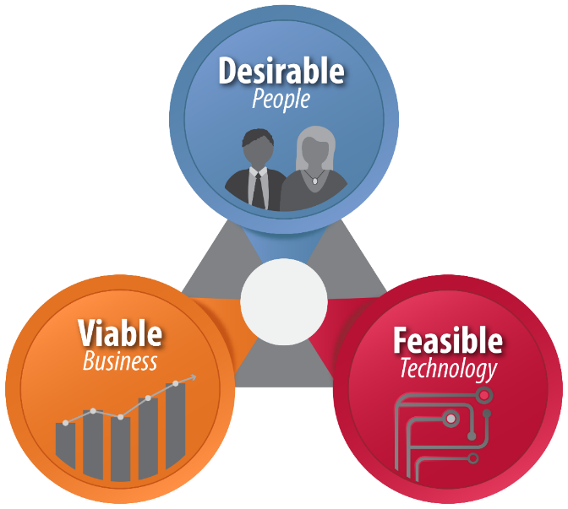
Using Customer Centered Design
Start with people

Slide 14
How might we...
assume solutions exist

Slide 15
How might we...
reduce risk and commitment

Slide 16
How might we...
do it together

Slide 17
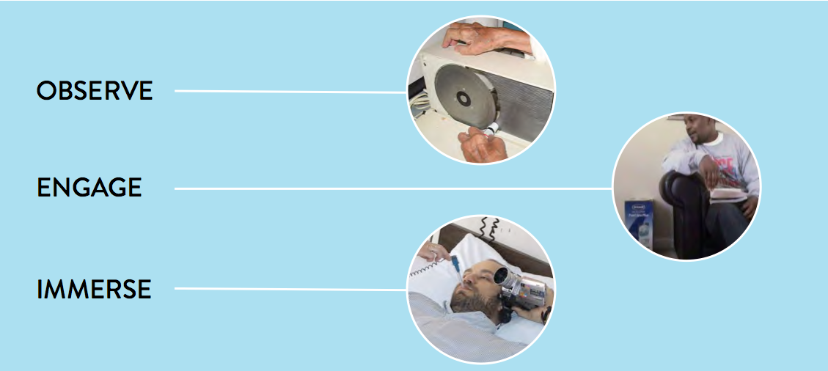
Build empathy

Slide 18
“
I’m copying a friend’s resume, but putting my words to it because I don’t know how to make one.
“
David, 18

Slide 19
“
I’m copying a friend’s resume, but putting my words to it because I don’t know how to make one.
“
David, 18
What if?
Instead of resume-building classes, we provided templates for youth to adapt quickly, since a resume is a means to an end at this stage?

Slide 20
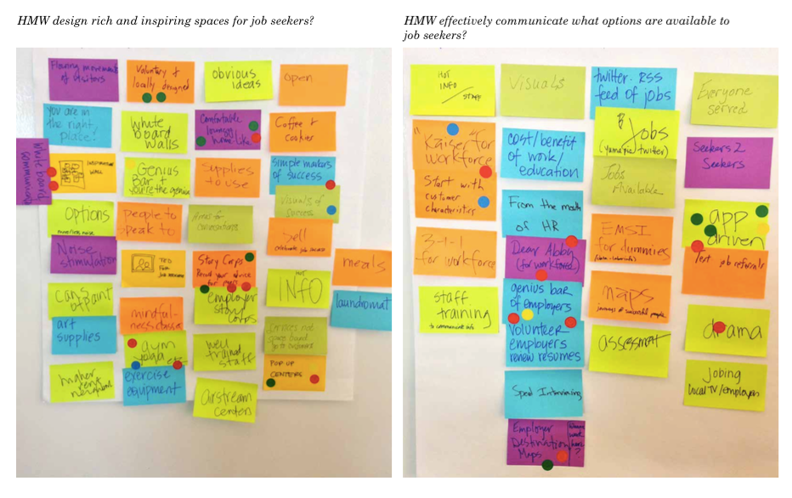
How might we...

Slide 21
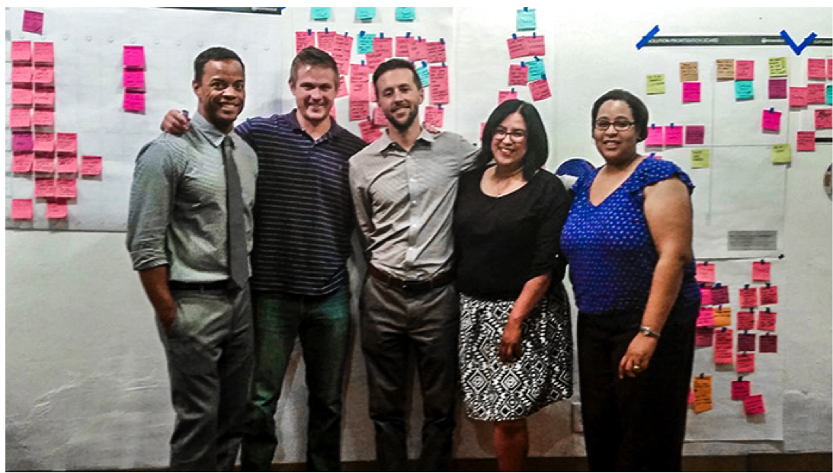
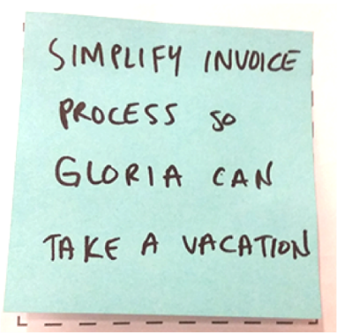

Slide 23
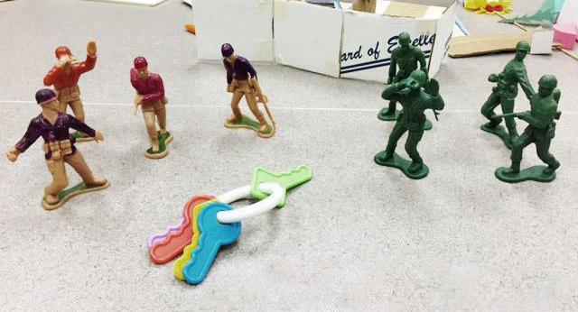
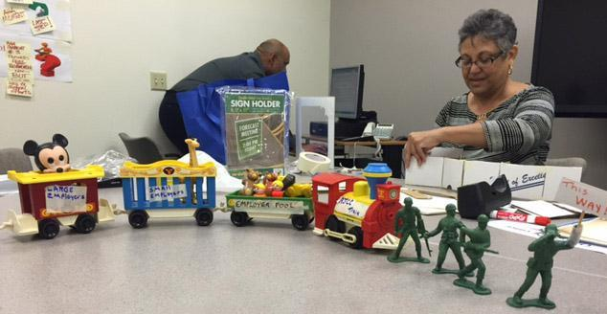
Prototyping
One team leading the way for small and large employer pool to the workforce resource center (AJCC)
The key is to form one team and to be seen as one team

Slide 24
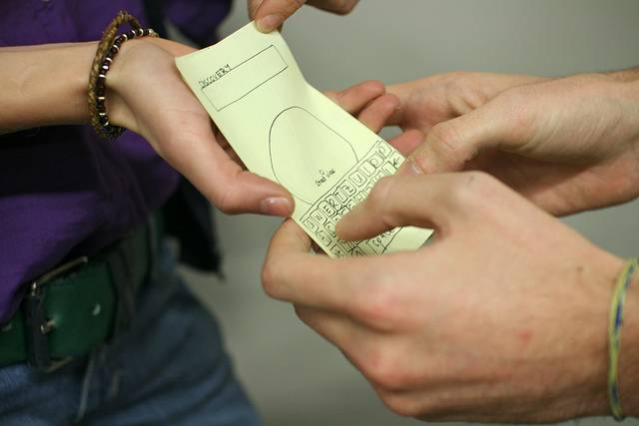

Slide 25
The outcomes
Services are designed for employers and job seekers that better meet their needs.
WIOA implementation is transformative, not “check-the-box.”
You and your Team are supported to think outside of what you know, and use tools to make implementation happen in new, creative ways.
Federal, State, and local workforce professionals have a much better understanding of who the customer is.
Service design happens in a collaborative way with all stakeholders participating.
There is capacity in the system for on-going process improvement, and agencies use design thinking as a regular practice.

Slide 26
WorkSource Spokane- Spokane Workforce Development Council
Customer Centered Design Challenges & Outcomes

Slide 27
Spokane, WA – The Challenge
We sought to transform our one-stop center and provide world-class services where all teams are function-based to eliminate duplication and increase the customer experience and bolster staff expertise.

Slide 28
Starting Point
Fairly typical one-stop with fairly typical comments from customers:
Great staff
Amazing if you give it a chance
I thought this was the unemployment office – I didn’t realize you offered employment services
Appears to be only for low-income job seekers
Governmental feel
Service and program names not clear, for example: WIOA, BFET, WorkFirst, NEG Grant

Slide 29
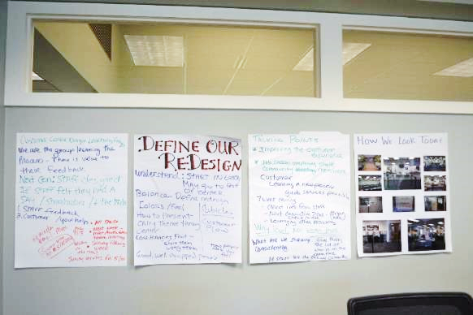
Ideation & Prototyping
Physical Redesign
Update the lobby
Clean up/modernize
Greeter/no large desk
Resource Room
Technology upgrade
Modernize
Open concept design
Create dedicated space for daily hiring events

Slide 30
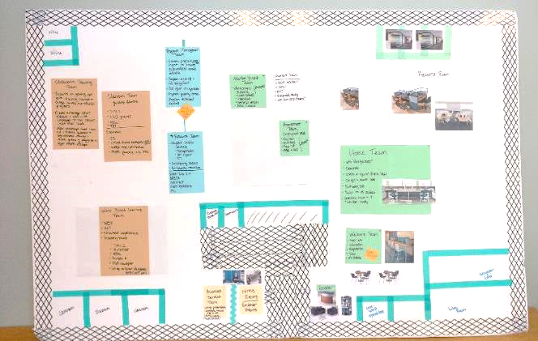
Ideation & Prototyping
Functional Redesign
Implement Integrated Service Delivery: exchange “programs” for “functions”
Braid funding to seamlessly address customer needs
Reduce duplicative activities
Ensure all processes are value-added for customers

Slide 31
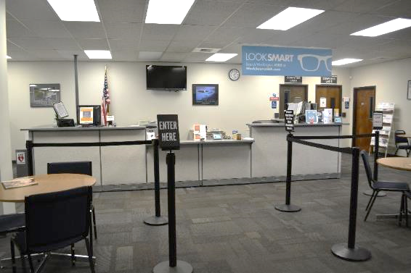
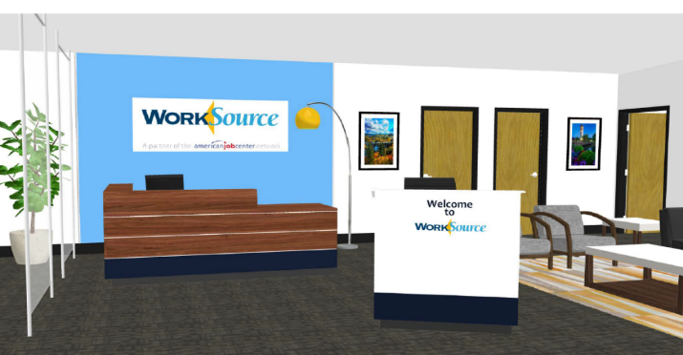
Physical Redesign
Lobby
Before After

Slide 32
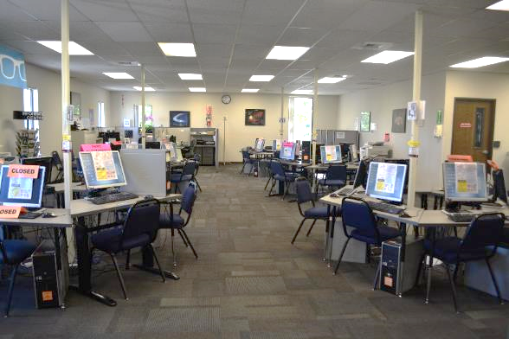
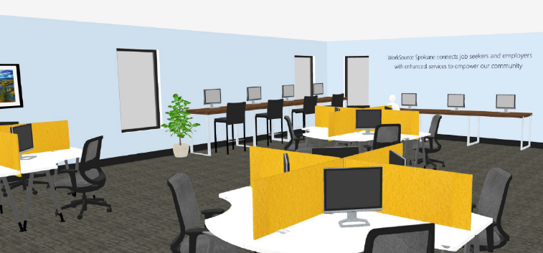
Physical Redesign
Resource Room
Before After

Slide 33
Functional Redesign
Existing Teams (Current State)
Career Services
Wagner-Peyser
RESEA
Business Services, Vets & Other
State & private grants
Wagner-Peyser
WIOA Adult
WIOA DW
Vets
Voc Rehab
Career & Training Team
WIOA Adult & DW
TAA
State & private grants
SNAP grant 1
NEGs
Other/standalone programs
Labor & Industries
Voc Rehab
WorkFirst
BFET
SNAP grant 2

Slide 34
Functional Redesign
Functional Teams (Future State)
Welcome Services
Greeter
Member Registration
Career Coaching
Skill Discovery & Assessment
Classes & Workshops
Financial Aid
Education & Training
Employer Connections
Funding
All funding supports all services: WIOA Adult, WIOA DW, Wagner-Peyser, RESEA, Trade Adjustment Assistance, Vets, state grants, private grants, Voc Rehab, SNAP 1 grant, SNAP 2 grant, WorkFirst, BFET, NEG grants, etc.

Slide 35
Tools

Slide 36
Greater Lowell Workforce Development Board Team - Career Center of Lowell AJC
Customer Centered Design Challenges & Outcomes

Slide 37
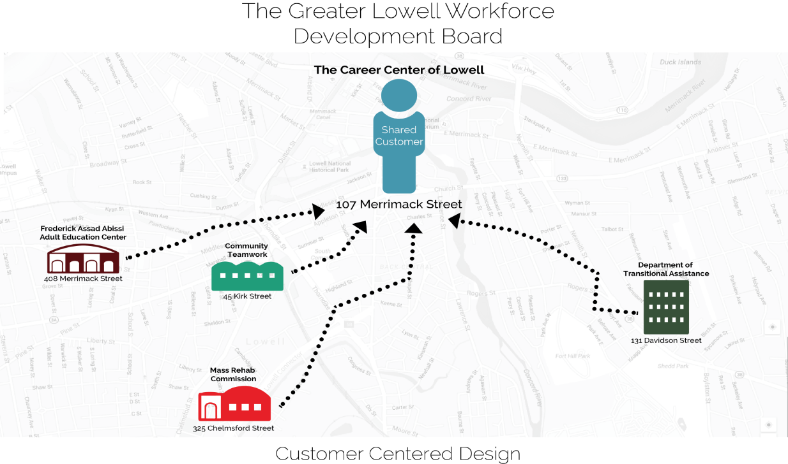
Challenge:
How to collaborate effectively to make things easier/better for our shared customers?

Slide 38
Time to Dig
In order to make things better we had to get to the root of the issues/challenges impacting our shared customers.
Step 1: Identify the customers
Step 2: Talk to the customers in our and their environment
Visit the locations where services are provided (learn more about the partner organizations)
Step 3: Ensure that the actions that you take moving forward best meet the customer’s needs

Slide 39
Customer Identification
The Career Center (One-Stop Operator)has two main streams of customer:
Unemployment Insurance (UI) customers who are seeking employment and/or training assistance
Non-UI customers who are seeking the same.
Our UI clientele represents a steady stream of repeat visiting customers. Our ability to assist and outcomes with this group are exemplary.
Our Non-UI customer group, when examined, did not meet our self-imposed outcome standards. So we knew some changes were needed.
We got to work.

Slide 40
Inspiration in Interviews
In order to truly see what direction we needed to move in; where the changes needed to be made, we had to consult with people who knew what we do AND those who experienced the services we provide...
Customers & Industry Experts

Slide 41
A Memorable Quote
When asked what color(s) would describe your initial feeling of entering the Career Center through the Seminar.
Response: “Well I came in feeling positive so I would say purple, but I’d also choose blue because that is how I left feeling”.
A group of customers that attended a Non-UI Career Center Seminar

Slide 42
Expert Interview Commentary
Internal Expert Q & A
External Expert Q & A
Q
Question:
What tools do you think could assist in providing better customer service here at the Career Center (of Lowell) and in general?
Response/Answer
“A friendly face, cheerful, and accommodating staff…I try to remember a customer’s name so they feel welcomed. A good idea is giving customer a name tag so they feel important and welcomed”
Q
Question:
What do you feel is integral in providing quality/effective customer service?
Response/Answer
“Forgetting about those performance measures. Don’t worry about regs. Build it and step back. Then assess. Find out where “are the trouble buckets”. Then we can look at things like can I change”
A
A

Slide 43
Initial Conclusions…
We need to make sure customers feel welcomed in our space.
We have to ensure that our welcome seminar properly addresses and engages the customer.
We need to re-design the Career Center Seminar so that it is more customer-friendly.
We must create a clear system so customers know what their next steps would be/how to navigate services. Offer triage for each customer.

Slide 44
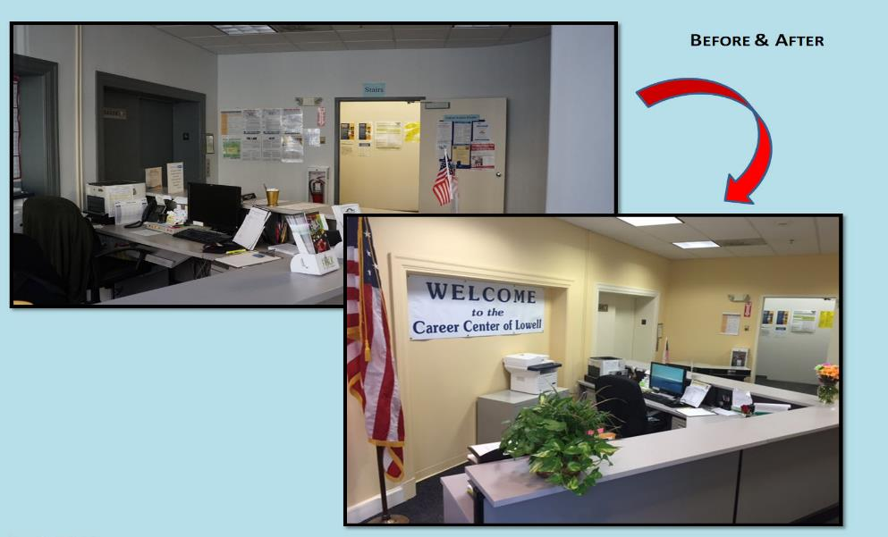
A Warmer ‘Reception’
The prototype lead to the physical alteration of our space to create a less sterile, more inviting lobby area. There have been many positive comments about the color and less cluttered signage.

Slide 45
Non-UI Career Center Seminar
Before Prototype
Post-Prototype
Long
Covered Areas That Did Not Apply to Attendees
Too much information
No Ability to Meet with Career Advisor/Limited Next Step Assistance for All
More concise
Slides/Presentation Geared to Population
Essential Information
Concentrating on Next Step Guidance

Slide 46
Lessons Learned
Know your customers.
Take the time to get to know their needs, goals and barriers. Changes should be made with the CUSTOMER in mind.
Don’t be afraid to fail/prototype.
Success may not happen on the 1st, 2nd or 13th attempt. It may be challenging but trust in the process. But trying is not failure but the elimination of something that wasn’t right or didn’t achieve your goal.
Adapt your mentality about change so that you can convince others to buy into it.
People like to do what is comfortable/known. Change can be scary and fear of failure paralyzing.

Slide 47
Lessons Learned
Be patient (with yourself, others and the process)!
Laugh often.
While challenging this process should not feel like pulling teeth. There are many funny things that happen as you challenge yourself and your organization to change. If the whole process is painful, you aren’t going to win over people to become agents of change.

Slide 48
Future Iterations… What would we do NEXT????
There is still so much to do to with customer centered design. These are some options:
Explore the possibility of a Mobile Career Center Seminar
More physical changes to the center to ensure a warm
Strengthen systems to assist non-computer savvy members
Create ongoing improvement teams
Budget ideas to have customer service improvement plan wiggle room

Slide 49
Any Questions?
Enter your questions in the Chat Window (lower left of screen)
?

Slide 50
Universal Design 101
This web page provides a brief description of the seven principles of universal design.
http://www.southwestada.org/html/publications/design/ud101.html
Equal Access: Universal Design of Physical Spaces
A Checklist for Designing Spaces that Are Welcoming, Accessible, and Usable.
http://www.washington.edu/doit/sites/default/files/atoms/files/EA_Spaces_06_08_12.pdf
What is the Difference Between Accessible, Usable, and Universal Design?
This web page explains terms that describe similar though somewhat distinct design concepts.
http://www.washington.edu/doit/what-difference-between-accessible-usable-and-universal-design
Best Practices in Universal Design: Strategies for Intake & Orientation
This PowerPoint presentation describes universal design strategies to support job seekers during intake, orientation, and assessment of American Job Centers.
http://www.leadcenter.org/system/files/resource/downloadable_version/NAWDP_2014_Universal_Design.pdf

Slide 51
Evaluating the Accessibility of American Job Centers for People with Disabilities
U.S. DOL final report issued January 13, 2017, measuring the accessibility of American Job Centers.
https://www.dol.gov/asp/evaluation/completed-studies/AJC-Accessibility-Study.pdf
Promising Practices in Achieving Universal Access and Equal Opportunity: A Section 188 Disability Reference Guide
Information and technical assistance to public workforce system in meeting their nondiscrimination and universal access obligations for individuals with disabilities.
https://www.dol.gov/oasam/programs/crc/Section188Guide.pdf
When We Design for Disability We All Benefit
TedTalk with Elise Roy, describing how designing for disability has provided innovations for all customers in every products.
http://www.dailygood.org/story/1388/when-we-design-for-disability-we-all-benefit-ted-com/

Slide 52
Upcoming One-Stop Technical Assistance Events

Slide 53
Upcoming One-Stop Technical Assistance Webinars
American Job Center Branding for the Next Generation Workforce System April 5, 2017 | Exploration of available resources Branding success highlights from around the country
American Job Center Certification: A Tool to Maximize State’s Quality and Consistency of Services April 12, 2017 | Discussion on: Emerging practices occurring in states evaluating effectiveness Physical and programmatic accessibility Continuous improvement
MOU Part I: Overview & Development April 26, 2017 | Discussion of different types of MOUs and key elements Showcase a sample MOU document
To register for these events, go to https://ion.workforcegps.org/events

Slide 54
Upcoming One-Stop Technical Assistance Webinars
Increasing Opportunity for Shared Customers: Integrated Service Delivery through the American Job Center Network May 17, 2017 | Advice and lessons learned when building an integrated service delivery system
MOU Part II: Local vs. State Funding Mechanism May 31, 2017 | Infrastructure costs are funded either through the Local or State funding mechanism Federal partners walk participants through both options and provide examples
To register for these events, go to https://ion.workforcegps.org/events

Slide 55
ION Website – New Focus Areas Tab
The new Focus Areas navigation tab on the ION homepage offers a host of resources on 11 key elements of WIOA. This information was formerly housed on the WIOA Implementation Training page.

