Slide 1
RECRUITING WOMEN FOR NONTRADITIONAL APPRENTICESHIP & EMPLOYMENT
March 23rd, 2017

Slide 2
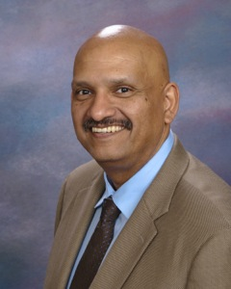
WELCOME
Daniel Villao, Deputy Administrator
OFFICE OF APPRENTICESHIP
U.S. DEPARTMENT OF LABOR

Slide 3
WANTO OVERVIEW
The Women in Apprenticeship and Nontraditional Occupations (WANTO) Act of 1992 authorized the U.S. Department of Labor to award grants to Community-based Organizations to assist employers and labor unions in promoting the recruitment, training, employment and retention of women in apprenticeship and nontraditional occupations.
The U.S. Department of Labor funded a total of $1,998,000 in grants to help women through the WANTO program, an initiative designed to recruit, train and retain women in high-skill occupations in advanced manufacturing, transportation, energy, construction, information technology and other industries.

Slide 4
Survey Question
What type of industry stakeholder are you?
Registered Apprenticeship Program
Employer
WIOA / American Jobs Center
Community College
Community-based service program
Government
Other

Slide 5
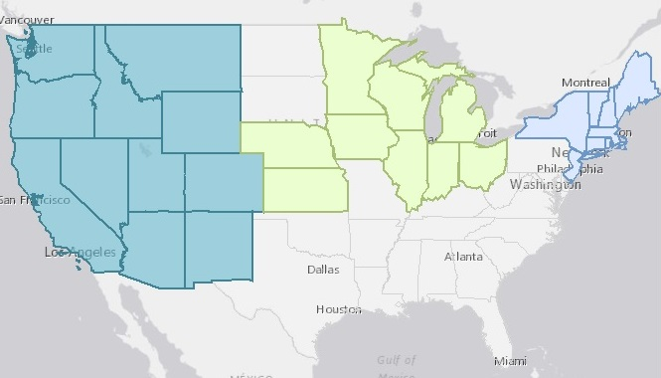
WANTO Regional Technical Assistance Centers
Nontraditional Employment for Women (NEW NYC)
Chicago Women in Trades
Western WANTO Consortium
Oregon Tradeswomen, Inc.
Tradeswomen, Inc. (CA)
Apprenticeship and Nontraditional Employment for Women (ANEW – WA)

Slide 6
Erik Antokal
Workforce Development Officer
Nontraditional Employment for Women
New York, New York
Morgan Stonefield
Program Director
Apprenticeship & Nontraditional Employment for Women
Seattle, Washington
Linda Hannah
Technical Opportunities Director
Chicago Women in Trades
Chicago, Illinois

Slide 7
Strategies for Providing recruitment support and employment opportunities
Erik Antokal
Nontraditional Employment for Women

Slide 8
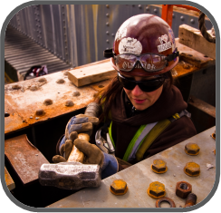
NEW Welcome and history
Founded in 1978
Preparing Women for Blue-Collar Careers in the Tri-State Area
Wrap-Around Program Model
Partnership with Building & Construction Trades

Slide 9
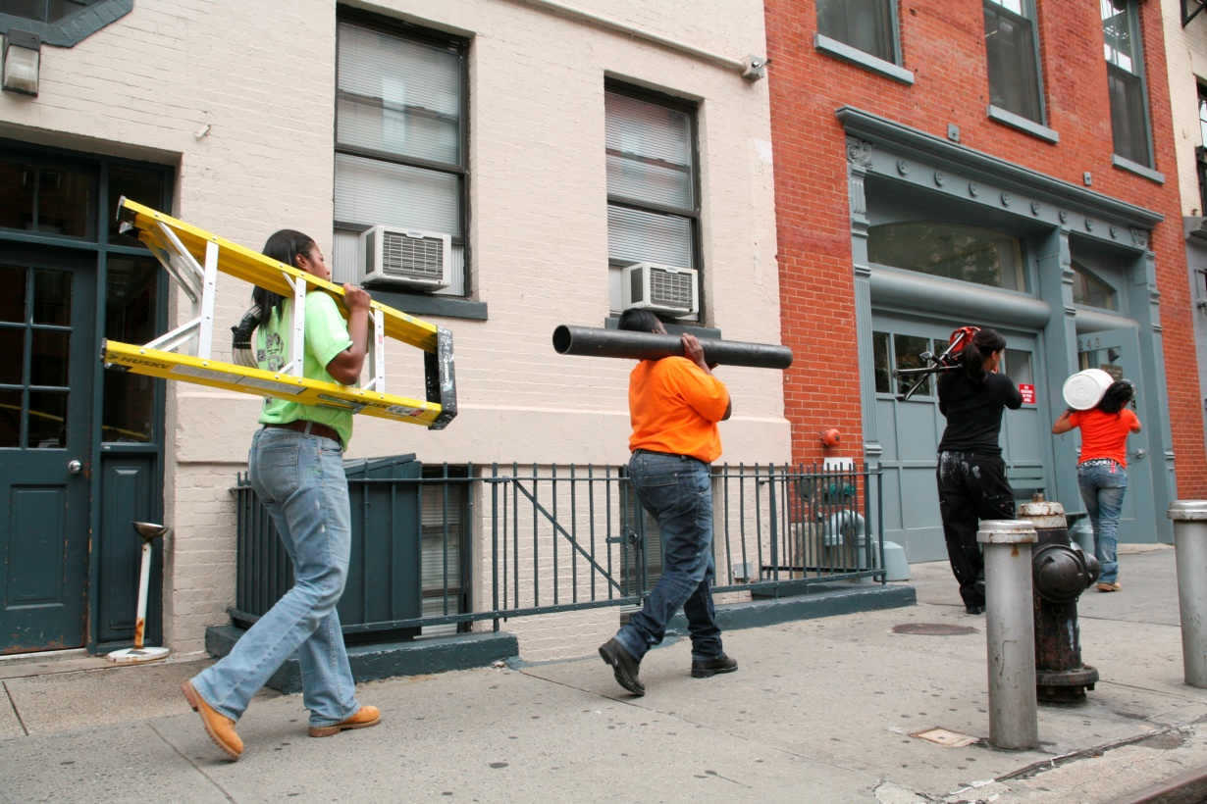
NEW Program Highlights
Training
Placement
NEW has placed over 1,400 graduates in construction apprenticeships
NEW has placed an additional 1,000 graduates in energy, transportation, and facilities maintenance industries
NEW enrolls 400 women in core training and an additional 100 in specialized training each year
NEW graduates are placed in jobs with wages averaging over $17 per hour

Slide 10
NEW Strong women
82% of NEW’s clients identify as minority
51% African-American
18% Hispanic
13% Asian or other
80% are classified as low-income
Trini Dent-Fernandez
NEW graduate, Sep 2006
Laborer, Local 79
NEW helps women achieve economic independence and a secure future

Slide 11
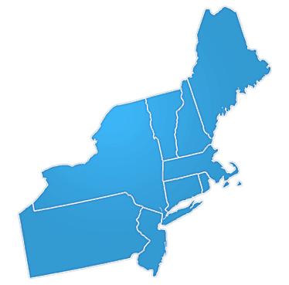
New employment partners
Carpenters NYC District Council
Carpenters Dock Builders Local 1556
Carpenters Floor Coverers Local 2287
Carpenters Millwrights Local 740
Cement and Concrete Workers District Council
Electricians IBEW Local 3
Heat and Frost Insulators, Local 12
Ironworkers Local 40 & 361, Structural Ironworkers
Ironworkers Local 46, Metallic Lathers and Reinforcing Ironworkers
Ornamental Ironworkers Local 580
Laborers Local No. 78 Hazardous Materials
Laborers Local No. 79 Construction and General Building
Laborers Local 731 Excavators
Operating Engineers, Local 15
Painters and Allied Trades DC9 – Painters
Painters and Allied Trades DC9 – Bridge Painters Local 806
Painters and Allied Trades DC9 – Drywall Tapers Local 1974
Plasterers, Local 262
Plumbers Local Union No. 1
Sheet Metal Workers Local 28
Steamfitters Local 638
Tile, Marble and Terrazzo Local 7

Slide 12
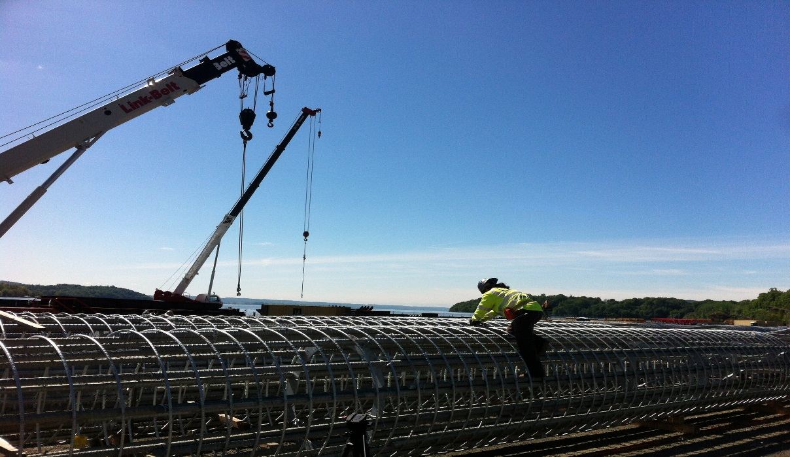
Building the future
Retaining Tradeswomen
Direct Support
Networking Events
Assisting Apprenticeship Programs in New York City and throughout the Northeast Region
NEW Signature Projects Program
‒ Nani Noverita
NEW graduate, July 2012
Metal Lather, Local 46
44 NEW Signature Projects Citywide

Slide 13
Recruitment support
Industry Demystification
Skills Development
Pre-Screening
Employment Prep
Retention Resources
Value-Add of Direct Entry Process

Slide 14
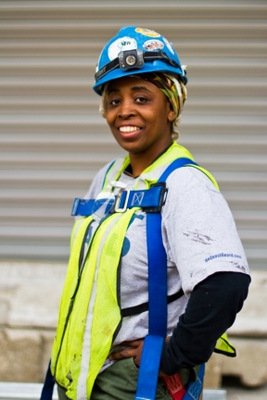
Industry Demystification
Single Stop for Women
Wrap-Around Services
Industry Exploration
“Taste-Of” Apprenticeship
Lifestyle

Slide 15
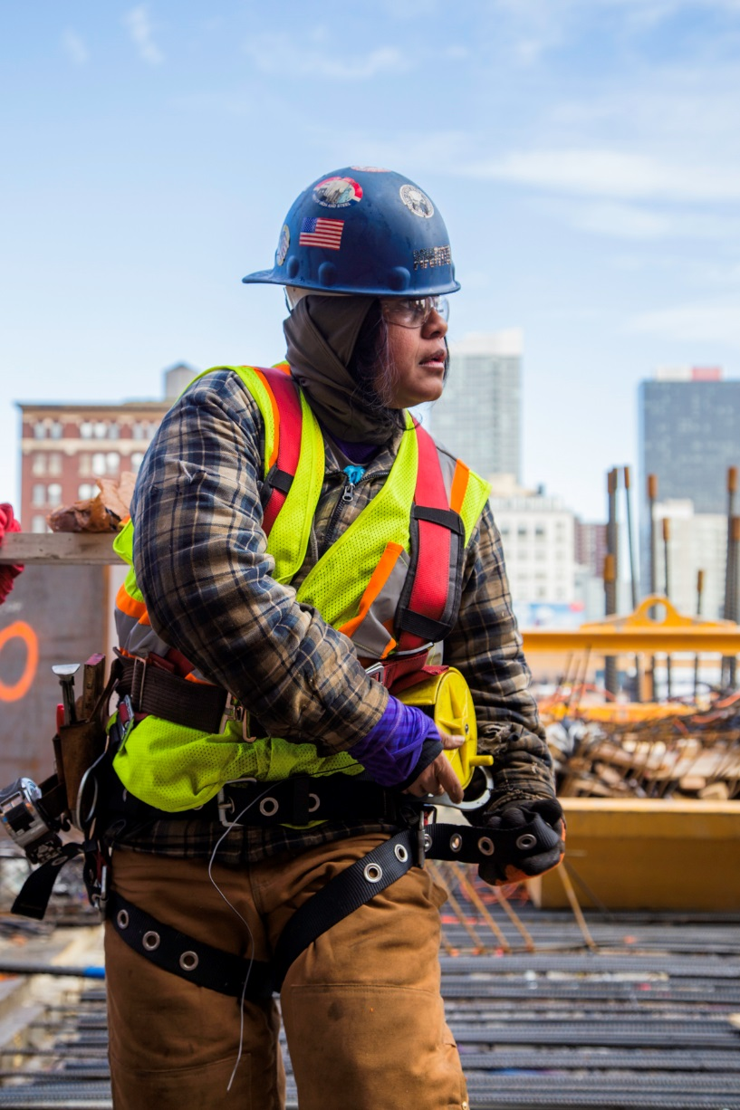
Skills Development
Job Readiness
Hands-on shop classes in carpentry, electrical work, and painting
Trades Math
Health and Safety
Lifting and Carrying

Slide 16
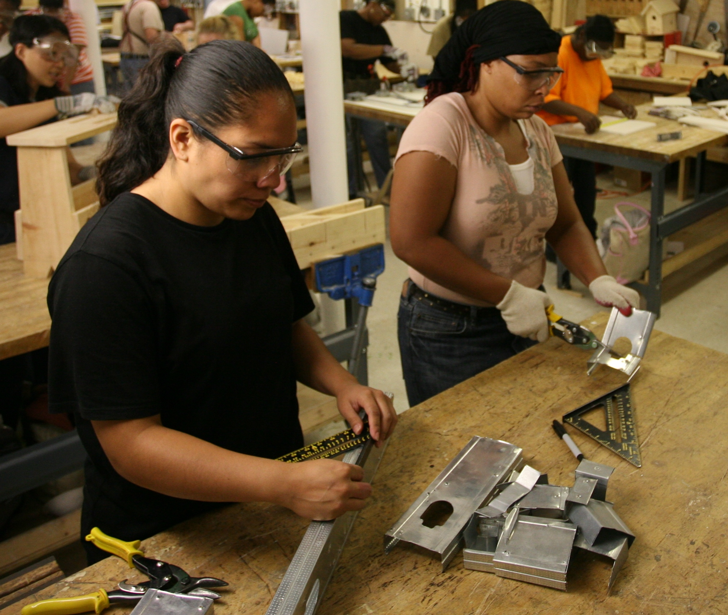
Pre-screening
Training as Proving Ground
Multi-Department Evaluation
Industry & Union Expertise
Real-Time Screening

Slide 17
Employment Prep
Process Navigation
“Teaching to the Test”
Case Management
Union/Employer Relationship

Slide 18
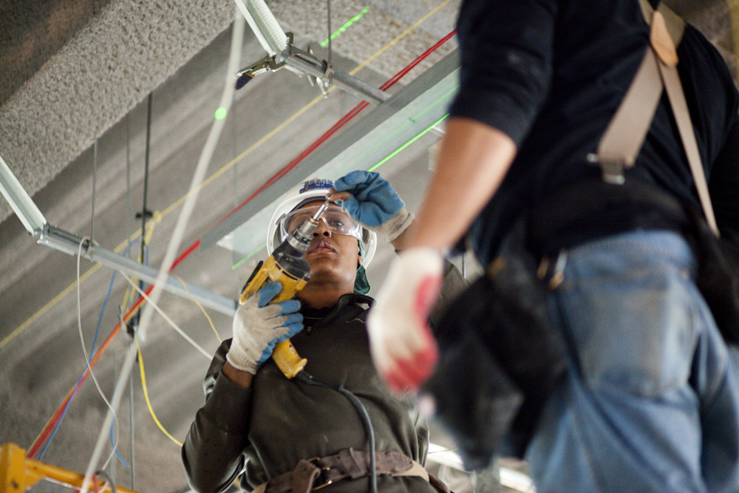
Retention resources
Direct Financial Assistance
Process Navigation
Networking Facilitation
Third-Party Troubleshooting

Slide 19
Next Steps
Follow-Up Discussions about integration of model with individual RAPs
What NEW program components could be readily integrated?
NEW can provide Technical Assistance
What are your ideas?

Slide 20
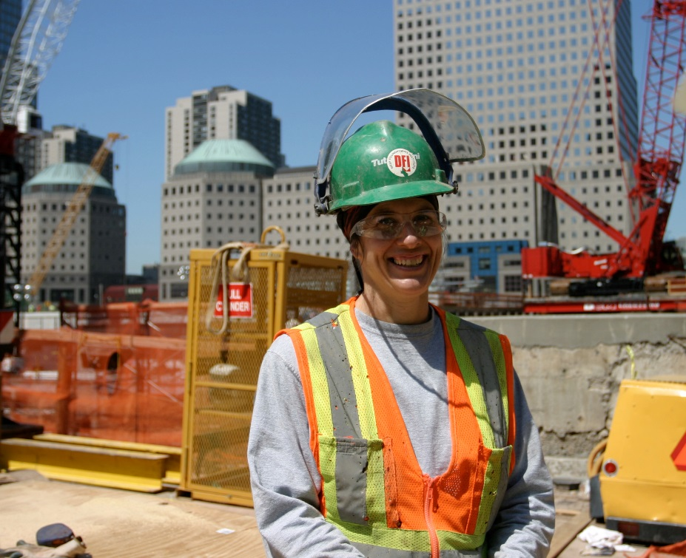
Thank you
Thank you for listening! Please feel free to contact me with any questions or comments.
Erik Antokal
Workforce Development Officer
eantokal@new-nyc.org
646-257-5097

Slide 21
Recruiting Women into the Trades
Morgan Stonefield
Apprenticeship and Nontraditional Employment for Women

Slide 22
Objective: To demonstrate effective practices and practical approaches for recruitment of women into the trades
“Women are more than capable of doing the work. Anybody that’s ignoring half of the workforce is doing themselves a disfavor.”
Ron Genereux
Vice President, Construction Suncor Energy

Slide 23
Employer Approach
Make the commitment and make it public
Add recruitment of women to your strategic plan and make it a priority
Establish a team- company/program wide on how to not only recruit women but also a team that can focus on the retention of women.
Train the hiring team, or add to the hiring team to ensure those responsible for hiring have positive attitudes towards women in the trades
Set a clear goal, create a timeline, ,and establish performance indicators.
Publish and share with organization internal and external partners
Report progress, change the plan if needed, seek outside support

Slide 24
Recruitment- The basics
Attract women- make sure its clear women are encouraged to apply, use pictures of REAL tradeswomen from your current workforce in your promotional material.
Outreach support- a place where you can find potential women recruits
Women’s programs/groups within trades organizations (Carpenters have Sisters in the Brotherhood) make a connection with someone who can help facilitate interviews and create an applicant pool.
Women’s community organizations
Trade schools
Fitness and recreation centers
Women veteran’s organizations
Social media

Slide 25
Unconventional Partners
The apprenticeship/union hall office managers – The managers of the administrative duties in an apprenticeship program are often the first points of contact for women and ensuring that the application process is accessible to women and that the administrative culture is not a “turn off” for women and people of color.
“Sisters in the Brotherhood” or similar organizations can partner with your organization to host community events like Volunteer Build Days to improve neighborhoods, or host Kid’s Hands-on Build events.

Slide 26
What we know works
Recruiting from Pre Apprenticeship training or similar trades related training programs (go to your states Labor Departments for program information)
When interviewing- make sure everyone is asked the SAME questions
Take the time to “learn” about your workplace culture, then improve it. Once you have one successful hire, it will lead to more successful hires, your reputation matters.

Slide 27
Barriers
Lack of access to quality pre construction training
Often, young girls in secondary education are not offered trades related education
Lack of tools and clothes needed to seek a job (need to look the part, very expensive)
Hiring managers don’t believe women can do the job, afraid of lawsuits
Using resume to screen applications, often women are over looked
Skipping valuable transferable skills
Unconscious bias

Slide 28
Case Study
Carpenters- Sisters in the Brotherhood
Sheet metal- Women’s Group
Ironworkers
4 week pre apprentice “competition”

Slide 29
Thank you
Morgan Stonefield, Program Director
ANEW
Renton, Washington
morgan@anewaop.org
206-381-1384
www.anewaop.org

Slide 30
Expanding Your Program’s Recruitment Capacity
Linda Hannah
Chicago Women in Trades

Slide 31
Our Mission and History
Established in 1981 by tradeswomen
Potlucks to Picket lines to Policy & Programs
Mission: Economic Equity for Women through access to high-wage, high-skilled jobs
Pre-apprenticeship Training, welding, advocacy, and technical assistance

Slide 32
Industry and Community Partnerships
Hosting information tables & career fairs
Hands-on field trips at the
apprenticeship school for CWIT classes
Fast track referral process for CWIT PAT graduates.

Slide 33
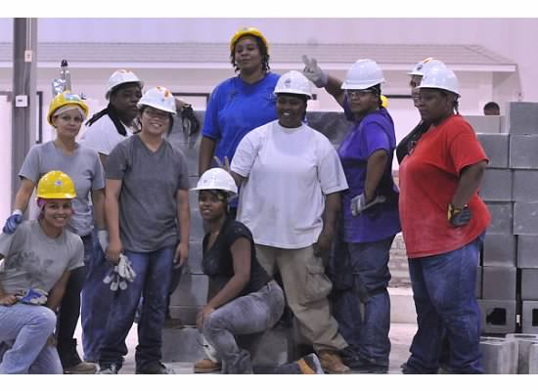
Role Models
Visible women in the industry – Recruiters and Role Models
Female staff and instructors
Large number of women in program

Slide 34
Showcase a Career in the Trades to Women
Marketing Materials
Orientation and Information Sessions
Pre-Apprenticeship Training (women-only)

Slide 35
Marketing Materials
Targeted outreach materials
Use gender neutral language
Include women in pictures & process!

Slide 36
Career Education & Awareness
Provide Industry Information
You Can Do It! A Women’s Guide to Construction Careers
Hands-on Opportunities
Understanding the Differences of Each Craft

Slide 37
Ambassador Program
Tradeswomen as role models
Women and girls “see themselves”
Expand capacity
Increase awareness
Reach more women
Leadership Development for tradeswomen
Engage membership

Slide 38
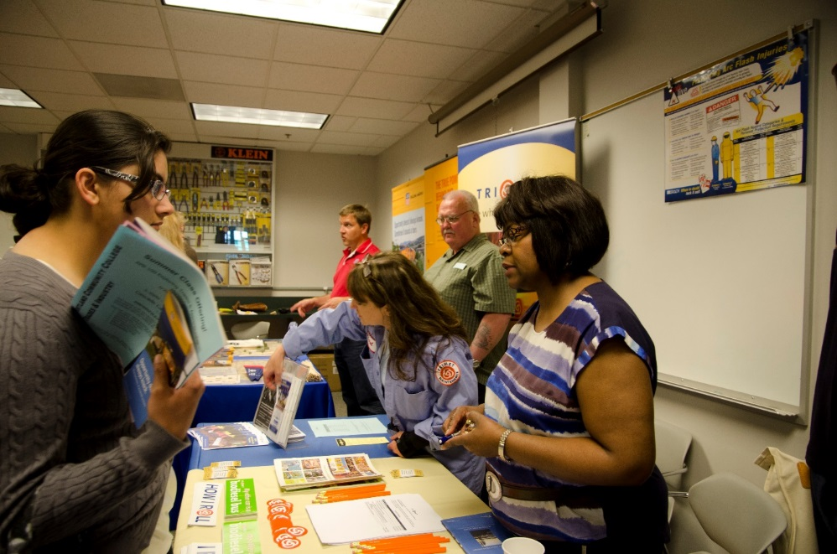
Ambassador Program
Women as Role Models
Promote Registered Apprenticeship and Unions
Support Diversity
Share Stories & Pride

Slide 39
Ambassador Program Training
Expectations
Goals
Benefits of Working in the Industry
Overview of Registered Apprenticeship
Application Process
Selection Criteria
Dress Code
Representing Industry

Slide 40
Career Fair Checklist
Address of Event
Date & Time
Set-up Time at Event
Materials and Hand-outs
Audio/video
Sign-up Sheets
Important Phone Numbers
Follow Up & Feedback

Slide 41
Communication
Registered Apprenticeship call and request volunteer
Tradeswomen confirm availability
Call list if need to cancel or will be late
Provide feedback to program after the event
Turn in paperwork
Promote your trades!

Slide 42
Thank you!
Linda Hannah, Technical Opportunities Director
Chicago Women in Trades
lhannah@cwit2.org
312.942.1444
www.womensequitycenter.org

Slide 43
Questions?

Slide 44
Survey Questions
What other topics would you like to see presented?
Mentoring
Tradeswomen Committees
Pre-apprenticeship Training
Gender Inclusive Curriculum
Sexual Harassment Prevention
EEO Compliance Resources

Slide 45
For More Resources:
For more resources on advancing women in apprenticeship, please visit the U.S. Department of Labor’s Apprenticeship USA website:
https://apprenticeshipusa.workforcegps.org/resources/2017/03/13/10/10/Expanding-Apprenticeship-for-Women

Slide 46
For More Information:
For more information on the WANTO grant,
please contact the U.S. Department of Labor:
Felecia Hart, Project Officer
U.S. Department of Labor
Employment & Training Administration
202-693-3792
Hart.Felecia@dol.gov

