Slide 1
State Apprenticeship Expansion Grants
March 29, 2017
Engaging Youth in Apprenticeship
Employment and Training Administration
Office of Apprenticeship

Slide 3
Amy Young
Senior Program Manager
Maher & Maher

Slide 4
Learn about US DOL’s new Framework on Registered Apprenticeship for High School Students
Hear about two apprenticeship program models for high school students and out-of-school youth
Get answers to your questions on youth apprenticeship

Slide 5
Amy Firestone, Ph.D.
Program Analyst
Office of Apprenticeship
Employment and Training Administration
Jamie Bernthal
Policy Analyst
Wisconsin Department of Workforce Development
Cheryl Feldman
Executive Director
District 1199C Training & Upgrading Fund, NUHHCE AFMSCE

Slide 6
Framework on Registered Apprenticeship for High School Students
Presenter: Amy Firestone, Ph.D.

Slide 7
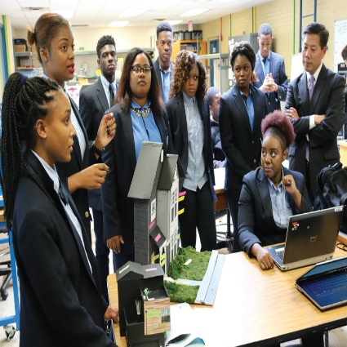
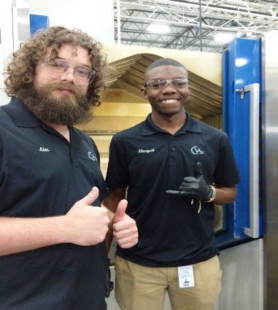
ApprenticeshipUSA

Slide 8
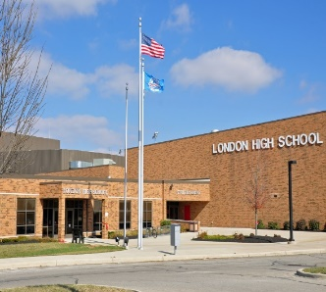
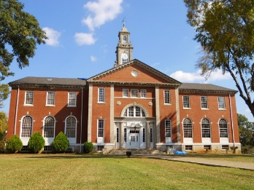
Apprenticeship in High School
Employers
Dual enrollment
High school student
College
High School
College credits and industry credentials
Registered Apprenticeship and CTE

Slide 9
Training and Employment Notice (TEN) 31-16
Framework on Registered Apprenticeship for High School Students
Published January 2017
Outlines the components of a high-quality RA program for high school students.
Provides recommendations on key elements of RA programs
Encourages greater use of RA and pre-apprenticeship programs for in-school youth at least 16 years old, enrolled in secondary schools.
https://wdr.doleta.gov/directives/corr_doc.cfm?docn=4799
http://cte.ed.gov/initiatives/potential-of-apprenticeships-in-secondary-education

Slide 10
Section 5. Elements of quality RA Programs for high school students
Pre-apprenticeship for High School Students or School-to-RA
RA Program that Begins in High School

Slide 11
Section 5. Elements of quality RA Programs for high school students
Pre-apprenticeship for High School Students or School-to-RA
Prepares individuals to enter RA
Courses approved for RA and high school coursework
OJL starting at 16 years old
Earn industry-recognized credentials and certifications
Can apply for RA program leading up to or upon high school graduation
Postsecondary credits available

Slide 12
Section 5. Elements of quality RA Programs for high school students
B. RA Program that Begins in High School
Begin RA in high school as registered apprentices
RA agreements signed by a parent/guardian, students, and employer/sponsor
Students take courses at high school, community/tech college, etc.. Courses count toward high school graduation.
Postsecondary credits may be awarded
Students start OJL at age 16
Students are employed by a participating signatory partner to the RA Guideline Standards
Enrollment in a RA program may begin in high school and continue after graduation.
Students may earn industry-recognized credentials

Slide 13
TEN Attachments
Attachment I: Guide on Child Labor Laws and Workers’ Compensation for Apprentice Minors

Slide 14
TEN Attachments
Attachment II: Workers’ Compensation for apprentices under age 18

Slide 15
USDOL: New Tools and Convening
Online toolkit on how to build a youth apprenticeship program
Step-by-step instructions
Videos
Information on child labor laws and workers’ compensation
High School Apprenticeship Convening
September 13 and 14
Trident Technical College, Charleston, South Carolina

Slide 16
Wisconsin Youth Apprenticeship
Jamie Bernthal
Policy Analyst – State of Wisconsin

Slide 17
YA Program Overview
Statewide paid work experience program
Standardized two-year program with one-year option
Combines academic and technical instruction with mentored on-the-job training
900 hours work-based learning and 360 hours classroom instruction (450 and 180 for one-year option)
Receives Certificate of Occupational Proficiency upon completion

Slide 18
YA History
Start-Up Funding:
General Purpose Revenue (GPR) funds for administration:
WI Act 39 created in 1991
School-to-Work Opportunities Act:
Investment Capitol
Wisconsin Act 9:
Local YA Grants Begin
Program Operation and Grant Funds

Slide 19
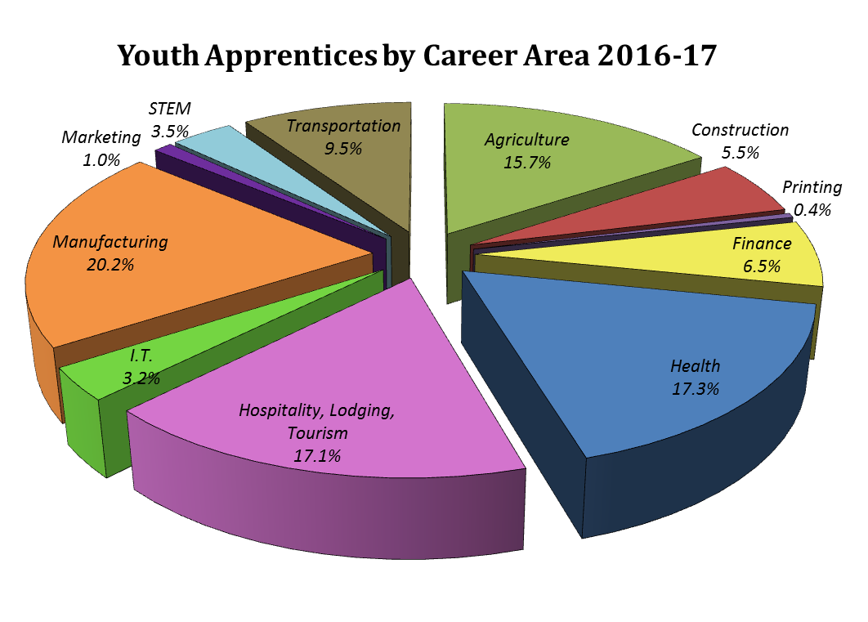
YA Participation
2016-17 Year:
YA Enrollees: 3,377
Employers: 2,145
Consortia: 32
Average Wage: $9.70
Completion Rate: 83%
State cost: Less than $900 per student served

Slide 20
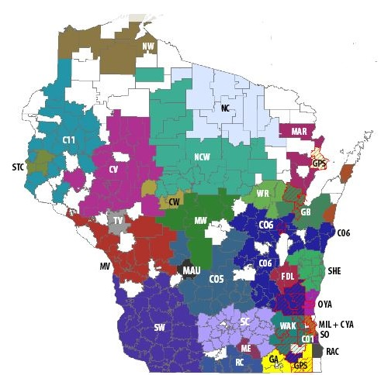
YA Program Implementation
YA Regional Consortiums:
WI is divided into 32 YA consortiums
Each consortium has a YA Regional Coordinator and a Steering Committee
Regional Coordinator typically recruits businesses, is employed outside of school district

Slide 21
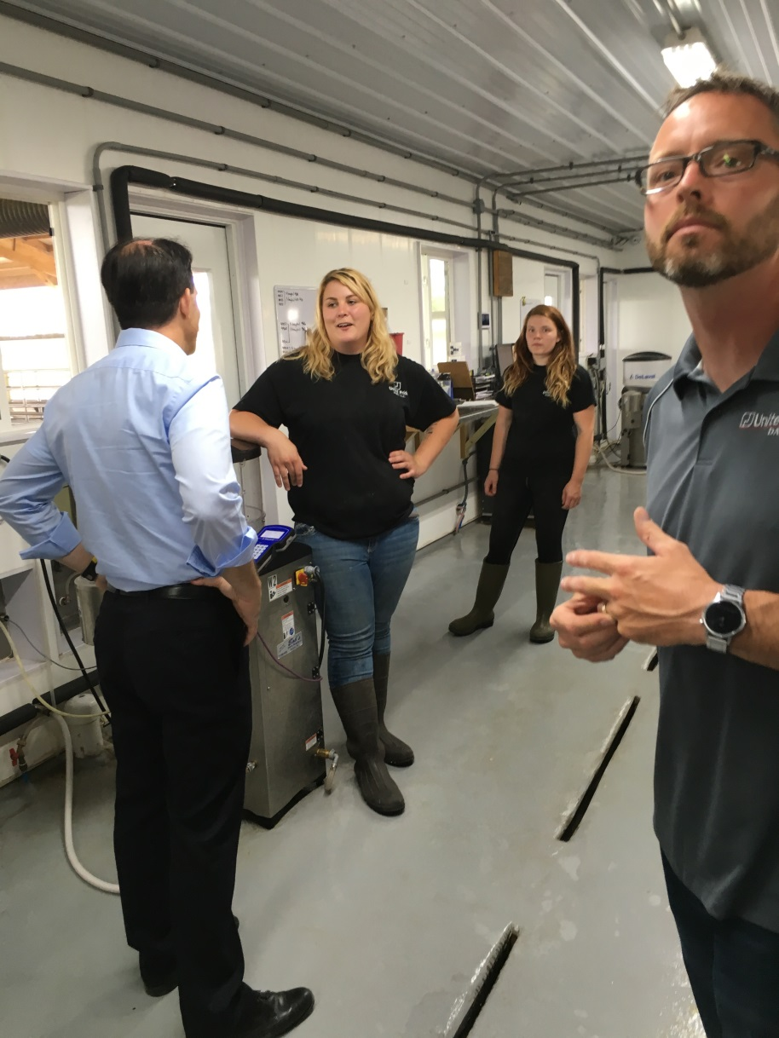
YA Program Implementation, continued…
Participating School Districts:
271 school districts participate
324 high schools participate
On-site teacher/staff coordinator
Advantages of Localized Model:
Responsive to local economy
Selects appropriate education
Reduces administrative costs
Picture: Wisconsin Governor Scott Walker meets with YA students working at a dairy.

Slide 22
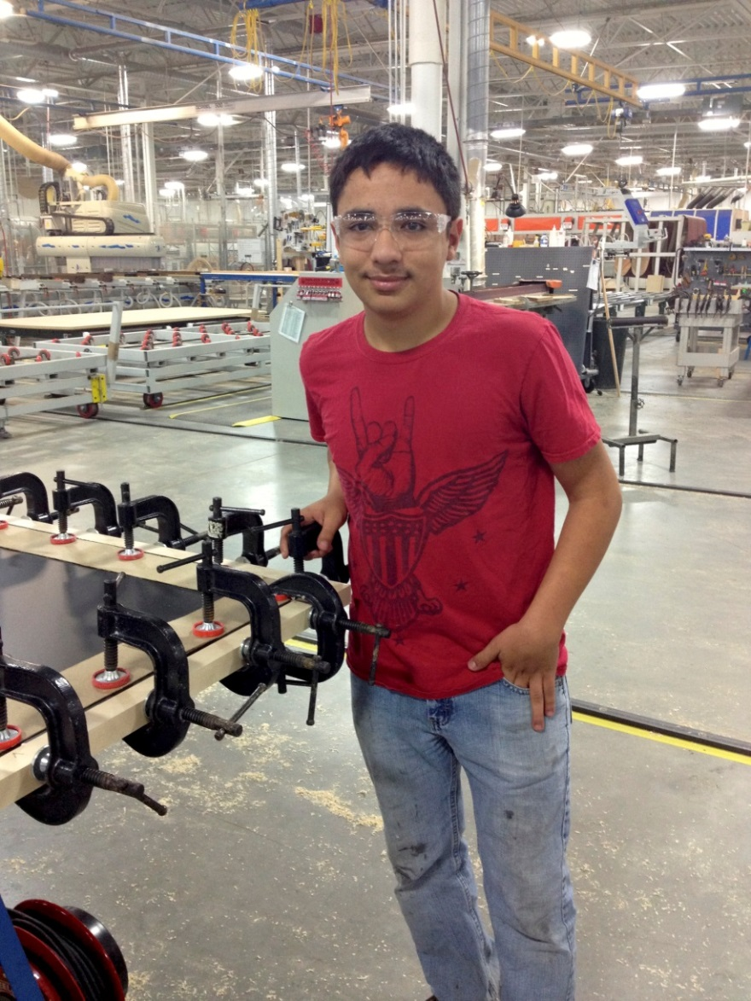
Program Design: Standardized Skill Competencies
Developed by industry
Standardized statewide
Links to RA!
Simultaneous work/learning:
Learning Objectives show student knowledge
Worksite Competencies show student skills/abilities
Flexible instruction delivery

Slide 23
Wisconsin YA to RA Bridge
YA
RA
High school juniors and seniors
450-900 hours of work-based learning
Two semesters per year of related instruction
Competencies defined and assessed
Gives broad overview of industry
Adult workers (average age 28)
2,000 – 10,000 hours of work-based learning
144 hours per year of related instruction
Competencies defined and assessed
Gives thorough knowledge of occupation

Slide 24
Starting a YA program
Assess the local climate
Recruit industry support
Develop statewide standards
Design a program for the local community
Utilize existing community organizations
Find appropriate classroom instruction
Train instructors and workplace mentors
Recruit and select students
Note: start-up costs are significant!

Slide 25
Questions?
Youth Apprenticeship Coordinators
ya@dwd.wisconsin.gov http://ya.wi.gov

Slide 26
BUILDING HEALTH & HUMAN SERVICES APPRENTICESHIP PROGRAMS FOR
YOUNG ADULTS
Cheryl Feldman
Executive Director
District 1199C Training & Upgrading Fund, NUHHCE AFMSCE
Philadelphia, PA

Slide 27
BACKGROUND
42 year-old Labor Management Partnership, includes 50 Delaware Valley healthcare employers
Serving incumbent workers and community residents with health and human services career pathway programs:
Nursing
Behavioral Health
Health Information Technology
Allied health
Community health
Hospitality
Early childhood education

Slide 28
YOUNG ADULT PROGRAMS
Programs offered for in- and out-of-school young adults
Out-of-school pathways include:
GED® to College
Post-Secondary Education
Nurse Aide
Occupational Training
Employment &/or further training
Behavioral Health Pre-Apprenticeship
Registered Apprenticeship

Slide 29
1199C YOUNG ADULT PROGRAM MODEL
<< SUPPORTIVE COUNSELING & FINANCIAL COACHING >>
JOB PLACEMENT
<< INTEGRATED ACADEMIC & CAREER READINESS SKILLS >>
CONTEXTUAL
OCCUPATIONAL
BRIDGE CLASS
PRE-APPRENTICESHIP
& TECHNICAL
TRAINING
RETENTION SUPPORT &
NEXT STEPS ON CAREER PATHWAY
TARGETED
OUTREACH &
RECRUITMENT
“myPLACE”
ASSESSMENT & ORIENTATION
REGISTERED APPRENTICESHIP
<<ONGOING EMPLOYER ENGAGEMENT>>
COLLEGE & OTHER POST-SECONDARY
PBL / WBL:
BLENDED CLASSROOM & WORKPLACE PROJECT ASSIGNMENTS
STRUCTURE, SUPERVISED INTERNSHIP EXPERIENCES
JOB SHADOWING

Slide 30
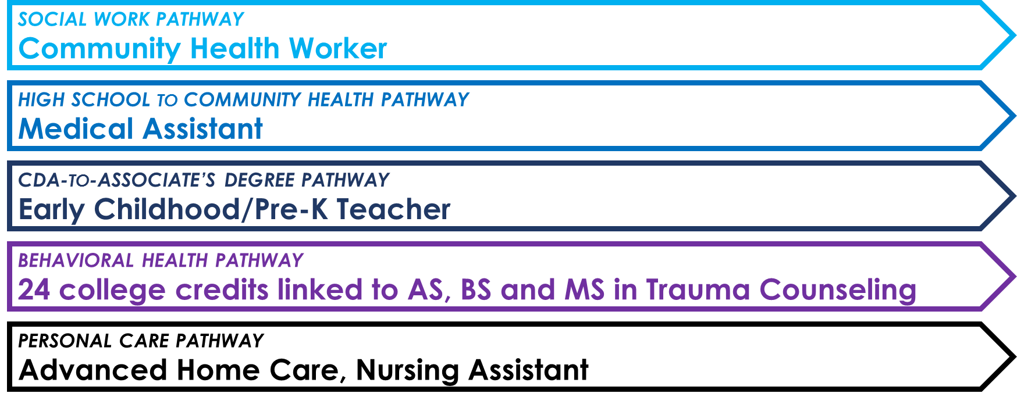
WORKING WITH EMPLOYER PARTNERS
Building healthcare apprenticeship programming with our employer partners:
In Process: Young Adult Nursing Assistant Apprenticeship (partnership with hospital employers)

Slide 31
PRE-APPRENTICESHIP: Behavioral Health
SCREENING:
Assessment, Orientation,
Industry Exposure
BRIDGE:
Integrated Academic &
Industry Readiness
4 weeks
PRE-APPRENTICESHIP:
Occupational Preparation with Work-Based Learning Experience
6 weeks
REGISTERED APPRENTICESHIP IN BEHAVIORAL HEALTH:
POST-SECONDARY: 300 hours classroom instruction
+3-credit Philadelphia University course resulting in 24-credit transcript award
ON-THE-JOB LEARNING: Minimum 2,000 supervised hours at participating employer
Approximately 1 year
NEXT STEPS:
Philadelphia University Associate’s Degree in Health & Human Services

Slide 32
KEY STRATEGIES:
Upfront employer buy-in
Understanding industry/occupational competencies
Connecting classroom and on-the-job learning outcomes to credentialing and college credit/degree pathways
Connecting upfront assessment and work/college readiness design to learning outcomes
Selecting, training, and supporting mentors; providing them with good assessment tools
Counseling support for Apprentices
Administrative support and TA for employers

Slide 33
Success Story: BRITTANY SPIVEY
Brittany obtained her GED® in June 2016 from the Training Fund’s GED to College Program, funded by Philadelphia Youth Network and Philadelphia Works. In October, Brittany enrolled in our Nurse Aide Program for young adults between the ages of 17-24. Students in this program are dually enrolled in a LISC-supported Bridges to Career Opportunities program. Brittany excelled in her coursework, completing her Nurse Aide and CPR/First Aid certifications. After succeeding in both programs, she enrolled in classes at Community College of Philadelphia in January to become a sonographer.
While at the Training Fund, Brittany participated in a clinical job shadowing experience at a nursing home, met with several employers at regional hospitals,
and toured local colleges and universities. She met with an employment coach for support with résumé development and interviewing skills, and a financial coach for assistance in getting her own apartment. In order for to be accepted into subsidized housing with the Women's Community Revitalization Project, she had to interview with multiple staff, provide financial statements, and provide documentation of her budget/goals. Brittany was able to do all this with the help of program staff, and moved into a brand-new two-bedroom apartment with her daughter on October 1st. Brittany's long term goal is to work in a hospital setting and become a motivational speaker about her experience as a survivor of domestic violence.

Slide 35
Youth Apprenticeship Resource Page
ApprenticeshipUSA Community of Practice!
https://apprenticeshipusa.workforcegps.org/sitecore/content/sites/_21stcenturyapprenticeship/resources/2017/02/02/10/56/Apprenticeship-Youth
Framework on Registered Apprenticeship for High School Students
Training and Employment Notice No. 31-16
https://wdr.doleta.gov/directives/corr_doc.cfm?DOCN=4799
Role of Secondary CTE Programs in Preparing Students for Apprenticeship Programs
Perkins Collaborative Resource Network
http://cte.ed.gov/initiatives/potential-of-apprenticeships-in-secondary-education

Slide 36
Amy Firestone, Ph.D. Program Analyst Office of Apprenticeship U.S. Department of Labor – ETA Firestone.amy@dol.gov 202-693-3998 | Jamie Bernthal Youth Apprenticeship Coordinator Wisconsin Department of Workforce Development ya@dwd.wisconsin.gov 608-267-7210
Amy Young Senior Program Manager Maher & Maher ayoung@mahernet.com 732-918-8000 | Cheryl Feldman Executive Director District 1199C Training & Upgrading Fund cfeldman@1199ctraining.org 215-568-2220, ext. 5101

