Slide 1
Grantee Polling Question
Let’s get to know who is on the call today. Using the poll, select the role that you play in your TechHire grant
Choose the answer that best reflects you (or your group):
Authorized representative
Program director/manager
IT/data manager or staff
Training partner
5. Employer partner
6. Service provider
7. Other (please specify!)

Slide 2
H-1B TechHire Grants Recruiting and Outreach Technical Assistance Webinar
Building Strong Partnerships For Effective OutReach and Recruitment
Jobs for the Future
For U.S. DOL

Slide 4
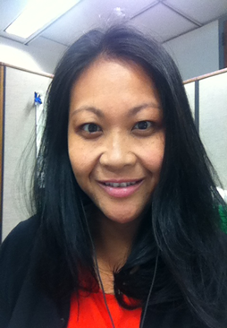
Ayreen Cadwallader
Department of Labor Employment and Training Administration
Division of Strategic Investments
____________________________________________________
Workforce Analyst
U.S. Department of Labor, Employment and Training Administration
Danielle
Kittrell
Workforce Analyst
U.S. Department of Labor, Employment and Training Administration

Slide 5
Terry Grobe
Director
Jobs for the Future
Lucretia Murphy, JD, PhD
Senior Director
Jobs for the Future

Slide 6
Sara Lamback
Senior Program Manager
Jobs for the Future
TechHire Grantee Spotlight Michelle Schultz
Programs Director
CareerSource Tampa Bay

Slide 7
Highlight actionable strategies to meet TechHire outreach and recruitment goals, with a focus on youth and young adults
Identify how the strategies presented for youth and young adults are similar to and different from those for other TechHire target populations
Interact with both expert practitioners and fellow grantees on what works (and doesn’t) for recruitment of specific TechHire target populations

Slide 8
1:00 | Introduction
1:10 | Strategies for recruiting TechHire target populations, including:
Youth and young adults ages 17 to 29
Individuals with limited English proficiency, individuals with criminal records, and individuals with disabilities
Individuals who are unemployed, dislocated, underemployed, and incumbent workers
1:25 | Grantee spotlight: CareerSource Tampa Bay
1:30 | Breakout group discussion
1:45 | Reports out and Q&A
2:00 | Closing and next steps

Slide 9
Grantee Question
What is the biggest challenge or question your project faces, related to outreach and recruiting?
Choose the answer that best reflects you (or your group):
Please type your response into the chat box!

Slide 10
Key Strategies to Support TechHire Recruitment and Engagement
Terry Grobe Director, Jobs for the Future

Slide 11
A Strategic Approach to Recruitment
Identify the ideal candidate
Identify relevant strategic partners for recruitment
Build and maintain these strategic partnerships
Utilize a multifaceted approach to recruitment
Consider best practices—what typically works for the target population?

Slide 12
Identify the “Ideal” Candidate
Determine the ideal candidate with your design team
Identify who is most likely to benefit from the program
Consider who may need additional support to be ready
Specify requirements as you outreach to partners
Test hypotheses during your first program cycles

Slide 13
Identify the “Ideal” Candidate (Cont’d)
Source: College, Career & Technology Academy Toolkit. Jobs for the Future.

Slide 14
Identify strategic partners
Potential partners may include:
Youth and young adults:
Public schools, alternative schools, social workers
Additional Key Partners: Goodwill Workforce Solutions, Education and Training Providers: University of Maine System, University of Maine Augusta, Maine Community College System, Husson College, Thomas College, University of New England (Grantee: Coastal Communities Workforce, Inc.)
Individuals with criminal records:
Missouri State Department of Corrections, Taskforce, Common Ground Foundation, Division of Adult Institutions, Great Circle, Job Finders, Missouri River Regional Library, Missouri Division of Vocational Rehabilitation, Project Homelessness Taskforce, Right Turn Reentry, St. Raymond's Society, United Way (supportive services) (Grantee: State Tech College of Missouri)
Other community-based organization (CBO) system staff, probation officers
Individuals with limited English proficiency:
Indiana Adult Education, Su Casa Columbus, Cummins GOAL—the Latino Affinity Group of Southern Indiana, Cummins Latino and Community Outreach, Sacoma, Faurecia, and other community-based organization system staff (Indiana AFL–CIO Labor Institute for Training)

Slide 15
Identify strategic partners
Potential partners may include:
Individuals with disabilities:
Bakersfield Adult School (Education Partner) Valley Achievement Center (Training / Service-Provider Partner); UCLA Extension—Bakersfield (Training/Education Partner) (Grantee: Exceptional Family Center)
Vocational rehabilitation agencies, local CBOs
Cross-population partners may include:
Regional partnerships
Collective impact efforts centered on similar youth populations

Slide 16
Build and Maintain Partnerships
Conduct outreach to develop working partnerships; this may include:
Regular face-to-face briefings
Clear written communication on who is or is not a good candidate for the program
Ongoing communication and follow-up:
Stay in close touch with partners

Slide 17
A Multifaceted Approach to Recruitment
Specific recruitment strategies include:
Utilize a variety of social media
Use both unconventional outreach methods and established methods that have proven effective (e.g., reengagement centers, outreach workers)
Construct powerful, intriguing outreach materials
Don’t just adapt from materials for adults/partner organizations
Differentiate your message for different populations
Strategies for recruiting individuals with LEP, individuals with disabilities, and individuals with prior records

Slide 18
Sample Outreach Materials

Slide 19
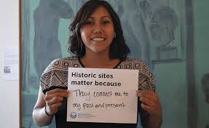
Take Advantage of Social Media
Engage potential participants through a twitter campaign or on Instagram
Use (relevant) existing hashtags or create a new one that is pertinent
Encourage participants themselves to generate content (e.g., blogs, Instagram posts, Snapchat) to support outreach and recruitment
Consider paid placement to reach certain audiences (i.e., lead capture)
Use planned twitter chats or job/career centric twitter chat
#MyClassroom Campaign

Slide 20
Prince George’s County SYEP Flyer
Developed for partners and system leads
Provides general information and contacts to learn more
May not be designed for direct service or youth

Slide 21
Next Generation Youth Program Flyer
Designed with young people in mind
Uses creative messaging and graphics
Provides sufficient detail to interest young people or direct service staff

Slide 22
Practical Tools and Resources
Practical tools and resources to aid in developing a recruiting strategy:
Recruitment toolkit
PSJA College, Career & Technology Academy model
PSJA College, Career & Technology Academy Flyer

Slide 23
Grantee Polling Question
Which recruitment strategy have you found to be most effective for your TechHire program to date?
Choose the answer that best reflects you (or your group):
Word of mouth
Printed collateral
Social media
Strategic partnerships
Other (please describe)

Slide 24
What Works and What Doesn’t
Lessons from the Field

Slide 25
Example 1: Youth and Young Adults
Lessons for working with youth and young adults
Youth need to be ready
Partners need care and “feeding," including updates on those whom they refer
Partners appreciate if you can refer youth who aren’t ready to on-ramp programs
Engage participants in partner meetings to jump-start recruitment
Personal contact is often the most effective recruitment strategy

Slide 26
Example 2: Crafting your message for the Adult Population
Partner with organizations that can provide referrals (e.g., social service agencies and organizations, churches, neighborhood organizations, schools)
Utilize multiple media channels like Internet, radio, and print, and work with a diverse range of publications (e.g., newsletters targeting African American communities, veterans, etc.)
Ensure that materials are clear and understandable for a range of reading levels
Train staff throughout the organization to serve as recruiters and support outreach efforts
Support peer outreach through stipends, part-time position, or internships

Slide 27
Example 3: Individuals with Criminal Records
Avoid recruitment strategies that would require people to self-disclose publicly
Build partnerships with organizations in the criminal justice sector for referrals
Work with corrections facilities to disseminate information as part of the transition planning
Identify staff to follow up on outreach upon an individual’s release

Slide 28
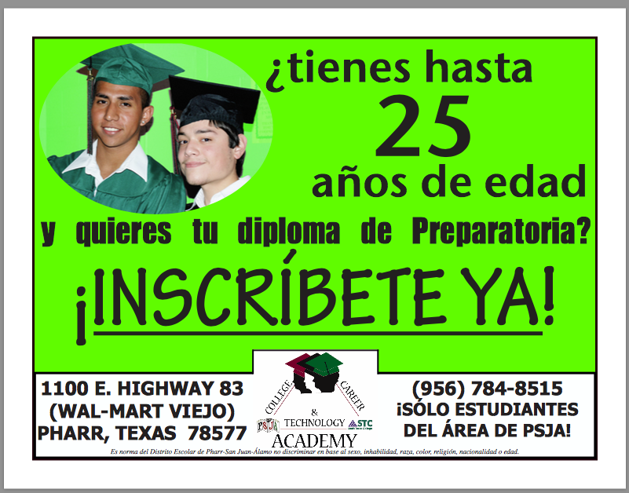
Example 4: Individuals with Disabilities and Individuals with LEP
Individuals with Disabilities
Use fully accessible online program applications and electronic and social media recruitment materials.
Post program information on sites designed for people with disabilities, in disability-related publications and with disability organizations will increase the diversity of the applicant pool
Connect with Internship Programs designed specifically for people with disabilities: these are another effective and cost efficient recruitment strategy (Source: Society for Human Resource Management)
Individuals with LEP
Translate materials in the languages relevant for your catchment area
Hire bilingual staff to support recruitment goals
Partner with training providers that offer English instruction
Identify community champions to support outreach and recruitment efforts
When possible, have students recommend peers for the program.
Source: College, Career & Technology Academy Toolkit. Jobs for the Future.

Slide 29
Grantee Polling Question
Based upon what you’ve heard, what are some new ideas you may be able to apply in your TechHire project?
Please type your response in the chat box!

Slide 30
TechHire Grantee Spotlight
CareerSource Tampa Bay

Slide 31
Example 4: TechHire Target Populations
Overview of CareerSource Tampa Bay’s TechHire program
Outreach and recruitment strategies for youth and young adults and incumbent workers:
Know your audience
Utilize research and resources
Consider a dedicated staffer to lead program outreach and recruitment
Develop creative outreach and recruitment approaches
Advance partnerships and employer engagement

Slide 32
Breakout groups

Slide 33
Discussion
Small group discussion, based on grantee target population. Grantees serving:
Youth and young adults (ages 17 to 24)
Young adults (ages 25 to 29)
Special populations (individuals with limited English proficiency, individuals with disabilities, individuals with criminal records)
Discussion Questions:
1.) What information from today's webinar stuck out to you? Is there anything you plan to implement in your respective programs?
2.) Which recruitment strategies are you currently using? Are they effective?
3.) What are some best practices for accessing your program target population?
4.) What questions do you have for the group and/or speakers?

Slide 35
Upcoming TechHire TA Activities
May
May/June: grantee needs assessment
June
Monthly coaching call
Performance reporting webinar (date TBD)
Launch of online TechHire community of practice
Peer learning call (date TBD)

Slide 36
TechHire Grantee Mailbox TechHire@dol.gov To Reach your Federal Project Officer, DOL National Office, and Technical Assistance Providers

Slide 37
Post Webinar Feedback
Thank you for participating in the H-1B TechHire: Recruiting and Outreach Technical Assistance: Building Strong Partnerships For Effective Outreach and Recruitment
Please take a minute to complete this brief poll regarding the Webinar on today May, 25, 2017.
The input you provide will help us better the delivery of future webinars and create technical assistance meaningful for your work.

