Slide 1
TAACCCT Performance Reporting
Q&A:
.
May Topic: Exit Scenarios for Reporting Outcomes Across Multiple Years
U.S. Department of Labor
Employment & Training Administration
May 25, 2017

Slide 2
Presenters
Kristen Milstead, Presenter
  Staff Lead for Performance, TAACCCT Grants
Scott Estrada, Presenter
  Performance Specialist, Maher & Maher, TAACCCT Grants

Slide 3
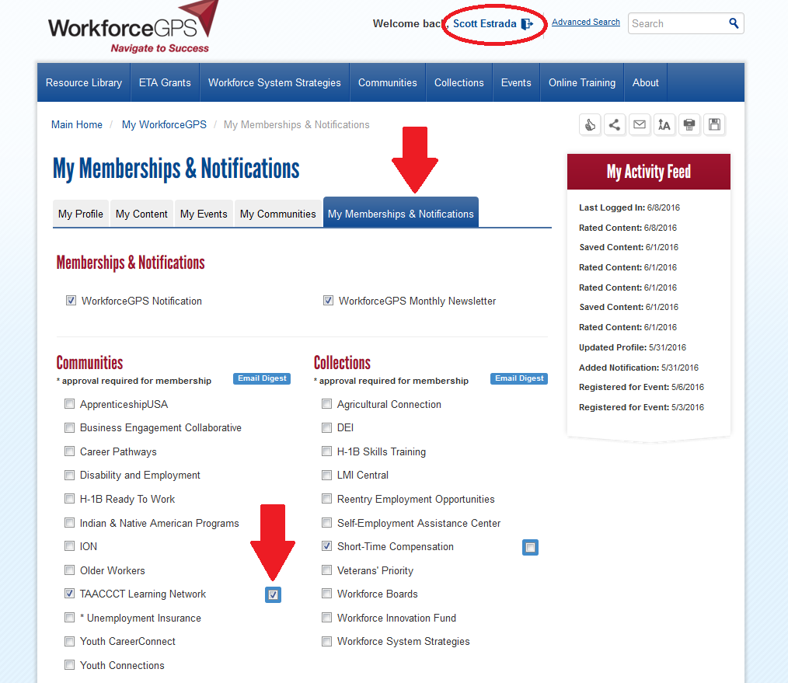
Sign up for the TAACCCT Weekly Digest

Slide 4
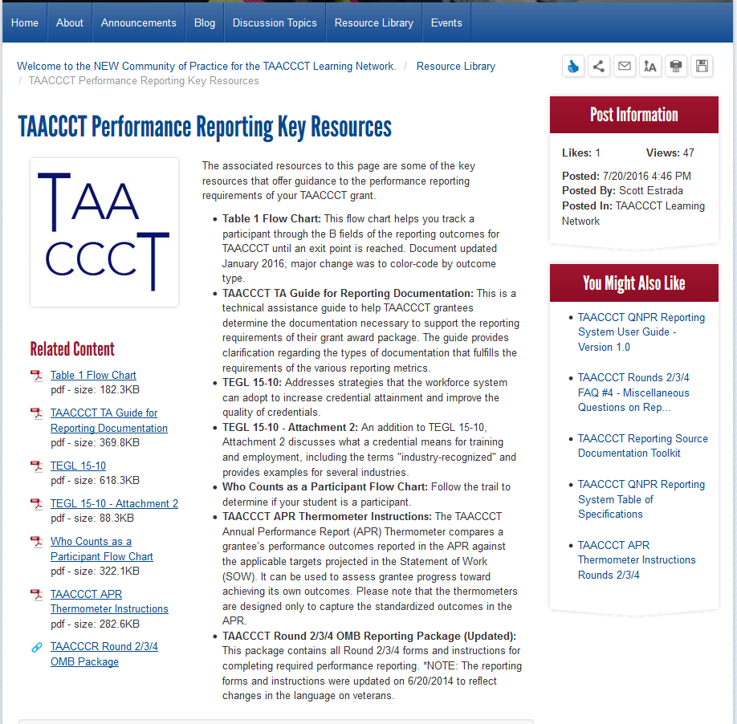
TAACCCT Performance Reporting Key Resources

Slide 5


Reminder
Data Validation Corrections past due: May 19
If you received an E-mail indicating that you have corrections to make, please check your records and contact us to open the relevant reports
NOTE: Some grantees only received letters reminding them that data should be reporting annually and not cumulatively
Please contact us at taaccct@dol.gov if you have any questions

Slide 6
Today’s Agenda
Questions From You
Today’s Special Topic:
  A Deeper Dive into Completion and Exit
  Exit Scenarios for Counting Outcomes
Open Question Period

Slide 7
Question #1: B4
If a participant attends a TAACCCT grant funded program in Year 2, and then enrolls in a non-grant funded program in that same year, their status is reported in B.4 in the Year 2 APR. Do we stop reporting this status after the Year 2 APR?

Slide 8
Response #1
Yes*
B.4 is a reporting “exit point” for tracking purposes
  They only belong in B.4 if they didn’t complete a TAACCCT program
  If they don’t complete a program, there is nothing further to track down the road
  Can’t be re-enrolled later as a unique participant
*With the exception of B.10, if the participant is an incumbent worker!

Slide 9
Question #2
Re: different scenario, the same participant from previous question
What if they remain in the non-grant funded program throughout Year 3? Is their status counted again in B.4 in the Year 3 APR?

Slide 10
Response #2
No*
Because B.4 is a reporting “exit point,” you would not even need to track their school status for TAACCCT anymore in Year Three
*NOTE: If the participant is an incumbent worker, you would still track whether they received a wage increase (B.10)!

Slide 11
Question #3: Program Activities Extension
If an unemployed participant completes a program and exits the institution in May 2018 (e.g., they graduated with a degree), and enters employment in July 2018, their post-March 2018 data cannot be counted in B.2-B.6, but can their employment data be counted in the B.8 Entered Employment performance outcome?

Slide 12
Response #3
Yes!
The completion date is not relevant to triggering follow-up outcome status
As long as the participant completed at least one program that was paid for with TAACCCT funds, they can be counted in B.8, if applicable
Pay attention to the exit date, which starts the clock for tracking follow-up outcomes

Slide 13
Question #4:
Wage Increase for Incumbent Workers (B.10)
Does an incumbent worker have to complete a program before they can be counted as having received a wage increase? Do they have to exit the institution to be counted?

Slide 14
Response #4
No, neither!
  An incumbent worker only needs to enroll in a TAACCCT-funded program to be counted in B.10, not complete a program or exit the institution
Incumbent workers sometimes enroll in individual courses to enhance their skills, resulting in an event that leads to a wage increase
  B.10 is an opportunity to capture this!

Slide 15
Question #5:
Counting Credit Hours (B.10)
May we count all credit hours that the participants have earned if they are working towards their Associate’s Degree that is a TAACCCT funded program? Or do we only count the IN classes that were funded through the grant?

Slide 16
Response #5
Only count credits from courses that are specifically touched by grant-funds
Although this was specified in the original OMB package, the language was ambiguous
  Updated OMB package revised 8/8/2016 clarifies this

Slide 17
Understanding Completion and Exit
A Deeper Dive

Slide 18
Exit and TAACCCT
Understanding how to count many of the outcomes requires the realization that a participant’s exit may or may not coincide with completion of a “program of study”

Slide 19

What is a Program of Study?
When all of the credit hours required for the first certificate or degree are completed, a participant is considered a completer
Even if participants remain at the institution to enroll in additional certificate or degree programs
    Examples: latticed or stackable credentials

Slide 20

The First Rung on the Ladder
  1st certificate/degree attained = completer

Slide 21
When Does Exit Actually Occur?
When a participant is no longer enrolled at the college
In any program of study
Includes formal withdrawal, expulsion, graduation and other reasons

Slide 22
What are “Other Reasons?”
DOL does not define for institutions any or all of the other reasons a student may exit or an institution may decide to “exit” a participant
A reason your institution will likely need to exit a participant for reporting purposes is if they “ghost” (disappear)

Slide 23

How Do You Know When to “Exit” Disappearing Participants?
Develop a formal written policy
Apply to all TAACCCT participants equally?
May use institutional policy (if it exists)

Slide 24
Things to Note about Your “Exit Policy”
Your exit policy starts the clock for counting follow-up outcomes that may apply
      Once you exit a participant, if he or she returns, you cannot count:
          That student as a new participant
          Any additional credits or credentials they earn

Slide 25

Exit Scenarios for
Counting Outcomes

Slide 26

Exit Without Completion
Yes
If still enrolled
in subsequent years until year of exit
If any credits are earned before exit
If participant is an incumbent worker and receives a wage increase

Slide 27
Simultaneous Completion and Exit
Yes
Yes
If credential not obtained until in a year after the first one until year of exit
Yes
Yes; B.6 and either B.6a, B.6b or B.6c
Yes, after exit, if applicable, and occurs in time prior to entering employment
If participant is an incumbent worker and receives a wage increase
Yes, if occurs during first quarter after exit and occurs first in time prior to going on to further education*
Yes, for those entering employment who retained it in second and third quarters after exit*
*Non-incumbent workers only

Slide 28
When Completion and Exit Occur at Different Times and are Not Simultaneous
Yes
Yes
If credential not obtained until in a year after the first one until year of exit
Yes
Yes
ONE TIME in B.6;
ONLY ONE TIME in each of B.6a, B.6b and B.6c, as applicable
Yes, after exit, and occurs in time prior to entering employment, if applicable
If participant is an incumbent worker and receives a wage increase
Yes, if occurs after completion but before last day of first quarter after exit and occurs first in time prior to going on to
further education*
Yes, for those entering employment who retained it in second and third quarters after exit*
*Non-incumbent workers only

Slide 29
Six Month Extension of Program Activities: Completion and Exit
Completion must occur within the program activities extension in order to be counted
Exit does not have to occur within the program activities extension
    Exit is not an outcome; it only triggers follow-up outcomes
    Follow-up tracking is the purpose of the last six months of your grant period

Slide 30
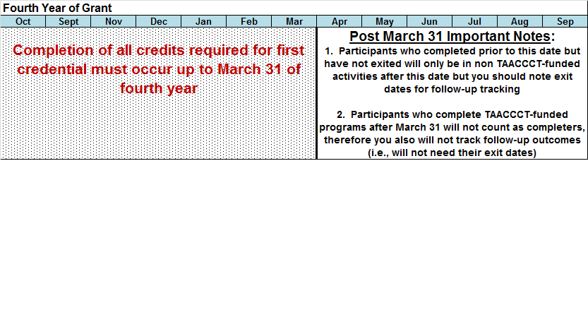
Timing and Triggering Follow-Up Outcomes During the Fourth Year

Slide 31

Questions?

Slide 32
Poll question:
Which performance-related topics would you like to see a short presentation on in a future monthly Webinar?
Type your answer into the chat box. Please choose the topic you would like to see the most even if you have more than one.

Slide 33
Knowledge Check #1
When should you count a participant as a completer?
When he or she completes their first course in a program of study
When all of the credit hours required for the first credential are completed
When he or she completes their first program of study and exits the institution
When he or she completes all of the programs of study at the institution they intended to complete
A participant is a completer for TAACCCT reporting purposes according to a policy set by your own institution

Slide 34
Knowledge Check #2
Which of the following is not true about exit?
Completion and exit can occur either at the same time or at different times
The reasons a participant is considered an exiter are formal withdrawal, expulsion, graduation or other reasons
If a participant exits the institution and re-enrolls, he or she can count again as a participant
Exit policies should be applied equally to all participants

Slide 35
Knowledge Check #3
Grantees must get approval from DOL for a policy that falls into the “other reasons” category.
          TRUE
          FALSE

Slide 36
UPCOMING WEBINAR
Next Month’s TAACCCT Performance Reporting Q&A
Topic to be announced!
June 29, 2017*** 3:00 pm EST

Slide 37
Send performance-related questions to the TAACCCT mailbox (taaccct@dol.gov)
by June 21, 2017
for guaranteed inclusion

Slide 38
Thank you
for attending!

