Slide 1
Region I Case Counselor Training
Four indicators
of effective
service delivery
ETA Region I

Slide 3
Kate Banimenia (McLaughlin)
Workforce Development Specialist
ETA Region 1
U. S. Department of Labor
Boston, MA
Benjamin Kushner
Workforce Analyst
Independent Consultant: Jobs for the Future
Los Angeles, CA
Benjaminkushner.com
John Sousa
Program Manager
Bristol County Career Centers
Fall River, Massachusetts

Slide 4
Learn about four indicators of effective service delivery
Keeping Precise and Effective Case Notes
Understanding the Different Career Service Options
Improving Time Management
Knowing What Employers Want
Preview training modules, teaching aids, and quizzes
Consider certification for front line staff

Slide 5
Case Counselor Training

Slide 6
Case Counselor Training Associated Materials

Slide 7
Case Counselor Training
Keeping precise
and effective case notes

Slide 8
Put Yourself in the Reader’s Place
Case Notes are Shared Data: Identify yourself!
Write for the reader:
Will these case notes be understood?
Is customer’s status clear?
Are next steps, assignments, objectives documented?

Slide 9
Clear, Understandable, Language
Writing should be clear and understandable
Common English vocabulary
Acceptable and unacceptable acronyms
9

Slide 10
What’s Your Opinion? (Keep it Objective)
Think intuitively
Write objectively
Be explicit
Write professionally
10

Slide 11
When Should We Capture Case Notes?
Immediately after the interview
Very soon after the interview
Before starting another significant activity
Before leaving the office for the day

Slide 12
Capturing Follow-Up Case Notes (not intake)
What is the practice at your Center?
Choose the answer that best reflects you (or your group):
Type while the customer is being interviewed
Hand-write on a pad and transfer the notes within 24 hours after customer leaves
Longer timeframe than 24 hours (please specify)
Not applicable or unable to respond

Slide 13
Telling Your Customer’s Story

Slide 14
Case Note Elements
Customer Situation or Background
Reason for Visit
Goal Setting & Achievement
Progress
Next Steps & New Goals
Case Closing

Slide 15
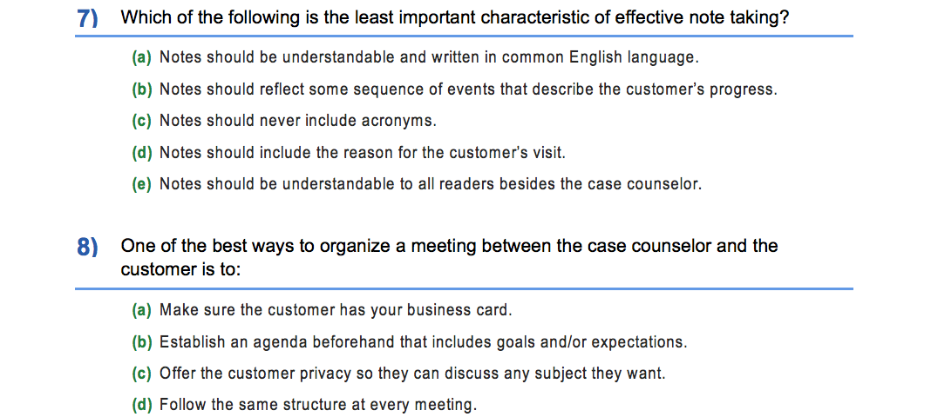
Case Notes Quiz
Quiz to measure front line staff understanding of the content
Could lead to the issuance of a certificate
Excerpt:

Slide 16
Case Note Teaching Aid
Includes group exercise for larger trainee group
Includes examples of case note entries
Excerpt:

Slide 17
Case Counselor Training
understanding basic, individualized and follow-up career services

Slide 18
Lighting Round: Career Services 1
In your Center, can self-service customers receive Individualized Career Services?
Choose the answer that best reflects you (or your group):
Yes, they can receive both basic and individualized services.
No, customers receiving Individualized Career Services must be enrolled and receive staff-assisted services.
Not applicable or unable to respond
Other answer (please use chat feature)

Slide 19
Lightning Round: Career Services 2
In your Center, if a customer needs their aptitude or interest assessment interpreted by someone, are they considered a “staff-assisted” customer?
Choose the answer that best reflects you (or your group):
Yes
No
It depends upon the extent of the interpretation
Not applicable or unable to respond
Another answer (please use chat feature)

Slide 20
Lightning Round: Career Services 3
In your Center, do you offer any workshops for non-enrolled customers such as how to independently conduct career exploration or job search?
Choose the answer that best reflects you (or your group):
All workshops (except Orientation) are exclusively for enrolled customers
Some workshops are mixed with enrolled, non-enrolled, self-service and staff-assisted customers
Not applicable or unable to respond
Other answer (please use chat feature)

Slide 21
Lightning Round: Career Services 4
In your Center, what is the typical size of a Case Counselor’s caseload?
Choose the answer that best reflects you (or your group):
Less than 50 customers
Between 51 and 100 customers
Between 101 and 200 customers
More than 200 customers
Not applicable or unable to respond
Other answer (please use chat feature)

Slide 22
Self-service customers
Receiving minimal Basic Career Services
Independent self-assessment and interpretation
Reportable Individuals, not enrolled
Independent job searcher
Qualified, job-ready, no skills gap

Slide 23
Staff-assisted customers
Receive Basic or Individualized Career Services
May require training or education to move along their career pathway
May have a barrier or skills gap that needs attention
Enrolled, tracked, “Participant”

Slide 24
Service Integration: How To
Case Management
No Wrong Door Policy
Cross Training
Professional development
Job shadowing
Team meetings
Socials
Don’t forget Career Services/Business Services Cross Training

Slide 25
How do we do this?
Common Identifier
Common business card look and logo
Drop program name and funding stream from job title
Identify with the Center, not the Program
“Take a sledgehammer to the silos”

Slide 26
Strategy: Map Community Resources
Convene a Workforce Solutions Forum in your community
Invite community members from education, business, support services, justice, vocational rehabilitation, Veterans services, local elected officials, among others
Identify and document their services
Develop and publish a resource or asset map

Slide 27
Time Management Tip
Create Career One-Pagers
Most in-demand sectors and industries
Top occupations within the sector in your economy
Links to helpful Web pages with key information and data
List of employers in your area

Slide 28
Case Counselor Training
Improving Time management

Slide 29
Organizational Skills
List tasks that every customer encounter has in common
Ask your colleagues for ideas
Establish a checklist to follow
Adapt the checklist for case notes
Prioritize the tasks

Slide 30
Polling-Chat Feature Question
Enter into the chat feature the top three tasks that Case Counselors need to perform with almost every customer encounter
In other words, what would YOU put into a “To-Do” list or a list of tasks and reminders?

Slide 31
Structure & Schedule Time
To read and answer email
To answer phone calls
To place phone calls
To conduct personal business
To get your own “To Do” list done
To plan ahead (practice, rehearse)
To deliver difficult news

Slide 32
Share Responsibility with Customer
How can we save time?
What can we do by email, text, and phone?
How should we structure our one-on-one meetings?
What can customer do independently?
What workshops can free up our time?

Slide 33
Devote Time at Staff Meetings
Brainstorm with colleagues
What works?
Incorporate promising practices
Report out results

Slide 34
Case Counselor Training
Knowing what employers want

Slide 35
What do Employers Want?
Electrical
Plumbing
Carpentry
Welding
Accounting
Hazmat
Communication
Customer Service
Management
Food handling
Safety

Slide 36
What do Employers Want?
Ready to work
“Folks who will apply themselves”
Enthusiasm, competence, capability
Recent work history
Experience over training

Slide 37
What do Employers Want?
Ability to read and write
Tests for math and reading
Computer literacy

Slide 38
It All Starts with Listening
Job Development and Business Services require listening skills
Near perfect matches often required
Be EEO “script ready”
Retention services may be critical

Slide 39
Share Labor Market Information
Manufacturing
Retail
Professional Business Services
Education – Health Services
Construction
Wholesale
Financial Services
Transportation/ Warehousing

Slide 40
Polling: What Employers Want
At your Center, do Case Counselors and Business Services Reps Cross Train and Share Information?
Choose the answer that best reflects you (or your group):
Yes, this is built into our standard operating procedure
Yes, but we would like ideas on how to expand this
No
Not applicable or unable to answer
Other answer (please use chat feature)

Slide 41
Webinar: Implementing Comprehensive, Affiliate, and Co-Location Requirements
On WorkforceGPS
http://tinyurl.com/lx69xgb
What Are Career Services?
20 CFR 678.430
34 CFR 361.430
34 CFR 463.430
Use any Search Engine
TEGL 10-16
Guidance on Implementing WIOA Joint Regulations
http://tinyurl.com/kdezdc5
Webinar: Universal Design: A Customer Centered Approach
On WorkforceGPS
http://tinyurl.com/k5rhhqf
CareerOneStop
Career Exploration Tool
https://www.careeronestop.org/
O*NET
Career Exploration & LMI Tool
https://www.onetonline.org/
mySkillsmyFuture
Transferable Skills Research Tool
http://www.myskillsmyfuture.org/

Slide 43
Thank you!
Jobs for the Future (JFF) completed this project with federal funds awarded to Maher & Maher under contract number DOLQ131A22098 DOL-ETA-14-U-00011, from the U.S. Department of Labor, Employment and Training Administration. The contents of this publication do not necessarily reflect the views or policies of the Department of Labor, nor does mention of trade names, commercial products, or organizations imply endorsement by the U.S. Government.
Jobs for the Future (JFF) designs and drives the adoption of innovative, scalable approaches and models—solutions that catalyze change in our education and workforce delivery systems.

