Slide 2
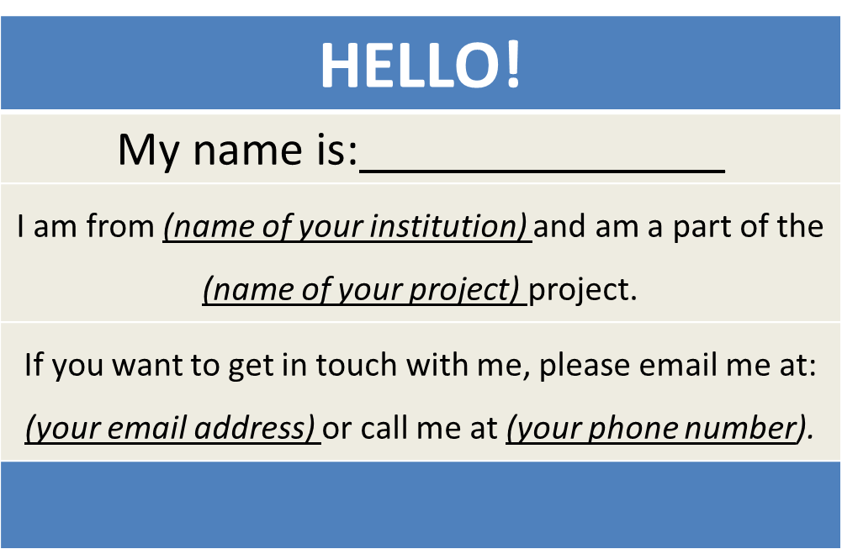
America’s Promise Grantees
Create a virtual name tag…

Slide 4
Grantee Polling Question
Let’s get to know who is on the call today. Using the poll, select the role that you play in your America’s Promise grant
Authorized Representative
Program Director/Manager
Training Partner
4. Employer Partner
5. Service Provider
6. Other (please specify!)

Slide 5
H-1B America’s Promise Grants Technical Assistance Launch Webinar
Department of Labor/ETA and High Impact Partners

Slide 6
Gregory Scheib
America’s Promise Program Lead
Workforce Analyst
U.S. Department of Labor
Division of Strategic Investments
Employment and Training Administration
Steven Canger
Workforce Analyst
U.S. Department of Labor
Division of Strategic Investments
Employment and Training Administration

Slide 7
Susan Shorters
CEO
High Impact Partners
Erika Humphrey
TA Coach Lead
High Impact Partners

Slide 8
Provide an overview of planned H-1B America’s Promise programmatic TA activities
Introduce the TA team (and roles) to grantees, including coaches and subject matter experts (SME)
Provide an overview of the coaching process, including coach/grantee matches
Alert grantees to upcoming H-1B America’s Promise events and activities

Slide 9
America’s Promise program overview
Snapshot of grantees
America’s Promise programmatic TA
The TA Team
TA Goals and objectives
America’s Promise coaches: roles and introductions
Upcoming events and activities
Questions and discussion
Closing

Slide 10
Grantee Polling Question
In what stage of implementation is your America’s Promise project?
Preparation: Key staff are still being hired, identification of key policies and procedures
Early Implementation: Staff hired, initial participants recruited for service delivery
Full Implementation: Project is fully implemented and staff are providing skillful service delivery
Other (please specify in the textbox!)

Slide 11
America’s Promise Program Overview
Gregory Scheib and Steven Canger, DOL, ETA H-1B Grants

Slide 12
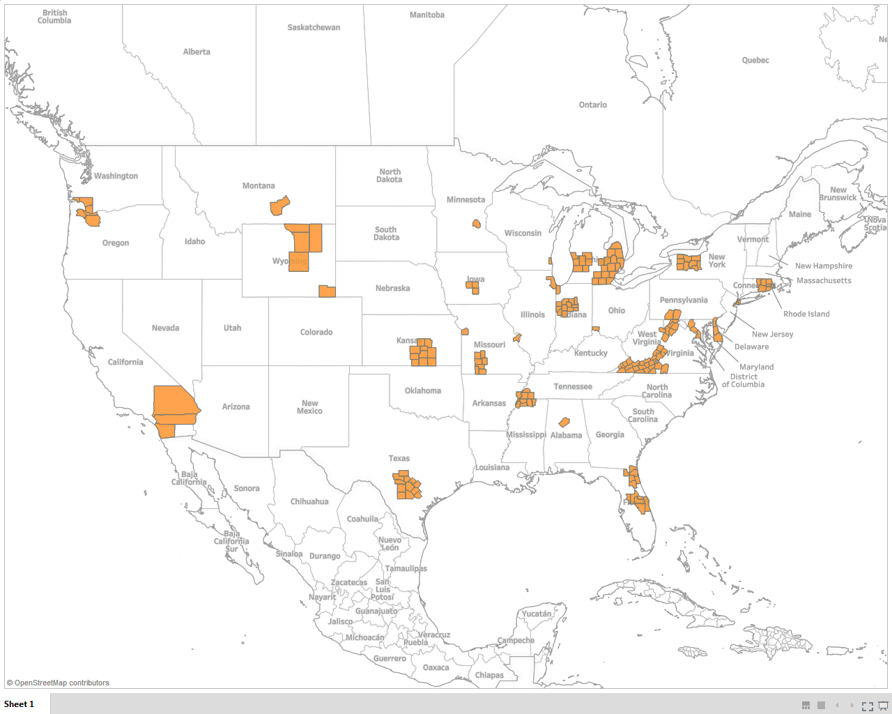
H-1B America’s Promise Regional Workforce Partnerships

Slide 13
Overview of Grantees
23 regional workforce partnerships (public and private) providing services in and located
across 28 states
Lead entities in the Regional Workforce Partnership grants include:
11 education and training providers, of which 7 are community colleges
9 workforce investment system entities
3 business related non-profits/workforce intermediaries

Slide 14
Populations Served
The AP grant program will serve approximately 21,000 participants.
Projects are serving unemployed, underemployed, and incumbent workers, including the following groups:
veterans (10);
individuals with criminal records (2);
refugees eligible to work in the US (2);
low-income individuals,
individuals with limited English proficiency, underrepresented populations, and minorities.

Slide 15
H-1B Industries
Advanced Manufacturing (15)
IT (12)
Healthcare (7)
Financial Services (1)
Aerospace and Blue Technology (1)
STEM Occupations (1)

Slide 16
Training Design
OJT (16)
Paid Work Experience and Internships (13)
Registered Apprenticeships (9)
Incumbent Worker Training

Slide 17
Grantee Polling Question
What ETA grant do you currently or have previously managed?
This is our first ETA grant
H-1B Grants: TST, Jobs Accelerator, Make it in America, Ready to Work, or Youth CareerConnect
TAACCCT Grant Program
American Apprenticeship Grants
YouthBuild or Other Youth Programs
Other ETA grant

Slide 18
America’s Promise Technical Assistance

Slide 19
The America’s Promise TA Team
Team HIP-AACC includes High Impact Partners, American Association of Community Colleges, International Economic Development Council, and National Association of Workforce Boards.
Together, the TA team will:
Provide TA to America’s Promise grantees
Support the America’s Promise Program Office and your Federal Project Officer (FPO)

Slide 20
Overview of America’s Promise TA
TA will be provided to grantees on the eight AP core program design elements:
Secured regional workforce partnerships
Integrated sectoral strategy
Engaged employer and industry partnerships
Demonstrated outreach, recruitment, and assessment strategies
Demonstrated employment and training strategies
Integrated supportive services
Demonstrated job placement strategies
Completed project work

Slide 21
Grantee Polling Question
In what area is your America’s Promise partnership particularly strong?
Employer engagement
Developing and maintaining strategic partnerships
Outreach and recruitment
Other (please specify in the textbox!)

Slide 22
Initiatives for Providing TA
Training on the program model, its components, and integration of program activities
Support for organizational development
Support for case management and coordination within and across the organization(s)
Strategies for improving outreach and recruitment

Slide 23
Initiatives for Providing TA
Specialized strategies for success with specific target populations
Support for forming, maintaining and improving grantees’ relationships with employers and workforce development entities
Improving grantees’ post-secondary education practices and relationships with post-secondary institutions, and expanding placement opportunities

Slide 24
The various topics will be delivered through:
Webinars - featuring subject matter experts (SMEs)
Monthly individualized TA Coaching calls
Small-group learning events
On-line Community of Practice (CoP)
Peer-to-peer sharing activities and networking
Case studies of lessons learned
In-person grantee convenings

Slide 25
Grantee Polling Question
Which of the following types of America’s Promise peer learning group are you most interested in?
Peer groups based on industry
Peer groups based upon target populations
Peer groups based upon training strategies
Other (please specify!)

Slide 26
Responsive TA
Your needs will drive TA topics and events. As such, we’re building in several grantee feedback loops:
Coaching calls
Virtual TA events
Peer calls
Convenings
On-line CoP Discussion Boards
Quarterly Narrative Reports (QNR)

Slide 27
Grantee Polling Question
What are your 3 biggest programmatic concerns:
Developing regional partnerships
Sectoral strategies
Career Pathways
Outreach, recruitment, and assessment strategies
Integrated supportive services
Other (Please specify!)

Slide 28
The America’s Promise CoP
Your centralized location to find grantee resources and information
Peer-to-peer sharing
Latest project announcements, best practices
Monthly blog posts

Slide 30
America’s Promise Coaching

Slide 31
Purpose of TA Coaching
Assist grantees’ implementation of AP program components and organizational systems
Provide coaching through a variety of modalities (phone, virtual meetings, in-person)
Develop strong relationships with open communication among grantee staff, coaches, and DOL FPOs, and National Office (NO) staff
Cultivate a holistic learning experience for grantees through coaching, trainings, and other TA strategies
Ensure AP participants are prepared for a successful transition to post-secondary education and/or career pathways

Slide 32
Role of TA Providers
Federal Project Officer’s Guidance | TA Coach’s Guidance
Clarification of H-1B FOA, including definitions | Organizational structure: staffing, systems, and processes
Statement of work alterations | Participant outreach and recruitment strategies
Fiscal questions, including allowable expenditures and budget | Participant services, including case management, supportive services, and job placement
Quarterly performance outcomes against target outcomes | Training design and implementation
Other policy questions, as they arise | Employer engagement and participant placement

Slide 33
Erika humphrey
Brevard Workforce Development Board, Inc. dba CareerSource Brevard
Florida State College at Jacksonville
Worksystems, Inc.
michael laidlaw
Illinois Manufacturing Excellence Center
RFCUNY on behalf of CUNY OAA – CEWP
United Way of Central Iowa (Central Iowa Works)

Slide 34
Libby Livings-Eassa
University of Alabama at Birmingham (UAB)
Lyle Neumann
Tecumseh Area Partnership, Inc.

Slide 35
Eunice maize
Delaware Technical Community College
Montgomery College
Bruce rankin
City of Springfield, Workforce Investment System
SE Michigan Community Alliance (SEMCA)
Amanda kosty
Employ Milwaukee, Inc.
Monroe Community College
New River/Mount Rogers Workforce Investment Area Consortium Board of Local Workforce Area 2

Slide 36
sarah garcia
Alamo Colleges
Greater Memphis Alliance for a Competitive Workforce (GMACW)
lynn knight
Northern Wyoming Community College District (NWCCD)
Rhode Island Governor’s Workforce Board

Slide 37
Kelly middleton
MiraCosta College
Workforce Alliance of South Central Kansas, Inc.
Jan bray
Grand Rapids Community College
West Virginia Higher Education Policy Commission

Slide 38
Grantee Polling Question
How do you feel after today’s webinar?
Green Light, Go! We are ready to jumpstart our program!
Brakes, Please?!…We still have a few more questions!
Slowly processing, but committed!

Slide 39
Next Steps
America’s Promise TA Menu Release -Download now:
Overview of our America’s Promise TA plan and identifies your dedicated TA coach.
Initial Calls with Your TA Coach:
Your TA coach will contact you via email (primary program POC) within the next week!

Slide 40
Other Upcoming TA Activities
June
Coaches will schedule individualized grantee coaching calls
Coaching calls
Grantees receive America’s Promise TA Guide outlining America’s Promise TA efforts
July
Launch of online America’s Promise Community of Practice
Virtual Chat – Webinar, topic to be determined
This Year
Grantee convening – More information forthcoming

Slide 42
America’s Promise Grantee Mailbox AmericasPromise@dol.gov To Reach the DOL National Office, and Technical Assistance Providers

