Slide 1

From Design to Implementation: Flexible Apprenticeship Models That Work
November 7, 2017
1:00 – 2:00 p.m. EST

Slide 2
PRESENTERS
Presenter(s):
Geri Scott, Program Director, Jobs for the Future
Rebecca Lake, Dean of Workforce and Economic Development, William Rainey Harper College
Valerie Piet, Healthcare Program Supervisor, Montana Department of Labor & Industry
Christian Lagarde, Consultant, American Association of Community Colleges
Moderator(s):
Cheryl Martin, Program Manager, TAACCCT Grants, U.S. Department of Labor, Employment and Training Administration
Amy Firestone, Senior Advisor, U.S. Department of Labor, Employment and Training Administration, Office of Apprenticeship

Slide 3
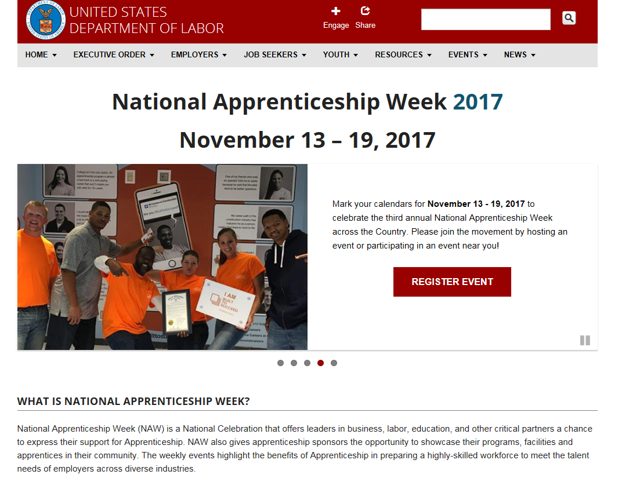
National Apprenticeship Week 2017

Slide 4
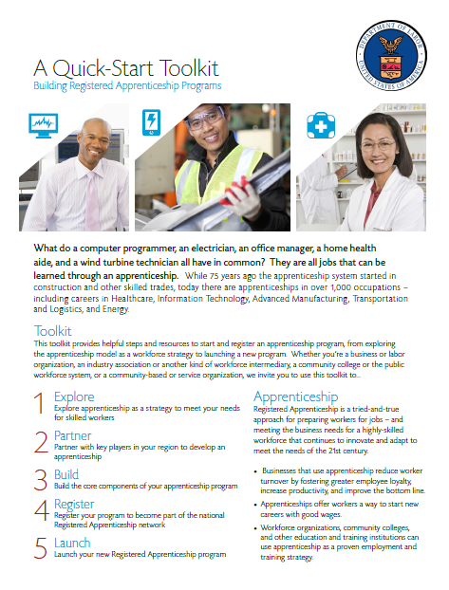
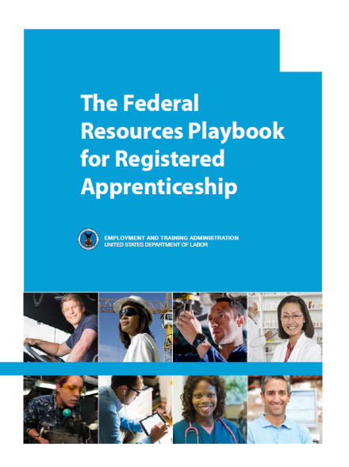
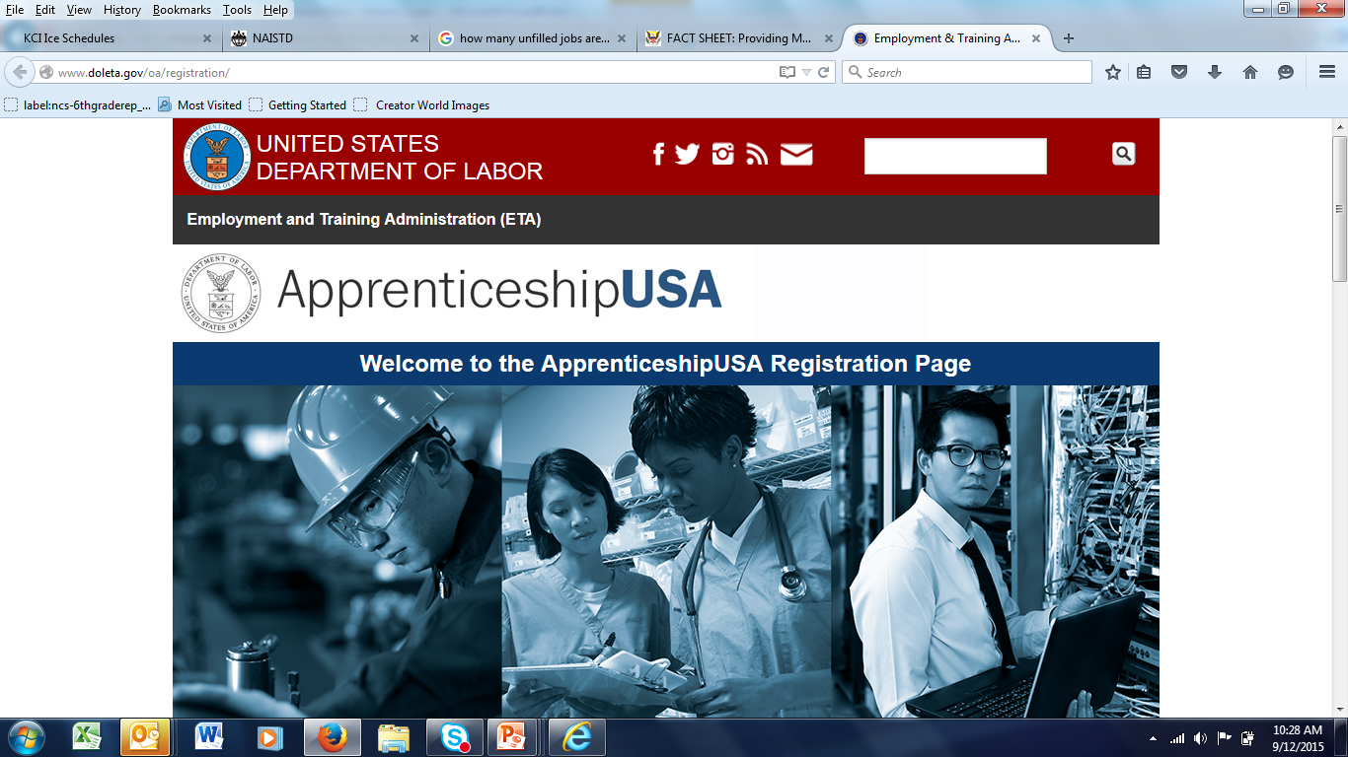

Resources at doleta.gov/apprenticeship
Quick-Start Toolkit
5 Step Format to take you from “exploring” to “launching” a Registered Apprenticeship Program.
http://www.doleta.gov/oa/employers/apprenticeship_toolkit.pdf
Federal Resources Playbook for Registered Apprenticeship
Guide to resources from the Departments of Labor, Education, Veterans Affairs, Agriculture, Transportation, and Housing and Urban Development to support Registered Apprenticeship
http://www.doleta.gov/oa/federalresources/playbook.pdf
DOL Registration Site
An electronic apprenticeship standards builder that allows potential new sponsors to build and register their program online.
http://www.doleta.gov/oa/registration/
RACC Site
Find information on becoming a RACC member and a database of college members and sponsors.
https://www.doleta.gov/oa/racc.cfm

Slide 5
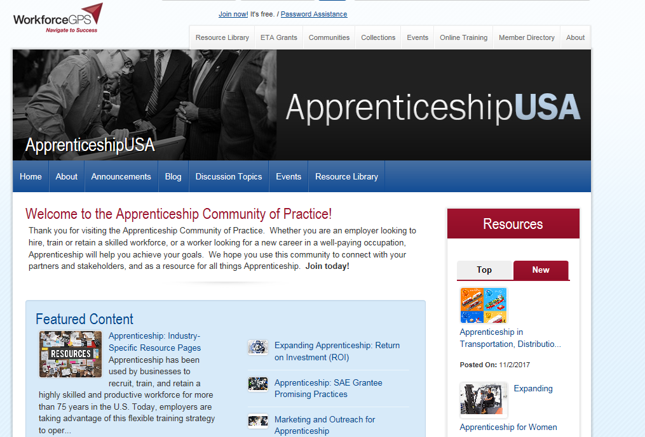
Apprenticeship Community of Practice: https://apprenticeshipusa.workforcegps.org/

Slide 6
OVERVIEW
Overview of Today’s Webinar:
The design of their Apprenticeship Programs
Flexible Models (Competency Based, Credit-Bearing, European)
Community Colleges as Sponsors
Converting Internships/Co-ops to Registered Apprenticeships
Common Pitfalls and How to Avoid Them
Your questions!

Slide 7
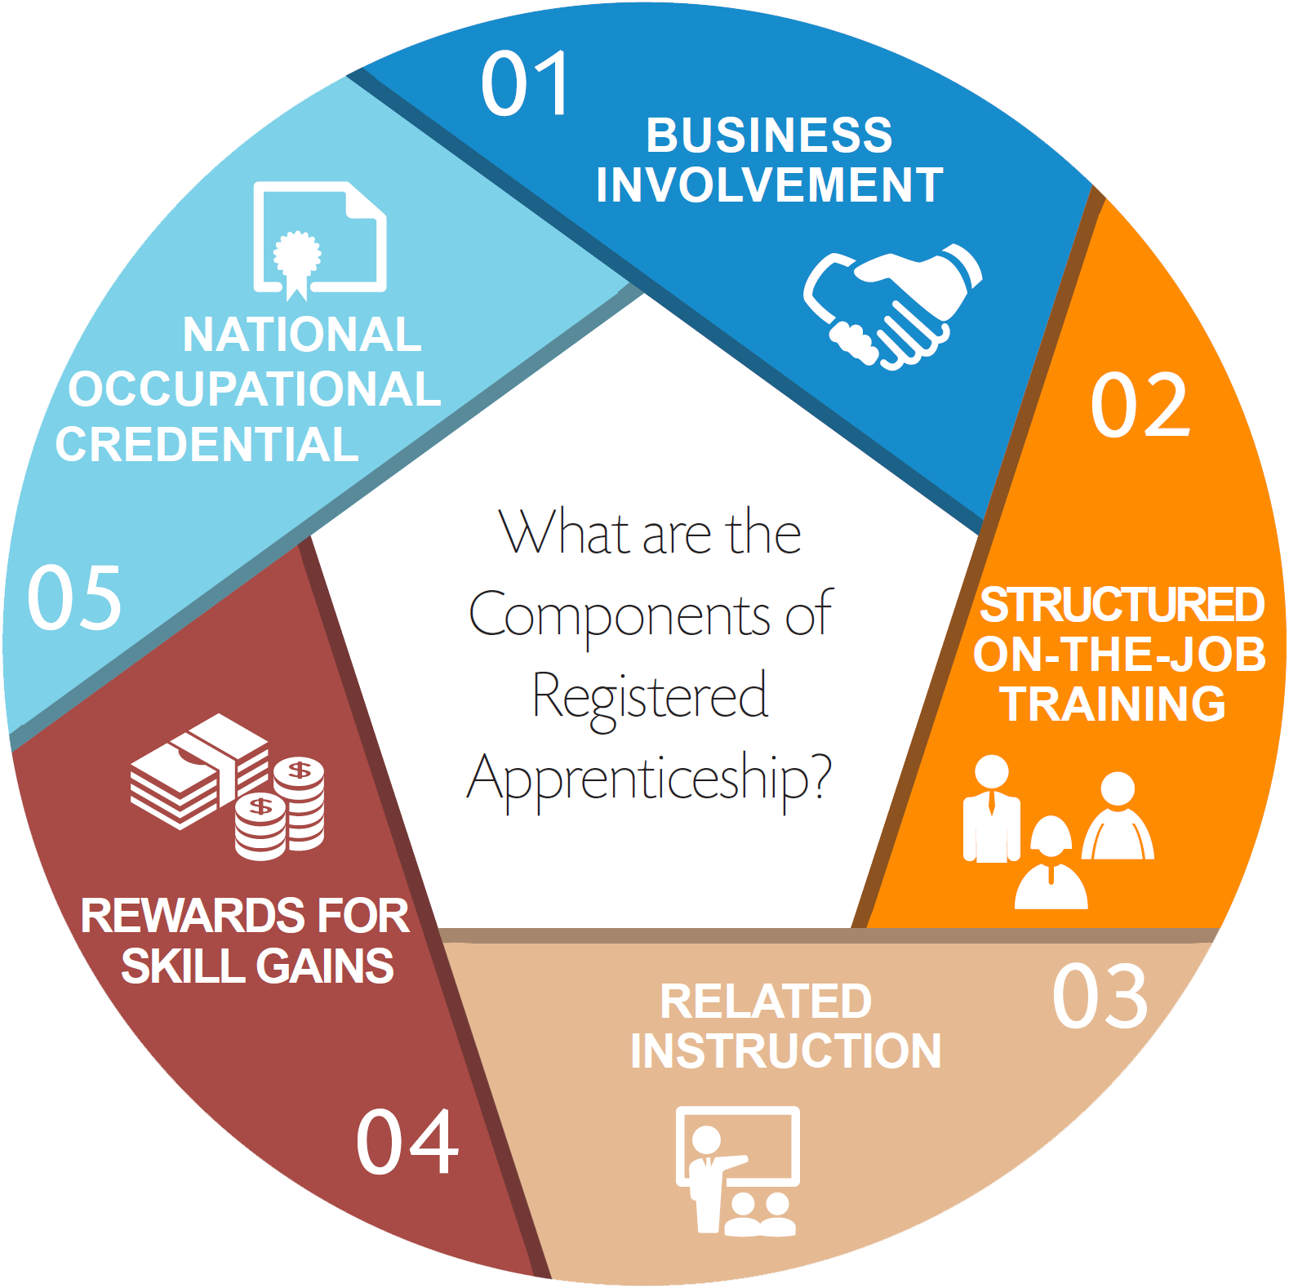
WHAT IS
REGISTERED APPRENTICESHIP?
Apprenticeship Design Basics
Registered Apprenticeships (RA) are innovative work-based learning and postsecondary earn-and-learn models that are distinguished by several factors:
Programs must meet national standards for registration with
the U.S. Department of Labor (USDOL), or federally-recognized
State Apprenticeship Agencies
Programs provide on-the-job learning and job-related |technical instruction
Training results in an industry-recognized credential
Participants who are newly hired (or already employed) earn
wages from employers during training
On-the-job learning is conducted in the work setting
under the direction of one or more of the
employer’s personnel

Slide 8
Apprenticeship Roles and Responsibilities
Sponsor Commitment
Execute Sponsor Agreement*
Documentation*
Identify and Select Journey Level Worker
Support Journey Level Workers and Apprentices
Attend Train the Trainer Classes
Apprentice
Sign Apprentice Agreement
Assessments / Pre Apprentice Resources
Community College
Coordinate with Companies/Sponsor
Align RTI with degree Programs of Study
Identify and Select Apprentice(s)
Journey Level Worker
Complete On-The-Job Training
144 Hours Each Year for Related Instruction
Track and Report Training Completion – Blue Book
Identify potential funding for RTI
Potential Sponsor*
Coordinate Related Instruction Training*
Provide Required On-The-Job Training
Confirm / Document Apprentice Completion
Wage Progression
RTI Provider

Slide 9
INNOVATIONS
IN APPRENTICESHIP
ACADEMIC CREDIT
  Related Technical Instruction aligned with degree programs of study
FLEXIBLE SCHEDULING
  RTI delivery arranged to best meet competency development and employer requirements
COMPETENCY BASED APPRENTICESHIP
  Performance benchmarks for knowledge and skill competencies
THE GERMAN MODEL
  Aligned program of study starting in secondary school

Slide 10
How Registered Apprenticeship Programs are Integrated into Community Colleges?
TLN Webinar 1-2 PM EST
November 7, 2017
Dr. Rebecca Lake
Dean, Workforce and Economic Development Harper College Palatine, Illinois

Slide 11
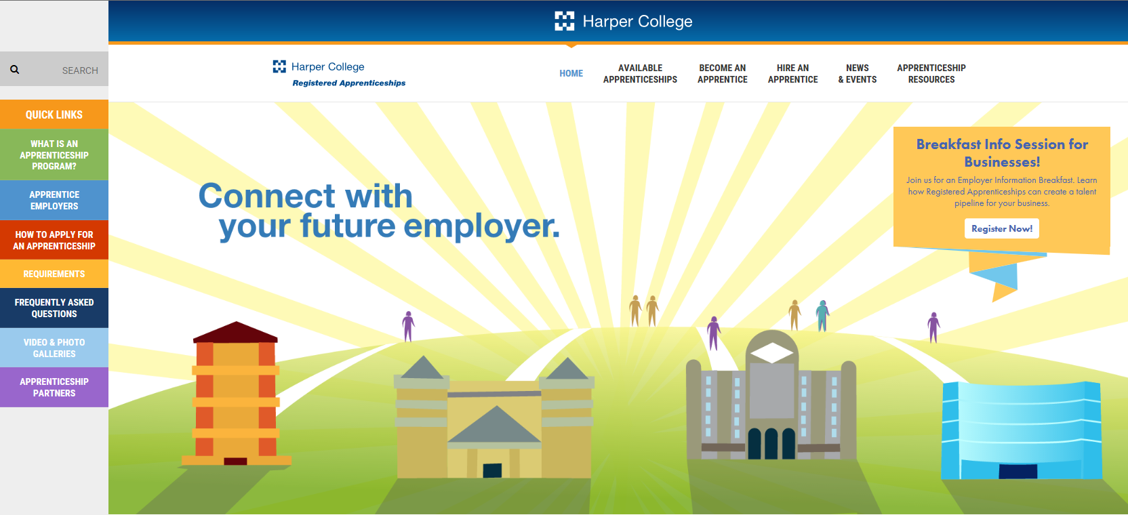
HTTP://WWW.HARPERAPPRENTICESHIPS.ORG/

Slide 12
Why Offer RA Program(s)?
1) Meet needs of employers
2) Meet needs of job seekers & career changers
3) Fulfill our mission and:
a) Increase enrollments
b) Enhance retention rates
c) Increase completion rates
d) Improve fiscal bottom-line

Slide 13
1st Decision Step: General Questions to Ask
Should Harper invest time, effort, funds, internal and external political capital, and internal resources?
Does Harper have faculty (FT, PT), top administrators, staff willing to develop, implement, grow and sustain apprenticeship programs? (Are we in it for long haul?)
Is there a leader (at least at a Dean position)invested or willing to become energetically invested in project?

Slide 14
2nd Decision Step: Internal Evaluation
Assess organizational capacity and readiness:
  Internal structure conducive (academics, student services, support services, finance, etc.)
  College departments agree to streamline student and services for companies
  Faculty agree to “tweak” curriculum to meet standards
  Dedicated management structure established and responsible for all RA activities (for coordination, marketing, coaching, robust CQI)

Slide 15
3rd Decision Step: External Interst
Diligently educate, then assess external environment
  Educate companies about registered apprenticeships
  Assess number of companies interested in a specific RA program and strength of company’s commitment
  Feedback regarding on RA program
  a) 8,10,12, or 15 -16 wk educational blocks
  b) Degree/certificate, curriculum, course learning
  objectives and program competencies
  c) Identify national portable credentials to embed in
  curriculum

Slide 16
The “Musts”: or Don’t Do RA Programs
1) Employers committed to RA program
(also help identify competencies)
2) Faculty willing to work with you
3) Admissions Staff that gets it
4) A “Champion”

Slide 17
Website and Branding the Look
Brand the “Look” on all marketing pieces
Website MUST be easy to use and not crowded
http://www.harperapprenticeships.org/
Marketing activities & info relevant for all groups
Include videos, pictures, links to partner companies
Form samples for companies

Slide 18
Harper Outreach: Employer partners
Hire part-time consultants to meet with employers
Target card mailer, drop-offs for employers
Host info employer breakfasts
Attend activities at Business Associations, Village Economic Development, Business fairs, etc.
Provide Apprenticeships tables at events (be selective)
Hold target employer group information sessions

Slide 19
Harper Outreach: Potential apprentices
Target card mailer to veterans
Hold Monthly info sessions at Harper 6 – 7:30 PM
Attend activities in High Schools
Present info in classrooms at HS and at Harper
Work with workNet Center (WIOA) specialists
Email blast sent by Admissions to Harper students

Slide 20
Harper’s 5 Apprenticeship Programs
General Insurance (2 yr AAS degree)
Industrial Maintenance Mechanic (3 yr AAS degree)
CNC Precision Machining (3 yr AAS degree)
Supply Chain Management (2 yr AAS degree)
Cyber Security (1 yr non–credit; CompTIA credentials)

Slide 21
Cost of Harper’s RA Programs
Cost: $3,000 per semester Adv. Manufacturing
$2,500 per semester non-traditional programs
Six semesters of course work towards AAS degree
Includes items such as tuition, books, fees, mentor training, tutoring, and coaching
Registration of apprentices to facilitate receipt of a national RA credential at completion of program

Slide 22
Current Number of Apprentices
RA Enrollment Fall 2017 and Spring 2018
31 Industrial Maintenance Mechanic and
CNC Precision Machining
4 Supply Chain
52 General Insurance
87 Total number

Slide 23
Current Number of Companies
Fall 2017 and Spring 2018
22 Advanced Manufacturing companies
4 Supply Chain
2 Insurance companies
28 Total number

Slide 24
RA Programs Coming to Harper Fall 2018
New RA programs must be driven by companies – with enough industry support to drive development of a new apprenticeship program.
Developing programs in these fields:
a) Banking and Finance (just approved)
b) Sales and Sales Merchandizing
c) Print Graphics
d) Private Security

Slide 25
More Information
Visit the Harper Apprenticeship Website
http://www.harperapprenticeships.org/
Call 847-925-6630

Slide 26
TAACCCT IV – HealthCARE Montana
Missoula College, lead grantee, plus 14 consortium colleges
Montana Department of Labor & Industry
406-490-8788 vpiet@mt.gov
Valerie Piet

Slide 27
Approaches of MT Colleges
Approaches MT colleges have used to incorporate apprenticeship:
  Serving as Registered Apprenticeship sponsor
    Tribal focus
  Incorporation Existing Programs as RTI
  Promotion of distance delivery
  Development of Non-credit modules
  Degree Completion Pathways for graduated apprentices

Slide 28
Building on Existing Programs
Apprenticeships have been incorporated various degree programs with no programmatic change:
  Surgical Technology, Pharmacy Technology, Practical Nurse
  Medical Claims
Successes:
  Faculty involvement, varying degrees
  Increase enrollment/promote degree completion
  Promotes “grow your own” and in-place career advancement
Challenges:
  Availability of appropriate “step down” role
  Clinical rotations are considered RTI

Slide 29
Distance Delivery Expansion
RFP Process to put programs online to incorporate apprenticeship:
  5 Colleges received funding
  8 Programs including pharmacy tech and medical lab tech
  2 Colleges engaged in course sharing
Successes:
  Quality concerns of employers and faculty
  Apprenticeship as statewide program promotion
Challenges:
  Faculty time
  Navigating licensing requirements; licensing boards as partners

Slide 30
Non Credit Modules
Certified Nurse Aide:
  Restorative Care
  Dementia Care
  Patient-Centered Care
Behavioral Health
Successes:
  Quick and easy to develop and deliver
  Massive interest
Challenges:
  Learning Management System
  Continuous updating

Slide 31
Degree Completion Pathways
Statewide PLA Task Force
  25% cap on PLA credits counted discouraged degree completion
  Task force recommended distinction between experience and instructional programs (latter now has no cap)
PLA to AS to BS Completion Model designed with MSU-Billings and IBEW Union Program
  54 credits recommended by American Council of Education (ACE)
  29/54 applied towards 60 credit AS, remaining 25 towards BSLS
Successes:
  Major policy revision
Challenges:
  Multiple parties involved in acquiring transcripts
  Replicating with other programs, union or non union

Slide 32

QUESTIONS?

Slide 33
Thank You!
Ask questions and to connect with peers and resources at TAACCCT@dol.gov

