Slide 1
Trade Adjustment Assistance:
Targeting Program Challenges
Using Case Management Funds
November 14, 2017
State Best-Practice Spotlight: New Hampshire & Massachusetts

Slide 3

Susan Worden
  Supervisory Program Analyst
    Performance and Data Reporting Unit
    Office of Trade Adjustment Assistance

Slide 4
Employment and Case Management Funds
  IT Integration
  Connectivity (TAA-UI)
New Hampshire Best Practices
Massachusetts Best Practices
Questions
Resources
Contact Information

Slide 5
POLLING QUESTION
Hypothetically, how much of a TAA Program Grant can be spent on Case Management?
5 %
10%
100%

Slide 6
TAA REAUTHORIZATION ACT OF 2015
FLEXIBILITY FOR USING EMPLOYMENT AND CASE MANAGEMENT FUNDS
SEC. 235A. LIMITATIONS ON ADMINISTRATIVE EXPENSES AND EMPLOYMENT AND CASE MANAGEMENT SERVICES. Of the funds made available to a State to carry out sections 235 through 238 for a fiscal year, the State shall use— (1) not more than 10 percent for the administration of the trade adjustment assistance for workers program under this chapter, including for— (A) processing waivers of training requirements under section 231; (B) collecting, validating, and reporting data required under this chapter; and (C) providing reemployment trade adjustment assistance under section 246; and (2) not less than 5 percent for employment and case management services under section 235.

Slide 7
PROJECTION OF RETURNED FUNDS
FY 2015
State | Region | Unspent as of 6/30 | Projected Unspent as of 9/30
CT | 1 | $365,166.79 | $181,570.93
NJ | 1 | $1,570,563.41 | $1,371,952.68
NY | 1 | $6,401,987.89 | $5,527,154.59
PR | 1 | $484,706.58 | $325,970.81
DC | 2 | $110,233.54 | $100,977.95
MD | 2 | $6,426,998.37 | $5,863,194.31
VA | 2 | $1,974,435.00 | $1,926,790.21
WV | 2 | $1,161,396.25 | $711,737.59
AL | 3 | $1,102,475.16 | $709,024.34
FL | 3 | $1,758,325.35 | $1,215,591.91
GA | 3 | $1,222,949.04 | $633,518.59
NC | 3 | $3,587,315.78 | $2,669,227.76
SC | 3 | $2,976,440.66 | $2,882,446.12
TN | 3 | $2,656,655.48 | $1,001,143.13
AR | 4 | $3,304,932.06 | $3,287,276.26
LA | 4 | $1,183,518.25 | $736,660.07
TX | 4 | $15,679,325.91 | $15,674,468.77
IL | 5 | $883,030.37 | $113,922.78
KS | 5 | $3,523,920.30 | $753,450.17
MI | 5 | $6,738,535.00 | $5,349,421.00
MN | 5 | $2,441,196.13 | $843,572.91
OH | 5 | $4,214,795.38 | $4,122,908.20
WI | 5 | $3,654,334.32 | $487,115.91
CA | 6 | $6,925,815.88 | $6,833,507.50
ID | 6 | $574,641.64 | $565,266.24
TOTAL |  | $86,944,065.22 | $63,887,870.72

Slide 8
IDEAS FOR USING EMPLOYMENT AND CASE MANAGEMENT
CONNECTIVITY IS KEY
TAA
RR/
Employer
WIOA
DW
UI
Rapid Response
WIOA DW
UI/TRA
TAA

Slide 9
POLLING QUESTION
Which entity within the state agency establishes worker eligibility based on TAA certification?
TAA/Workforce
TRA/UI
Other (Please detail in chat box.)

Slide 10
STATE BEST PRACTICE SPOTLIGHT
Why NEW HAMPSHIRE?
Take-up rate* – 64.7%
  National average is 21.7% Efforts to Improve Outcomes Reporting in TAPR
Spent all FY15 allocated funds, including spending 20% on Case Management
*Take-up rate: New TAA Participants (4/1/16-3/31/17)/Certified Workers (10/1/15-9/30/16)

Slide 11
Trade Act in NH!
November 14, 2017

Slide 12

Jeri Jewell
  Trade Act Coordinator
    NH Employment Security

Slide 13
Petition filing
Worker Notification
Filing for Trade benefits
NH Automation

Slide 14
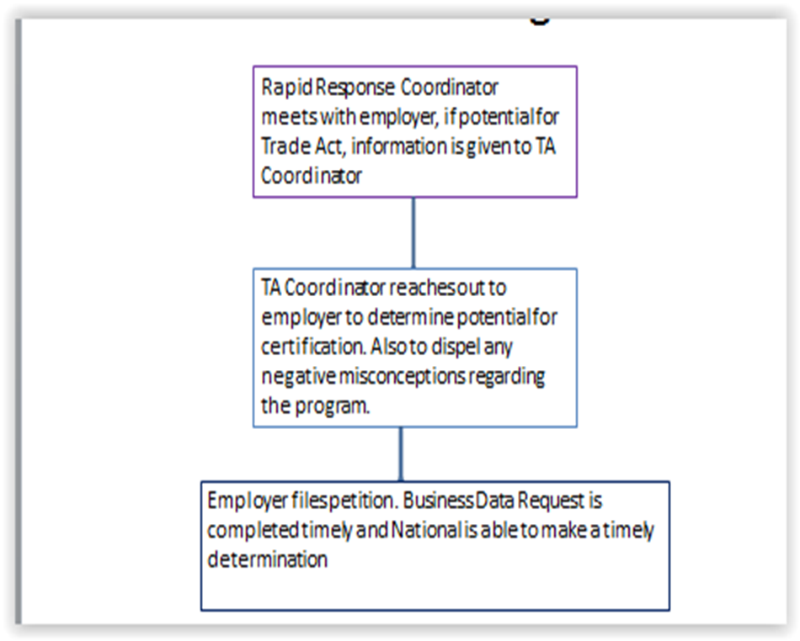
Petition Filing

Slide 15
Adversely Affected Worker List
Once company is certified, we receive the layoff list from the employer and load it into our database.
Overnight notification is automatically sent to all workers on layoff list advising of potential eligibility under the Trade Act program.
Trade Unit follows up with a letter inviting them to a Benefits Information Session.
Case Manager also attends Information Session to schedule initial assessments immediately.

Slide 16
3 Ways We Reach out to Workers
Through our automated benefit system
Benefits Information Sessions
By partnering with our neighboring states

Slide 17
Challenges Before Automation
Training contracts
  Fiscal Dept. had to keep track of all payments
  Hard to keep track of total contract costs
TRA
  Tracking number of weeks paid under Basic, Additional and Completion
  Implementing new rules such as pay TRA before UI
  Whether or not they received TRA prior to applying for RTAA
Absolute Reporting Nightmare!

Slide 18
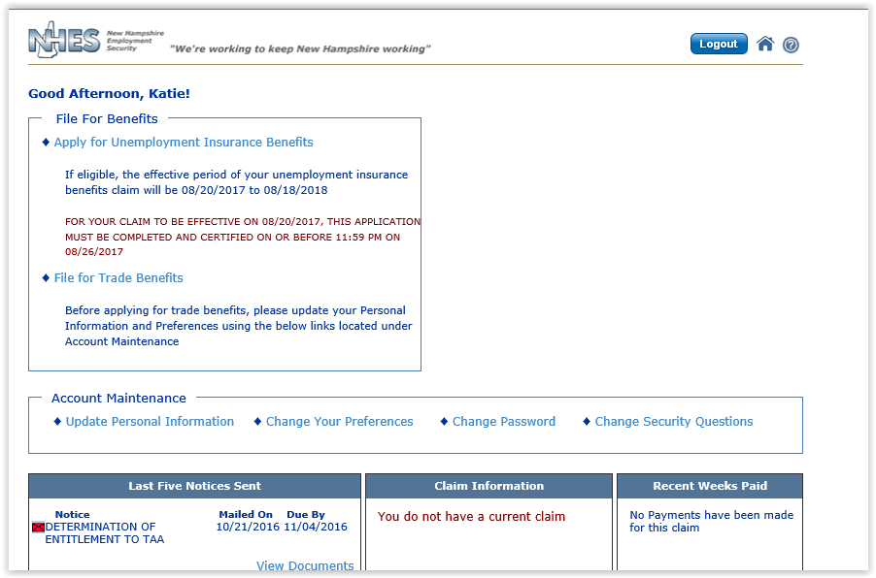
Filing for Trade Benefits

Slide 19
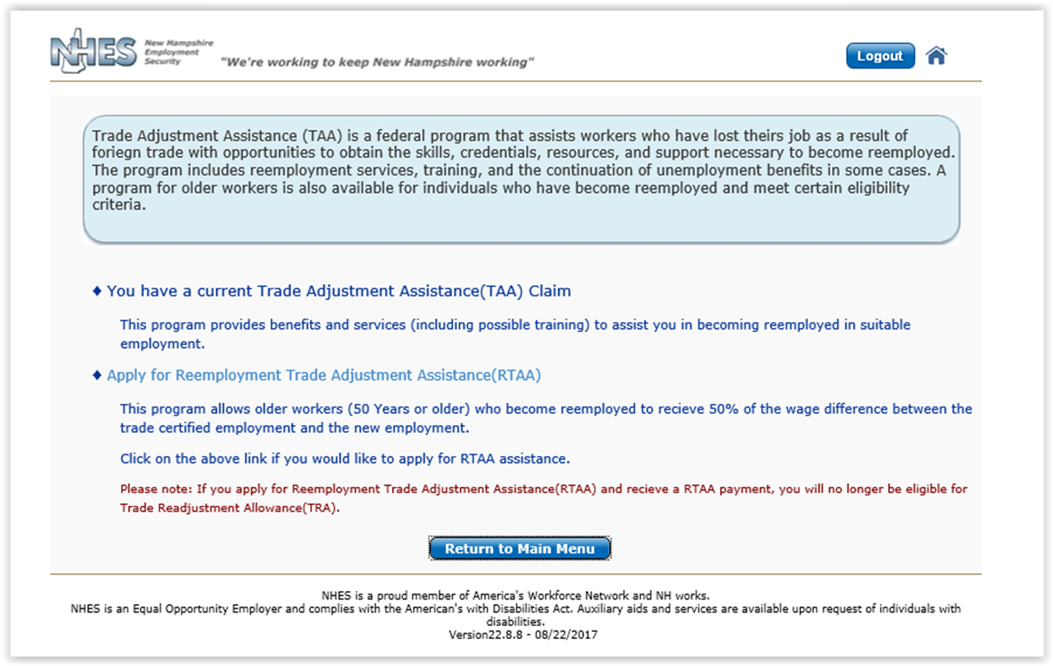
Filing for Trade Benefits Cont’d…

Slide 20
File for TAA
If they have not …
If they already have…
The system will allow them to file
Alert goes to TAA Coordinator
TAA Coordinator determines eligibility and sends determination
Coordinator also contacts counselor to reach out to worker
The system will advise that they cannot file again
If covered under more than one petition, system will allow them to file 2nd time and alert will go to Coordinator that a petition choice must be made

Slide 21
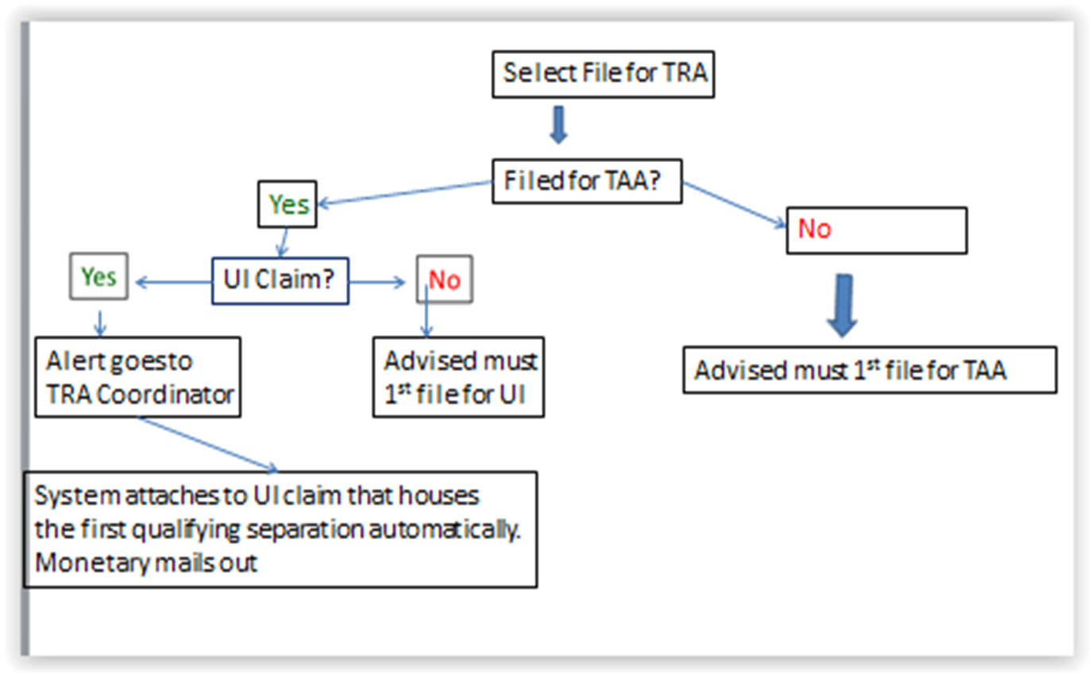
Filing for TRA

Slide 22
Automated TRA Issues & Alerts
No qualifying separation
  If separation reason is anything other than lack of work this alert will go to the TRA Coordinator in order to determine eligibility
26/26 Deadline
  This alert goes to the TRA Coordinator to determine if this was met
Eligible for 2 or more petitions
  Choice will need to be made
Review Qualifying Separation – 26 x 30
  If the system can’t determine whether or not this has been met, this issue will go to the TRA Coordinator
Pay TRA before UI
  When filing a new benefit year claim, this issue is created to enable a choice to be made whether to receive UI or go on TRA
Receive RTAA after TRA
  If an individual files for TRA but have already received RTAA, this issue is created

Slide 24
STATE BEST PRACTICE SPOTLIGHT
Why Massachusetts?
MOSES System – industry standard
Provides an alternative means of automating eligibility between TAA and UI
RR Layoff Aversion Results
  38% of those who receive RR Services in MA never become unemployed.

Slide 25
Integration and the Trade Program in Massachusetts
November 14, 2017

Slide 26

Beth Goguen
  Central and TAA Programs Manager
  Department of Career Services

Slide 27
Although not all state’s employment and unemployment systems and structures are the same, by sharing information we hope to inspire ideas and change for others that may just not know where to start.
Overview of Massachusetts TAA Program and the systems joined to make it work for our customer.

Slide 28

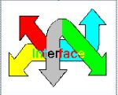
Background
In MA, the Trade Program is administered by the Department of Career Services (DCS) and the Department of Unemployment Assistance (DUA).
Customers TAA benefits are administered and customers are case managed through our Massachusetts One-Stop Employment System (MOSES) (supported and maintained by the Department of Career Services). This system is utilized by all Career Centers in Massachusetts.
Customers TRA benefits are administered via UI Online (UIO) (supported and maintained by the Department of Unemployment Assistance).
Through a series of interfaces MOSES and UIO share information regarding TAA petitions, potentially eligible customers and ultimately enrolled TAA participants.

Slide 29
Challenges Before Automation
All data entry was manual
  Emails regarding training approvals, etc. all went to DUA TRA Unit and then information had to be manually entered into the benefits system that paid TRA benefits.
  Tracking modifications and disqualifications was challenging
  Hard to keep track of total contract costs/payments
Customers
Manual paperwork completed and sent into TRA unit each week for benefit payments
Misplaced forms
Snail mail

Slide 30
In July 2013, the Department of Unemployment Assistance (DUA) launched a modern, web-based UI system to better serve customers. As part of that modernization effort, the Trade Program (administered by the Department of Career Services) partnered with DUA to share information regarding benefits for TRA processing.
UI Online
Unemployment Insurance Online
TRADE PROGRAM
MOSES
Massachusetts One Stop
Employment System
www.mass.gov/dcs/trade

Slide 31
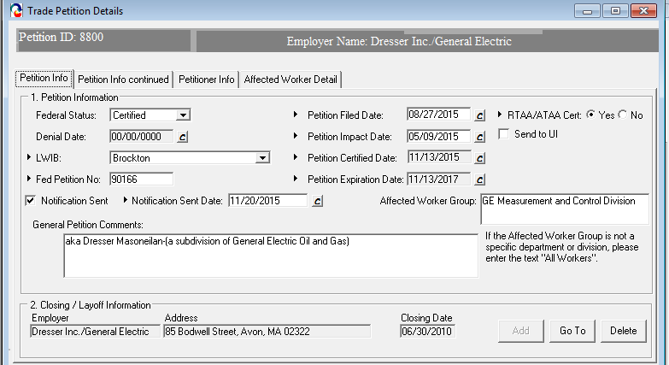
MOSES
interface
UI Online
Once a company is certified, the certification is entered into the MOSES database and an interface sends the information to UIO. In return, UI Online sends affected workers back to MOSES for notifications to then be mailed. The Affected Worker Detail tab is updated regularly. The list of affected workers may also include Career Center members without a UI claim or a spreadsheet provided by the employer that can be uploaded.

Slide 32
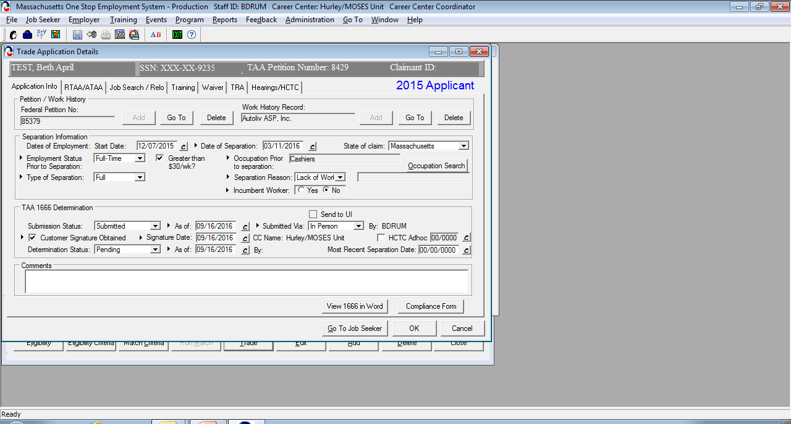
TAA Eligibility in MOSES
MA directs customers to the career center
The first part of the trade process is entering information for TAA Eligibility
Applications are submitted at the local Career Center (CC) level via MOSES. This requires (most of the time) for the customer to go to the Career Center which allows them to become familiar with staff, etc.

Slide 33
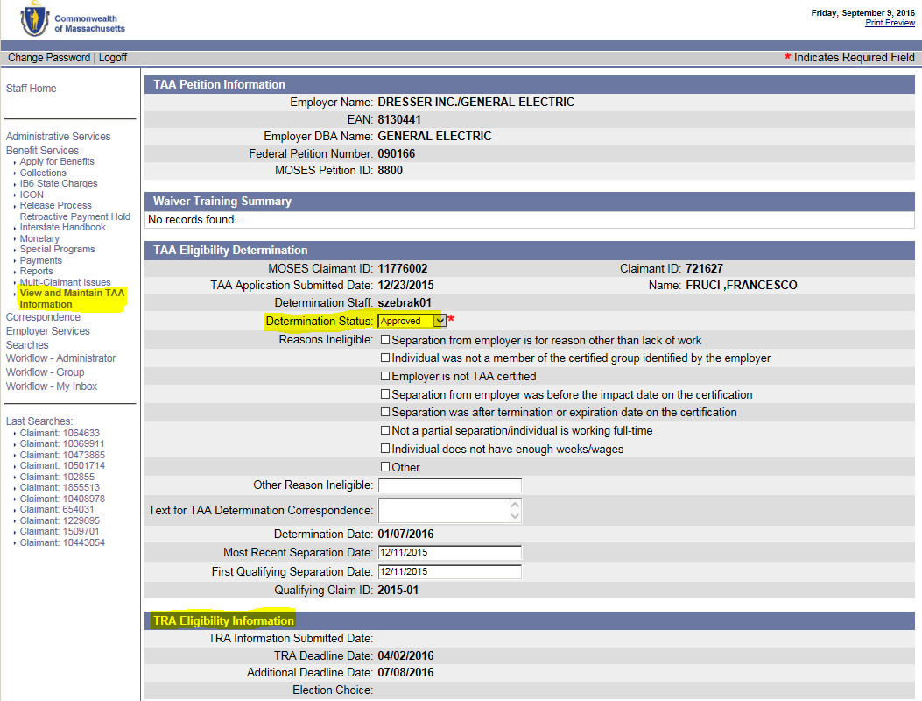

Through an the TAA application is then sent to UIO for processing. Notices are automatically issued to employer and customer to verify employment and layoff, etc.
Once the application is approved in UIO……..
Once the TAA Eligibility is approved the TRA Deadline is generated and visible in UI Online and sent to MOSES

Slide 34
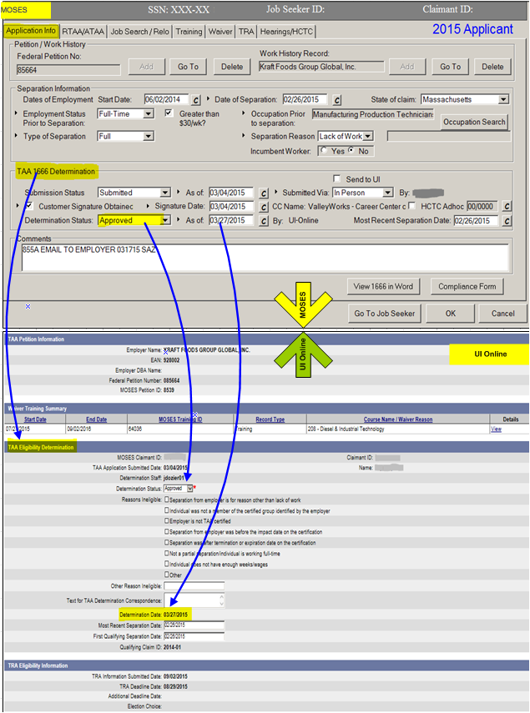
TAA Eligibility in MOSES ➔ ➔
TAA Eligibility
in UI Online ➔ ➔

Slide 35
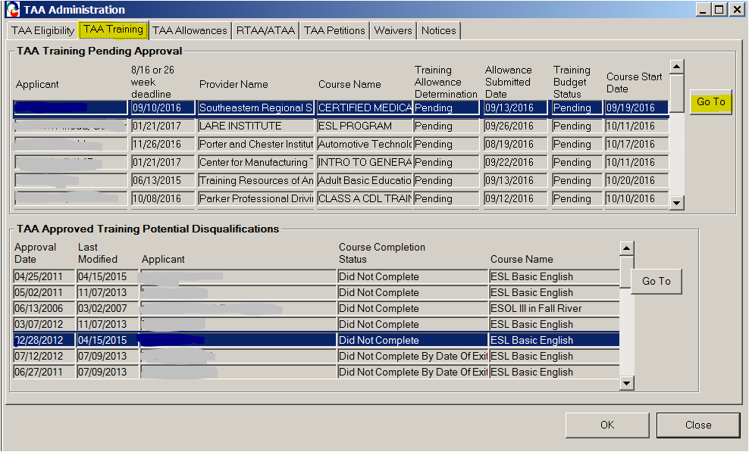
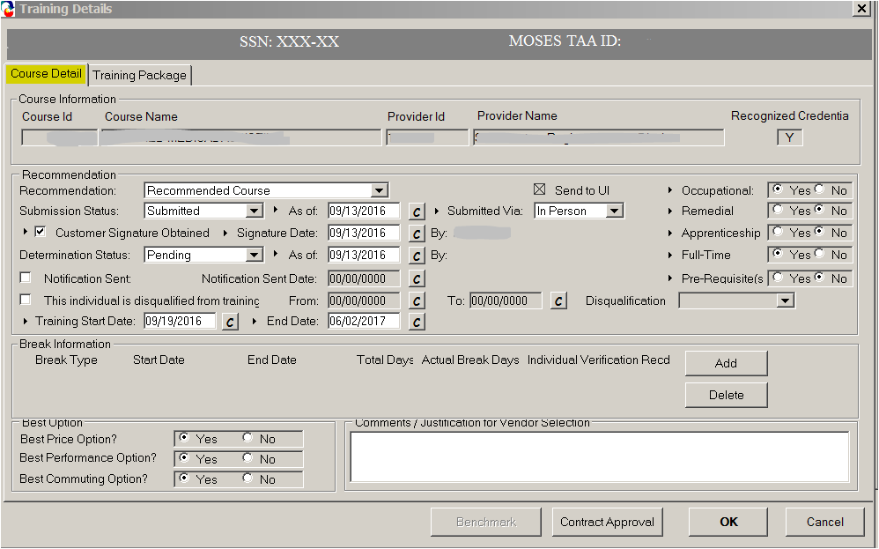
Training in MOSES
List of Trainings Pending review
➔➔
Course details ➔➔

Slide 36
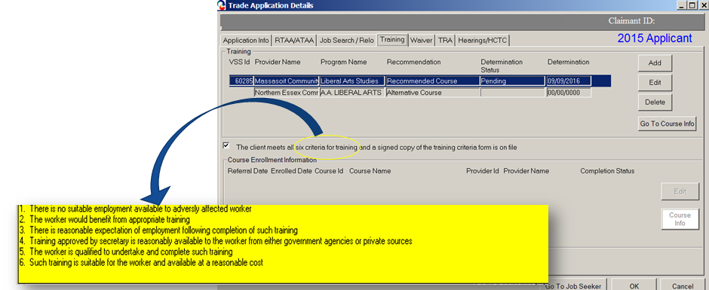
TAA Training Approval in MOSES
The Career Center Counselor informs the applicant of services that will help in determining the appropriate training programs and obtain reemployment at the conclusion of the training program. The CC Counselor helps the applicant complete the Vendor Selection sheet which includes two or three course comparisons. Of these courses, a recommended course must be selected and a budget is submitted only for the recommended course. The Career Center counselor must also submit verification that the applicant satisfies the six training criteria. The State Trade Office makes the determination regarding the recommended course.

Slide 37
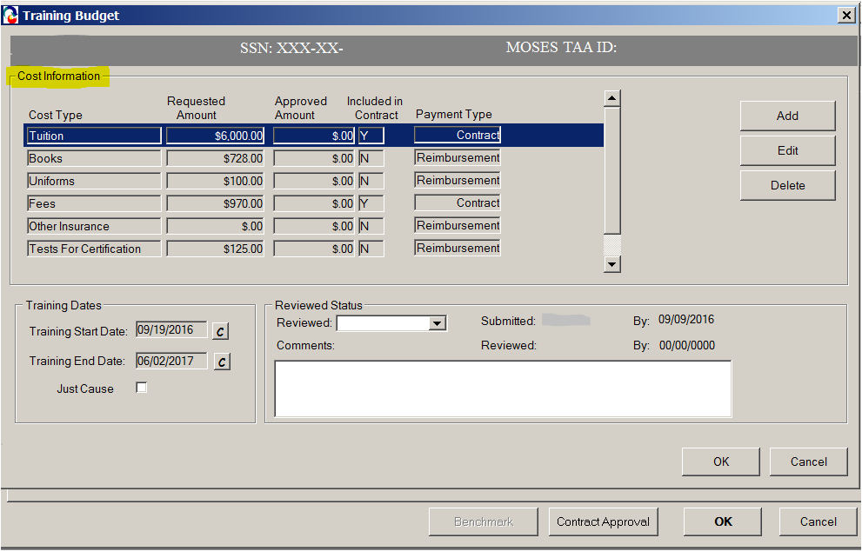
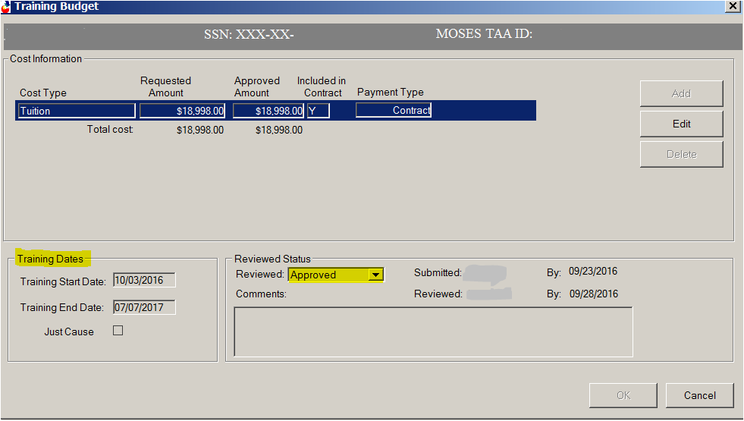
Funding Training in MOSES
Training budget showing itemized cost per training➔➔
Approved Training➔➔

Slide 38
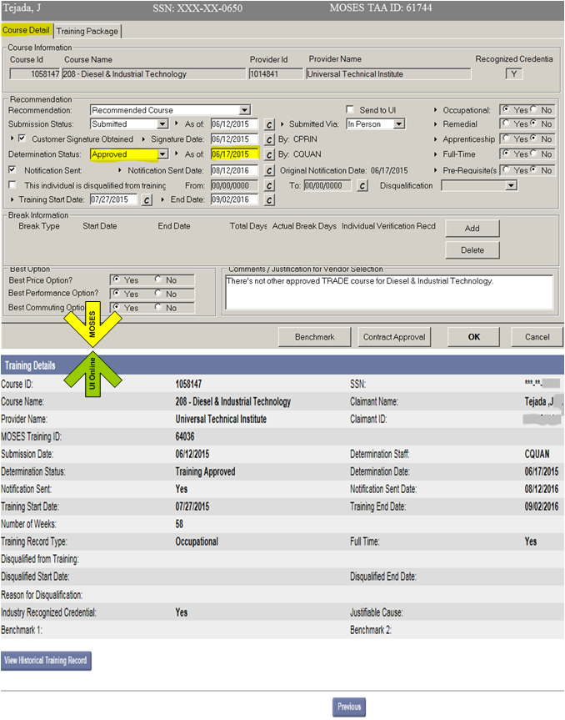
Training Approval in MOSES➔➔
Interface sends training approval over to UI Online-nightly batch process
Training Approval
in UI Online➔➔

Slide 39
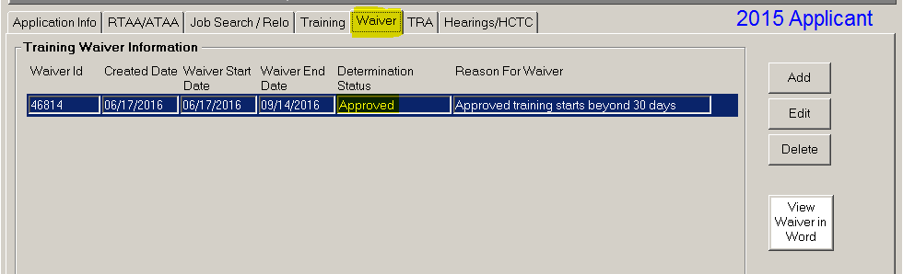
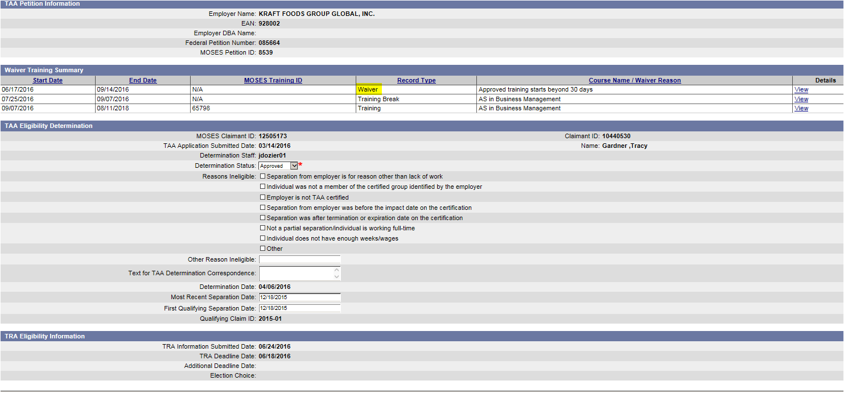
Waiver in MOSES and UI Online
If a Waiver is approved in MOSES it is sent to UI Online.

Slide 40
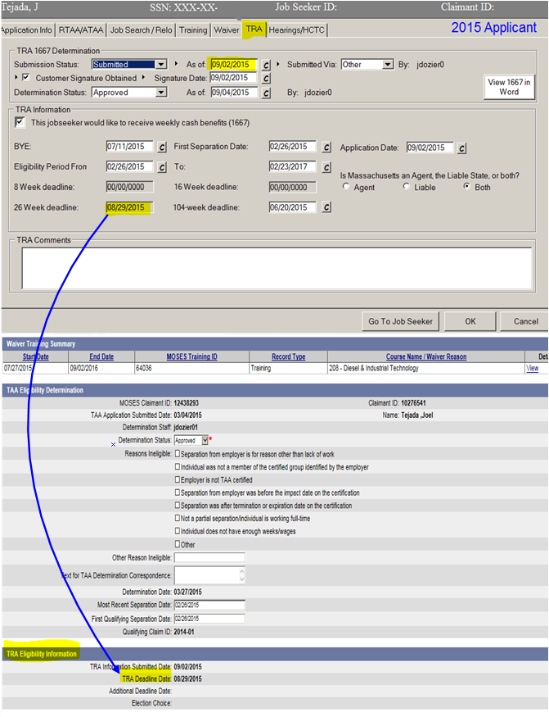
TRA Deadline in MOSES ➔ ➔
TRA Deadline
in UI Online ➔ ➔

Slide 41
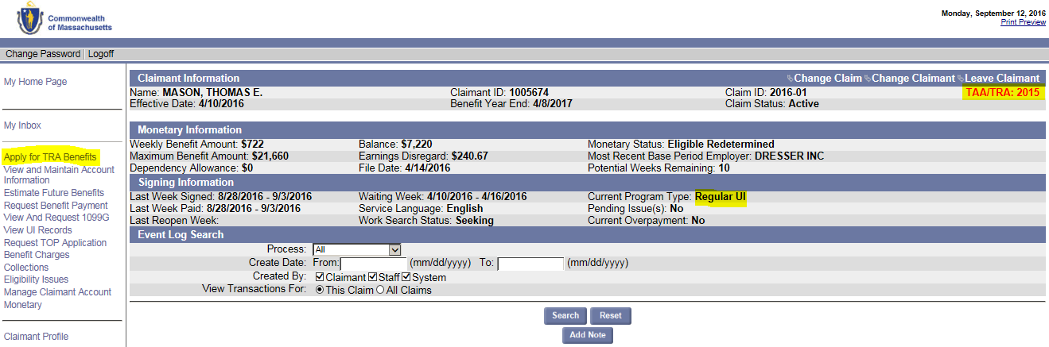
Activate TRA Application In UI Online
Once someone is determined potentially TAA eligible the Apply for TRA link will appear in UI Online.
Visible for UI Staff and Indicates which law the worker is eligible under

Slide 42
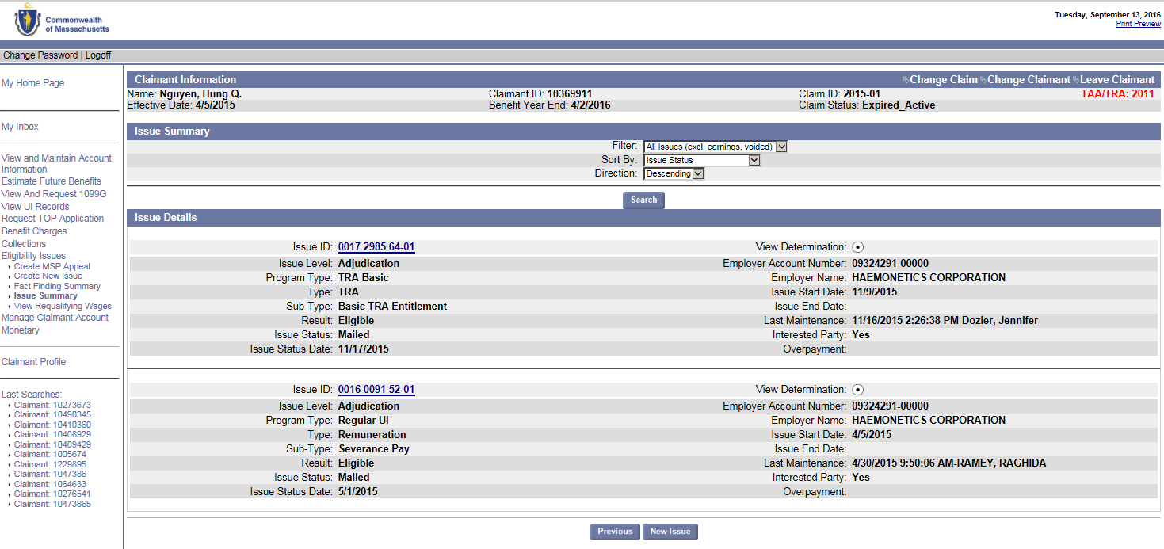
Application for TRA creates Issue for review
After applying for TRA an Issue is created in UI Online for adjudication
If determined eligible to receive TRA a notification is mailed
The application is stored for processing

Slide 43
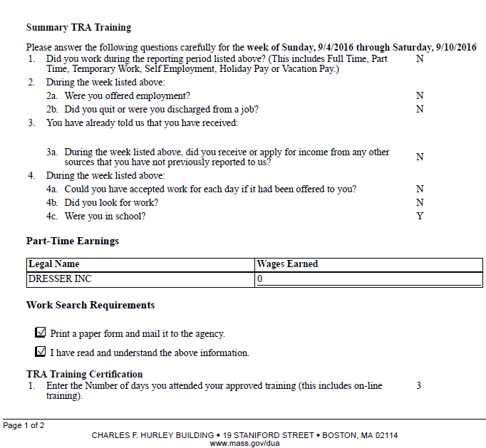
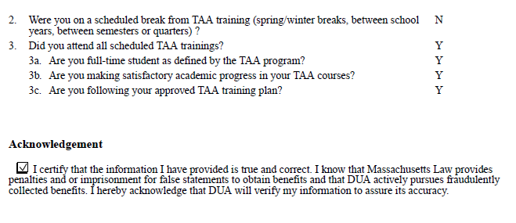
Weekly Certification in UI Online
Workers are required to certify weekly in order to receive TRA Benefits.
These are the questions included in the weekly certification for TRA participants enrolled in training ➔ ➔ ➔ ➔ ➔ ➔
The responses to the questions determine if a TRA Payment is processed.
If the response results in a TRA Payment not being processed, then an Issue will be generated and adjudication required for payment to be released.

Slide 44
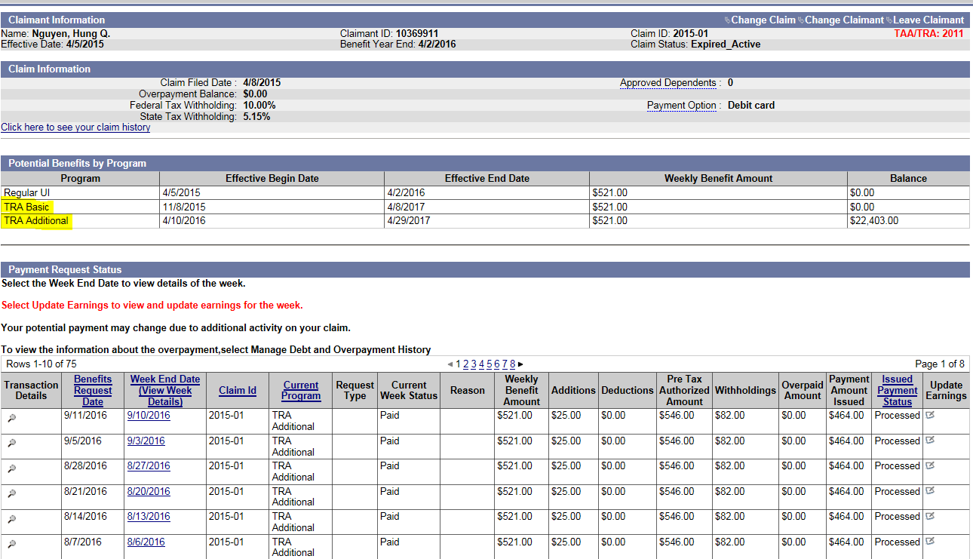
TRA in UI Online
Below shows the UI Online screen for a Trade Participant that is enrolled in training, collected UI, Basic TRA and is presently collecting Additional TRA
If eligible for Completion TRA, it would display here: ➔ ➔ ➔ ➔
Weekly Certifications trigger TRA payments➔➔➔

Slide 45
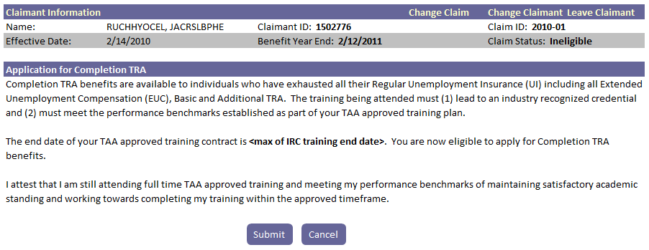
Completion TRA Application in UI Online
The Application for Completion TRA benefits will only be enabled when the Trade Participant becomes eligible (i.e. exhaustion of UI and Additional TRA)
Similar weekly certification is required once eligible and approved for Completion TRA.

Slide 46
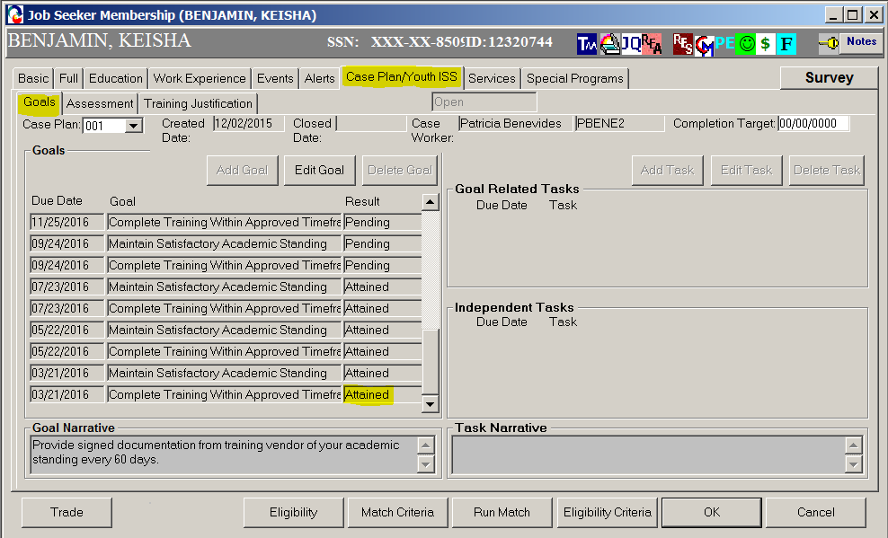
Training Benchmarks in MOSES
Training Benchmarks are documented in MOSES (Case Plan – Goals ➔ ➔ ➔ ➔ ➔
In order for Completion TRA to be collected, benchmarks must be established at the beginning of all training programs longer than 3 months.
Once on Completion TRA, these benchmark results are sent to UI Online and edited against how a person responds to their weekly certification. If there is a discrepancy, then an Issue will be generated and adjudication required for continued TRA eligibility.

Slide 47
Health Coverage Tax Credit (HCTC)
Now that HCTC is reinstated DCS and DUA collaborate on reporting the results of potential eligibles to the IRS.
MOSES send to UIO, on a daily basis, customers who are potentially HCTC eligible participants, including A/RTAA participants.
UIO will then matches for UI or TRA payments and sends the IRS those customers who matched (within the month being reported).
This matching is all done via a series of interfaces. Discrepancies (IB13s) are reviewed and manual adjustments to resend data, if needed, are completed.

Slide 48
Other MOSES-UIO Interfaces
DCS and DUA also have a number of other interfaces that support the RESEA Program and federal reporting for WIOA, NWDGs, Rapid Response, etc.
Future interfaces will include WOTC for processing long-term unemployed (LTU) and LTU Veterans.
This massive undertaking to develop and implement these interfaces has resulted in the elimination of duplicate data entry, timely determinations and benefit payments and accurate and timely federal reporting.

Slide 50
How to File a TAA Petition Online (2015)
  Tips and Tricks for Quality Petition Filing to Support Expedited Group Eligibility
    https://www.workforcegps.org/events/2016/04/20/12/59/How_to_File_a_TAA_Petition_OnlineName of reference item
Who is the TAA Customer. Resources, Characteristics and Strategies for TAA and other Adult Learners (2015)
  Tips and Tricks for Quality Petition Filing to Support Expedited Group Eligibility
    https://taaccct.workforcegps.org/resources/2016/04/15/16/28/Who_-is_the_TAA_Customer-_Resources-_Characteristics_and_Strategies_for_TAA_and_other_Adult_Learners
Rapid Response Reporting for Trade Adjustment Assistance (2015)
  Examines how RR shapes outcomes, how TAA Data Integrity (TAADI) aims to improve Rapid Response reporting, and provide a forum for states to discuss the costs and benefits
    https://www.workforcegps.org/events/2015/11/23/15/01/Rapid_Response_Reporting_for_Trade_Adjustment_AssistanceName of reference item
TAA Fiscal and State Best Practice Webinar (2013)
  Provides Fiscal overviews for spending TAA Program Funds and State Best Practices to provide ideas for leveraging resources
    https://www.workforcegps.org/events/2014/07/08/13/59/trade-adjustment-assistance-taa-fiscal-and-state-best-practices-webinar

Slide 51
Susan Worden
  Supervisory Program Analyst
    Office of Trade Adjustment Assistance
      worden.susan@dol.gov
        202.285.4372
Jeri Jewell
  Trade Act Coordinator
    NH Employment Security
      Jeri.a.jewell@nhes.nh.gov
        (603)229-4355
    Beth Goguen
  TAA State Coordinator
    MA Department of Career Services
      bgoguen@detma.org
        (617)626.6053

Slide 52
Regional Trade Coordinators:
https://www.doleta.gov/tradeact/FedContacts_Regional.cfm
Region I
Amanda Poirier (TAA)
Christine Macauley(TRA)
Region 2
Steve Duval (TAA)
Ann-Marie Merena (TRA)
Region 3
Rachel Floyd-Nelson (TAA)
Rosemary Williams-Raysor (TRA)
Region 4
Kathy McDonald (TAA)
Keith Rowe (TRA)
Region 5
Jason Hudson
Region 6
Consuelo Hines

Slide 53
TAA Reporting in PIRL
  Transitioning TAA Reporting from TAPR to PIRL: FY 2018 and Beyond
    November 21, 2017

