Slide 3
Trade Adjustment Assistance: Targeting Program Challenges Using Case Management Funds
October 17, 2017
State Best-Practice Spotlight: OREGON

Slide 4
Susan Worden
Supervisory Program Analyst
Performance and Data Reporting Unit
Office of Trade Adjustment Assistance

Slide 5
Overview of Key TAA Program Challenges
Oregon Trade Navigator Model
Oregon Petition Coordinator Role
Q and A
Other Resources
Contacts
Upcoming Events

Slide 6
POLLING QUESTION What is your role? (can choose more than one)
Federal/ETA
State Administrator
State Trade Coordinator
State TRA Coordinator
Rapid Response
Performance Reporting
One Stop
Other (please use chat box)

Slide 7
TAA PARTICIPANTS SERVED 2009-2017

Slide 8
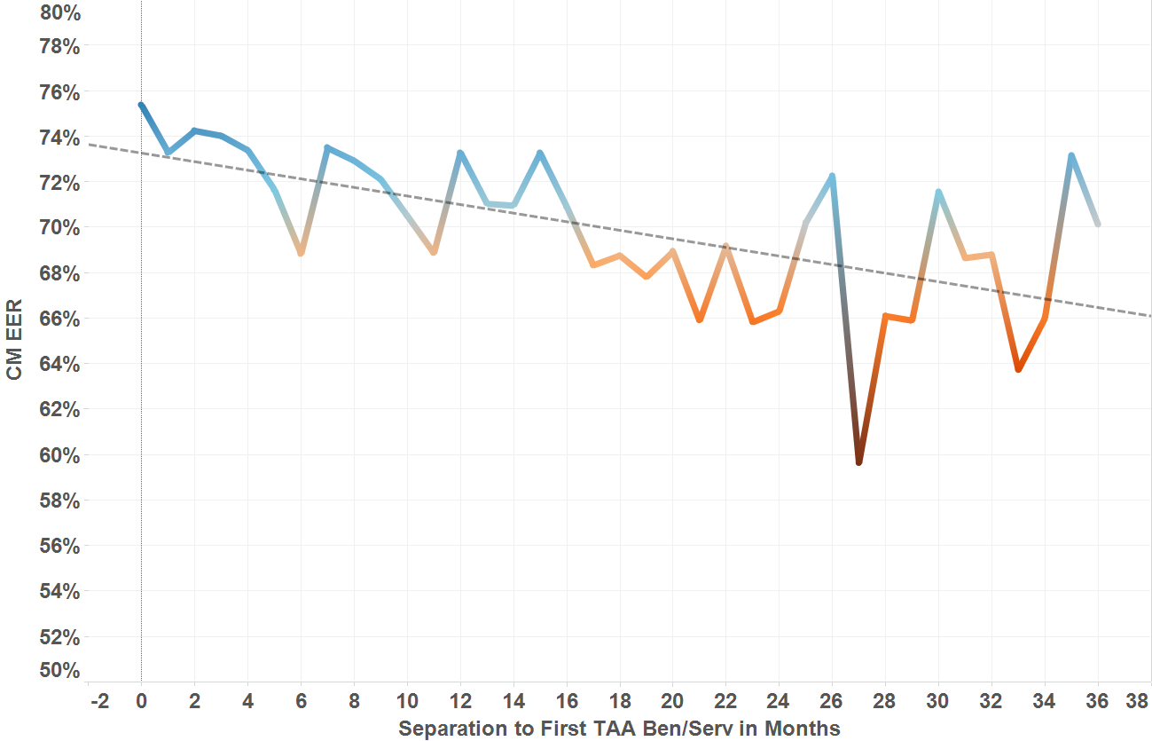
Gap Between Separation to TAA Participation – Correlation with Employment

Slide 9
PROJECTION OF RETURNED FUNDS FY 2015
State | Region | Unspent as of 6/30 | Projected Unspent as of 9/30
CT | 1 | $365,166.79 | $181,570.93
NJ | 1 | $1,570,563.41 | $1,371,952.68
NY | 1 | $6,401,987.89 | $5,527,154.59
PR | 1 | $484,706.58 | $325,970.81
DC | 2 | $110,233.54 | $100,977.95
MD | 2 | $6,426,998.37 | $5,863,194.31
VA | 2 | $1,974,435.00 | $1,926,790.21
WV | 2 | $1,161,396.25 | $711,737.59
AL | 3 | $1,102,475.16 | $709,024.34
FL | 3 | $1,758,325.35 | $1,215,591.91
GA | 3 | $1,222,949.04 | $633,518.59
NC | 3 | $3,587,315.78 | $2,669,227.76
SC | 3 | $2,976,440.66 | $2,882,446.12
TN | 3 | $2,656,655.48 | $1,001,143.13
AR | 4 | $3,304,932.06 | $3,287,276.26
LA | 4 | $1,183,518.25 | $736,660.07
TX | 4 | $15,679,325.91 | $15,674,468.77
IL | 5 | $883,030.37 | $113,922.78
KS | 5 | $3,523,920.30 | $753,450.17
MI | 5 | $6,738,535.00 | $5,349,421.00
MN | 5 | $2,441,196.13 | $843,572.91
OH | 5 | $4,214,795.38 | $4,122,908.20
WI | 5 | $3,654,334.32 | $487,115.91
CA | 6 | $6,925,815.88 | $6,833,507.50
ID | 6 | $574,641.64 | $565,266.24
TOTAL |  | $86,944,065.22 | $63,887,870.72

Slide 10
Why Co-enrollment Matters

Slide 11
POLLING QUESTION Which of the following are TAA Program challenges in your state? (select as many as apply)
Not enough petitions/potentially TAA- eligible worker groups
Spending Program Funds
Delays in group eligibility process (impacts volume of take-up)
Collecting worker lists from Employers
Coordinating with Partner Programs to ensure seamless service
Other (please detail in chat box)

Slide 12
STATE BEST PRACTICE SPOTLIGHT
Why OREGON?
Efforts to Improve Outcomes Reporting in TAPR
#1 in Petition Filings in FY 2016
#1 in TAA Participation in FY 2016

Slide 13
Ricque Smith
Trade Act Coordinator
Oregon Employment Department
Shelley Forsberg
Petition Coordinator
Oregon Employment Department

Slide 14
Targeting performance… the Trade Act Navigator and Petition Coordinator Model
Ricqué Smith and Shelly Forsberg

Slide 15
Background of Oregon’s service delivery Planning meetings around change in service delivery The role of the Trade Act Navigator (TAN) The role of the TAA Petition Coordinator Funding for positions Rewards reaped and lessons learned Question and Answer
Topics for Review

Slide 16
Walt Disney
Times and conditions change so rapidly that we must keep our aim constantly focused on the future.

Slide 17
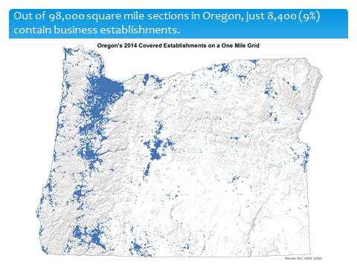
History of TAA service delivery in Oregon
9th largest state by area
(98,380 sq miles)
99% is considered rural

Slide 18
History of TAA service delivery in Oregon continued…
Change in service delivery needed for consistency and workload
Unique centralization approach began in 2009; full implementation in 2012
While highly efficient and cost effective,
wanted to increase TAA program knowledge and connectivity across the state.

Slide 19
POLLING QUESTION T/F Question: TAA Funds may be used to fund Program Awareness/Outreach
True
False

Slide 20
Trade Act Navigator
Proposed the idea of change in service delivery in March 2015

Slide 21
Trade Act Navigator Proposal
Concept
Align with the 9 Workforce Regions
Localized approach while maintaining centralized functions
Promote TAA program
Navigate incoming TAA participants
Connect TAA participants to On-the-Job Training through Job Development
Mirror Sector Strategy messaging to TAA participants in each area
Increase entered employment rates of TAA participants
Connection to local Rapid Response teams, regardless of Trade activity

Slide 22
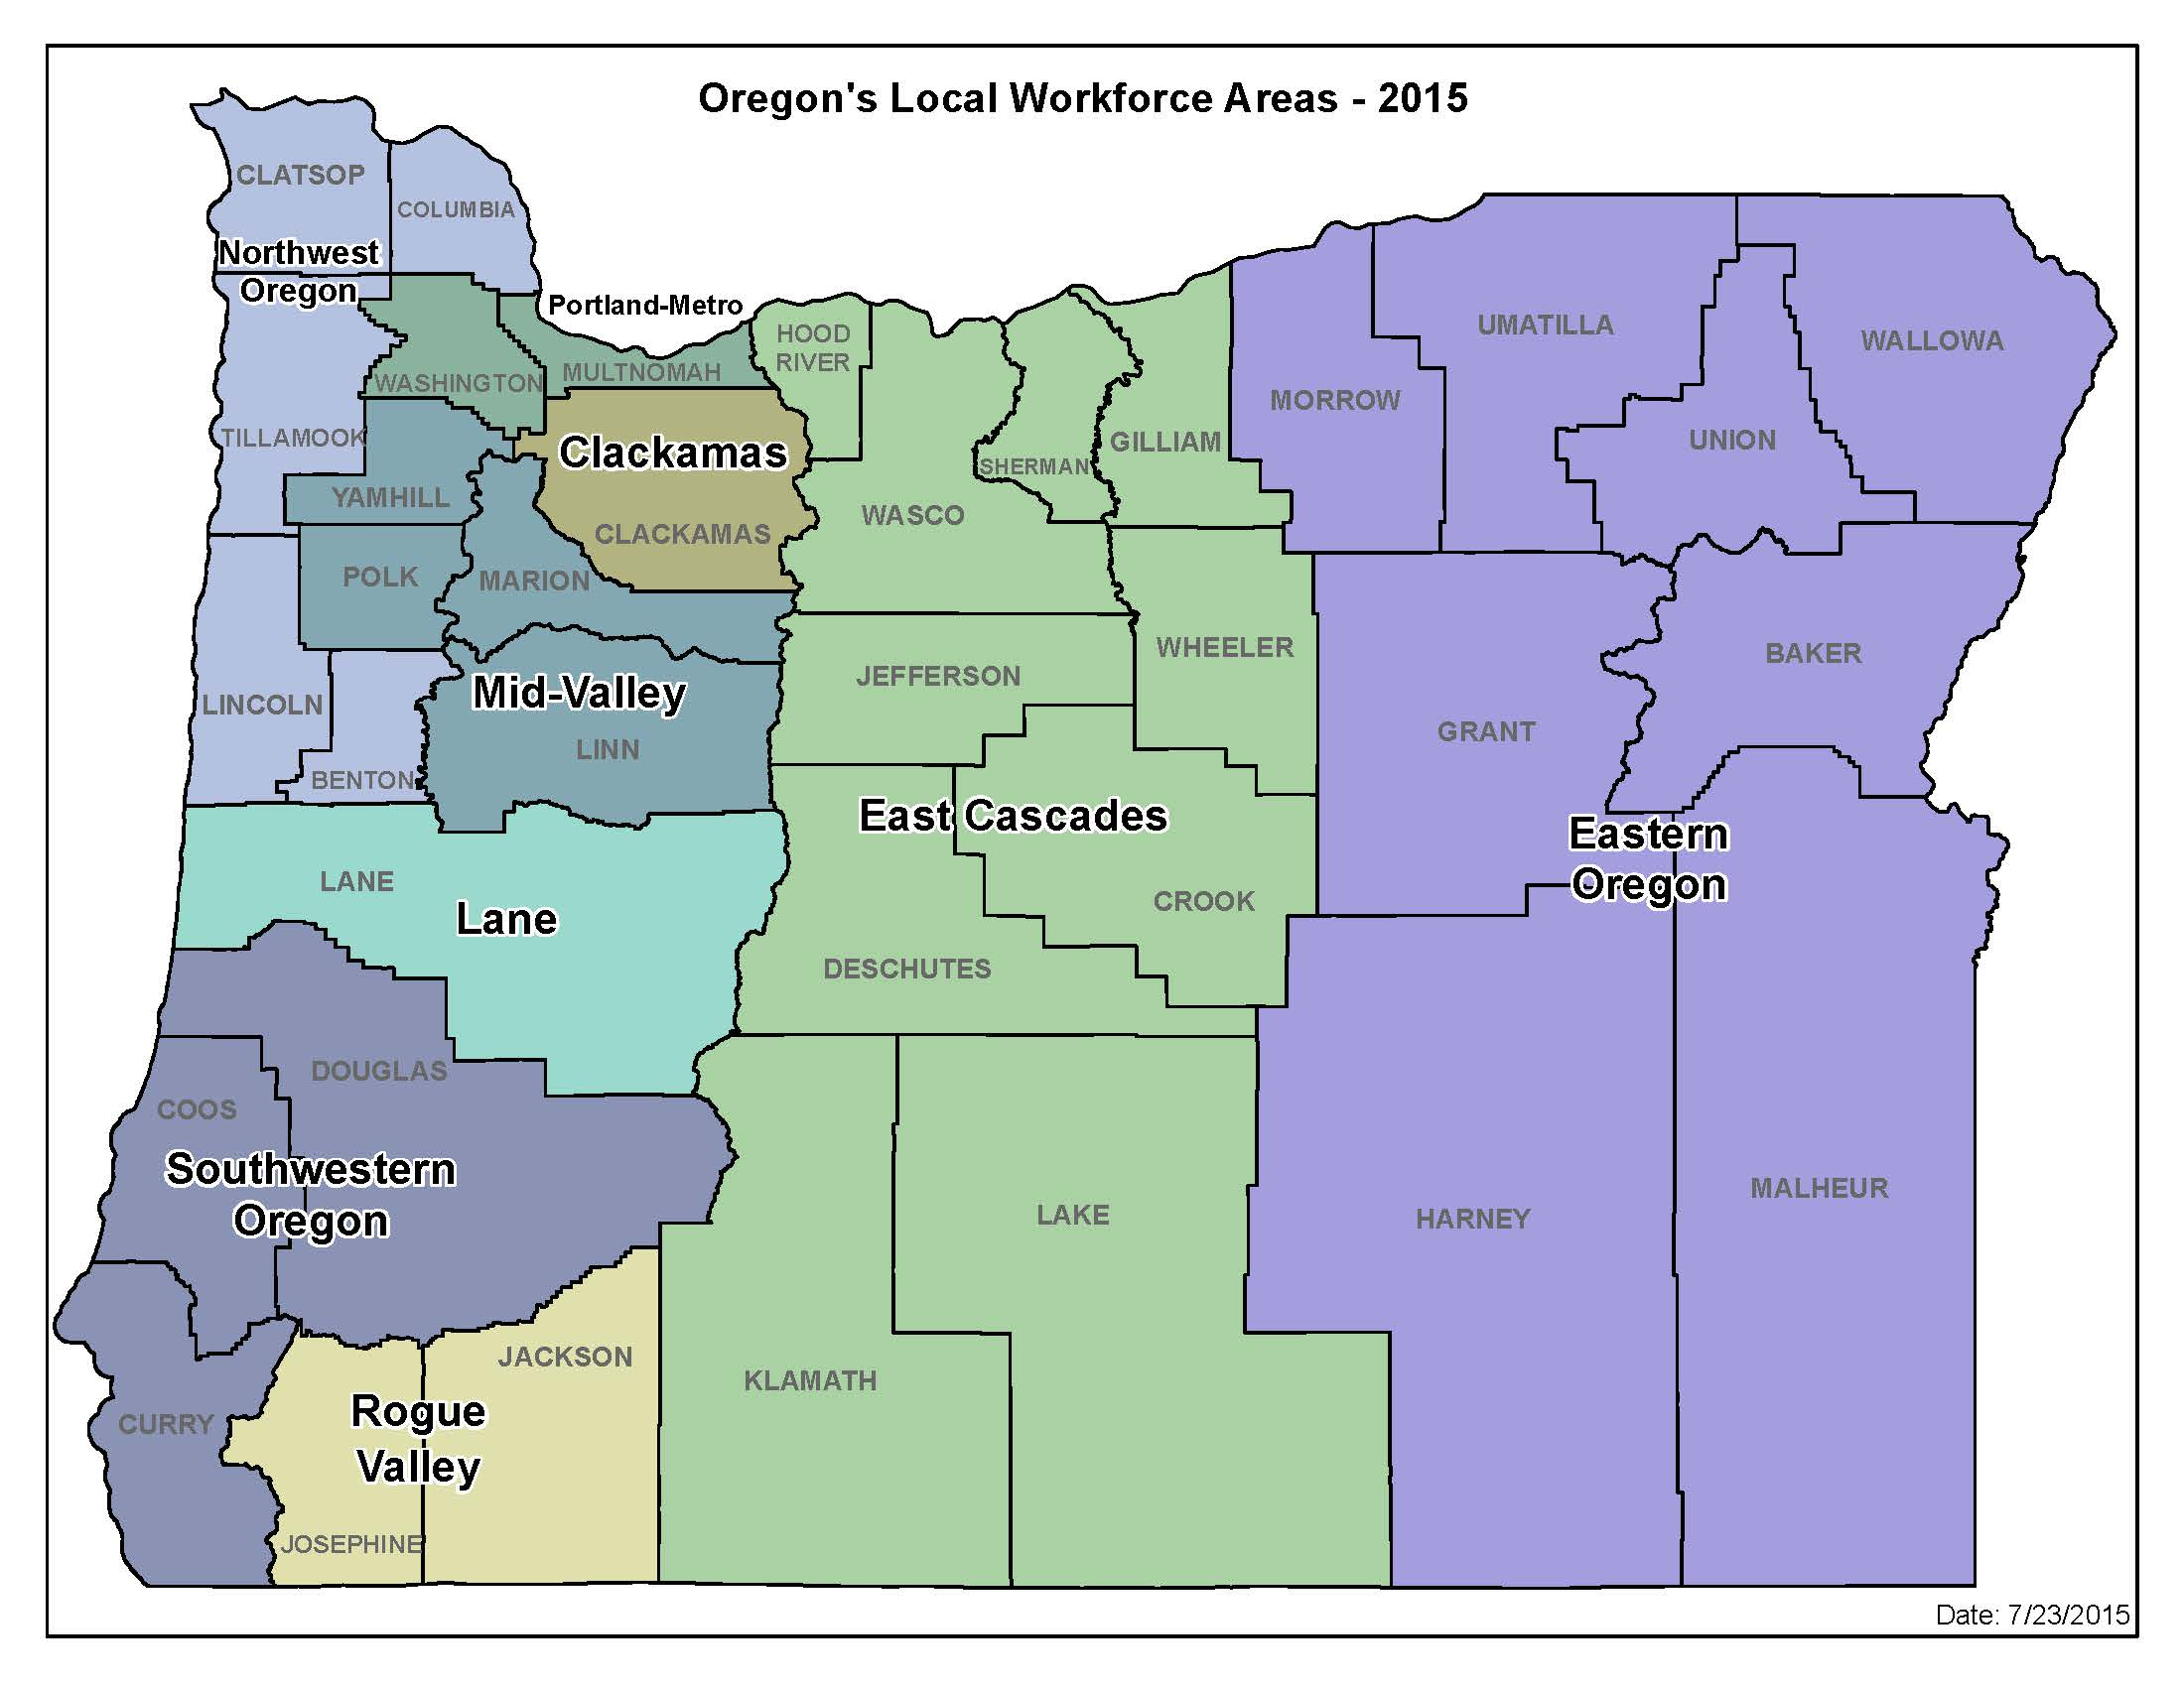
Nine Workforce Areas

Slide 23
Trade Act Navigator Proposal
Planning
Began with Portland and Clackamas area
Invited stakeholders from both (local) Workforce Boards, both (local) Title 1 Service Providers, (state) Community Colleges and Workforce Development (CCWD) and (state and local) Employment Department staff to a series of meetings
Presented concept
Discussed various team connections, location of positions, determined appropriate name for positions, and scope of work

Slide 24
TAN Planning Meetings and Training
Portland and Clackamas
Meetings provided a foundation for the remaining regional planning meetings
Positions went from concept to clarity through collaboration
Response was positive from all stakeholders
Remaining Area’s Scheduled
Reviewed concept
Identified each areas unique resources and connections for TAN’s
Response remained positive from all stakeholders
Each area collaborated on TAN interview panel
Training
2 ½ weeks in Central Trade Act Unit
Paired with mentor
Focus on high level program info, goals of position, political dynamics
Area binder of information on area information and minutes from planning meetings

Slide 25
After months of planning, recruitments, and training…
The TAN service delivery model rolled out in December 2015 in 7 of the 9 Workforce Areas in Oregon.

Slide 26
Initial Goals of TAN’s
01
TAA Participants
Navigate and connect
02
Rapid Response
Member of local team
03
Promoting TAA
Increase literacy and awareness
04
Increase OJT’s
Job development, collaboration

Slide 27
TAA Participants
Connect with TAA participants in classroom training the last term to focus on transition to employment
Navigate TAA participants through WorkSource system and to TAA case manager
Connect TAA participants interested in On-the-Job Training to employers through Job Development

Slide 28
Sector Strategy Emphasis
Definition: “Goals, plans of action, policies, and service delivery strategies developed and continuously re-examined by sector partnerships to meet the ongoing and changing needs of employers within that sector.”
Messaging to participants at Rapid Response and TAA Information Sessions
Educating case managers on local Sector Strategies; focus on mirroring messages during career guidance

Slide 29
Rapid Response
Consistent member of local team(s)
Educate members of team on Trade, review program information at Rapid Response sessions
Collect data for reporting
Poised to transition affected workers to TAA if and when eligible
Inform Petition Coordinator of all lay off activity

Slide 30
T/F Question: TAA Funds may be used to identify Employer-Based Training Opportunities
True
False

Slide 31
Petition Coordination TEGL 5-15 “CSA’s must make every effort to notify workers that a petition should be filed as soon as possible if they believe that a worker group may be eligible…”
Connection to Rapid Response

Slide 32
Identifying Affected Workers

Slide 33
Common Employer Concerns
Are we in trouble?
How much is this going to cost me?
This is going to look bad to our stockholders.
We are trying to save our company and we can’t do
that if our employees quit and you send our workforce
to school.

Slide 34
Petition Coordination Continued…
Ask the “Why”
Reason vs. Factor
“Contribute Importantly”
Follow the trail

Slide 35
Expanding Program Awareness
Promotion and Education
Program
Petition filing
Successes
Desire and need for collaboration
Stakeholders
Workforce Boards
Title 1 Service Providers
Employment Department staff
Community Colleges
One Stop partners
Public
Entering American Job Centers
Attending Rapid Response
Attending Community Colleges and training facilities

Slide 36
On-the-Job Training
Goals:
Increase OJT opportunities
Promote TAA program awareness in community
Message as part of “lay-off aversion”
On-going Collaboration:
Messaging OJT as a “system”- not program specific
Connect the “right” talent to employer
Case load to be managed by TAN’s

Slide 37
Nine Workforce Areas
Portland Metro and Clackamas: supported by seven
The remaining supported by one in each area:
Mid-Valley and NW
Lane and Eastern
Southwestern OR
Rogue Valley
East Cascades

Slide 38
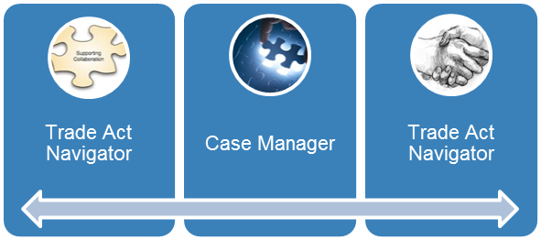
Model in practice
Lay off
Rapid Response
Trade Act Information Sessions
Assessment Workshops
Hand off to case managers
Resource
Locally for participants
Partners
Community Colleges
Sector Strategy information
Re-employment and Training
Outreach to increase participation
Outreach to those completing training to transition to employment

Slide 39
Frees up other key positions
TAA Coordinator can focus on program performance, innovation and staff development
Case Managers able to focus on case management and career development

Slide 40
Regular Communication
Weekly email updates focus on:
Sector Strategies
Local Office Updates
Petition Activity
OJT/Training Completer Lists
Training facility updates
Accomplishments
Quarterly all staff training and meetings:
First scheduled in March 2016- focused on defining roles and hand off between teams
All Trade staff present including our TRA counterparts
Scheduled meetings:
One-on-one phone meetings every third week
As needed (individual or leadership meetings)

Slide 41
“…case management expenditures should be consistent with providing effective services to adversely affected workers and increasing performance outcomes.” “In addition to staff costs for career counselors, employment and case management services funds may be used for: assessment tests; skills transferability analysis; peer counselors; development and provision of labor market information; follow-up services;…” “…any other staff costs related to case management. This list is not intended to be all inclusive.”
Funding
Case management funded positions as interpreted under section 235A and 239(g) of 2015 Act; TEGL’s 15-12, 19-16.

Slide 42
POLLING QUESTION Multiple Choice: With regard to TAA Employment and Case Management Funds and Trade Program Grant Funds (TaoA), which answer is correct?
States must spend a minimum of 5% of their total FY Grant during the 3 year life of the grant.
States must spend a maximum of 5% of their total FY Grant during the 3 year life of the grant.
States must spend a maximum of 10% of their total FY Grant during the 3 year life of the grant.

Slide 43
Rewards Reaped and Lessons Learned…

Slide 44
Rewards!
Outreach
Petition activity
Increased program knowledge
Use lists to reach out to eligible for program and not engaged
Entered Employment
Focus on transitioning participants into employment last term of training
Use lists as tool
Rapid Response
TAN’s listed as a resource
Full integration into Rapid Response teams
Data collection and sharing increase

Slide 45
Activity since December 2015
Petition
Activity
Case
Management
OJT
OJT’s have increased 250%
Petition activity=
2014: 30 petitions filed; 19 certifications
2015: 35 petitions filed; 23 certifications
12/2015-7/2017: 135 petitions filed, 89 certifications, 21 pending decisions
Case management: 52% increase in spending (comparison based on 4 quarters preceding new model and 4 quarters following implementation) in large part due to TAN efforts and role

Slide 46
Lessons Learned
Need constant leadership for roles
New Workforce Boards
WIOA
New positions
Prime time to make changes
Activity level of program manageable
Collaboration highly sought by stakeholders
WIOA requires alignment
Need to tell our story

Slide 47
Kurt Shovlin
The Trade Act Navigators and other staff from the Central Trade Act Unit in particular, usefully guided the employer through the Trade Act application process and succinctly outlined the basic elements and benefits of the Trade Act Program to an appreciative and grateful audience over the course of six large Rapid Response Information Sessions. It’s a memorable moment anytime faces of despair turn to those of delight as is often the case, in my experience, when a rapid response Trade Act presentation is completed, not unlike my own reaction despite the number of times I have witnessed it!
Senior Project Manager, Portland Metro Rapid Response Lead, Worksystems, Inc.

Slide 48
Kathy Wilcox
The addition of Trade Act Navigators has had a very significant and positive effect on Rapid Response delivery in Oregon. The Trade Act Navigators knowledge of the Trade Act Program and commitment to act together as a team with Rapid Response has been impressive and has made a positive difference in the lives of dislocated workers in Oregon.
Office of Workforce Investments, Office of Higher Education and Coordinating Commission

Slide 49
Sherri Stratton
The new Trade Act Navigator (TAN) model has progressive influences for our local and state workforce service delivery model. Our local TAN provides TAA specialist knowledge and resources across organizational boundaries and regions. Josh Morell, WorkSource Rogue Valley Trade Act Navigator, is connected to all three of our local workforce centers, our workforce board, and our region’s sector strategy efforts. He contributes to our regional business team coordination efforts to streamline services and leverage support for the impacted workers and businesses. In addition, Josh is well connected with his peers and partners across the region.
Rogue Valley Area Manager, Oregon Employment Department

Slide 51
How to File a TAA Petition Online (2015)
Tips and Tricks for Quality Petition Filing to Support Expedited Group Eligibility
https://www.workforcegps.org/events/2016/04/20/12/59/How_to_File_a_TAA_Petition_OnlineName of reference item
Who is the TAA Customer. Resources, Characteristics and Strategies for TAA and other Adult Learners (2015)
Tips and Tricks for Quality Petition Filing to Support Expedited Group Eligibility
www.address.com
Rapid Response Reporting for Trade Adjustment Assistance (2015)
Examines how RR shapes outcomes, how TAA Data Integrity (TAADI) aims to improve Rapid Response reporting, and provide a forum for states to discuss the costs and benefits
https://www.workforcegps.org/events/2015/11/23/15/01/Rapid_Response_Reporting_for_Trade_Adjustment_AssistanceName of reference item
TAA Fiscal and State Best Practice Webinar (2013)
Provides Fiscal overviews for spending TAA Program Funds and State Best Practices to provide ideas for leveraging resources
https://www.workforcegps.org/events/2014/07/08/13/59/trade-adjustment-assistance-taa-fiscal-and-state-best-practices-webinar

Slide 52
Susan Worden
Supervisory Program Analyst
Office of Trade Adjustment Assistance
worden.susan@dol.gov
202.285.4372
Ricque Smith
Trade Act Coordinator
Oregon Employment Department
Ricque.J.Smith@state.or.us
(503) 947-1665
Shelly Forsberg
Petition Coordinator
Oregon Employment Department
shelly.D.forsberg@oregon.gov
(503)947.1688

Slide 53
Regional Trade Coordinators:
https://www.doleta.gov/tradeact/FedContacts_Regional.cfm
Region I
Amanda Poirier (TAA)
Christina McCauley(TRA)
Region 2
Steve Duval (TAA)
Ann-Marie Merena (TRA)
Region 3
Rachel Floyd-Nelson (TAA)
Rosemary Williams-Raysor (TRA)
Region 4
Kathy MacDonald (TAA)
Keith Rowe (TRA)
Region 5
Jason Hudson
Region 6
Consuelo Hines

Slide 54
Targeting TAA Program Challenges with Case Management Funds
Best Practice Spotlight: New Hampshire and Massachusetts
November 14, 2017
TAA Reporting in PIRL
Transitioning TAA Reporting from TAPR to PIRL: FY 2018 and Beyond
November 21, 2017

