Slide 1
WIOA Youth Eligibility Live Question and Answer Session
October 18, 2017
October, 24, 2017

Slide 3
Sara Hastings
Unit Chief /Division of Youth Services
DOL/ETA

Slide 4
Our Journey Together TA Series Two Day Kick-off Webinars
Series Kick-Off: Where we’ve been, where we are now and where we’re going! Tuesday, October 24, 2017 at 11:30 AM ET
WIOA Youth Eligibility Live Question and Answer Session Tuesday, October 24, 2017 at 2:30 PM ET
Coming Together at the Table--The Power of Youth Committees to Convene, Coordinate and Collectively Impact Youth Lives Wednesday, October 25, 2017 at 11:30 AM ET
WIOA Youth Performance Accountability Wednesday, October 25, 2017 at 2:30 PM ET

Slide 5
Evan Rosenberg
US Department of Labor, Employment and Training Administration, Division of Youth Services

Slide 6
Provide refresher of WIOA Youth eligibility regulations and guidance
Provide an opportunity to ask DOL any questions you have related to WIOA Youth eligibility

Slide 7
Eligibility Quiz Question
True or False: A youth in postsecondary education, enrolled in credit-bearing courses, who is basic skills deficient, is an out-of-school youth?
True
False

Slide 8
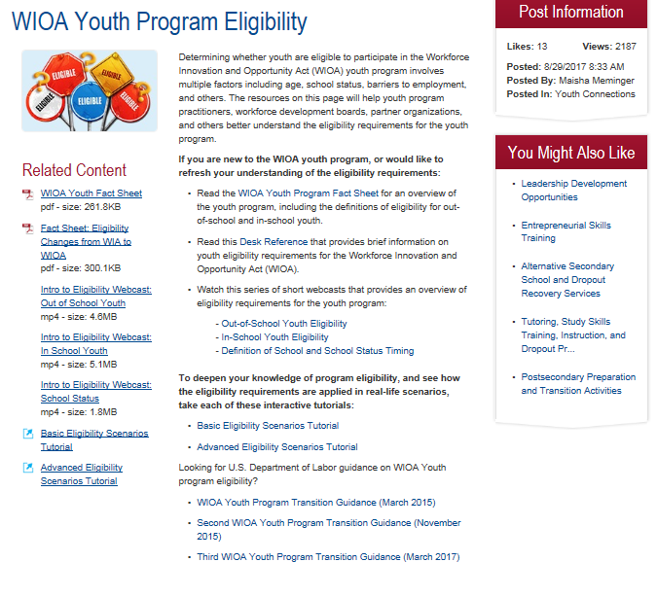

Slide 9
WIOA Youth Eligibility Refresher
Please follow along for a refresher of WIOA Youth Eligibility regulations and guidance ….

Slide 10
Eligibility Quiz Question
True or False: there is a 5% limitation on using the “additional assistance” barrier for eligibility determination for out-of-school youth?
True
False

Slide 12
Quiz Question
True or False: An in-school youth who is age 21 at their date of program participation and turns 22 while a participant in the program is no longer eligible for WIOA youth services and must be exited immediately.
True
False

Slide 13
Quiz Question
True or False: If an OSY, while in the WIOA youth program, returns to high school, their status changes to ISY on the date they re-enroll in high school?
True
False

Slide 14
Quiz Question
True or False: A youth who is enrolled in the Title II Adult Education program and subsequently enrolls in the WIOA youth program is an OSY?
True
False

Slide 15
Quiz Question
Which of the OSY barriers only count if the individual is also low income?
An individual in foster care
An individual who requires additional assistance
An individual who is pregnant or parenting
All of the above

Slide 16
Quiz Question
True or False: All ISY (other than those who fall under the 5% exception) must be low income to be eligible for the WIOA youth program?
True
False

Slide 17
Quiz Question
Which of the following may be used to document low income for youth?
A youth who lives in high poverty
A youth who receives reduced price lunch
A youth who is homeless
A youth who is a foster child
All of the above

Slide 18
Resources
Workforce Innovation and Opportunity Act, Pub. L. 113-1128
Workforce Innovation and Opportunity Act Statute
https://www.gpo.gov/fdsys/pkg/PLAW-113publ128/pdf/PLAW-113publ128.pdf
WIOA Final Rule
DOL Only Final Rule: Youth Section is 681
https://www.gpo.gov/fdsys/pkg/FR-2016-08-19/pdf/2016-15975.pdf
Training and Employment Guidance Letter (TEGL) No. 21-16
Third Workforce Innovation and Opportunity Act (WIOA) Title I Youth Formula Program Guidance
https://wdr.doleta.gov/directives/corr_doc.cfm?DOCN=7159

Slide 19
Ways to Engage and Connect: DOL and your colleagues need to hear from you!
1st things 1st: Become a GPS member and use the Member Directory
Share your work
Submit a Resource on WorkforceGPS.
Send us your lessons learned and successful strategies to share with the field to youth.services@dol.gov
Participate in Discussion Threads

Slide 20
If you have further questions …
If you have a question that we were not able to get to during the webinar, or if you have additional questions, please email us at:
DOL.WIOA@dol.gov

