Slide 1
Monitoring & Managing Your WIF Grant
October 26, 2017

Slide 2
Presenter
Charles Cox
U. S. Department of Labor
Employment and Training Administration
Office of Special Initiatives & Demonstrations
Region 4 – Dallas
Today’s Facilitator:
Wendy Havenstrite
U. S. Department of Labor
Employment and Training Administration
National Office of Workforce Investment

Slide 3
Q & A
Joining for questions & answers:
Latha Seshadri
Federal Project Officer
ETA Region 6 – San Francisco
Jessica Otieno-Jani
Federal Project Officer
ETA Region 3 – Atlanta
This Photo by Unknown Author is licensed under CC BY-NC

Slide 4
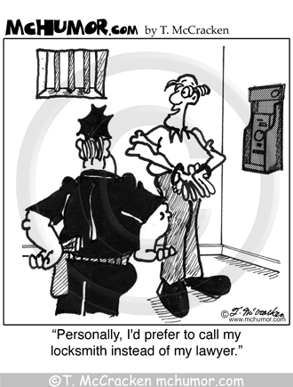
Monitoring and Managing Your WIF Grant

Slide 5
Monitoring and Managing Your Grant
Monitoring
Types of Grant Monitoring
On-Site Reviews: The Basics
Purpose of Grant Monitoring
How to Prepare for a Monitoring Visit
On-site Monitoring
Understanding the Monitoring Report
Finding(s)
Area(s) of Concern

Slide 6
Types of Monitoring
Quarterly Performance Reviews
Quarterly Narrative Report
Quarterly Performance Report
Quarterly Financial Report
Desk Monitoring Reviews
Quarterly Narrative Report
Quarterly Financial Report
Grants e-Management System (GEMS)
On-Site Reviews

Slide 7
On-Site Reviews: The Basics
Who conducts On-Site Reviews?
FPO (with additional ETA Staff if needed)
When is the review conducted?
Usually midpoint during your grant’s period of performance
What is the duration of the review?
Usually five days
Notification of Review:
Letter confirming scheduled date of review and Core Monitoring Guide/Review Planning Tool mailed to Grant Recipient

Slide 8
On-Site Reviews: The Basics
What not to do when you receive notification that your grant is about to be monitored.

Slide 9
What is the Purpose of Grant Monitoring?
It is NOT a “GOTCHA”
It is an opportunity to:
Ensure that the Department of Labor grant funded program is aligned with:
Statute/Regulations/Grant terms & conditions
Federal financial and administrative requirements including cost principles
Funding Opportunity Announcement (FOA)
Identify promising practices that can be shared
Identify technical assistance needs

Slide 10
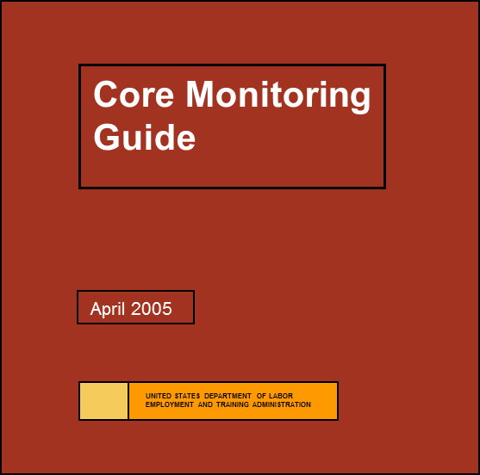
How to Prepare for a Monitoring Visit
Review the Core Monitoring Guide
Five Core Activities
Design and governance
Program/Grant Management Systems
Financial Management Systems
Service/product Delivery
Performance Accountability
Guide is available at:
https://www.doleta.gov/regions/reg02/documents/OSID%20Conference/Resource%20-%20Core-Monitoring-Guide.pdf

Slide 11
How to Prepare for a Monitoring Visit
Review the following:
Funding Opportunity Announcement (aka Solicitation for Grant Application [SGA])
Statement of Work (SOW)
Monthly Reports that have been submitted
Narrative, Financial, and Performance
Subrecipient Reports (if applicable)
Policies and Procedures
Participant Files

Slide 12
On-site Monitoring Structure
Introductory Conference (Day 1)
Review (Days 2-4)
Exit Conference (Day 5)
Preliminary findings and observations
Written Report (45 days following the exit meeting)

Slide 13
On-Site Monitoring
What do we look at?
Connection/Compliance to the FOA
Connection/Compliance to the SOW/Grantee Agreement
Performance
Service Delivery
Financial Management
Policies and Procedures

Slide 14
Understanding the Monitoring Report
Written Report (45 days following the exit meeting)
Findings and required corrective actions
Opportunities for improvement, i.e. Area of Concern
Positive observations

Slide 15
Understanding the Monitoring Report
What is a finding?
A finding is any “violation of”
Law
Regulations
Grant agreement
SGA/FOA requirement

Slide 16
Understanding the Monitoring Report
Examples of Findings:
Changes were made to the Statement of Work (SOW) without Grant Officer approval
Change in scope or objective
Adding/deleting program component
Adding/deleting subrecipient
Changing target group

Slide 17
Understanding the Monitoring Report
Examples of Findings:
Grant funds were used to purchase equipment without Grant Officer approval
Unit cost of $5000 and useful life of one year
Prior approval required even if included in the grant budget
This requirement also applies to subrecipients

Slide 18
Understanding the Monitoring Report
Examples of Findings:
Negotiated Indirect Cost Rate Agreement is expired
The Equal Opportunity (EO) requirements are not being fully implemented
The Grant Recipient realigned the budget without prior Grant Officer approval
Subrecipients are not monitored
Project significantly behind schedule in implementing grant activities
Procurement files do not contain required support documentation

Slide 19
Understanding the Monitoring Report
What is an Area of Concern?
Concern about effectiveness or efficiencies
Not related to compliance with law, regulation, FOAs, grant agreements or federal policy
Can relate to performance, services or operational efficiencies/effectiveness
Should convince/compel grantees to take action

Slide 20
Understanding the Monitoring Report
Examples of Areas of Concern:
Performance Concern
Projected outcomes based on current data
Not mandated by law, regulation or milestones listed in SOW
Service Concern
Business services, involvement of business, involvement of listed partners, quality and timely services, customer access, etc.
Operational Concern
Procedural bottlenecks, staff knowledge, internal security and controls, internal communication, training, policy distribution, etc.

Slide 21
Responding to the Monitoring Report
Grantees have 45 days to respond
Response is submitted to your FPO
Findings will have a “Required Action”
Submission of a modification request
Action plan to address the finding
Evidence the finding has been corrected
Area(s) of Concern do not require a response, but it is advised that you address it in the report

Slide 22
Tips for Successfully Managing Your Grant
Review the Grantee Handbook (June 2016)
ETA’S Team Approach to Grant Management – Organizational Roles and Responsibilities
An Overview of Award Documents, Grantee Obligations, and Regulatory Requirements
How to Manage Your Period of Performance
Modifying Grants
Grant Closeout Phase
Evaluation: What Do I Need to Know as a Grantee?
Grantee Handbook can be found @:
https://www.doleta.gov/dinap/pdf/Grantee-Handbook-(2016).pdf

Slide 23
Tips for Successfully Managing Your Grant
Communicate with your FPO
Email and telephone
Identify issues early
Recruitment, financial, and reporting
Track progress
Document successes and challenges
Don’t be afraid to ask for help or technical assistance
Work with your partners and coaches

Slide 24
Uniform Guidance
Uniform Guidance at 2 CFR Part 200 (effective on Dec 26, 2014) consolidated eight previously applicable OMB Circulars
DOL’s exceptions to the Uniform Guidance are at 2 CFR Part 2900
All grant awards or grant modifications released on or after Dec 26, 2014 must adhere to the Uniform Guidance
Electronic Code of Federal Regulations: www.ecfr.gov

Slide 25
Other Resources
ETA-9130 Financial Report Form
TEGL issued on July 14, 2016 (TEGL 02-16)
Forms and instructions may be found at:
https://www.doleta.gov/grants/financial_reporting.cfm
Core Monitoring Guide
https://www.doleta.gov/regions/reg02/documents/OSID%20Conference/Resource%20-%20Core-Monitoring-Guide.pdf

Slide 26
What Questions Do You Have?

Slide 27
Bark Less ☺ Wag More!

