Slide 1
TAACCCT Job Placement Strategies: From Enrollment to Employment
October 31, 2017
3:00 – 4:00 p.m. EST

Slide 2
Moderator
Eugenie Agia, Workforce Analyst, TAACCCT Grants, U.S. Department of Labor, Employment and Training Administration
Robin Fernkas, Division Chief, Division of Strategic Investments

Slide 3
TAACCCT Announcements
Webinars
From Design to Implementation, Flexible Apprenticeship Models That Work
Tuesday, November 07, 2017 @ 1:00 PM PM ET
TAACCCT Performance Reporting Q & A Series – November
Thursday, November 09, 2017 @ 1:00 PM PM ET

Slide 4
Job Placement
Why Job Placement is Important
Key aspect of TAACCCT: Building capacity at your institution to help students – particularly dislocated adults – get jobs
Job Placement is a major way you – and TAACCCT are evaluated
Performance
You can use TAACCCT funds to hire staff or a vendor to TRACK your employment outcomes in the last 6 months

Slide 5
Presenters
Facilitator
Scott Estrada, Performance Analyst, Maher & Maher

Slide 6
Job Placement
Career and Job Placement Services
How often are they meeting with students?
How often are they meeting with employers?
Employer Engagement
How often are employers meeting with students?
How engaged are your employers with your curriculum?
Does your program/employers have WBL agreements?
Oct 1 – March 31
It’s not too late to build capacity

Slide 7
Presenters
Presenters
Michelle Hall, Project Director, Manchester Community College
Mary Benedict, Project Manager, Clark State Community College
Jennifer Poe, Lead Data and Project Manager, Chaffey College

Slide 8
Connecticut Advanced Manufacturing Initiative (CAMI)
Michelle Hall
Project Director, Manchester Community College

Slide 9
Connecticut Advanced Manufacturing Initiative (CAMI)
A Problem…
Current & Future Skilled Workforce Shortage in Connecticut
Increased Statewide Manufacturing
Advent of New Technology
Rapidly Aging Workforce
A Solution…
$15,000,000 USDOL award
7 community colleges
5 Workforce Investment Boards
1 state college
CT-DOL
Hundreds of employers
Hire Personnel
Renovate Labs
Purchase Equipment
Develop Curriculum
Recruit & Retain Students
Develop Employer Partnerships

Slide 10
CAMI Grant
Employment & Internship Snapshot
1.
2.
3.
4.
5.
86%
25%
32%
69%
53%
Completers self-reported that they became employed
Participants identified themselves as incumbent workers
Incumbent workers switched to manufacturing-related jobs
Incumbent workers received training at behest of employer
Participants began an internship
Item #1 includes completers that become employed within the quarter and after the quarter they completed
Items #1 and #5 do not include the 530 participants that began Fall 2017
Items #2 and #4 will not change
Items #1, #3, and #5 will increase in QR2 2018
Post-completion employment data is self-reported and is captured via exit interview and phone call and/or email

Slide 11
CAMI Grant
Employer Contributions
521 Unduplicated Employers

Slide 12
CAMI Grant
Creative Employer Strategies
EXAMPLES:
Governor-Appointment Statewide Advisory Council
Employer Satisfaction Survey
Recruitment Strategy – EDAC Technologies
CT Department of Labor – Unemployed Population
Joint Effort – Changing Perception of Manufacturing

Slide 13
CAMI Grant
Example #1: Governor-Appointed Board
A statewide platform to discuss…
Adopting competitive starting salaries for program completers
Paying a differential for new employees with NIMS credentials
Developing regionally specific curriculum
Identifying soft-skills deficiencies
Participating in joint education/employer initiatives
Cultivating strategic plans to address “perception”
Added Credibility
Validated Employers

Slide 14
CAMI Grant
Example #2: Employer Satisfaction Survey
 |  | Excellent | Good | Satisfactory | Fair | Unsatisfactory
Job Understanding | Individual possesses a clear knowledge of the responsibilities and tasks he/she must perform |  | X
Job Performance | Individual is able to complete all assigned tasks with minimal supervision |  | X
Productivity | Neatness, thoroughness, timeliness and accuracy of work | X
Dependability | Individual can be relied upon for regular attendance, being on time, and completing assigned tasks |  | X
Cooperation | The ability to work willingly as part of a team with associates, supervisors, and others | X
Attitude | Individual can be relied upon to act in a courteous and mature manner | X
Safety/Housekeeping | Practices safe, clean work habits on equipment and areas of work | X
Additional Comments (strengths, weaknesses, suggestions, etc.):
Mike is a team player. He listens and follows directions well. He picks up new methods and processes well.
Suggestions for AMTC program improvement:
One drawback of the program is the speeds and feeds that the students learn. Most CNC work is done at significantly faster rotes. Tooling is far superior to what was used at school.
Comments upon your interaction with the AMTC staff:
Only interacted once. They seem to have a serious interest in each students’ progress.
Employer’s Signature: ______________________________________________ Date: ____________________
Moving towards online survey and analysis w/ grant $

Slide 15
CAMI Grant
Example #3: Recruitment Strategy - EDAC
Earn Full-Time Wages While You Go to School!!!
Next Generation Recruitment
Tuition reimbursed from EDAC for 2nd semester (up to IRS limit)
Full-time employment @ $10.10 w/ benefits (CT minimum wage)
Must complete 1st semester w/ minimum 3.0 and recommendation
2nd semester attend class 30 hrs/wk with 10 hrs/wk at EDAC
Earn $1,500 sign-on bonus when you complete the full certificate
Sign 2-year commitment to EDAC post-completion
Starting salary $20/hr
Two-year increase at $8/hr
Last year EDAC lost 60% of their new hires to companies whose salaries that were $2 - $8 higher per hour.

Slide 16
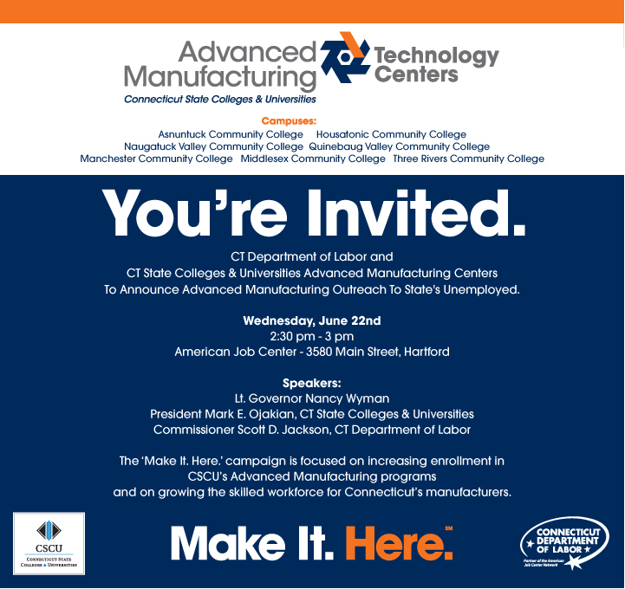
CAMI Grant
Example #4: CT-DOL Unemployed
CSCU was granted unprecedented access to the email addresses of thousands of unemployed residents across the State through a partnership with CT-DOL.
Despite the losses we routinely hear about in the manufacturing area in Connecticut, manufacturing continues to be the single largest contributor to Connecticut’s gross state product. In sectors as diverse as aerospace, defense, automotive, metalworking, electronics and others, there are over 160,000 workers active in manufacturing jobs today, paying over $14 billion in wages.
As you may remember, Connecticut is aggressively pursuing resources to help us promote growth in the manufacturing sector. We were recently designated by the Obama Administration under the Investing in Manufacturing Communities Partnership (a federal program designed to strengthen manufacturing capabilities nationwide by supporting states with long-term economic development strategies. And in 2014 we applied for and were awarded a $15 million grant Trade Adjustment Assistance Community College and Career Training grant…

Slide 17
CAMI Grant
Example #5: Changing Perception
Fox News Highlights
NBC News Coverage
News 8 Recap
FREE
News Coverage
Press Releases
Partnership w/ State DOL
Appearances by Political Leaders
Employer Speaking Engagements

Slide 18
Questions?

Slide 19
Clark State Community College
Mary Benedict,
Project Manager, Clark State Community College

Slide 20
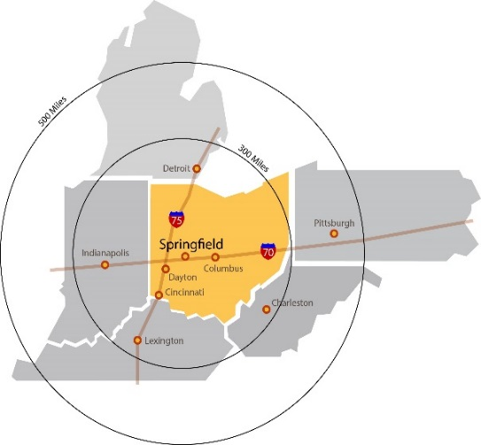
Overview of the Clark State TAACCCT Grant
The Need in Our Community
Service Area of Four Counties
(Clark, Champaign, Logan and Greene)
60% of High School Graduates
do not go to college
Manufacturing—3rd most powerful economic driver in the region
Small-mid sized manufacturers (1-300 employees) make up 90% of the companies

Slide 21
Advanced manufacturing: a solution to multiple challenges?
Employers and Clark State address the skills crisis by crafting a thoughtful grant proposal
$2.5M grant from
US Department of Labor awarded October 2014
Funding for curriculum development, renovation and equipment purchases
Certificate programs created/revised:
Computer Numerical Control (CNC) (new)
Welding (new)
Additive Manufacturing (new)
Industrial Maintenance (revised)
SCADA—Supervisory Control and Data Acquisition (new)

Slide 22
.
Current Metrics

Slide 23
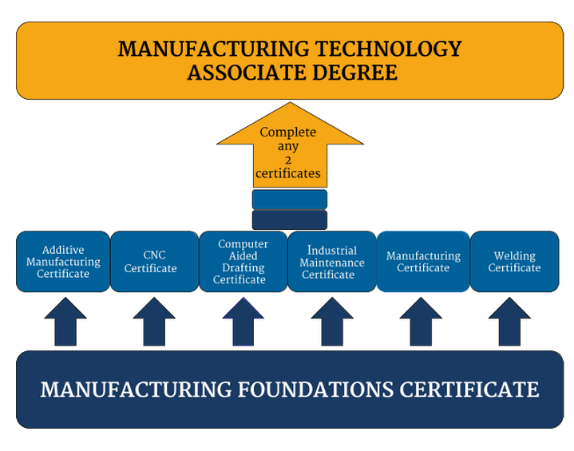
Employer Engagement
Now the work begins…..
Employers Endorse Stackable Certificates

Slide 24
Student Perspective
All registration, retention and placement happens with the Career Navigator!
Interaction with employers occurs in the first two classes (SME’s, tours, interviews)
Associate degree seekers will have at least one co-op, but certificate students can co-op as well
Most students work part-time, so the opportunities to work in manufacturing must have a reasonable chance of full-time employment

Slide 25
Employer Perspective
Clark State has incorporated the employer’s recommendations into the curriculum content and equipment selections throughout this process
Employers serve as Subject Matter Experts in the classes, and can share on special topics that pertain to their business needs
Job postings are free, and welcome!
Employers get valuable insights into the quality of students through the co-op experience
If graduates fall short of meeting employer needs, that feedback is used to improve the courses

Slide 26
Foundations that Create Better Employment Outcomes
If the employers have had their input throughout the creation and training process, placement is just a natural outcome
Relationships = unpublished postings
Relationships = insight into expansions, which leads to jobs
Multi-craft, multi-skill graduates are the hot commodity
Employers have limited time, but are reachable in community activities. Become the go-to.

Slide 27
Strategies for Finding Employment
Most Successful Methods for Our Graduates Based on Student Surveys

Slide 28
Questions?

Slide 29
Chaffey College
Jennifer Poe,
Lead Data and Project Manager, Chaffey College

Slide 30
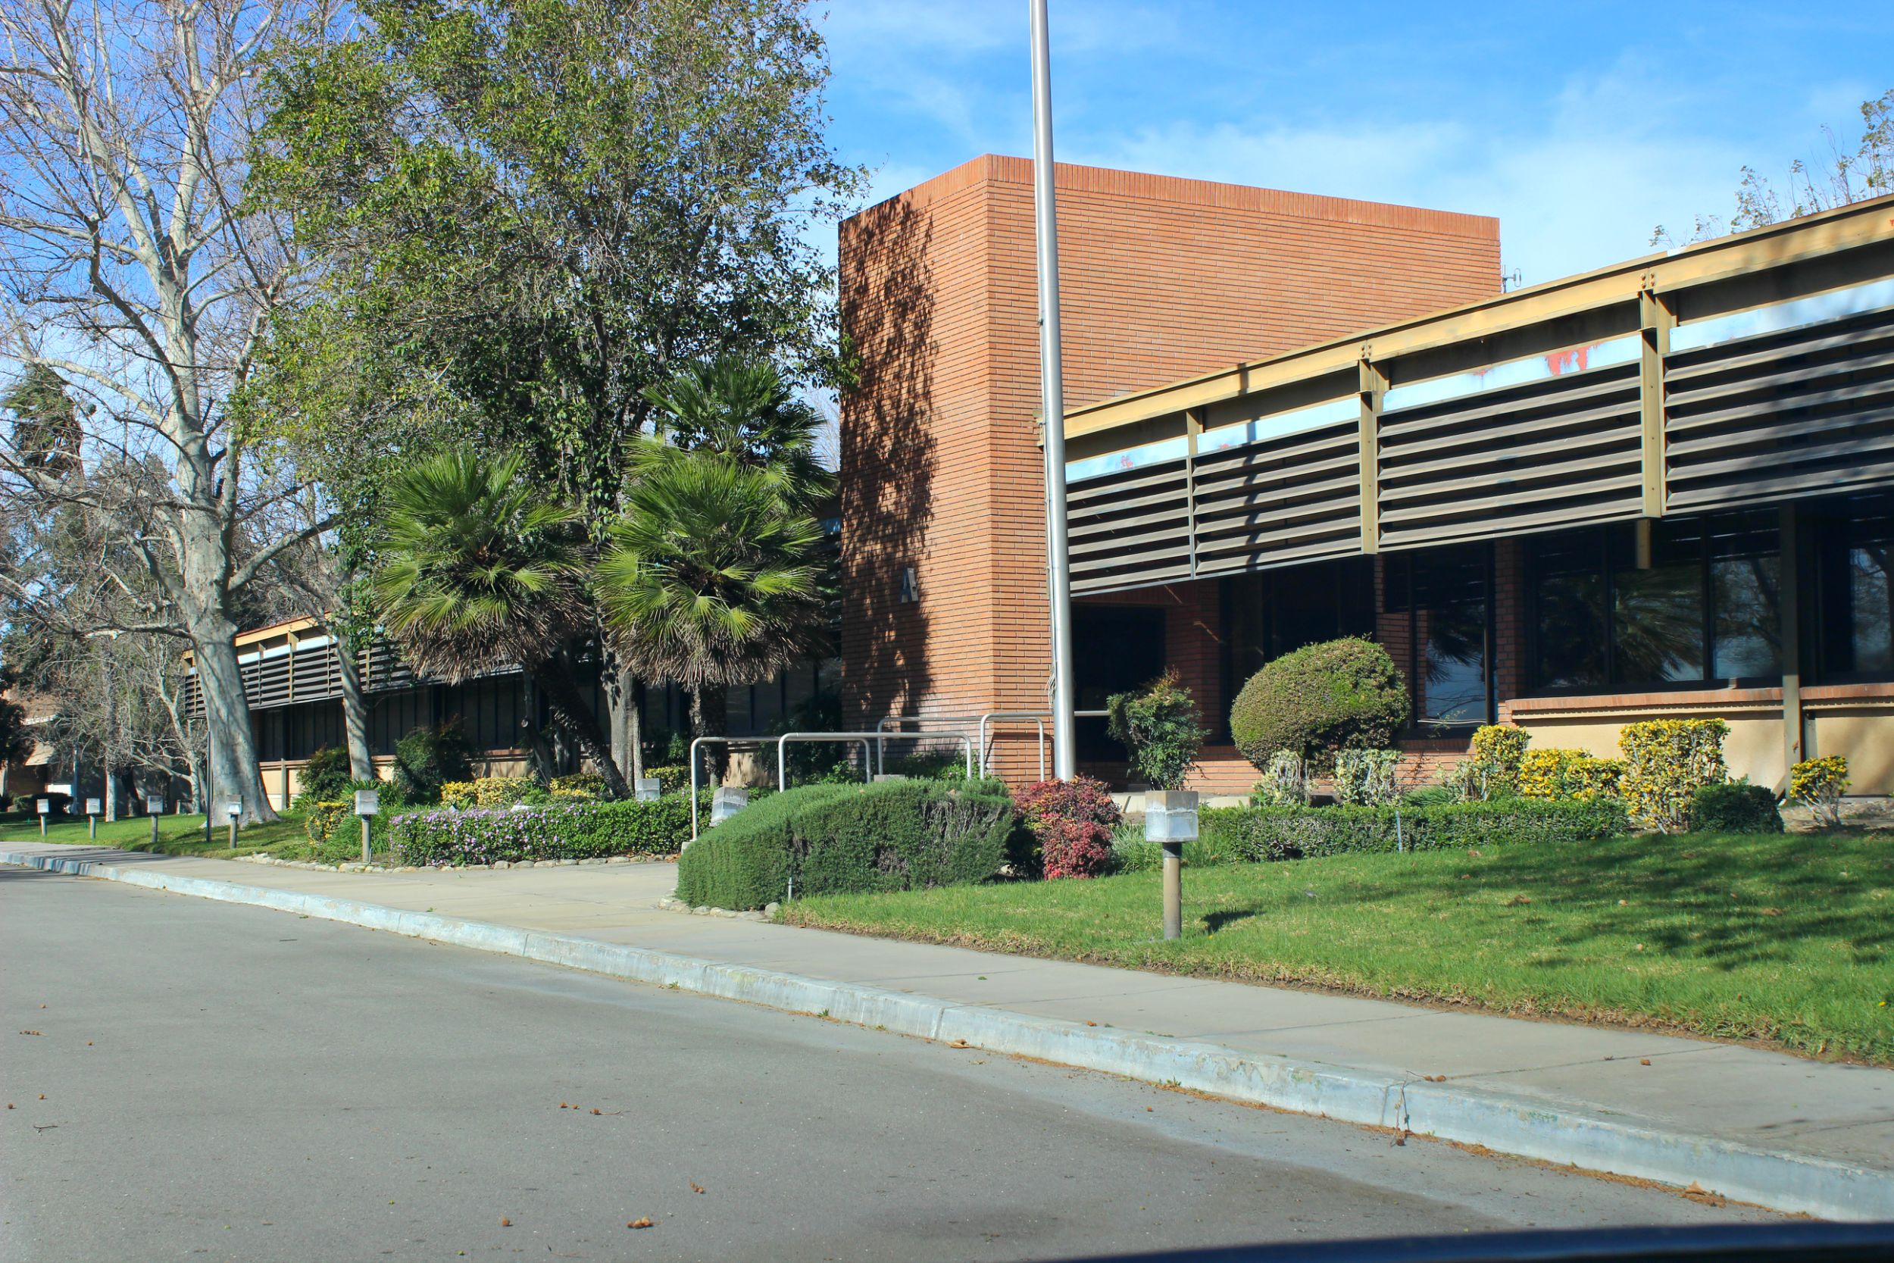
CHAFFEY COLLEGE / INTECH CENTER

Slide 31
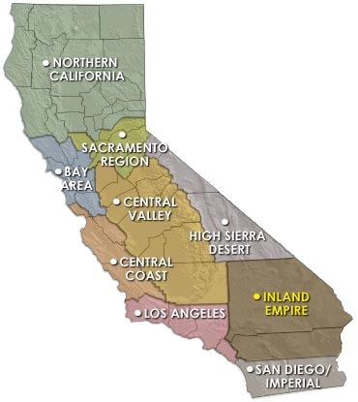
BACKGROUND INFORMATION
Inland Empire Regional Training Consortium
Total Award: $14,980,284
Partners: 12 Colleges
- 10 Community Colleges
- 2 Universities
Service Area: Inland Empire
- 27,000 square miles
- Population of 4.3 Million
Population to be served:
TAA-eligible workers, long-term unemployed, veterans populations and incumbent workers.

Slide 32
Grant details

Slide 33
CURRENT REGIONAL METRICS (Updated 7/20/17)
1,698 Completers
487 Retained in Employment
799 Incumbent Workers
475 Job Placements
4,005
Students Served
Note: Many students are still completing their programs. As each college’s programs can vary dramatically a student’s time in a grant funded program can vary as well. It was identified that many items were under-reported in year 2. Metrics are being re-calculated.

Slide 34
Chaffey College / InTech Center Student Flow At-a-Glance
Meet w/Placement Team throughout programs
Softskills Workshops throughout program
Focused on Job Matching and Student Interest Placement
Consistent Follow-up and Contact
Program Referral /
Recruitment
Info. Session
- Program Overview
- Pre-assessment
- Interview
One-on-One Info Sessions
Or
Small Group
Program Selection
Follows same flow as the Information Sessions.
Begin Training

Slide 35
RELATIONSHIPS
Constant Contact
Gentle but relentless pressure
Constant communication
Nurture relationships
Assess their needs
Site tours
Cold calls
Recruitment / Outreach
EDD / TAA / AJCC ●
Veteran Orgs. ●
Foster Care ●
Career Fairs ●
Social Media ●
Orientations ●
Student Selection
Case Mgmt.
Job Placement
Employer Relations
Relationship Building
Engagement
Outcome form
Email job leads
Resume building
Ongoing follow-up
Touches start on day one
Before/During/After hours
Constant Touches
Send job leads ●
Open door policy ●
Refer to WIOA, etc. ●
Email / Phone / Text ●
Classroom instruction ●
Assess personal needs ●

Slide 36
CONTRACT EDUCATION
Meeting Employer Needs
Incorporation of employer recommendations and customized topics to meet employer needs
Training is subsidized by Employment Training Panel (ETP) funding
Training is designed to increase operational efficiencies, enhance productivity and increase organizational performance
Lean Manufacturing
Project Mgmt.
Haz. Mat.
CNC Programming
Comp Skills
APICS
Print Reading
Six Sigma
Industrial Electrical

Slide 37
PLACEMENT SUCCESS
Hire dedicated staff that remember their “why” through all the ups and downs
Understand each trainee, company and program curriculum and take the time to match all three… Focus on quality over quantity. Listening to the students and be willing to provide career counseling
Be willing to go above and beyond
Stay up to date on workforce related information, labor laws, hiring practices, application and interview trends, etc.

Slide 38
Questions?

Slide 39
Thank You!
Connect with the NEW TAACCCT Community of Practice and search for TAACCCT resources at:
https://TAACCCT.workforceGPS.org
Ask questions and to connect with peers and resources at TAACCCT@dol.gov
If you want to learn more about peer mentoring email TAACCCT@dol.gov

