Slide 1
Telling your Story
October 5, 2017
Presented By:
Coffey Consulting

Slide 3
John Rakis
Consultant
Coffey Consulting
Bethesda, Maryland
Lenora Thompson
Consultant
Coffey Consulting
Bethesda, Maryland

Slide 4
Learn the value of great storytelling.
Learn how to tell a great story that evokes emotion and builds support for your work.

Slide 5
Poll
Do you maintain a story “bank” that you can tap into when engaging participants, employers, and the general public?
Yes, we have a story “bank”
No, we don’t have a story “bank”
No, we don’t have one, but are interested in setting one up.

Slide 6
The Power of Story

Slide 7
The Power of Story
“Whether you’re addressing five people or five hundred: in a two-hour speech, people will remember a two minute story.”

Slide 8
The Power of Story
“There isn’t anyone you couldn’t love once you’ve heard their story. ”
Mary Lou Kownacki

Slide 9
The Power of Story
People respond to stories.
Individual stories are more convincing than numbers.
Stories bring the invisible and abstract to life.

Slide 10
Telling your Story

Slide 11
Stories are about people.

Slide 12
Stories need to be fixed in time and space.

Slide 13
Make a promise that this story will lead someplace and be worth your time.

Slide 14
The people in your story have to want something.

Slide 15
Let your characters speak for themselves.

Slide 16
Audiences bore easily.

Slide 17
Include interesting details.

Slide 18
Speak the audience’s language.

Slide 19
Stir up emotion.

Slide 21
Stories have clear meaning.

Slide 22
Good stories have a moment of truth.

Slide 23
At the end of your story, reflect.

Slide 24
Stories from the field

Slide 25
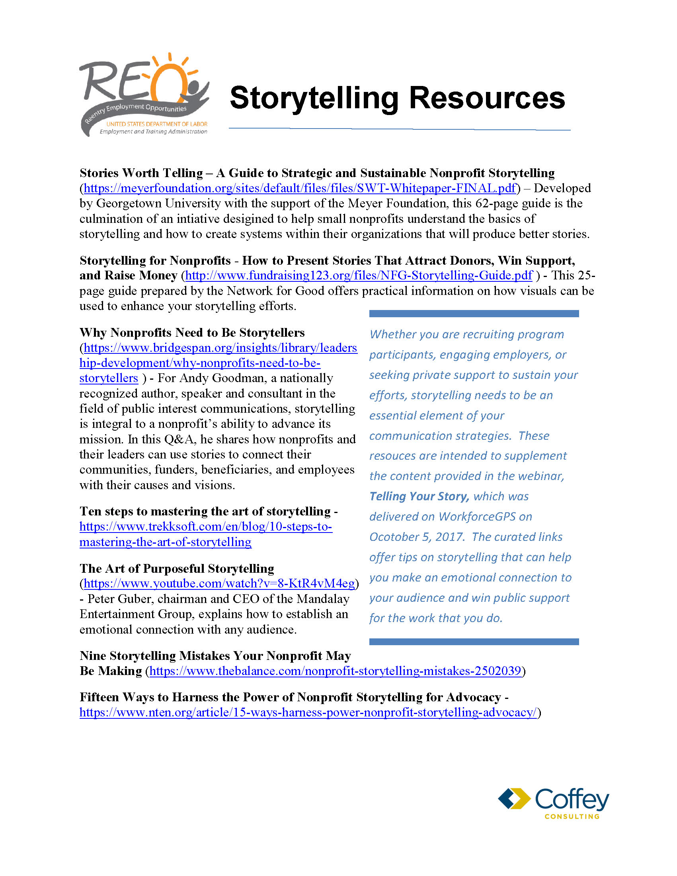
Resources
You can download this document now!

