Slide 1
WIOA Annual Performance Report
September 13, 2017
Title I (Adult, Dislocated Worker & Youth)
Title III (Wagner-Peyser Employment Service)

Slide 3
Shelia F. Lewis
Workforce Analyst
Employment & Training Administration
U.S. Department of Labor

Slide 4
Annie Leonetti
Supervisory Workforce Analyst
Employment and Training Administration
U.S. Department of Labor
Cesar Acevedo
Workforce Analyst
Employment and Training Administration
U.S. Department of Labor

Slide 5
We will cover the following topics:
WIOA Statewide Annual Performance Report Requirements and Expectations:
Who reports
Important dates
Contents
How to Certify and Submit the WIOA Statewide Annual Performance Report to DOL

Slide 6
WIOA Statewide Annual Report
1
States must submit to DOL required individual records containing performance information for titles I and III programs
The WIOA Statewide Annual Report will be generated from this submitted data
States must then certify the WIOA Statewide Annual Report

Slide 7
WIOA Annual Report: Important Dates
1
On or before October 16, 2017 – Submission deadline for PY 2016
On or before September 15, 2017 – Extension request deadline for PY 2016
On or before October 1, 2018 – Submission deadline for PY 2017; subsequent reports will be due on October 1 of each year

Slide 8
Poll Question #1 What results can States expect to see in the WIOA Statewide Annual Performance Report for PY 2016?
Choose the best answer(s)
Measurable skill gains
Effectiveness in Serving Employers
Median Earnings
Participants served
All of the above

Slide 9
Poll Question #1 Discussion What results can States expect to see in the WIOA Statewide Annual Performance Report for PY 2016?
Measurable Skill Gains ✓
Effectiveness in Serving Employers
Median Earnings
Participants served ✓
All of the above

Slide 10
WIOA Annual Report – Contents: Indicators of Performance
1
PY 2016 – due October 16, 2017
Measurable Skill Gains
PY 2017 – due October 1, 2018
Employment Rate 2nd Quarter after Exit
Employment Rate 4th Quarter after Exit
Median Earnings 2nd Quarter after Exit
Credential Attainment Rate
Measurable Skill Gains
Effectiveness in Serving Employers
Retention with the Same Employer
Repeat Customer (one year)
Market Penetration

Slide 11
Annual Report – Contents
1

Slide 12
WIOA Annual Report – Contents
1
Participants Served – Including participant characteristics and services received
Funds Expended – The amount expended on participants during the reporting period
Cost per participant – Funds expended divided by the count of participants
Exiters – The count of participants who exited during the reporting period
Reportable Individuals – The WIOA Statewide Annual Report does not include counts of reportable individuals

Slide 13
Workforce Integrated Performance System (WIPS)
3
WIPS – accepts State and grantee performance reporting data and generates quarterly and annual performance reports for States to certify
WIPS will continue to be enhanced and improved over time
WIPS users with technical questions should reference the ETA WIPS User Resource Library Information Page at: https://doleta.gov/performance/wips/

Slide 14
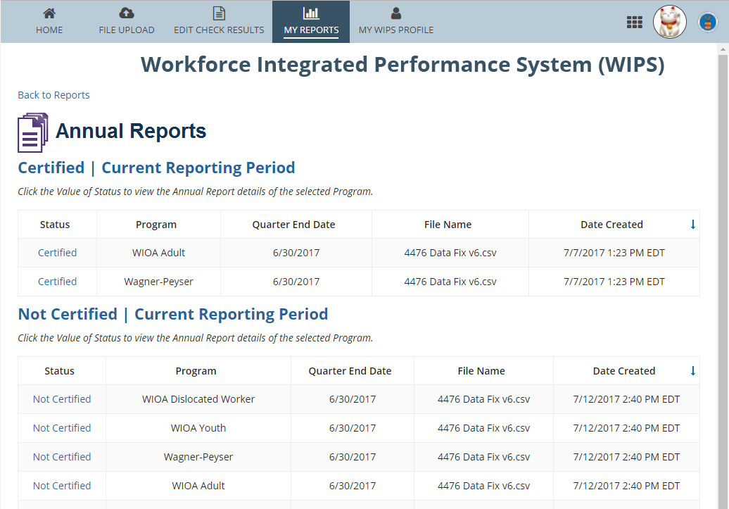
WIPS WIOA Annual Report Landing Page
3
If a user chooses to view APRs, they are taken to an overview of current and previous APRs
Users can select a specific APR to view a detailed report
Multiple reports are generated when a user submits a file with multiple programs’ data

Slide 15
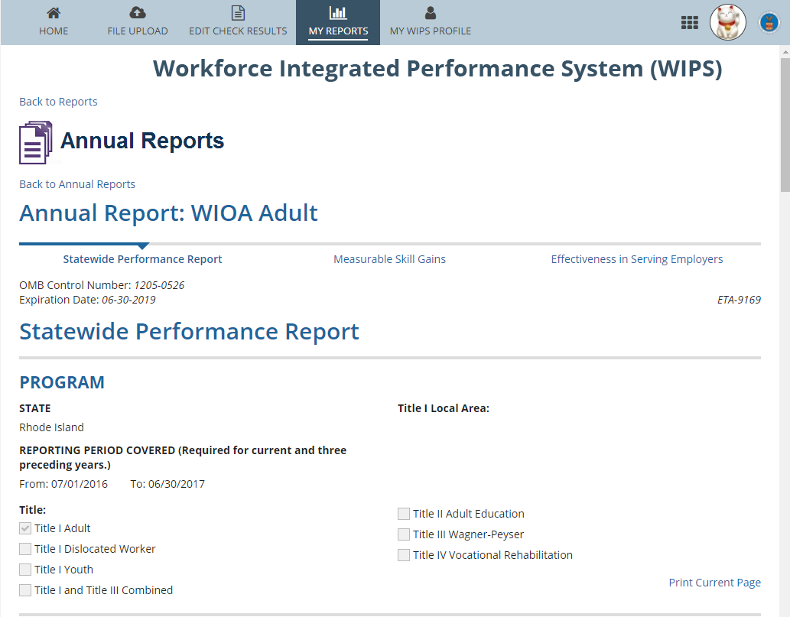
WIPS WIOA Annual Report
3
WIOA Annual Reports are split into three sections that users can toggle between:
Statewide Performance Report
Measurable Skill Gains
Effectiveness in Serving Employers
Users must input “state” before submitting
Certification process for Annual Report is the same as QPR
Users must certify their 4th Quarter QPRs before certifying their annual reports

Slide 16
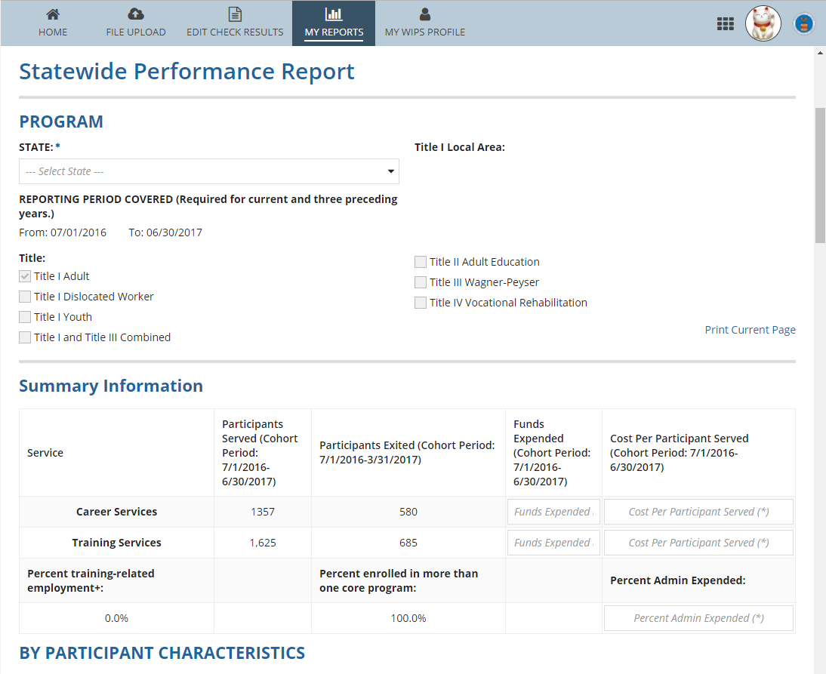
WIPS - WIOA Annual Report
3
Statewide Performance Report
Users enter the fields highlighted in RED
Once a “state” is selected, that information is populated on all pages

Slide 17
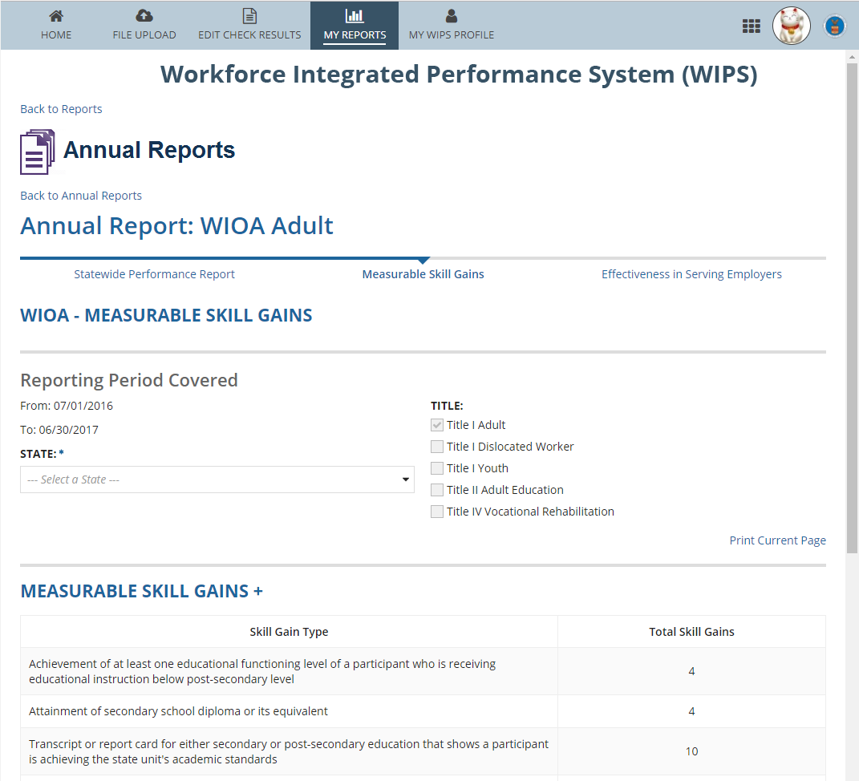
WIPS - WIOA Annual Report
3
Measurable Skill Gains
Users enter the fields highlighted in RED
Once a “state” is selected, that information is populated on all pages

Slide 18
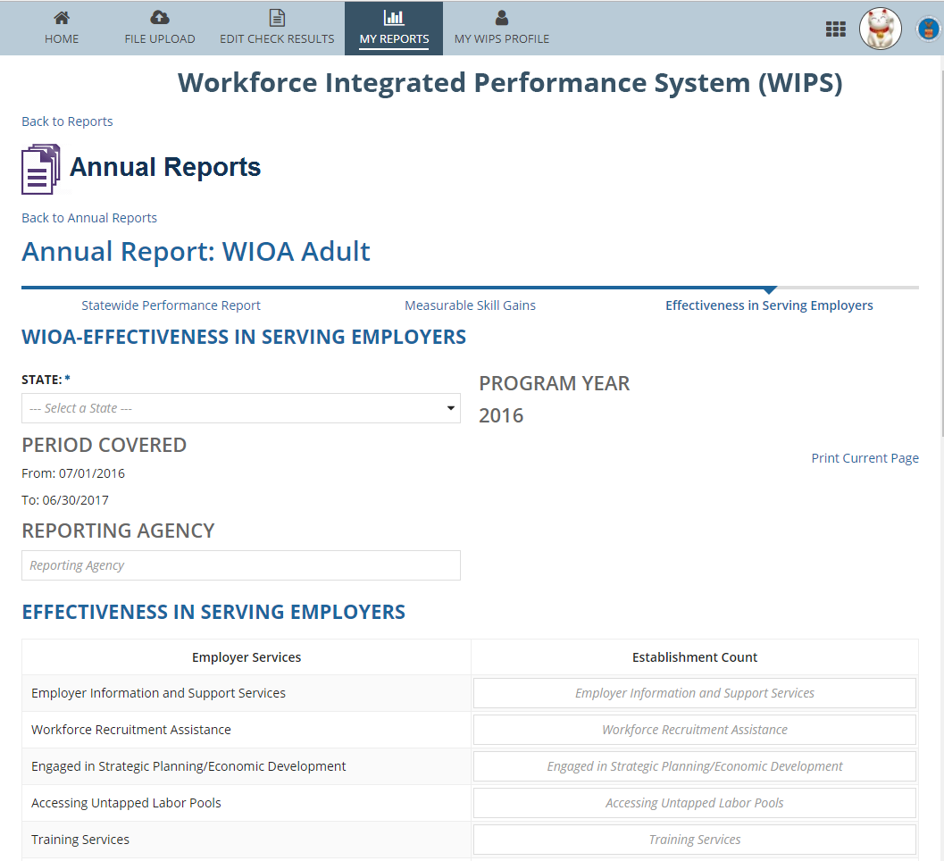
WIPS - WIOA Annual Report
3
Effectiveness in Serving Employers
Users enter the fields highlighted in RED
Once a “state” is selected, that information is populated on all pages
All report items are user-filled

Slide 19
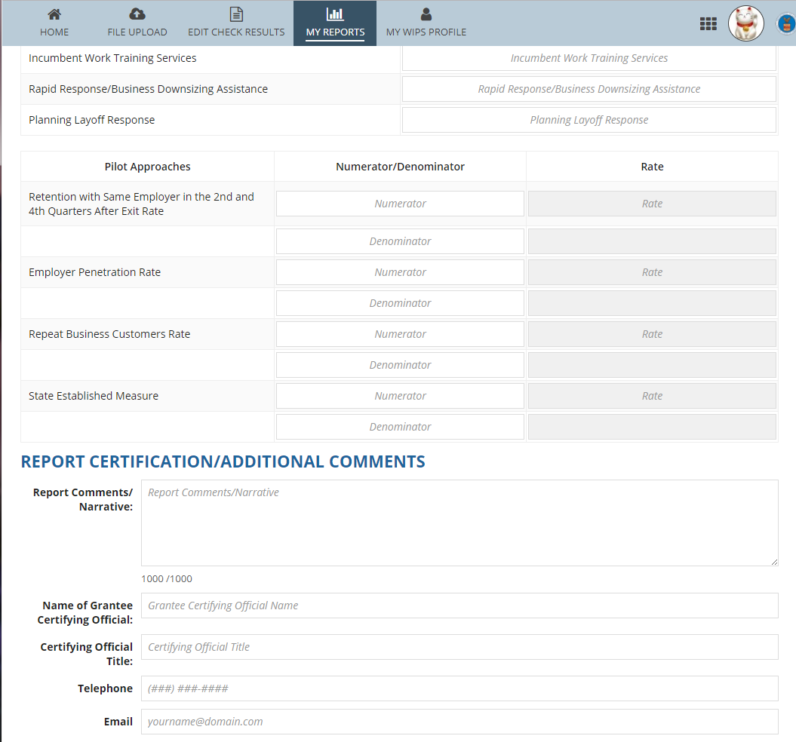
WIPS - WIOA Annual Report
3
Effectiveness in Serving Employers cont’d
Users enter the fields highlighted in RED
All report items are user-filled; items that are not applicable may be left blank
Indicate pilot measures in the comment field

Slide 20
WIPS - WIOA Annual Report FAQs
3
If there are no errors within the submitted Q4 file, the system will generate both a QPR and an APR
The grantee must certify the Q4 QPR before certifying the APR
WIPS does not provide the capability to produce Quarterly or Annual Reports for workforce development boards at this time
States may resubmit and recertify PY 2016 Q4 reports up until the Annual Report deadline on October 16, 2017
The WIOA Credential Attainment Rate Report will not be in the system for the PY 2016 annual reporting cycle

Slide 21
Eligible Training Provider (ETP) Reports
4
No ETP report is required for PY 2016 Annual Report
Guidance and Technical Assistance on ETP reports will be available after the ETP report is finalized through the ICR process

Slide 22
Effectiveness In Serving Employers
5
Pilot programs began July 2016
States should report which approaches they are using in their pilot programs
States will begin reporting outcomes in October 2018
States must select one lead agency to report data on this indicator. All data for each core program should be combined and reported to the Department of Labor or Department of Education by the State as one set of data.

Slide 23
WIOA Annual Report – Submission Questions
6
Are States expected to collect and report any new data elements proposed in the amended WIOA Common Performance Reporting ICR, published in January 2017, or the DOL-only Performance Accountability, Information, and Reporting System ICR, published in May 2017?
No
Which of the two (2) PIRLs should be used to submit data to ETA?
The DOL-only PIRL (ETA-9172)
Will subsequent data file submissions in WIPS overwrite previously-submitted files?
Yes
How will the reporting system handle participants that choose not to disclose their SSNs?
WIPS will allow for a blank in the SSN field. The lack of an SSN will not exclude any individuals from performance indicators. States have the option to provide supplemental wage information to obtain data for performance indicators.

Slide 24
Poll Question #2 For Effectiveness in Serving Employers, States must choose two of the three approaches described in the regulation to report on during the pilot program.
Choose the best answer(s)
True
False

Slide 25
Poll Question #2 Discussion For Effectiveness in Serving Employers, States must choose two of the three approaches described in the regulation to report on during the pilot program.
Choose the best answer(s)
True
False

Slide 26
Poll Question #3 For Effectiveness in Serving Employers, States may develop their own approaches in lieu of reporting on two of the three approaches defined in the regulations and guidance (TEGL 10-16) and submit them as alternate options on the WIOA Annual Report.
Choose the best answer(s)
True
False

Slide 27
Poll Question #3 Discussion For Effectiveness in Serving Employers, States may develop their own approaches in lieu of reporting on two of the three approaches defined in the regulations and guidance (TEGL 10-16) and submit them as alternate options on the WIOA Annual Report.
True
False

Slide 28
Key Take Aways
5
Annual Report – Important Dates
October 16, 2017
October 1, 2018
Annual Report – Q4 report must be certified first
ETP Reports – Not due for PY 2016
Effectiveness in Serving Employers – Indicate two pilot measures

Slide 29
Workforce Innovation and Opportunity Act, Pub. L. 113-1128
Workforce Innovation and Opportunity Act Statute
https://www.gpo.gov/fdsys/pkg/PLAW-113publ128/pdf/PLAW-113publ128.pdf
WIOA Joint Rule for United and Combined State Plans, Performance Accountability, and the One-Stop System Joint Provisions, 81 FED. REG. 55791 (Aug. 19, 2016)
This Joint WIOA Joint Final Rule provides guidance for State and local workforce development systems
https://www.gpo.gov/fdsys/pkg/FR-2018-08-19/pdf/2016-15977.pdf
Training and Employment Guidance Letter (TEGL) No. 10-16
Performance Accountability Guidance for WIOA Title I, Title II, Title III and Title IV Core Programs
https://wdr.doleta.gov/directives/corr_doc.cfm?DOCN=8226
Training and Employment Guidance Letter (TEGL) No. 3-17
WIOA Annual Performance Report Submission
https://wdr.doleta.gov/directives/corr_doc.cfm?docn=9924.

Slide 30
WIOA Resource Page
The Department of Labor (DOL), in coordination with the U.S. Departments of Education (ED) and Health and Human Services (HHS), has worked to prepare everyone for the implementation of WIOA. The WIOA resource page provides information and resources for States, local areas, non-profits and other grantees, and other stakeholders to assist with implementation of the Act.
www.doleta.gov/wioa
Performance and Results Web Site
The Performance and Results Web Site will assist you in understanding how performance is measured, reported, and evaluated at ETA.
www.doleta.gov/performance
ETA WIPS User Resource Library Information Page
WIPS users with technical questions may access this page for assistance.
https://doleta.gov/performance/wips

Slide 32
Annie Leonetti
Supervisory Workforce Analyst
Employment and Training Administration
U.S. Department of Labor
ETAperforms@dol.gov
Cesar Acevedo
Workforce Analyst
Employment and Training Administration
U.S. Department of Labor
ETAperforms@dol.gov
All questions related to reporting via WIPS should be emailed to:
WIOA.Feedback@dol.gov

