Slide 1
Opening Poll
Which grant rounds do you work on?
(Select One)
Round 3
Round 4
Rounds 3 and 4
I’m not a grantee

Slide 2
Opening Poll
Which option best describes the status of your 2017 APR?
(Please select only one)
I haven’t started working on it yet but will start soon
I work on my APR data year round
I’m starting to collect and review the data now
I am done and could submit it now if my report was available
Why are you asking me this, when is the APR due?

Slide 3
Opening Poll
If you’re a Round 3 grantee, who will be submitting your final APR and QNPR?
Someone very familiar with the performance reporting requirements
Someone new to the performance reporting requirements
Someone unfamiliar with the performance reporting requirements who will be given instructions because the program manager will no longer be on staff

Slide 4
TAACCCT Performance Reporting September Q&A:
Quarterly Narrative Progress Report (QNPR) Best Practices and Tips
September 14, 2017

Slide 5
Presenters
Moderator:
Cheryl Martin, Program Manager, TAACCCT Grants, U.S. Department of Labor, Employment and Training Administration
Presenter:
Scott Estrada, Performance Specialist, Maher & Maher, TAACCCT Grants

Slide 6
apr and Quarter 4 QNPR due November 14th Next webinar is on October 19th Round 4 grantees: Performance office hours are available during convening, email the taaccct mailbox if you want to set up an appointment ROUND 3 OER and Evaluations due by sep 30!
TAACCCT Announcements

Slide 7
TAACCCT Performance Reporting Key Resources
https://taaccct.workforcegps.org/resources/2016/07/13/11/53/TAACCCT_Performance_Key_Resources

Slide 8
Agenda
Questions From You
Today’s Special Topic
Quarterly Narrative Progress Report (QNPR) Best Practices and Tips
Open Question Period

Slide 9
Questions From You

Slide 10
Question
If a student earns a certificate or a degree in year one and another certificate or degree in year two, do you only count them in B.6a and B.6c for the year they earned these certificates?
If we add all the APRs together, wouldn’t that double count the number of students earning a certificate?

Slide 11
Answer
Yes, [you count them in the year the certificate was earned.]
Because of this, you can’t extract the number of students earning a certificate from the performance data (though you might be able to from your own internal data)
In addition, a student could be double counted in a single year because he/she can be counted in more than one sub category of B.6 (B.6a, B.6b or B,6c)
The closest you can get to counting how many students earned a certificate is B.2, because to qualify as a completer you have to earn a certificate and you only count them as a completer once

Slide 12
Quarterly Narrative Progress Report (QNPR) Best Practices and Tips
Today’s Special Topic

Slide 13
What is the QNPR?
Quarterly Narrative Progress Report
It is a quarterly progress report on your program activities
Status update to the regional and national office on achieving your objectives in your SOW
More Qualitative than Quantitative

Slide 14
Notes on Today’s Webinar
We are covering both requirements and best practices
Offering TLN’s perspective, not necessarily your FPO’s perspective
TAACCCT is a capacity building grant, the QNPR can be the best report to DOL to capture your capacity building effort

Slide 15
Last QNPR for Round 3 Grantees
The next QNPR due (by November 14) will be the last one due for Round 3 Grantees
For Round 3, this QNPR should be a final summary of the entire life of the grant
Not just of the year or quarter
All activities and deliverables should be marked as either complete or incomplete. If some are incomplete, you can use the text section to describe their status

Slide 16
Last QNPR for Round 3 Grantees
Reports generate automatically on October 1
Not available ahead of time
We understand this is AFTER the end of the 2017 fiscal year
This is done on purpose so as not to shorten the last quarter
Is someone who is unfamiliar with this process be the one submitting this report? Did you answer C in the above poll?
Please do not hesitate to ask for assistance through the TAACCCT mailbox and copy your FPO
Make sure your Authorized Rep is up to date (more on this to come)

Slide 17
QNPRs by the Numbers
2,657 Programs Launched Nationally to Date!
96% of Round 3 programs planned have been launched as of March 31, 2017
94% of Round 4 programs planned have been launched as of March 31, 2017

Slide 18
QNPRs by the Numbers
Were there any direct hires of program of study completers by employer?
226 out of 256 grantees (88%) responded “yes” in at least one quarter
8 grantees have had direct hires in every quarter to date (Rounds 3 and 4)
1-3 quarters: 31 (12%)
4-6 quarters: 19 (7%)
7-9 quarters: 71 (28%)
10 or more: 105 (41%)

Slide 19
When is the QNPR due?

Slide 20
General Makeup of the QNPR
Sections;
A. Summary of Grant Activities
B. Status Update on Leveraged Resources
C. Status Update on Employer(s) Involvement
D. Timeline for Grant Activities and Deliverables
E. Key Issues and Technical Assistance Needs
F. Best Practices, Promising New Strategies and Success Stories
G. Additional Outcome Information
I., J. & K. , Name of Grantee Certifying Official, Telephone Number, Email Address

Slide 21
A. Summary of Grant Activities
Sections;
A. Summary of Grant Activities
B. Status Update on Leveraged Resources
C. Status Update on Employer(s) Involvement
D. Timeline for Grant Activities and Deliverables
E. Key Issues and Technical Assistance Needs
F. Best Practices, Promising New Strategies and Success Stories
G. Additional Outcome Information
I., J. & K. , Name of Grantee Certifying Official, Telephone Number, Email Address

Slide 22
A. Summary of Grant Activities
“This section is an executive summary of grant activities for the quarter, and should serve as the annual summary each fourth quarter.” – OMB Reporting Package
Expectations and Tips
Concise and substantive
But not too much – don’t need every meeting.
Ok to use abbrevs. incomplete sentences, etc.
4th quarter report should summarize the grant’s activities for entire year
Last report of grant should summarize entire life of grant

Slide 23
A. Summary of Grant Activities
“Do Not Do’s”
Don’t copy and paste past QNPR summaries
Show new activities and progress this quarter
Don’t be TOO concise
2,500 characters is not a lot, try to use most of it
Don’t repeat performance data that is on the APR
If additional to APR, OK
If used to tell a larger story of program success or challenges, OK

Slide 24
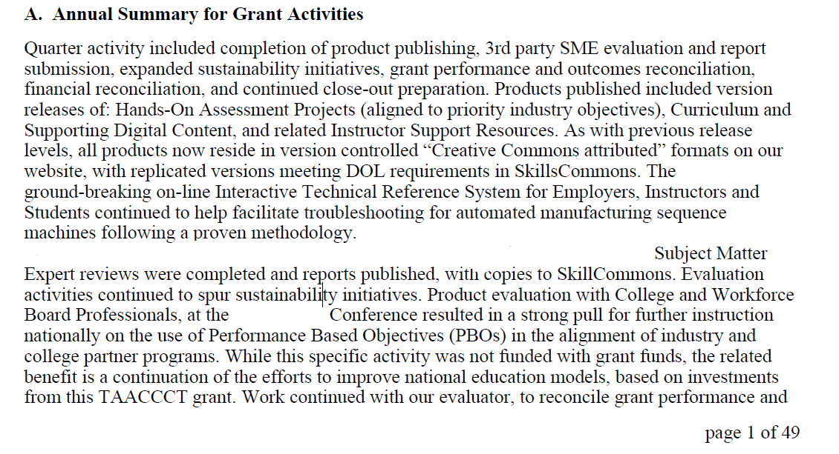
Good Example

Slide 25
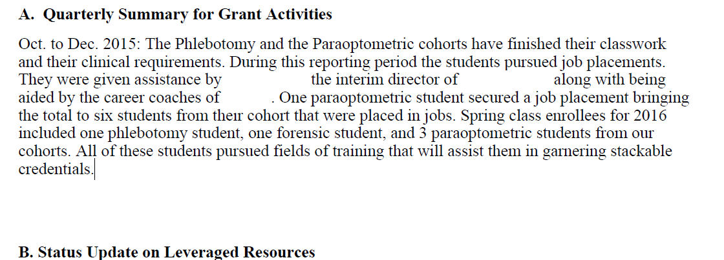
Not Quite as Good Example

Slide 26
B. Status Update on Leveraged Resources
Sections;
A. Summary of Grant Activities
B. Status Update on Leveraged Resources
C. Status Update on Employer(s) Involvement
D. Timeline for Grant Activities and Deliverables
E. Key Issues and Technical Assistance Needs
F. Best Practices, Promising New Strategies and Success Stories
G. Additional Outcome Information
I., J. & K. , Name of Grantee Certifying Official, Telephone Number, Email Address

Slide 27
B. Status Update on Leveraged Resources
“Use this section of the narrative to report leveraged resources used to support grant activities. Leveraged resources include both Federal and non Federal funds, and may take the form of cash or in-kind contributions.” –OMB Reporting Package
Update:
The organizations that contributed the resources
The ways in which the resources were used during the current quarter

Slide 28
QNPRs by the Numbers
During this quarter, did you receive any additional leveraged resources beyond what is listed in your statement of work?
181 of 256 grantees (71%) responded “yes” in at least one quarter
1-3 quarters: 93 (36%)
4-6 quarters: 30 (7%)
7-9 quarters: 35 (14 %)
10 or more: 23 (9%)

Slide 29
C. Status Update on Employer(s) Involvement
Sections;
A. Summary of Grant Activities
B. Status Update on Leveraged Resources
C. Status Update on Employer(s) Involvement
D. Timeline for Grant Activities and Deliverables
E. Key Issues and Technical Assistance Needs
F. Best Practices, Promising New Strategies and Success Stories
G. Additional Outcome Information
I., J. & K. , Name of Grantee Certifying Official, Telephone Number, Email Address

Slide 30
C. Status Update on Employer(s) Involvement
“This section should be used to:
discuss how the required employer(s) has been involved during the current phase of the project;
outline specific roles and contributions of the employer(s) during this quarter;
identify any challenges encountered/resolved in the development and management of the employer involvement; and
discuss new employers and commitments that may have been added to support the project..”
– OMB Reporting Package

Slide 31
QNPRs by the Numbers
Have you had any consultation or advisory meetings with business or employer partners during this quarter?
253 of 256 (99%) grantees responded “yes” in at least one quarter
77 grantees have held meetings in every quarter of their grant (all rounds)
1-3 quarters: 0 (0%)
4-6 quarters: 6 (2%)
7-9 quarters: 80 (31 %)
10 or more: 167 (65%)

Slide 32
D. Timeline for Grant Activities and Deliverables
Sections;
A. Summary of Grant Activities
B. Status Update on Leveraged Resources
C. Status Update on Employer(s) Involvement
D. Timeline for Grant Activities and Deliverables
E. Key Issues and Technical Assistance Needs
F. Best Practices, Promising New Strategies and Success Stories
G. Additional Outcome Information
I., J. & K. , Name of Grantee Certifying Official, Telephone Number, Email Address

Slide 33
C. Status Update on Employer(s) Involvement
“Use this section to provide a timeline of the progress of grant activities, key deliverables for this quarter, and if applicable, deliverables available this quarter for broad dissemination. Use the timeline in the grant’s statement of work to identify all major
program activities for the entire life of the grant…”
“Items to incorporate in the timeline include: project goals, benchmarks, milestones, special events, important deadlines and deliverables.”
- OMB Reporting Package

Slide 34
E. & F. Key Issues and Technical Assistance Needs
Sections;
A. Summary of Grant Activities
B. Status Update on Leveraged Resources
C. Status Update on Employer(s) Involvement
D. Timeline for Grant Activities and Deliverables
E. Key Issues and Technical Assistance Needs
F. Best Practices, Promising New Strategies and Success Stories
G. Additional Outcome Information
I., J. & K. , Name of Grantee Certifying Official, Telephone Number, Email Address

Slide 35
E. Key Issues and Technical Assistance Needs
“Summarize any significant issues or problems encountered during the quarter and resolution of previous issues and challenges identified in previous quarters. Describe any actions taken or plans for addressing issues, any question you have for DOL, and any need for assistance from DOL or others.”
–OMB Reporting Package

Slide 36
F. Best Practices, Promising New Strategies and Success Stories
“Describe promising approaches, innovative processes, and grant-level and/or participant level success stories. Examples may include developing and implementing an outreach plan, developing new or enhancing existing curriculum, and creating new career assistance tools and resources.”
-OMB Reporting Package

Slide 37
E. Key Issues, TA Needs, Best Practices & Success Stories
Along with the FPOs’ review at the grant level, Jobs For the Future reviews all QNPRs every quarter for TA Needs, Best Practices and Success Stories.
Trends in TA needs → help develop event topics
Best practices/ solutions to challenges → relay them to other grantees
JFF’s QNPR review is one way to get the whole TAACCCT picture

Slide 38
What Not to Do

Slide 39
Good Example

Slide 40
G. Additional Outcome Information
Sections;
A. Summary of Grant Activities
B. Status Update on Leveraged Resources
C. Status Update on Employer(s) Involvement
D. Timeline for Grant Activities and Deliverables
E. Key Issues and Technical Assistance Needs
F. Best Practices, Promising New Strategies and Success Stories
G. Additional Outcome Information
I., J. & K. , Name of Grantee Certifying Official, Telephone Number, Email Address

Slide 41
G. Additional Outcome Information
“This section allows grantees to report any grant-specific outcomes not captured in other sections of the quarterly narrative progress report, including, but not limited to, any specific outcomes included in the statement of work…”
“…for every fourth quarterly report, this update may include additional information about activities and outcomes to supplement data submitted on the Annual Performance Report form.”
OMB Reporting Package
DO NOT USE UPLOAD FUNCTION FOR SUPPLEMENTARY INFORMATION (Technical glitch: You can see it but we can’t)
Send to FPO and TAACCCT@dol.gov instead

Slide 42
I., J. & K. , Name of Grantee Certifying Official, Telephone Number, Email Address
Sections;
A. Summary of Grant Activities
B. Status Update on Leveraged Resources
C. Status Update on Employer(s) Involvement
D. Timeline for Grant Activities and Deliverables
E. Key Issues and Technical Assistance Needs
F. Best Practices, Promising New Strategies and Success Stories
G. Additional Outcome Information
I., J. & K. , Name of Grantee Certifying Official, Telephone Number, Email Address

Slide 43
I., J. & K. , Name of Grantee Certifying Official, Telephone Number, Email Address
Only 2 people can access EBSS
The Authorized Representative; to certify the contents for the report
Someone who has been granted the legal authority by the board of trustees or president of the college to verify the contents of the report
The Point of Contact (not the SF 424 POC); to enter the information
Often times a program manager,
Changing the Program Manager doesn’t require a mod
Changing the names on the SF-424 requires an administrative grant modification
If the authorized representative changes before November 14, please submit a modification ASAP!

Slide 44
Questions ABOUT THE QNPR?

Slide 45
OPEN QUESTIONS PERIOD

Slide 46
Thank You!
Connect with the NEW TAACCCT Community of Practice and search for TAACCCT resources at:
https://TAACCCT.workforceGPS.org
Ask questions and to connect with peers and resources at TAACCCT@dol.gov
If you want to learn more about peer mentoring email TAACCCT@dol.gov

