Slide 2
Best Practices for Adopting or Implementing Updated EEO Regulations
Women in Apprenticeship and Non-Traditional Occupations Grantees

Slide 4
Felecia Hart
Office of Apprenticeship
U.S. Department of Labor

Slide 5
WANTO OVERVIEW
The Women in Apprenticeship and Nontraditional Occupations (WANTO) Act of 1992 authorized the U.S. Department of Labor to award grants to Community-based Organizations to assist employers and labor unions in promoting the recruitment, training, employment and retention of women in apprenticeship and nontraditional occupations.
The U.S. Department of Labor funded a total of $1,998,000 in grants to help women through the WANTO program, an initiative designed to recruit, train and retain women in high-skill occupations in advanced manufacturing, transportation, energy, construction, information technology and other industries.

Slide 6
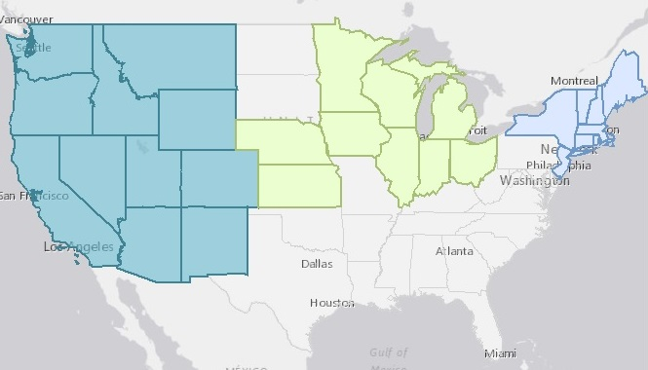
WANTO Regional Technical Assistance Centers
Nontraditional Employment for Women (NEW NYC)
Chicago Women in Trades
Western WANTO Consortium
Oregon Tradeswomen, Inc.
Tradeswomen, Inc. (CA)
Apprenticeship and Nontraditional Employment for Women (ANEW – WA)

Slide 7
Meg Vasey
Executive Director
Tradeswomen Inc.
Oakland, CA
Patrick Reardon
Executive Administrator
ApprenticeOhio
Columbus, OH
Tiffany Thompson
Advocacy Program Manager
Oregon Tradeswomen
Portland, OR

Slide 8
1:00 pm | Introduction
1:05 pm | Overview of Updated EEO Regulations and Best Practices for Implementing the Regulations by Programs Registered with OA
1:20 pm | Best practices for adopting consistent regulations by SAAs
1:30 pm | Best Practices in Providing Anti-Harassment Training
1:40 pm | Question & Answer
2:00 pm | Thank you & Wrap Up

Slide 9
Overview of Updated EEO Regulations and Best Practices for Implementing the Regulations by Programs Registered with OA
Meg Vasey
Executive Director
Tradeswomen Inc.

Slide 10
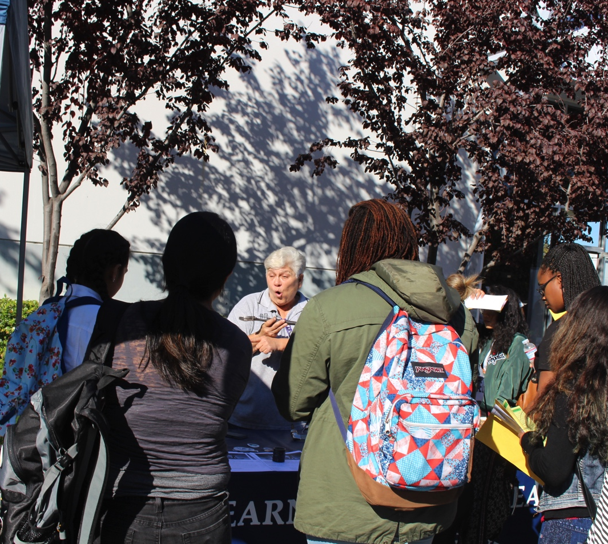
Tradeswomen Inc.
Tradeswomen Inc. was founded 1979 by tradeswomen and tradeswomen advocates to serve women in nontraditional trades.
Our mission is to support…
Outreach
Recruitment
Retention
Leadership development
For women, Tradeswomen Inc. provides…
Information
Direct services
Technical assistance
Policy advocacy

Slide 11
Phase-In Schedule for Sponsors Registered with OA
 | Existing Sponsors | New Sponsors
Initial Requirements | January 18, 2017 | Upon registration
July 17, 2017 Requirements: New bases protected from discrimination Assignment of EEO responsibility Internal dissemination of equal opportunity policy Universal outreach and development of a recruitment sources list Maintenance of an environment free from harassment (including providing anti-harassment training) | July 17, 2017 | Upon registration
Further Affirmative Action Requirements | January 18, 2019 | Two years after registration

Slide 12
Discrimination Prohibited
It is unlawful for a sponsor of a registered apprenticeship program to discriminate against an apprentice or applicant for apprenticeship on the basis of race, color, religion, national origin, sex, sexual orientation, age (40 or older), genetic information, or disability.
§30.3(a)(1)

Slide 13
Prohibited Discriminatory Acts
Discrimination with respect to the following employment actions is prohibited:
Recruitment, outreach, and selection procedures.
Hiring and/or placement, upgrading, periodic advancement, promotion, demotion, transfer, layoff, termination, right of return from layoff, and rehiring.
Rotation among work processes.
Imposition of penalties or other disciplinary action.

Slide 14
Prohibited Discriminatory Acts
Rates of pay or any other form of compensation and changes in compensation.
Conditions of work.
Hours of work and hours of training provided.
Job assignments.
Leaves of absence, sick leave, or any other leave.
Any other benefit, term, condition, or privilege associated with apprenticeship.
14

Slide 15
Harassment Prevention Requirements
Sponsors must:
Provide interactive anti-harassment training that communicates, at a minimum:
That harassing conduct will not be tolerated
The definition of harassment and the types of conduct that constitute unlawful harassment
The right to file a harassment complaint with the registration agency (for OA states, this is OA)
Make facilities and activities available to all
Establish and implement their own procedures for handling and resolving complaints about harassment or retaliation

Slide 16
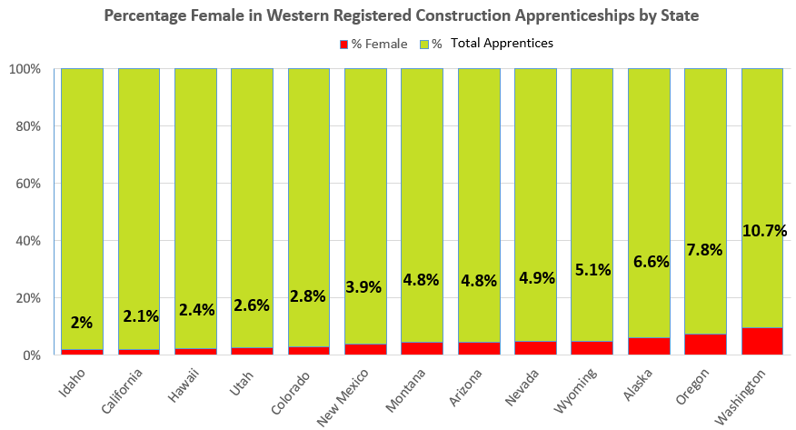

Slide 17
Looking Ahead: 2019 Phase-In
Provisions phasing in January 18, 2019 for OA-Registered Sponsors:
Draft written AAP (§30.4(e))
Conduct initial workforce analysis for race/sex (§30.5(b))
Conduct initial workforce analysis for individuals with disabilities (§30.7(d)(2))
Conduct initial review of personnel practices (§30.9)
Begin invitations to self-identify as having a disability at pre-offer and post-offer stages (§30.11)
Disseminate one-time invitation to self-identify for all current apprentices (§30.11)

Slide 18
Looking Ahead: 2019 Phase-In
At the time of a sponsor’s first compliance review following implementation of these provisions, sponsors will also need to:
Conduct a utilization analysis for race/sex (§30.5(c)) and for individuals with disabilities (§30.7)
If necessary, set a utilization goal and assess impediments to EEO and undertake action-oriented programs (§30.6, 30.8)

Slide 19
Meg Vasey
Executive Director
Tradeswomen Inc.
meg@tradeswomen.org
www.tradeswomen.org

Slide 20
Best practices for adopting consistent regulations by SAAs
Patrick Reardon
Executive Administrator
Apprentice Ohio

Slide 21
State VS. FEDERAL Regulations
U.S. Department of Labor – Title 29 CFR Part 30 – final federal rule – December 2016
29 CFR 30.18 – State Apprenticeship Agencies – submit draft state regulations by January 18, 2018
Sponsors have 180 days from date of U.S. Department of Labor approval to comply for federal purposes
Council subcommittee to review state regulations

Slide 22
Patrick Reardon
Executive Administrator
ApprenticeOhio
Patrick.Reardon@jfs.ohio.gov

Slide 23
Anti-Harassment training
Tiffany Thompson
Advocacy Program Manager
Oregon Tradeswomen

Slide 24
Oregon Tradeswomen

Slide 25
Three Levels of Training
Response
“After” an incident
Focus on legal definitions
Outline policies
Explain reporting process
Intervention
“During” an incident
Focus on immediacy
Awareness training
Skill Building
Prevention
“Before” an incident
Focus on culture shift
Communicate expectations verbally and non-verbally

Slide 26
Response: DOL Office of Apprenticeship

Slide 27
Response: Equal Employment Opportunity Commission

Slide 28
Intervention
Worksafe BC
Bystander Intervention

Slide 29
Video

Slide 30
Prevention
Response
Intervention
Prevention

Slide 31
Tiffany Thompson
Advocacy Program Manager Oregon Tradeswomen
tiffany@tradeswomen.net
www.tradeswomen.net

Slide 32
Western Resource for Women in Apprenticeship
womeninapprenticeship.org
National Center for Women’s Equity in Apprenticeship and Employment
www.womensequitycenter.org
DOL Office of Apprenticeship
www.doleta.gov/oa/eeo/anti_harassment_resources/
Equal Employment Opportunity Commission
www.eeoc.gov/eeoc/task_force/harassment/report.cfm
Bystander Intervention
www.itsonus.org
Worksafe BC
www.worksafebc.com/en/health-safety/hazards-exposures/bullying-harassment/resource-tool-kit
Video
www.youtube.com/watch?v=3KdXNTs5uCs
Green Dot
www.livethegreendot.com

