Slide 2
Building Evidence The Evaluation of the America’s Promise Job Driven Grant Program
September 26, 2017
Megan Baird, H-1B Program Manager, DOL
Molly Irwin, Chief Evaluation Officer, DOL
Megan Lizik, Chief Evaluation Office, DOL
Jeanne Bellotti, Mathematica Policy Research

Slide 3
Megan Baird
Program Manager, H-1B Grants
U.S. Department of Labor

Slide 4
Molly Irwin
Chief Evaluation Officer
U.S. Department of Labor
Megan Lizik
Senior Evaluation Specialist
U.S. Department of Labor
Jeanne Bellotti
Project Director
Mathematica Policy Research

Slide 5
Why the focus on evidence
About the America’s Promise evaluation
What we’ve learned so far…

Slide 6
Polling Question #1
Does your organization have a continuous improvement initiative or otherwise make learning a priority?

Slide 7
Polling Questions #2
How often do you use data or research to inform program decisions?

Slide 8
Evaluating America’s Promise Job Driven Grant Program
The Division of Strategic Investment’s (DSI) goal is to support the successful evaluation of the America’s Promise Grant Program
DSI will facilitate the coordination of evaluation efforts and communication between:
Grantees;
Federal Project Officers (FPO);
The Chief Evaluation Office (CEO); and
The evaluation team (Mathematica Policy Research)
Please send any questions or concerns to us at:
AmericasPromise@dol.gov with a cc to your FPO

Slide 9
Why the focus on evidence

Slide 10
Why focus on evidence?
Increased emphasis on evidence-based policymaking at all levels of government and in the private sector; for example:
The President’s FY18 budget: An effective and efficient Federal government requires evidence—evidence about where needs are greatest, what works and what does not work, where and how programs could be improved...
The Commission on Evidence-Based Policymaking
Evidence reviews and tiered-evidence funding initiatives
Private philanthropic organizations calling for evaluation and the use of evidence
DOL evaluations are tied to research questions posed by programs and other stakeholders, which add to the evidence base. The answers can increase informed decision making/program design.

Slide 11
Use of Evaluation in Policy/Program Implementation
Plan
Use Evidence
to Improve
Implement
Evaluate

Slide 12
What we know now
There is growing evidence that sector strategies can increase the employability, employment, earnings, and outcomes of job seekers, and at the same time benefit employers through improved worker productivity, job retention, and enhanced profitability
Career pathways is gaining acceptance as a potentially promising strategy to meet the needs of workers and businesses, though it is still relatively new and there is much to be learned

Slide 13
How the America’s Promise Program Evaluation will add to the literature
It will seek to answer these questions:
How were regional partnerships built and maintained? What factors influenced the regional partnerships and the engagement of employers?
What are the types and combinations of services and approaches provided? How were they implemented?
What are the characteristics of the target population?
What impact does America’s Promise have on the training and employment outcomes of participants and subgroups of participants?

Slide 14
Where you fit in
As partners in building evidence base workforce programs so we can continue to improve the programs and outcomes for the people we serve.

Slide 15
About the America’s Promise Job Driven Grants Program Evaluation

Slide 16
Independent evaluation
DOL has contracted with an independent, third party to conduct a rigorous evaluation of the America’s Promise Job Driven Grant Program
Evaluation contractor: Mathematica Policy Research, with Social Policy Research Associates
Period of performance: 2017-2022

Slide 17
Components of the evaluation
How will we answer the research questions?
Implementation evaluation (all 23 grantees will participate)
In-depth implementation study (12 grantees will participate)
Network analysis (6 grantees will participate)
Impact evaluation (3-5 grantees will participate)
The timeline for reports and other dissemination deliverables is forthcoming.

Slide 18
Implementation study: data sources
Documents from all 23 grantees
Web-based survey with all 23 grantees
Interviews with all 23 grantees
Telephone interviews with 11 grantees
Two-day site visits to 12 grantees
Partner network survey with 6 grantees
Two rounds to assess systems change over time

Slide 19
Impact study: assessing feasibility
Review grant materials
Conduct clarifying calls with all 23 grantees
Conduct site visits to up to 5 promising grantees
Develop recommended design and 3 to 5 grantees for inclusion

Slide 20
Impact study: key considerations
Is America’s Promise different from the counterfactual?
What does “business as usual” look like?
Is the expected number of people served realistic and large enough to be an adequate sample size?
Is random assignment feasible?
Is high quality administrative data available for a Quasi-Experimental Design?

Slide 21
Early Knowledge Development
What we’ve learned so far about America’s Promise

Slide 22
Basic structure of America’s Promise
DOL awarded $111 million in grants to 23 regional partnerships in January 2017
Grants are 4 years, including 6 to 9 month planning phase
Many have begun enrolling participants as of August 2017
Required activities are:
Education or training leading to a career pathway in an H-1B industry or occupation
Expansion of regional workforce partnerships
Employer engagement in sector strategies
Strong commitment to customer-centered design

Slide 23
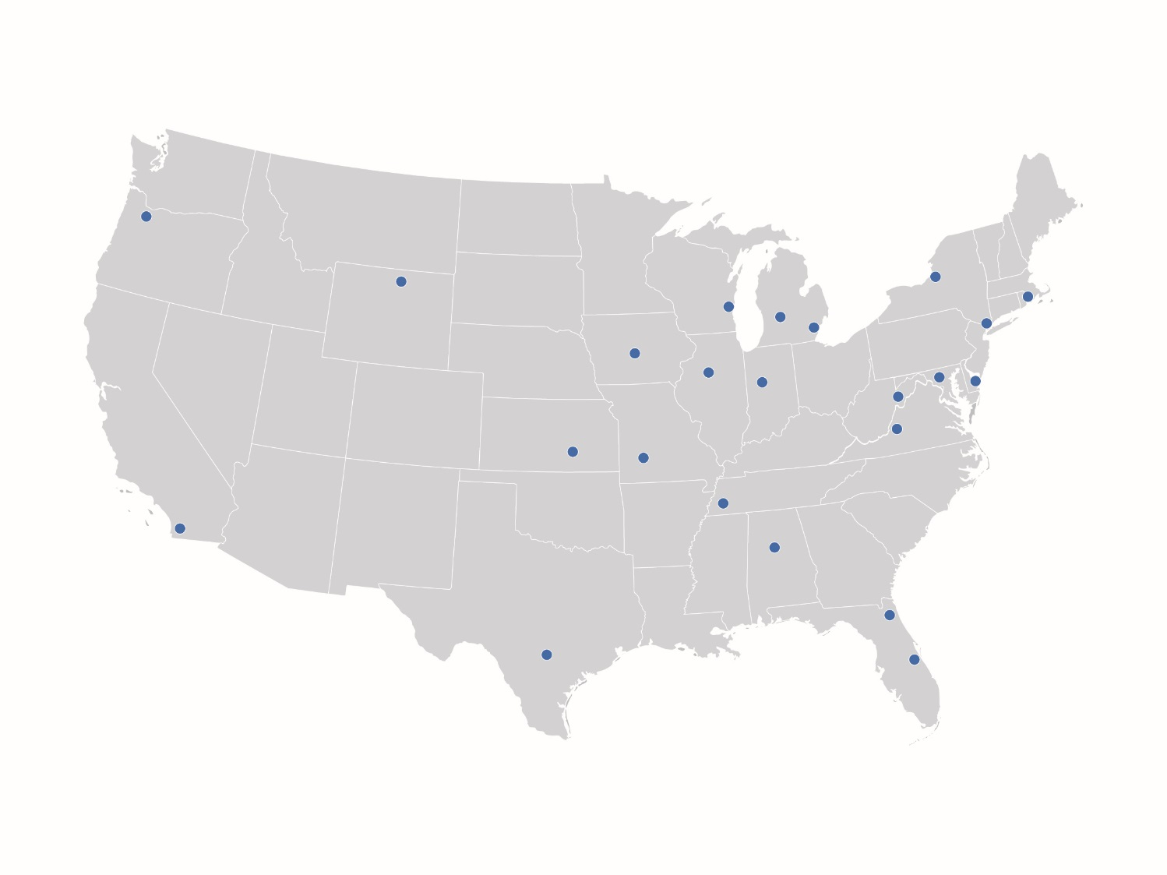
Grants are spread across the country

Slide 24
Regional partnership structure
Most regional partnerships had already formed before the America’s Promise grant.
Applications and grantee phone calls referenced partnerships on prior grants.

Slide 25
Regional partnership structure
Workforce (11) and higher education (7) entities lead most of the grants.

Slide 26
Regional partnership structure
Grantees had an average of 22 partners at application.
Phone interviews suggest fewer partners (average of 6) are actively engaged with early activities.

Slide 27
Regional partnership structure
Based on calls with grantees, employers have been engaged most commonly with advisory boards and development of career pathways.
Number of grantees

Slide 28
Sector focus
Manufacturing, IT and healthcare were the primary industries.
Nine grantees are focusing on two or more H-1B industry sectors.

Slide 29
Number of participants
The expected number of participants varies widely.
Total of 21,716 participants expected across grantees.
Average of 944 with range from 250 to 3,000.

Slide 30
Target populations
Grantees can serve unemployed, underemployed and incumbent workers, but not all are serving all three target populations.
Within these target populations, most grantees are also serving at least one special population.
18 of 23 grantees are targeting veterans, but expected numbers vary based on phone calls.
Other key target populations include:
Low-income individuals
Groups underrepresented in the target occupation
Recent HS graduates or non-degree completers

Slide 31
Recruitment and intake activities
16 grantees are using a centralized approach for recruiting and enrolling participants, based on phone calls
7 grantees through education providers
6 grantees through workforce partners
3 grantees will rely on grant-funded staff for intake
The remaining 7 grantees plan to use a decentralized approach with multiple partner types completing intake.

Slide 32
Common types of training
16 grantees will offer on-the-job training.
Paid internships (14 grantees) and paid work experience (11 grantees) are also common.
10 grantees mentioned registered apprenticeships in their applications but only 4 discussed them in telephone interviews.

Slide 33
Your past evaluation experience
15 grantees reported participating in some type of evaluation before America’s Promise.
6 grantees have participated in random assignment studies.

Slide 34
What’s next?

Slide 35
Immediate next steps
Activity | Month
Knowledge development | June 2017-September 2017
Site visits | October 2017
Site selection recommendations | October 2017
Grantee meetings to discuss evaluation design and participation | October – December 2017
Development of final evaluation design | November 2017

Slide 36
What can grantees expect for the implementation study?
A brief survey of all 23 grantees in spring 2018.
A partner survey with a subset of 6 partnerships in summer 2018 and winter 2020.
Site visits to a subset of 12 partnerships for two to three days in summer/fall 2019.
Telephone interviews with the remaining 11 partnerships in summer/fall 2019.

Slide 37
What can grantees expect for the impact study?
One-day site visits to a subset of 5 grantees in fall 2017
DOL and Mathematica will finalize the impact design and select sites in early 2018
Mathematica will work in partnership with sites selected for the impact study to:
Develop a memorandum of understanding for the evaluation
Customize impact evaluation procedures to minimize burden
Train local staff in evaluation procedures
Provide ongoing evaluation technical assistance through a dedicated liaison.
For more information, check out our evaluation one-pager. You can download it now from the file share window!
We’ll also be talking to you again at your grantee meeting and as we finalize the design!

Slide 39
Still have evaluation-related questions?
Please send any questions or concerns you may to the program office (DSI) at:
AmericasPromise@dol.gov
* Please be sure to cc to your FPO *

