Slide 1
Our Journey Together: The Power of Relationships
January 9, 2018
Workplace Mentoring with Youth

Slide 3
Maisha Meminger
US Department of Labor,
Employment and Training Administration,
Division of Youth Services

Slide 4
Mentoring in important!
Happy National Mentoring Month!
Mentoring is one of the 14 program elements for the WIOA youth program (20 CFR 681.460).
20 CFR 681.490 notes mentoring is a formal relationship between a youth participant and an adult mentor that includes structured activities where the mentor offers guidance, support, and encouragement to develop the competence and character of the mentee.
Last at least 12 months and may take place both during the program and following exit from the program;
While group mentoring activities and mentoring through electronic means are allowable as part of the mentoring activities, at a minimum, the local youth program must match the youth with an individual mentor with whom the youth interacts with on a face-to-face basis.
Mentoring may include workplace mentoring where the local program matches a youth participant with an employer or employee of a company.
Additional Resources, https://youth.workforcegps.org/resources/2017/01/27/12/39/Adult-Mentoring

Slide 5
Daniel Horgan
Senior Director – Corporate Engagement
MENTOR

Slide 6
Carolina Dominguez
Assistant Director – Americas Corporate Responsibility
EY
Linda Rodriguez
Head of The Fellowship Initiative & Program Officer for Youth Employment
JPMorgan Chase & Co.

Slide 7
Gail Gershon
Executive Director – Community Leadership
Gap Inc.
Matt Ybarra
Community Outreach Coordinator
General Motors

Slide 8
Articulate the business case for youth mentoring
Align diversity of mentoring programs with business priorities
Integrate effective private-sector engagement practices in youth mentoring

Slide 9
The Business Case for Mentoring

Slide 10
The Business Case for Mentoring
To engage employees and customers
To recruit, develop and retain talent
To elevate brand recognition
To strengthen communities

Slide 11
Spotlights: The Business Case for Mentoring
Gap Inc.
EY
This Way Ahead
A life skills and paid store internship program, to help teens and young adults from low-income communities land their first job
Leverages the powerful connections between employee volunteers, the young people served and the training ground that stores provide
College MAP
A multi-year, group-mentoring program focused on empowering students in underserved high schools so that they can gain access to college and succeed in higher education
College MAP is led by EY professionals who work with students to demystify the college admissions process and help Scholars build the skills they need to persist in college in partnership with College for Every Student

Slide 12
Toolbox: The Business Case for Mentoring
Mentoring: At the Crossroads of Education, Business and Community
http://bit.ly/2fFGXc9
The Mentoring Effect
http://bit.ly/1MJYUlj
Creating a Culture of Mentorship
http://bit.ly/2CsgWrb

Slide 13
The Diversity of Corporate Engagement in Youth Mentoring

Slide 14
The Diversity of Corporate Engagement in Youth Mentoring
Engage employees and/or customers as mentors
Leverage communication channels to advocate for and promote mentoring
Capacity building via research, pro bono / skills-based volunteerism, board leadership, in-kind donations
Invest in mentoring programs and mentoring field

Slide 15
Spotlights: Diverse Corporate Engagement
JPMorgan Chase
General Motors
The Fellowship Initiative
A 3-year comprehensive academic, socio-emotional, college access and career readiness support program operating in LA, Chicago, NYC & Dallas
1:1 employee volunteer mentoring
Employee resource and affinity group engagement
Student Corps
Nine-week program helping young people in underserved school districts transform their communities and jump start their futures through paid internships, important life skills training, career and college preparation
College intern and GM retiree engagement

Slide 16
Toolbox: Diverse Corporate Engagement
IMPACT Webinar Series
http://bit.ly/2vI9DfH
Connecting Youth & Business
http://bit.ly/2p7lot2

Slide 17
Effective Corporate Engagement Practices in Youth Mentoring

Slide 18
Effective Corporate Engagement Practices in Youth Mentoring
Elements of Effective Practice in Mentoring
Standard 1: Recruitment Recruit appropriate mentors and mentees by realistically describing the program’s aims and expected outcomes.
Standard 2: Screening Screen prospective mentors to determine whether they have the time, commitment and personal qualities to be an effective mentor.
Standard 3: Training Train prospective mentors in the basic knowledge and skills needed to build an effective mentoring relationship.
Standard 4: Matching Match mentors/mentees along dimensions likely to increase the odds that relationships will endure.
Standard 5: Monitoring and Support Monitor mentoring relationship milestones and support mentors with ongoing advice, problem-solving support, and training opportunities for the duration of the relationship.
Standard 6: Closure Facilitate bringing the match to closure in a way that affirms the contributions of both the mentor and mentee and offers both individuals the opportunity to assess the experience.
http://bit.ly/1njn90B

Slide 19
Effective Corporate Engagement Practices in Youth Mentoring
Industry alignment (i.e. school vendors & education programs)
Corporate giving alignment (i.e. health/wellness focus and sports-based mentoring)
Employee engagement alignment (i.e. service days; skill-based volunteers; board leadership; diversity networks)
Workforce alignment (i.e. talent recruitment; skill building)
Customer alignment (i.e. ice cream shop and mentoring milestones)
Brand alignment (i.e. brand/PR agency and mentor match storytelling)
Geographic alignment (i.e. neighborhood focus; multiple markets)
Network alignment (i.e. existing relationships)
Youth
Goals
Business
Goals
Nonprofit Goals

Slide 20
Effective Corporate Engagement Practices in Youth Mentoring
Strong commitment from leadership demonstrated by adequately resourcing mentoring initiatives, establishing a culture of mentoring throughout the entire organization and being directly involved in mentoring.
Thoughtfully developed partner relationships that connect partner needs with company resources and are sustained through respect, trust and open communication.
Genuine and targeted employee engagement including personal invitations from leadership, consistent recruitment campaigns, a variety of mentoring options with different partners, policies and incentives that encourage participation, training and support, and recognition.

Slide 21
Spotlights: Effective Corporate Engagement Practices

Slide 22
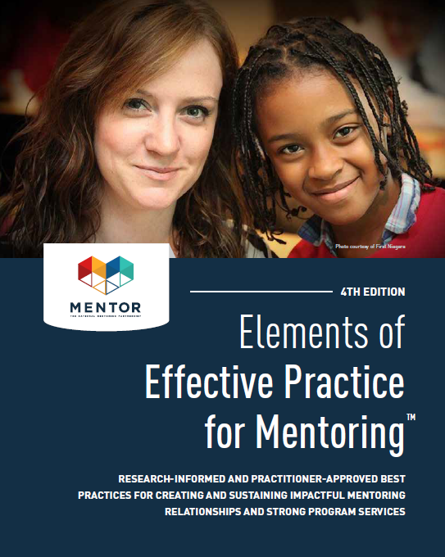
Toolbox: Effective Corporate Engagement Practices
Elements of Effective Practice for Mentoring
http://bit.ly/1njn90B
Growth Mindset Toolkit
http://bit.ly/2zaJ7sb
Finding the Greatness Within
http://bit.ly/2hHA8vn

Slide 24
Division of Youth Services
Youth.services@dol.gov
Daniel Horgan – MENTOR
dhorgan@mentoring.org

