Slide 1
Getting to know our partners: What role do you play in your organization?
Outreach Worker
Workforce Professional (provide direct service)
Administrator or Policymaker
Employer
Other

Slide 2
Protecting Farmworkers from Sexual Harassment & Human Trafficking
February 2, 2018
State Level Activities

Slide 4
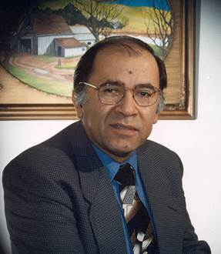
Bhavani Arabandi, Ph.D.
Workforce Analyst, National Monitor Advocate Team
U.S. Department of Labor
Juan Regalado
National Monitor Advocate
U.S. Department of Labor

Slide 5
Jorge Acero
State Monitor Advocate
Maine Department of Labor

Slide 6
To learn about:
The prevalence of sexual harassment and human trafficking within the farmworker community;
WIOA regulation on sexual harassment and human trafficking;
Leveraging resources and support from state administration and partners;
Developing a sexual harassment and human trafficking training plan that outlines audience, needs, objectives, strategy, and key training contents.

Slide 7
Webinar Format: Live Podcast
Questions to be discussed:
What was the driving force behind WIOA regulations & state level work?
How does it relate to the Department of Labor’s mission?
How did Maine lay the ground work for this?
What are some of the challenges you faced?
What is the impact?
Would this training be useful for other programs?

Slide 8
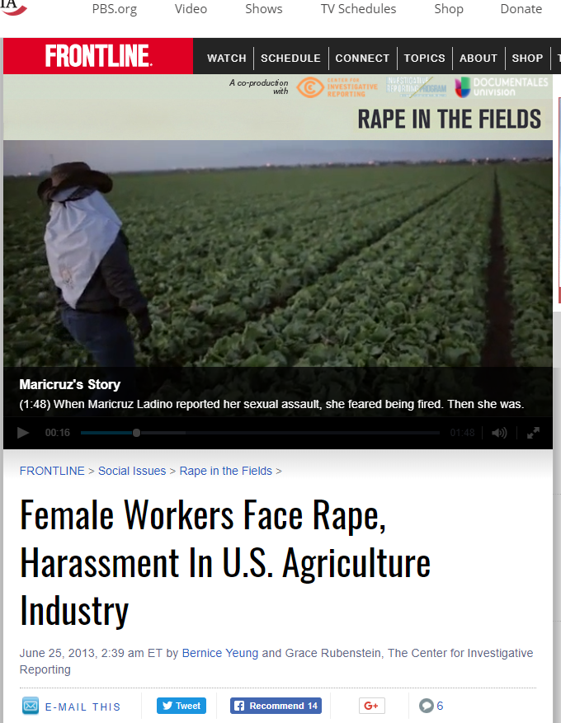
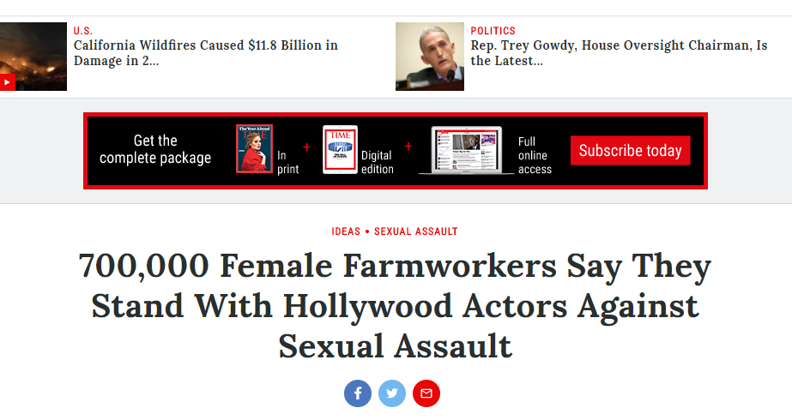
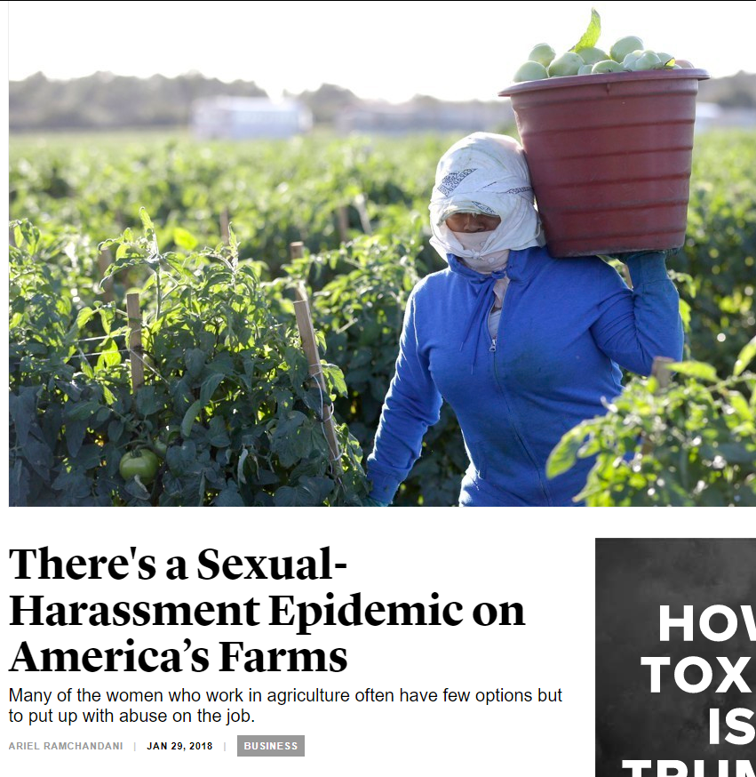
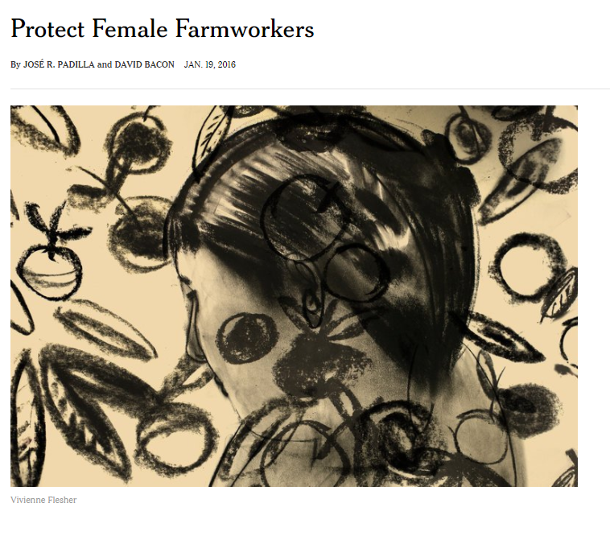
Campesinas,A 2017 "700,000 Female Farmworkers Say They Stand With Hollywood Actors Against Sexual Assault" Time
Yeung,B 2013 "Female Workers Face Rape, Harassment in U.S. Agriculture Industry" PBS
Ramchandani, A 2018 "There's a Sexual-Harassment Epidemic on America’s Farms" The Atlantic
Bacon,D 2016"Protect Female Farmworkers" New York Times

Slide 9
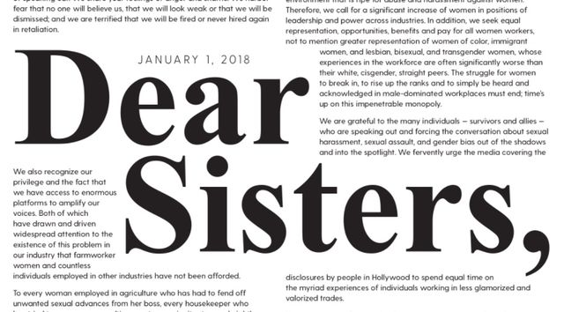
Sexual Harassment

Slide 10
Human Trafficking
Sex Trafficking
Labor Trafficking

Slide 11
What is the prevalence of sexual harassment and human trafficking among farmworkers or others in your state?
High
Moderate
Low
Non existent
Not sure

Slide 12
What was the driving force?
1
What are the Workforce Innovation and Opportunity Act (WIOA) regulations on sexual harassment and human trafficking?
What was the driving force behind including this in WIOA regulations?

Slide 13
What was the driving force behind your involvement in this initiative?
2
Training and Employment Guidance Letter (TEGL) No. 9-12
Human Trafficking Work Group
2014 National Monitor Advocate (NMA) / State Monitor Advocate (SMA) National Training
Advisory Committee

Slide 14
How does it relate to the Department of Labor’s mission?
U.S. Department of Labor
Maine Department of Labor
Welfare of wage earners
Working conditions
Barriers to employment
Barriers to service delivery
Safe positive work environments

Slide 15
How did you lay the ground work for this?
4
Outline plan
Educating the state administration

Slide 16
Are you a member of a Human Trafficking Taskforce (at any level)?
Yes
No

Slide 17
How did you keep the ground swell going? How are you going to sustain this?
5
Work collaboratively
Community groups
Multi-Disciplinary Referral Network
American Job Center (AJC) staff training
Discussions with trainers to develop training content

Slide 18
What are some of the challenges you faced and how did you overcome them or change them into opportunities?
6
Maine does not have a large mass of migrant workers
Who will provide such training
State Administrators’ buy-in

Slide 19
As a result of the efforts you’ve described today, what is the impact?
7
Broadening awareness
Connected to resources/agencies
Continuous improvement

Slide 20
How would this training be useful for other programs such as Youth Build, adult services, and AJC staff? Do you have any best practices to share with the audience?
8
These issues are prevalent across many populations we serve
Improve awareness across agencies

Slide 21
Has your organization provided or developed any training on combating sexual harassment and human trafficking?
Yes
No
I don’t know

Slide 22
Any last take-aways for our audience as they go about setting up collaborations and services in their own states?
9

Slide 24
WIOA Regulations
§653.107 (b): Outreach worker responsibilities
(7) Outreach workers must be trained in local office procedures and in the services, benefits, and protections afforded MSFWs by the ES, including training on protecting farmworkers against sexual harassment. While sexual harassment is the primary requirement, training also may include similar issues such as sexual coercion, assault, and human trafficking. Such trainings are intended to help outreach workers identify when such issues may be occurring in the fields and how to document and refer the cases to the appropriate enforcement agencies. They also must be trained in the procedure for informal resolution of complaints. The program for such training must be formulated by the State Administrator, pursuant to uniform guidelines developed by the Employment and Training Administration (ETA). The SMA must be given an opportunity to review and comment on the State's program.

Slide 25
Training and Employment Guidance Letter (TEGL)
TEGL No. 9-12: Human Trafficking: The Role of the Public Workforce System in the Delivery of Services and Referrals to Victims of Trafficking
MOU TEGL

Slide 26
Migrant and Seasonal Farmworkers Monitor Advocate System
https://www.doleta.gov/programs/msfw.cfm
Agricultural Connection
https://farmworker.workforcegps.org/

Slide 27
Jorge Acero
State Monitor Advocate
Maine Department of Labor
Jorge.a.acero@maine.gov
207.623.7928
Juan Regalado
National Monitor Advocate
U.S. Department of Labor
Regalado.juan@dol.gov
415.625.7904

