Slide 1
February 6, 2018
Creating Career Pathways
January 2018

Slide 2
Susan Worden
Supervisory Program Analyst
Performance and Data Reporting Unit
Office of Trade Adjustment Assistance

Slide 4
Discussion of PluggedinVA
Partnership with TAA and its resources
Considerations for what other states can explore
Partnering with Adult Ed (understands training needs of TAA demographic)
Identifying Employer Needs
Tiered levels of remedial training that is work contextualized
Cohort model
Integration of soft skills and IT Competencies

Slide 5
Kate Daly Rolander
Workforce Education Specialist
Virginia Adult Learning Resource Center
Anna Rice-Wright
TAA State Coordinator
Virginia Employment Commission

Slide 6
What are your biggest challenges in developing/identifying effective employer based training in your state?
Foundational skill levels (literacy/numeracy)
Soft skills
Staff levels
Others

Slide 7
What resource/strategy would resolve this issue in your mind?
Business engagement expertise
Ability to engage partners to come up with comprehensive solutions/eliminating partner silos
Other?

Slide 8
PluggedInVA is a career pathways bridge program that prepares adult learners with the knowledge, skills, and credentials they need to succeed in postsecondary education, training, and high-demand, high-wage careers in the 21st century.

Slide 9
A Very Brief History of PluggedInVA
2008: PluggedInVA development at VCU’s Literacy Institute
2009: First PluggedInVA pilot began in Feb. in Southwest Virginia in Information Technology
2011-12: Governor’s Innovation Fund -Expansion to 2 additional sites
2014: Line item in the VA Governor’s budget – Expansion to 12 additional sites
2013: Development of models to expand to lower skill levels:
PluggedInVA Workforce (5th – 8th grade)
PluggedInVA Pathways (literacy – 4th grade)
2013 – 2018: Expansion through partnerships: TAA; SNAP E&T; DARS, CPID; VCCS Initiatives

Slide 10
Key Elements
Industry-specific contextualized curriculum
Co-enrollment at a postsecondary institution
Industry-recognized credentials or certificates
Career Coaching
Active business participation / curriculum input
Capstone project
Cohort model
Supportive services through partnerships (TAA)

Slide 11
College & Career Readiness Outcomes
GED / Secondary credential
Digital Literacy Certification
A Workplace Readiness Certificate
Industry Certifications
Academic Skills Gain
Transferrable / Stackable Occupational Training

Slide 12
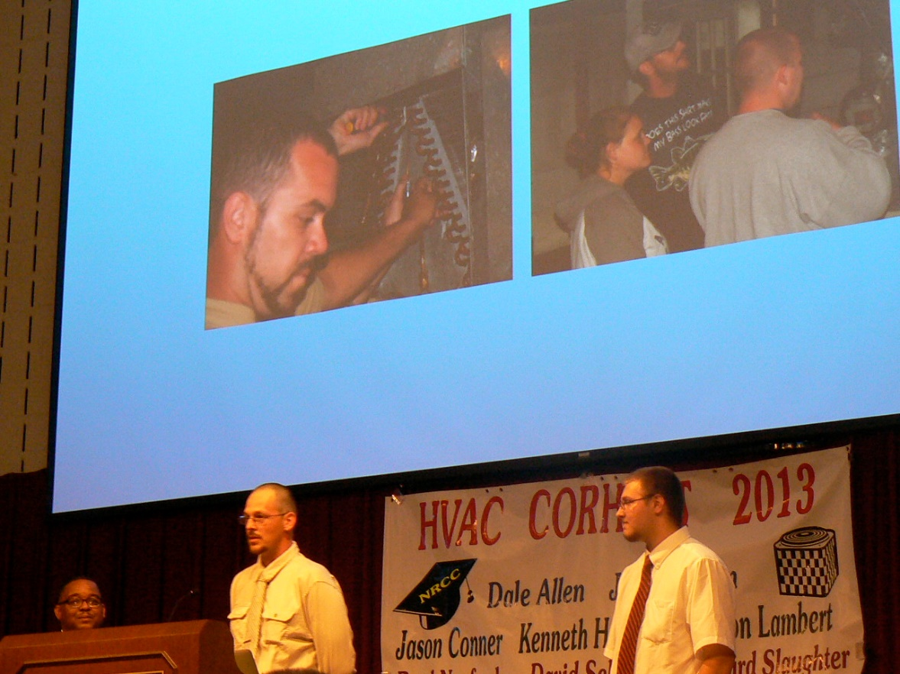
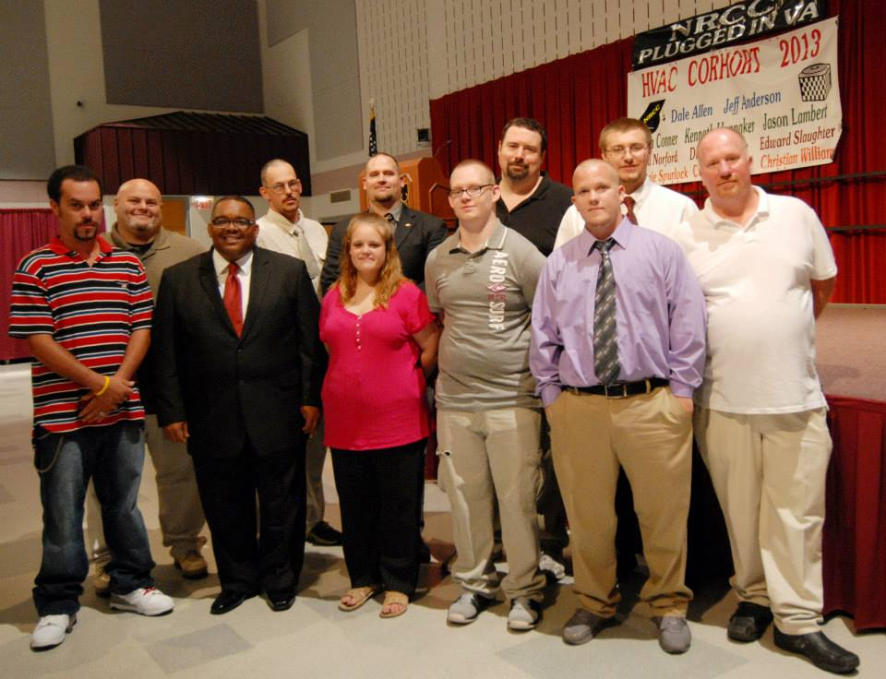
Capstone Projects
Rigorous community-engaged team projects that showcase 21st century skills, IT skills, and soft skills.

Slide 13
Partnerships Make it Work
Relationships
Adult Education
Workforce Development
Employers
Postsecondary

Slide 14
Business Engagement
How are businesses engaged?
What does engagement look like?

Slide 15
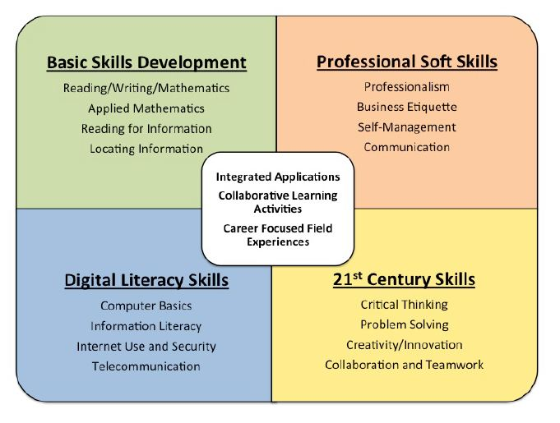
Overall Framework

Slide 16
PluggedInVA Curriculum
Aligns with
Secondary completion
College readiness
Workplace readiness
Assessments
Assessments
VPT (Virginia Placement Test)
CRC (Career Readiness Certificate)
GED2014
Digital Literacy Certificate(s)
Industry-recognized credentials

Slide 17
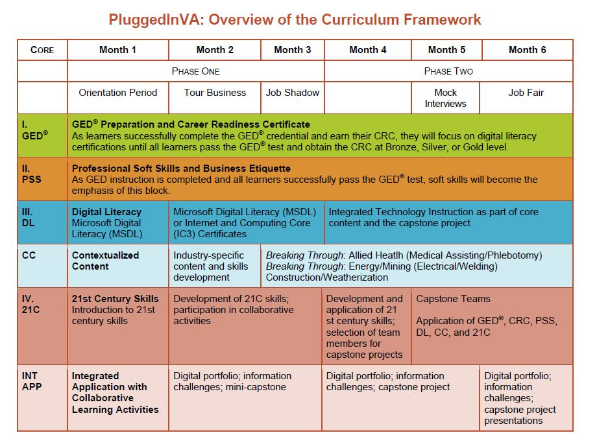

Slide 18
CERTIFICATES
IC3 NCCER HIPAA
CEHRS OSHA Safety CPR & First Aid
CNA Medication Administration Pharmacy Technology
Refrigeration Recovery OSHA 10 Welding
Phlebotomy HVAC CNC Machining
Electronic Medical Records Electricity Dental Assisting/X-ray
CDL-A (Commercial Driver) Grounds Maintenance
CAREER STUDIES
Information Technology Manufacturing Technician
Construction/Weatherization Entrepreneurship
Electrician Helper Customer Care
Software Quality Assurance Electronic Medical Records
Phlebotomy HVAC
CNC (machining) Welding
Customer Care Phlebotomy
Industrial Maintenance Aviation Mechanic
Carpentry

Slide 20
Expanding the Pipeline from Literacy to Careers
Pathways (Literacy – 4th)
Workforce (5th to 8th)
Careers (9th to postsecondary)

Slide 21
TAA/NRCC Project Managing multiple levels and cohorts
Assessments and Placement
Building cohorts
Participant training schedules
Staff preparation and management
Curriculum
Outcomes
Lessons Learned

Slide 22
TAA/NRCC Project Outcomes after one semester…
 | PIVA Pathways | PIVA Workforce | PIVA Careers
Enrolled | 9 | 34 | 15
Post-tested | 4 | 19 | 8
Educational Gains | 4 | 14 | 7
Enrolled in Postsecondary | 8 | 33 | 12
Retained | 4 | 31 | 15
Left: Gained Employment | 4 | 3 | 0

Slide 23
Outcomes
Through FY2012-13, 70% of completers continued with at least one additional semester at the community college level—4 times the rate of general adult education students.
47% of students enrolled in 2012-13 gained or retained employment by September 1, 2013.
PluggedInVA cohorts are operating in 14 adult education regions in Virginia – in both urban and rural areas.

Slide 24
PluggedInVA Outcomes 2009 - 2018
Cohorts Completed | >150
Learners Completing Cohorts | >1600
GED Completion Rate | ~90%
Industry-Recognized Credentials | 100%
Funding Streams and Partnerships
Virginia Governor’s Budget | 2013 - 2018
TAA, New River Valley | 2014
Title II, Career and Technical Education | 2009 - 2018
Governor’s Innovation Fund | 2012 - 2013
SNAP E&T, U.S. Dept. of Agriculture | 2015 - present
VA DARS - CPID | 2017 - present
VA DSS, VCCS - RSVP | 2017 - present
VCCS, Strada | 2016 - present

Slide 25
How to File a TAA Petition Online (2015)
Tips and Tricks for Quality Petition Filing to Support Expedited Group Eligibility
https://www.workforcegps.org/events/2016/04/20/12/59/How_to_File_a_TAA_Petition_OnlineName of reference item
Who is the TAA Customer. Resources, Characteristics and Strategies for TAA and other Adult Learners (2015)
Tips and Tricks for Quality Petition Filing to Support Expedited Group Eligibility
https://taaccct.workforcegps.org/resources/2016/04/15/16/28/Who_-is_the_TAA_Customer-_Resources-_Characteristics_and_Strategies_for_TAA_and_other_Adult_Learners
TAA Fiscal and State Best Practice Webinar (2013)
Provides Fiscal overviews for spending TAA Program Funds and State Best Practices to provide ideas for leveraging resources
https://www.workforcegps.org/events/2014/07/08/13/59/trade-adjustment-assistance-taa-fiscal-and-state-best-practices-webinar
TAA State Best Practice - Oregon
Oregon’s Trade Navigator system addresses outreach, identification of on the job training (OJT), leveraging resources, and increasing take up.
https://www.workforcegps.org/events/2017/09/27/11/10/Trade-Adjustment-Assistance-Oregon-Best-Practice

Slide 27
Susan Worden
Supervisory Program Analyst
Office of Trade Adjustment Assistance
worden.susan@dol.gov
(202) 285.4372
Kate Daley Rolander
Workforce Education Specialist
Virginia Commonwealth University
kedaly@vcu.edu
(804) 827-1946
Anna Rice-Wright
TAA State Coordinator
Virginia Employment Commission
Anna.rice-wright@vec.Virginia.gov
(804) 786-8825
www.pluggedinva.com

Slide 28
National Adult Education State Directors:
www.naepdc.org/members/members_home.html

Slide 29
State Trade Coordinators:
https://www.doleta.gov/tradeact/contacts.cfm#State
Regional Trade Coordinators:
https://www.doleta.gov/tradeact/FedContacts_Regional.cfm

Slide 30
Leveraging TAA Data
March 20, 2018, 2-3:30PM Eastern

