Slide 1

WIOA State Plans:
Using the Online Portal for Plan Submission
Presented by:
U.S. Department of Labor
U.S. Department of Education

Slide 2
Heather Fleck
  Employment and Training Administration, U.S. Department of Labor

Slide 3
Jim Doyle
  Rehabilitation Services Administration,
  U.S. Department of Education
Shannon Moler
  Rehabilitation Services Administration,
  U.S. Department of Education

Slide 4
Provide a general overview of the WIOA planning requirements for the required two-year modification.
Provide a general overview of the State plan portal for State users.
Provide focused training and tips for State users on how to use the State plan portal.

Slide 5
WIOA State Plan Overview
1
WIOA requires that States review their plans every two years and update State Plan strategies based on changes in the labor market and economic conditions or other factors affecting the implementation of the State Plan.
States must use the Information Collection Request (ICR) Workforce Innovation and Opportunity Act (WIOA) Unified and Combined State Plan Requirements approved under Office of Management and Budget (OMB) control number 1205-0522 to develop and submit the two-year modification (see slide 27).

Slide 6
WIOA State Plan Overview
1
States must submit a WIOA Unified or Combined State Plan two-year update to the Departments by March 15, 2018 using the WIOA State plan portal.
The Departments have issued joint and program specific guidance for further reference (see slide 27).
Please carefully review the program guidance and ICR before submitting your State’s plan.
Portal planning requirements mirror the ICR.

Slide 7
WIOA State Plan Overview
1
According to WIOA, a Unified or Combined State Plan must be submitted every four years with a two-year modification submitted to the Secretary of the Department of Labor.
While multiple individuals in the State may enter content into the portal, only one State individual may submit the entire plan on behalf of all included programs through the portal for review.
Each Governor must submit or designate a primary official to serve as the final submitter on behalf of all included programs for the State Plan.
If the individual designated in the State has changed, please notify the Departments of such designation via correspondence in an email to WIOA.Plan@dol.gov.

Slide 8
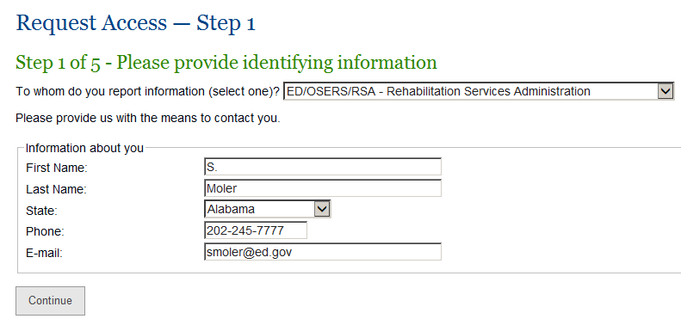
How to Use the Portal
2
Web portal basics - How to request access
Visit the webpage https://rsa.ed.gov/request-access.cfm?usp=Y Internet Explorer is recommended.
Step 1 - Choose the agency to whom you report data from the dropdown list, and enter the contact information requested.

Slide 9
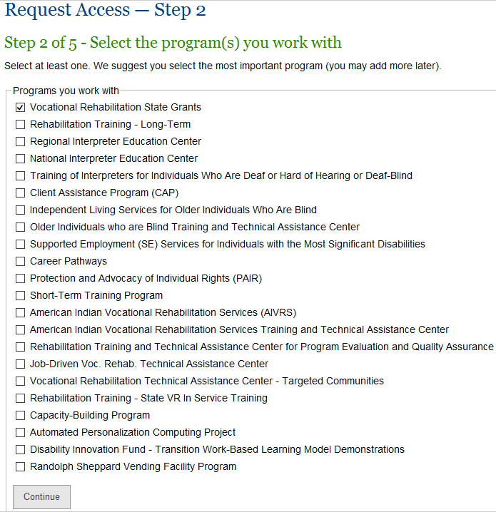
How to Use the Portal
2
Web portal basics - How to request access
Step 2 - Select the Federal program associated with the information you will be entering.

Slide 10
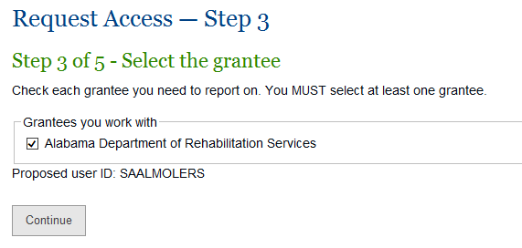
How to Use the Portal
2
Web portal basics - How to request access
Step 3 - Select the State ‘Grantee’ with which you are associated for the purposes of reporting. Please note the list of available grantees will be filtered down based on the user’s options chosen in the previous steps.

Slide 11
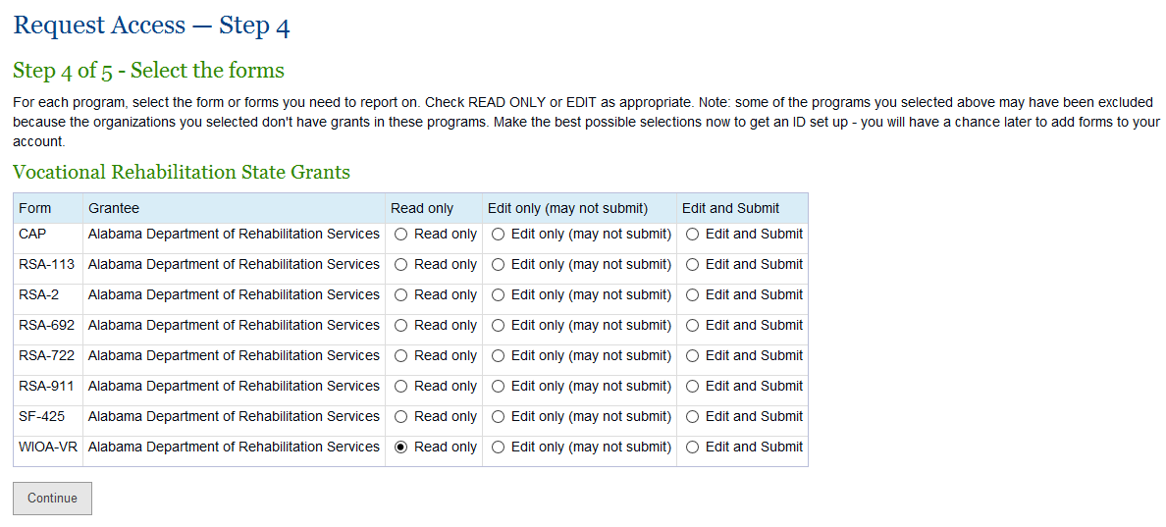
How to Use the Portal
2
Web portal basics - How to request access
Step 4 - Select the access level required (Read only, Edit only, or Edit and Submit)
Note that the system automatically grants VIEW access and may be upgraded by the User Administrator, as appropriate; users may request EDIT or EDIT/SUBMIT access to other forms by clicking on “Technical Support” (located under “Help”) and then clicking on “I need to enter data on a form that isn't listed on my Data Entry screen, or I need to upgrade my access” option.

Slide 12
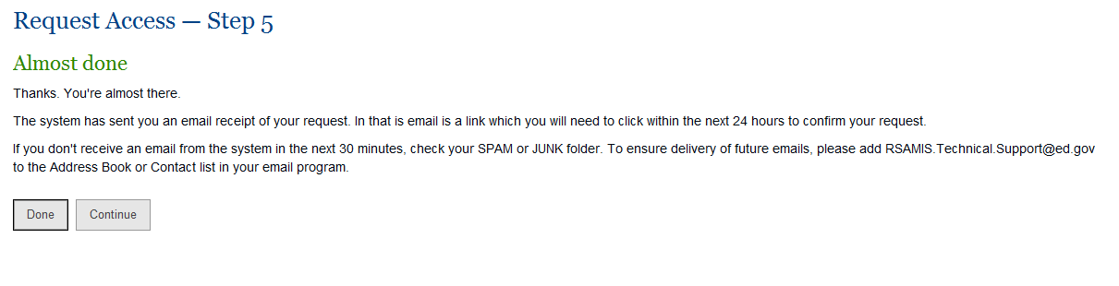
How to Use the Portal
2
Web portal basics - How to request access
Step 5 – A summary of what happens next
On the access request confirmation page, select Done.
An automated email will be sent to the address entered in Step 1 with a confirmation of the request.
Click on the link in the email within 24 hours to confirm the request.
Do NOT attempt to log in before being granted access – doing so will lock the user out of the system and cancel the pending request.
Once the request is processed by the appropriate Department, the user will receive an email with a one-time password.

Slide 13
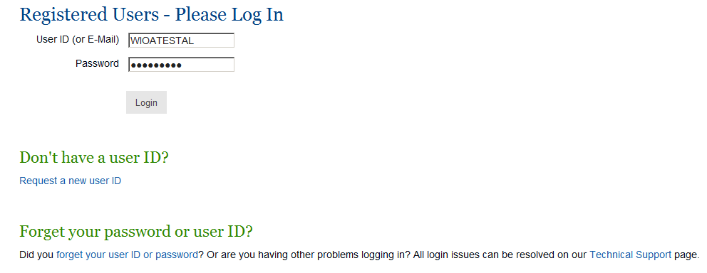
How to Use the Portal
2
Web portal basics – Logging into the portal
Use the following link when logging on and enter username and password: https://rsa.ed.gov/login.cfm?mode=form&usp=Y, or go to rsa.ed.gov and click “Log On” at the right top portion of the webpage.

Slide 14
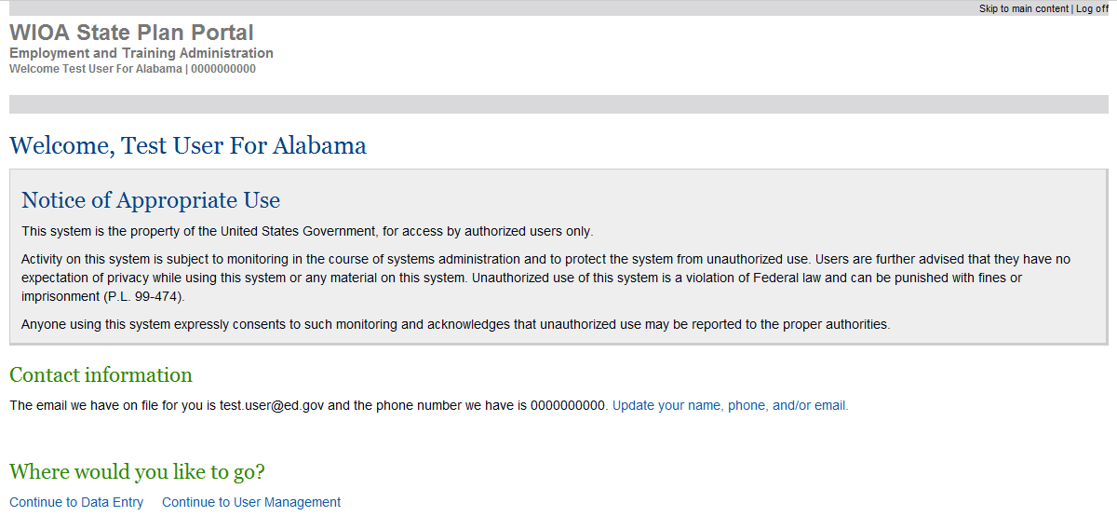
How to Use the Portal
2
Web portal basics – The “Welcome” Screen
After logging in, the user will see the ‘Welcome’ screen where he or she may:
Update contact info,
Continue to the Data Entry screen, or
Some users may continue to user management.

Slide 15
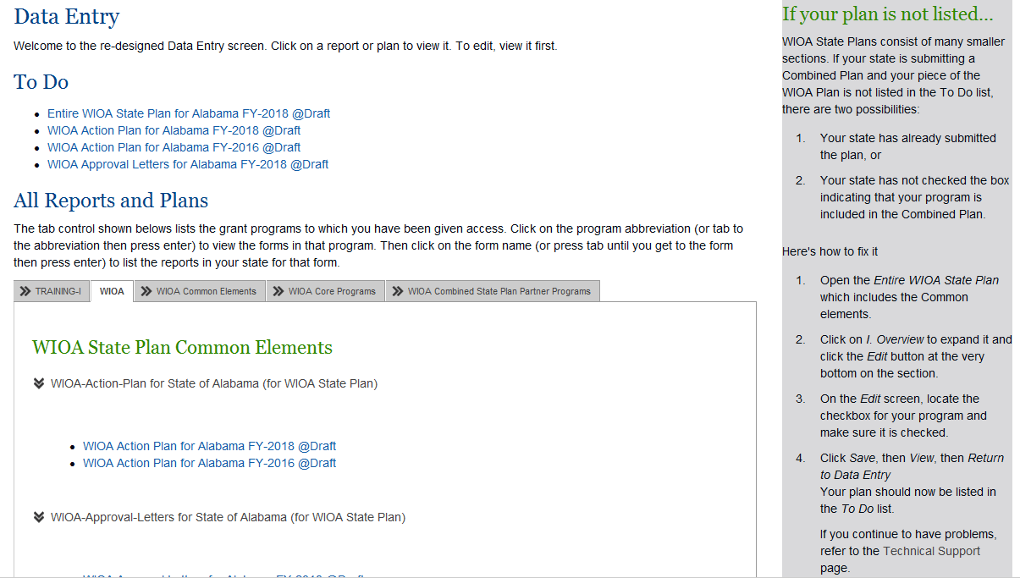
How to Use the Portal
2
Web portal basics – The “Data Entry” Screen
After logging in, the user will see the “Data Entry” screen where he or she may access plan elements for which they have been given access.

Slide 16
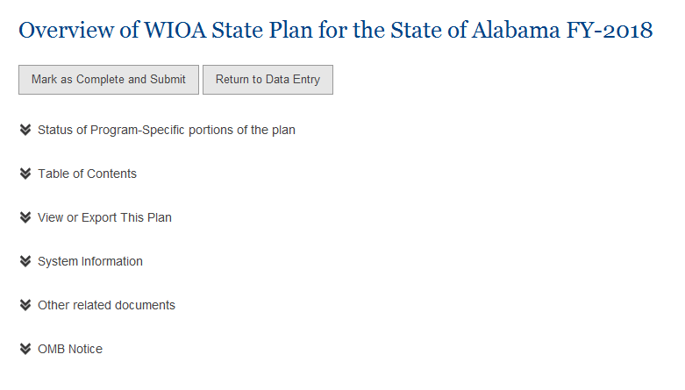
How to Use the Portal
2
State Plan Structure – The “Overview” Screen
The State Plan is organized into expandable panels that, when opened, will show details for each section (users using screen readers will hear the main sections as links; click the link to open the section).

Slide 17
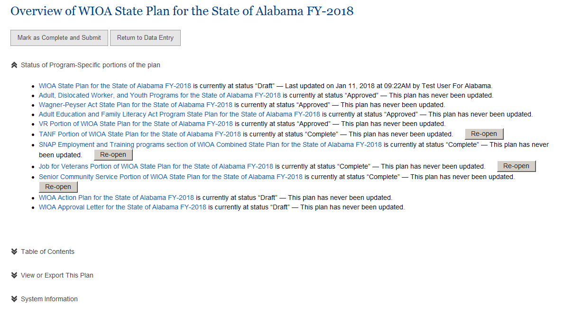
How to Use the Portal
2
State Plan Structure – The “Dashboard”
Clicking on “Status of Program-Specific portions of the plan” will take the user to the “Dashboard”

Slide 18
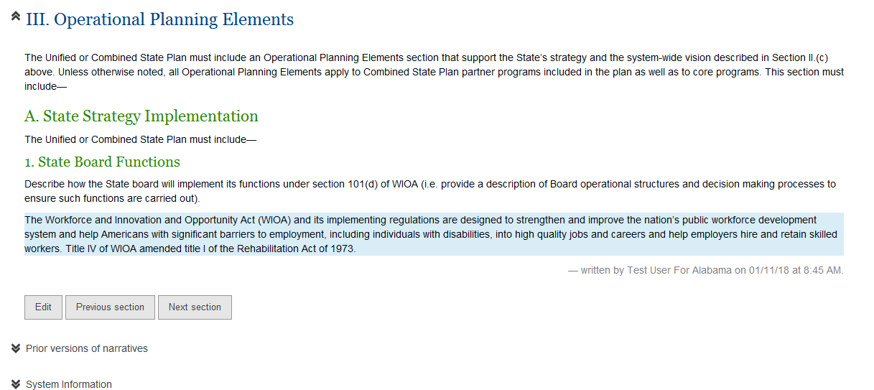
How to Use the Portal
2
State Plan Structure – Editing Comments
Once you open up a report panel, there will be an Edit button for each major element (sometimes several elements are gathered together into one group). Click Edit on any section to make edits.

Slide 19
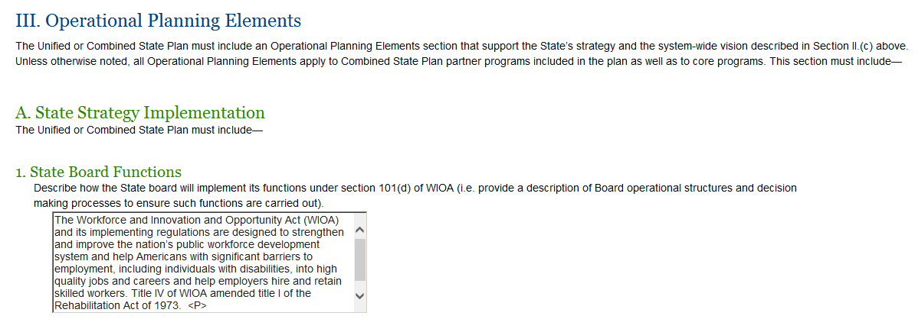
How to Use the Portal
2
State Plan Structure – Editing Comments
An Edit box will open up. Narratives can be entered through several methods. The user can type narratives directly into the Edit box, or the user can paste text from another source into the Edit box.

Slide 20
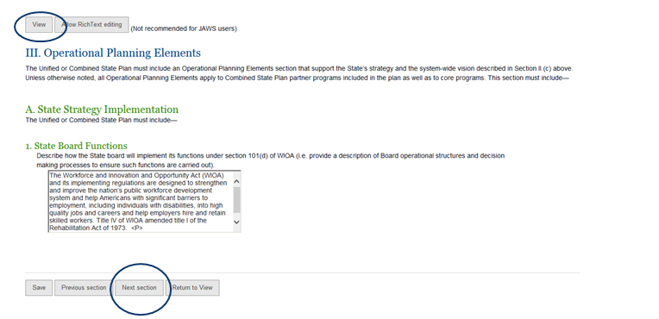
How to Use the Portal
2
State Plan Structure – Saving Information
Each screen that contains an edit box will be followed by a set of four buttons: Save (ALT+S), Previous section (ATL+P), Next section (ALT+N), and Return to View (ALT+V) as shown below. Clicking any of these options will save the information entered on the screen.
Clicking on Return to View or the View button at the top of the screen allows the user to move to a different portion of the Plan.

Slide 21
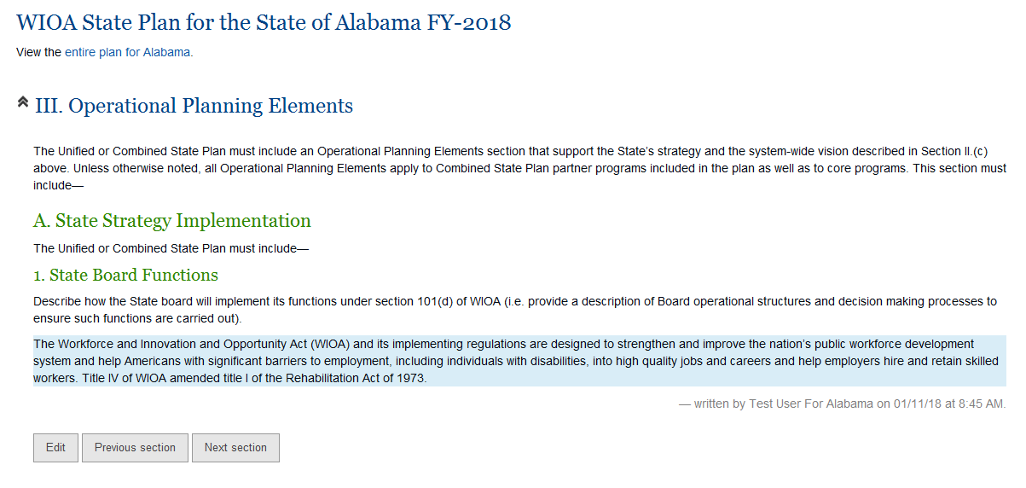
How to Use the Portal
2
State Plan Structure – Navigating the Plan
A user may easily navigate a State plan by clicking the Previous section and/or Next section buttons.
Clicking on “View the entire plan for [State]” will take the user back to the OVERVIEW screen.

Slide 22
Helpful Tips
3
Ensuring Accessibility
Text will automatically be added to the proper place in the outline. Further, font size and font face choices will be removed and made consistent with the rest of the plan. If using Rich Text, underlines, italics, and bold text will be retained. Rich Text will also retain tables. If using Plain Text mode, all formatting is removed.
The portal includes edit boxes following each prompt identifying the information needed. Once the information is entered into the text box, the user will have little-to-nothing to do to make the final document accessible.
If text is pasted in from another document (i.e. MS Word) and is accessible, the system will accept it. If text is deemed too long for the answer to be considered accessible, the system will alert the user (see slide 26 for further information).
  (While the system will accept virtually limitless text, Section 508 requires us to consider accessibility. Text longer than about 3½ pages needs to have headings added to ensure that it can be easily navigated for people using screen readers.)
If your text includes tables, the system will convert the tables to a standardized accessible format. If the tables are not accessible, the system will alert the user so that the tables can be modified as appropriate.
The goal of the system is to provide a consistently formatted, accessible document with as little effort as possible on the part of the user.

Slide 23
Helpful Tips
3
Saving your MS Word text into the portal
Rich Text editing v. Basic editing
The web portal has two modes for editing text. The portal will allow the user to toggle between the modes.
Rich Text editing allows the user to paste in formatted Word text and will preserve bold, underlines, italics, tables, and so on. It will remove most of the font style information in order to make the final document uniform in appearance.
Basic editing allows you to paste in plain text. It removes all formatting, but adds HTML code to allow for paragraph formatting.
Suggestions to consider:
Draft your responses in MS Word and use tools such as spell check and track changes to develop a high-quality draft. When the draft is finalized, run the Accessibility Checker (see slide 27). Fix any issues encountered (MS Word will provide tips about how to fix each error, with links to online resources).
Do not include the following special characters:~ < >

Slide 24
Helpful Tips
3
Narratives that include a table
Use the Rich Text mode and paste in your table as you would any other Word document. The user may paste a table from Word or from Excel. The portal will check for merged cells and flag them as an error.
If text includes tables, the user must ensure the accessibility of the table. Don’t use merged or split cells – keep the structure simple and consistent (every row should have exactly the same number of cells).
Also, the first row of the table – and only the first row – will be marked as a header row for the contents of the table.

Slide 25
Helpful Tips
3
Narratives that include an image
Images present special challenges to users with visual disabilities. However, accessibility standards do allow the use of images if the content of the image is fully described.
Additionally, there is a technical challenge: the web portal does not (at this point) support uploading of images. However, the portal can display an image that the user has stored on another location on the web (users may need assistance from local technical folks to help with the HTML code to display the image).
Resources:
See Using the Portal on the help menu for additional details.
Microsoft provides further information on creating accessible tables. See Make Your Word Documents Accessible in slide 27.
  If there are no merged rows and merged columns, the system will adjust your tables automatically. It will tag the first row as the header and will make it grey. Also the contents of the cell will be adjusted: numeric information will be right-justified and textual information will be left-justified.

Slide 26
Helpful Tips
3
User Responsibilities to Ensure Accessibility
While the system will assist the user in creating a final accessible and uniformly-formatted output, the portal depends on the user to provide accessible content. The following are the considerations the user must make when entering specific narratives:
Text answers that are four pages or less
If the narrative related to a single element consists of text that is roughly four pages or less (or to be precise, 12 thousand characters or less), the system will accept it. All the user has to do is paste in the answer.
Text answers that are longer than four pages
If your narrative related to a single element consists of text that is more than four pages, the user should ensure accessibility before pasting it in. Run Microsoft’s Accessibility Checker to ensure text is accessible. Usually, this means assigning heading levels to the document using the built-in “Heading 1,” “Heading 2,” etc. styles. Microsoft has provided helpful documentation on accessibility, including videos and step-by-step instructions for using the built-in Accessibility Checker. Please refer to Microsoft’s Make Your Word Documents Accessible for more information (see slide 27).

Slide 27
RSA-TAC-18-01: Two-Year Modification Requirements for Workforce Innovation and Opportunity Act (WIOA) Unified and Combined State Plans
    https://www2.ed.gov/policy/speced/guid/rsa/subregulatory/tac-18-01.pdf
Training and Employment Guidance Letter 06-17: Modification Requirements for Workforce Innovation and Opportunity Act (WIOA) Unified and Combined State Plans
    https://wdr.doleta.gov/directives/corr_doc.cfm?DOCN=5822
Information Collection Request (ICR) Workforce Innovation and Opportunity Act (WIOA) Unified and Combined State Plan Requirements approved under Office of Management and Budget (OMB) control number 1205-0522
    https://www.doleta.gov/wioa/docs/December17-ICR-State-Plan-Modification.pdf
Make Your Word Documents Accessible
  This resource includes tips on the accessibility checker and how to make tables accessible
    https://support.office.com/en-us/article/Make-your-Word-documents-accessible-D9BF3683-87AC-47EA-B91A-78DCACB3C66D?ui=en-US&rs=en-US&ad=US

