Slide 1
Make Industry Experts into Expert Instructors to Increase Student Success
February 28, 2018
Innovations Leading to Career Success Webinar Series
Employment and Training Administration
Office of Career, Technical, and Adult Education

Slide 2
Moderators
Cheryl Martin, TAACCCT Program Manager, Division of Strategic Investments, Employment and Training Administration, U.S. Department of Labor
Erin Berg, Community College Program Specialist, Office of Career, Technical, and Adult Education, U.S. Department of Education, U.S. Department of Education

Slide 3
About this Webinar
Learn about the videos, tools, and resources produced by the Industry Expert to Expert Instructor (IE2EI) IMPACTcommunity on SkillsCommons.org, which you can use to prepare your industry experts to become excellent teachers.
The Industry Expert to Expert Instructor (IE2EI) Network, and the many other resources available on SkillsCommons, were produced by grantees of the Trade Adjustment Assistance Community College and Career Training (TAACCCT) program, a collaboration between the US Department of Labor and the US Department of Education.
Part of a webinar series showcasing strategies and resources developed by community colleges that are of broad interest to educational institutions engaged in career-focused education and training.

Slide 4
Innovations Leading to Career Success Webinar Series
February 28 - Make Industry Experts into Expert Instructors to Increase Student Success
March 14 - Scaling Career Pathways in Wisconsin
March 28 - Resources for Developmental Education Using Competency-Based Education
April 11 - Affordable Learning Solutions Showcase
April 25 - Sustaining Innovation
May 9 – Free Resources for Apprenticeship & Work-based Learning
For more information, please visit: Innovations Leading to Career Success Webinar Series

Slide 5
Polling Question
?
Do you use Open Educational Resources at your organization?
Yes, frequently!
Yes, just starting to explore
No, what is OER?
?
?
?
?

Slide 6
Polling Question
?
What challenges does your organization face for training industry experts as instructors? Please type your questions into the webinar chat.
?
?
?
?

Slide 7
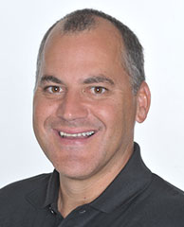
Presenters
Rick Lumadue, Senior Program Manager, California State University-MERLOT, SkillsCommons.org
Brenda Perea, IMPACTcommunity Ambassador, California State University-MERLOT, SkillsCommons.org

Slide 8
.org An online library of 12,000+ free workforce development resources ready to be downloaded, adapted, and used
Notes:
https://www.doleta.gov/taaccct/pdf/TAACCCT_Fact_Sheet_SkillsCommons_Open_Educational_Resources_11.4.2016.pdf

Slide 9
Goals of .org
Capture and preserve instructional and program support materials produced by over 700 colleges across the US through the TAACCCT program
Enable discovery of content materials so others can easily reuse the materials to accelerate and expand access to workforce development programs
Build sustainable communities of practice of colleges, businesses, and local, state, and national organizations to assure the quality and continued use of content

Slide 10
Industry Expert to Expert Instructor Network
Supporting Workforce
Development Programs
Preparing Industry Expert Teachers

Slide 11
IE2EI Community Members

Slide 12
Challenges
Tackling one of the largest challenges in higher education today
Upskilling industry experts for the challenges of post-secondary education
What did we really want to accomplish?
Create a Solution for Common Issues New Faculty experience and their “Pain Points” upon entering the academic arena
What was the process we used?
Interviews with new college faculty members and experienced instructors who came from industry
Used a collaborative, iterative build process
Develop “appetizer” sized course content combined into a full “meal”

Slide 13
Content
Chunked into short independent modules
Just-in-time training to be utilized
Before first day of course
Second week of course
Midterm
Before start of new semester

Slide 14
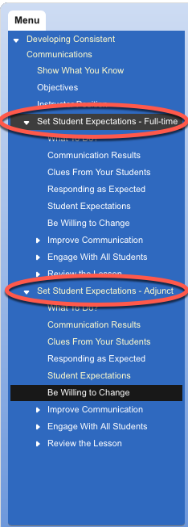
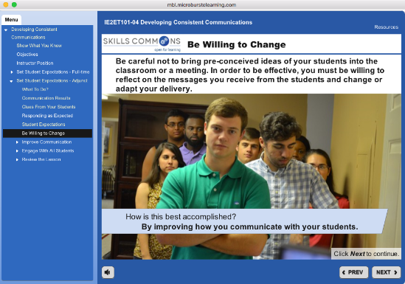
http://bit.ly/IE2ET

Slide 15
Live Site Share:
http://support.skillscommons.org/connect/impact-communities/ie2et/

Slide 16
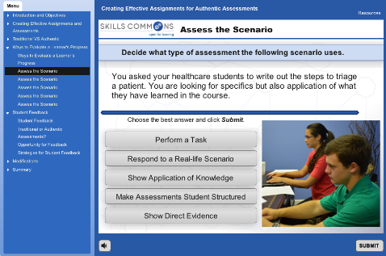
http://bit.ly/IE2ET

Slide 17
Questions
Polling Questions
?
Do you plan on using the Industry Expert to Expert Instructor (IE2EI) Network?
If so, how?
Please share your answers with us in the webinar chat.
?
?
?
?

Slide 18
Polling Questions
?
Do you have questions about the Industry Expert to Expert Instructor (IE2EI) Network?
Please type your questions into the webinar chat.
?
?
?
?

Slide 19
Innovations Leading to Career Success Webinar Series
Please join us for the other webinars in the series:
March 14 - Scaling Career Pathways in Wisconsin
March 28 - Resources for Developmental Education Using Competency-Based Education
April 11 - Affordable Learning Solutions Showcase
April 25 - Sustaining Innovation
May 9 – Free Resources for Apprenticeship & Work-based Learning
For more information, please visit: Innovations Leading to Career Success Webinar Series

Slide 20
Connect with SkillsCommons Communities
Stay current! Follow SkillsCommons on social media:
www.skillscommons.org/Facebook
www.twitter.com/SkillsCommons
www.linkedin.com/company/6650163
SkillsCommons Basecamp
Join others in this online resource-sharing and problem-solving community. Send an email to
connect@skillscommons.org, and we’ll get you connected right away!
SkillsCommons Voices
Join a Voices Industry Sector & IMPACTcommunities forum. Stay informed and get involved in
leadership. Participate in the online communities where you can engage in online dialogs, post
materials, and get connected with colleagues.
SkillsCommons Connect Center Get all the latest SkillsCommons news and feeds!
http://bit.ly/IE2ET

Slide 21
Thank you!
For more information, please visit http://support.skillscommons.org/connect/impact-communities/ie2et/
If you have further questions, you can contact the SkillsCommons team at:
SkillsCommons Support
support@skillscommons.org
This work is licensed under a Creative Commons Attribution 4.0 International License.
This workforce solution was created through a cooperative agreement between the U.S. Department of Labor's Employment and Training Administration and the California State University-Multimedia Educational Resource for Learning and Online Teaching (MERLOT).

