Slide 1
Resources for Developmental Education Using Competency-Based Education
March 28, 2018
Innovations Leading to Career Success Webinar Series
Employment and Training Administration
Office of Career, Technical, and Adult Education

Slide 2
Moderators
Cheryl Martin, TAACCCT Program Manager, Division of Strategic Investments, Employment and Training Administration, U.S. Department of Labor
Erin Berg, Community College Program Specialist, Office of Career, Technical, and Adult Education, U.S. Department of Education

Slide 3
About this Webinar
Learn about the use of open educational resources (OER) for competency-based education (CBE), including competency frameworks for a variety of career pathways, soft skills, and developmental education (Dev Ed), as well as the latest research on CBE and Dev Ed.
The Knowledge to Work web portal featured in this webinar was funded in part though the Trade Adjustment Assistance Community College and Career Training (TAACCCT) program, a collaboration between the US Department of Labor and the US Department of Education.
Part of a webinar series showcasing strategies and resources developed by community colleges that are of broad interest to educational institutions engaged in career-focused education and training.

Slide 4
Innovations Leading to Career Success Webinar Series
This webinar series showcases strategies and resources that are of broad interest to educational institutions engaged in career-focused education and training.
February 28 - Make Industry Experts into Expert Instructors to Increase Student Success
March 14 - Scaling Career Pathways in Wisconsin
March 28 - Resources for Developmental Education Using Competency-Based Education
April 11 - Lowering the Cost of Course Materials with Free and Open Educational Resources
May 2 - Sustaining Grant-funded Projects for Long-term Success
May 16 – Free Resources for Apprenticeship & Work-based Learning
For more information, please visit: Innovations Leading to Career Success Webinar Series

Slide 5
Polling Question
?
Which describes your role in regard to Developmental Education? (check all that apply)
I am an instructor
I am a school administrator
I design course materials and/or curricula
I use it in my work at a Workforce Board or American Job Center (AJC)
I don’t work with Dev Ed yet, but I want to!
Other
?
?
?
?

Slide 6
Polling Question
?
Do you use competency-based education at your organization? (Check all that apply)
We use CBE extensively!
We’re starting to incorporate CBE into our strategies
We’ve recently redesigned our developmental education program using competency-based education to be more effective
No, what’s CBE?
?
?
?
?

Slide 7
Polling Question
?
Do you use open educational resources (OER) at your organization?
Yes, frequently!
Yes, just starting to explore
No, what is OER?
?
?
?
?

Slide 8
Agenda
Leverage latest research on CBE Dev Ed, including TAACCCT grantee models
Explore use of OER for CBE, including soft skills and Dev Ed, that prepare students for career pathways in healthcare, IT, and manufacturing
Showcase Lord Fairfax Community College’s (LFCC) http://knowledgetowork.com portal for personalized learning tied to competencies using OER
Describe LFCC CBE work with adult basic education (ABE), soft skills, and Dev Ed
Share Dev Ed resources available at http://skillscommons.org and http://knowledgetowork.com

Slide 9
Presenters
Joe Deegan, Program Manager, Building Economic Opportunities Group, Jobs for the Future
John Milam, Ph.D. Executive Director, Knowledge to Work TAACCCT Grant, Lord Fairfax Community College

Slide 10
Latest Research on Dev Ed & CBE
What does the latest research say about Developmental Education using
Competency-Based Education (CBE)?

Slide 11
CBE for Dev Ed: Research
TAACCCT helped strengthen innovations that were already underway at the nation’s community colleges.

Slide 12
Accelerated Learning
Prior Learning Assessment (PLA)
Competency-based Education (CBE)
Online/hybrid Models

Slide 13
Completion Strategies
Developmental Education Redesign
Student Supports
Revised Scheduling

Slide 15
Challenge
Most developmental education is still course-based and tied to the credit hour (Carnegie Unit).

Slide 16
Next Generation CBE Series

Slide 17
Next Generation CBE Series
Concept Paper
Entry and Placement
Co-Requisite Models
Student Supports
Curriculum, Assessment and Pacing

Slide 18
Benefits of CBE

Slide 19
Questions From the Field
How might CBE align with the what works in developmental education redesign ?
What can we learn from existing pockets of innovation that resemble a CBE approach to developmental education?
Where are the gaps in evidence?
What can we draw upon to create the OER and frameworks to bring Dev Ed CBE to scale?

Slide 20
TAACCCT Model: Salt Lake Community College
College Academic Readiness (KCAR)
Lab-based, individualized, with flexible pacing supported by faculty
Open entry/open exit
JFF Paper Series: Next Generation CBE http://www.jff.org/publications/next-generation-cbe-designing-competency-based-education-underprepared-college-learners

Slide 21
TAACCCT Model: State University of New York (SUNY) Empire State
Starts with rigorous prior learning assessment (PLA) to identify gaps. SUNY Empire State developed the Global Learning Qualifications Framework (GLQF) to cover eight learning domains
Faculty mentors use PLA results to engage in flexible degree planning
Students can opt in to customized independent study courses to fill in gaps
JFF Paper Series: Next Generation CBE http://www.jff.org/publications/next-generation-cbe-designing-competency-based-education-underprepared-college-learners

Slide 22
Existing National Frameworks
K-12
College & Career Readiness Competency Frameworks
Workforce
Industry and Occupational Competency Frameworks

Slide 23
Existing National Frameworks
K-12
College & Career Readiness Competency Frameworks
Developmental Education Competency Framework
Workforce
Industry and Occupational Competency Frameworks

Slide 24
Questions?
Joe Deegan
Program Manager,
Building Economic Opportunities Group, Jobs for the Future
jdeegan@jff.org

Slide 25
Dev Ed and CBE at LFCC
How do Dev Ed & CBE play out at
Lord Fairfax Community College?

Slide 26
A Vision for CBE Using OER
Direct assessment CBE: New paradigm for learning that focuses on attainment of competencies regardless of delivery and time
Potential for great savings in cost and time and reducing barriers to completion
Takes PLA to the next level, looking forward in a personalized way
Captures how we really learn 24/7 on our smart phone with knowledge chunks
Still need to ensure quality and use faculty in the discipline to create OER
Use new Competency-Based Education Network’s Quality Standards, such as alignment with national competency frameworks
Direct assessment is not course-based. Title IV aid is prohibited for PLA and for Dev Ed through direct assessment, so hybrid approach needed
LFCC offered direct assessment in 7 programs with TAACCCT grant, then switched to course-based to increase enrollment and serve employers

Slide 27
Alternatives for ABE, Soft Skills, Dev Ed
Knowledge to Work portal meets the continuum of learning, from ABE to associate degrees
Incorporates national competency frameworks for programs from variety of sources
Worked with AHIMA and created new model for IT in Healthcare with national certification
Uses PluggedInVA model, a TAACCCT grant success story for ABE
Part of Virginia Community College System redesign of Dev Ed, featuring:
new placement test
use of modular approach to working on core competencies
co-requisite courses
contextualized math
multiple measures
longitudinal tracking of success with gateway courses
professional development of faculty and student services staff
creative commons practice materials
early alerts
case management

Slide 28
Alternatives for ABE, Soft Skills, Dev Ed (cont.)
Identified OER with faculty and digital librarian and mapped to competencies for personalized learning for direct assessment
Created open source software for personalized learning plans, with case management and extended transcripts of competencies and courses
Moved plan software, competency frameworks, and OER links to web with free portal
Spanish version available
includes resources from Learning Registry, Merlot, SkillsCommons, OER Commons, and others

Slide 29
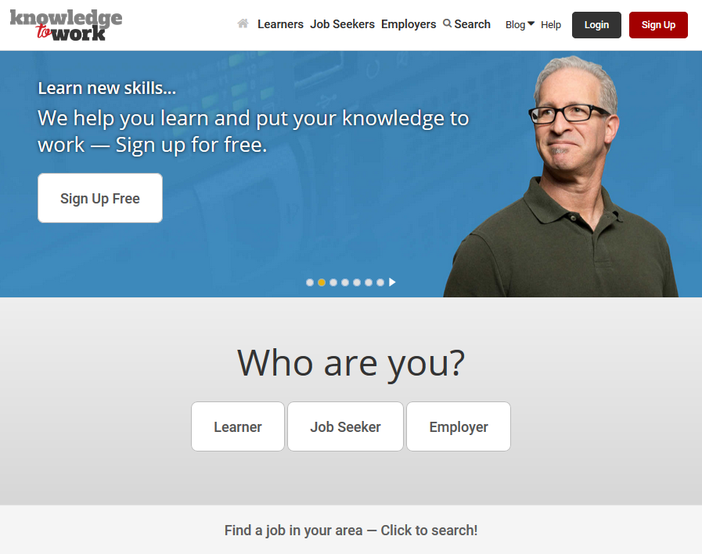
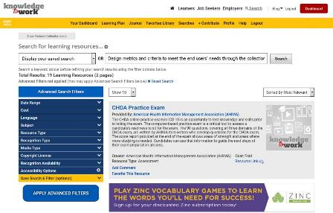
KnowledgeToWork.com
KnowledgeToWork.com
Use Free… Search then Sign Up.
Kick the tires, find what is useful
to your learning method.

Slide 30
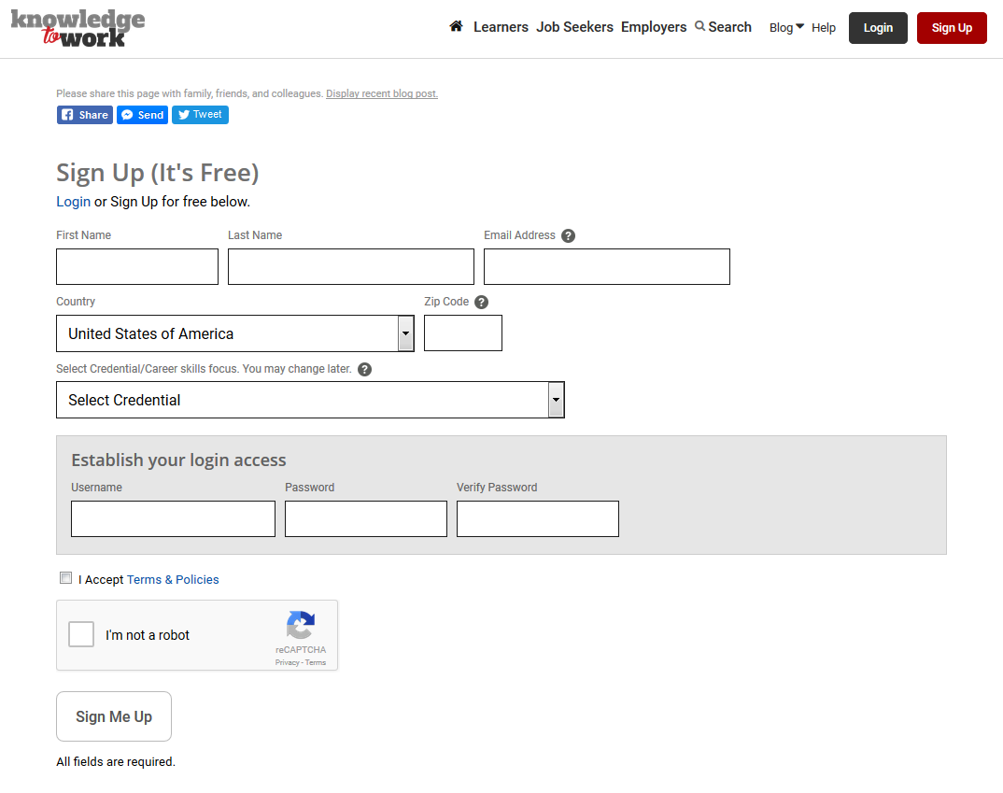
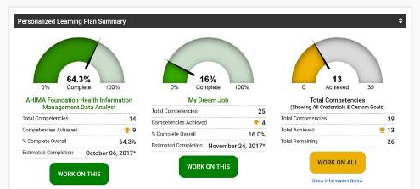
Sign Up Free… Load Competencies
We will automatically load competencies associated with the credential they select into their Learning Plan. Plus, they can create “Custom Goals” within their plan and select individual competencies they want to learn.
Loading competencies for credentials:
AAS Health Information Management
AAS Information Systems Technology with Cyber Security
AAS Information Systems Technology with Networking Specialist
AHIMA Foundation Clinical Documentation Improvement Specialist
AHIMA Foundation Health Information Management Business Analyst
AHIMA Foundation Health Information Management Data Analyst
AHIMA Foundation Hospital/Facility Coder
Certificate in Office Systems Assistant
CSC in Cyber Security
CSC in Hospital Facility Coding
CSC in Information Processing Technician
CSC in Networking Specialist
IAAP Certified Administrative Professional (CAP) Exam

Slide 31
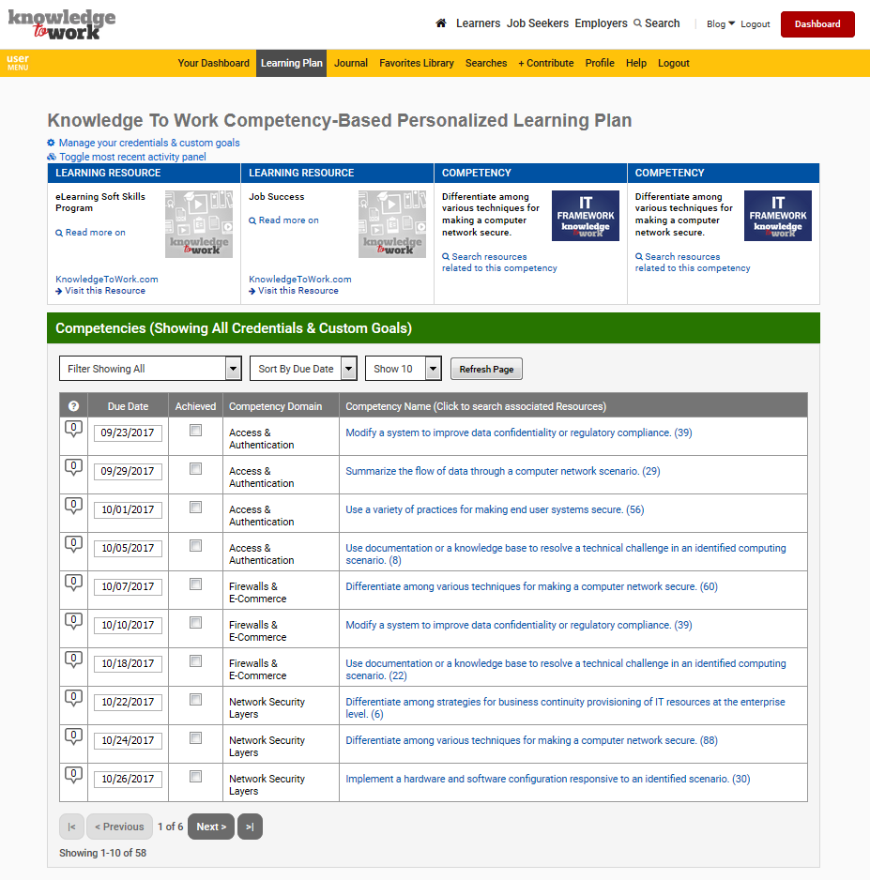
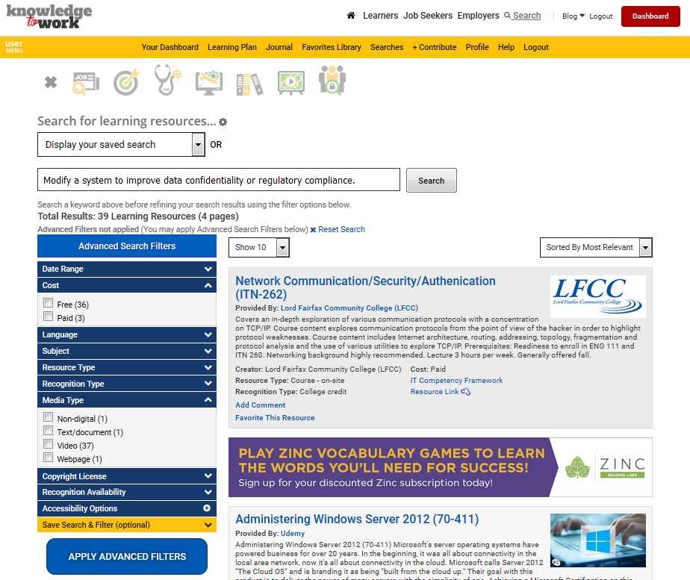
Click Competency, Launch Search
Click Competency, Launch Search
When users click a competency in their Learning Plan,
it launches a new search displaying the learning resources that are aligned to that competency.

Slide 32
Dev Ed Resources: KnowledgetoWork.com
Created special collections with one for dev ed. Use icon or filter by subject in search menu
No clear Dev Ed competency framework to adopt yet
Six+ subjects/topics with OER, including:
Study skills – 52
College readiness – 162
Reading comprehension – 51
Basic math – 55
Basic computer skills – 135
Basic writing - 249

Slide 33
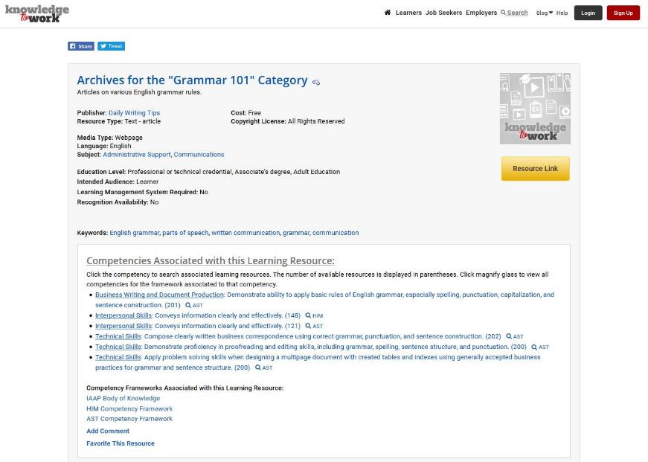
Operational Management
Convener
Facilitator
Regularity
Follow-up
Interest based perspective

Slide 34
Dev Ed Resources: SkillsCommons.org
Created special industry collection for dev ed. View by audience and types of materials from TAACCCT grants
Within Dev Ed, the audiences include training/instruction (1,357) and administration/ marketing (846)
Types include assignment (97), drill & practice (105), grant management role (156), online course (86), online course module (297), presentation (177), and quiz/test (109)
Seven+ subjects/topics with resources, including:
Study skills – 2
College readiness – 44
Reading – 7
Math – 203
Basic computer skills – 12
Writing – 111
Reading and writing - 46

Slide 35
Dev Ed Resources: SkillsCommons.org

Slide 37
Resources
ETA Competency Model Clearinghouse https://www.careeronestop.org/competencymodel/
Competency-Based Education Network http://www.cbenetwork.org/
C-BEN Quality Standards http://www.cbenetwork.org/sites/457/uploaded/files/CBE17__Quality_Standards_FINAL.pdf
CBExchange Conference Sept 24-27 – Disney World Resort http://www.cbexchange.org/
CBE Links https://www.highered.org/cbe
JFF Paper Series http://www.jff.org/publications/next-generation-cbe-designing-competency-based-education-underprepared-college-learners

Slide 38
Questions?
John Milam, Ph.D.
Executive Director, Knowledge to Work TAACCCT Grant, Lord Fairfax Community College
jmilam@lfcc.edu

Slide 39
Thank you!
Please join us for the other webinars in the series:
February 28 - Make Industry Experts into Expert Instructors to Increase Student Success
March 14 - Scaling Career Pathways in Wisconsin
March 28 - Resources for Developmental Education Using Competency-Based Education
April 11 - Lowering the Cost of Course Materials with Free and Open Educational Resources
May 2 - Sustaining Grant-funded Projects for Long-term Success
May 16 – Free Resources for Apprenticeship & Work-based Learning
For more information, please visit: Innovations Leading to Career Success Webinar Series

