Slide 1
Lowering the Cost of Course Materials with Free and Open Educational Resources
April 11, 2018
Innovations Leading to Career Success Webinar Series
Employment and Training Administration
Office of Career, Technical, and Adult Education

Slide 2
Moderators
Cheryl Martin, TAACCCT Program Manager, Division of Strategic Investments, Employment and Training Administration, U.S. Department of Labor
Erin Berg, Community College Program Specialist, Office of Career, Technical, and Adult Education, U.S. Department of Education
2

Slide 3
Innovations Leading to Career Success Webinar Series
This webinar series showcases strategies and resources that are of broad interest to educational institutions engaged in career-focused education and training.
February 28 - Make Industry Experts into Expert Instructors to Increase Student Success
March 14 - Scaling Career Pathways in Wisconsin
March 28 - Resources for Developmental Education Using Competency-Based Education
April 11 - Lowering the Cost of Course Materials with Free and Open Educational Resources
May 2 - Sustaining Grant-funded Projects for Long-term Success
May 16 – Free Resources for Apprenticeship and Work-based Learning
For more information, please visit: Innovations Leading to Career Success Webinar Series
3

Slide 4
Polling Question
What best describes your organization?
Secondary Career/Technical
Community or Technical College
Four-Year Institution
Workforce System
Other
4

Slide 5
Polling Question
What best describes your experience using free or low-cost course materials at your organization?
We have very little experience
We’re in the process of developing free or low-cost materials
We provide students access to a broad range of free or low-lost materials
5

Slide 6
Polling Question
Do you use open educational resources (OER) at your organization?
Yes, frequently!
Yes, just starting to explore
No, what is OER?
6

Slide 7
Presenters
Gerry Hanley
Director, SkillsCommons
Executive Director, MERLOT
Assistant Vice Chancellor, Academic Technology Services
California State University, Office of the Chancellor

Slide 8
.org An online library of 12,000+ free workforce development resources ready to be downloaded, adapted, and used

Slide 9
Goals of .org
Capture and preserve instructional and program support materials produced by over 700 colleges across the US through the TAACCCT program
Enable discovery of content materials so others can easily reuse the materials to accelerate and expand access to workforce development programs
Build sustainable communities of practice of colleges, businesses, and local, state, and national organizations to assure the quality and continued use of content

Slide 10
Let’s Begin with an Institutional Context
California State University (CSU) “Access to Excellence” Mission offering more than 1,800 degree programs in 240 subject areas.
Among the most diverse university systems in the country, striving to be inclusive of students of all social, economic and educational backgrounds.
Full-time student tuition is about $5,700 per year.
80 percent of CSU students receive some financial aid.
Are you implementing a Graduation Initiative to increase graduation rates and eliminate equity gaps?

Slide 11
Textbook Affordability Affects Access to an Excellent Education and Graduation in a Timely Manner
2016 Florida students’ responses to costs (survey)
Take fewer courses (47.6 percent)
Drop a course (26.1 percent)
Fail a course (19.8 percent)

Slide 12
How Much Of A Difference Can We Make?
Imagine saving every student in California’s higher education…
$170 per semester – cost of 1 new textbook
With 3 million students in California (CA) higher ed
We can save students…
$1 BILLION EVERY YEAR

Slide 13
SkillsCommons: Affordable Learning Solutions
How to deliver the $1B in “financial aid” to students?

Slide 14
http://als.skillscommons.org/

Slide 15
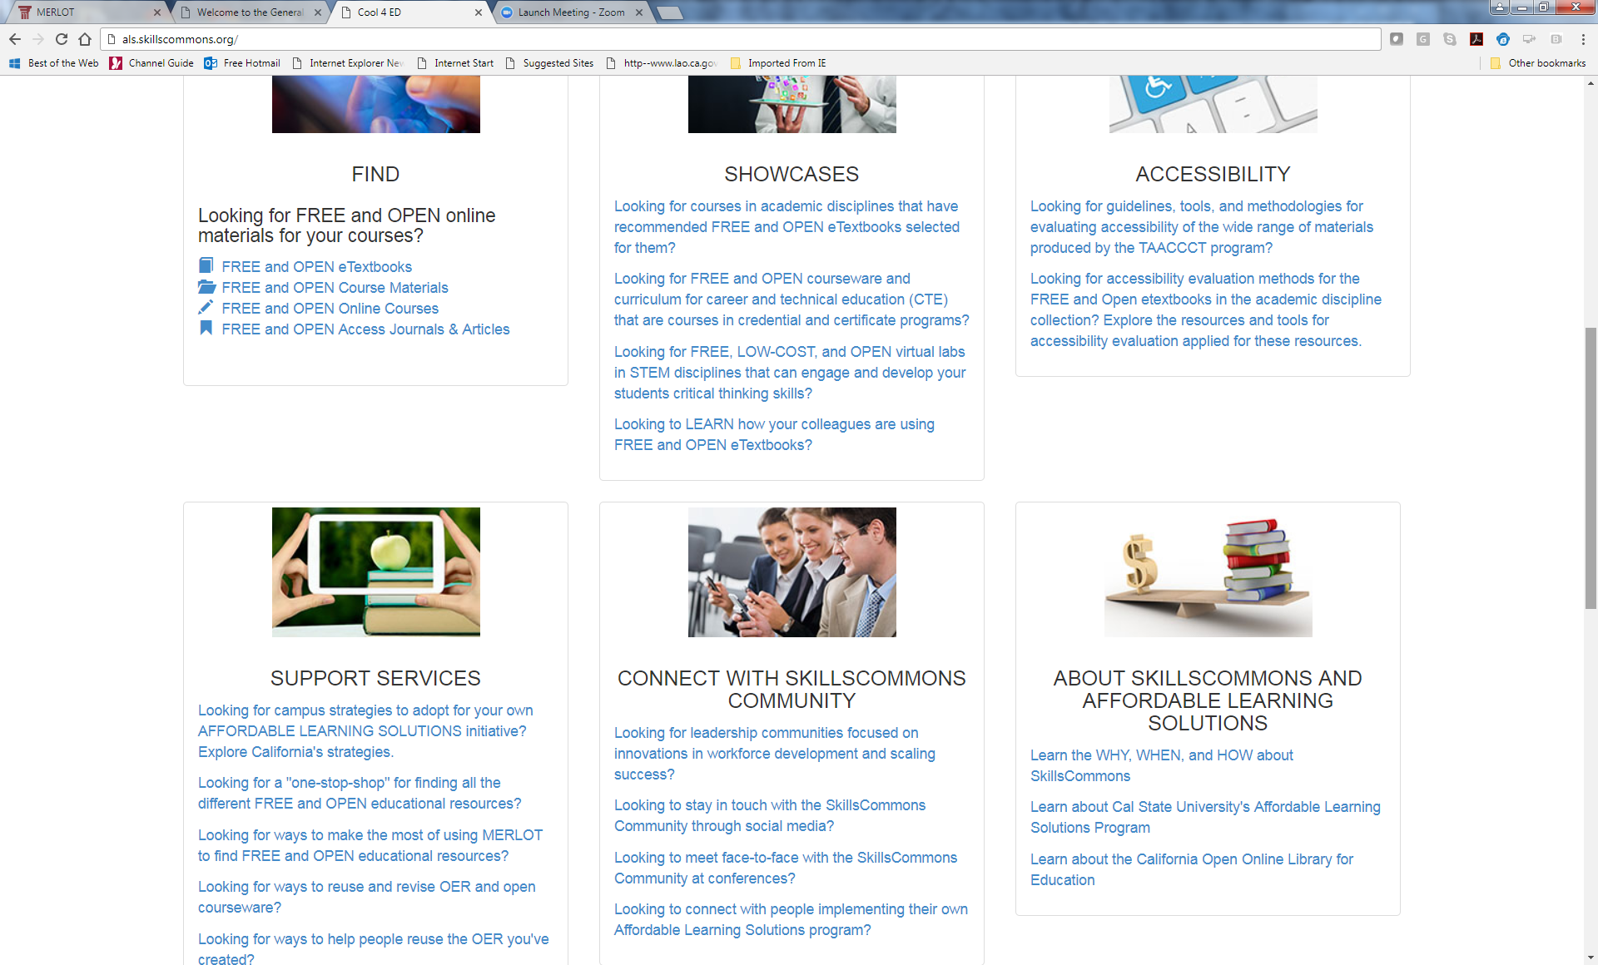
Online Support For Your Affordable Learning Solutions (AL$) Program

Slide 16
Let’s Take A Tour of AL$ @ SkillsCommons
http://als.skillscommons.org

Slide 17
Quick Summary of What’s Available for FREE
Free and open educational resources that faculty and students can choose for their teaching and learning
General Education in academic disciplines
Career and Technical Education disciplines
Wide choice of materials
eTextbooks, open courseware, learning modules, syllabi, simulations and virtual labs
Creative Commons licensing enables you to customize materials
Online support services are available to help you use these materials successfully

Slide 18
How can you bring these free and open educational resources and services into your institution and community?

Slide 19
Implementation Strategy
SkillsCommons Leveraged
California State University’s Affordable Learning Solutions
Enabling
Ecosystems
with policies, leadership,
business models
Developing Demand with communications, training, professional development
Creating Capabilities with convenient and affordable access to content through technologies
Leveraging Content Providers Free and open educational resources, library materials, publisher low cost digital materials, faculty authored

Slide 20
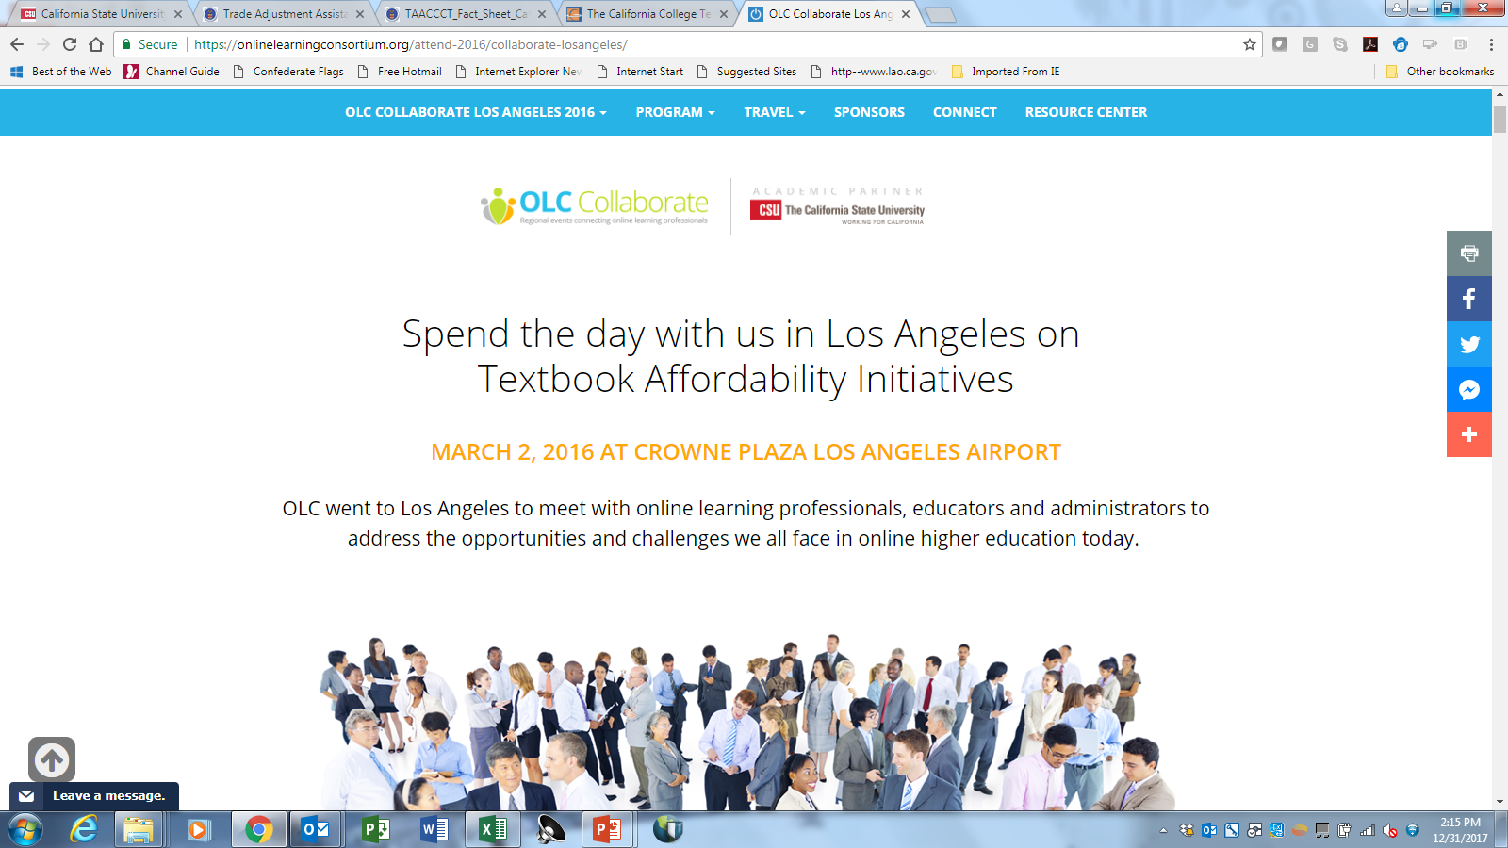
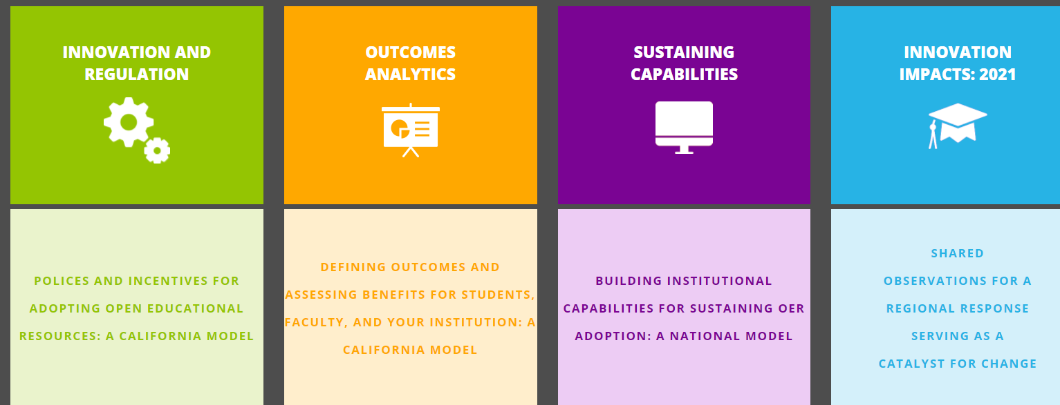
Developing demand is critical and takes
time, persistence, and collaboration!

Slide 21
Enable Your Ecosystem with a plan that builds collaboration
Types of Services | Strategies for Campus Plans
Communication and Outreach | Presentations at standing meetings, memos, emails and webinars
Training and Professional Development | Empower the people who do training already. SkillsCommons provides online services including webinars, “how-to” videos, and examples
Help and Support Services | Enlist support from your reference librarians and campus technology support.
Providing Print Copies | Work with your bookstore. OpenStax has print copies ready. Additional strategies in the works.
Library, Discovery, Curation | Leverage AL$-SkillsCommons library. Your faculty and students can curate and share their own recommended collections.
Technology Services | Add links in your Library Management Systems (LMSs) and LMSs-Learning.
Campus Coordination | Leverage existing campus leadership. Stay connected with the SkillsCommons community

Slide 22
Facilitate Organizational Changes
Librarians and bookstores can reimagine their responsibilities to support the discovery and adoption of free and open educational resources.
Presidents and provosts become advocates of the Affordable Learning Solutions Initiative and faculty recognition programs.
Faculty become champions of the AL$ program, with a critical mass of faculty participating.
Students become beneficiaries. In 2016-2017 academic year, CSU posted over $36M student savings from the AL$ program.

Slide 23
Customize Your OWN AL$ Program!

Slide 24
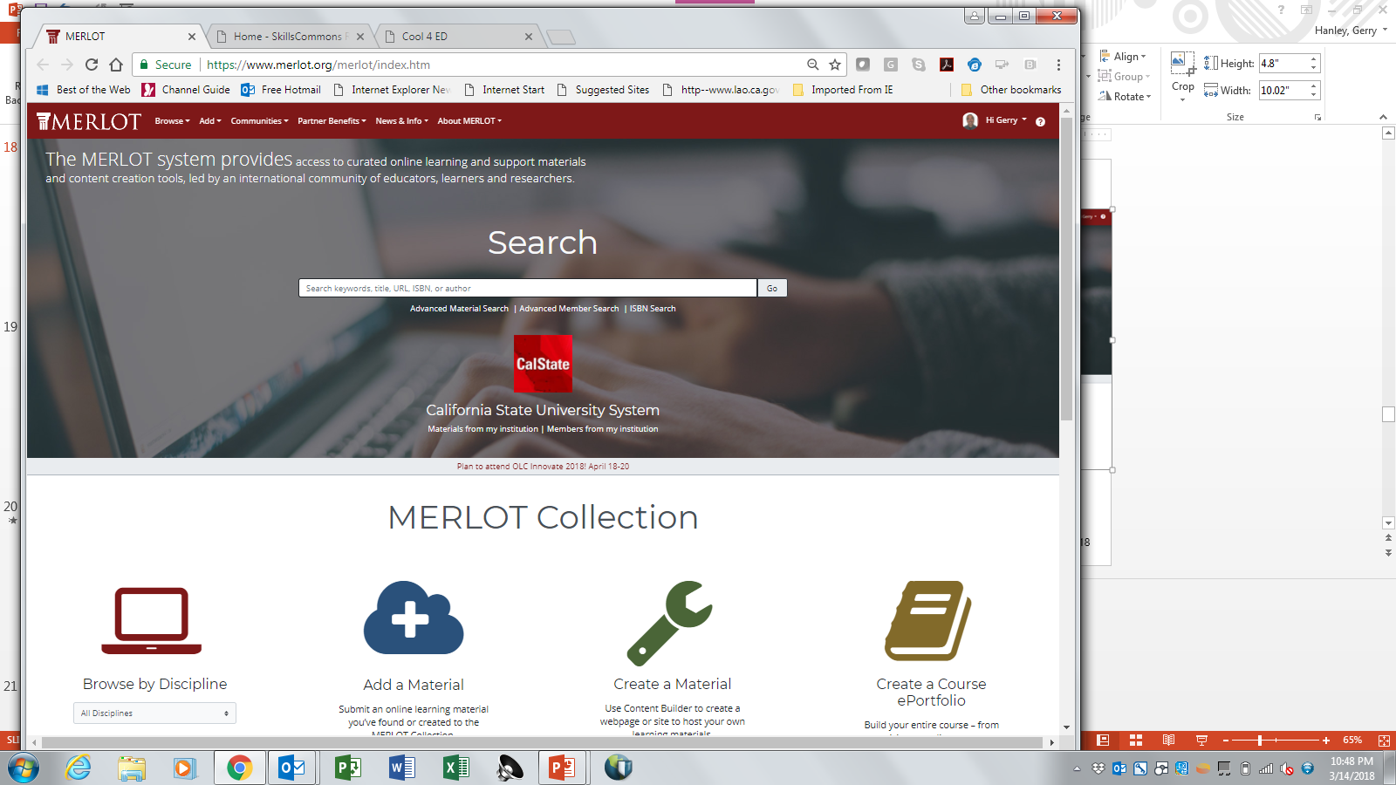
www.merlot.org

Slide 25
MERLOT since 1997
Multimedia Educational Resource for Learning and Online Teaching
A free and open community for all who use, share, advise and evaluate online teaching and learning materials with over 150,000 members.
A free digital library of online teaching and learning materials that is open for all to use… with over 80,000 materials across disciplines contributed by members.
A consortium of higher education institutions, professional societies, digital libraries, corporations, and other organizations supporting educational improvement through technology

Slide 26
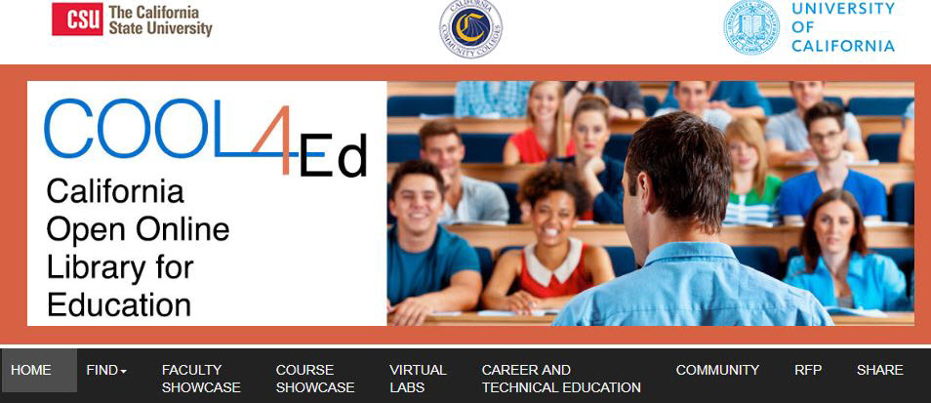
www.COOL4Ed.org
Check out COMMUNITY and Request for Proposal (RFP)
26

Slide 27
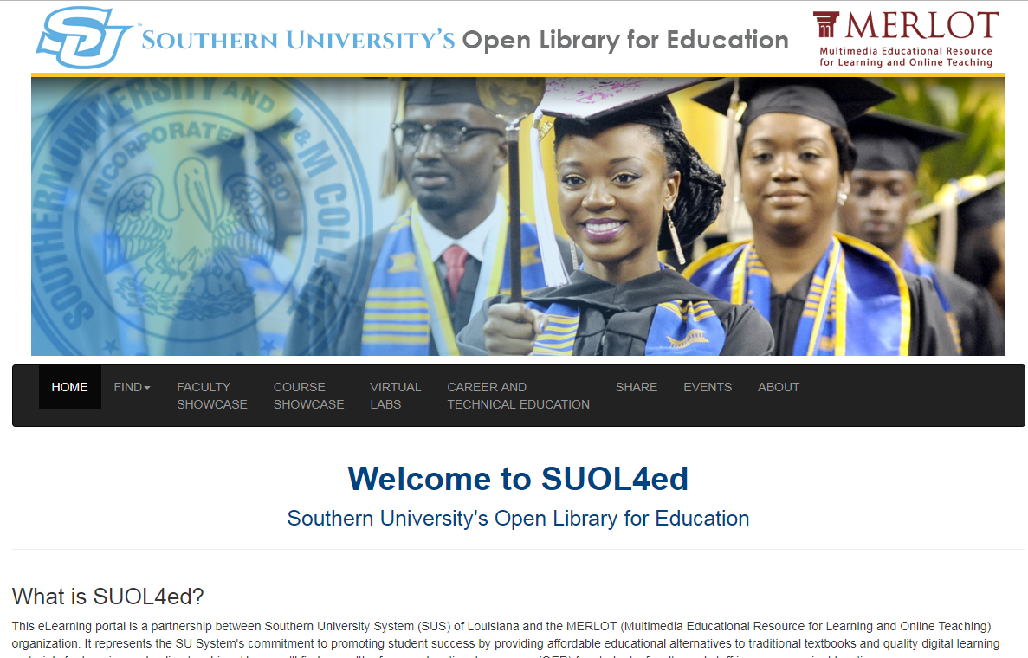
We can create customize AL$ sites
www.suol4ed.org
27

Slide 28
SkillsCommons is Always OPEN!
Our Job: Give a Gift and Not a Burden
You can explore SkillsCommons at your own pace.
SUPPORT Center
CONNECT Center
SHOWCASE Center
About Us
Contact us – a 15 minute conversation can make a difference!
Support@skillscommons.org

Slide 29
Questions?
Gerry Hanley
Director, SkillsCommons.org
Executive Director, MERLOT, California State University, Office of the Chancellor
SkillsCommons Support
support@skillscommons.org
29

Slide 30
Thank you!
Please join us for the other webinars in the series:
February 28 - Make Industry Experts into Expert Instructors to Increase Student Success
March 14 - Scaling Career Pathways in Wisconsin
March 28 - Resources for Developmental Education Using Competency-Based Education
April 11 - Lowering the Cost of Course Materials with Free and Open Educational Resources
May 2 - Sustaining Grant-funded Projects for Long-term Success
May 16 – Free Resources for Apprenticeship and Work-based Learning
For more information, please visit: Innovations Leading to Career Success Webinar Series
30

