Slide 1
Reemployment & System Integration (RSI)-Dislocated Worker Grants (DWG)
April 17, 2018
WIOA Wednesday
April 18, 2018
11:00AM – 12:30PM Eastern

Slide 3
Dana Matthews, Workforce Analyst
Division of WIA Adult Services and Workforce Systems (DWASWS)
Employment and Training Administration (ETA)
U.S. Department of Labor (DOL)

Slide 4
Poll Question #1 What has been most challenging when spending your grant funds?
?
1. Financial or budget modifications
2. Partner Engagement
3. Finding a vendor and the proper equipment
4. Staff issues: training current or hiring new
5. Other: Type your answer in the chat

Slide 5
Poll Question #2 To date, what percentage of your state’s RSI-DWG project is complete? Guess if you’re not sure.
?
1. 80 – 100%
2. 50 – 79%
3. 20 – 49%
4. 0 – 19%

Slide 6
Poll Question #3 Do you think your state will need an extension beyond September?
?
1. Yes
2. No

Slide 7
Review the purpose, goals, expected outcomes and requirements of RSI-DWG
Meet and hear from members of two state agencies who are successfully using RSI-DWG
Discuss common challenges and strategies used to integrate UI, Wagner-Peyser (ES) and WIOA Workforce IT systems.
Ask questions of your peers and DOL staff, as you move forward with successfully implementing your program.

Slide 8
Goals of RSI-DWG
1
To provide technology solutions that support and improve connectivity among existing state IT systems and partner program data systems in service areas such as:
Common Registration and Case Management across DW programs, ES programs, and UI
Dislocated workers and UI claimants will experience a robust on-line service delivery hub that integrates the information and on-line services
Improved methods to connect job seekers to real-time LMI and training providers with performance outcomes.

Slide 9
Expected Outcomes of RSI-DWG
2
Improved service delivery and employment outcomes for dislocated workers
More effective connections to all available services through Integrated Case Management
Decreased or prevention of Long-Term Unemployment
Increased early intervention and layoff aversion
Increased accessibility to services through automation and self-service

Slide 10
Key Reminders
3
Funds Availability: Expire on 9/30/2018
Partnership Engagements: UI, ES and DW
Consortium: All changes have to be reported on the modification form
Reporting: Quarterly Reports and Narratives due 45 days after the end of each the quarter
UI Requirements: Individual confidentiality
POP Extensions: Deadline is 8/1/2018

Slide 11
Highlighted IT Vendor
Vendors who can assist with obtaining that single sign-on, integrated registration and personalized workforce profile dashboard:
Workforce Connect Technology Tools/Workforce Connect Technology Support Center provided by ITSC
America’s One-Stop Operating System (OSOS)

Slide 12
Featured RSI-DWG Grantees
Mississippi Department of Employment Security
New York State Department of Labor

Slide 13
Jackie Turner
Deputy Executive Director, CFO
Mississippi Department of Employment Security
Laura Ring
Director, Office of Grant Management
Mississippi Department of Employment Security

Slide 14
Jonathan Barlow
Associate Director for Architecture and Development
National Strategic Planning and Analysis Research Center

Slide 15
Mississippi Department of Employment Security
Current System Integration
Unemployment Insurance, Wagner Peyser, WIOA, Trade, Veterans, WOTC
Future System Integration
Adds TANF, Rehabilitation Services, and Adult Education
WIOA Partner Collaboration
Vendor Selection
Highlights
Challenges

Slide 16
MDES: WIOA Hub Supports “Smart Start Pathway Model”
Hub technology developed to support the “no wrong door” programmatic plan set by interagency WIOA plan

Slide 17
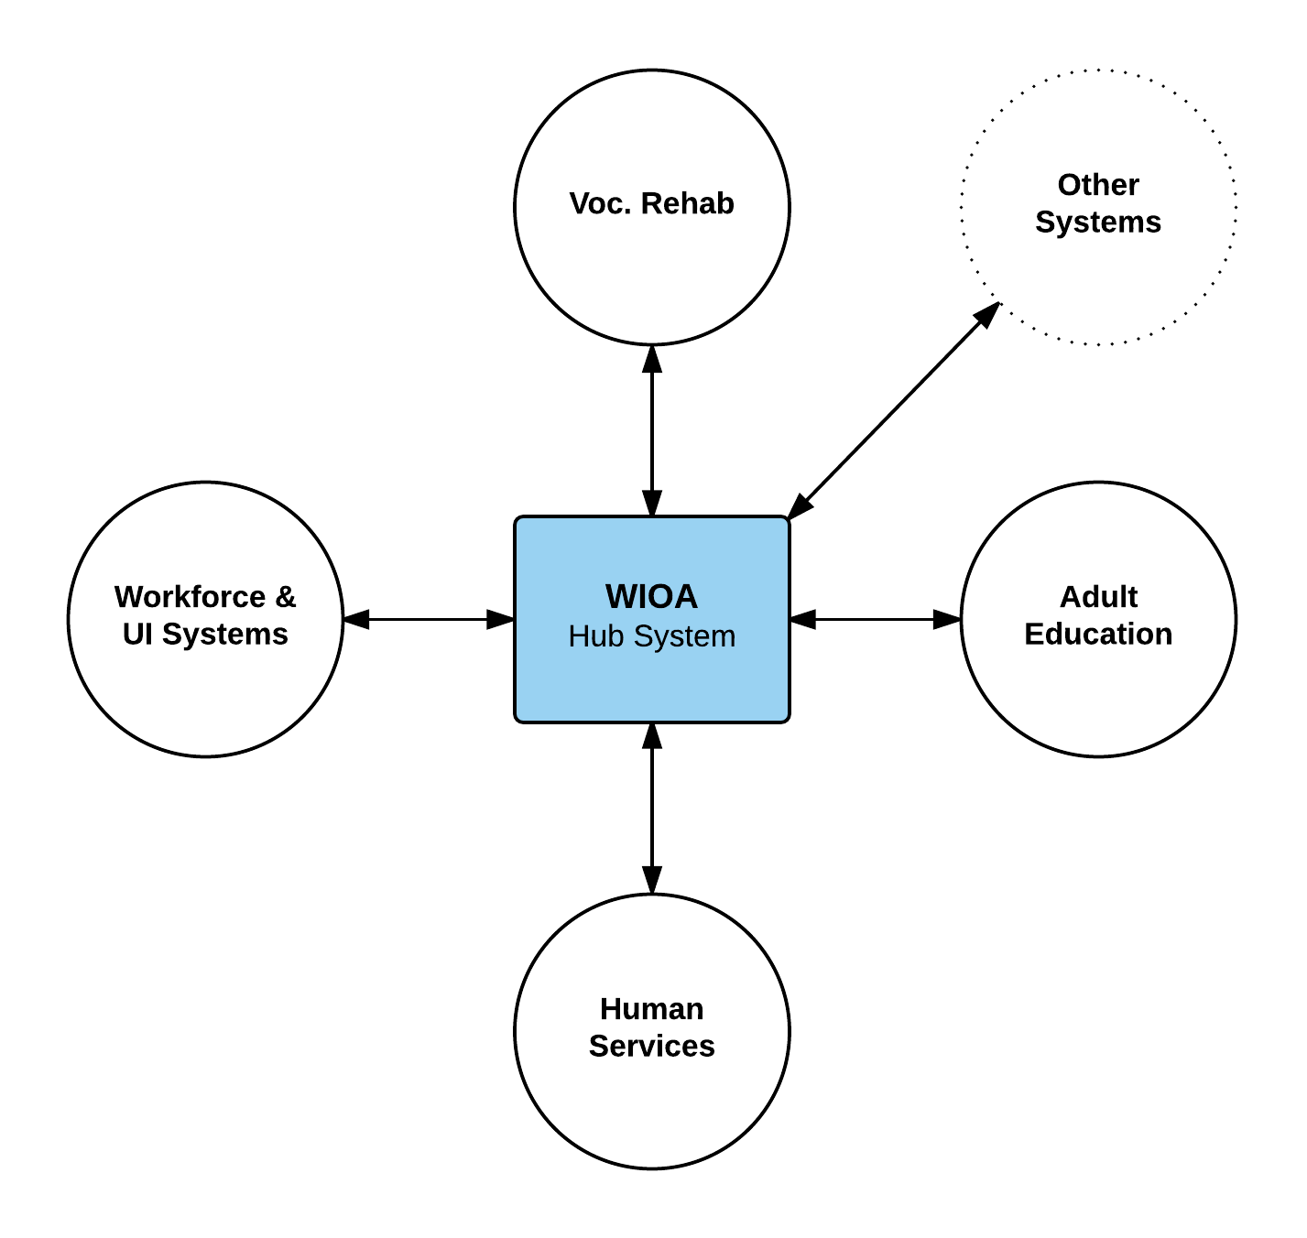
MDES: WIOA Hub

Slide 18
WIOA Hub: Data for Customer Service, Continuous Improvement, and Reporting
Interagency Lookup Tables
Agencies
Programs
Partners
Local Centers
Service Categories
Services
Assessments
Credentials
“Versioned” Data
Participant Profile
Participant Success Plan
WIOA Customer Data
Participant Service Enrollment
Participant Score
Participant Earned Credential
Interagency Referral
Participant Service Assessment

Slide 19
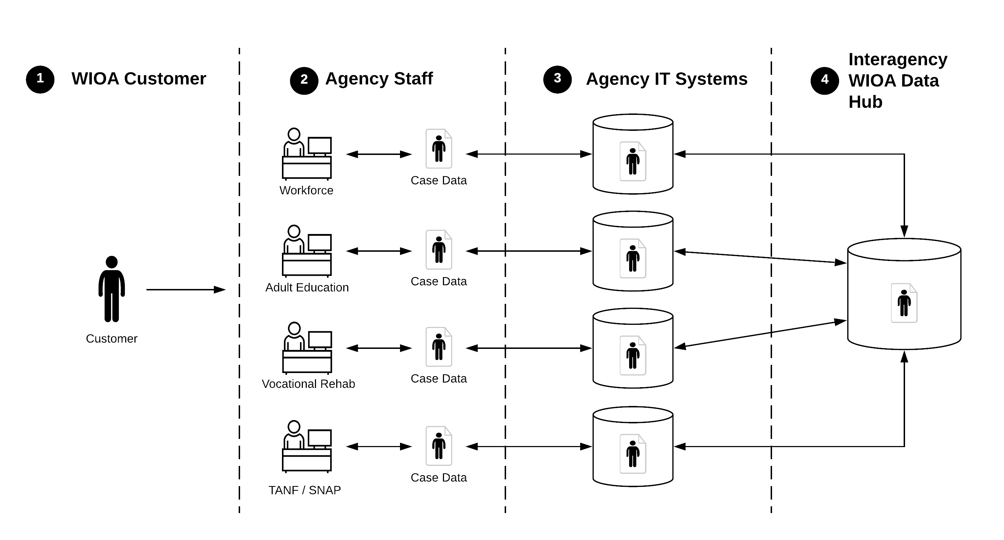
MDES: WIOA Hub Data Flow

Slide 20
Vicki Mockler
Employment Services Manager
New York State Department of Labor

Slide 21
New York State Department of Labor
Service Integration
System Integration
Functional Alignment
Co-enrollment
Streamlined Registration
Improved Service Delivery
Single Point of Access
Data Sharing Across Applications
Increased Reporting Capabilities
Increased Outcomes for Jobseekers

Slide 22
ES-UI Connectivity Project
Single Sign-on
Workforce Integrated Profile Page (WIPP)
Integrated Workforce Registration (IWR)

Slide 23
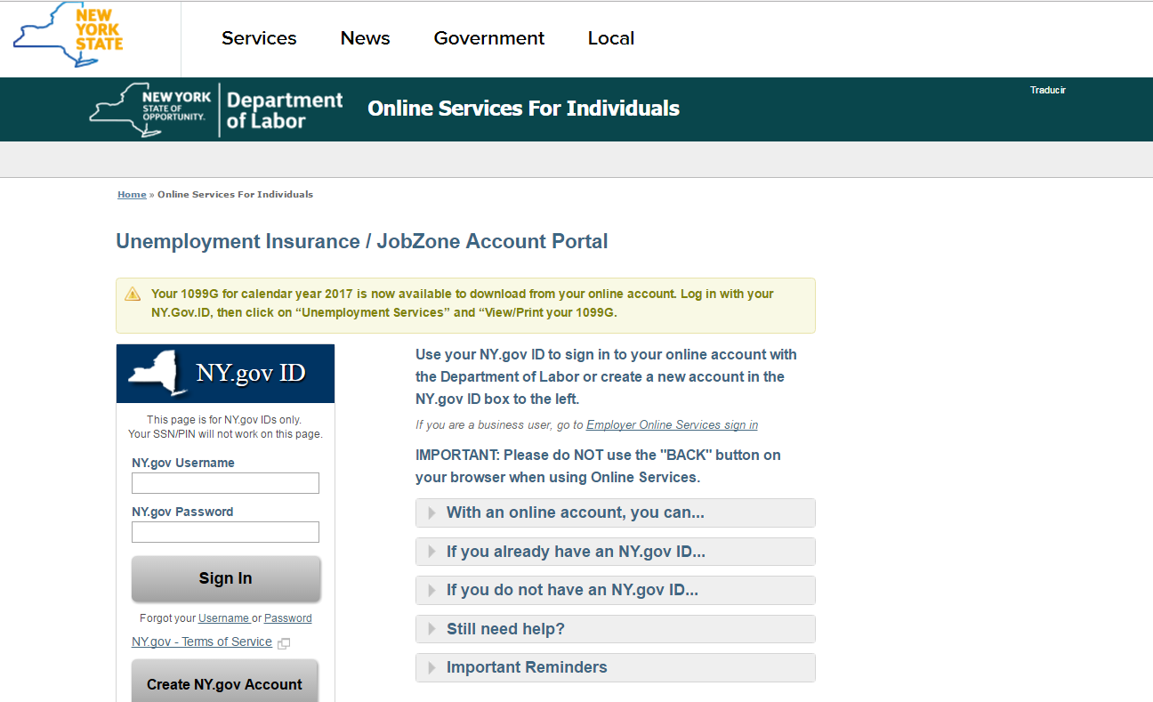
Integrated Sign-on

Slide 24
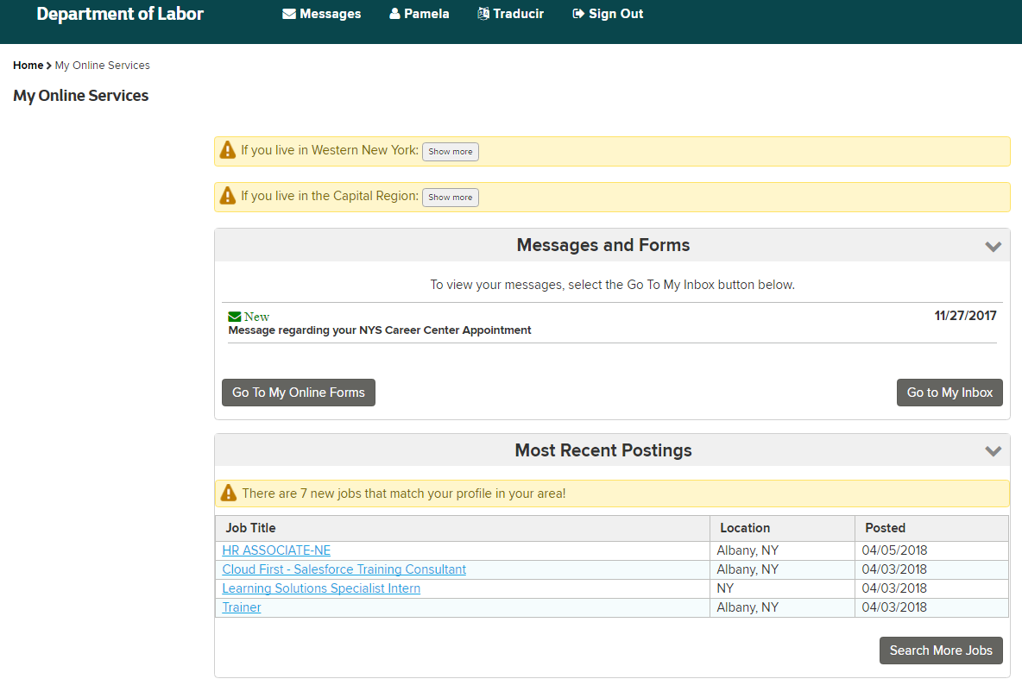
Workforce Integrated Profile Page (WIPP)

Slide 25
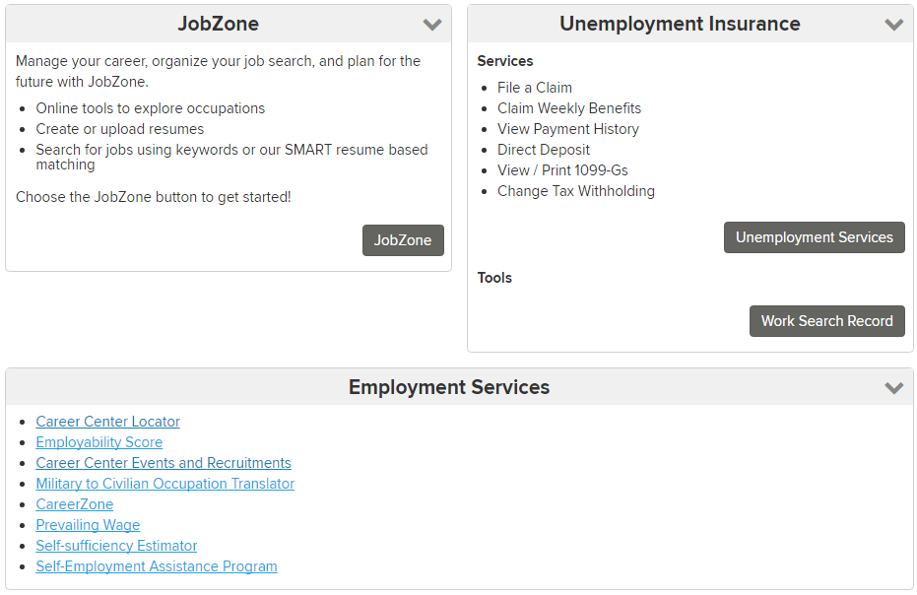
Workforce Integrated Profile Page (WIPP)

Slide 26
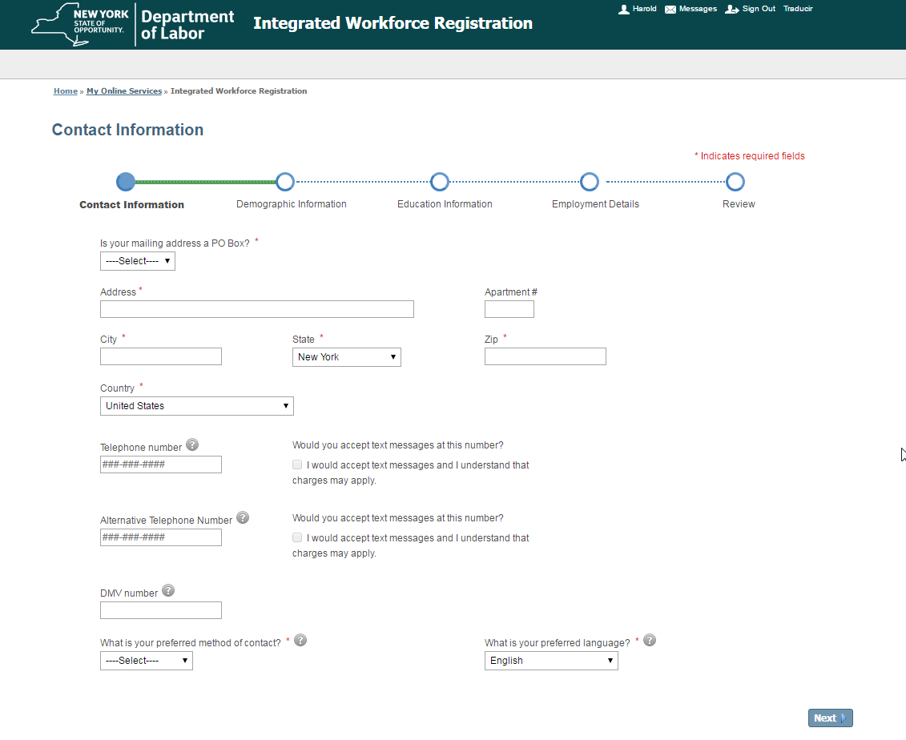
Integrated Workforce Registration (IWR)

Slide 27
RSI DWG Grant Goals
America’s One-Stop Operating System (OSOS) Technology Refresh
JobZone Resume Writer Enhancements

Slide 28
OSOS Technology Refresh
Increased Integration and Connectivity
Service Oriented Architecture
Upgraded Data and Reporting Capabilities

Slide 29
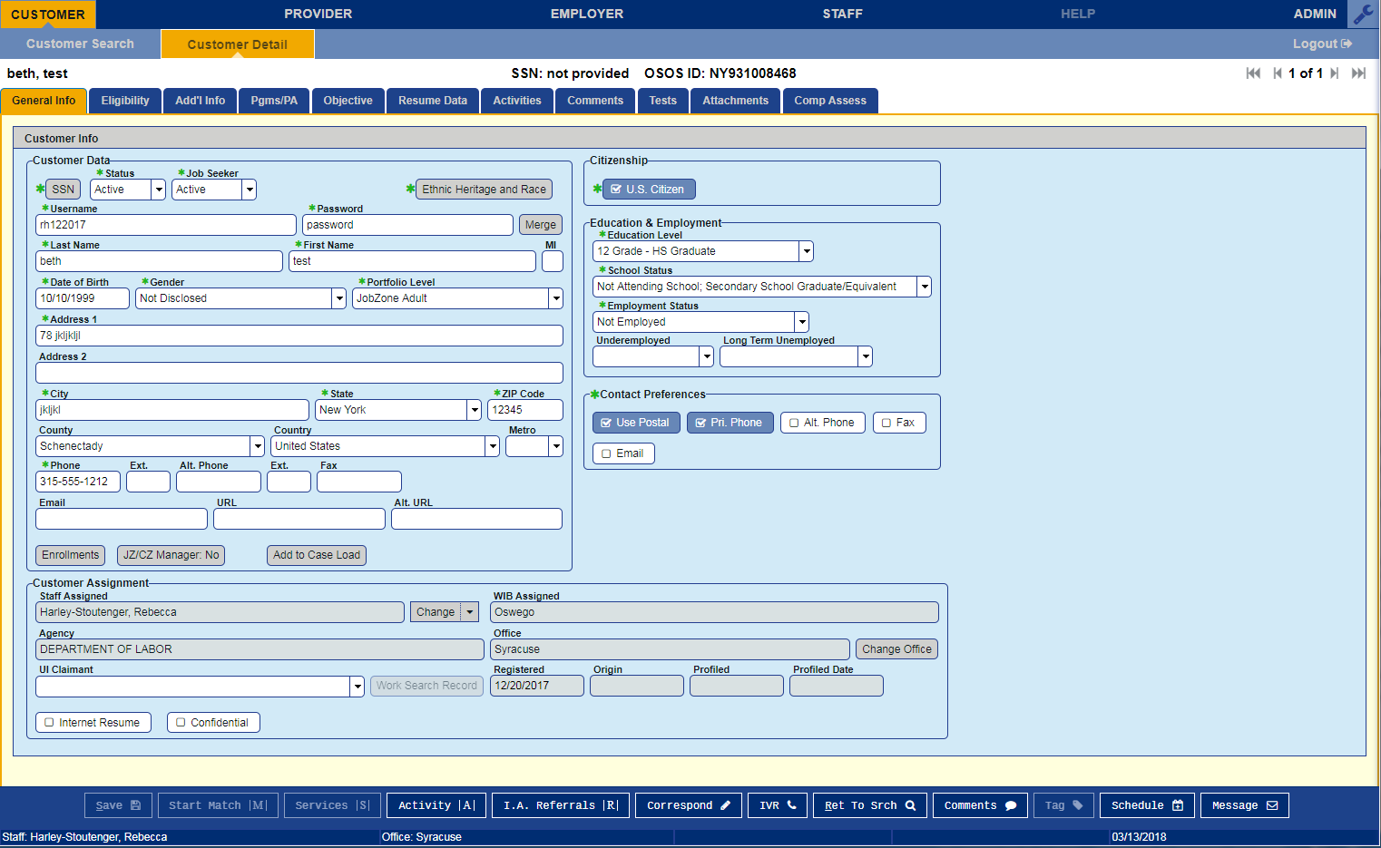
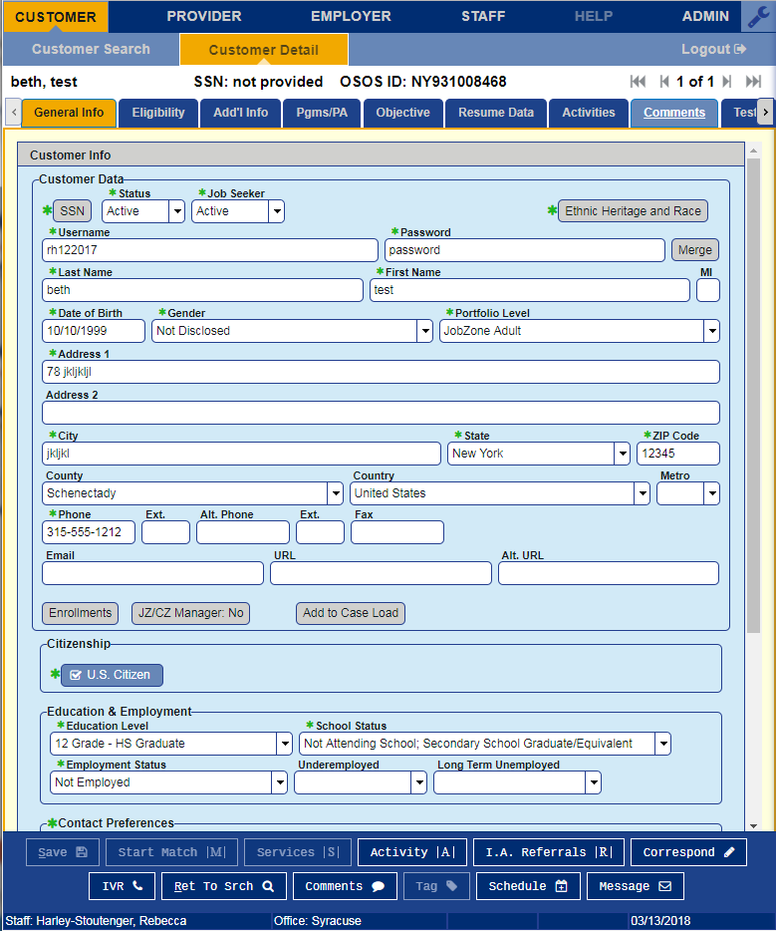
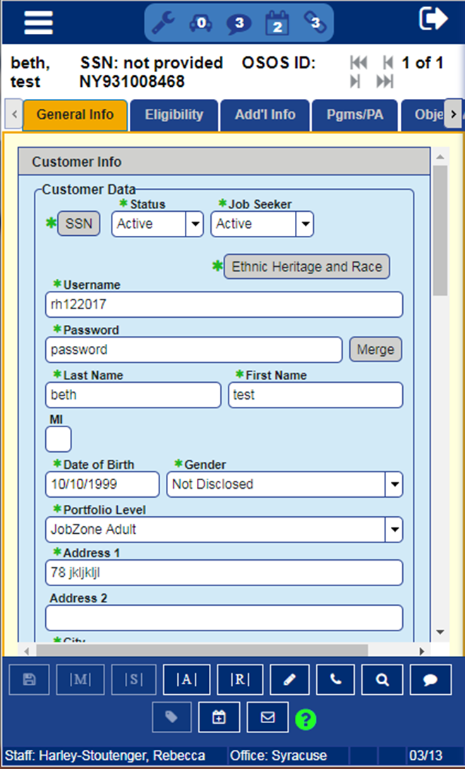
OSOS Technology Refresh

Slide 30
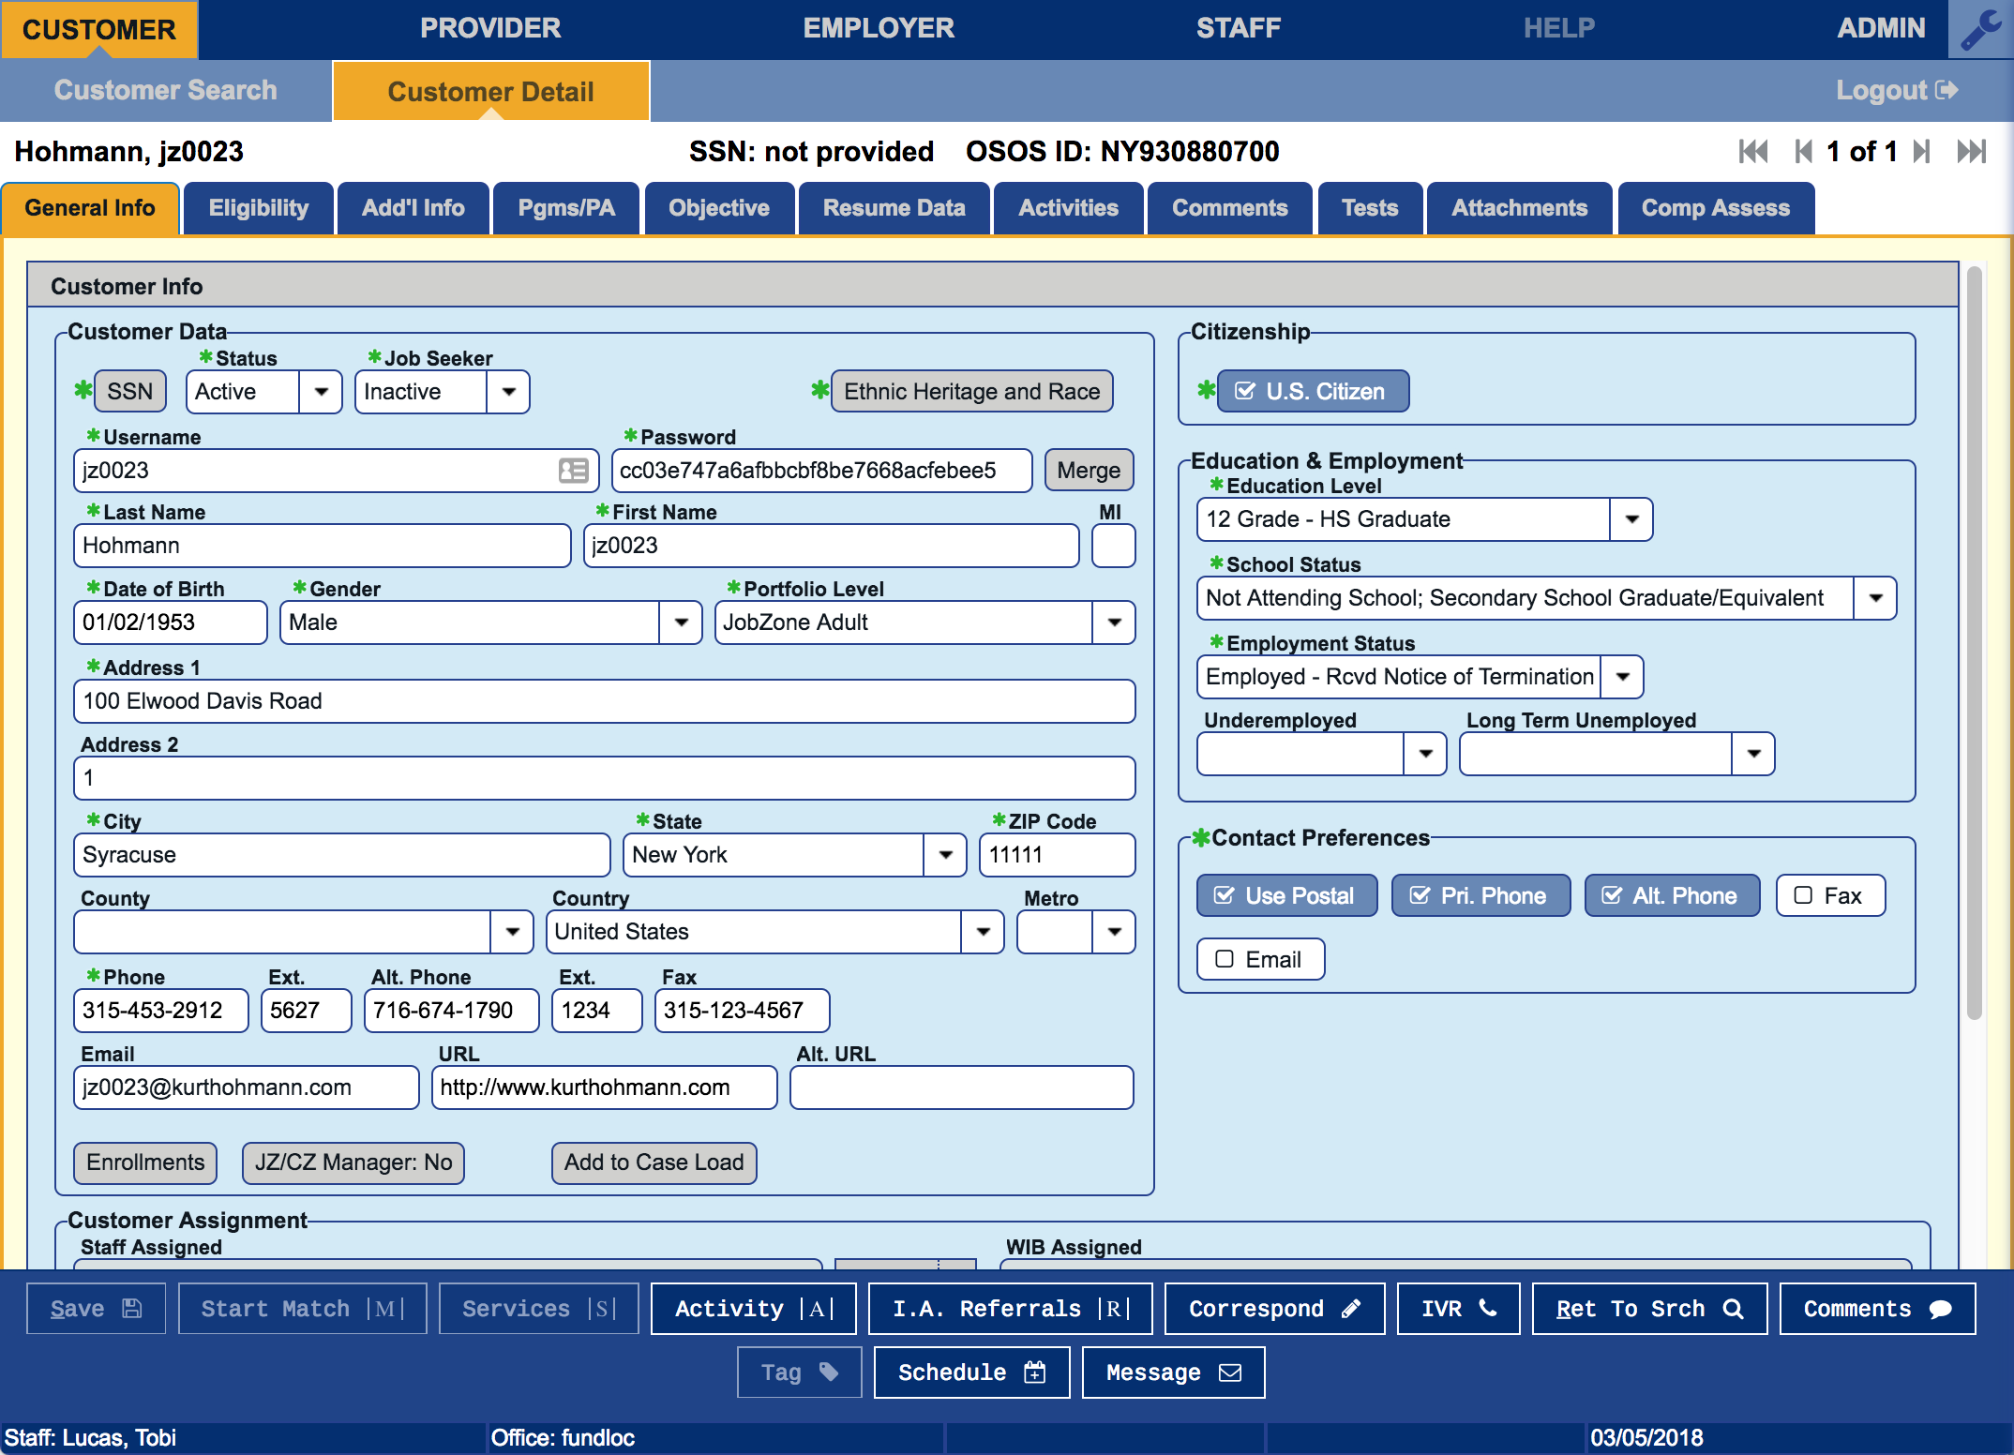
OSOS Technology Refresh

Slide 31
JobZone Resume Writer
User-friendly for Jobseekers and Staff
Fully Integrated with OSOS
Improved Outcomes for Jobseekers

Slide 32
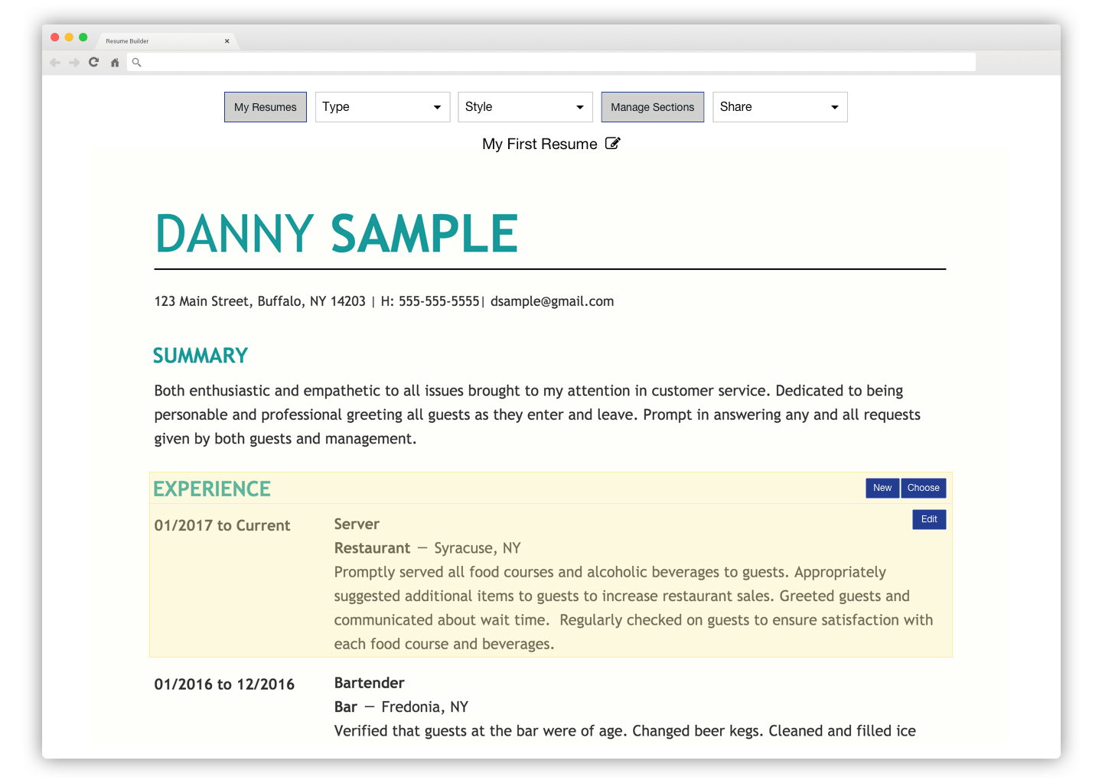
JobZone Resume Writer

Slide 33
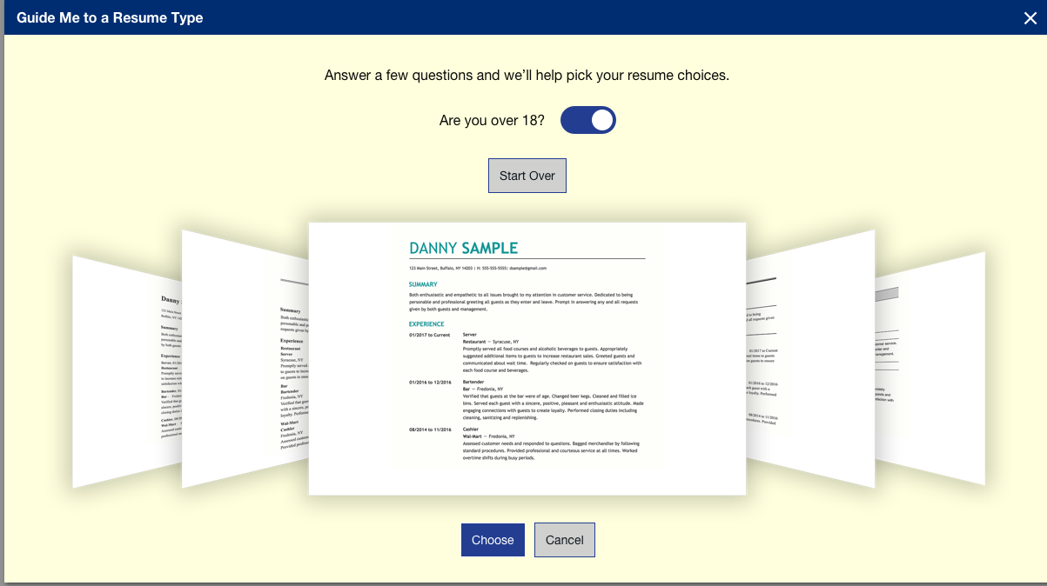
JobZone Resume Writer

Slide 34
TEGL 19-16: Guidance on Services provided through the Adult and Dislocated Worker Programs under the Workforce Innovation and Opportunity Act (WIOA) and the Wagner-Peyser Act Employment Service (ES), as amended by title III of WIOA, and for Implementation of the WIOA Final Rules
TEGL 5-16: Reemployment & System Integration Dislocated Worker Grants
TEGL 1-17: Dislocated Worker Opportunity Grants
Modification Request for Period of Performance Extension Forms ETA-1-17: Attachment E Attachment
Information Technology Support Center (ITSC) Workforce Connect
http://www.itsc.org/Pages/WF_Connect.aspx
AOSOS Consortium
www.ososinfo.org

Slide 36
Wrap Up
!
Final comments from presenters
Final comments from moderator

Slide 37
Jackie Turner
Deputy Executive Director/CFO
Mississippi Department of Employment Security
Jturner@mdes.ms.gov
601-321-6346
Vicki Mockler
Employment Services Manager
New York State Department of Labor
Vicki.Mockler@labor.ny.gov
518.485.2601

