Slide 1
Sustaining Grant-funded Projects for Long-term Success
May 2, 2018
Innovations Leading to Career Success Webinar Series
Employment and Training Administration
Office of Career, Technical, and Adult Education

Slide 2
Moderators
Cheryl Martin, TAACCCT Program Manager, Division of Strategic Investments, Employment and Training Administration, U.S. Department of Labor
Erin Berg, Community College Program Specialist, Office of Career, Technical, and Adult Education, U.S. Department of Education

Slide 3
About this Webinar
Three types of grant-funded innovations will be discussed by presenters:
Strategies to accelerate credential attainment;
Strategies to support program completion; and
Strategies to engage employers and align programs with labor market need.
The examples shared come from TAACCCT, but the approaches these grantees took to sustaining their work can apply to anyone seeking to make a long-term impact with a grant-funded project. Speakers will describe their successes in sustaining and institutionalizing their work and the challenges they faced.
Part of a webinar series showcasing strategies and resources developed by community colleges that are of broad interest to educational institutions engaged in career-focused education and training.

Slide 4
Innovations Leading to Career Success Webinar Series
This webinar series showcases strategies and resources that are of broad interest to educational institutions engaged in career-focused education and training.
February 28:
Make Industry Experts into Expert Instructors to Increase Student Success
March 14:
Scaling Career Pathways in Wisconsin
March 28:
Resources for Developmental Education Using Competency-Based Education
April 11:
Lowering the Cost of Course Materials with Free and Open Educational Resources
May 2:
Sustaining Grant-funded Projects for Long-term Success
May 16:
Free Resources for Apprenticeship & Work-based Learning
For more information, please visit: Innovations Leading to Career Success Webinar Series

Slide 5
Polling Question
?
What best describes your organization?
Secondary Career/Technical
Community or Technical College
Four-Year Institution
Workforce System
Other (type in chat)
?
?
?
?

Slide 6
Polling Question
?
Are you currently or have you previously worked on a DOL Grant?
Current Round 4 Grantee
Worked on previous Rounds
Not directly, but my institution was a recipient.
Worked/partnered with a TAACCCT Grantee
?
?
?
?

Slide 7
Agenda
This webinar features four TAACCCT community college grantees who have been able to sustain innovations through a variety of creative approaches:
Job Development Career Coaches and Partnerships at Santa Fe Community College
Competency-based Education at Sinclair Community College
Sustainable Apprenticeship strategies at Grand Rapids Community College
Sustainable Partnership strategies at South Central College

Slide 8
Presenters
Kristen Krell, SUN PATH Director, Santa Fe Community College
Christina Amato, Competency-Based Education Program Manager, Sinclair Community College
Julie Parks, Executive Director of Workforce Training, Grand Rapids Community College
Anne Willaert, Statewide Director, Minnesota Advanced Manufacturing Partnership (MNAMP), South Central College

Slide 9
Skill Up Network: Pathways Acceleration in Technology and Healthcare (SUN PATH) Innovation: Job Development Career Coaches
Department of Labor’s Trade Adjustment Assistance Community College and Career Training (TAACCCT)

Slide 10
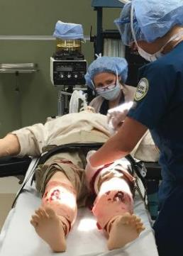
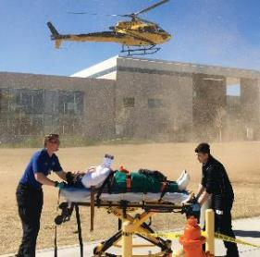
New Mexico SUN PATH Consortium: Improving Lives Strengthening Healthcare

Slide 11
NM SUN PATH Goals
Expand capacity and systemic improvements in the delivery of healthcare career pathways that align with industry needs;
Increase the attainment of degrees, certifications, and industry-recognized credentials; and
Create strategic alignment between education and workforce systems, resulting in improved employment outcomes, retention, and average earnings.

Slide 12
The Workforce/College Partnership
SUN PATH contracts with the Department of Workforce Solutions (DWS) to hire, train, and supervise Job Development Career Coaches (JDCC) on each campus
DWS hires a JDCC Manager to provide training and oversight
At least one part-time JDCC is located at each college depending on size
The college provides the office space, phone, and computer
The JDCC becomes a part of the SUN PATH team at each college
Regular communication of JDCC and SUN PATH college staff is key to success!

Slide 13
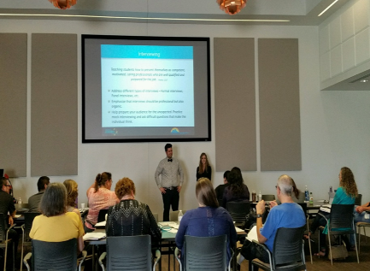
Job Development Career Coaches
Provide career readiness workshops Resources: https://www.sfcc.edu/jdcc-2017-resources/
Resume development
Professionalism training (soft skills)
Graduation checklist
Mock interviews
Organizes job fairs
Assists with job placement
Connect with employer partners

Slide 14
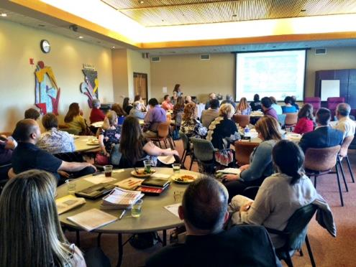
Leveraging Workforce Partnerships
Workforce Innovation Opportunity Act
JDCC’s assist with connecting students with WIOA scholarships
Regional Workforce Boards
Trade Adjustment Act/TAA
Human Service Department, SL Start
Northern Regional SUN PATH Employer Meeting

Slide 15
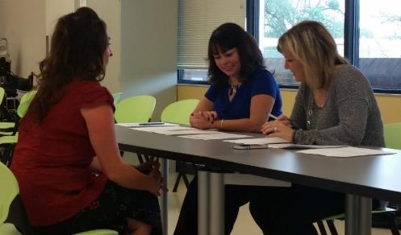
The Role of Employer Partners
Serving on SUN PATH Statewide Advisory Council and Regional Councils
Provide input on key skills and competencies needed for relevant job training programs
Identify healthcare jobs that are in demand
Offer internship, mock interviews and job placement support
Mock interviews with SUN PATH employer partner

Slide 16
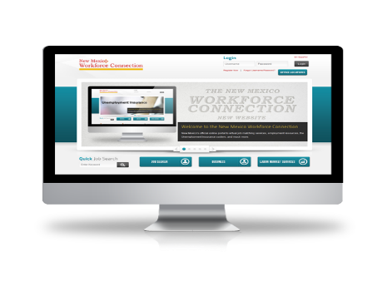
Workforce Online Connection System
www.jobs.state.nm.us
This site can be accessed via the internet or at any New Mexico Workforce Connection Center statewide.
The site is available in English and Spanish
It is the most powerful job searching system in New Mexico
The site typically contains over 10,000 jobs daily with new opportunities all the time.

Slide 17
Using Labor Market Data
Labor Market Facts
Answers commonly asked questions about the local labor market.
Area Profile
Summary of labor market in a selected area.
Industry Profile
Labor market information on industries in a selected area.
Occupational Profile
Labor market information on occupations in a selected area including wages.
Education Profile
Labor market information on education programs in a selected area.

Slide 18
Sustaining the Innovation
New Mexico Department of Workforce Solutions (DWS) has realigned workforce funding to sustain Job Development Career Coaches located on college campuses, after the TAACCCT funds expire.
Colleges have agreed to provide office space for the workforce employee.
JDCC’s will continue to integrate into the college campus after the grant.

Slide 19
Data Collection, Analysis, Evaluation and Reporting
JDCC’s and Coordinators enter student data into workforce online system
Consortium data Manager downloads and organizes participant data from DWS, and HED
Evaluator downloads complete data set, creates reports and data charts comparing actuals to targets
Reports are submitted to DOL and data charts are presented to stakeholders for review, analysis, and program recommendations
Implementation
of recommendations

Slide 20
SUN PATH Performance Outcomes
To access all SUN PATH Program Outcomes Dashboards: https://www.sfcc.edu/offices/sun-path-consortium/

Slide 21
Essential Components of a
High Performing Collaboration
Structure the system for success
Individual and distributed leadership that inspires
Set a clear vision and generate enthusiasm for it
Clear direction and communication about the goals and strategies to achieve excellence
Creating a culture of trust and support
“Love your employees” and provide honest feedback
Always stay student centered
Clear systems to measure, analyze, and manage results
Take time for fun, humor, and celebration!

Slide 22
Tips for Effectiveness as Change Agents
Prioritize – pick your battles
Trust others – assume the best and you’ll get the best
Use reason and thoughtfulness – minimize drama
Seek to understand the perspective of others
Propose ideas and seek input
Request rather than complain
Seek the Win-Win in any situation
Approach problems with kindness
Be persistent, patient, and positive!
Let go of what you can’t control
Seek to bring joy and tranquility to the situation and those around you

Slide 23
Thank you!
Contact information:
Kristen Krell – SUN PATH Director Kristen.krell@sfcc.edu
Waldy Salazar – JDCC Consortium Manager
Waldy.Salazar@state.nm.us

Slide 24
Competency-Based Education (CBE) at Sinclair
The FlexPace Program

Slide 25
What is CBE?
Traditional | CBE
 | Enrollment is continuous during the term; students may finish at any time.
 | Students advance based on “showing and doing” what they know.
 | Students may accelerate through courses by testing out of units entirely, or accelerating through assignments.
Structured terms with prescribed options for enrolling and finishing courses
Students advance based on weekly timelines.
Opportunities for course acceleration are limited.
Instruction is standardized across all levels of academic need. Advising is separate from the classroom experience.
Customized instruction and integrated advising based on individual student needs. Student is assigned a faculty and coach team.

Slide 26
CBE at Sinclair
Since 2013, Sinclair has developed 11 CBE programs, and 55 courses in Information Technology, Business Management, Manufacturing, and Unmanned Aerial Systems
1,220 CBE students have earned 623 certificates and degrees
Enrollment has increased 35% since last term
115% increase between 17SP and 18SP

Slide 27
Why CBE?
State climate: skills gaps, 1 million+ adult learners with some college, no degree, and state attainment goals
CBE is another, and sometimes the only option for students who need increased flexibility in higher education
70% of Sinclair CBE students are adult learners
military, veterans, working adults
Employers validate CBE with partnerships, internships, and providing curriculum feedback
Reverse internship fairs
CBE students are 10x as likely to take an internship
Internship-to-hire rate 90%
CBE students finish courses and programs faster, and at increased rates
30% faster course completion
Graduation rate is nearly double traditional students

Slide 28
What it took to get here…
Early Phases (2012-2015)
Grant stimulus
Early core of committed faculty
Executive-level support
Growth Phase (2016-now)
Creation of hard-funded positions dedicated to CBE
Identification as a college and eLearning priority
Creation of a strategic plan for growth

Slide 29
The Ongoing Impact
Competency-based education has generated $14 million in grants for Sinclair
Sinclair has been recognized by the Ohio Department of Higher Education as the best practice CBE model for the state
Sinclair co-chairs a state committee for CBE best practice development for Ohio
Sinclair presented or provided technical assistance to more than 60 schools and organizations nationwide in 2017

Slide 30
Our CBE Students
Jennifer
Army veteran
worked as a Network Engineer during Iraq War, but earned no credential
working full-time
young family
Dual major graduate in Network Engineering and Secure Systems Administration
Graduated in two years while working full-time
Interned and directly hired spring 2016

Slide 31
Questions?

Slide 32
U.S. DOL TAACCCT - Michigan Coalition for Advanced Manufacturing - MCAM
Sustainability Success
May 2, 2018

Slide 33
Apprenticeships
Customized Competency Based Apprenticeship with Autocam & NN Manufacturing for CNC tooling/Precision machining.
First cohort worked Monday-Thursday, attended GRCC Fridays for 8 hours.
Built as a customized non-credit apprenticeship.
Direct articulation to 30 credits towards a 60 credit associates degree in machining.
Individuals recruited through non-profit partners in Grand Rapids ‘neighborhoods of focus’ – low income.
Expanded to 2 more cohorts. One model goes to school on Tuesday and Wednesday afternoons, works 2nd shift other days. All individuals receive full time benefits while in the apprenticeship.

Slide 34
What its led to…
Success led to “talk” in the employer community about apprenticeships and how they could work in non-union environments. Invitations to explain what we did with these employer partners.
Expansion to Information Technology, healthcare and large increase in electrical and construction apprenticeships.
Strong success, stronger partnerships with non-profit partners, especially through the West Michigan Hispanic Center, Grand Rapids Urban League and West Michigan Literacy Center. This was a model that really worked for their clients. (Earn and Learn – career opportunities).

Slide 35
Changes at GRCC from TAACCCT
Closer relationships between employers and GRCC - quicker curriculum changes.
Alignment to national credentials and giving college credit for credentials earned (AWS, MSSC, PMMI, NIMS). (Aligns non-credit and credit). Applied to every sector not only manufacturing.
Buy-in for coach navigators at GRCC (success coaches)
Buy-in for job developers.
Changes to college enterprise systems to record credentials earned by students.

Slide 36
Ensuring Sustainability
Kept data on ROI (return on investment) for staff positions, student placement, employer involvement. Used to leverage general fund dollars from the College.
Our employers are the voice in the community about apprenticeships and what they are accomplishing for them.
Partnership with West Michigan Works (America Career Center). Leveraging funding streams.
State of Michigan Skilled Trades Training Funds.
Philanthropy (W.K. Kellogg Foundation, JPMorganChase Foundation, Grand Rapids Community Foundation)
Employers covering costs in order to “win” talent.

Slide 37
Minnesota Advanced Manufacturing Partnership

Slide 38
Why Expand on Employer Partner Relationships
Skills Gap
Declining Enrollment in 2 year institutions
Lower unemployment rates
Employment Demand

Slide 39
Challenges
Faculty Driven
Faculty Development
Industry Driven
Industry Development
Meeting todays student needs

Slide 40
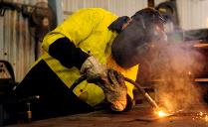
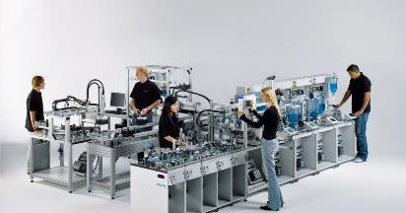
Strategy: Utilize Innovation Its Not Just One Thing!
Career Pathways
Standardized Core Curriculum
Industry Recognized Credentials
Credit for Prior Learning
Apprenticeships
+Connect

Slide 41
Innovation – Career Pathways

Slide 42
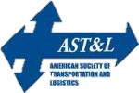

Slide 43
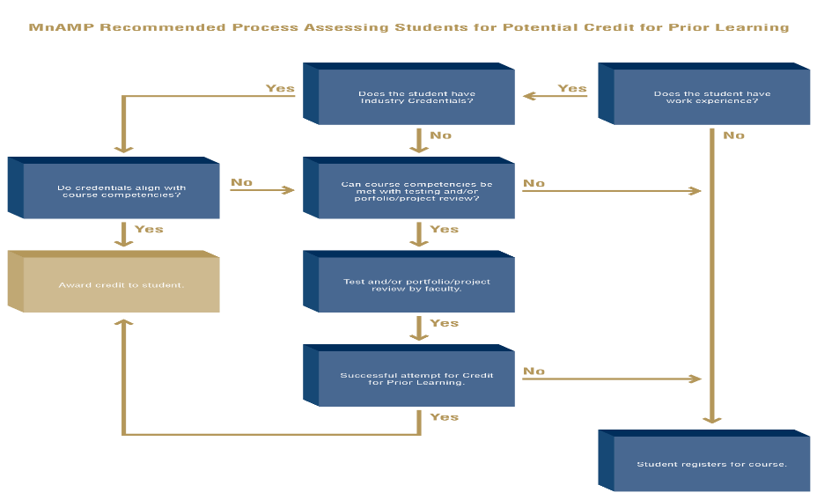
MnAMP CPL Guidebook

Slide 44
Military CPL
Mapping military experience to college courses to provide Veterans CPL
Faculty Driven
Veteran’s Education Transfer System (VETS)
http://www.mnscu.edu/college-search/public/military

Slide 45
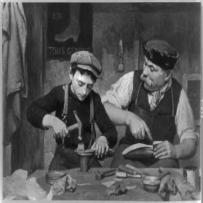
Learn Work Earn Apprenticeship
3 Apprenticeship Models
Academic/Non-Credit/On-line
+Connect
College Enrollment – Work Learn Earn 3/2 model
Company Based – Customized Learning
Funding
Minnesota Apprenticeship Initiative
Pipeline – Legislative
Partnerships

Slide 46
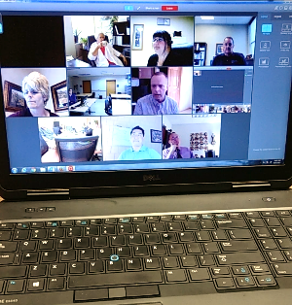
+Connect: Overview
Hybrid training courses
Live instruction via virtual classrooms
Pinnaca VCaaS Powered by Acano
Online course content in D2L
Collaborative model
Minnesota State system
Customized Training departments
Short-term sessions
1-3 hours per week for 8 weeks

Slide 47
+Connect: Demographics
Incumbent Workers
Upskill current employees
Apprenticeships and dual-training programs
Unemployed
Through Workforce Center partners
Others
Working toward industry or academic credentials

Slide 48
Sustaining Partnership Strategies
Partnerships and commitments with Industry Partners 500+
Understand Partnership(transactional, complementary, collaborative), create a shared vision, communication, build trust, coordinate leadership
College commitment – Positions (LWE)
College $ Assistant - Grants (Minn. State (P3), Build on Success with other sectors
Opportunity for Continued Communication and Involvement - Minnesota Manufacturing Workforce Partnership (Center of Excellence), Workshops, Grants (MAI, DT), Job Fairs, Apprenticeships,

Slide 49
Benefits and Differences
1214 Credentials earned
44% incumbent workers received wage increase due to training
170 Credits granted through CPL process
367 Industry Credentials earned
71 faculty credentialed
101 Registered Apprenticeships
182 Dual-Training apprenticeships

Slide 50
Resources
TAACCCT Sustainability Toolkit: This toolkit is designed to support the sustainability of the programs and innovations developed by TAACCCT grantees. https://taaccct.workforcegps.org/resources/2016/07/25/13/22/Resource_TAACCCTSustainabilityToolkit
Minnesota Advance Manufacturing Credit for Prior Learning Guidebook: This is a guide to assist with granting Credit for Prior Learning as it relates to Third Party Industry Related Credentials.
https://www.skillscommons.org/handle/taaccct/15165
TAACCCT Sustainability Plans: This includes Sustainability Plans, 3rd party evaluations, and other final reports that reference the practices, programs and innovations that will be sustained. https://taaccct.workforcegps.org/resources/2017/03/28/10/35/TAACCCT_Sustainability_Plans
TAACCCT Powerhouse Partnerships: This report describes the activities and strategies of a wide variety of partnerships between community colleges and workforce boards, with key takeaways that can assist other community colleges and workforce organizations to solidify their collaborations and further their mutual goals.
https://taaccct.workforcegps.org/resources/2018/04/09/17/11/Powerhouse_Partnerships_Community_Colleges_and_Workforce_Boards_Working_Together

Slide 51
Polling Question
?
?
What are some sustainability strategies you have applied to your work that have been successful? (answer in chat)
?
?
?

Slide 52
Polling Question
?
?
What have been some of your challenges with sustainability? (answer in chat)
?
?
?

Slide 53
Questions?

Slide 54
Thank you!
This webinar series showcases strategies and resources that are of broad interest to educational institutions engaged in career-focused education and training.
February 28:
Make Industry Experts into Expert Instructors to Increase Student Success
March 14:
Scaling Career Pathways in Wisconsin
March 28:
Resources for Developmental Education Using Competency-Based Education
April 11:
Lowering the Cost of Course Materials with Free and Open Educational Resources
May 2:
Sustaining Grant-funded Projects for Long-term Success
May 16:
Free Resources for Apprenticeship & Work-based Learning
For more information, please visit: Innovations Leading to Career Success Webinar Series

