Slide 1
Disaster Preparedness and Response: Serving Farmworkers
May 18, 2018
Part I – National Farmworker Jobs Program Grantee (NFJP) Experiences

Slide 2
Lianna Shannon
Workforce Analyst,
National Monitor Advocate Team
U.S. Department of Labor

Slide 3
Has your organization experienced a natural disaster in the past year?
Hurricane
Flood
Fire
Earthquake
Volcano
Tornado
Drought
Fortunately, no

Slide 4
Understand the impact of natural disasters on:
Farmworkers;
Agriculture; and
Farmworker service providers.
Hear how NFJP grantees responded to the disaster.
Identify lessons learned.

Slide 5
Gerald Williams
Coordinator
Farmworker Career Development Program
Immokalee Technical College
Collier District Schools

Slide 6
Disaster Impact on Southwest Florida
Hurricane Irma
Communities Affected
Effects on Farms and Farmworker Population
Recovery Period
Today-Lessons Learned

Slide 7
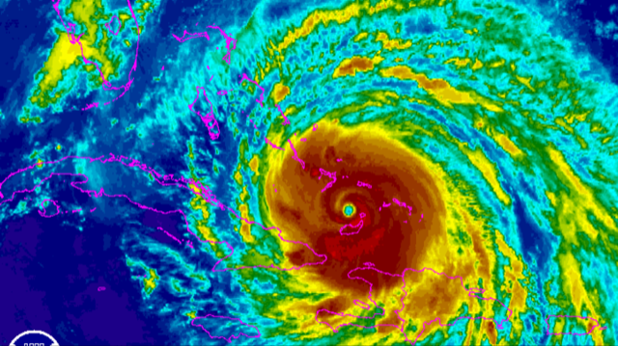
Hurricane Irma August 30th to September 13th, 2018
May 18, 2018
Southwest Florida

Slide 8
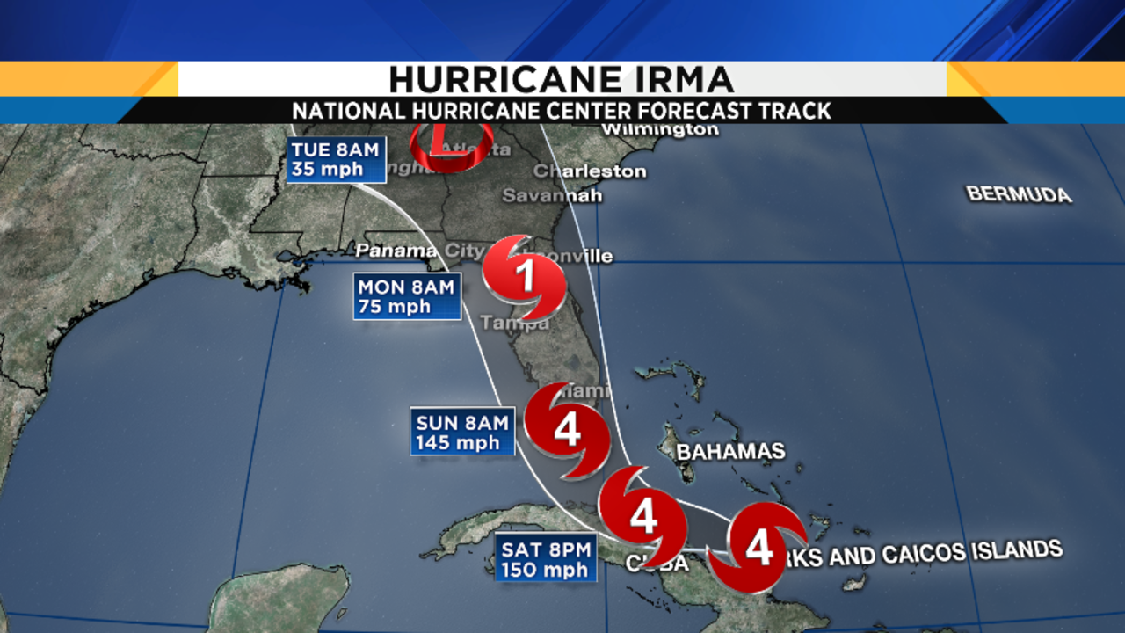
Hurricane Irma Track

Slide 9
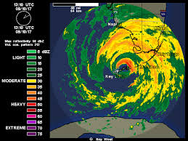
Hurricane Irma Two Landfalls in Florida

Slide 10
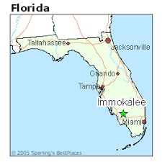
Communities Affected

Slide 11
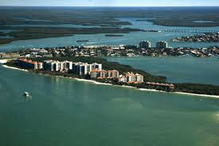
Marco Island
Photo Before
Photo After

Slide 12
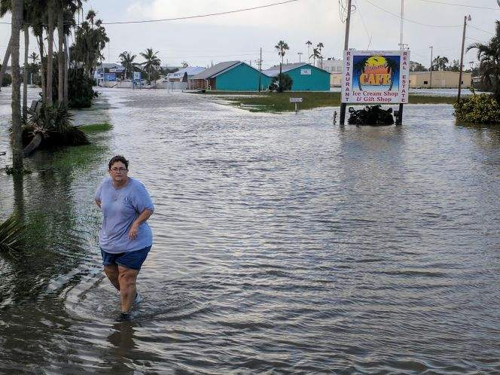
Everglades City
Photo Before
Photo After

Slide 13
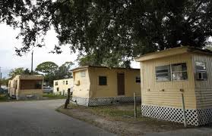
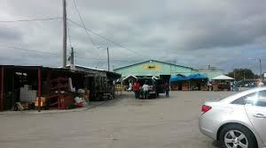
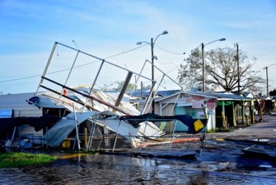
Immokalee
Photo Before
Photo After

Slide 14
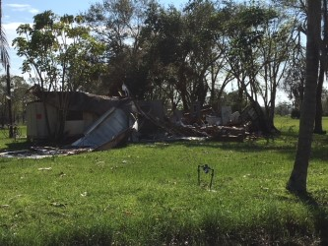
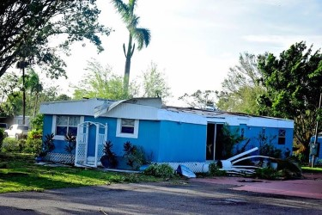
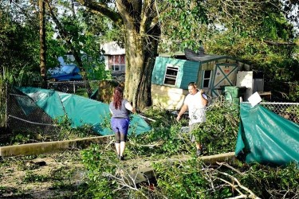
Immokalee
Photo After
Photo After

Slide 15
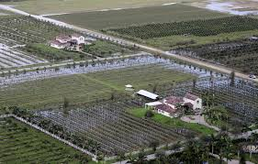
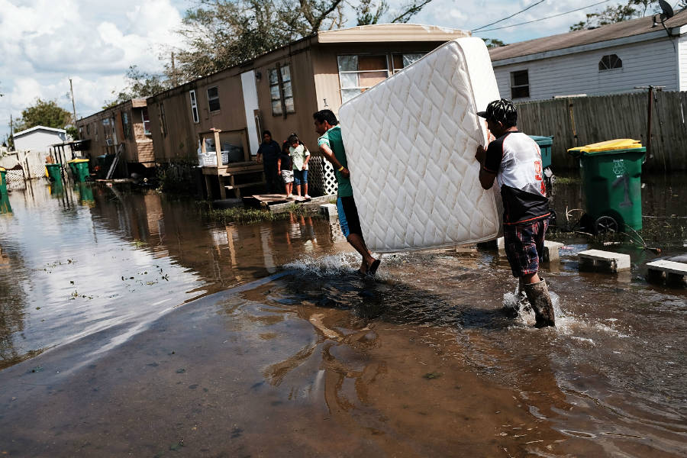
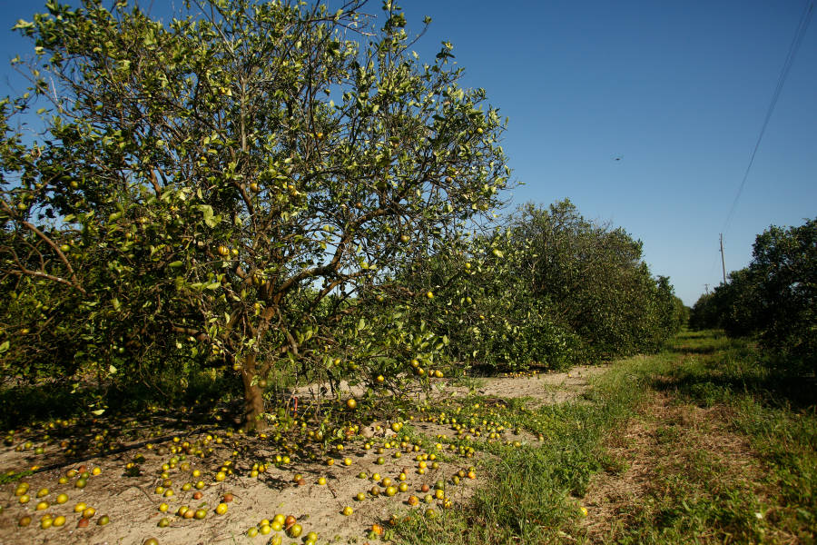
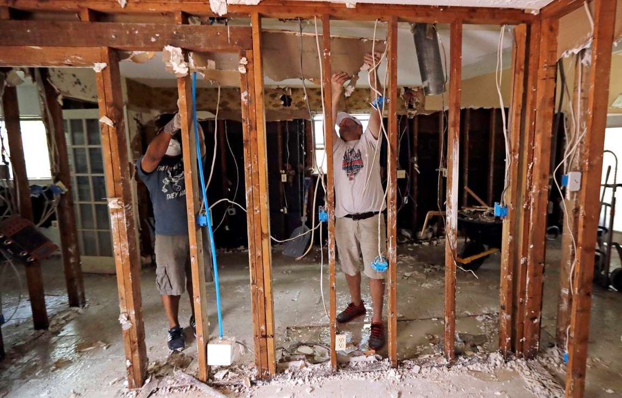
Effects on Farming and Farmworkers
Farming
Farmworkers

Slide 16
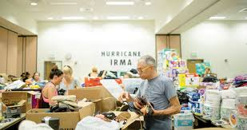
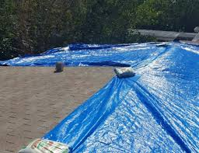
Immokalee
Recovery
Today

Slide 17
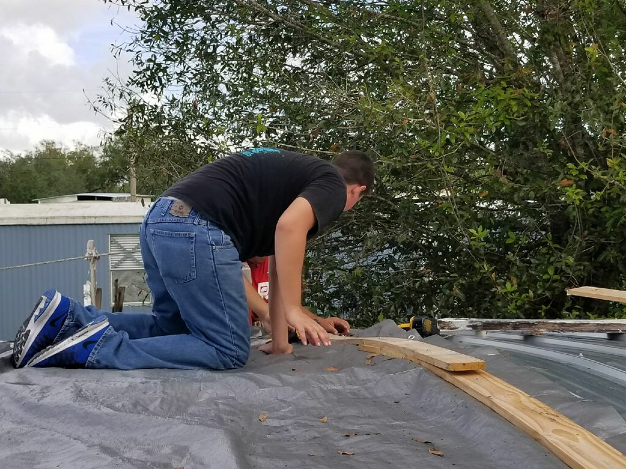
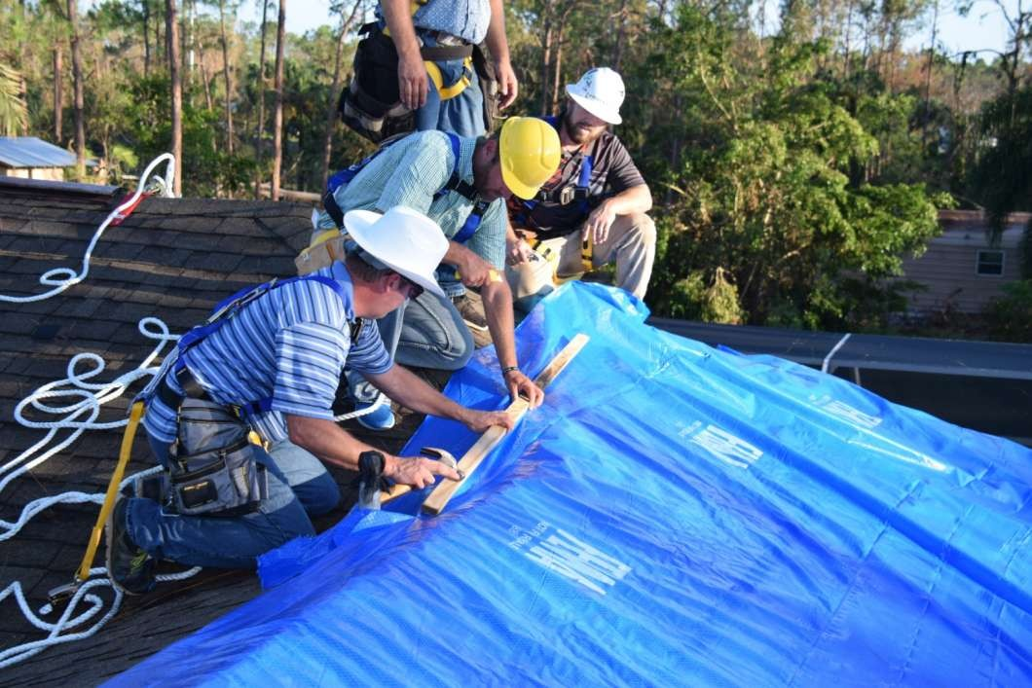
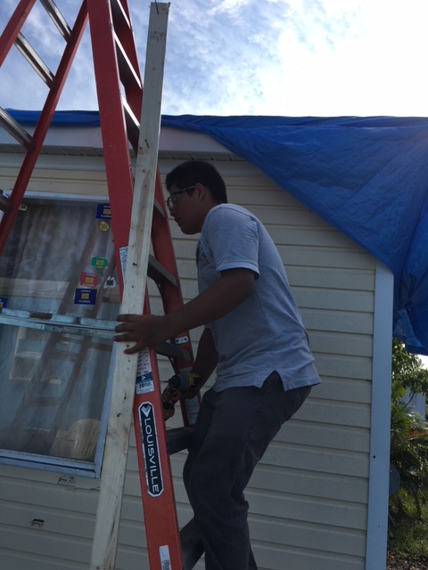
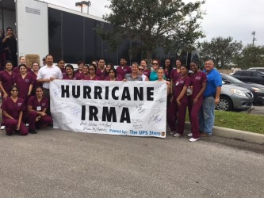
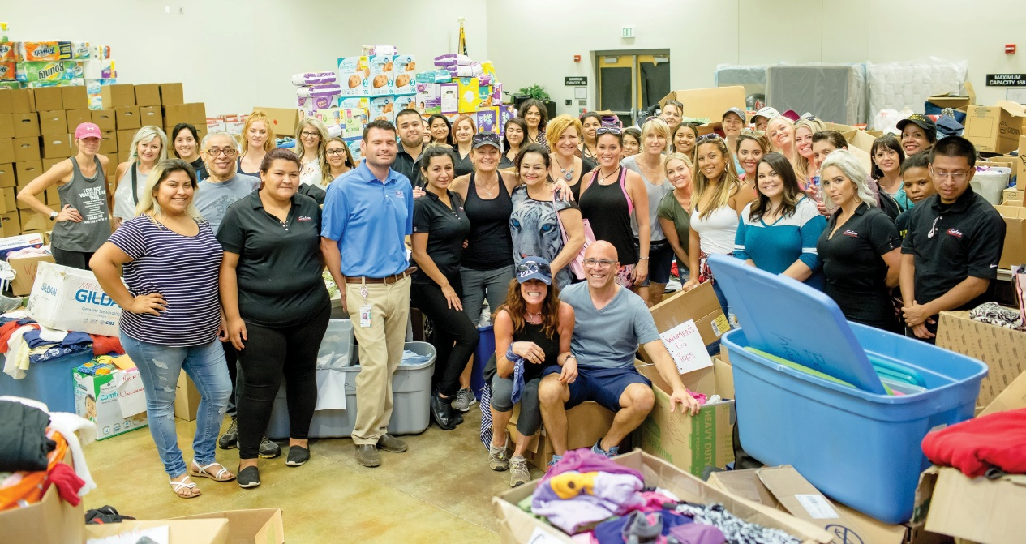
Students helping Students
School Support
Local, County & Federal

Slide 18
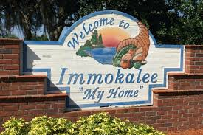
Immokalee
Today and Beyond
Lessons Learned
Many agencies working together make a huge difference.
Preparation is the key.
Provide the community with supplies before the storm to prepare.
Using the Amber alert system to provide storm information.
Providing more shelters, not just schools.
Providing more locations with generators and trained staff to use them.
Emergency housing for after the storm.
Restoring power quickly to Hospitals and other emergency buildings.
Organizing the donations is critical to get supplies to those in most need.
Coordination with the local law enforcement and first responders to locate those in need of assistance.
NFJP is using federal dollars to purchase prep kits for each FCDP participant.

Slide 19
Paul Castro
Director, Farmworker Services and Workforce Development Division
California Human Development
Norma Garcia
Special Programs Manager
California Human Development

Slide 20
California Natural Disasters: Drought, Flood, & Fire
Presented by California Human Development

Slide 21
Serving 31 counties in Northern California

Slide 24
Assistance provided
Housing assistance
4,126 Supportive services-$2,256,862
Temporary employment
180 individuals

Slide 25
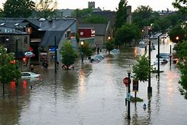
.
Flooding in early 2017

Slide 26
Governor Jerry Brown declared a state of emergency in 52 of the state’s 58 counties due to winter storm and flood damage, and 34 of those counties were declared federal disaster areas.

Slide 27
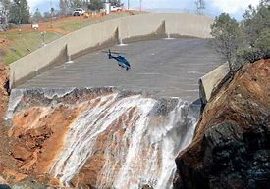
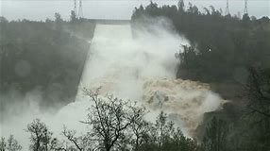
Winter Storms and Oroville Dam Damage
Damage estimates from the recent winter 2017 floods are still being calculated, the California Department of Transportation has estimated nearly $700 million just to repair storm damage to highways.
Erosion damage to spill ways at Oroville Dam leads to risk of catastrophic flooding, evacuation of nearly 200,000 residents, and presidential disaster declaration.

Slide 28
.

Slide 29
Assistance provided
Temporary employment-144
Housing assistance-$165,000

Slide 30
Fires

Slide 31
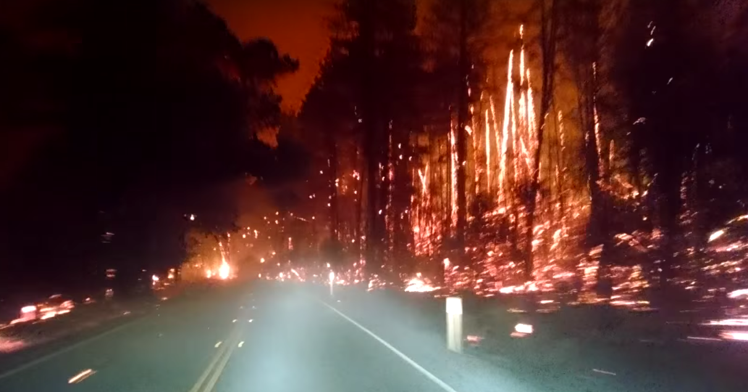
2015 Valley Fire-Lake County
Started September 12, 2015
76,067 acres burned
1955 structures destroyed

Slide 32
2015 Lake County-National Dislocated Worker Program
US Department of labor.
CA Employment Development Department.
La Cooperativa Campesina de California.
CA Human Development.
January 2016-December 2017.
$ 7,000,000- Payroll
382 enrollments.
$18.00 hourly average wage.
$1,500,000 contribution by worksite +/-

Slide 33
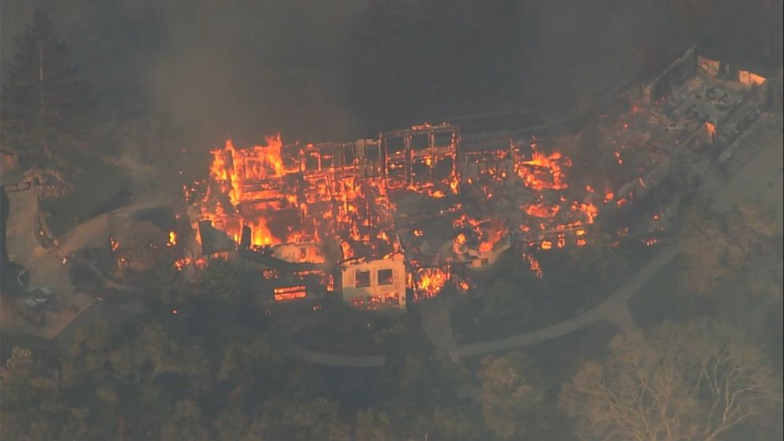
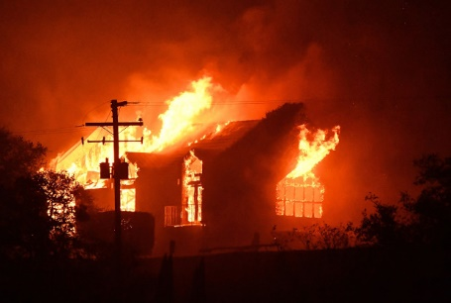
October 8 and 9, 2017 wildfires hit Napa, Lake, Sonoma, Mendocino, Butte, Yuba, Solano and Nevada Counties The 2 most affected counties were:
Napa County
Sonoma County

Slide 34
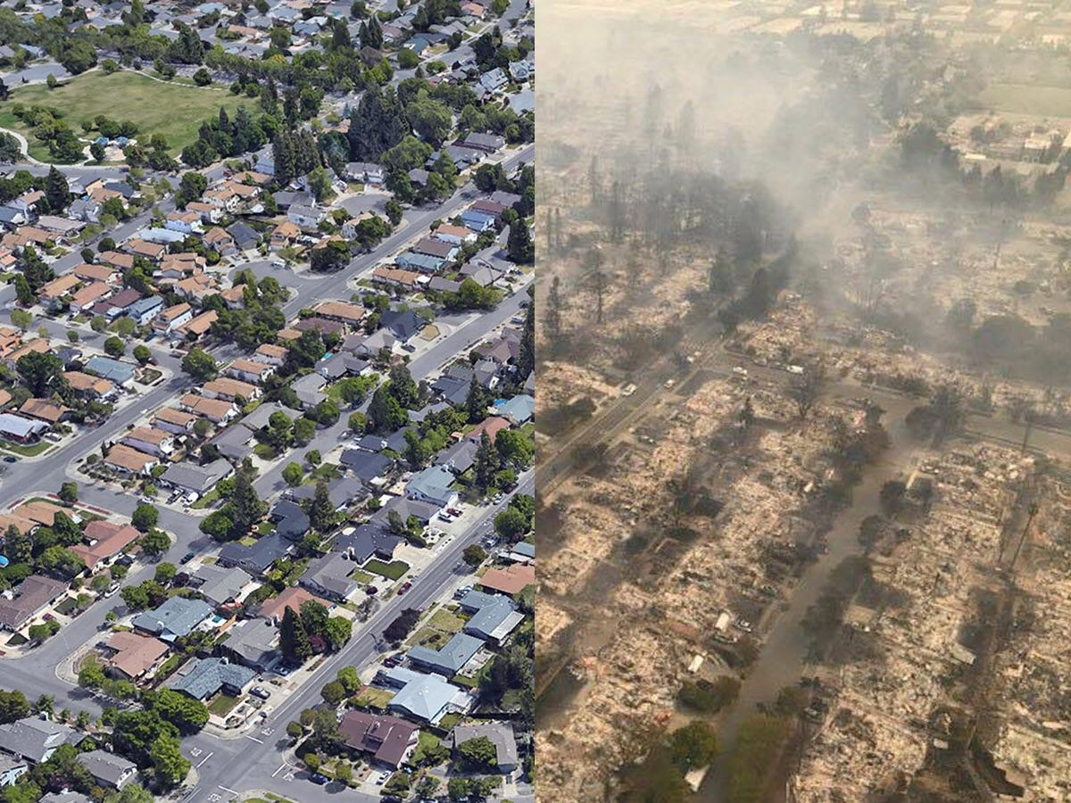
The October fires were the most costly group of wildfires on record, causing a least $9.4 billion in insured damages.
Predicted to cost the US economy at least $85 billion.
The largest portion of these losses was to residential property.
A total of 8,400 structures were destroyed. The City of Santa Rosa alone lost 3,000 homes to the fast spreading Tubbs fire.

Slide 35
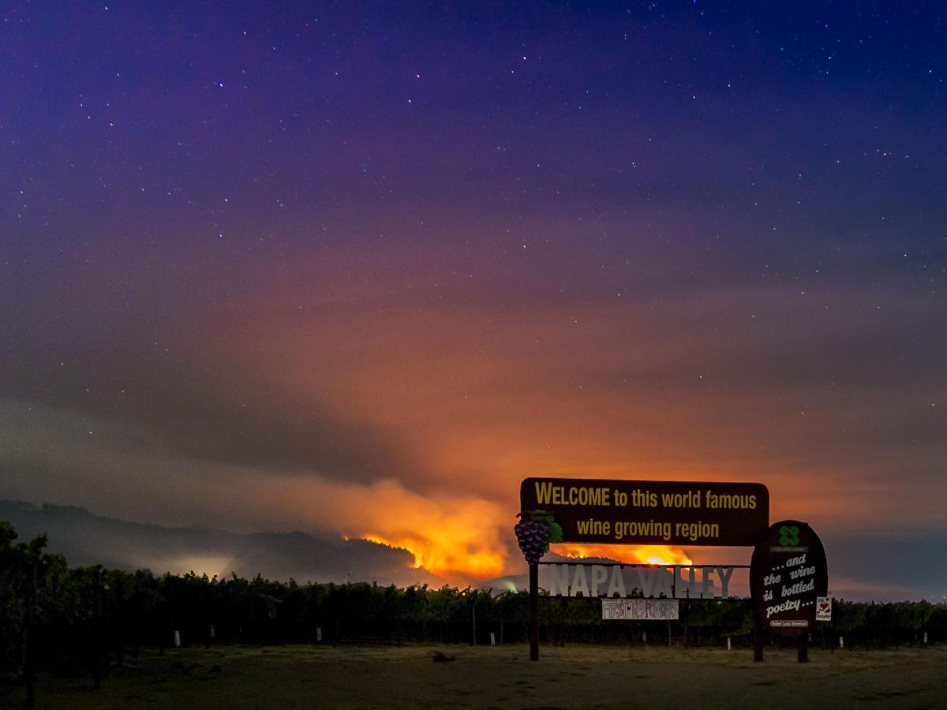
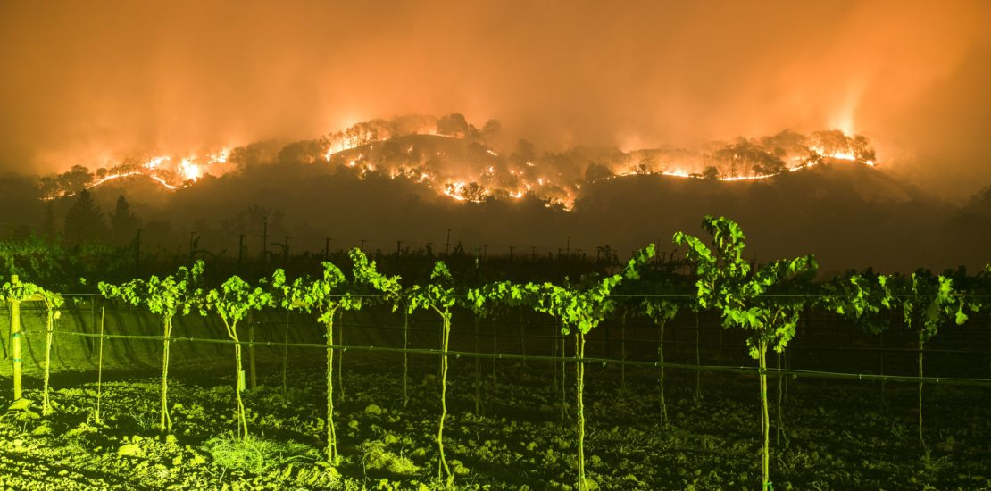
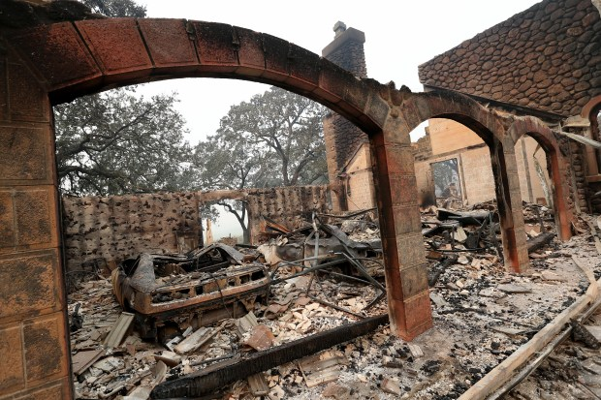
At least two dozen wineries in Napa, Sonoma, and Mendocino counties have been partly or fully destroyed. While some vineyards were able to finish out the harvest season, those most affected may take five years to grow back their vines:

Slide 36
Wineries are the backbone of the region’s tourism industry, visitors spend $1.92 billion last year.

Slide 37
Assistance provided
Housing assistance-$86,173
Temporary Employment-goal
To serve 990 individuals

Slide 38
Challenges
Limitations to program eligibility
High number of individuals in need of employment assistance
Agencies reluctant to work collectively-led to duplication of services and abuse
Work on private property to rebuild homes

Slide 39
Challenges-continue
Fear-kept many individuals/families from seeking assistance
Lack of staff to quickly implement program
Federal funding slow in getting to communities affected by the disaster
Worksites concerned with liability
Preventing injuries

Slide 40
Lesson Learned
Establishing relationships with state/county/local government and response networks in advance is critical to ensuring farmworker needs are addressed during emergencies.

Slide 41
Working together we are going back to be a beautiful place to live.

Slide 42
Stacey Taylor
Executive Director
MET, Inc

Slide 43
Hurricane Harvey
A necessary yet unpredictable response

Slide 44
Hurricane Harvey
Hurricane Harvey made it’s way to Houston on August 17, 2017. The water did not stop rising until September 3, 2017.
Hurricane Harvey was a Category 4 hurricane that included 60.58 inches of catastrophic rainfall.
The rain trigged mass flooding in the Houston metropolitan area inflicting $125 billion in damage. This included damage to over 100,000 homes.
107 people lost their lives. 68 as a direct result of the storm and 39 as an indirect result of the storm.

Slide 45
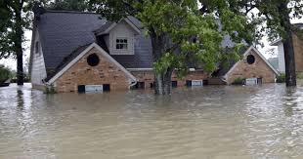
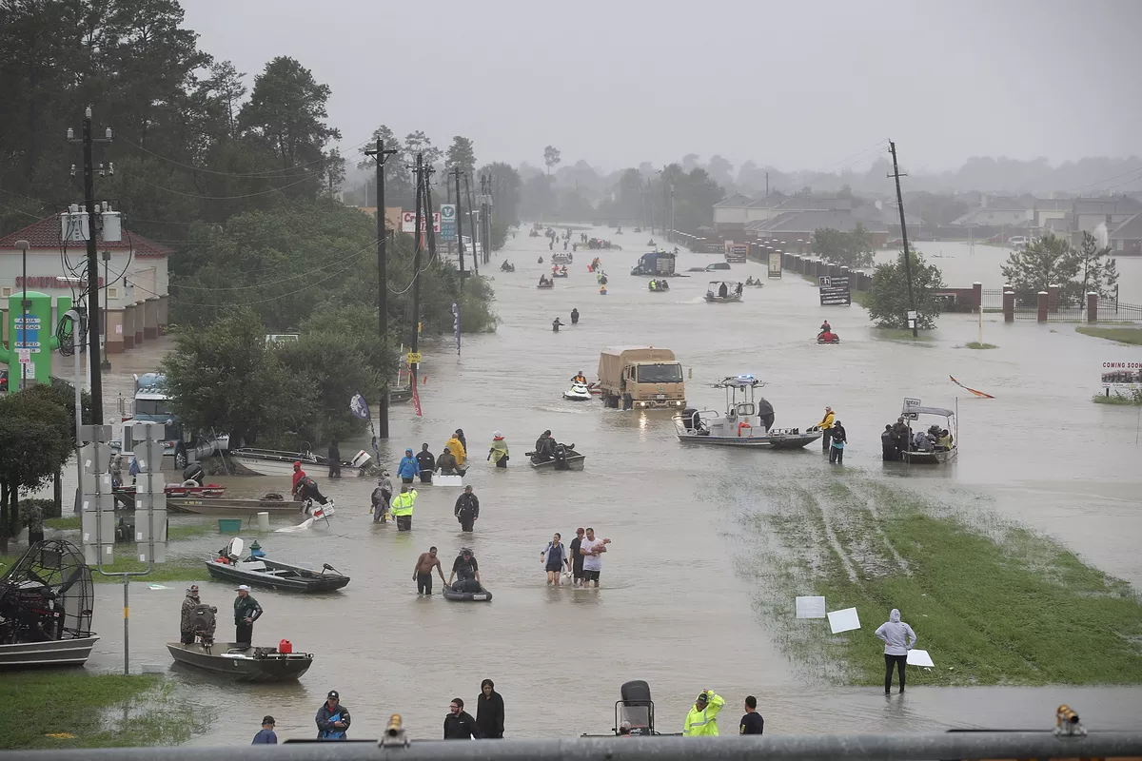
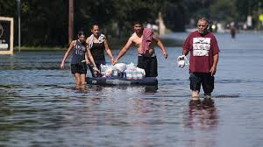
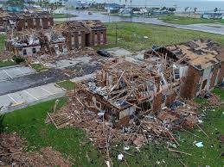
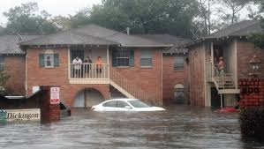
Hurricane Harvey

Slide 46
DISASTER DECLARATION OF MET COUNTIES
The State of Texas declared 60 Counties surrounding Houston disaster areas. 20 of those counties are served by MET.
MET Disaster Declared Counties
Angelina, Burleson, Chambers, Hardin, Harris, Jasper, Lee, Liberty, Milam, Montgomery, Newton, Orange, Polk, Sabine, San Patricio, San Augustine, San Jacinto, Trinity, & Walker Counties.

Slide 47
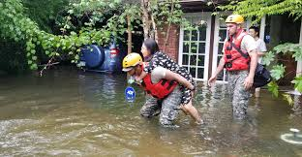
Immediate Ramifications for MET Staff & Clients
Roadways were impassable.
Many were stranded in their homes.
Shelters were full.
Mass loss of power in the Texas heat.
Cell phone towers were damaged/communication was difficult.
Fuel, food, & necessary supplies could not be re-stocked.
Emergency rooms & hospitals could not be accessed.

Slide 48
Supporting our Clients by Supporting our Staff
Senior managers remained in contact with staff via emergency phone tree throughout the storm.
Devised a three tier approach to dealing with our immediate concerns.
Support MET Staff
Determine Damage to met facilities
Support met clients
We quickly understood that met clients could not be supported until met staff were in a position to provide support.
Met facilities could not act as a refuge for clients if they were inoperable.

Slide 49
Supporting our Clients by Supporting our Staff
Hurricane Harvey hit during a payroll week. It was determined that payroll would be processed from the homes of the human resource director and executive director.
Facilities were assessed by leaning on community partners, staff & clients for regular updates. Local police & fire stations were instrumental in helping many determine the extent of damage to local business, churches, & nonprofits.
Assessment of our clients needs was critical. Senior program directors developed a survey and disseminated it via the agency emergency phone tree.

Slide 50
The Extent of the Damage
Eight MET locations were damaged by Hurricane Harvey.
30 staff members sustained flood damage to homes and vehicles.
75 clients were left homeless.
Food insecurity became a major issue.
Temporary housing was difficult to secure.
Mental health services accessed by met staff increased by 1,200 percent.

Slide 51
MET Response
Support staff by ensuring payroll was processed timely.
All met staff received full pay regardless of days worked.
This enabled many to secure hotel rooms or evacuate.
Worked quickly to assess and repair damaged facilities. We understood that clients needed our facilities open to access services.
Ensured licensed professional counselors were available for staff & families.
Collaborated closely with community partners for resources & supplies.

Slide 52
Lessons Learned & Long-term Planning
MET will develop a systematic disaster preparedness plan as part of the agency’s long term strategic plan.
MET will continue to transition software & technology to cloud based systems.
A mobile MET administration office is being developed.
MET will continue to include mental wellness benefits as part of the agencies health plan.
MET has secured flood insurance for all facilities regardless of location.

Slide 53
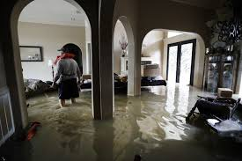
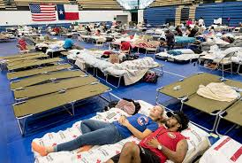
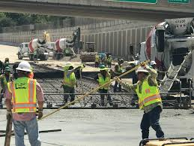
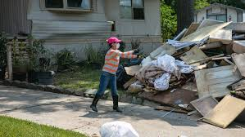
Recovery

Slide 54
Albert Rivera
Regional Administrator
PathStone Corporation
Brenda Lee Soto Colón
Director of Internal Quality Control
PathStone Corporation

Slide 55
Rebuilding Puerto Rico

Slide 56
We will be discussing:
Impact of hurricane María in Puerto Rico (services, economy, etc.).
Design of surveys for the communities and results.
Relief effort activities and number of families impacted.
Effective partnerships during the recovery process.
Management of relief efforts while complying with program goals.

Slide 57
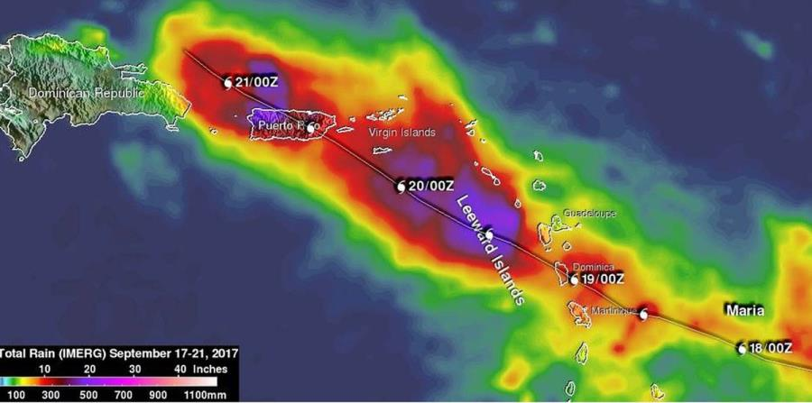
Hurricane María
Hit as a Category 4 storm on Sept. 20 with winds of up to 154 mph.
Most intense hurricane that has made landfall in Puerto Rico since the Great Depression.
Knocked out power for the whole island and caused damage estimated at more than $100 billion.
Estimated number of deaths is 1,065.

Slide 58
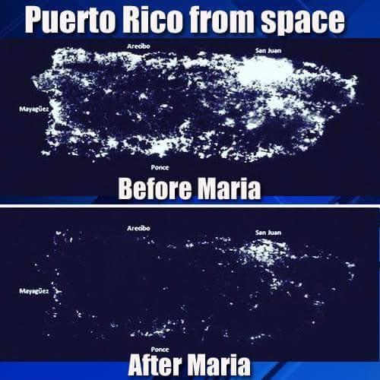

Slide 59
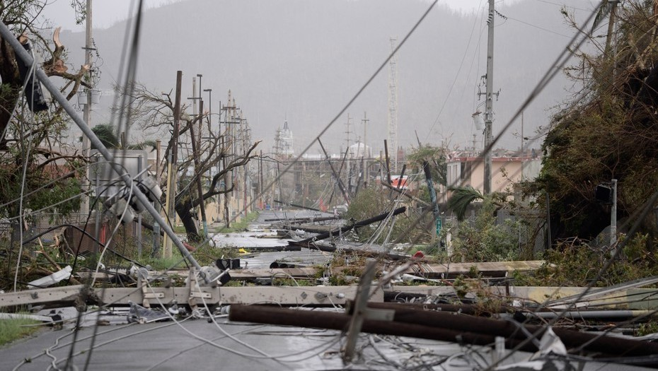
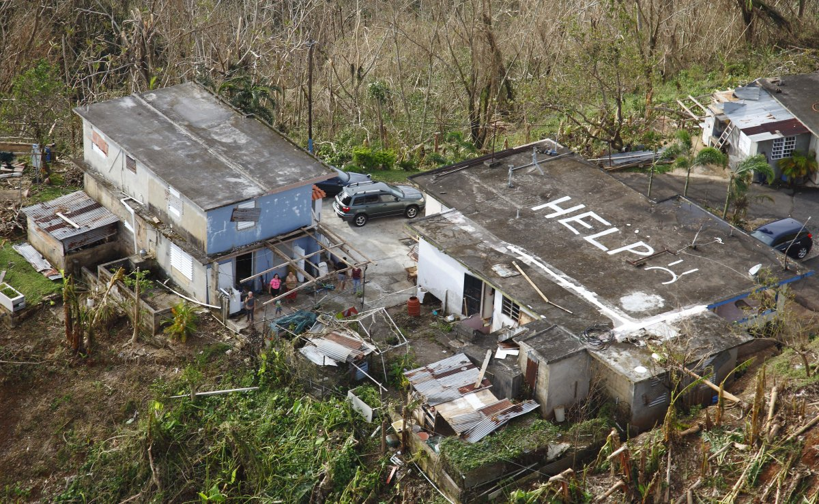
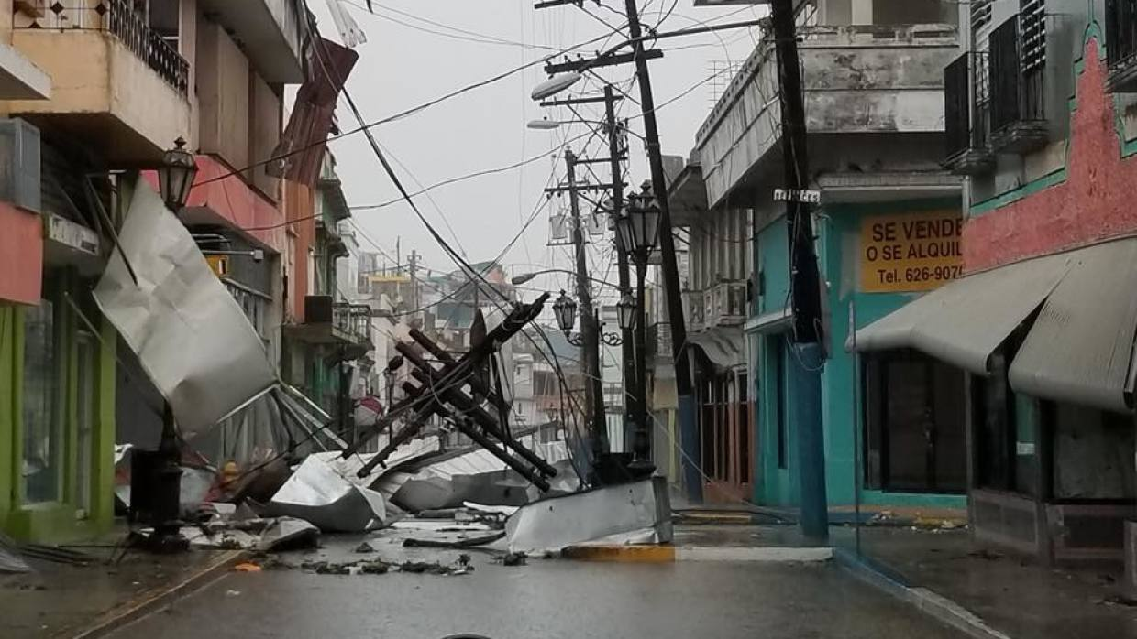
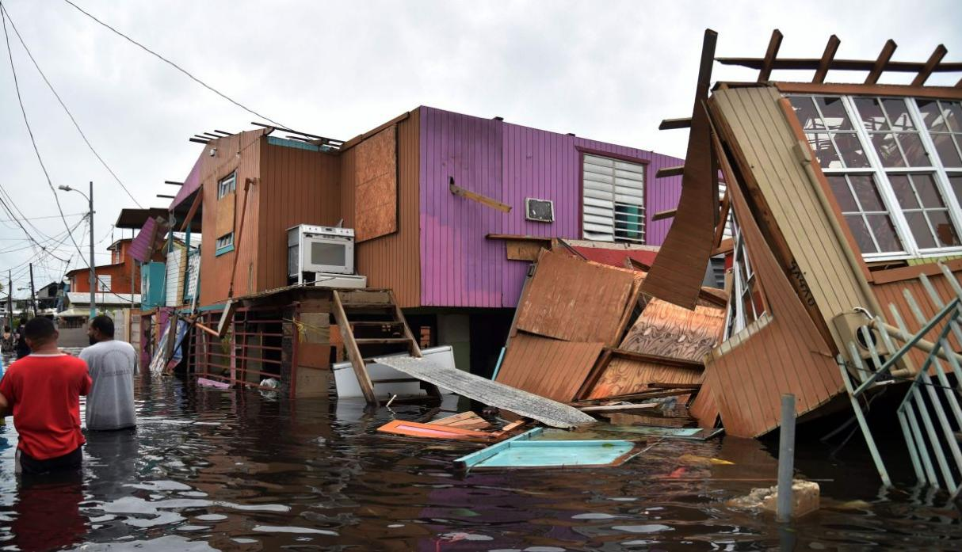

Slide 61
175 Days After Hurricane María (March 4, 2018)
88.30% Power Generation
89.43% Power Consumption
(Around 165,412 people are still without power)
98.83% of the people have water service
98.50% of the telecommunication systems have been restored
65 people are still living in shelters
Information provided by PREPA (Puerto Rico Electric Power Authority) and status.pr website

Slide 62
Hurricane María Main Effects
Loss of food / In need of nutritional assistance
Structural damages to house
Damage to house outdoors
Loss of furniture and/or appliances
Loss of personal belongings
No access to house/Homeless
Flooding
Damages to car / Problems with transportation
Loss of trees and agriculture products
Total loss
Lack of electricity, water, cell phone or internet service
Difficulty in communicating with family, friends and co-workers.
Long lines to get gasoline or cash
Lack of food
Children were not able to go to school
There was a sense that things are not progressing
Unemployment
Massive migration to the US
Limited access to work location
Information collected by PathStone Corporation in the assessments distributed to staff, participants, growers, and providers.

Slide 63
Grower Assessments
Economic Loss:
$5,000 - $50,000
$100,001 - $250,000
$250,001 - $500,000
$50,001 - $100,000
Over $500,000
Don't know
Under $5,000
Total of 6 growers
Total of 44 growers
Total of 16 growers
Total of 38 growers
Total of 27 growers
Total of 10 growers
Total of 20 growers

Slide 64
Grower Assessments
Insurance:
Impact in the Workforce:

Slide 65
Challenges Continue…
Exodus from Puerto Rico is growing every day
“The government of Puerto Rico’s guess is that by the end of 2018, 200,000 more residents will have left the U.S. territory for good, moving to places such as Florida, New York, Texas, Pennsylvania, New Jersey and New England. It would mean another drop of more than 5 percent in the island’s population.”

Slide 66
Steps taken by PathStone after Hurricane María
Step #1 – Assess the situation and make a plan
Assessments Design
Assessments Distribution
Assessments Collection
Reports Preparation
Follow Up
Staff
Participants
Growers

Slide 67
Steps taken by PathStone after Hurricane María
Step #2 – Making a difference with data
Food Boxes Preparation and Distribution
Community Visits
Applying for new funds in order to assist more families

Slide 68
Food Boxes Distribution ROUND #2

Slide 69
Relief Effort Activities
Over 2,000 Food Boxes
Generators Loaned
400 Water Filters
420 Solar Lights
120 Gas Stoves
Housing Rehabilitation
Micro Loans or Grants to Small Businesses

Slide 70
Food Distribution Activities
29 Municipalities Impacted
Over 2000 Families Served
Over 6000 Individuals Served

Slide 71
Community Laundry
More than 200 families from the community of Río Prieto in Yauco benefitted from this initiative. They also received solar lights and food boxes.

Slide 72
Partnerships

Slide 73
Objectives Accomplished:
Understood the impact of natural disasters on:
Farmworkers;
Agriculture; and
Farmworker service providers.
Heard how NFJP grantees responded to the disaster.
Identified lessons learned.

Slide 74
Common Lessons Learned:
Key Partnerships and farmworker needs
Need for employment and wrap-around services
Develop disaster preparedness plan with contingencies for loss of communication, electricity, and transportation
Transition software & technology to cloud based systems, if possible

Slide 75
Common Lessons Learned:
Remote services
Consider safety and wellness of agency staff
Use trauma informed care when addressing the needs of both staff and participants/customers

Slide 77
State Monitor Advocate
https://www.doleta.gov/programs/msfw.cfm
Emergency Partners Information Connection (EPIC)
The Center for Disease Control’s network, EPIC, partners with a broad array of organizations to exchange information that helps people stay safer and healthier during a public health emergency
https://emergency.cdc.gov/epic/
Agriculture Connection
The Agricultural Connection provides a collection of workforce information and technical assistance resources that support career services and training for migrant and seasonal farmworkers (MSFWs).
https://farmworker.workforcegps.org/

Slide 78
Part II Disaster Preparedness and Response: Serving Farmworkers
Part II of this series focuses on partnerships and resources. Participants will walk away with tangible next steps.
May 31, 2018

Slide 79
Gerald Williams
Coordinator-Workforce Education
Immolkalee Technical College
williage@collierschools.com
(239) 377-9906
Stacey Taylor
Executive Director
MET, Inc
taylor@metinc.org
(832) 432-7182

Slide 80
Paul Castro
Director, Farmworker Services and Workforce Development Division
California Human Development
paul.castro@cahumandevelopment.org
(916) 371-8220
Norma Garcia
Special Programs Manager
California Human Development
Norma.Garcia@cahumandevelopment.org
(707) 523-1155

Slide 81
Albert Rivera
Regional Administrator
PathStone Corporation
arivera@pathstone.org
787-947-6590
Brenda Lee Soto Colón
Director of Internal Quality Control
PathStone Corporation
bsoto@pathstone.org
787-812-4252

