Slide 1
Measuring the Impact of Adult Education & Training Programs
High Impact Partners on behalf
of the Employment and Training
Administration, DOL
May 22, 2018

Slide 2
Gregory Scheib
Workforce Analyst, U.S. Department of Labor
Employment and Training
Administration

Slide 3
Grantee Polling Question
Let’s get to know who is on the call today. Using the poll, select the role that you play in your America’s Promise grant
Choose the answer that best reflects you (or your group):
Authorized Representative
Program Director/Manager
Training Partner
4. Employer Partner
5. Service Provider
6. Other (please specify!)

Slide 5
Louise Anderson
Senior Associate, Managing Editor
International Economic Development Council

Slide 6
Emily Bell
Senior Director, Professional Development
International Economic Development Council

Slide 7
Overview of the IEDC’s training and certification program
Understanding the importance of needs identification
Why measuring impact is vital to ensure program sustainability
Ensuring proper programmatic oversight
Adjusting curriculum

Slide 8
Overview of IEDC
www.IEDConline.org
www.RestoreYourEconomy.org

Slide 9
About IEDC
Oldest, largest association for the economic development profession – roots go back 92 years
5,200+ members in 50 states, 5 U.S. territories,
19 countries
Non-profit 501(c)3 based in Washington DC
Mission: to help people involved in economic development do their jobs more effectively
When we succeed, economic developers help to create and retain jobs, and improve the quality of life in their communities
Knowledge-sharing: training, certification, accreditation of economic development organizations, 4 conferences annually, webinars, research, technical assistance, awards program.
We also have a national think tank of 65 that sets the research agenda

Slide 10
IEDC’s Training & Certification Program
Created to establish a baseline level of knowledge in the economic development profession
4 core courses, 9 electives based on the board level identification of necessary competencies of the profession
At least 25 courses throughout North America educating 1,200 people annually

Slide 11
IEDC’s Training & Certification Program
Training courses serve as a base requirement for the Certified Economic Developer (CEcD) exam
However, the primary goal is education of the profession (not creating CEcDs)
Other requirements are:
4 years full-time economic development experience
Attendance at a ‘Preparing for the CEcD Exam’ workshop

Slide 12
How America’s Promise Programs Can Use this Information
Keys to developing the right curriculum
Understanding what makes an effective training program
How evaluation fosters improvement
The importance of oversight/reporting

Slide 13
Identifying Needs

Slide 14
Are You Teaching the Right Things?
Long before you begin measuring, you must develop curriculum
Your first step: Market Research
Gap Analysis
Needs Assessment

Slide 15
Gap Analysis/Needs Assessments
You can assess the training needs of your community in several ways:
Individual interviews
Focus groups
Surveys
Observations

Slide 16
Effective Training Programs

Slide 17
Effective Training Programs
What are some characteristics of
effective adult training/education programs?

Slide 18
Some Strategies to Ensure Effectiveness
Train the trainers
Hold meetings with trainers across discipline throughout the year
Courses are taught by professionals working in the field and are practical – not academic
Focus on case studies, group work and peer-to-peer learning

Slide 19
Measuring Impact

Slide 20
How are you currently measuring the impact of your programs?
Survey
Interview
Skills testing
Other

Slide 21
Measuring Impact
It is important to measure programmatic impact on both the micro and macro scale
Macro:
Entire Training Curriculum/Training
Strategy
Micro:
Individual Courses/
Trainings

Slide 22
How to Measure Impact
Qualitatively
Is the content quality meeting the needs of the audience?
Quantitatively
Are you meeting attendance/graduation goals?
Are you meeting budget goals?
Skills testing/certification
Once training is complete, can participants demonstrate their skills?

Slide 23
Qualitative Measurement
Easiest to find this out via survey directly following a session
Can range from customer satisfaction with staff interaction, facilities ratings, and very specific instructor/content related questions

Slide 24
Examples of Qualitative Questions
Please rate the overall course
Was the instructor knowledgeable about the subject?
Did the instructor increase your knowledge of the subject?
Did the instructor facilitate group interaction?

Slide 25
Examples of Qualitative Questions
Would you recommend this training to a colleague?
Was this training useful to your professional development?
Will you take another IEDC training course?
Are you interested in certification?

Slide 26
Quantitative Measurement
Can help identify immediate budget and attendance goals but also long-term trends over time
Requires staff oversight to manage
Keeping records
Forecasting/budgeting for the future

Slide 27
Skills Testing & Certification
Demonstrates skills in a very tangible way to both internal and external audience
Helps both the program and individual gain credibility
Can be costly to manage
Need to consider continuing education for certification maintenance

Slide 28
IEDC’s CEcD Certification
CEcD Exam includes 3 parts:
Essay
Multiple Choice
Oral Interview
Why 3 parts?
The skills needed to pass all 3 are vitally important skills for economic developers to have: writing, critical thinking, communication

Slide 29
IEDC’s CEcD Certification
By offering the highly sought after and comprehensive CEcD designation, IEDC strives to promote the status and credibility, as well as enhance the knowledge and performance of economic developers.

Slide 30
Evaluating Training Strategy
Big picture training strategy should be discussed with instructors and oversight committees
Primary question: are we teaching the right skills based on data received?

Slide 31
Reporting & Oversight

Slide 32
Reporting
Once you have data, with whom do you share it?

Slide 33
Reporting
Internally: to help guide decision making and get internal buy-in
Staff leadership
Committees
Board of Directors
Externally: to help communicate your program’s value and neccessity
Wide reaching: community
Targeted: potential new recruits for program

Slide 34
Making Adjustments

Slide 35
Adjusting Curriculum
You will never be everything to everyone
As you go, you will notice things that can (and should) be changed or updated from time to time
Be mindful and strategic about how and when you make changes
Start this process at the staff level and then bring in your oversight committees
Have concrete recommendations before incorporating more people into the process

Slide 37
Emily Bell
Senior Director, Professional Development
International Economic Development Council
ebell@iedconline.org
(202) 942-9452

Slide 38
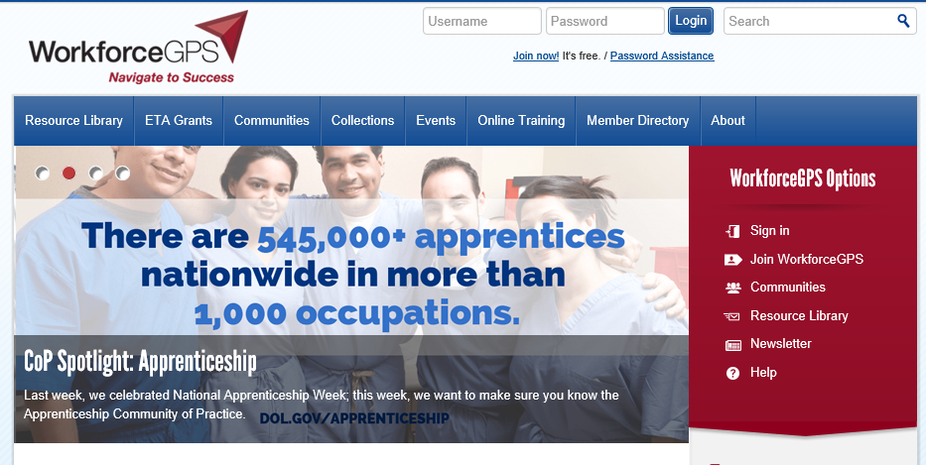
Register for the Community of Practice, get Connected!
https://h1bap.workforcegps.org/
.

Slide 39
More Technical Assistance
America’s Promise CoP
Resources, Blogs, Events, Community Discussions and more.
Next Webinar
Employer Panel
Industry Trends in Staffing Needs
June 19, 2018
1:00 – 2:30pm EST
Have more questions?
Contact your America’s Promise TA Coach

