Slide 1
Our Journey Together:
Building and Strengthening Partnerships to Best Serve Youth in Foster Care
May 22, 2018

Slide 2
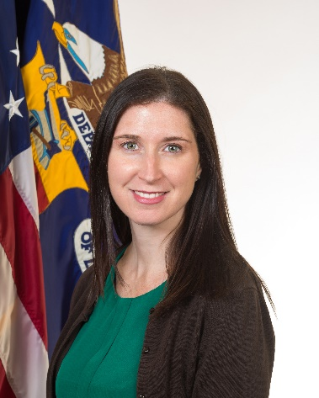
Sara Hastings
Unit Chief/Youth Policy and Performance
USDOL/ETA

Slide 3
Learn about Foster Care Month Resources
Debunking Myths about Serving Youth in Foster Care in the WIOA Youth Program
Learn from two state/local examples:
  Collaboration between Texas Workforce Commission (TWC) and Department of Family and Protective Services (DFPS)
  Child Welfare Services and WIOA in San Diego, CA

Slide 4
Catherine Heath
Children’s Bureau, Administration for Children and Families
Department of Health and Human Services
Taffy Compain, CPM
Children’s Bureau, Administration for Children and Families
Department of Health and Human Services

Slide 5


Jen Troke, Lanette Johndrow, and Ben Holquist, Texas Workforce Commission (TWC)
Gaye Vopat, Texas Department of Family and Protective Services (DFPS)

Slide 6


Krysta Esquivel, MSW
Executive Manager
YMCA Community Support Services
San Diego, CA
Sara Fox
Manager of Programs
San Diego Workforce Partnership
San Diego, CA

Slide 7




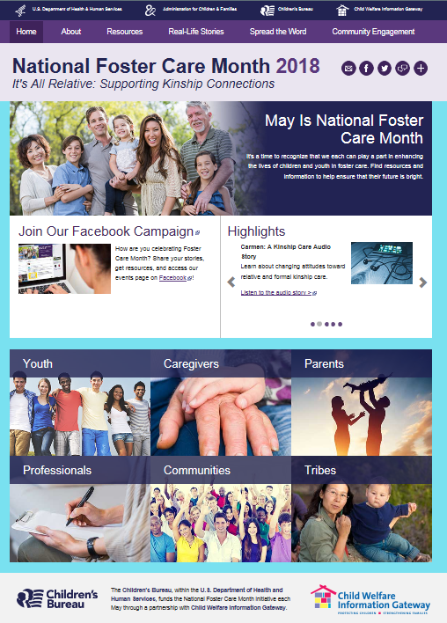




National Foster Care Month 2018
The purpose of National Foster Care Month is to bring awareness to the needs of children in foster care. During this month, we renew our commitment to ensure a bright future for the more than 430,000¹ children and youth in foster care, and we celebrate all those who make a meaningful difference in their lives.
The Children's Bureau, together with its partners, supports National Foster Care Month through a website developed with Child Welfare Information Gateway.
www.childwelfare.gov/fostercaremonth
1 U.S. Department of Health and Human Services, Administration for Children and Families, Administration on Children, Youth and Families, Children's Bureau. (2017). Preliminary estimates for FY 2016 as of October 20, 2017 (24). Retrieved from https://www.acf.hhs.gov/cb/resource/afcars-report-24
It’s All Relative: Supporting Kinship Connections
National Foster Care Month 2018

Slide 8
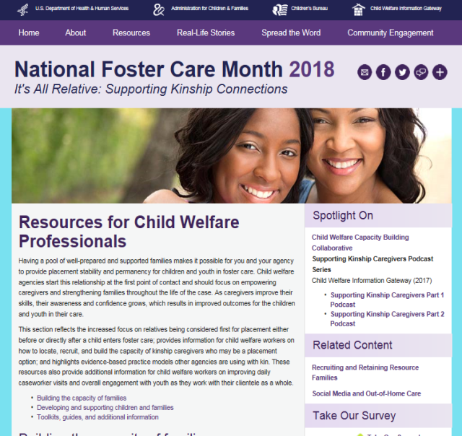


National Foster Care Month 2018
Resources for Child Welfare Professionals
The 2018 website features an array of resources that support this year’s theme, “It’s All Relative: Supporting Kinship Connections.”
The Resources for Child Welfare Professionals section reflects the increased focus on relatives being considered first for placement either before or directly after a child enters foster care. This section also provides information on:
  How to locate, recruit, and build the capacity of kinship caregivers who may be a placement option
  How to improve caseworker visits and overall engagement with youth
  Evidence-based practice models agencies are using with kin
It’s All Relative: Supporting Kinship Connections
National Foster Care Month 2018

Slide 9
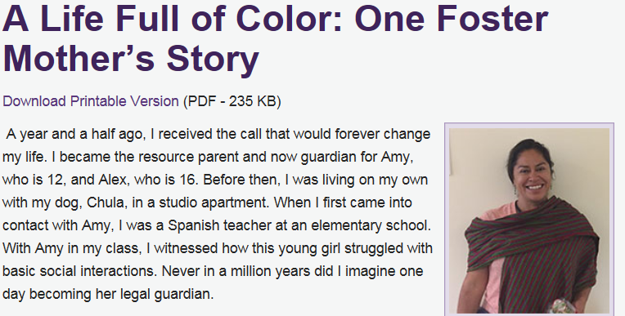
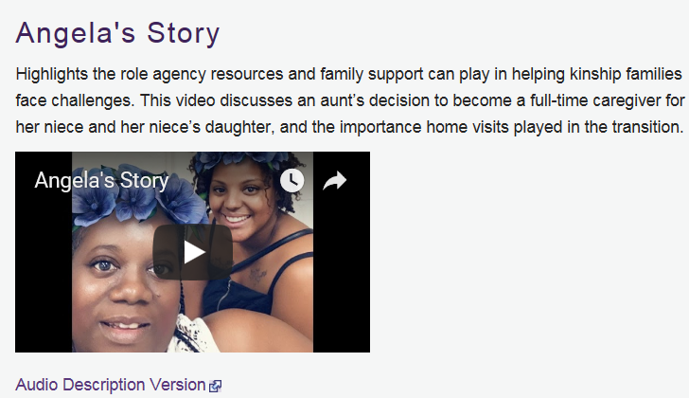
National Foster Care Month 2018
Real Life Stories: Narratives and Videos
  The 2018 website features 23 narrative stories, 15 videos, and one audio story from caregivers and professionals across the country.
  These inspiring stories are a powerful way to connect real life to important practice issues, and can be used as tools for training new child welfare professionals, recruiting and training foster parents, and in State and local National Foster Care media and awareness campaigns.
It’s All Relative: Supporting Kinship Connections
National Foster Care Month 2018

Slide 10
Youth in foster care cannot be served in the WIOA Youth program?
True
False

Slide 11
Youth in Foster Care CAN be Served in the WIOA Youth Program
Youth in foster care (both in-school and out-of-school youth) are eligible to be served in the WIOA Youth Program.
One of the barriers included in the WIOA Youth Program definition of both ISY and OSY is:
  “an individual in foster care or who has aged out of the foster care system or who has attained 16 years of age and left foster care for kinship guardianship or adoption, a child eligible for assistance under sec. 477 (the John H. Chafee Foster Care Program for Successful Transition to Adulthood (the Chafee program)) of the Social Security Act (42 U.S.C. 677), or in an out-of-home placement.”
Many youth in foster care fall into the category of OSY, and local areas have up to 25% of funds that can be spent on eligible ISY.

Slide 12
Extended foster care or state subsidy program Requirements
Extended foster care (and most state subsidy programs) require the youth to meet educational or employment conditions
Requirements include:
  1. Completing secondary education or a program leading to an equivalent credential, e.g., a youth age 18 and older is finishing high school or taking classes in preparation for a general equivalency diploma exam. (For WIOA Youth program eligibility purposes, those in high school at time of enrollment would be considered ISY. Those taking high school equivalencies may be considered OSY at time of enrollment)

Slide 13
Extended foster care or state subsidy program Requirements (cont’d)
Requirements (cont’d):
  2. Enrolled in an institution which provides post-secondary or vocational education e.g., a youth could be enrolled full-time or part-time in a university or college, or enrolled in a vocational or trade school. (For WIOA Youth program eligibility purposes, those engaged in this activity at time of enrollment would likely be considered ISY)
  3. Participating in a program or activity designed to promote, or remove barriers to employment e.g., a youth could be in Job Corps or attending classes on resume writing and interview skills. (For WIOA Youth program eligibility purposes, those engaged in this activity at time of enrollment would likely be considered OSY)

Slide 14
Extended foster care or state subsidy program Requirements (cont’d)
Requirements (cont’d):
  4. Employed for at least 80 hours per month e.g., a youth could be employed part time or full time, at one or more places of employment. (For WIOA Youth program eligibility, those engaged in this activity at time of enrollment and also not enrolled in high school or postsecondary education would likely be considered OSY)
  5. Is incapable of doing any of the previously described educational or employment activities due to a medical condition. (For WIOA Youth program eligibility purposes, those not engaged in educational or employment activities at time of enrollment would likely be considered OSY)

Slide 15
Collaborating for Success: Youth in Foster Care Are A Texas Priority

Slide 16
History of collaboration between Texas Workforce Commission (TWC) and Department of Family and Protective Services (DFPS)
  Local Workforce Development Boards (WDBs) and Transition Centers
  TWC Guidance
Local Partnership Model
  WDBs Activities
  Workforce Advocate Activities
Initiatives and benefits stemming from collaboration:
  Foster Youth Education Pilot
  Statewide Foster Youth Conference
  Improved Employment Outcomes
  New Legislation

Slide 17
Network of Support in Texas
Workforce Development Boards and
Workforce Solutions Offices
28 locally representative Workforce Boards covering all of Texas
Oversee approximately 200 Workforce Solutions Offices in 28 workforce areas that manage direct services to youth in foster care
Funded by WIOA, TANF, state and local funds
Services include:
  Job placement (Work In Texas.com)
  Training programs
  Career exploration
  Resume writing
  Interview skills
  Career development
  Childcare
  Transportation

Slide 18
Texas Transition Centers
18 one-stop centers statewide
Independently funded and operated and supported through partnerships with DFPS, their providers, community partners and Texas Workforce Commission.
Serve current and former youth in foster care, homeless youth and other at risk youth.
Services may include employment assistance, educational support, food and housing assistance, substance abuse/mental health services, access and referrals to community partners.
Co-location for partners such as Workforce Solutions staff, Workforce Advocate, college and university staff.
Many contract with DFPS to provide federal Chafee funded independent living services such as life skills training classes, case management and financial assistance such as After Care Room and Board.

Slide 19
History of Guidance
2004 – TWC issues first guidance letter, emphasizing foster youth as a priority population and advocating for collaboration between WDBs and local transition centers
2011 – TWC issues additional guidance mandating MOUs and further clarifying foster youth priority (over all recipients except veterans)
2016 – TWC funds Workforce advocates at all foster youth transition centers in Texas

Slide 20
WD 43-11 Priority of Service for Eligible Foster Youth
  Directive to prioritize foster youth for workforce center services (2011/Currently in review for 2018 update)
    http://www.twc.state.tx.us/files/partners/43-11.pdf
WD 38-11 Change 1 MOU with DFPS to Serve Foster Youth
  Directive to establish MOUs and formal partnerships with DFPS (2011)
    http://www.twc.state.tx.us/files/partners/38-11c1.pdf
WD 31-04 Coordination of Services to Foster Youth
  Directive to inform local workforce boards about the needs of foster youth (2004)
    http://www.twc.state.tx.us/files/partners/31-04.pdf
TAB 274 Coordination of Services to Foster Youth
  Technical and interpretive details regarding implementation of 38-11 and 43-11 (2016)
    http://www.twc.state.tx.us/files/partners/tab-274-twc.pdf

Slide 21



Local Partnership Model
Liaisons
@ Local Workforce Solutions Offices
Workforce Advocates @
Local Foster Youth Transition Centers

Slide 22
How the Collaboration Works
Workforce Board
Transition Center
Prioritize youth in foster care for employment and training, and support services for both current and former youth in foster care
Designate a point of contact, or liaison, at the Board and at each Workforce Solutions office
Ensure coordination of local services for foster youth with local Workforce Solutions offices
Hire a Workforce Advocate (funded by TWC) that will be housed at the transition center to facilitate access to available local services for transitioning youth in foster care

Slide 23
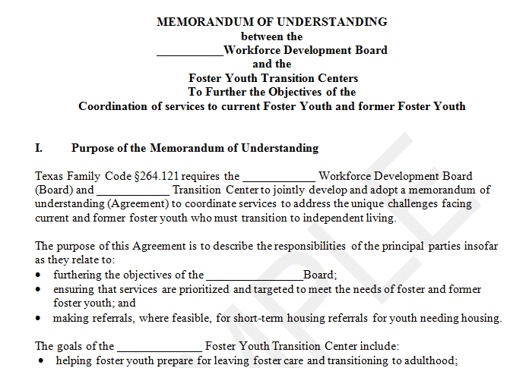
Sample MOU

Slide 24
Workforce Advocate Activities
Continuous Communication: Works with workforce board/workforce solutions offices and DFPS Case Manager to ensure individualized service plan is effective
Mobility: Ensures youth have transportation for appointments
Resource leveraging: Coordinates local services to achieve successful outcomes

Slide 25
Foster Youth Education Pilot
Foster Youth Dropout Prevention and Recovery High School Completion Pilot Program - Approximately $1,500,000 awarded to 4 grant recipients (3 are ISDs)
Designed to help current and former youth in foster care ages 16 to 25 earn a high school diploma or its equivalent, and obtain high-demand workforce skills with the goal of ensuring a pathway to postsecondary education or employment in high-demand occupations
2016 Tri-Agency commitment to guiding foster youth into higher education – partnership among Texas Education Agency (TEA), Texas Higher Education Coordinating Board (THECB), and TW

Slide 26
Texas Statewide Youth in Foster Care Conference
Supports the partnerships between Transition Centers, Workforce Development Boards, Community Colleges, Schools, and Industry
Supports local delivery of integrated services for youth in foster care
Share evidence based tools, practices and resources
Provide an opportunity to build the network of partnerships

Slide 27
National Youth in Transition Database (NYTD)
Employment Outcomes for Texas Foster Youth and Young Adults (Survey)
  Age 17: Anytime in a lifetime
  Age 19 and 21: In the last two years (random selection of youth surveyed at age 17)
Cohort 1 | Cohort 2
Age 17 - 9% (FFY ‘11) | Age 17 - 13% (FFY ’14)
Age 19 - 31% (FFY ‘13) | Age 19 - 39% (FFY ’16)
Age 21 - 52% (FFY ‘15) | Age 21 - TBD (FFY ’18)

Slide 28
Texas Legislature…More Collaboration!
Senate Bill 1220
  Requires DFPS to collaborate with the Texas Education Agency, local workforce development boards and another appropriate workforce industry resources to create a program that assists youth in obtaining their HS/GED, industry certifications, provides career guidance and informs youth about the Texas tuition and fee waiver.
  https://capitol.texas.gov/BillLookup/History.aspx?LegSess=85R&Bill=SB1220
House Bill 1608
  Requires DFPS to establish a summer internship pilot program that provides youth with marketable job skills and professional work experience with a business, non-profit or governmental agency. May collaborate with other state agencies as appropriate.
  https://capitol.texas.gov/BillLookup/History.aspx?LegSess=85R&Bill=HB1608

Slide 29
Jen Troke, Lanette Johndrow, and Benjamin Holquist
  Workforce Grants and Contracts,
  Strategic Workforce Initiatives
    Texas Workforce Commission – www.twc.state.tx.us
      Jennifer.Troke@twc.state.tx.us; lanette.johndrow@twc.state.tx.us; Benjamin.Holquist@twc.state.tx.us
Gaye Vopat
  Transitional Living Services Team Lead
    Department of Family and Protective Services – www.dfps.state.tx.us
      Gaye.Voypat@dfps.state.tx.us

Slide 30
Regional Strategies for Leveraging Systems and Funding
The San Diego Story

Slide 31
Who is the San Diego Workforce Partnership (SDWP)
Region’s Workforce Development Board, designated by the City and County of San Diego
Funded by federal, state, county and city contracts, corporate support and philanthropy
Our mission is to empower job seekers to meet the current and future workforce needs of employers in San Diego County

Slide 32
WIOA Title I Adult, Dislocated Worker and Youth Formula Programs -
San Diego County
6 Comprehensive Career Centers that serve adults 18+
  1 funded adult provider
10 Youth Career Centers that serve out-of-school youth ages 16-24
  7 funded youth providers
5 Youth Career Centers that serve foster youth ages 14-24
  San Pasqual Academy (in-school foster youth)
  Independent Living Skills and Foster Youth Workforce Services (in-school and out-of-school foster youth)

Slide 33
Leveraging Funding
CONNECT2Careers a program of the SDWP that helps young adults secure employment using an online portal filled with thousands of local jobs and internship opportunities
  Provide in-person training opportunities
Since 2016, Health and Human Services Agency provides 50 7-week,120-hour paid internships per calendar year
  Primarily for youth enrolled in a funded WIOA program or foster youth connected with HHSA
  Positions are with the County of San Diego

Slide 34
Collaboration between SDWP and County of San Diego, Health and Human Services Agency (HHSA)
Since 2001, SDWP has invested workforce funds at San Pasqual Academy (SPA), is a first in the nation residential education campus designed specifically for foster teens
  SPA’s work-readiness and self-sufficiency program, “Youth Empowerment Services,” provides direct services to youth in financial literacy, leadership development, internships, career explorations and job placement

Slide 35
One Request for Proposal (RFP) = Collaboration
Joint procurement between County of San Diego, Health and Human Services Agency, Child Welfare Services and San Diego Workforce Partnership (SDWP)
  Collaboration between Independent Living Skills and WIOA Workforce Services
  1.7 million funding allocated per year to provide services to foster youth utilizing County and WIOA funding

Slide 36
Child Welfare Services + WIOA in San Diego
2007 combined WIOA + Chafee Independent Living services (ILS) to support 16-21 y/o child welfare involved youth
Designed to reduce duplication, leverage resources, and improve client supports
County administered, contracted to community-based non-profits by region
Service delivery model varies

Slide 37
Child Welfare + WIOA in San Diego
Tier I Services
Tier II Services
Traditional Independent Living Services
Life Skills Training (LST) 14-15 y/o
16-21 y/o
County Administered
Contract ILP services to community-based non-profits regionally
WIOA Funded through San Diego Workforce Partnership
16-24 y/o in-school and out-of-school
Subsidized employment
Traditional work-readiness themes

Slide 38

YMCA Connections: Economic Stability & Mobility
Relationships are healing
Brain science & Physiology
Focus on self-regulation to increase social networks and relational competencies
Work readiness training centered on self-regulation
Adapted Dialectical Behavior Therapy (DBT) intervention

Slide 39

YMCA Connections: Economic Stability & Mobility
Self Regulation: Act of managing thoughts & feelings in order to engage in goal directed actions
Organizing Behavior, Thoughts & Emotions
Constructive Problem Solving
Controlling Impulses

Slide 40
YMCA Connections: Work Readiness Curriculum
The Mindful Employee:
Personal brand, social media, digital footprint, what empowers and motivates them, giving and accepting feedback, and strategic sharing
Diversity & Non-Judgment:
Inclusion in the workplace, working effectively with people of various backgrounds, experiences, opinions and perceptions.
Thoughtful Decision Making:
Importance of critical thinking in order to make sound judgments and apply learning from one situation to another.

