Slide 1
Understanding and Applying Disability Data
May 23, 2018
1:00 – 2:15 PM EST

Slide 2
David Jones
Workforce Analyst
Employment and Training Administration (ETA)
U.S. Department of Labor

Slide 3
Understand disability employment trends:
at the national, state, and county-levels
across different disability types
existing technical assistance resources available
Apply disability data as a tool to:
improve customer service and advocate
maximize effective outreach

Slide 4
Debra Brucker
Research Assistant Professor
Institute on Disability
University of New Hampshire
William Erickson
Research Specialist
Yang-Tan Institute
Cornell University

Slide 5
Susan Dooha
Executive Director
Center for Independence of the Disabled in New York (CIDNY)
Joseph Hampton
Research Specialist
West Virginia Division of Rehabilitation Services (WVDRS)

Slide 6
Part I: Understanding Disability Statistics and Data

Slide 7
National, State, and County-Level Disability Data
Debra Brucker
University of New Hampshire

Slide 8
Background – University of New Hampshire
1a
Mission - University of New Hampshire (UNH) Institute on Disability
UNH receives funding from the National Institute on Disability, Independent Living, and Rehabilitation Research (NIDILRR) housed within the U.S. Department of Health and Human Services (HHS)
In February 2018, UNH released the 2017 Annual Disability Compendium
The Compendium pulls together disability statistics on a variety of topics from numerous federal agencies

Slide 9
Disability Survey Data Tools
1a
Many national household surveys now collect information about disability
Leading survey examples include the following:
American Community Survey (ACS)
Annual survey
Conducted by the U.S. Census Bureau (Census)
Gathers broad amount of data - Demographics, employment, housing, immigration data elements are some examples
Current Population Survey (CPS)
Monthly survey
Conducted by Census & DOL Bureau of Labor Statistics (BLS)
More detailed focus on economic measures - Employment, job search, and wages are some examples

Slide 10
National-Level Disability Data Overview

Slide 11
People with Disabilities Living in the Community as Percentage of U.S. Working-age Population, 2016
1a

Slide 12
Employment among Working-age Persons with Disabilities by Gender, 2016
1a

Slide 13
Percentage of Persons Aged 25 and Older with Different Levels of Educational Attainment by Disability Status, U.S., 2016
1a

Slide 14
Historical Trend of Percent of Working-Age Persons Employed in the U.S.
1a

Slide 15
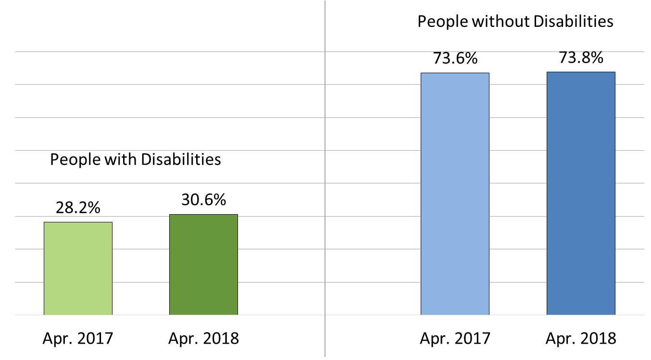
Employment-to-Population Ratio
1a
Up 8.5 percent …
2.4 points
Up 0.3 percent …
0.2 points

Slide 16
State-Level Disability Data Overview

Slide 17
Percent of Working-age Persons with Disabilities Employed by State, 2016
1a

Slide 18
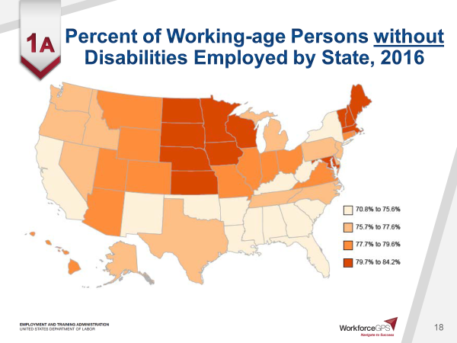
Percent of Working-age Persons without Disabilities Employed by State, 2016
1a

Slide 19
Gap of Percent Employed Among People with and without Disabilities by State, 2016
1a

Slide 20
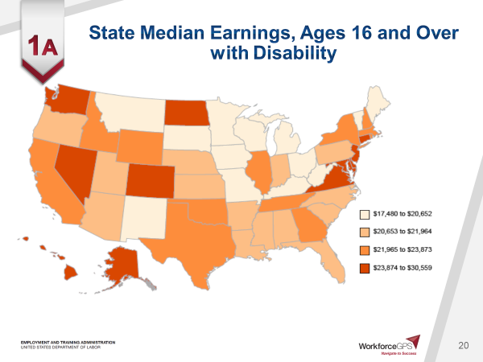
State Median Earnings, Ages 16 and Over with Disability
1a

Slide 21
County-Level Disability Data Overview

Slide 22
New Developments in Disability Tracking at the County Level
1a
University of New Hampshire recently released new reports at the county level focused on:
Disability Prevalence
Disability Employment
The county level reports can be found at the following link:
https://disabilitycompendium.org/county-reports

Slide 23
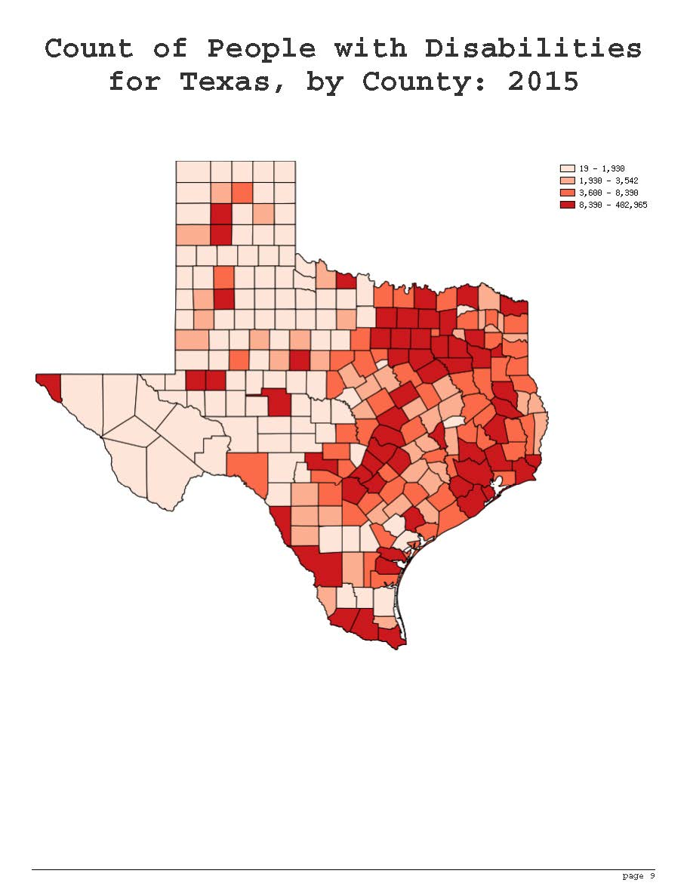
County-Level Data - Disability Tracking Overview
1a

Slide 24
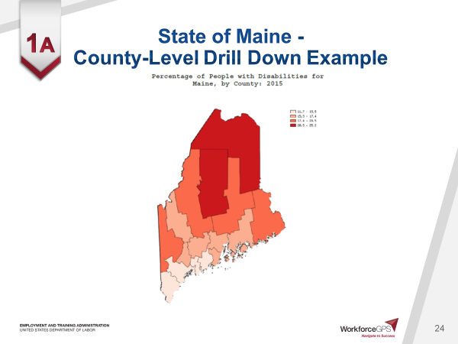
State of Maine - County-Level Drill Down Example
1a

Slide 25
Annual Compendium of Disability Statistics
National, state, and county-level data on prevalence of disability as well as educational attainment, employment, health, receipt of public disability benefits, and poverty among persons with and without disabilities.
www.disabilitycompendium.org
National Trends in Disability Employment (nTIDE)
Monthly webinar and press release issuance with updated national statistics on labor force participation and employment for disability population.
www.researchondisability.org/nTIDE
Technical Assistance Support
University of New Hampshire (UNH) is available to provide specific employment statistics of interest to help meet your needs.
Contact UNH by phone (866) 538-9521 or email disability.statistics@unh.edu

Slide 26
Disability Type Trends
William Erickson
Cornell University

Slide 27
Background – Cornell University
1b

Slide 28
Background – Cornell University
1b
Yang-Tan Institute on Employment and Disability
Originally founded in the 1960’s
Over 50 staff, very multi-disciplinary
Our mission is to advance knowledge, policies and practice to enhance equal opportunities for all people with disabilities.

Slide 29
YTI Disability Statistics
1b
Disability statistic focus initially began with an Department of Education (NIDRR) grant in the early 2000s.
Produce the Annual Disability Status Report series
Created DisabilityStatistics.org as a conduit to provide easy access to information regarding disability statistics.
DisabilityStatistics.org has been the top result on Google searches for disability statistics for over 15 years

Slide 30
Defining Disability Types

Slide 31
Defining Disability in the ACS
1b
Disability is defined by reporting one or more of the six disability types:
Visual
Hearing
Ambulatory
Cognitive
Self-Care
Independent Living

Slide 32
Breaking Down Disability: by Type and Age

Slide 33
Prevalence Rate by Type of Disability (Ages 21-64)
1b
Note: Respondents can report more than one disability type

Slide 34
Prevalence Rate by Age
1b

Slide 35
Prevalence Rates by Type & Age

Slide 36
Veterans with a Service-Connected Disability* (Civilian Vets ages 21 to 64)
*A "service-connected" disability is one that has been determined by the Department of Veterans Affairs (VA) as being a result of disease or injury incurred or aggravated during military service. Note that a veteran with a service-connected disability may not report having one of the six ACS functional or activity limitation disabilities.

Slide 37
Do Economic Outcomes Differ by Disability Type?

Slide 38
Employment Rates by Disability Type (Ages 21-64)
1b

Slide 39
Full-Time/Full-Year Employment Rates by Disability Type (Ages 21-64)
1b

Slide 40
Full-Time/Full-Year Employment Median Earnings by Disability Type (Ages 21-64)
1b

Slide 41
Poverty Rates by Disability Type (Ages 21-64)
1b

Slide 42
Poverty Rate: 2008-2016 (Ages 21-64)
1b

Slide 43
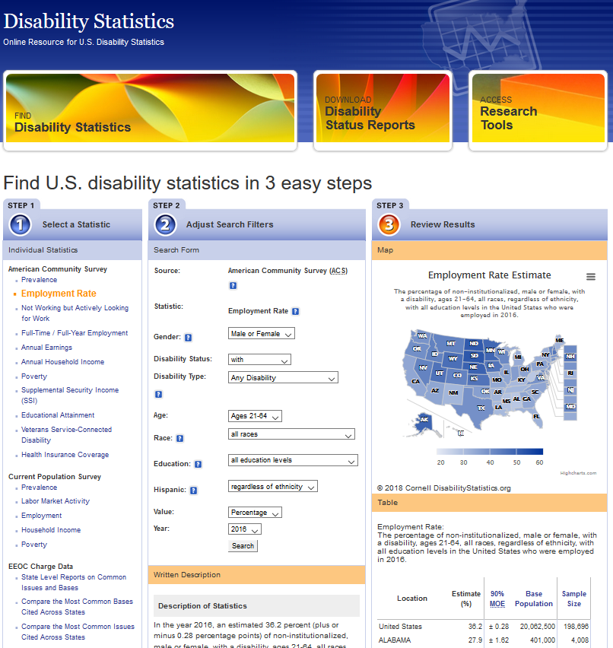
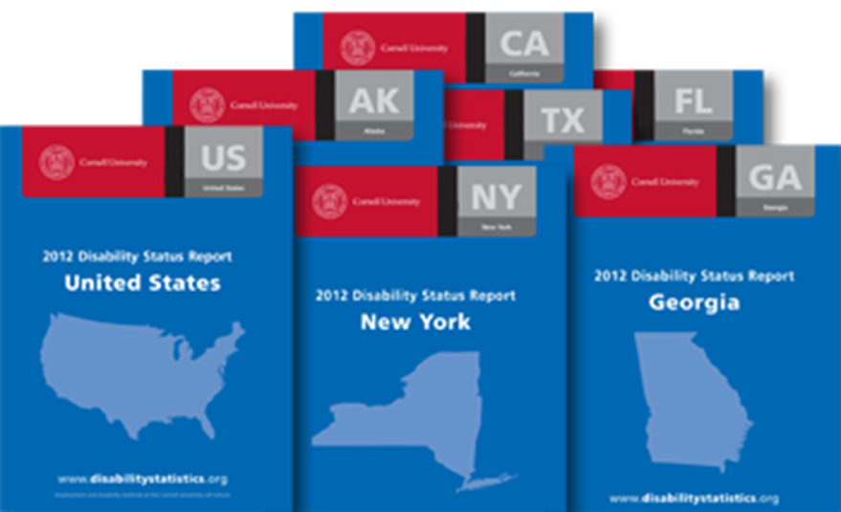
DisabilityStatistics.org
User & mobile friendly interactive online interface
DisabilityStatistics.org
Disability Status Reports
Concise annual ACS based national and state level reports covering the following topics:
Prevalence (by race, gender, ethnicity, age)
Economic situation (employment, income, poverty etc.) of the working-age population
DisabilityStatistics.org
Technical Assistance
Contact us with any additional questions regarding disability statistics or disability data sources at this address:
DisabilityStatistics@cornell.edu

Slide 44
Which state has the lowest prevalence of disability among the working age population according to the 2016 ACS? (Choose 2)
New Jersey
Hawaii
Nevada
Kentucky
West Virginia

Slide 45
Which state has the lowest prevalence of disability among the working age population according to the 2016 ACS?
New Jersey – 8% (Two Correct Answers – A tie!)
Hawaii – 8%
Nevada – Median at 11.4%
Kentucky – 17%
West Virginia – 18.5%

Slide 46
Part II: Applying Disability Data

Slide 47
Disability Data Matters!
Susan Dooha
Center for Independence of the
Disabled in New York (CIDNY)

Slide 48
Background - CIDNY
2a
CIDNY Mission:
Ensure full integration and equal opportunity for all people with disabilities by removing barriers to social, economic, cultural, and civic live of the community.
CIDNY serves people with disabilities throughout New York City who experience disparities in education, employment, and income/poverty.

Slide 49
A Common Focus with the American Job Center Network
2a
CIDNY has a similar joint customer focus with the American Job Center network to:
Support individuals with disabilities who seek employment;
Provide counseling regarding the impact of work on disability benefits;
Skill building workshops including resume development and interview skills; and
Identify learning opportunities and provide support for seeking educational opportunities.

Slide 50
Tracking Key Indicators
2a
To fully understand the needs and barriers of people with disabilities living in NYC, CIDNY monitors the following three indicators:
Education Attainment Levels
Employment Rate
Income and Poverty

Slide 51
Education – New York City (NYC)
2a
In NYC, there is an education gap between people with and without disabilities:
17.1 percent high school education gap
16.4 percent college graduation gap
CIDNY has observed that the above gaps are wider than the gaps at the State and national level.

Slide 52
Employment Rate – New York City (NYC)
2a
In NYC, the employment rate of people with disabilities is 29.1 percent. This percentage is the lowest compared to other regions of the state.
Amongst the five NYC boroughs, the Bronx Borough had the lowest employment rate at 24.1 percent.
In NYC, there is an employment rate gap of 41.2 percent between people with and without disabilities.

Slide 53
Employment Rate – Applying Visuals to Compare
2a

Slide 54
Income and Poverty – New York City (NYC)
2a
In NYC, CIDNY has observed that people with disabilities are often segregated into very low-wage occupations.
In NYC, there is a poverty gap of 19.9 percent between people with and without disabilities.

Slide 55
Poverty Gap in the Bronx Borough– Applying Visuals
2a

Slide 56
Applying the Data to Increase Awareness and Advocate
2a
CIDNY collected data to help educate the public and policy makers at the city and state level through the following publications:
Disability and Poverty Zip Code Chart (2016);
ADA at 26 Report (2016);
ADA at 25 Report (2015);
Disability Agenda for a new Mayoral Administration (2013); and
Disability Matters (2011)

Slide 57
Applying the Data to Increase Awareness and Advocate
2a
CIDNY provided data to agencies to help change policies and improve services:
New York State Rehabilitation Council used income and poverty data to inform its discussions and to educate the public (2011);
New York State Medicaid Redesign Team Work Group used data to support employment proposals (2017); and
Metropolitan Transportation Authority learned about the placement of inaccessible subways in high disability-density communities as a barrier to employment (2018).

Slide 58
Using Disability Data and Geographic Information Systems to Identify Potentially Underserved Areas
Joseph Hampton
West Virginia Division of Rehabilitation Services

Slide 59
Background- West Virginia Division of Rehabilitation Services (WVDRS)
2b
WVDRS is a state-federal vocational rehabilitation agency.
Provide services to individuals with disabilities to enable them to gain or maintain employment.
Served 12,283 in FY 2017
Enabled and empowered 1,671 individuals with disabilities to achieve an employment outcome in FY 2017

Slide 60
Comprehensive Statewide Needs Assessment (CSNA)
2b
Required to conduct a CSNA every three years.
One objective of the CSNA:
Assess the rehabilitation needs of individuals with disabilities who are minorities and individuals with disabilities who have been unserved or underserved by the vocational rehabilitation program.
How to identify individuals who are minorities AND who have been unserved or underserved?

Slide 61
Demographics – West Virginia
2b
The West Virginia landscape:
Very Rural State - Over 50 percent of the population lives in rural area
Small percentage of minority residents - Approximately 6 percent of West Virginia residents are non-white
Members of WVDRS staff published 2012 study in Journal of Rehabilitation Administration:
“Maximizing Needs Assessment Outcomes for Public VR Programs: Using GIS to Reach Consumers from Minority Backgrounders”

Slide 62
Geographic Information Systems (GIS) and Disability Data
2b
GIS
Software that gathers, manages, analyzes, and visually displays data
Very helpful for quantitative and spatial analyses
GIS Examples
Data sources used by WVDRS for minority outreach:
US Census
Zip code and block group level
US Postal Service
Every Door Direct Mail, mailing routes
WVDRS
Current and past clients’ zip code of residence

Slide 63
Using GIS to Conduct Effective and Efficient Minority Outreach
2b
Unserved area is defined as a zip code with 100 or more minority residents and zero minority WVDRS consumers in the previous three years.
Identify zip codes with WVDRS consumers who are minorities
Identify zip codes with 100 or more minority residents
Refine areas within each identified zip code
Identify mailing routes of the refined zip code

Slide 64
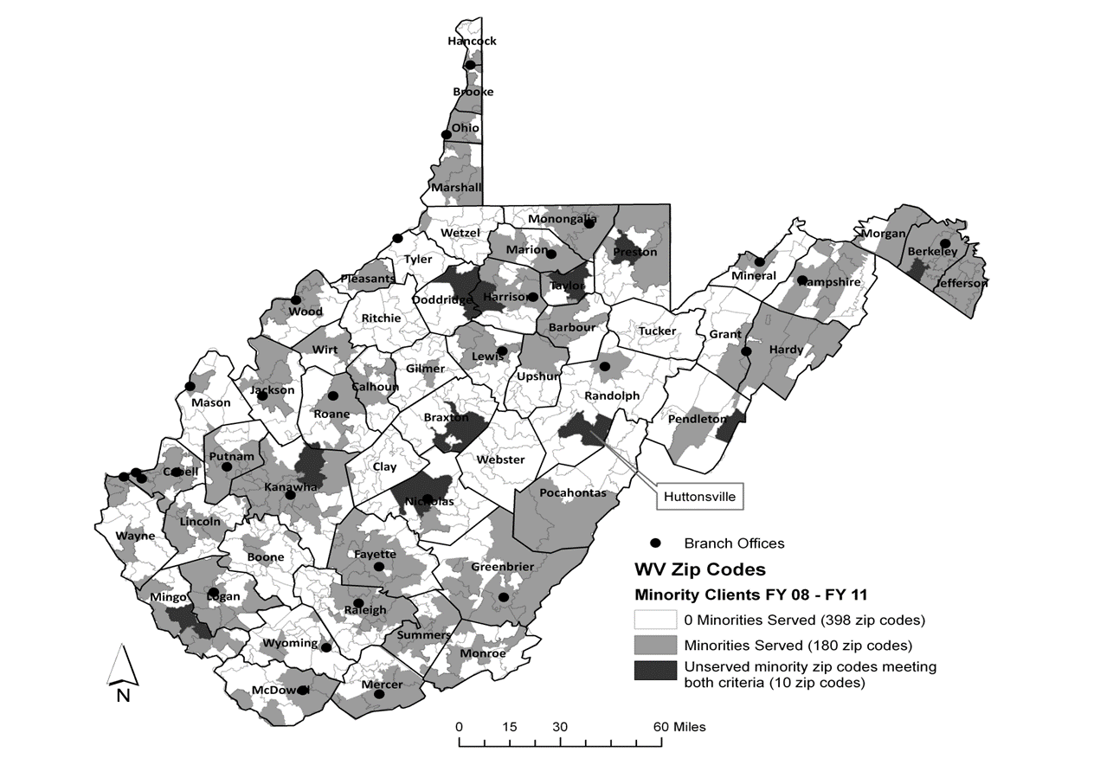
West Virginia Zip Codes with Client and Population Data
2b

Slide 65
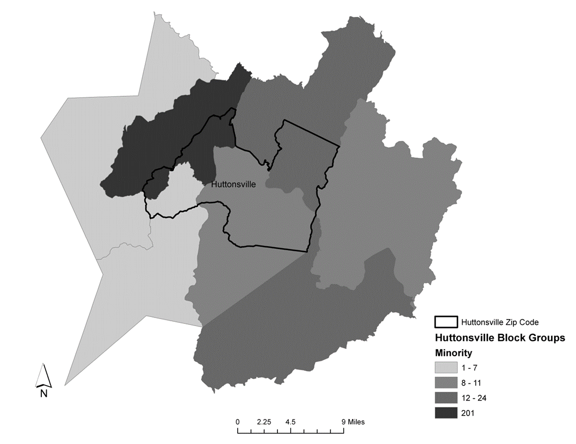
Zip Code and Census Block Areas
2b

Slide 66
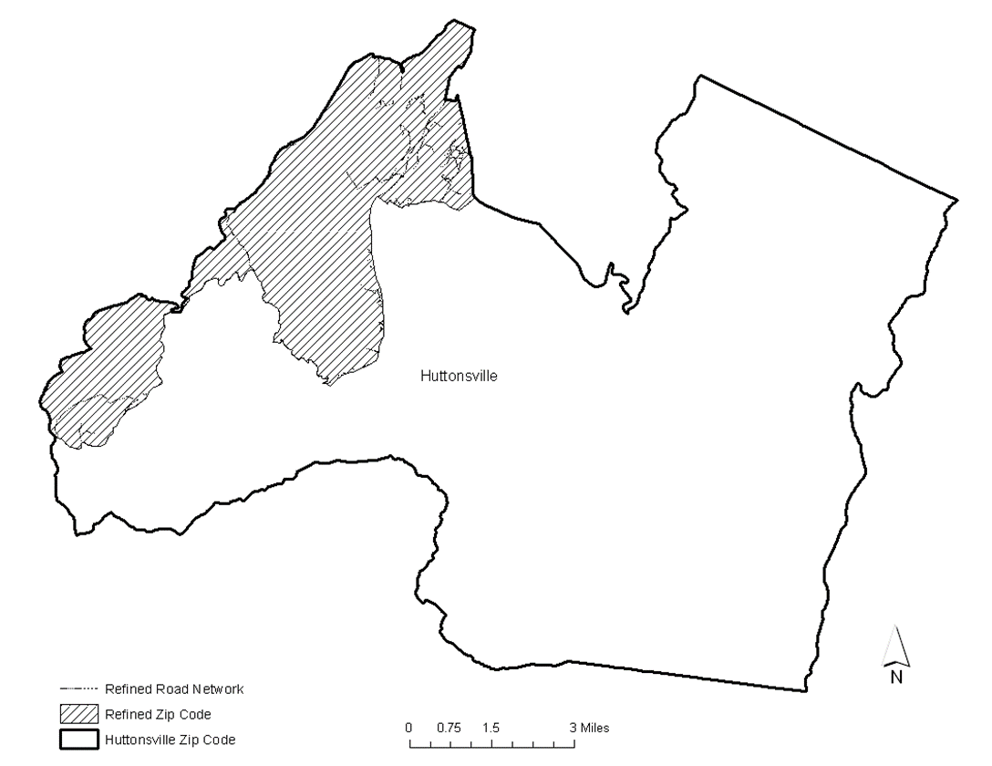
Refined Zip Code
2b

Slide 67
Cost-savings to WVDRS
2b
Zip Code | Refined Zip Code ($) Entire Zip Code ($) |  | Cost-savings ($) | Savings (%)
Brandywine | 178.34 | 251.96 | 73.62 | 29.21
Delbarton | 232.75 | 868.38 | 635.63 | 73.19
Elkview | 596.29 | 2,367.81 | 1,771.52 | 74.81
Summersville | 399.67 | 2,146.48 | 1,746.81 | 81.38
Sutton | 253.87 | 1,050.72 | 796.85 | 75.83
Huttonsville | 137.19 | 154.10 | 16.91 | 10.97
Salem | 292.66 | 1381.00 | 1,088.34 | 78.80
Grafton | 468.26 | 2,232.45 | 1,764.19 | 79.02
Kingwood | 489.75 | 1,343.50 | 853.75 | 63.54
Gerrardstown | 571.15 | 771.90 | 200.75 | 26.00
 | 3,619.93 | 12,568.30 | 8,948.37 | 71.19

Slide 68
Leading Results from Applying GIS
2b
10 zip codes met the criteria for unserved minority populations
Refining the zip codes to the census block group level reduced outreach costs by over 70 percent.
Potential for significantly higher cost-savings for larger states

Slide 69
Additional Applications of GIS
2b
Enhanced communication with legislature and stakeholders
Convey complex information in an easy-to-understand format
Display information by legislative district
Service usage
Identify high and low usage of specific services by geographic location
Ensure offices are close to the targeted population
Members of WVDRS staff published 2014 article titled, “Applying Location Theory in Vocational Rehabilitation”

Slide 71
Debra Brucker
Research Assistant Professor
University of New Hampshire
Debra.Brucker@unh.edu
William Erickson
Director of Research
Yang-Tan Institute
Cornell University
Wae1@Cornell.edu

Slide 72
Susan Dooha
Executive Director
Center for the Independence of the Disabled in New York (CIDNY)
sdooha@cidny.org
Joseph Hampton
Research Specialist
West Virginia Division of Rehabilitation Services (WVDRS)
Joseph.E.Hampton@wv.gov

Slide 73
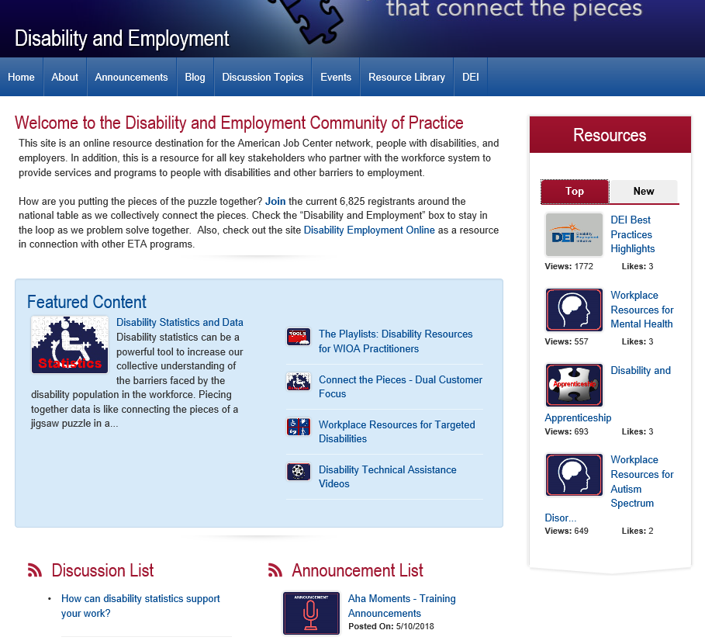
Disability.WorkforceGPS.org – “Let’s keep the Discussion Going”

