Slide 1
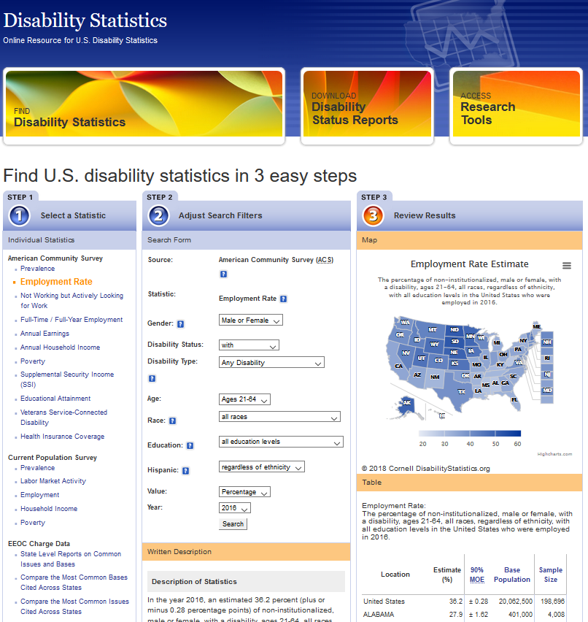
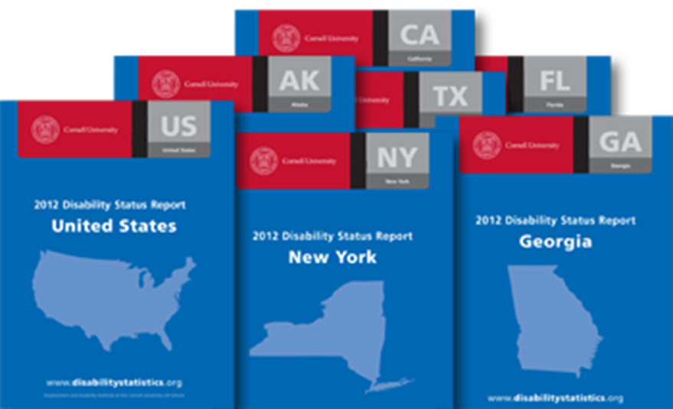
DisabilityStatistics.org
User & mobile friendly interactive online interface
DisabilityStatistics.org
Disability Status Reports
Concise annual ACS based national and state level reports covering the following topics:
Prevalence (by race, gender, ethnicity, age)
Economic situation (employment, income, poverty etc.) of the working-age population
DisabilityStatistics.org
Technical Assistance
Contact us with any additional questions regarding disability statistics or disability data sources at this address:
DisabilityStatistics@cornell.edu

Slide 2
Annual Compendium of Disability Statistics
National, state, and county-level data on prevalence of disability as well as educational attainment, employment, health, receipt of public disability benefits, and poverty among persons with and without disabilities.
www.disabilitycompendium.org
National Trends in Disability Employment (nTIDE)
Monthly webinar and press release issuance with updated national statistics on labor force participation and employment for disability population.
www.researchondisability.org/nTIDE
Technical Assistance Support
University of New Hampshire (UNH) is available to provide specific employment statistics of interest to help meet your needs.
Contact UNH by phone (866) 538-9521 or email disability.statistics@unh.edu

