Slide 1
Disaster Preparedness and Response: Serving Farmworkers
May 31, 2018
Part II: Partnerships and Resources

Slide 2
Lianna Shannon
Workforce Analyst
National Monitor Advocate Team Specialty National Programs
U.S. Department of Labor

Slide 4
Identify what you can do in advance of a natural disaster to ensure farmworkers are served;
Identify which resources and partnerships may be helpful and how they can be arranged; and
Identify next steps.

Slide 5
Which type of organization do you represent?
Federal government
State government
Local government
Non-governmental organization
Other

Slide 6
Which of the following are you already partnering with?
Federal government
State government
Local government
Non-governmental organizations
Other
Not yet partnering with other organizations

Slide 7
Minerva Figueroa
Senior Monitor Advocate
Florida Department of Economic Opportunity

Slide 8
Discussion Topics
1
Learn about Florida’s preparedness and response action plans for Hurricane Irma.
Understand impact of Hurricane Irma on agricultural businesses and MSFWs in Florida.
Hurricane Irma and lessons learned.
Notes:
Today’s discussion topics include learning about Florida’s preparedness and response action plans to respond to Hurricane Irma; understand the impact of Hurricane Irma on agricultural employers and MSFW families and present lessons learned in the aftermath of Hurricane Irma.

Slide 9
Florida’s MSFW Action Plan
1
Status of significant MSFW career centers statewide
Assessment of impacts and needs
Deployment plan for Senior Monitor Advocate and other staff
Coordination with local MSFW outreach workers and partner agencies
Outreach activities

Slide 10
Hurricane Impacts
2
Agricultural Businesses
MSFWs

Slide 11
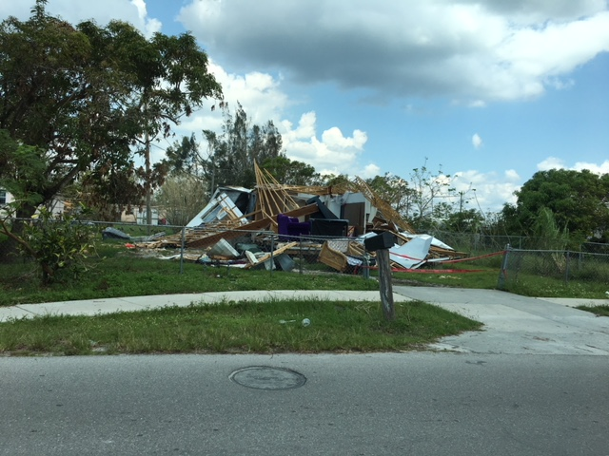
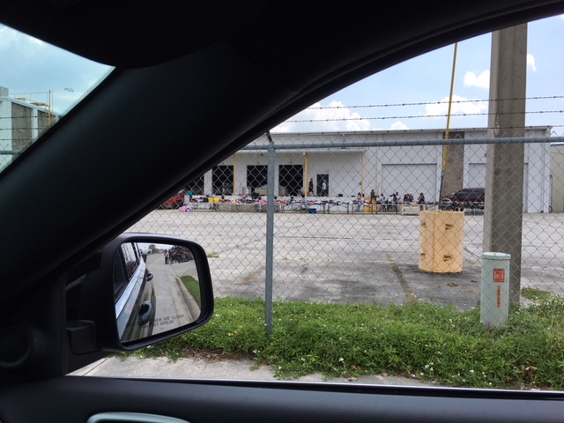
Hurricane Impacts (Continued)

Slide 12
Lessons Learned
3
Damage to agricultural business impacted outreach ability
Anticipation of labor needs of agricultural businesses
Opportunities to streamline process for H-2A program emergency filings
Earlier coordination with partner organizations

Slide 13
David G. Marín
Assistant District Director
Wage & Hour Division US Department of Labor

Slide 14
Effects of Hurricane Maria on Agriculture
U.S. Department of Labor
Wage & Hour Division
Caribbean District Office
Notes:
https://www.perfectdailygrind.com/2017/11/la-industria-de-cafe-de-puerto-rico-despues-de-huracan-maria/
http://futuroverde.org/2017/10/03/el-sector-agricola-de-puerto-rico-fue-diezmado-por-el-huracan-maria/
http://desdelaeea.eea.uprm.edu/2018/04/17/impacto-del-huracan-maria-en-la-agricultura-de-puerto-rico/
https://www.nytimes.com/es/2017/09/25/la-agricultura-de-puerto-rico-esta-diezmada-por-maria/
https://www.elnuevodia.com/noticias/locales/nota/losestragosdemariaenelsectoragricoladepuertorico-2361616/
https://www.nytimes.com/2017/09/24/us/puerto-rico-hurricane-maria-agriculture-.html
https://news.nationalgeographic.com/2017/11/puerto-rico-agriculture-destruction-resilience-hurricane-maria/
https://www.huffingtonpost.com/entry/puerto-rico-farmers-road-to-recovery-post-hurricane-maria_us_5a0f4bd9e4b0e97dffed381d
https://www.eater.com/2017/10/11/16434030/puerto-rico-hurricane-maria-coffee-farms-destroyed-how-to-help
https://tapasandtravels.com/2018/02/23/the-history-of-puerto-rican-coffee-and-the-effects-on-the-crops-after-the-hurricane-season-of-2017/
https://www.usatoday.com/story/news/world/2017/10/07/puerto-ricos-farmers-face-near-total-loss-hurricane-maria/736372001/
http://www.businessinsider.com/photos-hurricane-maria-puerto-rico-farms-damage-caribbean-2017-9#the-recovery-will-be-long-but-flores-puerto-ricos-agriculture-secretary-told-the-times-there-could-be-an-opportunity-to-make-the-rebuilt-farms-more-sustainable-and-efficient-13
http://wlrn.org/post/was-beautiful-place-puerto-ricos-coffee-farms-devastated-maria
http://www.myrecipes.com/extracrispy/hurricane-maria-puerto-rico-coffee

Slide 15
Hurricane Maria Facts
Hurricane María made landfall in Puerto Rico on September 20, 2017 beating the island with winds of up to 155 miles per hour for more than 30 hours.
It entered through Yabucoa, PR and exited through the northwest shores.

Slide 16
Hurricane Maria Facts
The interior part of the island, where most of the agriculture exists, received between 35 and 40 inches of rain.
Parts of Puerto Rico received 30 inches of rain in one day, equal to the amount that Houston received over three days during Hurricane Harvey.

Slide 17
Effects of Hurricane Maria on Agriculture
100% of farms in Puerto Rico suffered damage by the passing of the Hurricane. In more than 80% of these farms, the damage was substantial and devastating, wiping out their whole crops.
Reported losses
(as per PR Department of Agriculture):
$200M in crops
$1.2B in infrastructure

Slide 18
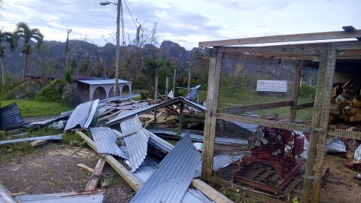
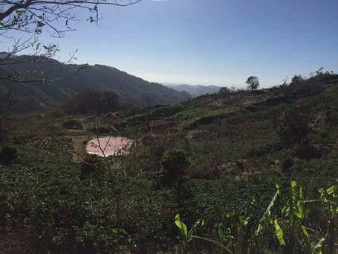
Effects of Hurricane Maria on Agriculture

Slide 19
Effects of Hurricane Maria on Coffee Farms
90% of all coffee trees were destroyed.
Lack of electricity does not allow for processing.

Slide 20
Recovery Period
Terrain clean up.
Soil preparation.
Planting new trees.
1st crop will be available on the 3rd year of the tree.

Slide 21
Challenges
Historically there have been challenges with information flow between the territorial agencies
The Puerto Rico Department of Labor is fully committed to cooperate with the USDOL

Slide 22
Challenges
USDOL relies on information provided by:
Puerto Rico DOL
Internet
Traveling to possible investigation sites
Surveys
Individuals (i.e. workers, grocery store representatives, coffee museums)
Competitor’s requests to investigate other farmers.

Slide 23
Challenges
Puerto Rico has the lowest agricultural wages.
Puerto Rico is the #1 exporter of agricultural workers to mainland US (mostly from Humacao, Naguabo, and Yauco)

Slide 24
Wage & Hour Enforcement Plan
Possible Outreach Contacts:
Puerto Rico Department of Agriculture
Puerto Rico Department of Labor

Slide 25
Krister Engdahl
Regional Monitor Advocate
Employment and Training Administration
US Department of Labor

Slide 26
Background
1
National Dislocated Worker Grants (DWGs), formerly known as National Emergency Grants (NEGs)
Provide resources to states and other eligible applicants to respond to large, unexpected layoffs.
Create temporary employment opportunities to assist with recovery efforts.

Slide 27
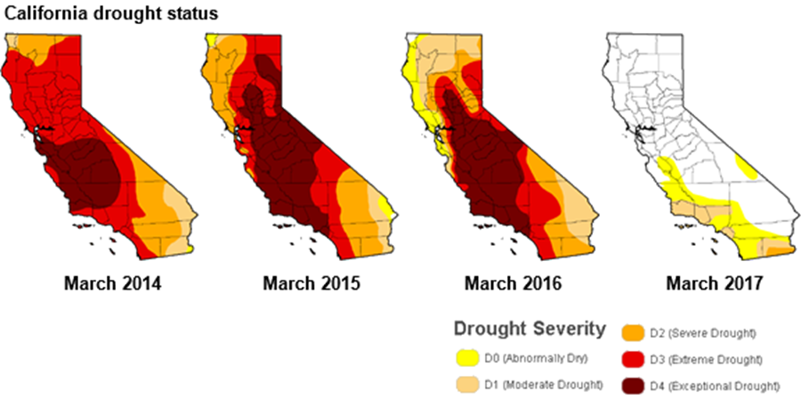

Slide 28
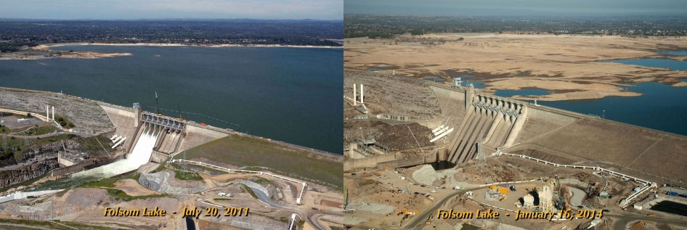
California EDD NDWG 2015
$31,000,000
Temporary employment to 1,000+ eligible individuals to aid in the clean up and recovery efforts
Reemployment services
Notes:
Photo source: https://www.nasa.gov/jpl/multimedia/california-drought-20140225/#.Ww3xdWgvzcs

Slide 29
CA EDD Partners

Slide 30
Impact
1,275 individuals served
Placements: local cities, counties, Caltrans, non-profit agencies
Job duration doubled
Many full-time placements

Slide 31
David King
UI Program Specialist
Office of Unemployment Insurance
US Department of Labor

Slide 32
Disaster Unemployment Assistance (DUA)
May 31, 2018
A Basic Overview

Slide 33
Answer the following:
What is Unemployment Insurance(UI)?
What is Disaster Unemployment Insurance (DUA)?
What is the difference between UI and DUA?
Who administers the DUA program?
Who is entitled to DUA benefits?
Are there special circumstances for Agricultural workers and Farmworkers?

Slide 34
Background of DUA activity
2
Fiscal Year 2015 – 44 declared disasters, 9 included DUA, with total DUA benefits obligated around 2.5 million dollars.
Fiscal Year 2016 – 41 declared disasters, 13 included DUA, with total DUA benefits obligated around 5 million dollars.

Slide 35
Background of DUA activity
2
Fiscal Year 2017 saw a large increase in disaster activity and the DUA program.
60 declared disasters, 21 included DUA, with total DUA benefits obligated around 50 million dollars.
FY’17 saw large increases in agricultural and farmworker DUA claims due to Hurricane Harvey, Irma, Maria, and Wildfires.

Slide 36
Background of DUA activity
2
Fiscal Year 2018 so far has 22 declared disasters, 5 with DUA, and approximated 3 million dollars obligated for DUA benefits.
It was during this period (October 2017 through March 2018) that most of the FY’17 Hurricanes (Harvey, Maria, Irma) were active and paid benefits.

Slide 37
What is UI?
2
UI benefits are intended to provide temporary financial assistance to unemployed workers who meet the requirements of State law.
In a declared major disaster, most regularly employed individuals will qualify for UI benefits.

Slide 38
What is DUA?
1
DUA provides temporary benefits to individuals whose employment or self-employment has been lost or interrupted as a result of a major disaster and are not eligible for regular UI.
Individuals unemployed due to a declared major disaster are required to file for UI benefits. If ineligible for UI, the individual may then file for DUA benefits.

Slide 39
Who does not qualify for UI?
Individuals without covered wages do not qualify for UI benefits, but the DUA program does cover these individuals. Individuals often not having covered UI wages are:
Self-employed
Farmers and certain agricultural workers
Not enough wages earned in the “base period” to qualify
No prior employment

Slide 40
Who administers UI and DUA?
3
The U.S. Department of Labor (USDOL) oversees UI programs, which include the DUA program. USDOL coordinates with the Federal Emergency Management Agency (FEMA) to oversee the DUA program.
DUA is administered by State UI agencies acting as agents of the Federal government whenever a state or tribal declaration is made.

Slide 41
Definition of Major Disaster
4
Any natural catastrophe (including any hurricane, tornado, typhoon, storm, high water, wind-driven water, tidal wave, tsunami, earthquake, volcanic eruption, landslide, mudslide, snowstorm, or drought) or regardless of cause, any fire, flood, or explosion in any part of the United States, which in the determination of the President causes damage of sufficient severity and magnitude to warrant major disaster assistance. P.L. 100-707 (1988)

Slide 42
What triggers DUA?
5
Based upon the request of a State Governor or Tribal Governor/Chief, the President may declare a major disaster in the state.
The declaration will define the areas affected by the disaster and may authorize DUA with other types of Federal assistance.
Public announcements will be made in the disaster area advising that DUA is available, and how and when individuals can file for benefits with the State Workforce Agency.

Slide 43
Who can qualify for DUA?
6
One of the following conditions must have occurred as a direct result of the disaster to qualify for DUA.
The individual has had a week of unemployment following the date the major disaster began;
The individual is unable to reach his/her place of employment;
The individual was scheduled to start work, and the job no longer exists or the individual was unable to reach the job
The individual became the major support because the head of household died as a direct result of the disaster; or
The individual cannot work because of an injury cause as a direct result of the disaster.

Slide 44
What are the eligibility requirements?
7
To qualify, claimants must meet all of the following eligibility requirements.
The individual is not eligible for UI benefits
The individual is unemployed as a direct result of the disaster
The individual is able and available for work, unless injured as a direct result of the disaster
The individual filed an application for DUA within 30 days of the date of the public announcement of the availability of DUA; and
The individual has not refused an offer of employment in a suitable position

Slide 45
Are there other requirements?
8
The individual must continue to file weekly or biweekly claims for DUA benefits according to the instructions given by the State Agency where the DUA claim is filed.
Proof is required to substantiate employment or self-employment or to substantiate work that was to begin on or after the date of the disaster. Failure to provide proof within 21 calendar days from the time the DUA claim was filed may result in a denial of DUA, and any benefits already paid will be considered overpaid.
Proof of wages (employment or self-employment) must be presented so that the State can determine the Weekly Assistance amount.

Slide 46
How are DUA benefit amounts determined and how long do they last?
9
The DUA weekly benefit amount (WBA) will be based on the gross wages (or net income for self-employed) of the individual of the tax year prior to the effective date of the DUA claim. The calculation of the amount uses the same formula the State Workforce Agency uses to calculate UI benefits, however, DUA benefits have a different minimum weekly benefit amount for each State, which is published by USDOL each quarter.
DUA benefits are generally paid for up to 26 weeks, beginning with the first week following the date the major disaster began, and ending with the 26th week following the date the major disaster was declared.

Slide 47
Special Applicants
10
Migrant/Seasonal Workers
These farm workers who are prevented from their normal planting/harvesting activities because of inability to reach the place of work or because of damage to the place of work are potentially eligible for DUA.
Agricultural and other workers whose normal work depends on movement from on area to another will be deemed living in the major disaster area for the purpose of DUA if their presence in such disaster area is consistent with normal or reasonable migration required by their usual occupation.
Duration – only for weeks they would have worked (season).

Slide 48
Special Applicants continued
11
Farmers
In some cases self-employed individuals can be substantially impacted by a major disaster even though they are still able to perform some of their customary services in self-employment.
For example, diversified farmers can be eligible for partial DUA payments even if they are still able to render some of their customary services in self-employment.
The determination will be based on the individual performing less than his full time customary services and earning wages less than the applicable state law earnings limit.

Slide 49
How can you use this information?
11
Build a relationship with the SWA UI and DUA Program Coordinator. The SWA and FEMA are often looking for alternative ways to inform affected individuals of the availability of benefits during a disaster situation and work with SWA Management to generate DUA press releases and reach out to affected individuals.
Information regarding migrant farm worker populations could be useful.
Information is available that can be shared to those needing to apply for Unemployment Insurance or Disaster Unemployment Assistance, as well as job and career services.
https://www.careeronestop.org/LocalHelp/service-locator.aspx

Slide 50
Juan Regalado
National Monitor Advocate
Specialty National Programs Unit, US Department of Labor

Slide 51
Next Steps
Reach out to:
Federal Government Resources
Unemployment Insurance; Regional Monitor Advocates; Dislocated Worker Grant Representatives
State Government Resources
State Workforce Agencies; State Monitor Advocates; First responders
Local Government Resources
American Job Centers; Outreach Workers; First responders
Non-governmental organizations
Red Cross; Legal Aid organizations; Mental health organizations
Notes:
Build your network comprised of these organizations.

Slide 52
Next Steps - Continued
2. After you Reach Out:
Identify POCs within your organization and the partner organization
Organize presentations
Make a Plan
Check in with the partner organization over time to ensure POCs and Plan are up-to-date
Notes:
After identifying who the POCs should be in each organization, organize presentations. This will give you an opportunity to learn how the partner organization works and it will give them an opportunity to learn about what you do and how you do it. It will also give you an opportunity to identify the unique needs of farmworkers. Then, both organizations can work together to create a plan to ensure farmworkers are served during a disaster.

Slide 53
Next Steps - Continued
Disaster Response Plan
Contingencies for loss of power, communication, and transportation
Disaster impact assessment
Staff needs and well-being
Participant/customer needs and well-being
Wrap around services including mental health and trauma informed care

Slide 57
Other Helpful Tips:
Buddy System
Cloud technology
Mobile administrative office
Preparation/Response Kits
Suggestions? Please type in chat box.

Slide 58
Disaster Response Plan
Ready is a National public service campaign designed to educate and empower the American people to prepare for, respond to and mitigate emergencies, including natural and man-made disasters. The goal of the campaign is to promote preparedness through public involvement.
https://www.ready.gov/business/implementation/emergency
FEMA: Emergency Response Plan
A 10 pg document to help Businesses Identify the goals and objectives for the emergency response plan. Define what your emergency response team is expected to do during an emergency (e.g., evacuate employees and visitors, provide first aid, etc.), Identify any regulations covered by your plan (e.g., OSHA, fire code, etc.)
https://www.fema.gov/media-library/assets/documents/89518
OSHA
When large-scale emergencies occur, OSHA can be a critical resource to help response and recovery organizations protect their workers. OSHA has the authority to provide technical assistance and support to local, state, federal, tribal, territorial, and insular area agencies.
https://www.osha.gov/SLTC/emergencypreparedness/gettingstarted_role.html
CDC: Emergency Partners Information Connection (EPIC)
EPIC partners with a broad array of organizations to exchange information that helps people stay safer and healthier during a public health emergency. Through EPIC’s partnerships, CDC can more effectively reach some of the people most vulnerable to public health hreats.
https://emergency.cdc.gov/epic/

Slide 59
The National Institute for Occupational Safety and Health (NIOSH) Emergency preparedness for businesses.
https://www.ready.gov/business/implementation/emergency
DisasterAssistance.Gov Are you looking for assistance to help your business or community recover? Are you unsure of where to get information? Do you want to find local services? If you can answer “yes” to any of these questions, this page may be able to help. Here you can find resources, not just for individuals, but also for businesses, local governments, and communities. Your path to recovery may be able to start here.
https://www.disasterassistance.gov/get-assistance/other-recovery-help
USDA
Here you will you find information about specific disasters and emergencies, how to prepare, recover, and help build long-term resilience, as well as information about USDA assistance during disaster events.
https://www.usda.gov/topics/disasterTitle
Housing and Urban Development
Disaster recovery homelessness toolkit. Contains a Local Planning Guide, a Response Guide, and a Recovery Guide
https://www.hudexchange.info/homelessness-assistance/disaster-recovery-homelessness-toolkit/

Slide 61
Minerva Figueroa
Senior Monitor Advocate
Florida Department of Economic Opportunity
Minerva.Figueroa@deo.myflorida.com
850.921.3372
David G. Marín
Assistant District Director
Wage and Hour Division
US Department of Labor
Marin.David@dol.gov
787.775.1711

Slide 62
Krister Engdahl
Regional Monitor Advocate
Employment and Training Administration
US Department of Labor
Engdahl.Krister@dol.gov
415-625-7960
David King
UI Program Specialist
Office of Unemployment Insurance
US Department of Labor
King.David.H@dol.gov
202-693-2698

Slide 63
Juan Regalado
National Monitor Advocate
Employment and Training Administration
US Department of Labor
Regalado.Juan@dol.gov
415-625-7904

