Slide 1
Polling Question
Which best describes your organization?
College
Workforce system
Not-for-Profit
Federal
Other

Slide 2
Building Strategic Alliances between Colleges and Workforce Boards
June 6, 2018
Innovations Leading to Career Success Webinar Series
Employment and Training Administration
Office of Career, Technical, and Adult Education

Slide 3
Moderators
Cheryl Martin, Trade Adjustment Assistance Community College and Career Training (TAACCCT) Program Manager, Division of Strategic Investments, Employment and Training Administration, U.S. Department of Labor
Erin Berg, Community College Program Specialist, Office of Career, Technical, and Adult Education, U.S. Department of Education
3

Slide 4
About this Webinar
Presenters from three states will discuss collaborations between community colleges and workforce development boards (WDBs), and provide concrete steps that leaders and staff can take together to further their mutual goals and overcome common challenges.
Developing mutually beneficial partnerships between colleges and WDBs can sometimes be difficult; however, colleges and workforce boards that work systematically to address the complex challenges and needs inherent in local labor markets will have a head start toward accomplishing their goals.
4

Slide 5
Innovations Leading to Career Success Webinar Series
This webinar series showcases strategies and resources that are of broad interest to educational institutions engaged in career-focused education and training.
February 28:
Make Industry Experts into Expert Instructors to Increase Student Success
March 14:
Scaling Career Pathways in Wisconsin
March 28:
Resources for Developmental Education Using Competency-Based Education
April 11:
Lowering the Cost of Course Materials with Free and Open Educational Resources
May 2:
Sustaining Grant-funded Projects for Long-term Success
May 16:
Free Resources for Apprenticeship and Work-based Learning
June 6:
Building Strategic Alliances between College and Workforce Boards
For more information, please visit:
Innovations Leading to Career Success Webinar Series
5

Slide 6
Presenters
Amanda Duncan, Vice President and Chief Business Development Officer, Workforce Alliance of South Central Kansas
Mardy Leathers, Director, Division of Workforce Development at Missouri Department of Economic Development
Tonya Wagner, Dean, General Studies and Liberal Arts at Western Technical College
6

Slide 7
Workforce Alliance of South Central Kansas
Amanda Duncan
Vice President and Chief Business Development Officer, Workforce Alliance of South Central Kansas

Slide 8
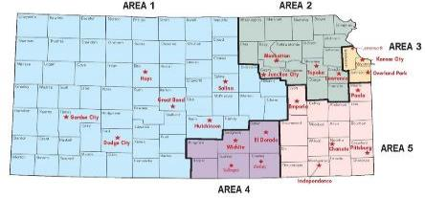
Workforce Alliance of South Central Kansas
Local Workforce Development Board in Wichita, Kansas serving six counties
Long time Board directed operational philosophy: Leverage resources and align services to create greater collective impact of Workforce Investment Act (WIA)/Workforce Innovation and Opportunity ACT (WIOA) programs
Key Projects and Regional Strategies Leveraged Into WIA/WIOA:
WIRED Grant, 2007-2010
NEG Grant, 2010-2014
H1B Grant, 2011-2016
America’s Promise 2017-2020
Youth Employment Project
Senior Employment Services
Ex-Offender Programs
National Fund for Workforce Solutions site, 2008-Present
Collaborated with 2 colleges on TAACCCT Grants

Slide 9
Reasons for Collaboration
Relationship Building
Deliberative strategy of inclusion and cooperation at senior level
Workforce Board President and College President meet face to face at least two times per year
College President Serves on the Local Workforce Development Board (LWDB)
Capacity
College can leverage existing employer relationship established by the LWDB
LWDB has existing capacity for data collection, reporting and follow-up
Improved Outcomes

Slide 10
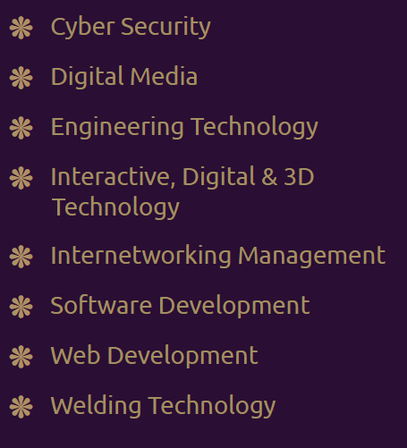
Key Outcomes
504
individuals enrolled in information technology (IT)
training programs
109
credentials were earned by participants
340
participants entered employment
149 in IT or training related occupations
9 in Manufacturing
3 in Healthcare
170 in Other Sectors
$18.69
Average hourly wage of training completers
27 credentials offered through the Butler IT Institute
6 degrees
21 certificates

Slide 11
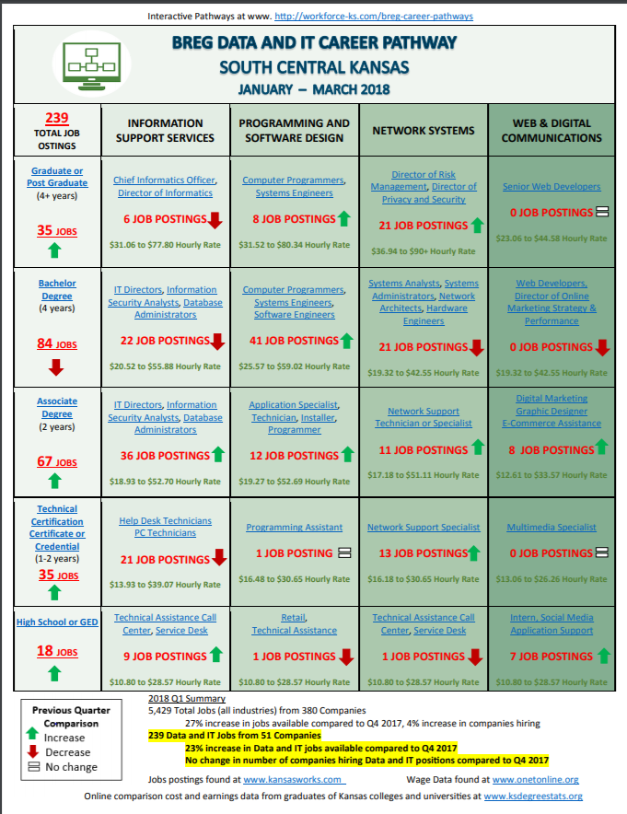
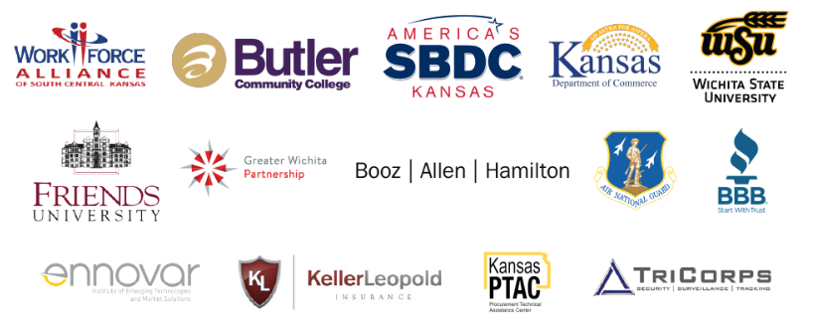
Key Outcomes
Career Pathway Development
Employer Engagement Events
Open House Tour of Institute
Cyber Security Forum
ters
266 Attendees
Four Program Options: Business, Educators,
Government and Students

Slide 12
Questions?
12

Slide 13
Missouri Workforce Partnerships
By Mardy Leathers, Director, Division of Workforce Development at Missouri Department of Economic Development

Slide 14
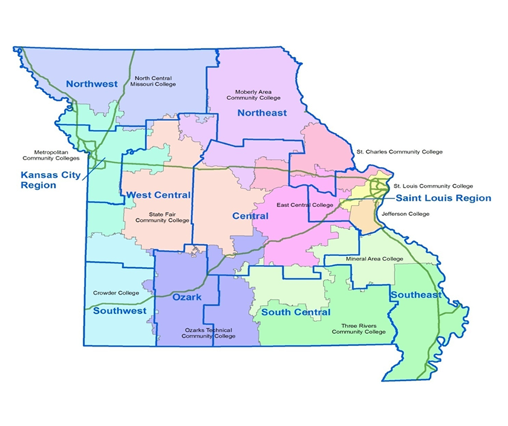
Partnerships
14 Workforce Regions
13 Community Colleges
State Technical Institute
14

Slide 15
Partnerships
Statewide Memoranda Of Understanding (MOU)
TAACCCT Grant Advisory Committee
Thought Leadership
Program Innovation and Expansion
15

Slide 16
Outcomes
Financial Aide Desk Aid
Career Pathways Reports
Burning Glass Reports
Key Programs
Registered Apprenticeships
Employer Engagement Teams
Employability Skills
Grant Projects
16

Slide 17
Questions?
17

Slide 18
Western Technical College (Wisconsin)
Framing Win- Win Workforce Partnerships
Tonya Wagner, Dean, General studies and liberal arts

Slide 19
Framing Win-Win Workforce Partnerships
We came together to help equip adults with limited computer literacy for college or career transitions with our Basic Information Technology Skills (BITS) training.
The TAACCCT three Wisconsin Consortium created interactive online training for potential IT students and other adults to gain the skills they need to enter training.
The modules were web based and could be completed anywhere
The modules are simple, engaging and allow students to complete and progress at their own pace
The trainees could track their progress, earn badges and certificates

Slide 20
Framing Win-Win Workforce Partnerships
Strategies for partnerships:
We worked to build trust.
We repaired old damage.
We got creative about building a new way of working together.
We built our partnership on shared values.
We communicated in the other organization’s language.

Slide 21
Framing Win-Win Workforce Partnerships
In our district, we trained over 250 participants during the grant period through our local job center with the use of a student intern to help facilitate workshops. We trained the job center staff to continue the workshops after the grant period to have ongoing impact:
We listened to what they needed
We had a single point of contact to aid in clear communication and act as a liaison
We flexed our approach
We thought about the long term

Slide 22
Questions?
22

Slide 23
Resources
Powerhouse Partnerships: Community Colleges and Workforce Boards Working Together
A Resource Guide to Engaging Employers
Basic Computer Skills Course
Building Partnerships with Community Colleges to Better Meet Workforce Needs
Connecting Community Colleges with Employers: A Toolkit for Building Successful Partnerships
The Goals and Dimensions of Employer Engagement in Workforce Development Programs
Career Pathways: Five Ways to Connect College and Careers
23

Slide 24
Thank you!
This webinar series showcases strategies and resources that are of broad interest to educational institutions engaged in career-focused education and training.
February 28: Make Industry Experts into Expert Instructors to Increase Student Success
March 14: Scaling Career Pathways in Wisconsin
March 28: Resources for Developmental Education Using Competency-Based Education
April 11: Lowering the Cost of Course Materials with Free and Open Educational Resources
May 2: Sustaining Grant-funded Projects for Long-term Success
May 16: Free Resources for Apprenticeship and Work-based Learning
June 6: Building Strategic Alliances between College and Workforce Boards
For more information, please visit:
Innovations Leading to Career Success Webinar Series
24

