Slide 1
Our Journey Together: Out-of-School Youth Cohort Challenge Review
Thursday, June 7th, 2018
2:30-3:30 PM ET
Out of School Youth

Slide 2
Moderator, Lisa Dieterle, Federal Project Officer, Region V WIOA Youth Program Lead, US DOLETA
Amy Landesman, Consultant, Maher & Maher
Matt Musante, Analyst, Maher & Maher
Out of School Youth

Slide 3
Welcome
Moderator, Lisa Dieterle, Federal Project Officer, Region V WIOA Youth Program Lead, US DOLETA
Out of School Youth

Slide 4
Session Objectives
Cohort Overview (purpose and structure)
Youth Engagement and Retention Challenges
Key Insights and Opportunities Identified
Outcomes
Out of School Youth

Slide 5
What are we experiencing?
An opportunity to hear from you………
Out of School Youth

Slide 6
OSY Cohort Overview
What was the purpose and structure?
Out of School Youth

Slide 7
Cohort Initiative - Purpose
Cohorts across five different focus areas tackled various challenges in the workforce development system
The Future of American Job Centers (AJCs)
Integrating Business Services Across a Region
State WIOA, TANF and SNAP Partnerships
Operationalizing WIOA Co-enrollment
Engaging and Retaining Out-of-School Youth
Out of School Youth

Slide 8
Cohorts - The Approach
Bring together multiple voices, perspectives, experiences, and expertise to the table. Identify and further understand challenge, develop innovative ideas and solutions that can benefit the entire system and each local cohort team.
Out of School Youth

Slide 9
Our Focus
“What does it take to effectively engage and retain out-of-school youth throughout the program lifespan?”
Our goal was to develop outcomes that would:
Help cohort teams address the challenges in their own local areas
Develop practical solutions to the challenges to be disseminated to the field nationally
Serve as an overall “Innovation Lab” for ideas that could drive integration and promote increased efficiencies and improved outcomes
Out of School Youth

Slide 10
Our Focus
For the youth cohort, the teams would define what the specific challenges are in engaging and retaining out-of-school youth, and produce the deliverables/outcomes
Based on the belief the teams would know best the challenges and the solutions!
Out of School Youth

Slide 11
What Happened?
85 team applications representing states and local areas
Many partners were represented including workforce, public sector, community-based organizations, criminal justice, education, economic development, community colleges, literacy, employers, etc.
8 teams were chosen (5-7 members each)
Out of School Youth

Slide 12
The Teams
Career Center of Lowell (MA)
Westmoreland-Fayette Workforce Investment Board (PA)
S. Central TN Workforce Alliance (TN)
Central Oklahoma (OK)
South Dakota (SD)
City of Brooklyn Park (MN)
Ashtabula County/Youth Opportunities Program (OH)
Orange County Development Board (CA)
Out of School Youth

Slide 13
Cohort Components
6 virtual sessions from February to May 2018
Moodle - collaborative platform/shared space
Presentations introducing cohort team community models
Efforts to engage and retain youth
Successes/challenges
Goals moving forward
Independent and Team Assignments aimed to further understand and identify challenges, learn best practices
Challenge Teams – worked on specific challenge areas identified by larger cohorts, developed deliverables
Out of School Youth

Slide 14
Common Challenges
Key patterns and themes
Out of School Youth

Slide 15
Common Engagement Challenges
Outreach/recruitment/marketing
Immediate needs (job, income) vs. long-term goals (beyond entry-level jobs/career pathways)
Lack of commitment, motivation, “sticking it out”
Overcoming stigma for out of school youth
Out of School Youth

Slide 16
Common Engagement Challenges
Need for support services – substance abuse, child care, mental health, legal services, etc.
Transportation
Housing and food security
Funding
Out of School Youth

Slide 17
Challenge Teams
After examining best practices in engagement and retention strategies (pre-program, program and post-program), topic areas were identified and four challenge teams were formed
Each Challenge Team, roughly 10-12 people each, consisted of members from all 8 Cohort Teams
Each challenge team met independently to further their challenge area and develop their outcomes/deliverable
Out of School Youth

Slide 18
Challenge Teams
Empowering Youth as Active Participants #1
Using Technology in Innovative Ways Through Programming
Recruitment, Marketing and Outreach Strategies
Empowering Youth as Active Participants #2
Out of School Youth

Slide 19
Key Learnings of the Cohort
What were the takeaways?
Out of School Youth

Slide 20
Key Learnings
Many specific challenges affected all cohort teams
While rural areas face certain challenges, members realized many of the challenges derived from similar needs, pain points
Out of School Youth

Slide 21
Key Learnings
Having cohort teams from different local entities on the team was an opportunity to develop new programming and practices
Several teams met in-person and used the time before and after the webinar to meet
Teams thought about how they could improve communication in the future
Teams thought about how they could leverage additional local partnerships or create new ones
Out of School Youth

Slide 22
Key Learnings
Certain program topics surfaced as warranting further exploration locally
Assessment as a critical point of engagement
Using technology or using it more in programming
Peer centered approaches to programming
Hearing other teams’ best practices of what went well was helpful, but so were the lessons learned from what didn’t work out as well
Out of School Youth

Slide 23
Key Learnings
Lower unemployment in many areas has allowed youth to obtain jobs faster but youth as a demographic still struggle when employers want highly skilled or semi-skilled workers
Engaging youth in credentialing and career pathway opportunities has become more challenging
Out of School Youth

Slide 24
Lessons from the Cohort Team
Norman Albances
Program Administrator
Orange County Development Board, OC Community Services - Community Investment Division
Out of School Youth

Slide 25
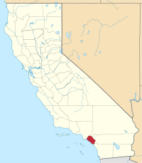
About the OC
Population of 3.1 million and the 6th largest county in the United States
The Orange County Development Board (OCDB) administers a local workforce system for 2.4 million of the region’s residents, serving 32 of the county’s 34 cities and all of the unincorporated communities of the county
In partnership with the Orange County Board of Supervisors, the OCDB oversees Orange County's workforce development activities and establishes programs in response to the workforce needs of Orange County, including labor market information, employment and training services, and business assistance.
Three service providers are split throughout the County to provide WIOA Youth services: the City of La Habra, KRA Corporation and the Orange County Asian and Pacific Islander Community Alliance (OCAPICA)
Team members have more than 30 years of WIA/WIOA experience combined

Slide 26
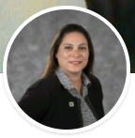
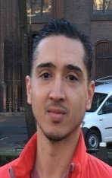
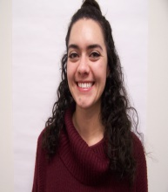
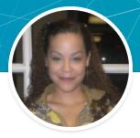
Name | Title | Organization | E-mail
Norman Albances | Program Administrator | Orange County Development Board | Norman.albances@occr.ocgov.com
John Gutierrez | Program Manager | Orange County Asian and Pacific Islander Community Alliance | jgutierrez@ocapica.org
Justin Nguyen-Amigo | Workforce Specialist | Orange County Asian and Pacific Islander Community Alliance | jamigo@ocapica.org
Jacqueline Cortes | Workforce Specialist | Orange County Asian and Pacific Islander Community Alliance | jcortes@ocapica.org
Al Rodriguez | Program Manager | City of La Habra | AGRodriguez@lahabraca.gov
Shawna Wright | Director of Workforce Operations | KRA Corporation | swright@kra.com
Esther Landin | Founder | Orange County Opportunity Youth Collaborative | ocyouthcollaborative@gmail.com
Norman
Justin
Al
Esther
John
Jacqueline
Shawna

Slide 27
What are you experiencing in your community working with youth?
“They are need of supportive services especially in shelter and transportation.”
“They are experiencing homelessness, and therefore have a high level of need.”
“Young adults are more disengaged than they used to be.”
“Young adults are not connecting with society.”
“Young adults strong desire to become independent.”
Out of School Youth

Slide 28
What are your goals?
Continue to strengthen ways to keep youth motivated.
Ensuring that participants are empowered to have the ability to take initiative towards making healthy progressive steps forward in their professional & personal lives.
Listen more to participants to hear what they are up against and to see if they have their own answers to how to meet their goals.
Accompany participants in realizing their own potential, and to facilitate growth.
Developing a stackable credential option for young adults.
Increase enrollments.
Add whole person components to offerings (i.e. resiliency, understanding trauma).
Create partnerships with business and educational community for tours, training-to-employment pipelines, apprenticeships, professional community workshops, etc.

Slide 29
What are your goals?
Human-Centered Design
Partnership and Outreach
Continue to strengthen ways to keep youth motivated.
Ensuring that participants are empowered to have the ability to take initiative towards making healthy progressive steps forward in their professional & personal lives.
Listen more to participants to hear what they are up against and to see if they have their own answers to how to meet their goals.
Accompany participants in realizing their own potential, and to facilitate growth.
Increase enrollments.
Add whole person components to offerings (i.e. resiliency, understanding trauma).
Create partnerships with business and educational community for tours, training-to-employment pipelines, apprenticeships, professional community workshops, etc.
Developing a stackable credential option for young adults.
Out of School Youth

Slide 31
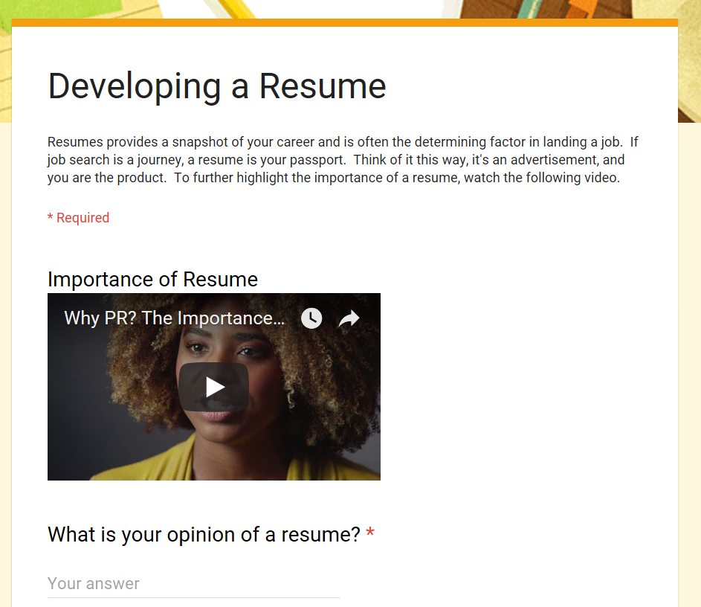
Goal: Human-Centered Design
Text line
Online interest form for young adults and to refer young adults
Online workshops
Out of School Youth

Slide 32
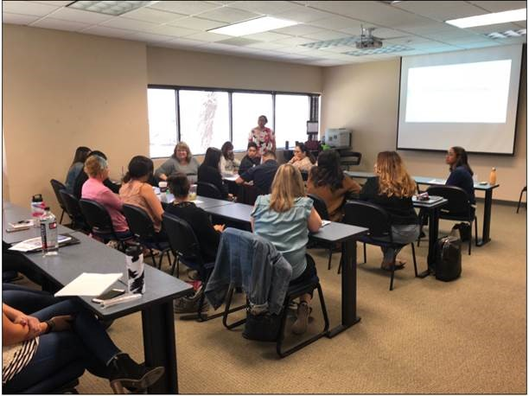
Goal: Human-Centered Design
Motivational Interviewing: A collaborative, person-centered form of guiding to elicit and strengthen motivation for change.
Motivational Interviewing is a goal-oriented, client-centered counseling style for eliciting behavior change by helping clients to explore and resolve doubt. Compared with non-directive counseling, it's more focused and goal-directed.
The main goals of motivational interviewing are to engage clients, elicit change talk, and evoke client motivation to make positive changes. For example, change talk can be elicited by asking the client questions, such as "How might you like things to be different?"

Slide 33
Goal: Human-Centered Design
The Baldrige Excellence Framework has three parts: (1) the criteria for performance excellence (2) core values and concepts (3) scoring guidelines. The framework serves two main purposes: (1) to help organizations assess their improvement efforts, diagnose their overall performance management system, and identify their strengths and opportunities for improvement. (2) to identify Baldrige Award recipients that will serve as role models for other organizations.
California Workforce Association conferences

Slide 34
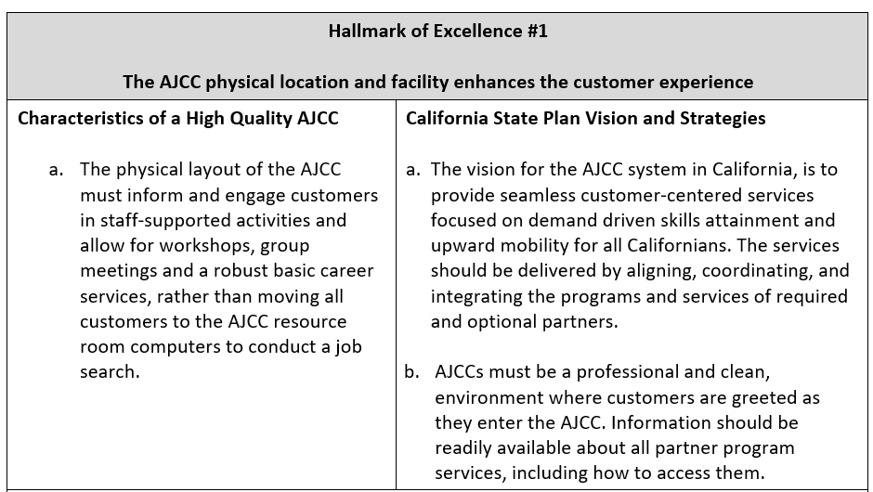
Goal: Human-Centered Design

Slide 35
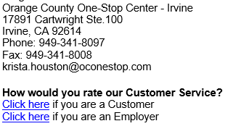
Goal: Human-Centered Design
Developed electronic customer satisfaction surveys and added them to staff signatures:
Also have a survey for staff and partners.

Slide 36
Goal: Partnerships and Outreach
To date: More than 90,000 people reached!

Slide 38
Goal: Partnerships and Outreach

Slide 39
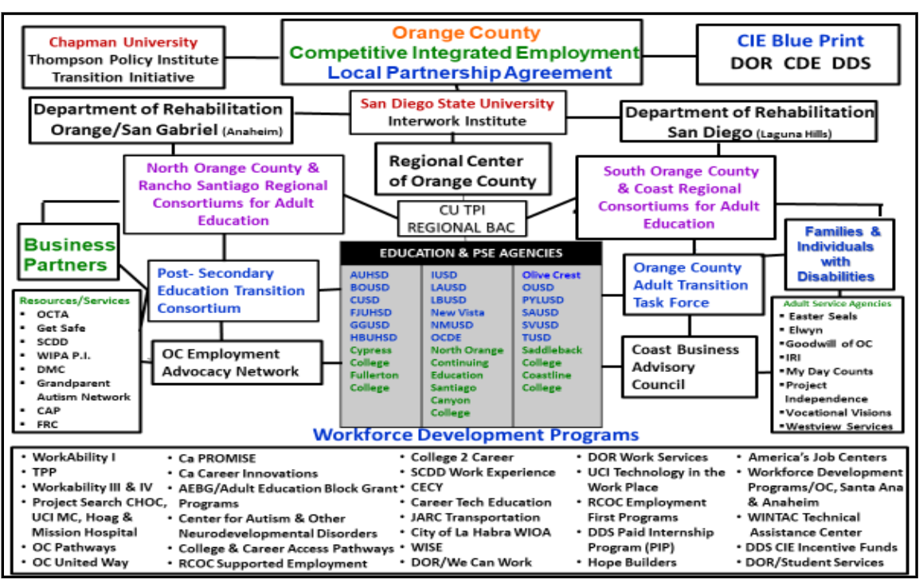
Goal: Partnerships and Outreach

Slide 40
Goal: Partnerships and Outreach
Strengthening Education and Workforce Development for Justice-Involved Young Adults – With support from the U.S. Department of Education’s Office of Career, Technical, and Adult Education, RTI International invited community partnerships to join a technical assistance initiative to improve the outcomes of justice-involved young adults (ages 16–24). This new initiative will connect these youths with career and technical education (CTE), workforce development, and special education services. We were selected to participate in this initiative.

Slide 41
Goal: Partnerships and Outreach
Co-location and/or integrating into AJC Orientations

Slide 42
Outcomes of the Cohort
What was developed……
Out of School Youth

Slide 43
Recruitment, Marketing and Outreach Strategies Tip Sheet
How to better reach youth
How to speak their language
Social media outlets youth are using
What to do if you are not social media savvy
Other relevant facts
Out of School Youth

Slide 44
Empowering Youth as Active Participants Tip Sheet
Assessment survey questions and tools
Staff tips
Motivational interviewing techniques
Case scenarios
Out of School Youth

Slide 45
Using Technology in Innovative Ways Through Programming Resource Guide
Relevant technology overview
How technology can be used in different phases of programming
Recommendations and precautions for how to effectively and appropriately use technology
Information about no/low cost technology tools
Out of School Youth

Slide 46
Lessons from the Challenge Team Experience
Yolanda Scott
Program Manager-Youth Services
Central Oklahoma Workforce Investment Board
Out of School Youth

Slide 47
Empowering Youth as Active Participants Story Board for Human Centered Program Design

Slide 48
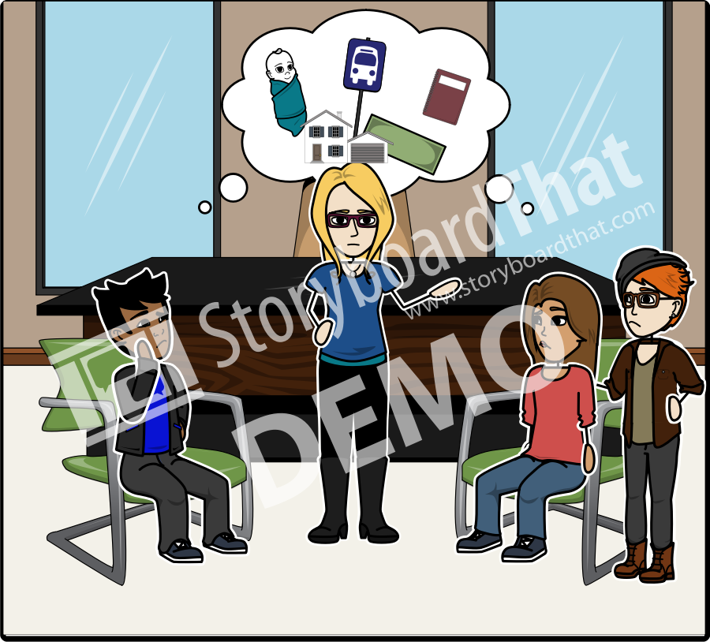
Observation
The goal here is to understand your customer (16-24 yr. old out-of-school youth). Identify patterns of behavior, barriers to success, places/situations/systemic issues that make it difficult for them to complete a program/activity.

Slide 49
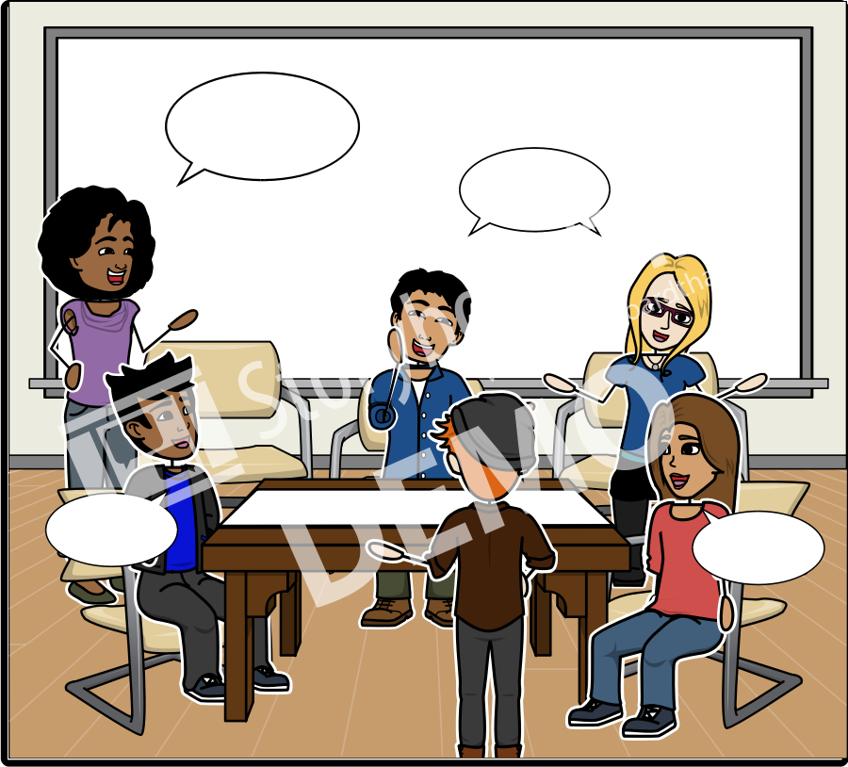
Ideation
With a team that includes providers and the youth you are serving, brainstorm ideas/solutions to address the observations made. Come up with as many ideas as you can! The group will eventually come up with the right solution!

Slide 50
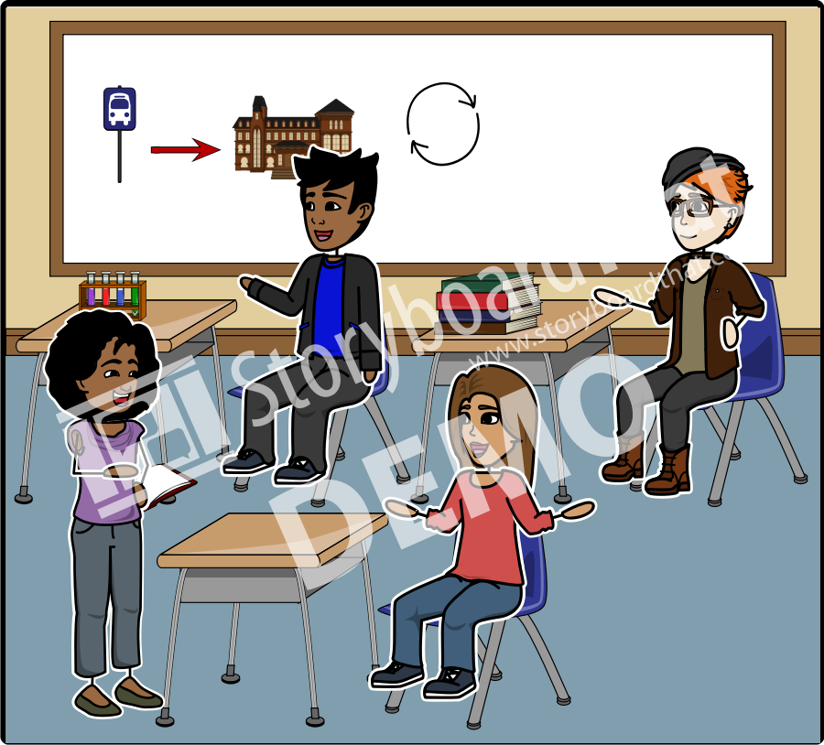
Rapid Prototyping
Quickly develop a simple activity/project to test the solution you came up with in ideation. This will not be the final version. Take this opportunity to test the preliminary model as quickly as possible with youth.

Slide 51
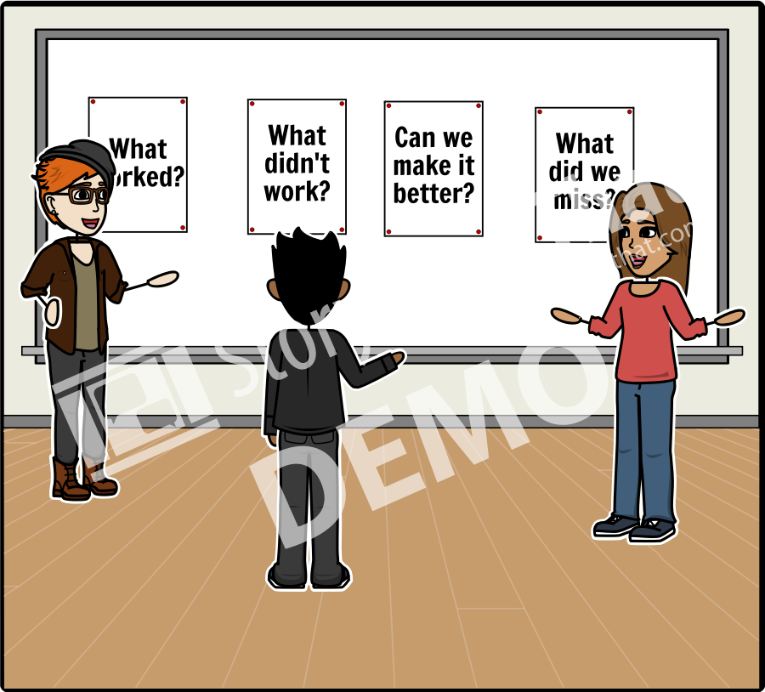
User Feedback
After trying the activity with the youth, get their honest feedback. What worked? What didn't work? How can we make it better? Did we miss anything? Get feedback from providers also.

Slide 52
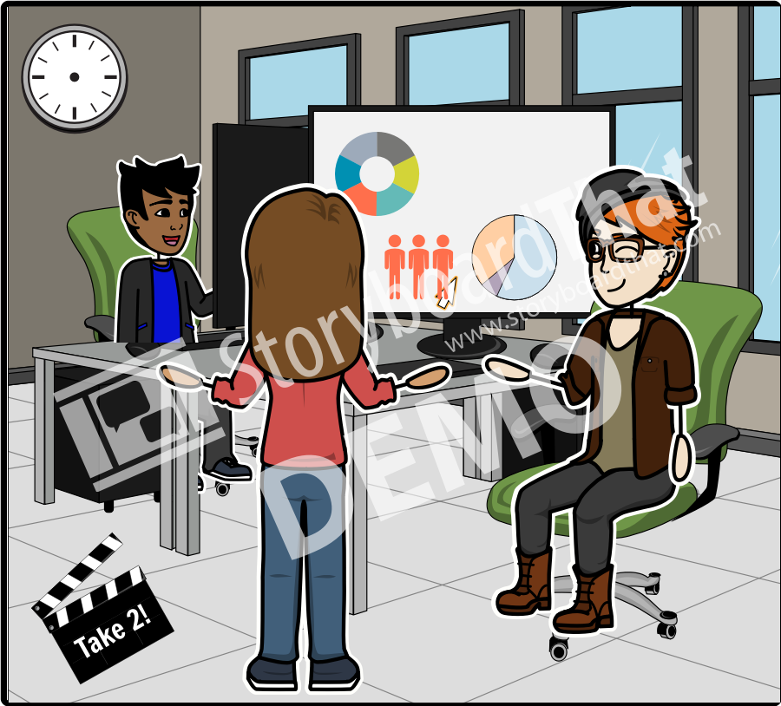
Iteration
Use that feedback to make necessary changes in the design of the activity/project. Keep testing and using feedback until you have fine tuned the solution. This may take a few rounds! When you have found the solution, move to implementation.

Slide 53
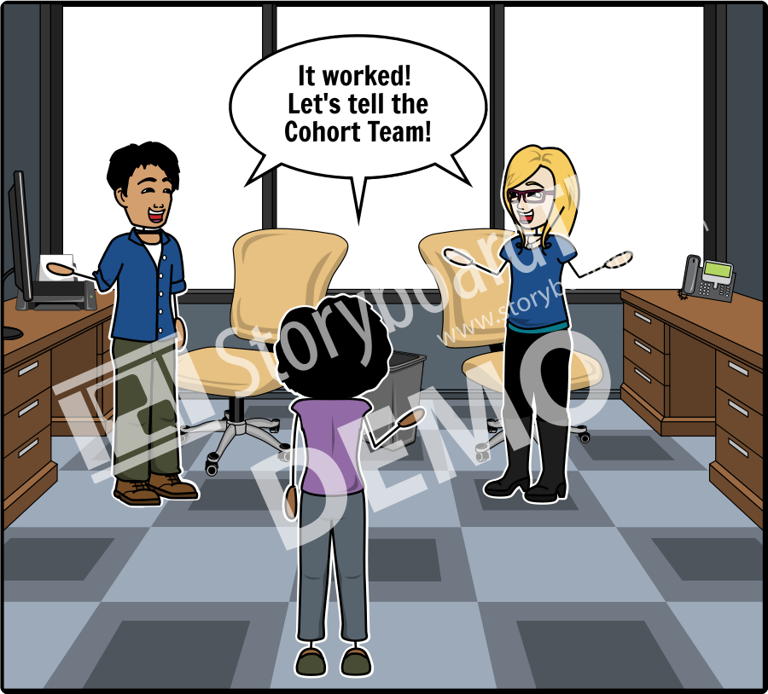
Implementation
You have found what works! Now share your idea, activity/program model with the world!

Slide 54
Out of School Youth

Slide 55
Amy Landesman
alandesman@mahernet.com
917-847-0474
Matt Musante
mmusante@mahernet.com
413-695-6937
Out of School Youth

