Slide 1
Adult Education and Family Literacy Act Program (Title II of WIOA) and Reentry Employment Opportunities
June 12, 2018
Department of Education
Department of Labor

Slide 2
Charlotte Harris
Workforce Analyst
U.S. Department of Labor
Employment and Training Administration
Office of Workforce Investment

Slide 3
Chris Coro
Deputy Director
Division of Adult Education and Literacy
Office of Career, Technical, and Adult Education (OCTAE)
U.S. Department of Education
Lekesha Campbell
Management and Program Analyst
Division of Adult Education and Literacy

Slide 4
Alexander M. Green
Workforce Analyst
U.S. Department of Labor-ETA
Reentry Employment Opportunities (REO)
Office of Workforce Investment
Division of Youth Services

Slide 6
Rate your knowledge of the WIOA Adult Education and Family Literacy Act program:
I’m an expert.
I know a fair amount, but not an expert.
I know a little bit, but would love to learn more.
Never heard of it.

Slide 7
Which of the following statements is false?
The AEFLA program serves both in-school and out-of-school youth over the age of 16.
The largest group of students served through the AEFLA program are English language learners.
The AEFLA program is required to ensure alignment of local programs with the local plan.
The AEFLA program may fund training services in coordination with adult education and literacy services.

Slide 8
Adult Education and Family Literacy Act Program (Title II of WIOA)

Slide 9
Overview of the AEFLA Program
The Adult Education and Family Literacy Act program (AEFLA), enacted as Title II of the Workforce Innovation and Opportunity Act (WIOA), is the primary Federal program that provides foundation skills below the postsecondary level and English literacy instruction (or EL) for out-of-school youth and adults.

Slide 10
AEFLA Program Purpose
The program seeks to:
assist students in acquiring the skills and knowledge necessary for employment and economic self-sufficiency;
assist parents or family members in obtaining the education and skills necessary to become full partners in the educational development of their children and lead to sustainable improvements in the economic opportunities for their family;
assist adults in attaining a secondary school diploma and in the transition to postsecondary education and training
assist immigrants and other English language learners improve their reading, writing, speaking and English comprehension skills and mathematics skills

Slide 11
What are adult education and literacy activities?
Programs, activities, and services include:
Adult education | Literacy
Workplace adult education and literacy activities | Family literacy activities
English language acquisition activities | Integrated English literacy and civics education
Workforce preparation activities | Integrated education and training

Slide 12
Target Population
The program provides educational opportunities for youth and adults who:
Are over the age of 16,
Are not enrolled or required to be enrolled in school, and
Are basic skills deficient, do not have a high school diploma or equivalent, or is an English language learner.

Slide 13
AEFLA Funding Structure
2018 Appropriations (rounded) | $630,667,000
Adult Education State-Administered Basic Grants | $616,955,000*
National Leadership Activities | $13,712,000
*Includes $542,832,558 for Basic State Grants and $74,034,600 for the Integrated English Literacy and Civics Education (IELCE) program. WIOA designates 12% of total AEFLA appropriations to fund the new IELCE program.
Of the formula grant (Adult Education State-Administered Basic Grants):
States distribute 82.5% of funds competitively to local adult education providers (including up to 20% to support correctional education)
12.5% of funds used to support State leadership activities
5% of funds used for administrative expenses

Slide 14
State-Administered Adult Education Program Eligible Agencies
Technical and Adult Education Workforce 05
Department of Labor
06
Community, Technical College or University 17*
State Education Agency 29**
*Includes American Samoa, Guam, Northern Marianas College
*Includes District of Columbia, Palau, Puerto Rico, Virgin Islands

Slide 15
Local Adult Education Providers
Eligible providers are organizations that have demonstrated effectiveness in providing adult education and literacy activities and may include:
Local educational agency | Community-based/faith-based orgs
Volunteer literacy orgs | Institution of higher education
Public/private non-profit agency | Libraries
Public housing authority | Non-profit institution that has the ability to provide adult education activities
Consortium/coalition or agencies, organizations, institutions, libraries or authorities described | Partnership between an employer and entity able to provide adult education services

Slide 16
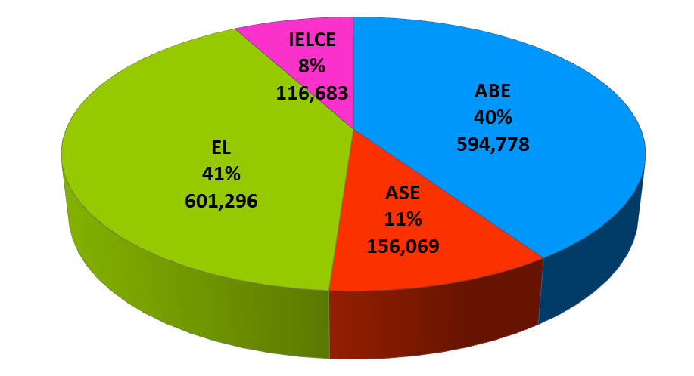
AEFLA Instructional Services
Instructional services offered in four areas:
Adult Basic Education (ABE) – basic skills instruction below the high school level
Adult Secondary Education (ASE) – high school level instruction
Integrated English literacy and Civics Education (IELCE) – instruction in literacy, English language acquisition, and the rights and responsibilities of citizenship and civic participation; and
English Literacy (EL) – English language instruction for adults who lack proficiency in English or seek to improve their literacy and competency.

Slide 17
New AEFLA Requirements under WIOA
Key changes under WIOA include:
Expands purpose related to immigrants and English language learners and includes transitions to postsecondary education through career pathways
Establishes three new activities:
Integrated education and training
Workforce preparation activities
Integrated English literacy and civics education program, which includes an IET component
Encourages activities that support alignment of core programs, including:
One-stop partnership requirements
Performance accountability requirements among core programs
Submission of local provider applications to local board for review to ensure consistency with local plan

Slide 18
One Stop Partnership Roles and Responsibilities
The AEFLA State Eligible Agency is the required partner in the one-stop delivery system.
The eligible agency may designate its responsibilities to one or more local providers in the area
The local provider then assumes the roles and responsibilities of the one stop partner, including contributing to infrastructure costs.

Slide 19
Performance Accountability Requirements
AEFLA program subject to the six common performance indicators:
Measurable Skill Gains - measured by achieving an educational functioning level gain (ABE, ASE, EL, etc.) or by the attainment of a secondary school diploma or its recognized equivalent.
Employment indicators (employment in 2nd and 4th quarter after exit; median earnings; effectiveness in serving employers) – excludes participants in a section 225 program for corrections education.
States negotiate adjusted levels of performance with federal (OCTAE) staff and submit state-level data to the federal office through the National Reporting System for Adult Education.

Slide 20
Adult Education Program Enrollment

Slide 21
Enrollment by Age Group

Slide 22
Enrollments by Ethnicity
Race/Ethnicity | PY 2014 | PY 2016
Black or African American | 315,874 | 285,714
Hispanic | 662,941 | 657,792
American Indian or Alaska Native | 15,878 | 14,411
Native Hawaiian or Other Pacific Islander | 5,330 | 4,720
Asian | 132,651 | 139,207
White | 368,456 | 334,467
Two or More Races | 34,009 | 32,018
Hispanics continue to be the largest population served by AEFLA programs (43% in PY 2014; 45% in PY 2016)
Percent decrease for two groups with largest drops: Black/African American (-10%); White (-9%)
Percent increase for only one group: Asian (+5%)

Slide 23
WIOA AEFLA Page
WIOA Title II Regulations (34 CFR Parts 462 and 463)
National Reporting System for Adult Education Technical Assistance
LINCS Community, Courses, and Resources for Adult Education

Slide 25
Reentry Employment Opportunities (REO)

Slide 26
REO Program Goals
Improve workforce outcomes for justice-involved youth, young adults and adults.
Projects typically incorporate mentoring, job training, education, legal aid services, and other transitional services.
Projects are located in areas with high rates of poverty and crime, serving those communities most in need.

Slide 27
Program Components – REO ADULTS
REO adult programs provide employment-focused services to formerly-incarcerated individuals age 18 and older, such as:
occupational skills training in demand industries leading to industry–recognized credentials
basic skills remediation
career counseling
case management
job placement and referrals to other transitional services.

Slide 28
Program Components – REO Youth/Young Adults
REO Youth/Young Adult programs serve youth and young adults between the ages of 14 to 24 that have been involved in the juvenile justice or adult criminal system.

Slide 29
Program Components – REO Youth/Young Adults
tutoring
mentoring
career exploration
summer employment and internships
occupational skills training in demand industries leading to industry –recognized credentials
restorative justice
career counseling
case management
job placement
Legal services
referrals to other transitional services

Slide 30
Federal Bonding
Program (FBP)
In 1966, the U.S. Department of Labor (USDOL) created the Federal Bonding Program (FBP) as an employer job-hire incentive. Federal financing of Fidelity Bond insurance, issued free-of-charge to employers, enabled the delivery of bonding services as a unique job placement tool to assist formerly incarcerated individuals and other at-risk/hard-to-place job applicants (e.g., recovering substance abusers, welfare recipients, poor credits, etc.)

Slide 31
Federal Bonding
Program (FBP) (Continued)
Bonds are provided at no cost to the employer or to the job-candidate through their State Bonding Coordinator.
The bond reimburses the employer for the dishonest acts of the employee for a six month term and may be renewed for a second six month term upon request.
Each bond has a $5,000 limit with $0 deductible so there are never any out-of-pocket expenses borne by the employer; and there are no applications for the employee or employer.

Slide 32
Work Opportunity Tax Credit (WOTC)
The Work Opportunity Tax Credit (WOTC) is a Federal tax credit available to employers for hiring individuals from certain target groups, which include ex-felons who have consistently faced significant barriers to employment.

Slide 33
Work Opportunity Tax Credit
(cont’d)
WOTC certified new hires working at least 120 hours, employers can claim 25% of first year wages paid up to $6,000 for a maximum credit of up t $1,500 per person; or
WOTC certified new hires working at 400 hours or more, employer can claim 40% of the first year wages up to $6,000 for a maximum tax credit of up to $2,400 per person.
For more information: www.doleta.gov/business/incentives/opptax

Slide 34
Web Resources
Portal for Employers – Provides employers with a one-stop shop for information on the benefits of hiring persons with criminal records. www.CareerOneStop.org/reentry
Portal for Justice-Involved Individuals – Provides information, career guidance resources and tools to persons with criminal records. http://www.careeronestop.org/ExOffender/index.aspx

Slide 36
FOR MORE INFORMATION:
www.doleta.gov/REO

Slide 37
Chris Coro
Deputy Director
Division of Adult Education and Literacy
Office of Career, Technical, and Adult Education (OCTAE)
U.S. Department of Education
Christopher.coro@ed.gov
Lekesha Campbell
Management and Program Analyst
Division of Adult Education and Literacy
Lekesha.campbell@ed.gov

