Slide 1


Integrated Business Services: A Road to Success
June 12, 2018
Integrating Business Services

Slide 2

Spring 2018 National Innovation Cohort: Outcomes
Florida: Effective State and Regional Business Engagement
Shenandoah Valley (VA): Building Out the Business Services Team
Resources and Next Steps

Slide 3
Today’s Moderators & Presenters
Moderators
Jeff Ryan, Business Solutions Specialist, U.S. DoL/ETA
Todd Cohen, Director of Strategic Initiatives, Maher & Maher
Presenters
Dr. Sharon Johnson, CEO, Shenandoah Valley Workforce Development Board, Inc.
Andra Cornelius, Senior Vice President, Business & Workforce Development, CareerSource Florida
Melissa Terbrueggen, Regional Director of Economic Development and Business Services, CareerSource Northeast Florida
Christine Quinn, Regional Administrator, U.S. Department of Labor, Employment and Training Administration, Region 5

Slide 4
2018 U.S. DOL/ETA Innovation Cohort on Integrated Business Services
Challenge: How can talent development organizations better collaborate to respond to regional demand?
LWDB
CBO
Integrated
Business Services
Post-secondary
Eco Dev
Voc Rehab
CBO
SWDB
LWDB

Slide 5
We Tackled Common Pressing Challenges
High quality business engagement (what does this look like as a ‘whole’? And what does putting business at the center really mean?)
Business services integration
  Visioning (which partners are in the mix?)
  Data/CRM ($, confidentiality)
  Operationalizing (staffing, intel sharing, BSR skill sets)
  Sustainability (measuring beyond WIOA)
  State vs. local role

Slide 6
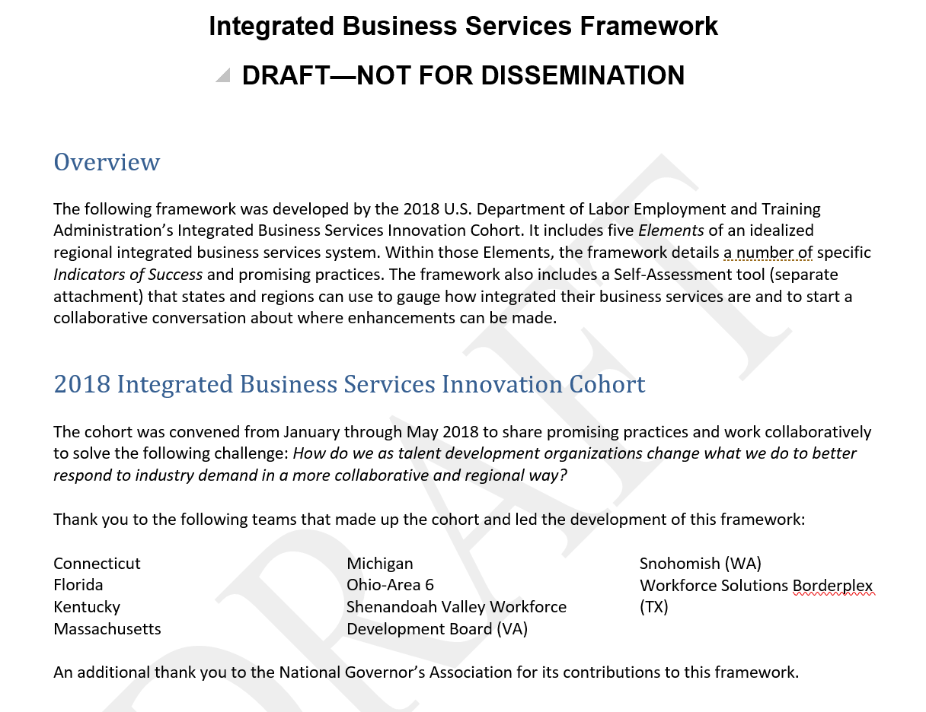
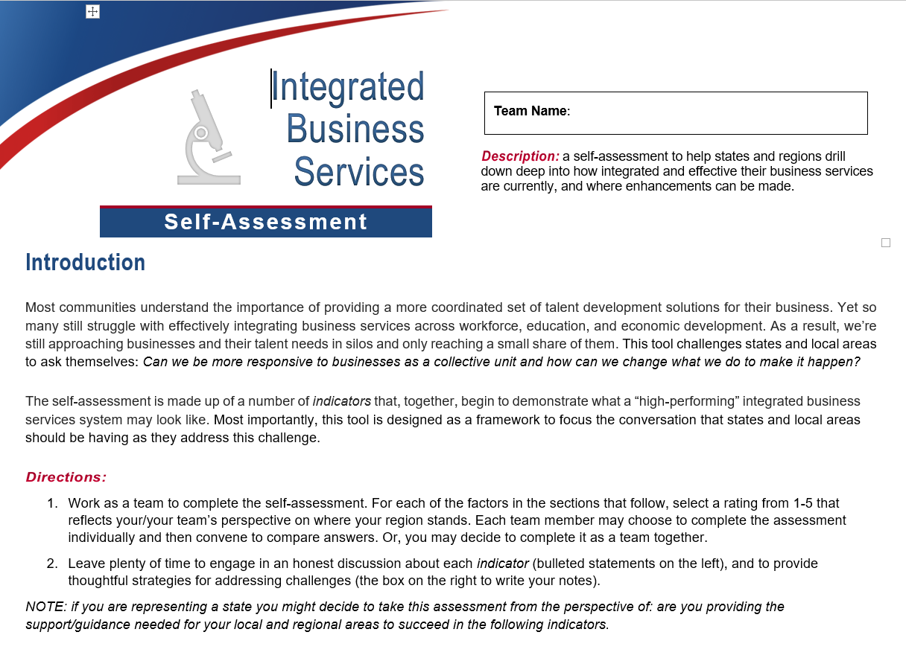
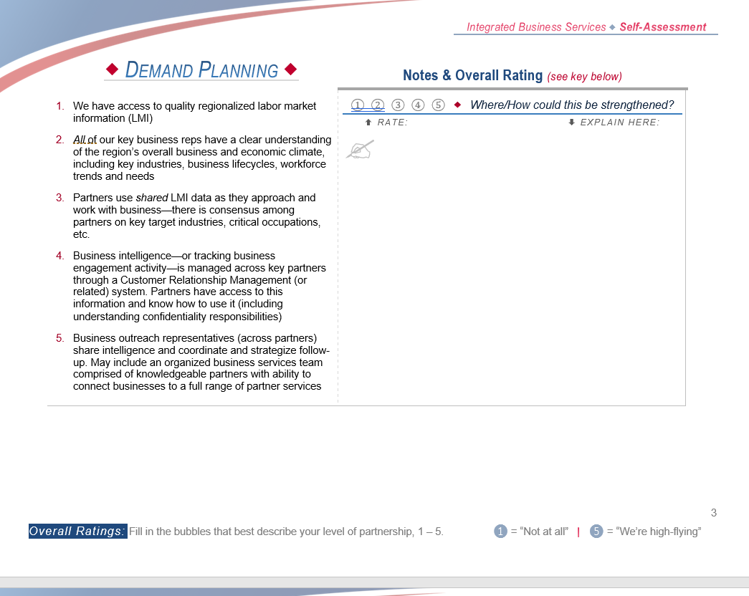
2018 USDOL Innovation Cohort & Outcomes
Connecticut
Florida
Kentucky
Massachusetts
Michigan
Ohio – Area 6
Texas – Borderplex
Virginia-Shenandoah Valley
Washington – Snohomish

Slide 7
Florida Business Services:
State and Local Dynamics
June 12, 2018

Slide 8
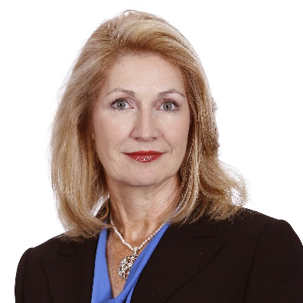
Florida Workforce System
and State Role
Andra Cornelius, CEcD
Senior Vice President, Business &Workforce Development

Slide 10
Business Outreach
State Role in Supporting Business Outreach
The Five “C’s”:
  Communicate
  Capacity-Building
  Calculate
  Compel
  Correct

Slide 11
Business Outreach
The Five “C’s”:
  Communicate:
    The Vision / Tell the Story
    Dashboard of Key Accomplishments
    Identify Business Champions & Personal Stories of Lives Changed
  Capacity-Building:
    Leverage Strategic Partnerships
    Training and Tools
    Sharing Peer-to-Peer Best Practices
    National Leadership

Slide 12
Business Outreach
The Five “C’s”, continued:
  Calculate:
    Performance Metrics
    Accountability / Transparency
    Research
  Compel:
    Vision / Mission / Promise
    System Values
    Encourage innovation – Discretionary Funds
  Correct:
    Eliminate hurdles in policy / guidance

Slide 13
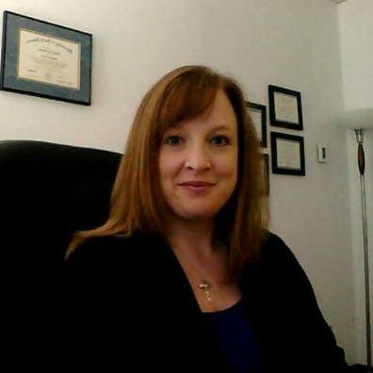
Local Role in Supporting Business Outreach
Melissa Terbrueggen
Economic Development and Business Services
CareerSource Northeast Florida

Slide 14
Business Outreach
Local Role in Supporting Business Outreach
  New structure for serving businesses
  Identifying targeted industries and developing a plan
  Connecting workers and jobs
  Strength in partnerships

Slide 15






Expanding Business Engagement
July 1, 2017 – April 30, 2018
Businesses Served Statewide
Quick Response Training Grant Projected Trainees
Open Job Positions
(April)
57,259
3,109
244,272
Industries of Focus
Top Industries
Unemployment Rate (Florida)
Unemployment Rate (National)
Healthcare
Manufacturing
Advanced Manufacturing
Corporate Headquarters Software Publishers
3.9%
April
3.9% April
4,367
businesses
4,717
businesses
High-Value Services Provided to Businesses
Incumbent Worker Training Grant Projected Trainees
Job Seekers Placed with CareerSource Florida Network Assistance
100,737
4,018
184,441
Top Trainings
Talent Acquisition
Human Resources Services
Customized Training
Lean, ISO, Six Sigma
Computer
Leadership
Private-Sector Jobs Created Since Dec. 2010
1,516,900

Slide 16
The Florida Team
Andra Cornelius, CEcD
CareerSource Florida
Jim McShane
CareerSource Capital Region
Beth Kirkland
Florida Economic Development Council
Katie Smith
Dept. of Economic Opportunity
Emily Sikes
State University System
Keantha Moore
Dept. of Economic Opportunity
Melissa Terbrueggen
CareerSource Northeast Florida
Kathy Davis
Florida Division of Vocational Rehabilitation

Slide 17
Opportunities Ahead
Vision:
Florida will be the global leader for talent by collaborating, innovating and leading market-relevant business services across talent supply organizations to meet market demands today and tomorrow.

Slide 18
Opportunities Ahead
Top Three Strategies:
Mine Industry Data Sources
Use a Common Technology Tool
Form a “Tiger Team”

Slide 19
Opportunities Ahead
Top Three Strategies:
Mine Industry Data Sources
  Asset-map existing data sources by partner
  Create Skills Gap report by Sector
  Create training for Business Services Team

Slide 20
Opportunities Ahead
Top Three Strategies, Continued:
Use a Common Technology Tool
  Asset-map partners with a CRM, data fields, costs
  Create a collaboration charter
  Create training on the tool

Slide 21
Opportunities Ahead
Top Three Strategies, Continued:
Form a “Tiger Team”
  Response team for Economic Development Opportunities (short-term) and talent pipeline development strategies (long-term)
  Create a collaboration charter
  Review existing laws / policies enabling joint work
  Process map talent solution—by company & sector

Slide 22

Questions?

Slide 23
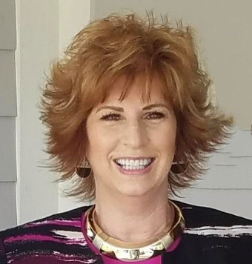

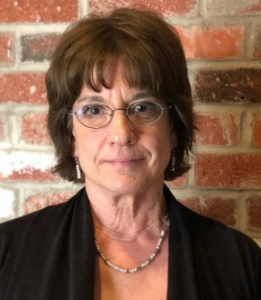
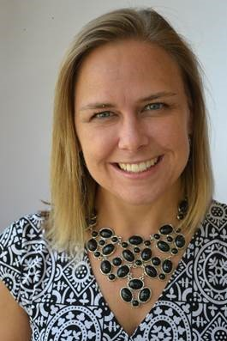
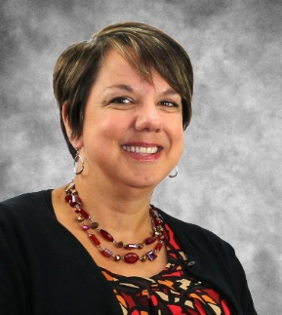
Shenandoah Valley Workforce Development Board - Virginia
Integrated Business Services Action Plan
Dr. Sharon Johnson, CEO
Shenandoah Valley Workforce
Development Board
Jeanian Clark, Vice President
Workforce Solutions
Lord Fairfax Community College
Joan Hollen, Data & Comm. Specialist
Shenandoah Valley Workforce
Development Board
Mary Ann Gilmer, Vice President
Mission Services
Goodwill Industries of the Valleys
Debbie Melvin, Asst. Vice President
Workforce Development
Virginia Economic Development Partnership
The Shenandoah Valley Team

Slide 24
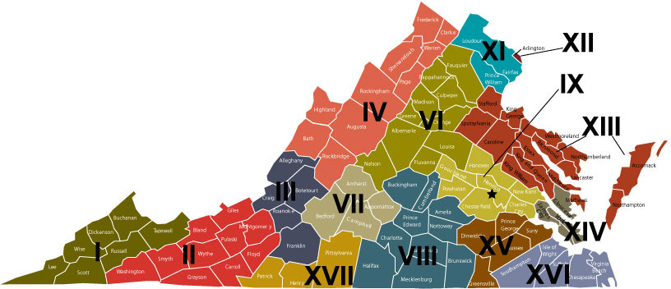
Shenandoah Valley Integrated Business Services - Background
Geographic location and service region
Alignment of two Business Services Teams
Shenandoah Valley Region is known for collaboration
Virginia Career Works: Workforce System Branding Initiative
Local areas act autonomously (training, outreach materials, CRM, funding, models)
Business Services Requirements Policy effective 10/1/17
State Business Services Team

Slide 25

Integrated Business Services - Challenges
Why integrated business services? Why now?
Getting the right people to the integration table
Fitting the statutory requirements of partner programs in an
integrated business services model
Understand now and re-engineer for the future
Getting to a common communication tool (Customer Relationship Management)
Local Workforce Development Board (LWDB) role to convene team and coordinate business service activities

Slide 26

Integrated Business Services
Start the Conversation: Integrated Business Services
Self Assessment
Developing a shared vision
Asset mapping and understanding performance metrics
Functional Alignment: Streamlined business process, preventing duplicative services and business contacts, leveraging resources
Business services training for all partners: Sector Strategies Academy
Outreach Plan: Development of business services app
Integrated Business Services Plan template

Slide 27
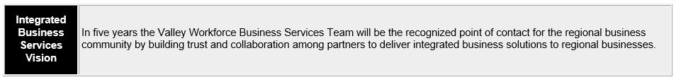

Slide 28
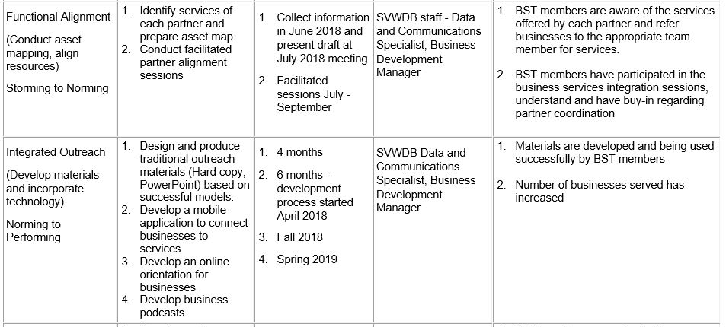

Slide 29
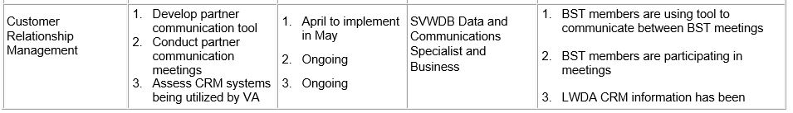

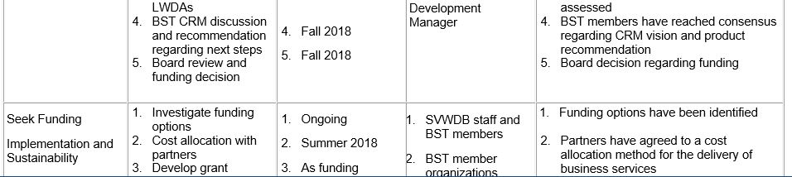
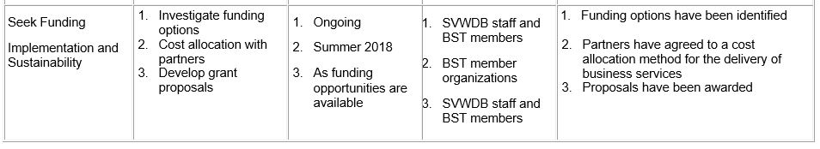

Slide 30
Questions?

Slide 31

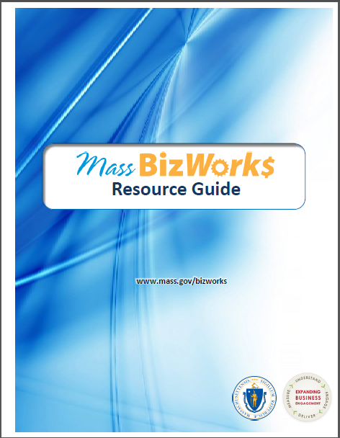
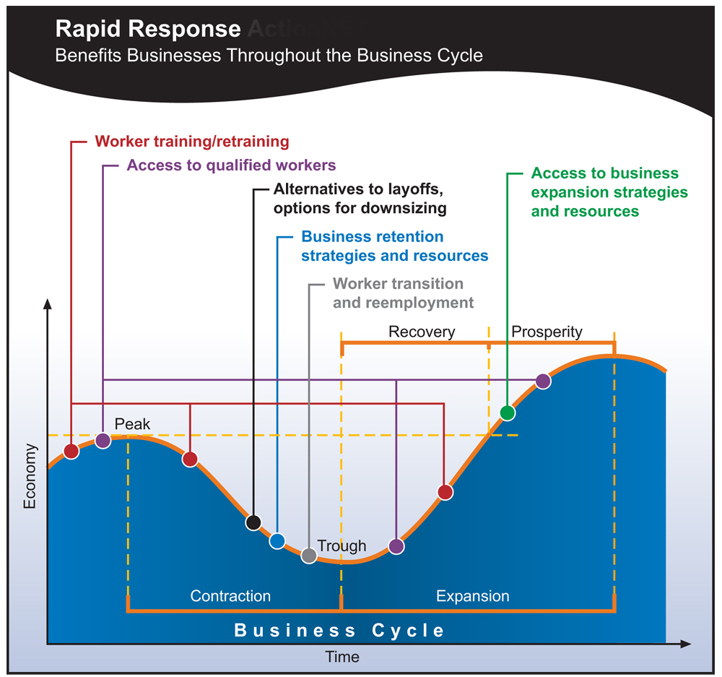

Other Cohort Promising Practices, Resources for View

Slide 32
Other Promising Practices, Resources for View
Three Step Process
Learning about the Business (targeted Interview using Synchronist; Assess Business Challenges and Opportunities)
Creating and Delivering a Customized Solution (Customized Proposal Delivered)
Providing Continued Support (BRN rep coordinates selected services; continues contact)
Ohio Area 6: Business Resource Network

Slide 33
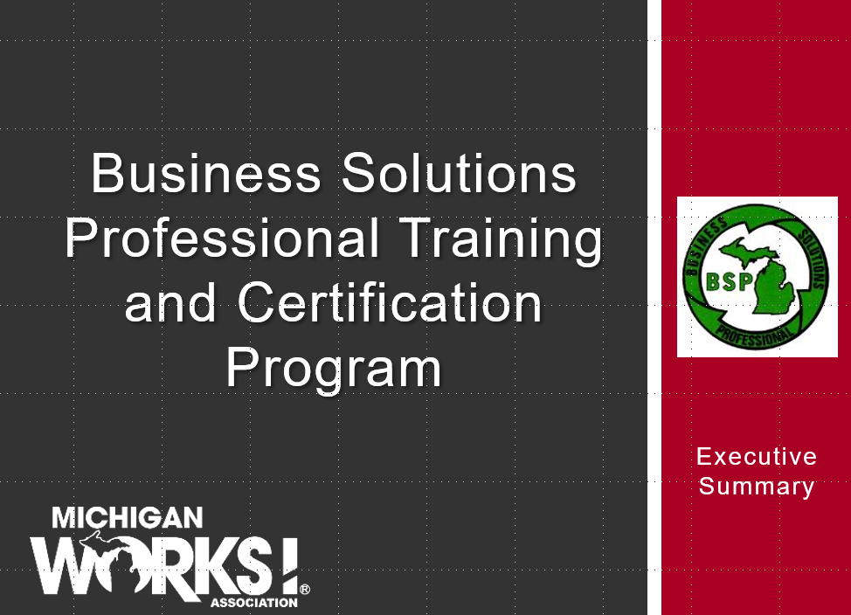
Other Promising Practices, Resources for View

Slide 34
Self-Assessment Tool

Slide 35
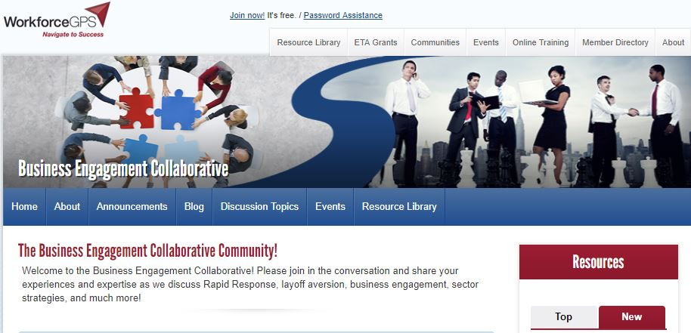
Other Promising Practices, Resources for View
…and many more. Available soon at https://businessengagement.workforcegps.org/

Slide 36

Where to go From Here?
We will be proposing ways to incorporate the Framework into future DOLETA guidance
Keep checking back to DOLETA Business Engagement CoP for more resources, tools
Early stages of a possible national convening on this topic. Stay tuned to the CoP!

Slide 38
Christine Quinn
  Regional Administrator
    USDOL/ETA
  Quinn.Christine@dol.gov
Jeff Ryan
  Business Solutions Specialist
    USDOL/ETA
  Ryan.Jeff@dol.gov
Susan Rusch
  Consultant
    Maher & Maher
  srusch@Mahernet.com
Todd Cohen
  Director, Strategic Initiatives
    Maher & Maher
  tcohen@Mahernet.com

