Slide 1
Future of AJCs Cohort Getting Inspired - The Future of Work
Thursday, June 14th, 2018
Future of AJC’s

Slide 2
Welcome!
Charlotte Harris
National Office
US Department of Labor/ETA
Future of AJC’s

Slide 3
Let us know you are here in the chat window to your left...
Welcome!
Future of AJC’s

Slide 4
Today’s Agenda
Welcome & Discuss Cohort Purpose
Discover Cohort Process
Understand Current Challenges
Explore Three Focus Areas for the Future of AJCs, Ideas and Potential Solutions
Cohort Panel Discussion

Slide 5
Meet Your Cohort Team
Organization | State | Region
NY State Department of Labor (state/local) | NY | 1
NJ Department of Labor and Workforce Development | NJ | 1
Mass. Dept of Career Services (state/local) | MA | 1
Pennsylvania Department of Labor & Industry | PA | 2
Northern VA WF Dev. Area | VA | 2
Northeast Workforce Dev. Brd | OK | 4
IL AJC Workforce Consortium | IL | 5
WF DEV Brd of Central Ohio | OH | 5

Slide 6
Cohort TA: This is Different!
Team time + cross-state/regional collaboration
Problem solving
Participant-driven!
Think “Innovation Lab”
Ideas that drive integration
Promote improved efficiencies
Get ahead of ETA ideas
Future of AJC’s

Slide 7
What were the Objectives & Expectations of this cohort?
Focus on re-engineering services based on the needs of their worker and business customers
Participate with peers across the nation as we ignite collective, creative brainstorming, in search of our most innovative solutions
Explore how technology can be a tool that aids us in improving service delivery and management of the workforce system.
Future of AJC’s

Slide 8
ETA Sponsors
Tim Martin
Region 1
US Department of Labor/ETA
Leo Miller
Region 2
US Department of Labor/ETA
Charlotte Harris
National Office
US Department of Labor/ETA
Future of AJC’s

Slide 9
Christy Montgomery
Senior Analyst
Maher & Maher
Matt Musante
Analyst
Maher & Maher
Geoff King
Senior Policy Analyst
National Governor’s Association
Future of AJC’s

Slide 10
Looking Into the Future
The Future of Work
Future of AJC’s

Slide 11
There are 53 million freelancers in America today. By 2020, 50% of the U.S. workforce will be freelancers.
Forbes Magazine
Jan. 26, 2016

Slide 12
This on-demand work, instant gig economy is moving more and more into independent professionals that are using mobile and technology to create ecosystems of work they enjoy.
Forbes Magazine
Jan. 26, 2016

Slide 13
In a Freelancer Dominated Economy:
Ask ourselves:
What would an AJC look like?
What services would we provide?
Would we incorporate shared workspace for entrepreneurs?
What skill sets would we need to teach?
Future of AJC’s

Slide 14
Rohit Talwar, Futurist Economist Focuses on Humans and Technology in Collaboration
Star Trek
Economy

Slide 15
Exponential Science & Technology Developments
A Path to Abundance?
3D & 4D Printing
Food Chain Transformation
Energy Innovations
Robotics/Drones
Brain Uploading
Healthcare Transformation
Human Augmentation
Synthetic Biology
Blockchain Technology
Immersivity/Mixed Reality Living
Hyper-connected Internet of humanity
New Computer Architectures
Nanotechnology
Atomically Precise Manufacturing

Slide 16
Hyperloop
700 mph subsonic train
Would take you from San Francisco to LA in 30 Minutes
Testing prototype in California
Cost is fraction of normal rail service
Can move water, fuel, and food

Slide 17
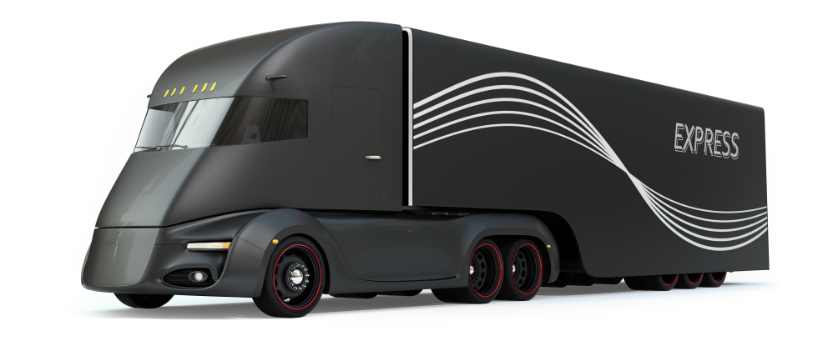
Driverless Cars
The UK is currently allowing driverless trucks on the road
They will drive in a convoy and the front truck will lead the convoy
In the U.S., up to six states have made driverless vehicles legal

Slide 18
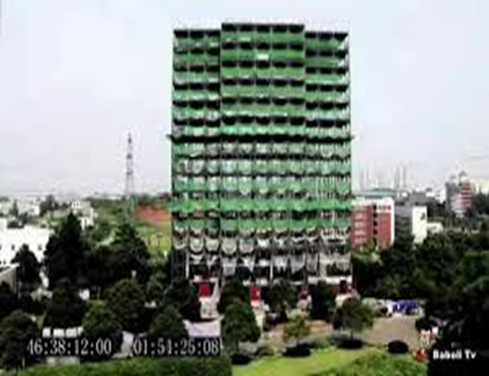
Rapid Execution of Construction
Source: https://www.wired.com/2012/09/broad-sustainable-building-instant-skyscraper/
Construction industry changing
Chinese Construction company, Broad Group built 30 story hotel in 15 days
Build to withstand magnitude 9 earthquake
Make everything in the factory
Plug together like Legos onsite

Slide 19
Future of Aging
Around the world, average age of life expectancy is rising
In the U.S., 65- to 69-year-olds grew the fastest.
This age group grew by 30.4 percent, (U.S. Census Bureau)
If you are under 50, you have a 90% chance of living to 100 years old
Metformin, a widely used first-line drug for treatment of type 2 diabetes (T2D), has been shown to extend lifespan and delay the onset of age-related diseases.
Future of AJC’s

Slide 20
Questions We Need to Ask Ourselves
How do we make sure we put people at the center of the story?
What are the broader social impacts?
How do we truly look into the “Future” of AJCs
How do we execute now, while developing a “long-path” approach for the future?
Future of AJC’s

Slide 21
Let’s Look at the Uber’s of the World
When companies like Uber are hiring 22 year olds and making them the Director of Countries
Asking Directors to sign up 100,000 drivers in one year
Allowing them to lead and telling them if you make a mistake we will help you... JUST GO FOR IT!!!!
Future of AJC’s

Slide 22
How Do We Drive Passion?
Ask yourselves, “How am I driving passion within my organization?”
Do you see clashes across those who are “tech” savvy and those who have more traditional skill sets?
Take an inward look at the strategies and opportunities you’ve put in place to allow your team to look into the future
Future of AJC’s

Slide 23
Elements of the Cohort Process
Look for outside inspiration from private industry
Examine effective practices currently employed at AJCs
Establish a baseline of current innovation levels
Examine the current customer experience
Creatively & collaboratively brainstorm innovative solutions through a virtual Innovation Lab

Slide 24
Themes and Patterns
Insights From Cohort Participants - Current Challenges, Best Practices and Opportunities
Future of AJC’s

Slide 25
Challenges Identified
Resources: shrinking resources while demand for services does not decrease, challenges leveraging/ coordinating funds from system partners and private sector
Data issues:
no single system across partners and different policies and procedures across partners
inability to track long-term outcomes/ assess big picture
inability to track referrals and follow-up/ get information from partner programs
Leveraging technology: Discomfort with technology among one-stop staff and customers, possible solution to reducing volume and improving in-person services
Awareness/ Marketing of Services: ensuring eligible clients are aware of services, branding is outdated and needs to be consistent across partners
Effective coordination among one-stop partners and services:
staff lack knowledge of partner programs, which inhibits effective referrals
addressing different rules and systems of programs is challenging
Gig economy: difficult to match clients with potential gig economy opportunities due to inability to count towards outcomes effectively/ enter as job orders through W-P

Slide 26
Current Strategies and Innovations Shared
Virtual career center services shared across workforce areas, including workshops (MA, PA)
Coordinated business engagement services (MA, IL, OH, VA)
Use of social media to engage customers (MA, PA)
Mobile one-stop services and/or apps (NY, OH)
Cross-training of core agency partners (IL, OH)
Dedicated resources for UI claimants both online and in AJCs (MA, PA)
Future of AJC’s

Slide 27
Current Strategies and Innovations Shared
Using one-stop certification and service integration policies to foster innovation and customer-centered design throughout the state’s one-stop delivery system (IL)
Common branding (MASS Hire)
Leveraging libraries to provide some one-stop services, in addition to adult education (NJ)
Burning Glass used to enhance LMI analyses beyond state systems (MA)
Use of Aztec literacy program for self tutoring and testing for adult education (NJ)

Slide 28
Looking Into The Future
AJCs Identified three areas of focus for Ideation:
Accessibility/Mobility of Services
Technology (advancements, opportunities)
Agility/Flexibility of Services (in response to relevant trends – Gig Economy, Economic, Workforce, etc.)
Future of AJC’s

Slide 29
Cohort Prototype (Ideas and Recommendations)
Bradley Burger, Pennsylvania President/CEO, Goodwill of the Southern Alleghenies
Jeffrey Turgeon, Massachusetts Executive Director, Central Massachusetts Workforce Investment Board
Future of AJC’s

Slide 30
Ideation
Highlights of Recommendations and Ideas to Explore for Future AJCs
Future of AJC’s

Slide 31
"How Might We... Design future American Job Center services that are fully accessible to ALL customers, including services that are mobile?”
Future of AJC’s

Slide 32
New Access Points to AJC Services – Physical and Technology-Based
Mobile AJC
Partner and combine with food banks, services for kids (childcare, other)
Pop-up store concept
Schools as "workforce hub" for getting to work, workshops, and accessing services
(band room example from PA - renovate an existing space - make it look inviting).
Buses already in place - have parents access too. Rural benefits from this strategy.
Goodwill stores - career corner
job search and LMI; retail location opportunities
Prison-based services (OH example - training module),
working with transferrable skills and VR services; also support and health services co-location
Shopping malls
link to people while doing other activities
Business - Tech Center partnerships
classes related to building their products and testing out talent

Slide 33
Technology-Based Access Points
Service delivery kiosks
widely distributed in public spaces
Services by Skype
Connect with video calls to access case managers and other staff
Develop apps for smart phones
put all resources (orientations, trainings, application for services, etc.)
Consult millennials on design
Online presence –
videos, tutorials, staff/ software providing info including accessibility features; teleconferencing services; comprehensive online portal
Virtual access tools like SARA : Socially Aware Robot Assistant – virtual assistant
Future of AJC’s

Slide 34
AJC Design and Format Redesign
Adjust hours to fit schedules of jobseeker and business clients
Adjust design of space
Reshape whole look of AJC and make inviting
Create multiple environments in AJC
Not just required services Partner agency co-location
Navigator staff
Assist with accessing key services as part of virtual and in-person service
Accessibility considerations - serving ESL, those with vision and hearing-related disabilities, service animals
Robot as remote greeter for intake and info (PA Example)
Virtual service provision (mix of virtual and bricks and mortar)

Slide 35
Addressing Technology Change with Clients and Balancing Different Needs and Comfort Levels
Digital literacy issues and access to tech to overcome
(WIOA Title 4 and Title 2 service providers are already focused on education related to this to some extent, so possible resource to leverage more broadly);
Ensure some in-person interaction still happens when needed
Significant education needed on Skill gaps related to technology and where future of work is going
Future of AJC’s

Slide 36
"How Might We... Adapt to and take advantage of advancements in technology to better reach and serve future AJC customers?”
Future of AJC’s

Slide 37
Automated/ Technology-Facilitated Service Provision
AI systems
chatbots, save staff for more complex tasks
self services are part of life now, model on other businesses;
Applications of block chain; data in hand drives AI
Virtual job coach/ employment app
Connect partners through videoconferencing to allow for real-time case management of co-enrolled partners
Web-based systems that have accessibility built in
model on health industry and other private sector models
buy-in from senior management and staff training needed
Future of AJC’s

Slide 38
Automated/ Technology-Facilitated Service Provision
Mobile-phone service delivery - real time services through those devices and majority of individuals have;
Could deliver workshop videos, career education content, and testing;
Use of texts alerts
need to make websites and other items more mobile friendly, make use of location services;
Make the technology user friendly, and more self-service. Offer, chats, and/or video assistance for those that need help.
Use of video game or VR to draw interest in services
Resource reductions to drive further automation
Outsource items outside our core strengths and leverage tech companies for theirs
Use of competitive bid processes - more open ended - let tech companies tell us what they can do

Slide 39
Automated/ Technology-Facilitated Service Provision
New Technology-Facilitated Processes
Automated job matching - real time access to leads looking for and match to staff helping fill - can offer more high touch where needed
Virtual job shadowing
Webinar training modules
One-time data entry processes/ communication between systems - ensure no repetition in data entry
Future of AJC’s

Slide 40
Technology Investments/ Policy Considerations
National platforms for data and other more standardized tasks could be helpful
cost savings and ease of use across jurisdictions benefits from larger scale
maintenance as important as build out
Educate leaders on technology needs so that policy/resources can support these changes.
Access for rural areas can still be challenging –
satellite as one possible current resource
broadband updates needed (municipal and state support possibly - Chattanooga, TN example)
leasing access spaces for rural clients in places with wi-fi access (AJCs as one possibility)

Slide 41
"How Might We... be both agile and flexible in our service delivery and structure, creating a system that is responsive to new economic and workforce trends (e.g. Gig Economy and new trends on horizon)?”
Future of AJC’s

Slide 42
Policy Changes/ High-Level Support
Federal Partner Support
Form an interdisciplinary panel of experts (science, technology, demography, economics, etc.) to help us sort through which trends are "response-worthy" and review proposals for change: Hone in on changes that are important across disciplines
Flexibility in performance - hard to innovate when there are risks to serving higher barrier populations based on outcomes criteria (re-entry example);
Unemployment drop means need to serve more high barrier populations, so need more flexibility (goal of WIOA too).
Future of AJC’s

Slide 43
Federal Partner Process Changes
Consider allowing flexible pilots and quick turnaround approvals of them; accountability still there, but look towards future needs and help innovate accordingly
Flexibility in federal grant implementation, including spending categories and eligibility - free of fear from not just performance but learning how to reach new clients too and allowed to do that
Consider giving stronger direction to those that interpret and audit the programs/grants would allow for more flexibility, creativity and agility.
Future of AJC’s

Slide 44
Staff Models
Develop new AJC staff position that is primarily focused on strategy and service delivery model changes - focused on flexibility, researching future trends and developing models to meet them
Utilize the center staff for onboarding services, professional recruiting and incumbent training for retention services.
Allowing your staff to help develop the changes, implement changes and adjust as needed knowing that you are trying to find the right key and willing to adjust and try again if needed builds confidence to change
Future of AJC’s

Slide 45
Professional Development
Front line staff training - free form discussion on how to do work differently - good product from process (Allegheny example)
Model desired behavior - create culture of calculated risk taking and reward good ideas; get past "we've always done it this way"
Staff training to ensure all staff up on current and future workforce needs
Future of AJC’s

Slide 46
Client Feedback and Information from Data
Regularly confer with our customers and front line staff to find out what trends they're seeing that excite/worry/frighten them
create new advisory structures to build in their insights - possibly via board or a committee (new members as jobseekers move through system)
Input from front line staff
Data gathering capabilities – ensure that technology upgrades track how services are used to assess what’s working and document performance
Future of AJC’s

Slide 47
Gig Economy and Career Navigation
Provide counseling that reconciles current career perceptions with the need for agility and flexibility
Difficult for many to navigate gig economy
Be realistic on career pathway options related to gig economy.
Important to educate parents about jobs of future too – context setting for careers and pathways
Consider training programs for AJC clients, educational institutions, and staff on what future of work is.
Get school counselors and teachers involved.
Example: Externships with employers for 4 weeks with stipends to learn about manufacturing firms - consider other career paths based on their experiences. Alignment in message on career options across systems.

Slide 48
Cohort Panel Discussion
Bradley Burger, Pennsylvania President/CEO, Goodwill of the Southern Alleghenies
Katie Geise, New York Executive Director, Chautauqua Workforce Development Board
Jeffrey Turgeon, Massachusetts Executive Director, Central Massachusetts Workforce Investment Board
Gretchen Evans, Oklahoma Northeast Area One Stop Operator, Oklahoma Works
Future of AJC’s

Slide 49
Future of AJC’s

Slide 50
Christy Montgomery
Senior Analyst
Maher & Maher
cmontgomery@mahernet.com
Matt Musante
Analyst
Maher & Maher
mmusante@mahernet.com

