Slide 1
Apprentice Outreach: Strategies and Tools for Recruiting a Diverse Workforce
July 10, 2018
Information for Apprenticeship Sponsors
Presented By: Office of Apprenticeship

Slide 2
Zachary Boren
Division Chief
Office of Apprenticeship
Employment and Training Administration
U.S. Department of Labor

Slide 3
Remind sponsors of outreach/recruitment requirements under apprenticeship EEO regulations
Demonstrate new Universal Outreach Tool
Discuss sponsors’ outreach strategies that expand apprentice recruitment

Slide 4
Layli Oliver
Project Manager/Sr. Analyst
Maher & Maher
Art Lujan
Special Assistant to the President
North America’s Building Trades Unions
Charnetia Young
Advisor, Workforce Initiatives
CVS Health

Slide 5
How do you currently recruit apprentices? [Check all that apply]
Word of mouth (through current workforce)
Outreach through education, workforce or community organizations
Company website
All of the above
Other (please specify)

Slide 6
Apprenticeship EEO Regulations: Outreach and Recruitment
Steps required of sponsors to fulfill universal outreach requirement:
Develop and annually update a list of recruitment sources
Identify a contact at each of these sources
Provide sources with advance notice of apprenticeship openings so they can refer candidates
Retain the information in apprenticeship recruitment records

Slide 7
Expanding Outreach and Recruitment
Broaden outreach to expand recruitment
Expand recruitment to provide opportunities to all available and qualified candidates

Slide 8
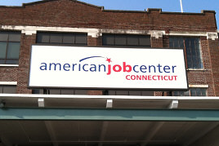
How Can Community Organizations Help Sponsors Recruit Apprentices?
By publicizing program openings to their customers
Identifying job-ready candidates for program openings
Partnering with American Job Centers, which routinely identify qualified candidates for employers in their communities

Slide 9
Sources That Will Generate Referrals from All Demographic Groups
Examples of sources serving broad client bases (listed in 29 CFR §30.3(b)(3)(i)):
American Job Centers/One-Stop Career Centers
Local workforce investment boards;
Community-based organizations;
Community colleges;
Vocational, career, and technical schools;
Pre-apprenticeship programs; and
Federally funded youth job-training programs such as YouthBuild and Job Corps
Examples of community-based organizations serving focused client bases:
National Urban League
Goodwill Industries
Disabled American Veterans Programs
YMCAs and YWCAs
Catholic Charities and other after-school programs for teens
Programs for women in the trades
Independent Living Centers

Slide 10
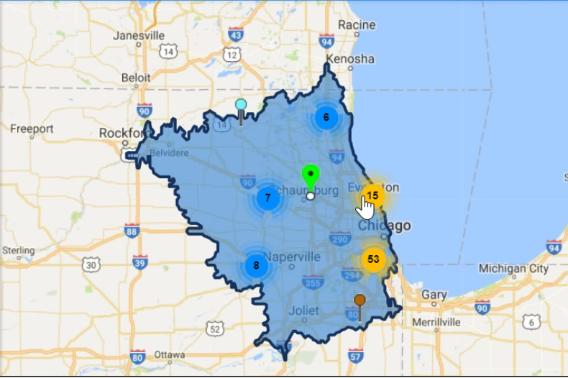
Universal Outreach Tool

Slide 11
Universal Outreach Tool
(demo of tool)

Slide 12
How the Universal Outreach Tool Can Help Sponsors Recruit
Use the tool to identify organizations and contacts
If necessary, visit those organizations’ websites and contact them to determine if they are an appropriate recruitment source
Include appropriate organizations on list of recruitment sources
Provide those sources with advance notice of openings
Refer back to the tool when updating recruitment list

Slide 14
North America’s Building Trades Unions (NABTU)
Art Lujan

Slide 15
More Information?
North America’s Building Trades Unions
And NABTU’s Committee of Women in the Trades
Diversity Toolkit
https://nabtu.org/wp-content/uploads/2017/07/Diversity-Toolkit-draft-6-15-17.pdf
Your Guide to Best Practices for Recruiting a
More Diverse Membership

Slide 16
More Information?
North Americas Building Trades Unions
Apprenticeship Readiness Programs

Slide 17
More Information?
The Apprenticeship Readiness Program is a comprehensive pre-apprenticeship training program that provides a gateway for community residents to gain access to Building Trades registered apprenticeships, which are jointly administered by labor and management.

Slide 18
More Information?
History
2007, Standing Committee on Apprenticeship and Training Committee created Apprenticeship Readiness Program curriculum – Multi-Craft Core Curriculum
ARPs sponsored by State and Local Building Trades Councils, Training Coordinators and JATCs in cooperation with local community groups, government agencies, schools (K-12 and community colleges), workforce investment boards and construction contractors

Slide 19
More Information?
Goals
Increase number of candidates for apprenticeship across all crafts
Increase diversity of apprenticeship candidates by recruiting women, people of color and veterans
Increase retention rate among apprentices by providing them with deeper understanding of the industry which allows them to make informed decisions on their career path

Slide 20
More Information?
ARP Statistics – Overview
Programs planned/in progress 2017 135
YouthBuildUSA programs in 16 states 25
40 ARPs in California, 14 CTE high school pilots
ARP Completions 2017 1,050
ARP Completions 2018 (to date) 1,000
(80% Communities of Color; 25% Women)

Slide 21
More Information?

Slide 22
More Information?

Slide 23
More Information?
Additional Information?
North America’s Building Trades Unions
https://nabtu.org/
Art Lujan - Special Assistant to the President
alujan@buildingtrades.org
Dr. Tom Kriger – Director of Research and Training
tkriger@buildingtrades.org

Slide 24
CVS Health
Charnetia Young

Slide 25
What is Workforce Initiatives?
Workforce Initiatives:
Healthcare
Education
Workforce Initiatives
Workforce

Slide 26
Workforce Initiatives
We Help People
on their path to better health by cultivating innovative Partnerships and programs that attract and equip diverse talent for dynamic and rewarding careers with CVS Caremark.
In Our Communities
we help to break the cycle of poverty
and dependence through our support of education, training, healthy living and career opportunities.
As a Pharmacy
Innovation Company
we explore new and creative ways to deliver on our purpose. We operate as a cutting edge workforce development and community healthcare leader as we build Partnerships for a Healthy Workforce.
30k
Summer Youth Hires per year
20%
Mature Workers (50+ years old) in our Workforce
14k
Trained in 5 Regional
Learning Centers per year
7,000+
Registered Apprenticeship
1M
Pathways to Pharmacy
2k
Moved from Public Assistance
26

Slide 27
CVS Health Diversity
“Diversity – any collective mixture characterized by differences and similarities and their related tensions and complexities.”

Slide 28
Programs and Partnerships
Target Groups
Programs
ABILITIES IN ABUNDENCE
disABILITIES
Talent is Ageless
Mature Worker
Pathways to Healthcare Careers
Youth
Collaborative of Caring
Caregiving
Veterans Alliances
Dislocated Workers
Faith-based Programs
Pre-Apprenticeship
Apprenticeships
On-the-Job Training
Health and Wellness
School-Based Health
Clinical Experience
Job Shadowing
Customized Training

Slide 29
The Value of WI Programs
Outcomes
Impact on the Business
Apprentices
~8,000
States
19
Occupations
4
Retail Pharmacy Technician
Retail Management
Logistics Supervisor
PBM Prior Authorization
Increased Retention
78% Retained
Increased Employee Diversity
80% Female
40% POC
Solution for Workforce Changes
Over 50% under the age of 25
~10% Mature Workers (50+)

Slide 30
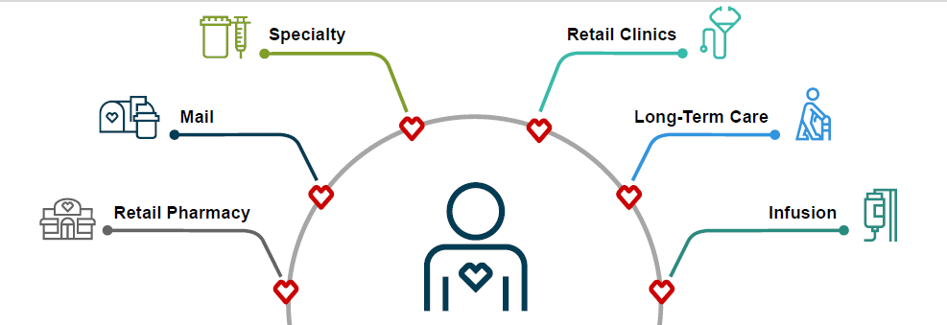
Thank You!!!!
For more information on CBO Recruitment and Employment Opportunities, contact Workforce Initiatives Advisors for PBM and Specialty:
Charnetia.Young@cvshealth.com
or: wi.info@cvscaremark.com

Slide 32
Outreach and Recruitment Information
https://doleta.gov/oa/eeo/outreach_recruitment
Apprenticeship EEO Website
https://doloeta.gov/oa/eeo

Slide 33
Zach Boren
Division Chief / Office of Apprenticeship
USDOL
Boren.Zachary@dol.gov
Natalie Linton
Program Analyst / Office of Apprenticeship
USDOL
Linton.Natalie.S@dol.gov
Dr. Tom Kriger
Director, Research & Education
North America’s Building Trades Unions
TKriger@buildingtrades.org
Charnetia V. Young
Advisor, Workforce Initiatives
Pharmacy Services
CVS
Charnetia.Young@CVSHealth.com
Layli Oliver
Project Manager/Senior Analyst
Maher & Maher
LOliver@mahernet.com

