Slide 1
Affirmative Action Plans Part 1:
Demographic Analyses
August 7, 2018
Information for Apprenticeship Sponsors
Presented By: Office of Apprenticeship

Slide 2

Zachary Boren
  Division Chief
  Office of Apprenticeship
  Employment and Training Administration
  U.S. Department of Labor

Slide 3
What type of organization are you with?
Apprenticeship sponsor
Office of Apprenticeship staff
State Apprenticeship Agency staff
Workforce system staff
Other

Slide 4
What is Affirmative Action?
Which sponsors need to develop Affirmative Action Plans (AAPs)?
AAP deadlines and components
Demographic analyses
Questions and answers

Slide 5
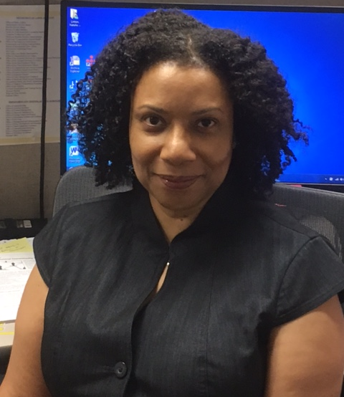
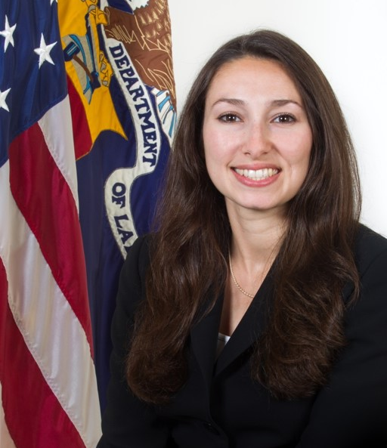
Natalie Linton
  Program Analyst
  Office of Apprenticeship
  Employment and Training Administration
  U.S. Department of Labor
Jennifer Frey
  Attorney
  Division of Civil Rights and Labor-Management
  U.S. Department of Labor

Slide 6
What is Affirmative Action?
Affirmative Action Programs:
Encourage and promote equal opportunity
Creative an apprenticeship environment free from discrimination
Address barriers to equal opportunity in apprenticeship
Affirmative Action Plan: A written description of a sponsor’s affirmative action program

Slide 7
Which Sponsors are Required to Develop Affirmative Action Plans?
Programs required to develop an AAP
Exempt programs
Both:
Have 5 or more apprentices
AND
Do not already have an EEO program in place under other laws/regulations
Either:
Have fewer than 5 apprentices
OR
Already have an EEO program in place under other laws/regulations (that includes apprentices)

Slide 8
Deadlines for Developing Initial AAPs
Sponsors registered with OA:
Sponsors registered with SAAs:
January 18, 2019
  OR
Two years from program registration
  Whichever is later
Check with the SAA to find out the deadline

Slide 9
Components of the AAP
Invite apprentices and applicants to self-identify as individuals with a disability
Demographic analyses
  Analyze demographics of apprentice workforce (for race, sex, ethnicity, and disability)
  Analyze race, sex, and ethnicity demographics of qualified workers in recruitment area
  Compare these two analyses (for race, sex, and ethnicity) to determine if any significant differences

Slide 10
Components of the AAP
Aspirational goals:
  Set aspirational goals for underutilized race/sex/ethnicity groups if differences are significant
  Determine if percentage of apprentices in sponsor’s workforce who are individuals with disabilities meets national aspirational goal of 7%. If not, evaluate impediments to their participation
Targeted outreach, recruitment, and retention activities, where needed
Annual review of personnel practices

Slide 11
Steps of Demographic Analyses for Race, Sex, and Ethnicity
Step 1: Analysis of the program’s workforce
Step 2: Availability analysis
  Individuals that meet minimum qualifications for entry into apprenticeship program in sponsor’s recruitment area
Step 3: Comparison of steps 1 and 2
  Identify if significant underutilization exists for race, sex, or ethnicity
Performed for each major occupational area, with support from Registration Agencies

Slide 12
Step 1: Analysis of the Program’s Workforce
Demographic classification of apprentices by:
Race
  African-American
  Asian
  American Indian or Alaska Native
  Native Hawaiian or Other Pacific Islander
  White
Sex
  Men
  Women
Ethnicity
  Hispanic or Latino
  Non-Hispanic or Latino

Slide 13
Sample Matrix of Apprentice Workforce Data
Active Apprentices As of (Date): ______________ | Total | Hisp. | Non- Hisp | AA | ASIAN | AI/AN | NH/PI | WHITE | Women | Men
Number
Percent

Slide 14
Step 2: Conducting the Availability Analysis for Race, Sex, and Ethnicity
Key concepts:
Minimum eligibility requirements for program entry:
  Education level
  Other
Recruitment populations:
  Internal vs external recruiting
  If external, use relevant recruitment area
Availability: Percentages of individuals eligible for enrollment who are:
  In populations from which sponsor recruits (internally or externally)
  Women, Hispanics, and members of each racial group

Slide 15
Step 3: Comparing the Workforce Analysis to the Availability Analysis
 | % Women | % Hispanic | %AA | %AS | %AI/AN | %NHPI
1. Workforce Analysis
2. Availability Analysis
3. Is workforce utilization significantly less than would be reasonably expected, given availability? Method for evaluating significance: 80% Rule Two Standard Deviations (limited to apprentice workforces of 30 or more) Other ________________________________________
4. Under- Utilization? (Y/N)
5. Goal

Slide 16
Establishing Utilization Goals
When a program is significantly underutilizing women, a specific racial group, or Hispanics/Latinos, the sponsor must set utilization goals in its affirmative action plan.
Goals must be at least equal to the availability of the underutilized group in the sponsor’s recruitment area.

Slide 17
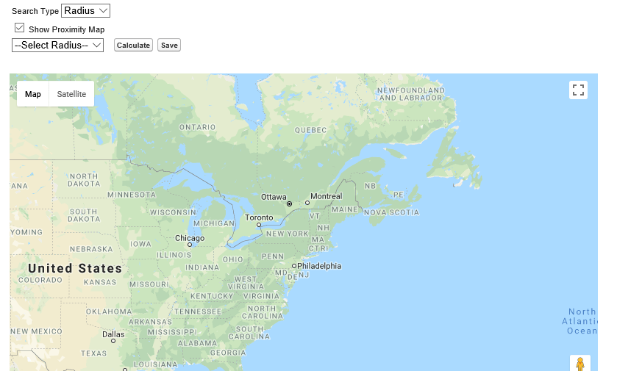
Demographic Analysis Tool

Slide 18
Remaining Areas of the AAP
Invitation to self-identify as an individual with a disability
Workforce analyses for disability
Assess progress against 7% aspirational goal for apprentices with disabilities – and evaluate impediments
Targeted outreach, recruitment, and retention
Annual review of personnel practices

Slide 20
Apprenticeship EEO Website
  https://doloeta.gov/oa/eeo
Webinar on inviting apprentices and applicants to self-identify as a person with a disability(June 6, 2018) https://www.workforcegps.org/events/2018/06/06/17/36/New-Self-Identification-Disability-Requirements-for-Apprenticeship-Programs
Register for the “Equal Employment Opportunity Regulations for Apprenticeship: Final Phase-in of Requirements” webinar scheduled for September 14, 2018 at 1-2 pm eastern. https://www.workforcegps.org/events/2018/07/17/15/35/Equal-Employment-Opportunity-Regulations-for-Apprenticeship-Final-Phase-in-of-Requirements

Slide 21
Zach Boren
  Division Chief / Office of Apprenticeship
    USDOL
      Boren.Zachary@dol.gov
Natalie Linton
  Program Analyst / Office of Apprenticeship
    USDOL
      Linton.Natalie.S@dol.gov
      Jennifer Frey
Attorney
Division of Civil Rights and Labor-Management
USDOL
      Frey.Jennifer.B@dol.gov

