Slide 1
Performance Driven Data Analysis for America’s Promise Grantees: Where We Are and Where We’re Headed
High Impact Partners on behalf
of the Employment and Training
Administration, DOL
August 22, 2018

Slide 2
Gregory Scheib
Workforce Analyst
U.S. Department of Labor, Employment and Training Administration

Slide 4
What is your role in the America’s Promise grant?
Authorized Representative
Program Director
Performance Specialist
IT Professional
Other

Slide 5
What is the frequency of your data collection and analysis?
Daily
Weekly
Monthly
Quarterly
What is data?

Slide 6
Kevin Mauro
HIP Project Lead, HUB
U.S. Department of Labor, Employment and Training Administration
Timothy Dudley
H-1B Performance Analyst
U.S. Department of Labor, Employment and Training Administration

Slide 7
Heidi Sheppard
America’s Promise
Technical Assistance Lead
U.S. Department of Labor, Employment and Training Administration

Slide 8
Review of the America’s Promise performance data
Discuss challenges facing grantees in Year 2 of the grant
How to use your data to reach your performance goals
Technical assistance and performance-related questions

Slide 9
America’s Promise Performance Reporting Data: Where Are We Now?

Slide 10
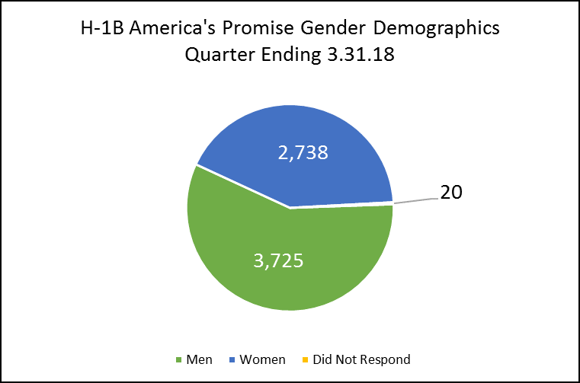
America’s Promise Performance Reporting Data: Where Are We Now?

Slide 11
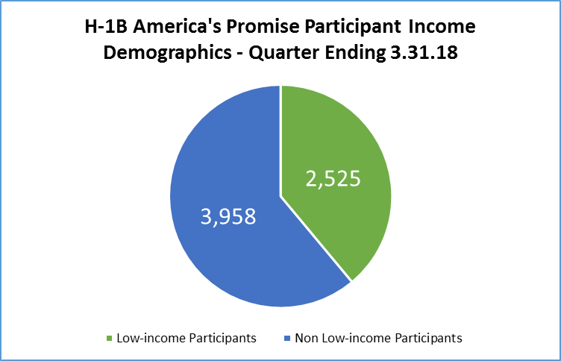
America’s Promise Performance Reporting Data: Where Are We Now?

Slide 12
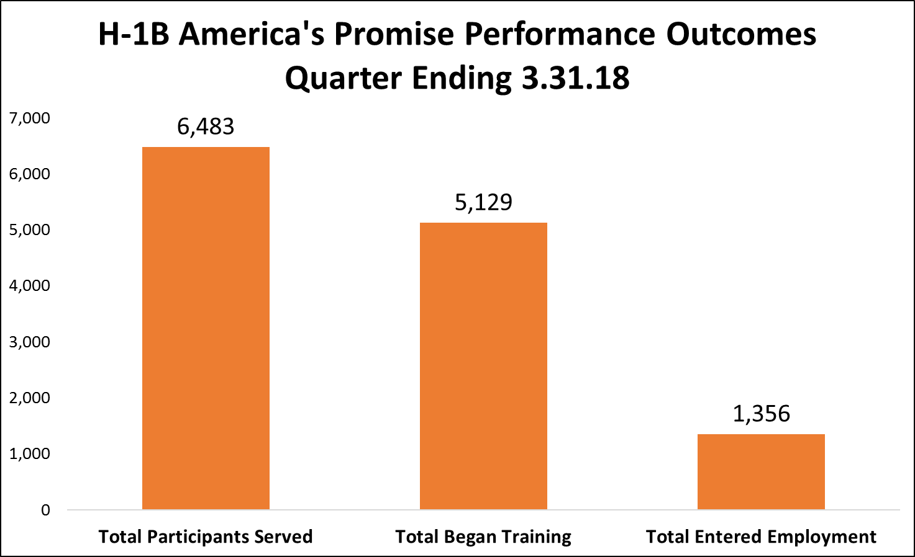
America’s Promise Performance Reporting Data: Where Are We Now?

Slide 13
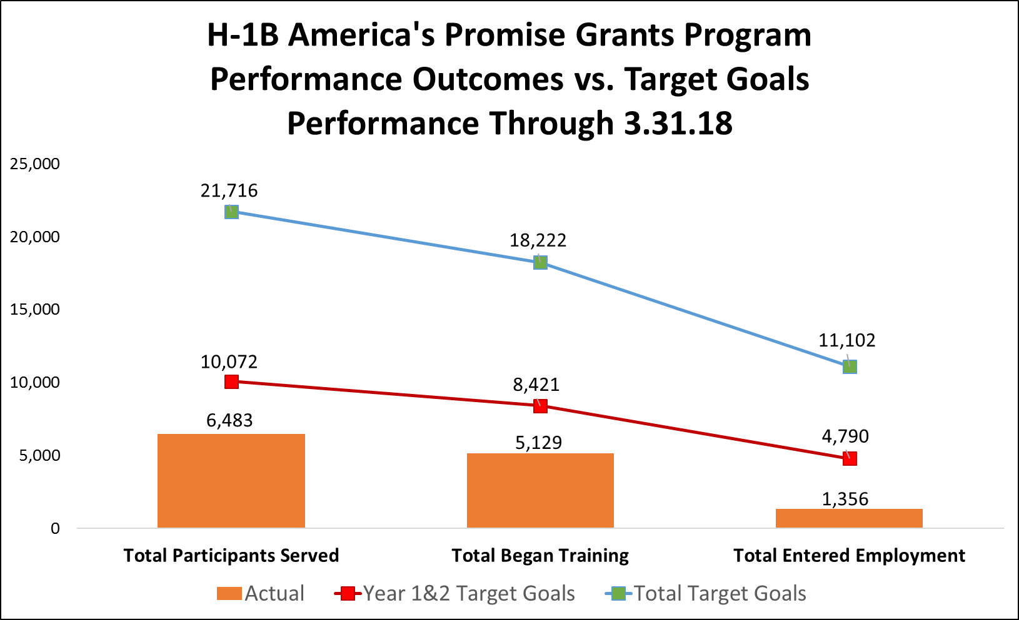
America’s Promise Performance Reporting Data: Where Are We Now?

Slide 14
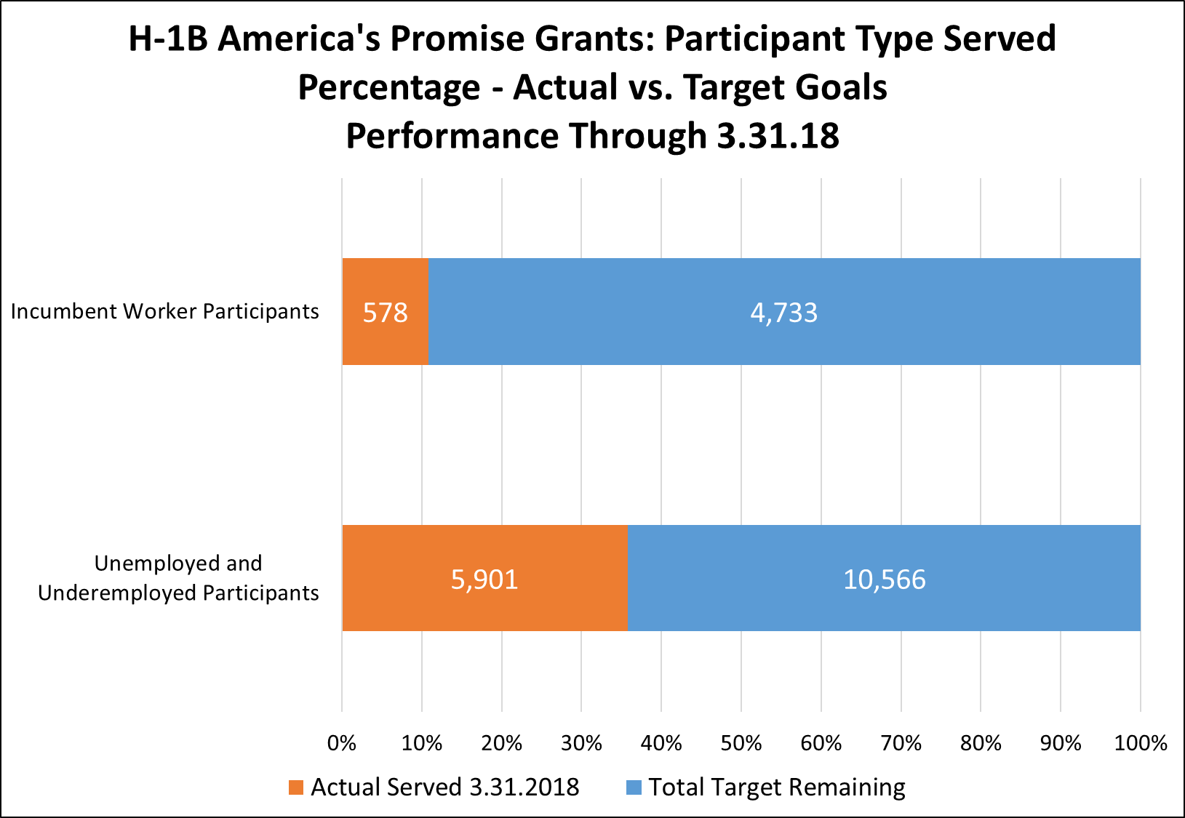
America’s Promise Performance Reporting Data: Where Are We Now?

Slide 15
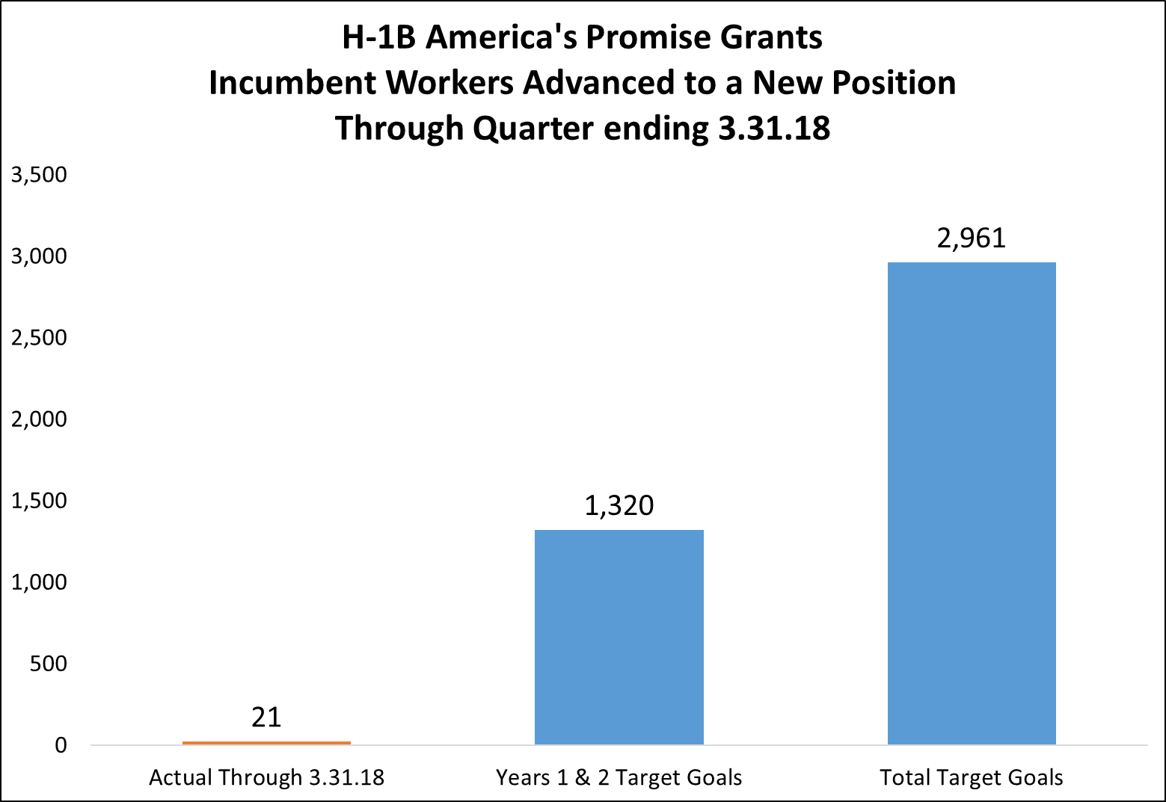
America’s Promise Performance Reporting Data: Where Are We Now?

Slide 16
America’s Promise Performance Reporting Data: Where Are We Now?
Participant Served Outcomes by Grantee as of 03.31.18 | Percentage Rate of Target Participants Served Years 1&2 | Percentage Rate of TOTAL Participants Served
Greater Memphis Alliance for a Competitive Workforce | 7.3% | 2.9%
Montgomery College | 27.4% | 12.6%
Brevard Workforce Development Board, Inc. | 27.4% | 12.0%
Worksystems, Inc. | 28.4% | 15.7%
Delaware Technical Community College | 32.3% | 20.2%
The University of Alabama at Birmingham | 32.5% | 14.9%
Illinois Manufacturing Excellence Center | 34.3% | 13.4%
Southeast Michigan Community Alliance (SEMCA) | 39.8% | 19.9%
Employ Milwaukee | 43.1% | 19.8%
Alamo Community College District | 45.1% | 24.4%
Northern Wyoming Community College District | 47.5% | 20.9%
Florida State College at Jacksonville | 52.0% | 20.8%
Workforce Alliance of South Central Kansas, Inc. | 52.9% | 22.1%
City of Springfield | 56.3% | 23.9%
West Virginia Higher Education Policy Commission | 66.5% | 21.6%
Rhode Island Department of Labor and Training | 71.2% | 35.6%
RFCUNY on behalf of CUNY OAA-CEWP | 77.2% | 34.8%
Grand Rapids Community College | 89.0% | 35.6%
New River Mount Rogers Workforce Investment Area Consortium | 92.2% | 41.9%
Monroe Community College | 118.3% | 59.2%
Tecumseh Area Partnership, Inc. d/b/a Region 4 Workforce Board | 126.7% | 62.5%
United Way of Central Iowa | 127.4% | 63.7%
MiraCosta Community College District | 145.3% | 65.9%
Totals: . | 64.4% | 29.9%

Slide 17
America’s Promise Performance Reporting Data: Where Are We Now?
Employment Outcomes by Grantee as of 03.31.18 as of 03.31.18 | Percentage Rate of Number Entered Employment Years 1&2 | Percentage Rate of TOTAL Number Entered Employment
Alamo Community College District | 0.0% | 0.0%
City of Springfield | 0.0% | 0.0%
Florida State College at Jacksonville | 0.0% | 0.0%
Greater Memphis Alliance for a Competitive Workforce | 0.0% | 0.0%
Montgomery College | 0.0% | 0.0%
Northern Wyoming Community College District | 2.0% | 1.0%
West Virginia Higher Education Policy Commission | 3.1% | 0.6%
RFCUNY on behalf of CUNY OAA-CEWP | 3.9% | 1.1%
Illinois Manufacturing Excellence Center | 4.0% | 1.4%
Worksystems, Inc. | 4.3% | 2.2%
Brevard Workforce Development Board, Inc. | 7.2% | 3.0%
Employ Milwaukee | 10.7% | 4.6%
The University of Alabama at Birmingham | 12.2% | 5.4%
Delaware Technical Community College | 13.7% | 8.2%
Monroe Community College | 16.2% | 8.1%
Grand Rapids Community College | 31.4% | 12.5%
MiraCosta Community College District | 33.1% | 15.0%
New River Mount Rogers Workforce Investment Area Consortium | 34.7% | 13.4%
United Way of Central Iowa | 38.9% | 18.4%
Southeast Michigan Community Alliance (SEMCA) | 46.2% | 23.2%
Workforce Alliance of South Central Kansas, Inc. | 57.0% | 24.3%
Tecumseh Area Partnership, Inc. d/b/a Region 4 Workforce Board | 64.1% | 31.3%
Rhode Island Department of Labor and Training | 89.6% | 44.0%
Totals: . | 28.3% | 12.2%

Slide 19
America’s Promise Performance Reporting Data: Discussion
How often do you and your partners review this data together?
Are you facing any difficulties that could be causing your reported performance data to be lower than your targets?

Slide 20
America’s Promise Performance Reporting Data: Discussion
What best practices would you attribute to some of the data where you are meeting measures?
What steps will you be taking in the next year to meet your grant outcomes?
What type of performance technical assistance or information would assist you in meeting or exceeding your performance targets in the coming year ?

Slide 22
Peer-to-Peer: New Program Leadership Onboarding (Webex)
September 2018
Webinar: Telling Your Story
September 2018
Webinar: Innovative Supportive Services
October 2018

Slide 23
Resources:
America’s Promise Community of Practice
Your home for all of America’s Promise online resources
https://h1bap.workforcegps.org/
H-1B Performance Reporting Resources for TechHire, SWFI and America's Promise Grants
Your go-to source for all things performance reporting related
https://h1bap.workforcegps.org/resources/2018/01/17/16/46/H-1B-Performance-Reporting-Resources-for-TechHire-SWFI-and-America-s-Promise-Grants
H-1B WIPS Tips
Guidance on common WIPS reporting issues
https://h1bap.workforcegps.org/blog/Tips-and-Information/2018/03/27/19/45/H-1B-WIPS-Tips

Slide 24
America’s Promise Mailbox
U.S. Department of Labor
AmericasPromise@dol.gov
202.693.3949

